Slide 1
FMS Update
12 February 2015
Spin PWG Meeting
Christopher Dilks

Slide 2

Outline
Channel Health
LED Resolutions
Gain Curves

Slide 3

Channel Health
Installed channels: 1237/1264 (761/788 large; 476/476 small)
  3 cells to stack (0.2%)
  24 bases to be installed (1.9%)
    21 new channels + 3 more bases which may need to be replaced
      (1/3 bases is an old base, but it's an edge cell)
    14-20 bases to be installed by next scheduled access (Feb. 18th)
30 channels missing LEDs (2.4%)
  Not required to monitor gain for new bases
3 channels missing signals in QTs (0.2%)
Other problems:
  11-16 small cell problems (2-3% of installed small cells)
  3 large cell problems (0.4% of installed large cells)

Slide 4
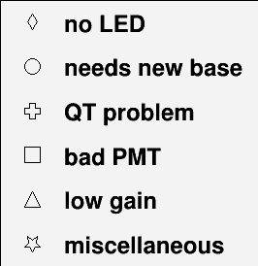
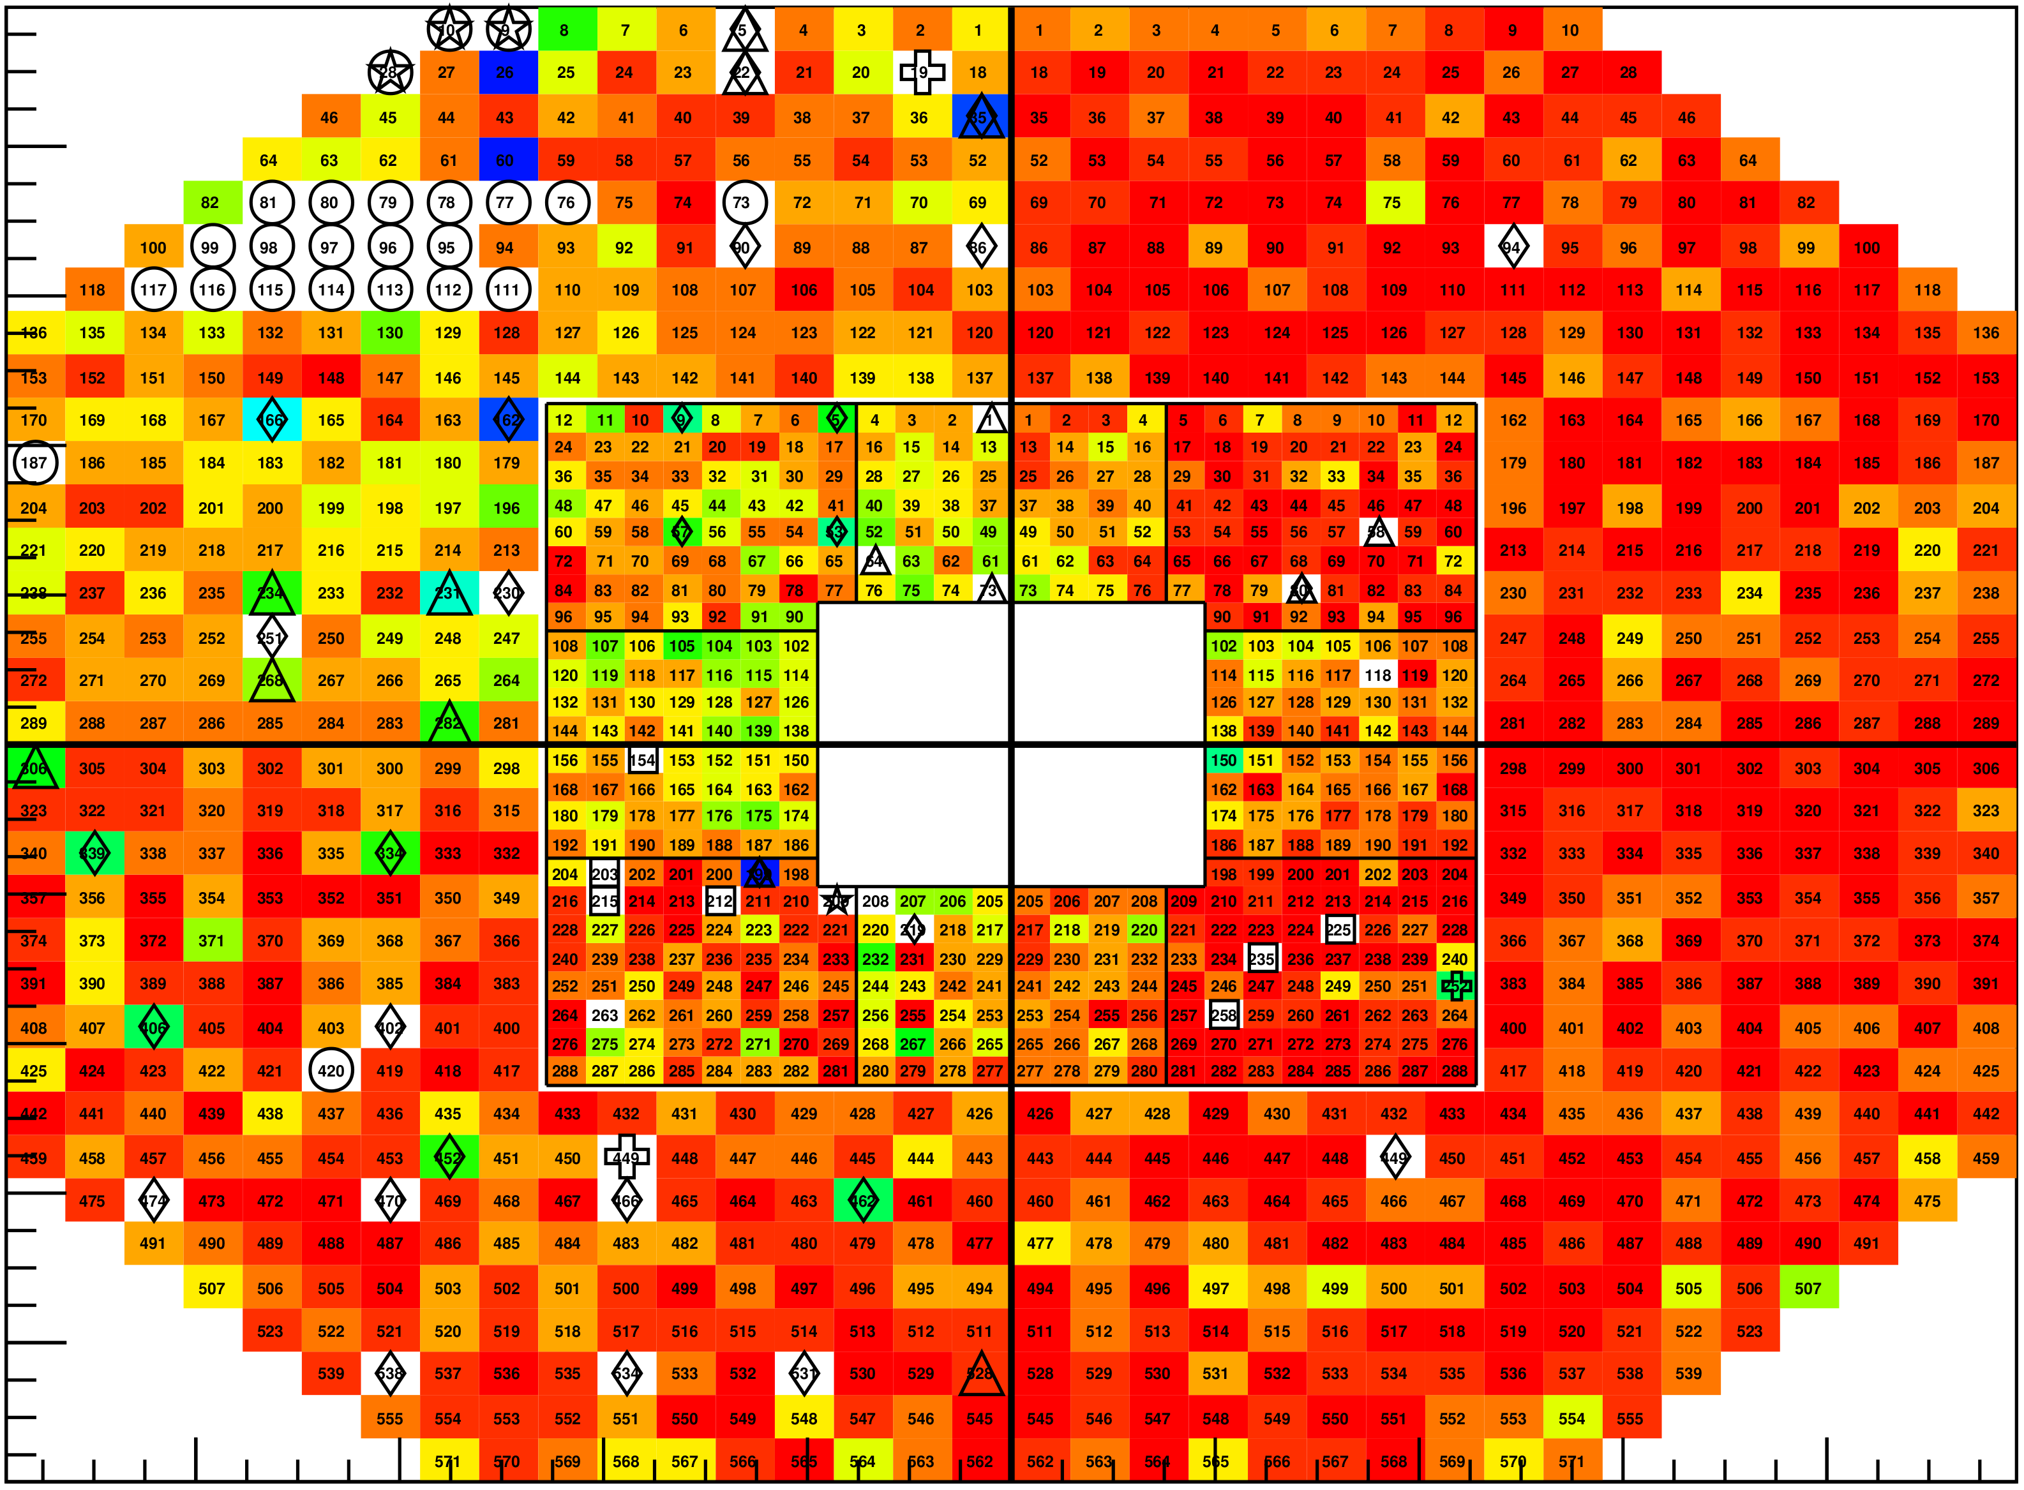
Channel Health
18 bases to install
3 cells to stack
Day 37 data
at typical
HV setpionts
Large: -1300V
Small: 0xA0
N
S

Slide 5
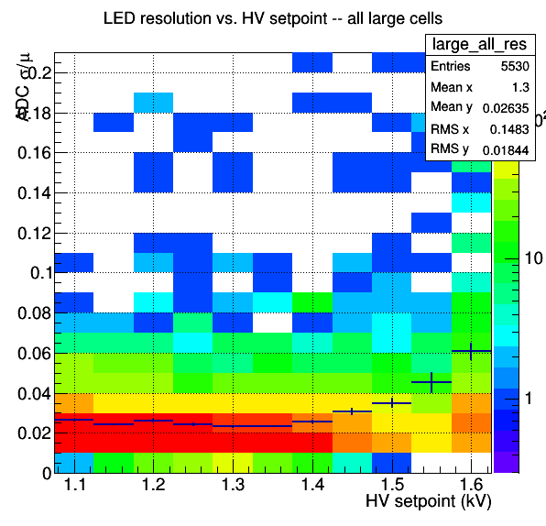
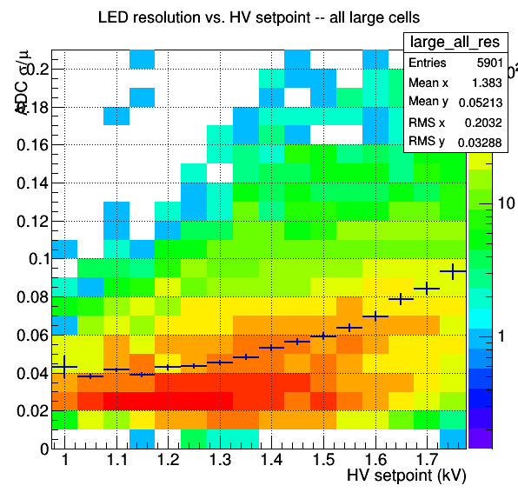
LED Resolutions – Large Cells
STAR magnet OFF
Day 20
STAR magnet ON
Day 41

Slide 6
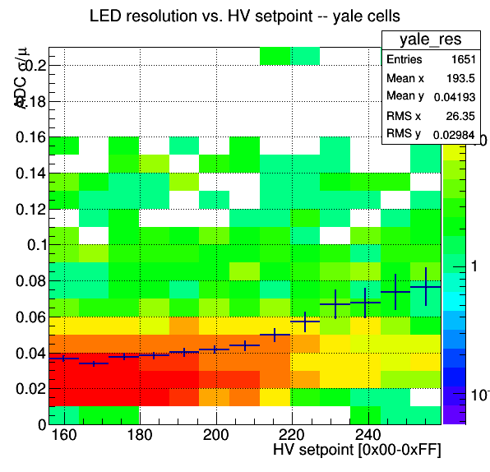
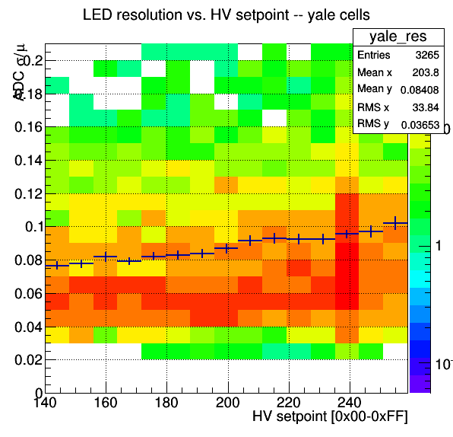
LED Resolutions – Small Yale Cells
STAR magnet OFF
Day 20
STAR magnet ON
Day 41

Slide 7
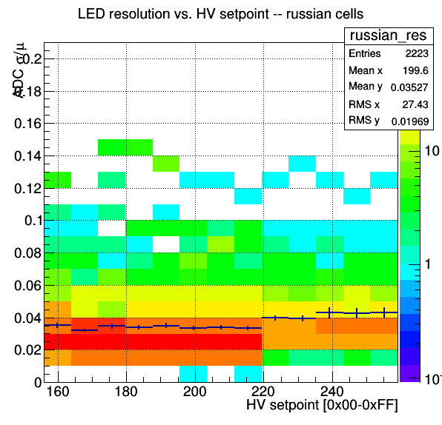
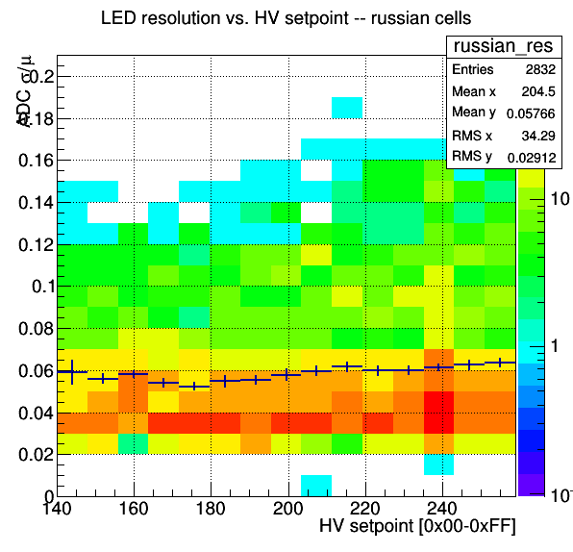
LED Resolutions – Small Russian Cells
STAR magnet OFF
Day 20
STAR magnet ON
Day 41

Slide 8

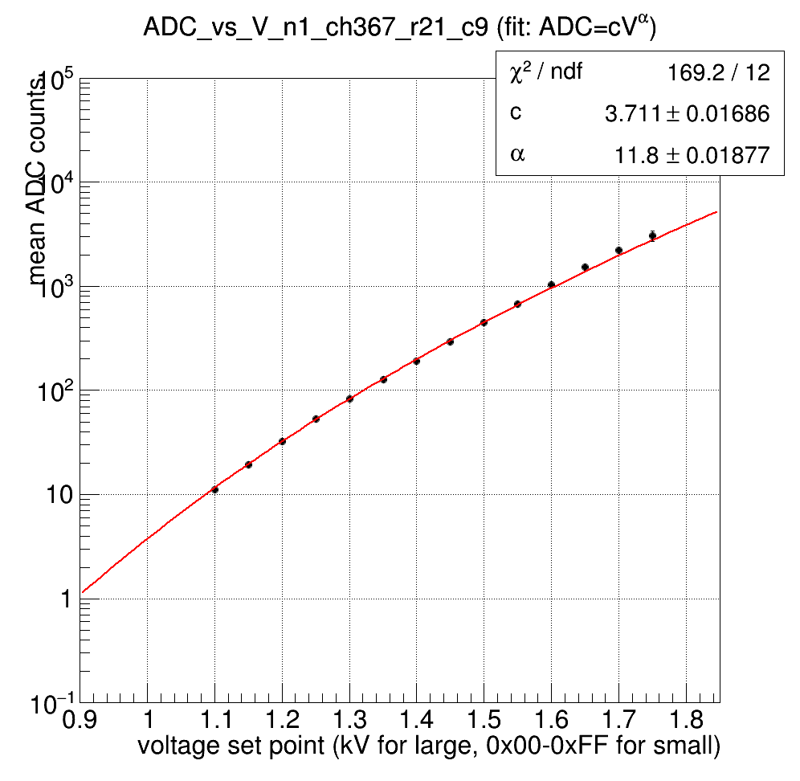
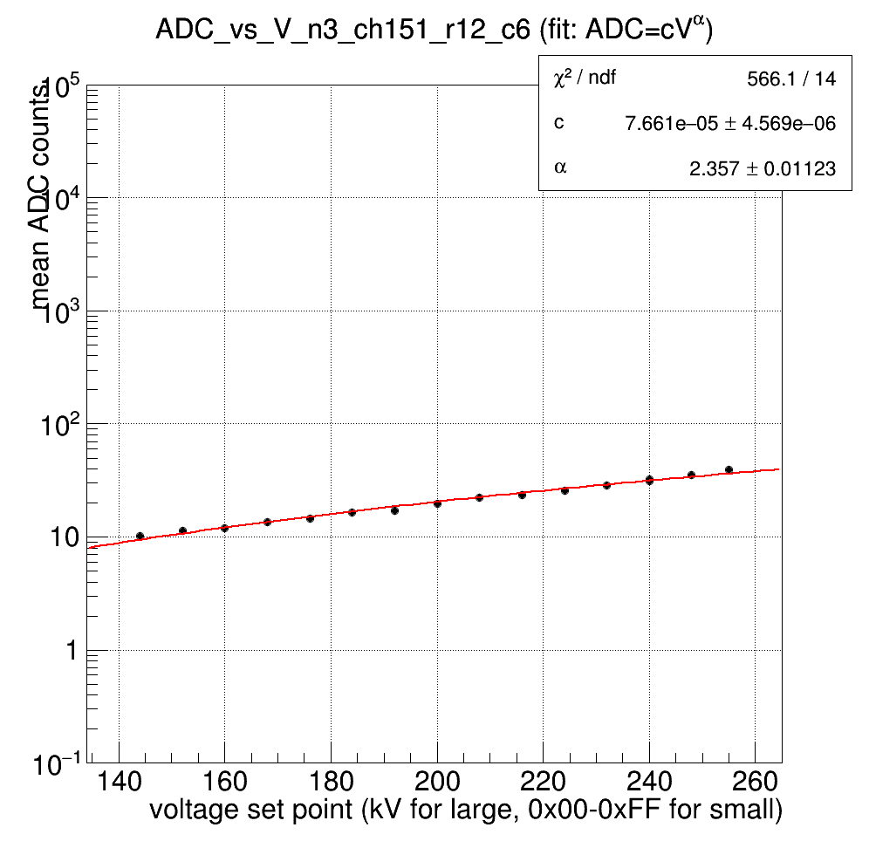

Gain Curves
Day 41 data
  STAR magnet ON
  HV setpoint ranges:
    1000-1750 V for large cells
    0x90-0xFF for small cells
      (max setting is 0xFF; typical running setting is 0xA0)
  Fit Function:
(Typical examples shown below)
Large cell
Small cell

Slide 9
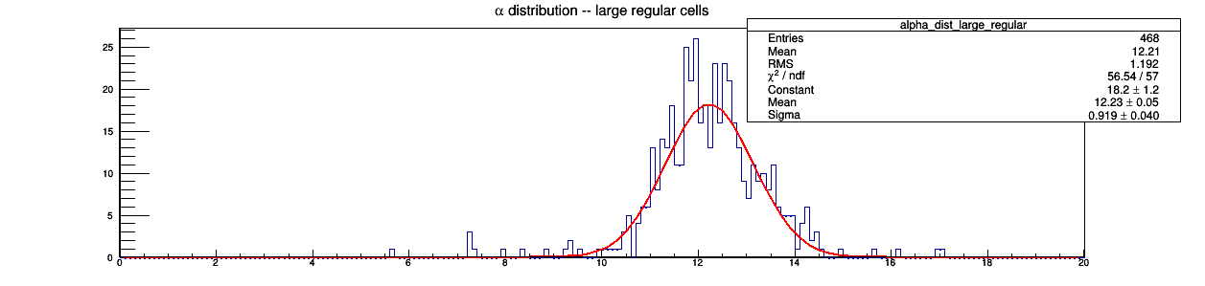
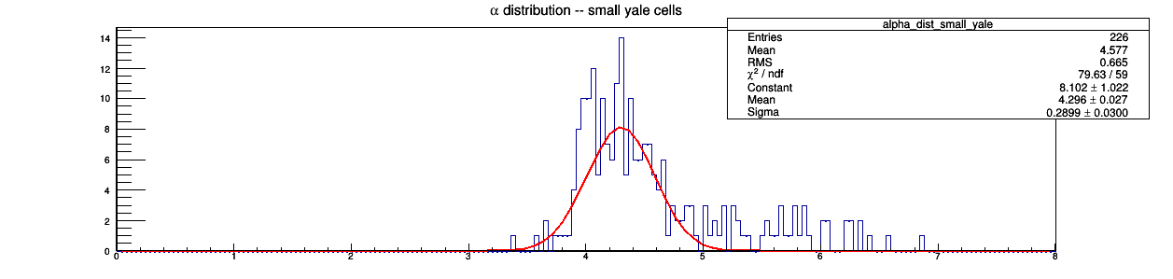
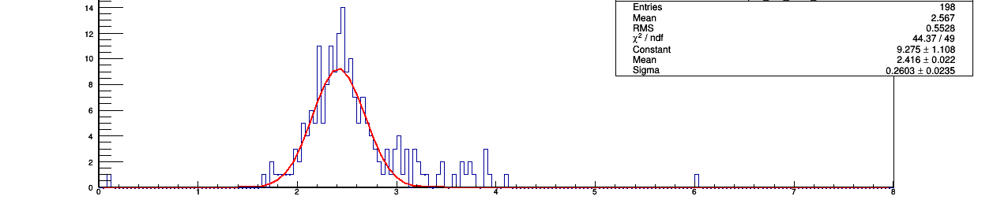
Gain Curves – α-distributions
α-distribution (large cells)
Large Cells
For gain calibration, we plan to use average α from fit results for different cell classes
α-distribution (small cells)
Yale Cells
Russian Cells

Slide 10

Conclusion
FMS programming completed by trigger group
QT timing is now optimized
PMT gain calibration is currently underway
  Hardware mapping problems between QTs and FMS to be resolved before taking calibration data
  New Tier1 file planned to mask disconnected QTs
  Calibration data to be taken later today

