Slide 1
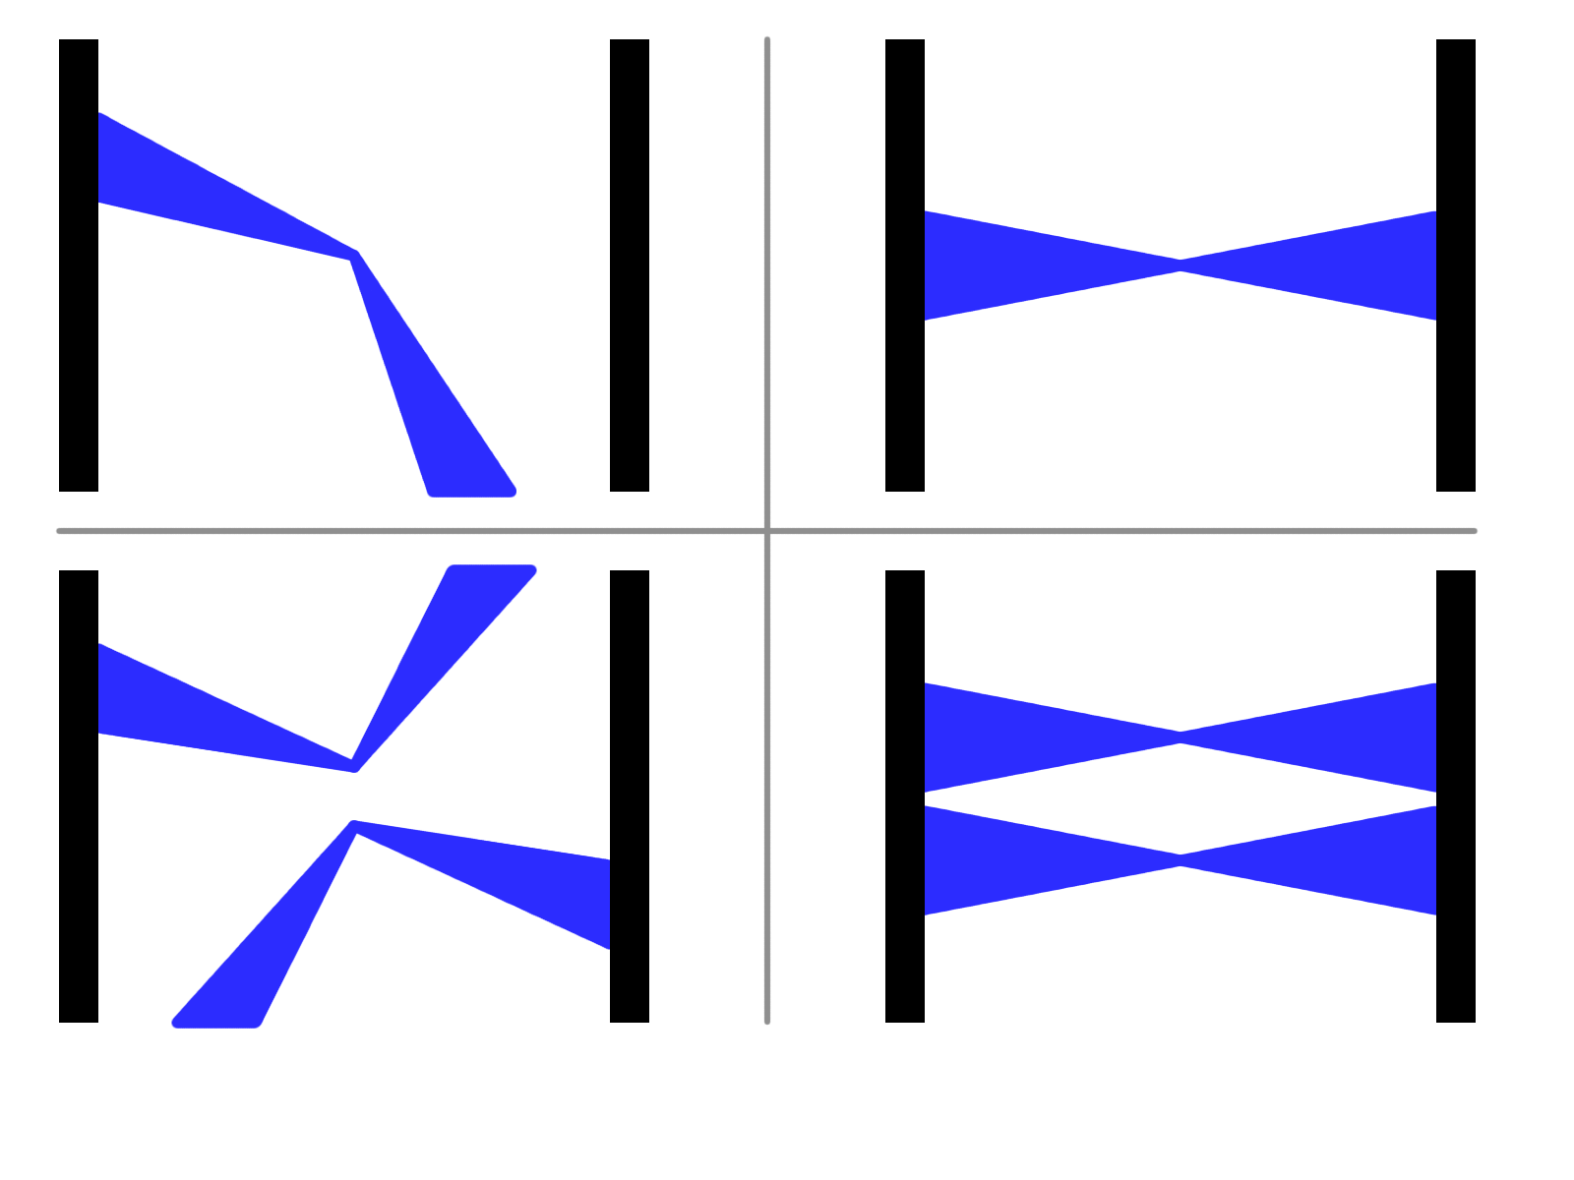
Accidentals / Multiples Corrections*
Single
Coincidence
Accidental
Multiple
*a.k.a. “CDF Luminosity Corrections”
Reference: Cronin-Hennessy, et. al; “Luminosity monitoring and measurement at CDF”
Nuclear Instruments and Methods in Physics Research A 443 (2000) 37-50

Slide 2
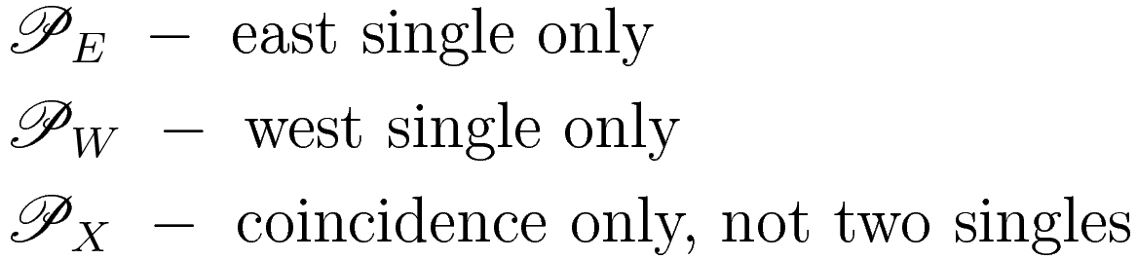
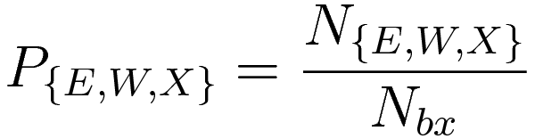
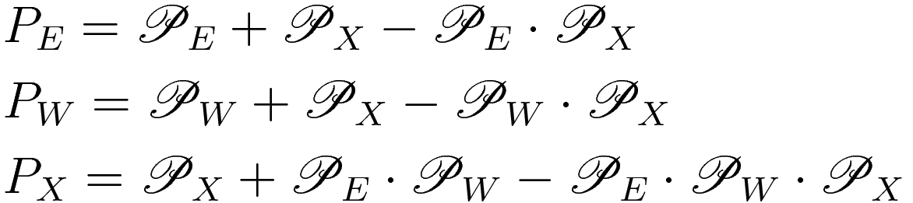
Accidentals Correction
Physical Process Probabilities
Scaled Probabilities
# scalers
(see next slide for diagrams)

Slide 3
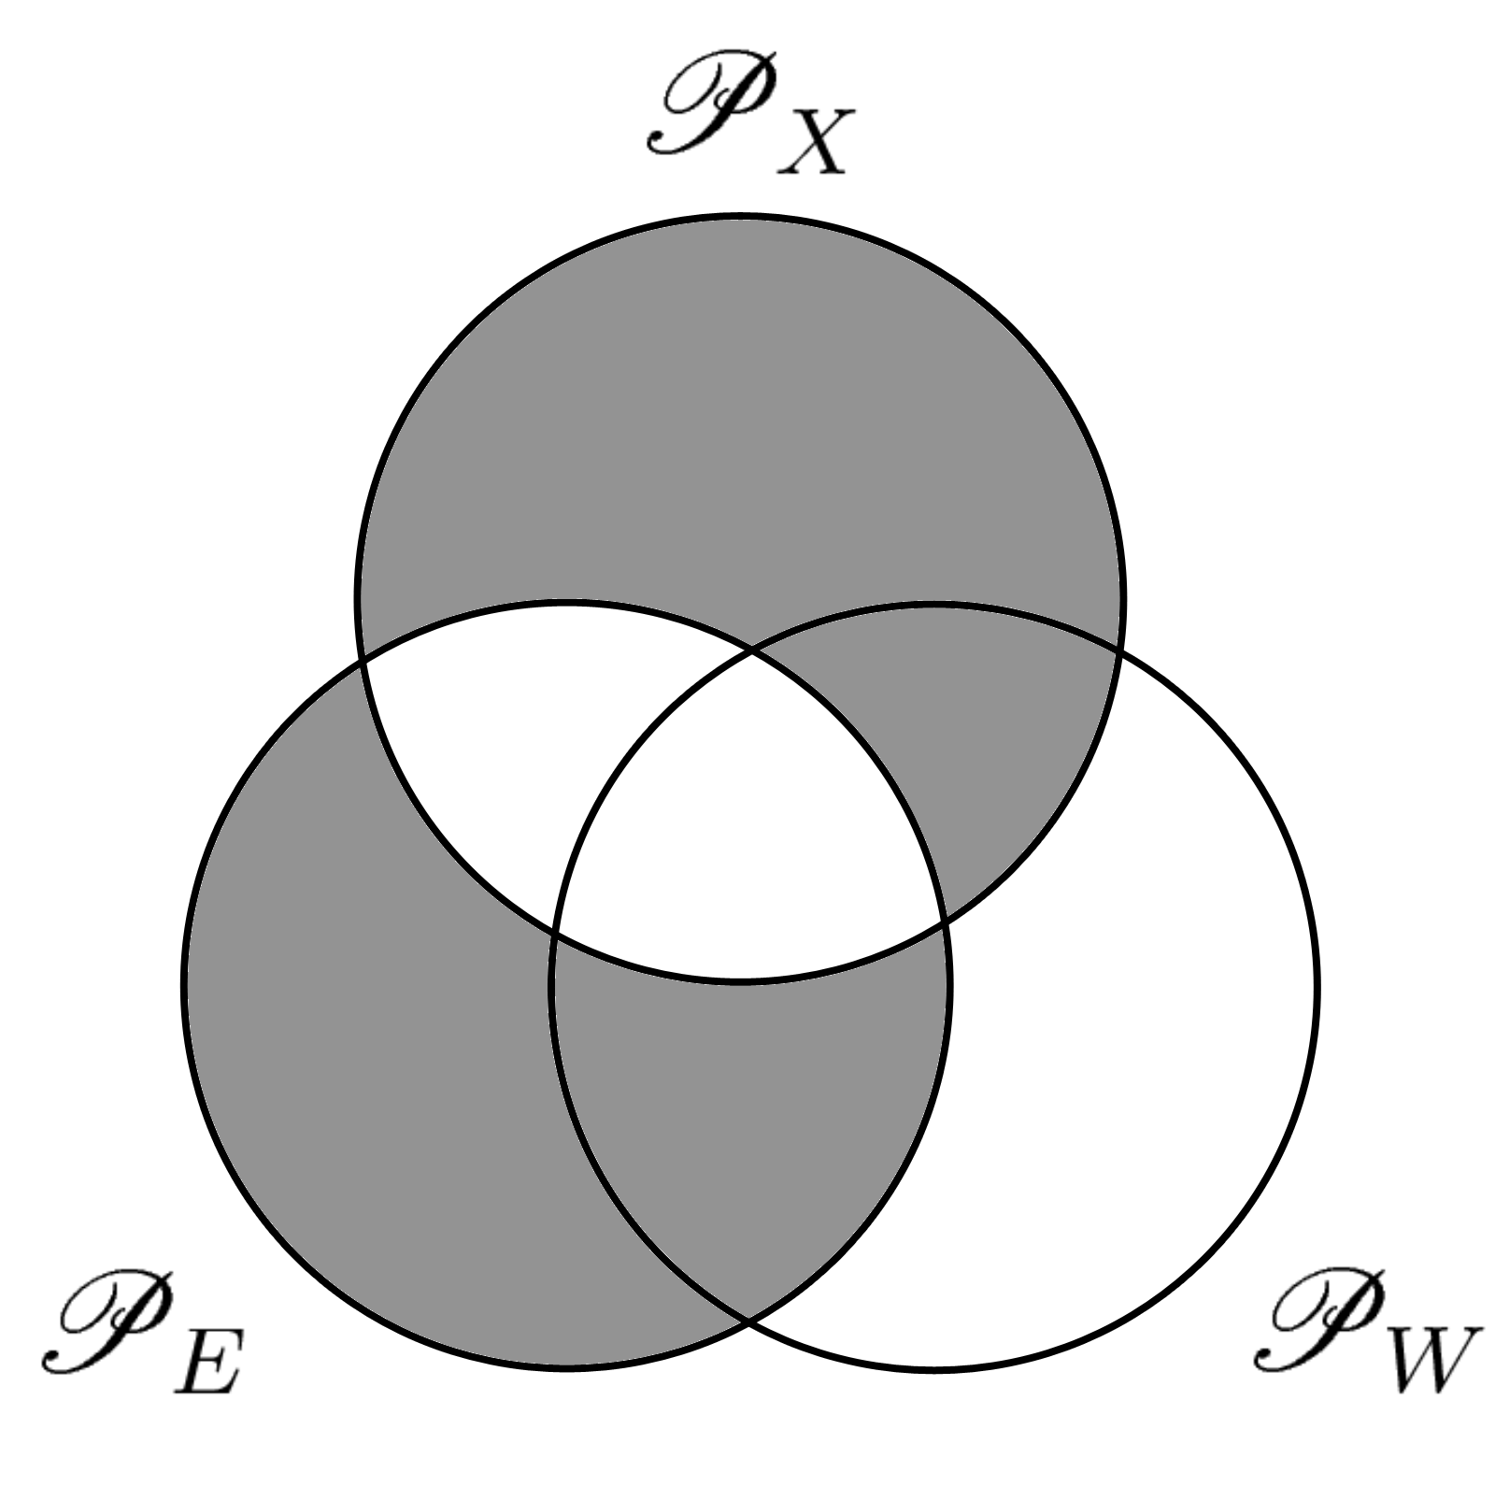
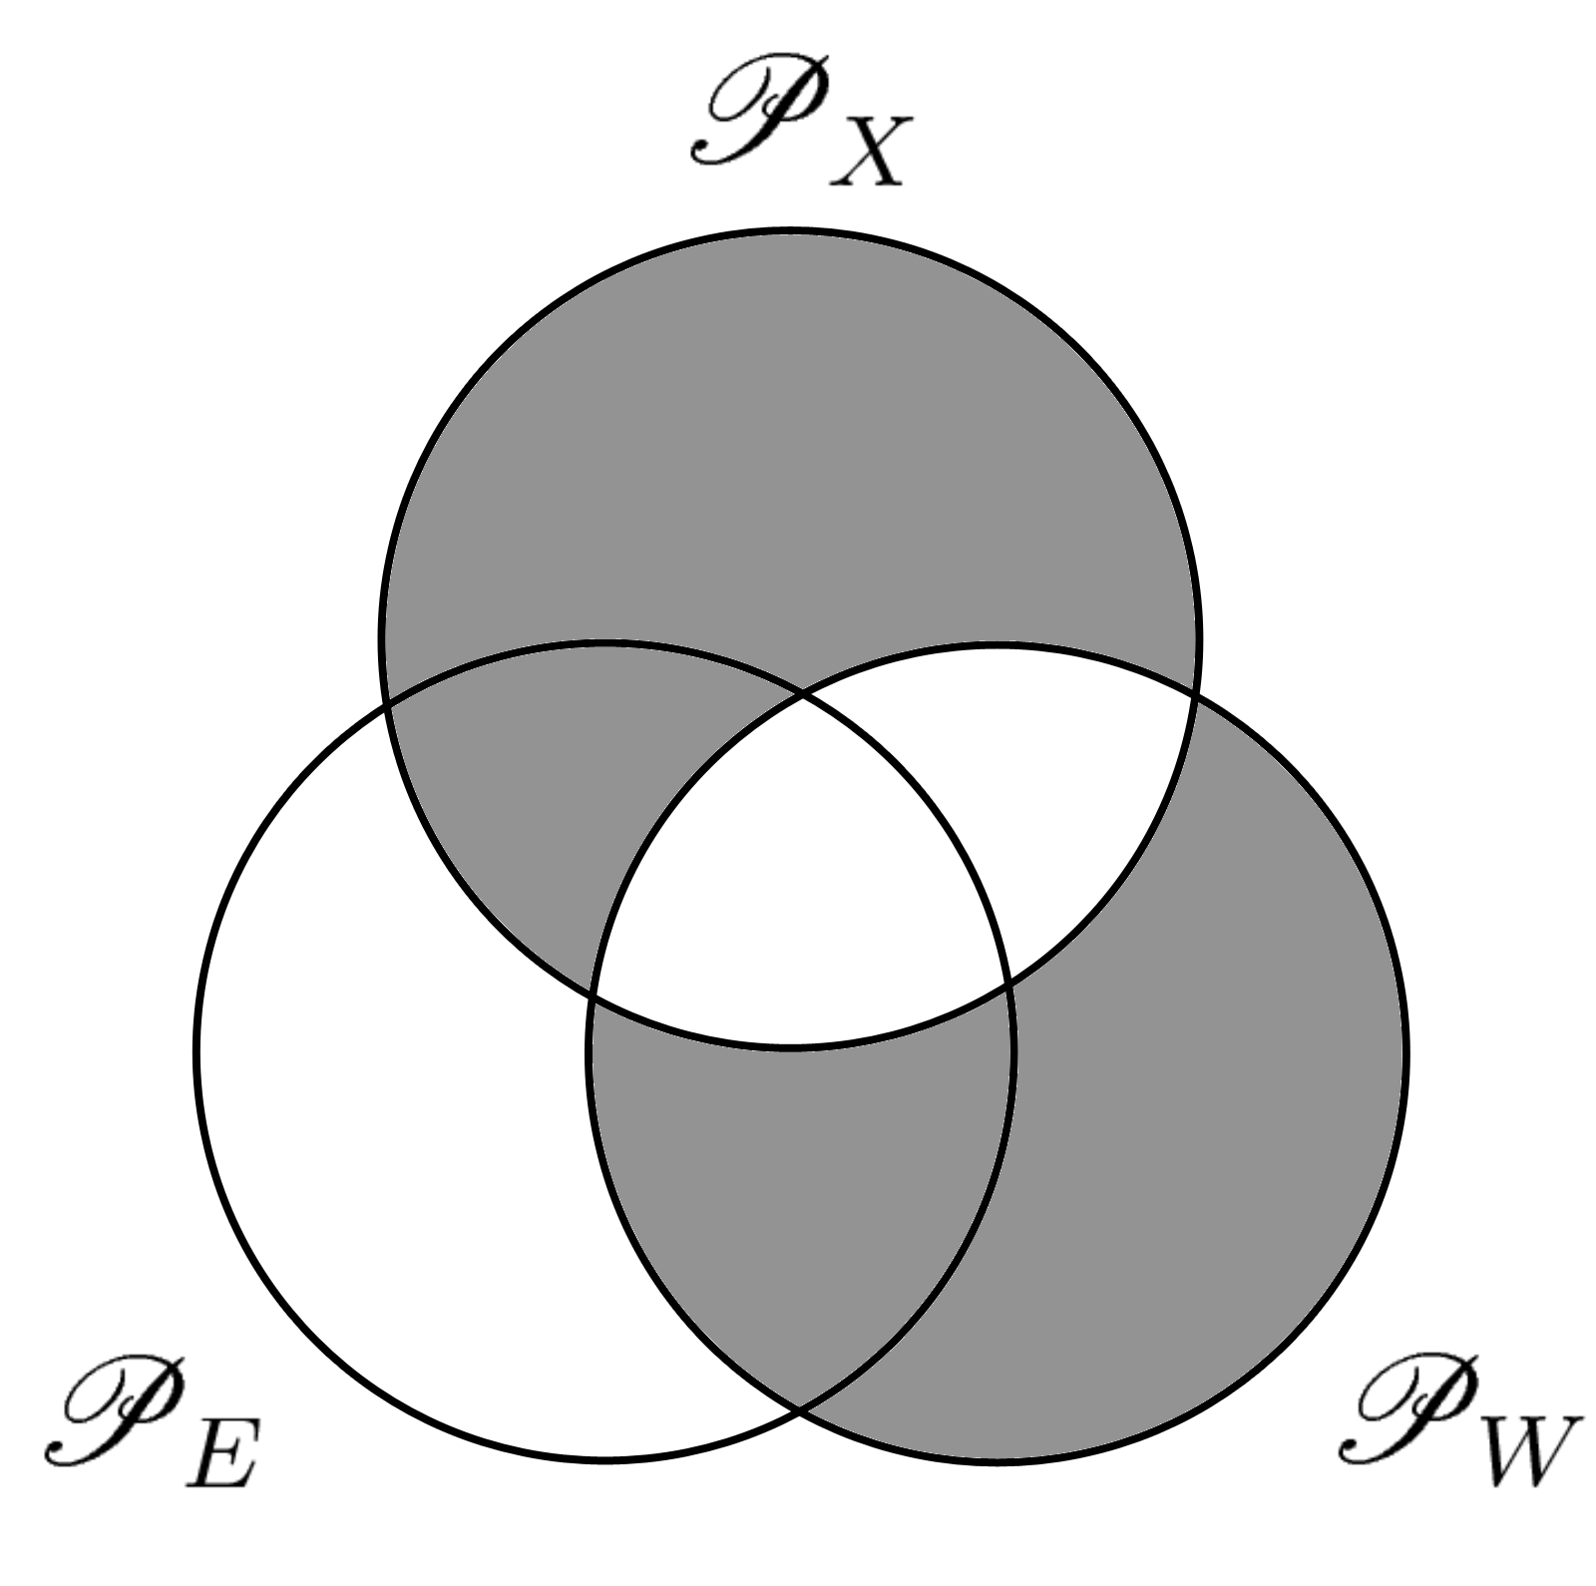


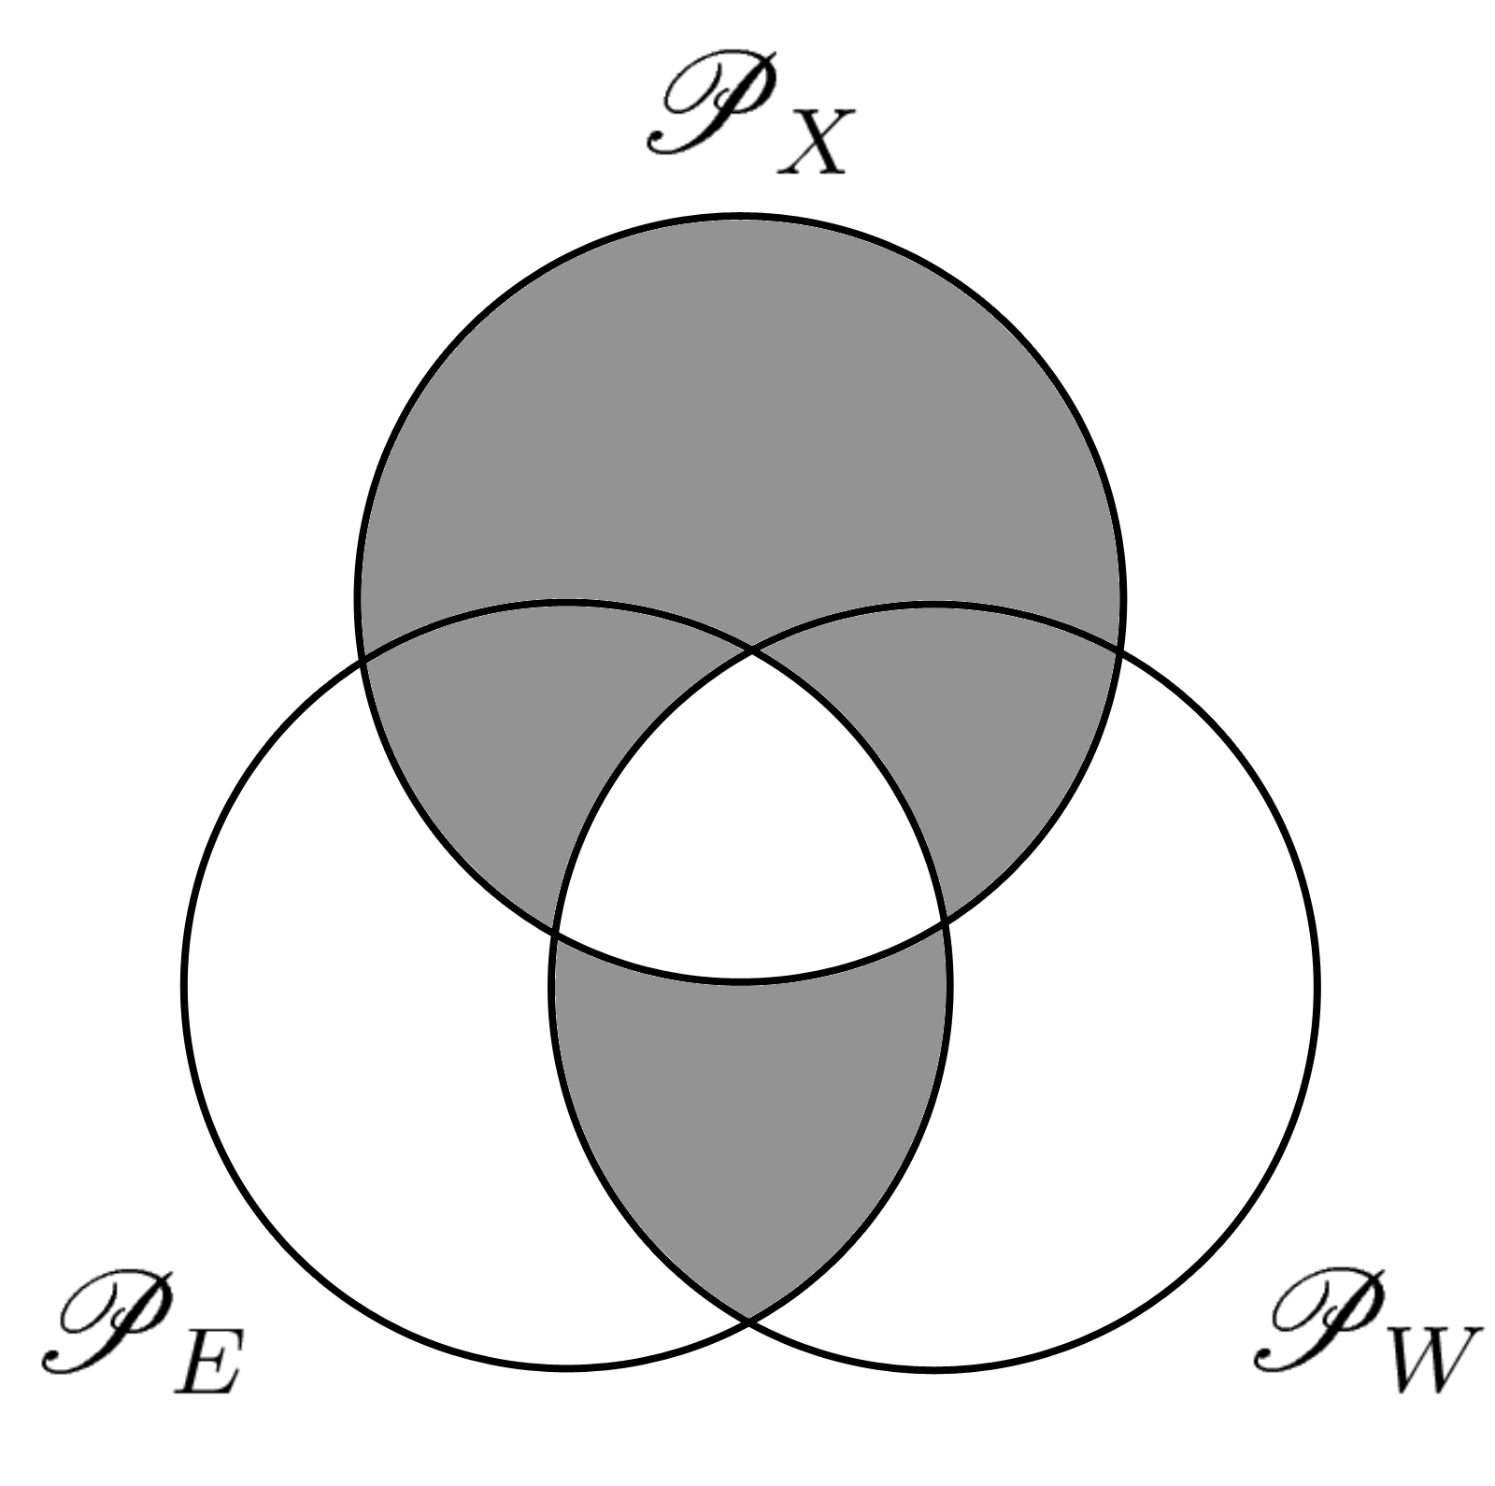

Accidentals Correction

Slide 4
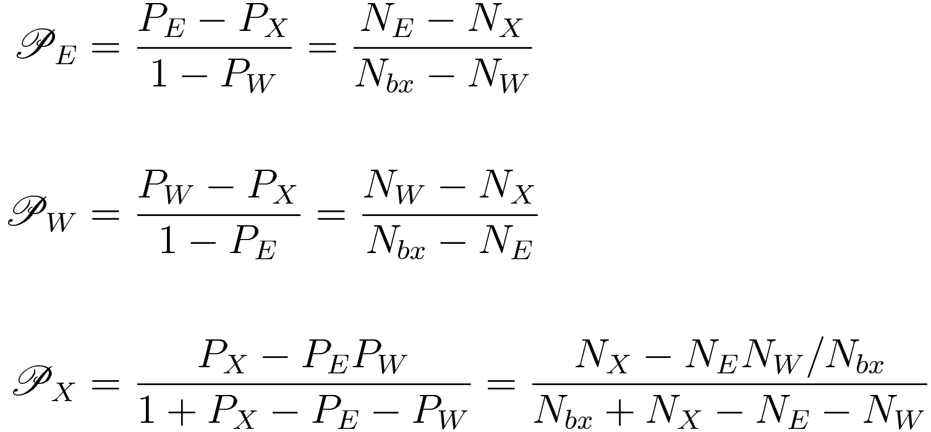
Accidentals Correction
Physical Process Probabilities i.t.o. Scaled Quantities

Slide 5
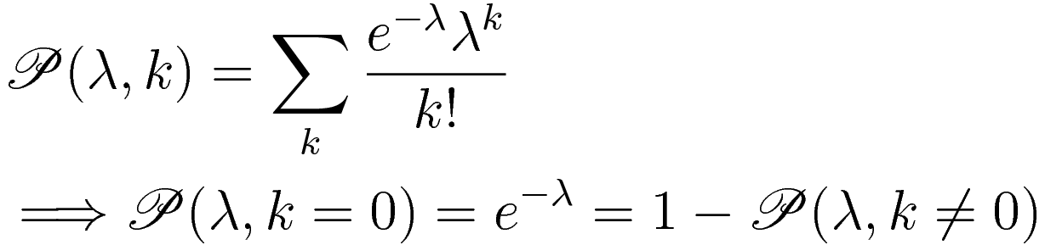


Multiples Correction
Poisson distribution for k events with λ as the “true” # events in a single bXing
Corrected # scalers:

Slide 6
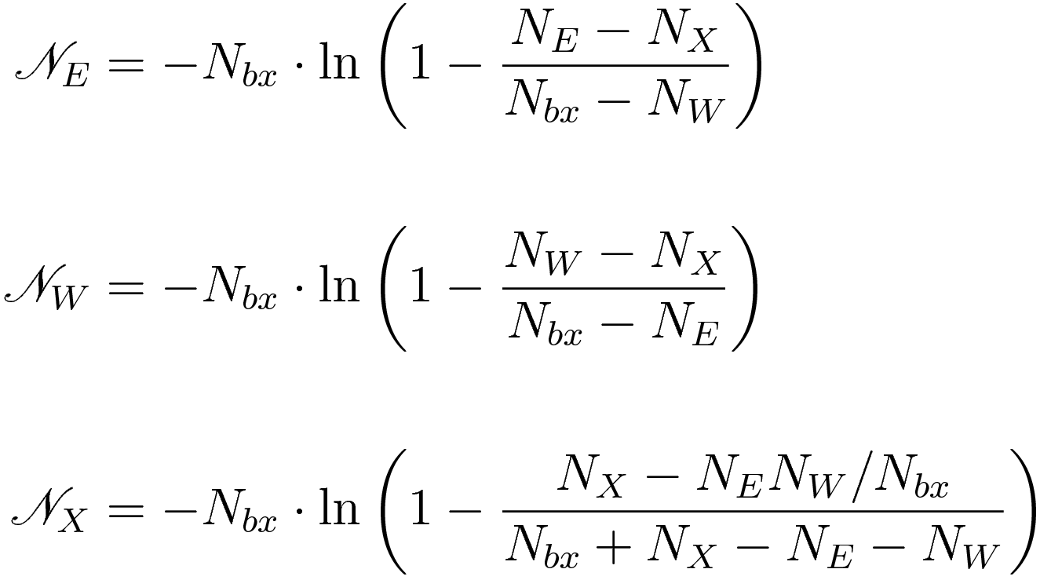
Accidentals / Multiples Corrections
Final Correction Equations

