Slide 1
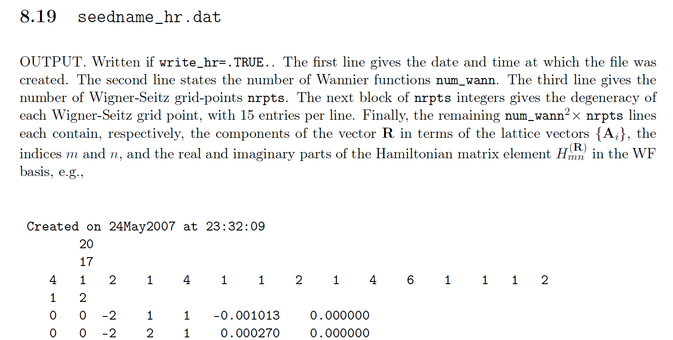
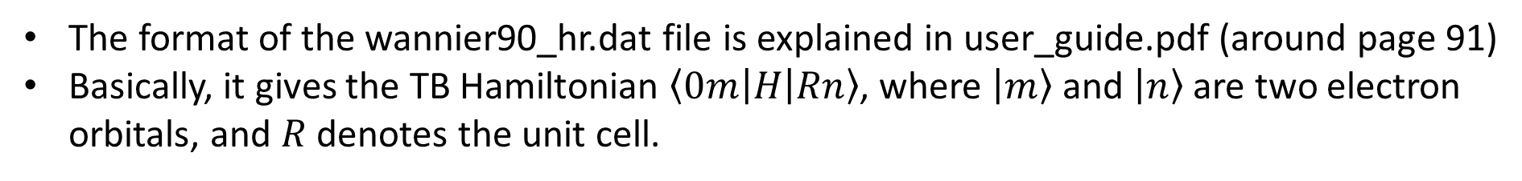
The format of the wannier90_hr.dat file is explained in user_guide.pdf (around page 91)
Basically, it gives the TB Hamiltonian $\left\langle 0m\left|H\right|Rn\right\rangle$, where $\left|m\right\rangle$ and $\left|n\right\rangle$ are two electron orbitals, and $R$denotes the unit cell.

Slide 2
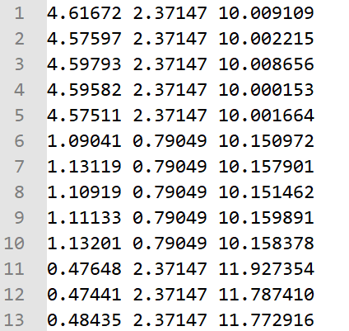
The TB model of 1T’ MoS₂ has 44 orbitals in total.
1:22 orbitals are spin-up states, while 23:44 orbitals are spin-down states
The 22 spin up (down) states are composed of five d-orbitals of two Mo atoms (10 in total) and three p-orbitals of four S atoms (12 in total)
The wannier90-wcenter.dat file contains the center of each orbital. You can see that 1:5 orbitals (also 6:10 orbitals, 11:13 orbitals, etc.) have almost the same center, because they belong to the same atom.

Slide 3
Band structure of 1T’ MoS₂
Zoom-in
Black lines: DFT results
Red dots: TB model

