Slide 1



Odoo - Python for business
Christo Goosen & Gutembert Nganpet

Slide 2
Who we represent
ERPWeb
ERPWeb are a committed Odoo Silver partner with over 10 years ERP implementation experience. ERPWeb is a Certified Training Partner.
To effectively implement Odoo, the services of an experienced partner will ensure a successful outcome. We offer training, development, deployment and support on Odoo.
Office:

Slide 3
Who we represent
Job Opportunities for python developers
Job Responsibilities:
  Working on Open Source Technologies like Linux, Odoo API, and Core, Python, PostgreSQL
  Adopt new and emerging technologies to provide solutions to client needs
  Ability to understand client requirements and translate them into suitable solution architecture
  Be flexible to work on varied technologies and cater to time difference needs
  Excellent communication skills
  Identify technical issues and provide resolution
If interested have a look at the following link: https://internal.odoo.zone/jobs/detail/erp-technical-consultant-1

Slide 4
Who we are - Christo Goosen
  ERP Technical Consultant
Python Developer
Systems administrator
  Business Analysis
Currently investigating/learning or reading about:
  OpenCV
  Ansible
  Blackhat Python
Involved in:
  OWASP Cape Town Chapter
  BSIDES Cape Town

Slide 5

OWASP Cape Town Chapter
OWASP - Open Web Application Security Chapter
Official Wiki: https://www.owasp.org/index.php/Cape_Town
Meetup: http://www.meetup.com/OWASP-Cape-Town-Chapter-Meetup/events/223412637/
Interesting OWASP project
  OWASP Python Security Project
  Website: http://www.pythonsecurity.org/
  Mailing List: https://lists.owasp.org/mailman/listinfo/owasp_python_security_project

Slide 6
Who we are - Gutembert Nganpet
  ERP Technical Consultant
Python Developer (gutembert@erpweb.co.za)
Qualification and background:
Qualified as Satellite System Engineer (MTech and MSc in Electrical and Electronic Engineering System)
(nganpet2007@gmail.com)

Slide 7
What is a ERP
  Enterprise resource planning (ERP) is business management software—typically a suite of integrated applications—that a company can use to collect, store, manage and interpret data from many business activities, including:
  Product planning, cost
  Manufacturing or service delivery
  Marketing and sales
  Inventory management
  Shipping and payment

Slide 8
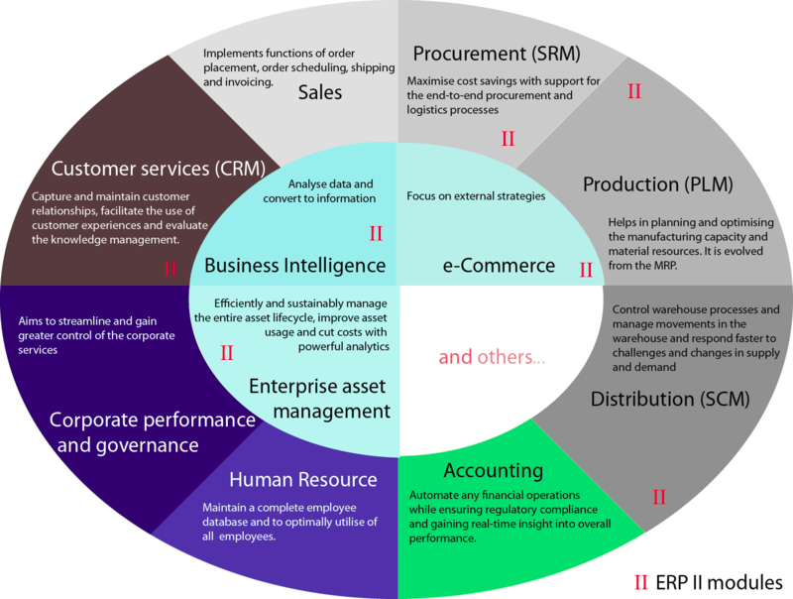
What is a ERP
Source: https://nl.wikipedia.org/wiki/OpenERP

Slide 9







Examples of ERP's

Slide 10
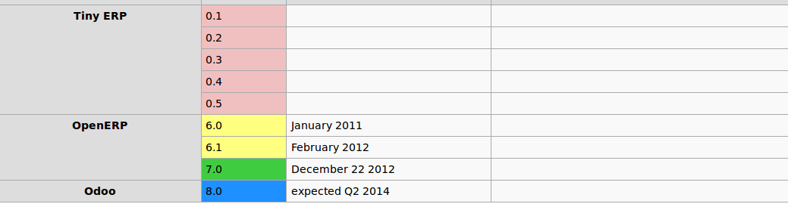
History of Odoo
Read further: https://www.odoo.com/blog/odoo-news-5/post/the-odoo-story-56
Source: https://nl.wikipedia.org/wiki/OpenERP

Slide 11
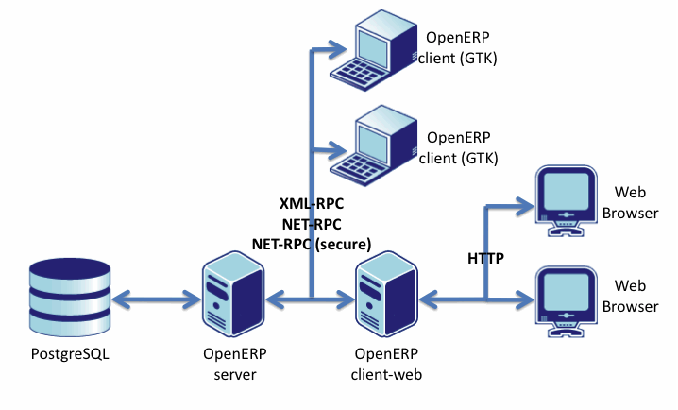
Architecture - overall

Slide 12
Architecture - Details
Postgresql 9.3
  psycopg2
OpenObject MVC
  Python 2.7
  XML/XHTML
  YAML
  QWEB (Templating system)
  XML-RPC
wkhtmltopdf
email
  postfix (virtual mailboxes)
  smtp to external mailboxes
  mailgate.py

Slide 13
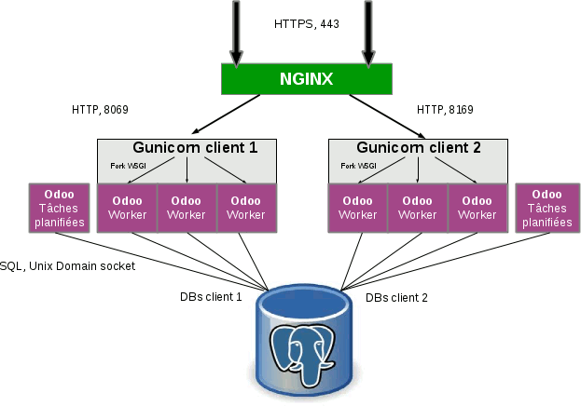
Architecture: web-server-dbs

Slide 14
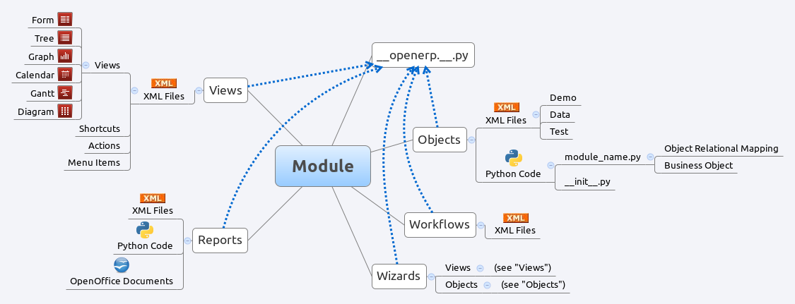
Development/Module Architecture

Slide 15
Odoo tips
Logs:
  tail -f /var/log/odoo/odoo-server.log
Settings:
  sudo vim /etc/odoo/openerp-server.conf
  inside of /etc/odoo/openerp-server.conf add to the following line:
    addons_path = /usr/lib/python2.7/dist-packages/openerp/addons
    You can add an additional directory for your own custom modules
    You can also change other settings like port number of postgresql, postgres user and password, etc.
Restarting server with log output
  sudo service odoo restart; sudo tail -f /var/log/odoo/openerp-server.log

Slide 16
Odoo - Example model
class Event(models.Model):
# Private attributes
_name = 'event.event'
_description = 'Event'
# Default methods
def _default_name(self):
...
# Fields declaration
name = fields.Char(string='Name', default=_default_name)
seats_reserved = fields.Integer(oldname='register_current', string='Reserved Seats',
store=True, readonly=True, compute='_compute_seats')
seats_available = fields.Integer(oldname='register_avail', string='Available Seats',
store=True, readonly=True, compute='_compute_seats')
price = fields.Integer(string='Price')

Slide 17
Odoo - Example controller
# compute and search fields, in the same order that fields declaration
@api.multi
@api.depends('seats_max', 'registration_ids.state', 'registration_ids.nb_register')
def _compute_seats(self):
...
# Constraints and onchanges
@api.constrains('seats_max', 'seats_available')
def _check_seats_limit(self):
...
@api.onchange('date_begin')
def _onchange_date_begin(self):
...
# CRUD methods
def create(self):
...
# Action methods
@api.multi
def action_validate(self):
self.ensure_one()
...

Slide 18
Odoo - Accessing model
ResPartner = self.env['res.partner']
partners = ResPartner.browse(ids)
partner_id = partners[0].id
or
ResPartner = self.env['res.partner']
partners = ResPartner.browse(ids)
for x in partners:
partner_id = x.id
partner_name = x.name

Slide 19
Inheritance - Python
Class inheritance:
class Event(models.Model):
_inherit = 'event.event'
Function inheritance:
def create(self, values, context=None):
id = super(Event,self).create(values, context)
Field inheritance:
name = fields.Char(string='Name Inherited', default=_default_name)

Slide 20
Inheritance - XML
<?xml version="1.0" encoding="utf-8"?>
<openerp>
<data >
<record model="ir.ui.view" id="view_event_form_inherited">
<field name="name">Event.Form_Inherited</field>
<field name="model">event.event</field>
<field name="type">form</field>
<field name="inherit_id" ref="event.view_event_form"/>
<field name="arch" type="xml">
<xpath expr="//page[@string='Other Info']/group/group/field[@name='name']" position="replace">
<field name="name" string="Name can also be inherited from XML"/>
</xpath>
</field>
</record>
</data>
</openerp>

Slide 21
XMLRPC Protocol
1. xmlrpclib
2. Remote connectivity
a) To the server : common = xmlrpclib.ServerProxy('{}/xmlrpc/common'.format(url))
b) To the database: uid = common.login(dbname, username, pwd)
c) To the models : models = xmlrpclib.ServerProxy('{}/xmlrpc/object'.format(url))
3. Accessing and or manipulating data
a) Read: event = models.execute(dbname, uid, pwd, 'event.event', 'read', event_id, ['name'])
event_name = events["name"]
b) write: models.execute(dbname, uid, pwd, 'event.event', 'write', event_id, {'name': “Remotely renamed Event's Name”})
c) create:
participant = {
'name': "New Name”,
'email': "Its email address”,
'lang': "Its language”,
}
models.execute(dbname, uid, pwd, 'event.event', 'create', participant)

