Slide 1


Micropython
Christo Goosen

Slide 2
Micropython
Python for microcontrollers
and constrained environments

Slide 3
About Me
Christo Goosen
Work
Work for VOSS Solutions
Python Dev and QA in Performance testing team.
OWASP Cape Town
https://www.owasp.org/index.php/Cape_Town
http://www.meetup.com/OWASP-Cape-Town-Chapter-Meetup/
VOSS Solutions
VOSS Solutions is a British founded multinational unified communications and collaboration corporation, presently headquartered in Richardson, Texas, United States, that provides service delivery and management software.
Contact Details:
Email:
christo@christogoosen.co.za
christo.goosen@owasp.org
Github: https://github.com/c-goosen
Website: http://www.christogoosen.co.za/
@OWASP_CPT

Slide 4
Outline
Why Micropython?
What is Micropython?
Micropython Hardware API
Micropython vs Arduino
Micropython Libraries
Micropython Framework
Building Micropython
Micropython for Unix
Pyboard
ESP8266
Q&A

Slide 5
Why Micropython?
Python 3
Microcontrollers
IOT

Slide 6
Why Micropython?
Why python(micro)?
High-level language
Fast development or prototyping
Big open source community
Easy to learn and read
Powerful features
It's not Javascript/Lua/C
Why not CPython/PyPy, etc.?
RAM
Microcontrollers need optimized code for constrained resources
CPython Integer operations, method calls and for loops expensive in RAM
Some CPython libraries cache disk data in RAM
List of differences between micropython and Cpython: https://github.com/micropython/micropython/wiki/Differences

Slide 7
Why Micropython?
Differences between micropython and CPython
“Unlike CPython3, which uses reference-counting, MicroPython uses garbage collection as the primary means of memory management.”
“MicroPython does not ship with an extensive standard library of modules. It's not possible and does not make sense, to provide the complete CPython3 library. Many modules are not usable or useful in the context of embedded systems, and there is not enough memory to deploy the entire library on small devices”
MicroPython does not implement complete CPython object data model, but only a subset of it. Advanced usages of multiple inheritance, __new__ method may not work. Method resolution order is different (#525). Metaclasses are not supported (at least yet).
List of differences between micropython and Cpython: https://github.com/micropython/micropython/wiki/Differences

Slide 8

So what is micropython?
“MicroPython is a lean and efficient implementation of the Python 3 programming language that includes a small subset of the Python standard library and is optimised to run on microcontrollers and in constrained environments. The MicroPython board is a small electronic circuit board that runs MicroPython on the bare metal, and gives you a low-level Python operating system that can be used to control all kinds of electronic projects. ”
Origin
Started as a kickstarter campaign (Link) with a focus on a “Micropython” board that was shipped on the successful backing of the project. The successful kickstarter campaign and open source community following widened the support of Micropython to more devices and applications beyond the pyboard.

Slide 9
Features
REPL (MicroPython Interactive Interpreter Mode)
Autocompletion
Auto-indentation
Paste Mode
WEBREPL
Hardware API
Execute Assembler
@micropython.asm_thumb
def led_on():
movwt(r0, stm.GPIOA)
movw(r1, 1 << 13)
strh(r1, [r0, stm.GPIO_BSRRL])
The special variable _ (underscore)
When you use the REPL, you may perform computations and see the results. MicroPython stores the results of the previous statement in the variable _ (underscore). So you can use the underscore to save the result in a variable. For example:

Slide 10
Hardware API
https://github.com/micropython/micropython/wiki/Hardware-API
The API should be Pythonic, obvious and relatively minimal. There should be a close mapping from functions to hardware and there should be as little magic as possible. The API should be as consistent across peripherals (Pin, UART, I2C, ADC, etc) as possible. There should usually be only one way to do something. A method name should do exactly what it says and no more (i.e. it shouldn't be heavily overloaded).
Import machine
From machine import Pin, I2C, UART, ADC
Devices supported: Teensy, micro:bit, wiPy, bare-ARM, cc3200, esp8266

Slide 11
How does MicroPython compare to Arduino?
First is that Arduino is an entire 'ecosystem' with the Arduino IDE (i.e. the desktop application you use to write and upload sketches), the Arduino programming language (based on C/C++), and Arduino hardware like the Arduino Uno R3 board.
MicroPython is only a programming language interpreter and does not include an editor. Some MicroPython boards support a web-based code prompt/editor.
The second important difference is that the MicroPython language is interpreted instead of being compiled.
You can even write and run interpreted code like MicroPython directly on a board without any compiling or uploading--something that's impossible with Arduino!
One disadvantage of interpreted code and MicroPython vs. Arduino is that there's less performance and sometimes more memory usage when interpreting code.
Source: https://learn.adafruit.com/micropython-basics-what-is-micropython/overview

Slide 12
Micropython Libraries
github.com/micropython/micropython-lib
Upip (micro pip)
uasyncio
Umqtt.simple & umqtt.robust
Urllib & urllib.urequest
Uuid
Multiprocessing
Itertools
Io
Gzip & tar
JSON
Argparse…..and many more

Slide 13
Micropython Specific Libraries
https://github.com/micropython/micropython/wiki/Hardware-API
Machine (Accessing hardware specifics of board)
Micropython (Internals of micropython)
network (Networking around WLAN)
Uctypes (access binary data in a structured way)

Slide 14
Framework - Picoweb
https://github.com/pfalcon/picoweb/
“Intro:
picoweb is "micro" web micro-framework (thus, "pico-framework") for radically
unbloated web applications using radically unbloated Python implementation,
MicroPython, https://github.com/micropython/micropython .
Features:
* Asynchronous from the start, using unbloated asyncio-like library
for MicroPython (uasyncio).
* Modest memory usage (I would say radically small memory usage, but
so far, trivial web app requires 64K (yes, kilobytes) of heap, which
is much more than I expected).
* Has API affinity with well-known Python web micro-framework(s),
thus it should be easy start if you have experience with that, and
existing applications can be potentially ported, instead of requiring
complete rewrite.
“
Has support for running on CPython 3.4.2

Slide 15
Picoweb
“picoweb API is roughly based on APIs of other well-known Python web
frameworks. The strongest affinity is Flask, http://flask.pocoo.org, as
arguably the most popular micro-framework. Some features are also based on
Bottle and Django. Note that this does not mean particular "compatibility"
with Flask, Bottle, or Django: most existing web frameworks are synchronous
(and threaded), while picoweb is async framework, so its architecture is
quite different
“

Slide 16
Building Micropython
Supported platforms:
Microcontrollers (Bare-Metal, without an OS)
UNIX
DEB-based systems
FreeBSD-based systems
RPM-based systems
Pacman-based systems
Gentoo-based systems
Mac systems
Still attempting to get a build system working on alpine Linux due to a Ubuntu docker container bloating to 4.5GB.
Guide to building: https://github.com/micropython/micropython/wiki/Getting-Started

Slide 17
Building Micropython
Building on Ubuntu (Unix port of micropython)
sudo apt-get install build-essential libreadline-dev libffi-dev git
git clone --recurse-submodules https://github.com/micropython/micropython.git
cd ./micropython/unix
make axtls
make

Slide 18
Building Micropython
Check if build was successfull:
root@ab58c2abf8f9:/home/micropy/micropython/unix# ./micropython
MicroPython v1.8.4-80-g0c595fa on 2016-10-01; linux version
Use Ctrl-D to exit, Ctrl-E for paste mode
>>>

Slide 19
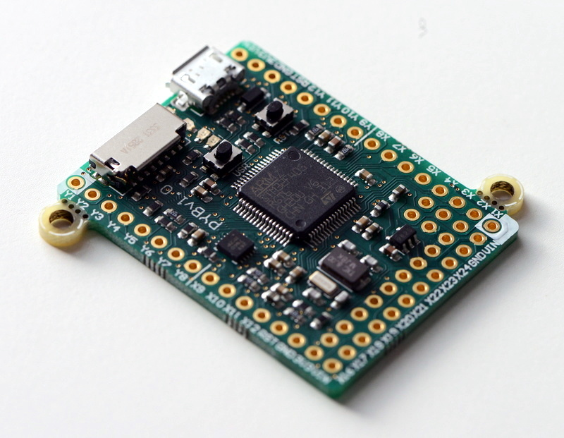
Pyboard

Slide 20
Pyboard
Easy programming with Pyboard
~import pyb
~ accel = pyb.Accel()
light = pyb.LED(3)
SENSITIVITY = 3
while True:
x = accel.x()
if abs(x) > SENSITIVITY:
light.on()
else:
light.off()
pyb.delay(100)

Slide 21
Pyboard
Main features of the hardware:
STM32F411RE microcontroller
96 MHz Cortex M4 CPU with hardware floating point
512KiB flash ROM and 128KiB RAM
Micro USB connector for power and serial communication
Micro SD card slot, supporting standard and high capacity SD cards
24 GPIO on left and right edges and 5 GPIO on bottom row, plus LED and switch GPIO available on bottom row
1x 12-bit analog to digital converter, available on 16 pins, 4 with analog ground shielding
4 LEDs (red, green, yellow and blue)
1 reset and 1 user switch
On-board 3.3V LDO voltage regulator, capable of supplying up to 250mA, input voltage range 3.6V to 16V
DFU bootloader in ROM for easy upgrading of firmware

Slide 22
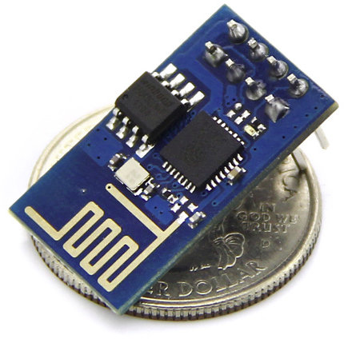
ESP8266

Slide 23
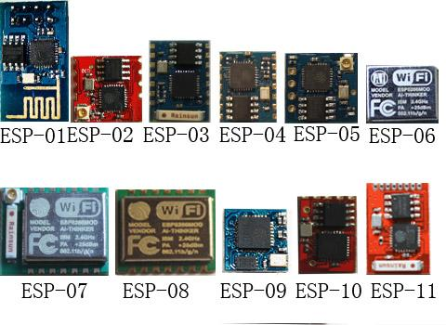
ESP8266

Slide 24
ESP8266
Main features of the hardware:
32-bit RISC CPU: Tensilica Xtensa LX106 running at 80 MHz*
64 KiB of instruction RAM, 96 KiB of data RAM
External QSPI flash - 512 KiB to 4 MiB* (up to 16 MiB is supported)
IEEE 802.11 b/g/n Wi-Fi
Integrated TR switch, balun, LNA, power amplifier and matching network
WEP or WPA/WPA2 authentication, or open networks
16 GPIO pins
SPI, I²C,
I²S interfaces with DMA (sharing pins with GPIO)
UART on dedicated pins, plus a transmit-only UART can be enabled on GPIO2
1 10-bit ADC

Slide 25
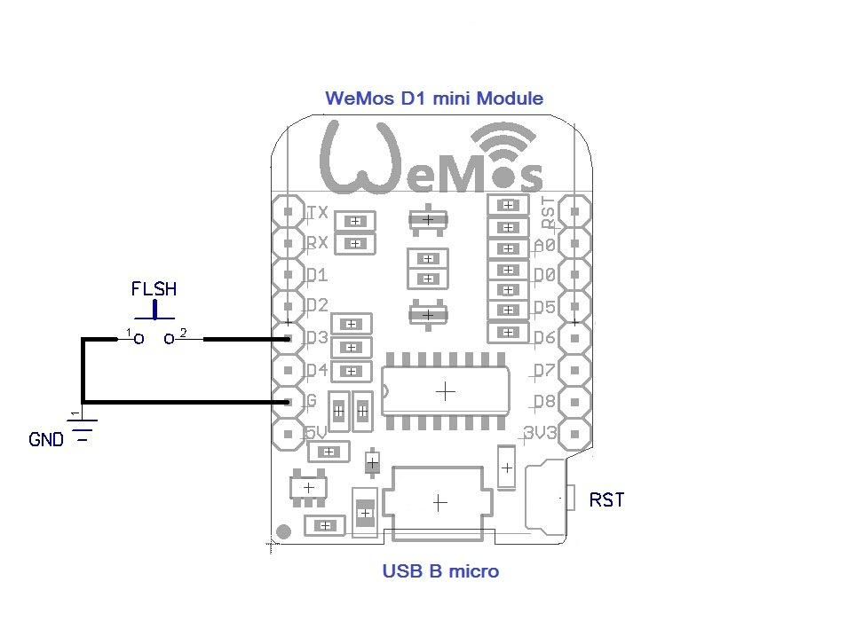
D1 Mini - based on ESP-8266EX.

Slide 26
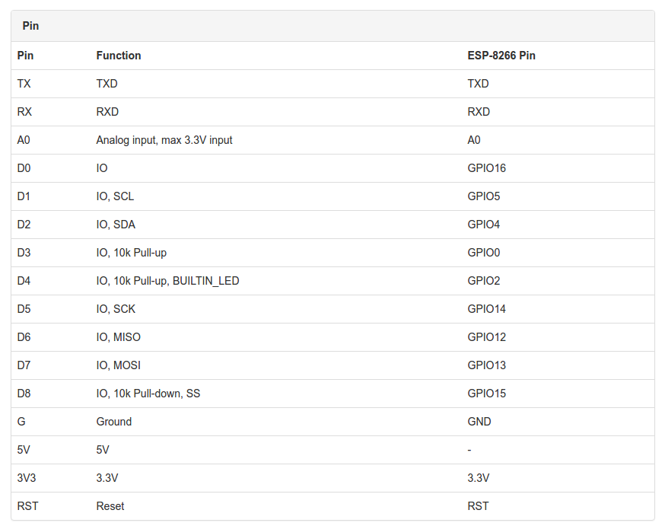
ESP8266 - D1 Mini

Slide 27
ESP8266
Micropython:
WARNING: The port is experimental and many APIs are subject to change.
Supported features include:
REPL (Python prompt) over UART0.
Garbage collector, exceptions.
Unicode support.
Builtin modules: gc, array, collections, io, struct, sys, esp, network, many more.
Arbitrary-precision long integers and 30-bit precision floats.
WiFi support.

Slide 28
ESP8266
Micropython:
Features continued:
Sockets using modlwip.
GPIO and bit-banging I2C, SPI support.
1-Wire and WS2812 (aka Neopixel) protocols support.
Internal filesystem using the flash.
WebREPL over WiFi from a browser (clients at https://github.com/micropython/webrepl).
Modules for HTTP, MQTT, many other formats and protocols via https://github.com/micropython/micropython-lib .
Work-in-progress documentation is available at http://docs.micropython.org/en/latest/esp8266/ .

Slide 29
ESP8266
Building micropython for ESP8266
Step 1:
Download: https://github.com/pfalcon/esp-open-sdk.git
sudo apt-get install make unrar-free autoconf automake libtool gcc g++ gperf \
flex bison texinfo gawk ncurses-dev libexpat-dev python-dev python python-serial \
sed git unzip bash help2man wget bzip2
git clone --recursive https://github.com/pfalcon/esp-open-sdk.git /home/micropy/esp-open-sdk

Slide 30
ESP8266
Building micropython for ESP8266
Step 2:
~ cd esp-open-sdk
~ git submodule update --init
~ make (This will take long, have some coffee)
Add to path /home/micropy/esp-open-sdk/xtensa-lx106-elf/bin:$PATH
~ cd micropython
~ make -C mpy-cross

Slide 31
ESP8266
Building micropython for ESP8266
Step 3:
~ git clone --recursive https://github.com/micropython/micropython.git (Skip if this step already done)
~ cd micropython/esp8266
~ make axtls
~ make

Slide 32
ESP8266
Building micropython for ESP8266
Step 4:
To flash the firmware you can do use make
~ make PORT=/dev/ttyUSB0 deploy
Or you can use esptool (pip install esptool)
~ sudo esptool.py --port /dev/ttyUSB0 write_flash --flash_mode qio --flash_size 32m 0x0 firmware-combined.bin --verify
Firmware is located in micropython/esp8266/build/

Slide 33
Micropython & ESP8266 specifics
Don’t have access to the Pyb API
Less modules
machine.freq(160000000) 160Mhz

Slide 34
Resources:
Alixpress
Communica.co.za
https://www.adafruit.com/categories/35
www.micropython.org
https://learn.adafruit.com/micropython-hardware-digital-i-slash-o/
https://github.com/micropython/micropython
http://docs.micropython.org/en/v1.8/esp8266/
https://media.readthedocs.org/pdf/micropython-on-esp8266-workshop/latest/micropython-on-esp8266-workshop.pdf
https://www.maker.io/en/blogs/programming-micropython-on-the-esp8266/57abec67b5c34eb398d8fe6ae6442f46

Slide 35
Q&A

