Slide 1

C-CI
Christopher Grigsby CSCI*210

Slide 2
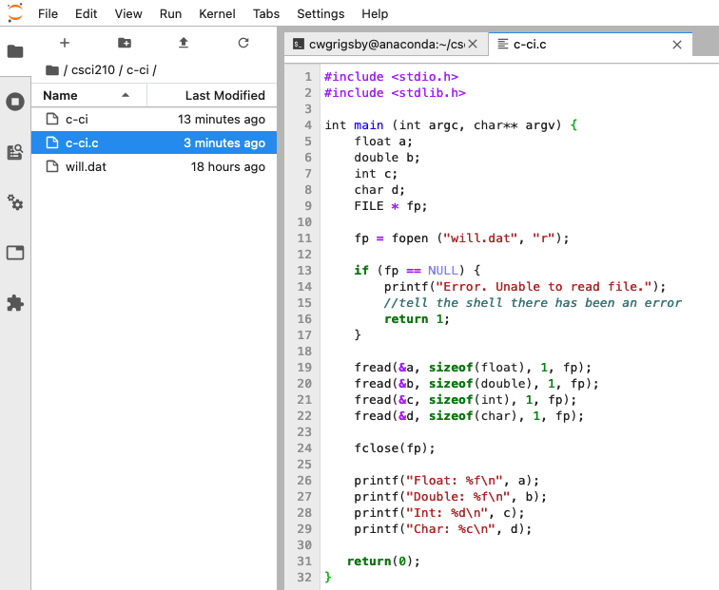
Write a c program that will determine the contents of the file (will.dat)

Slide 3
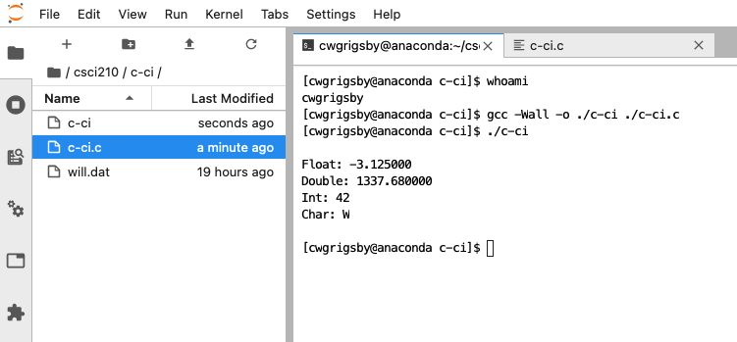
Show that the program will compile and execute, begin with $whoami

Slide 4
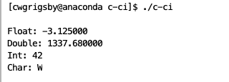
C Program results

Slide 5
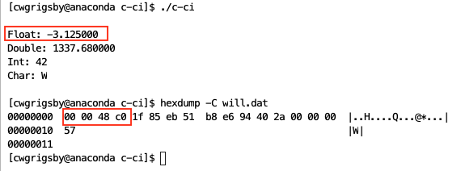
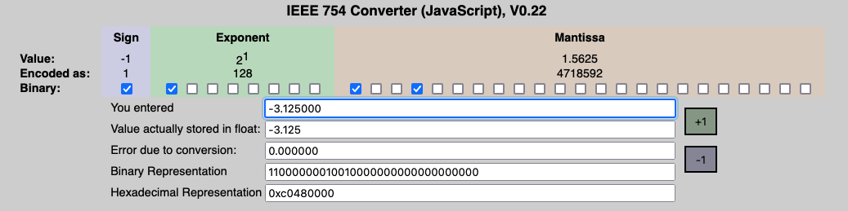
Confirm your results with hexdump: Float = -3.125000 4 bytes

Slide 6
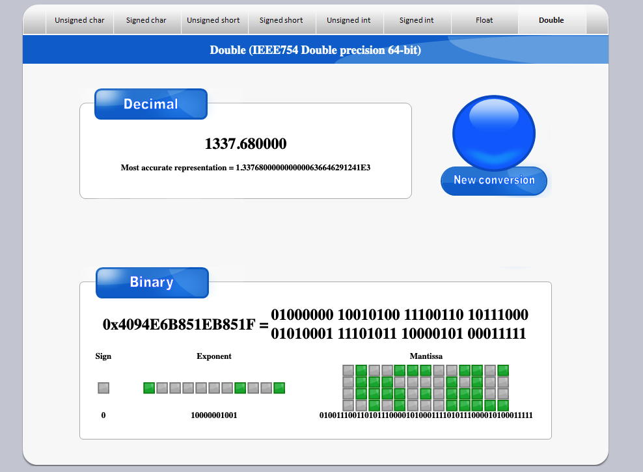
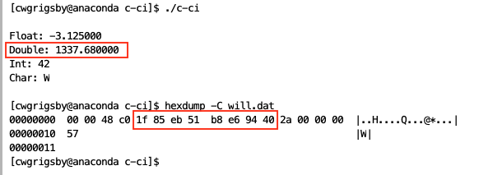
Confirm your results with hexdump: Double = 1337.680000 8 bytes

Slide 7
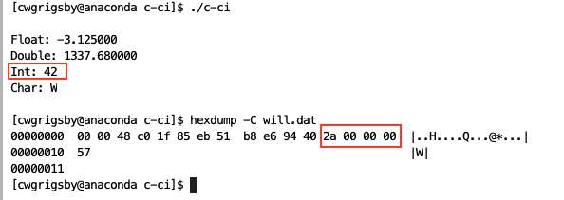
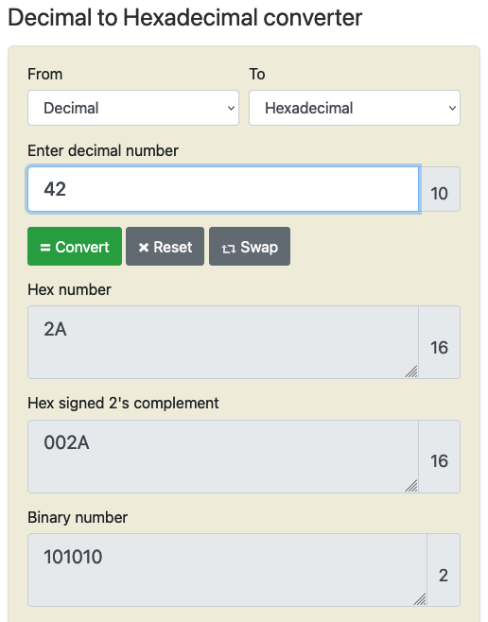
Confirm your results with hexdump: int = 42 4 bytes

Slide 8
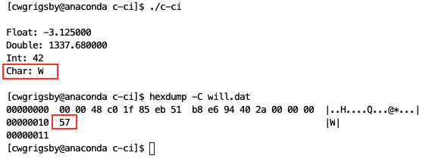
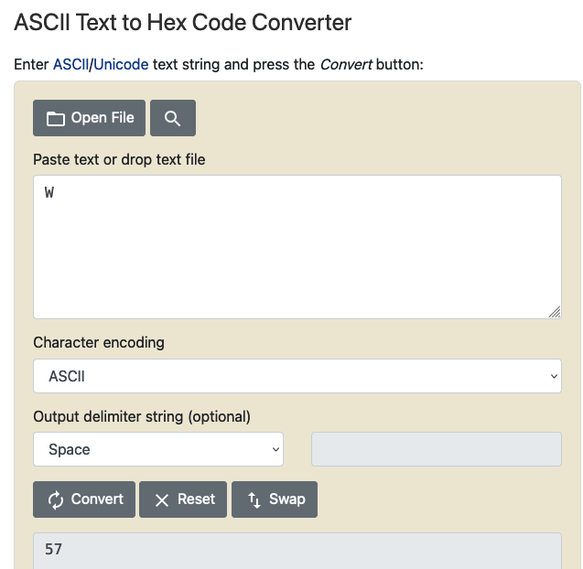
Confirm your results with hexdump: char = w 1 byte

