Slide 1
A Mobile Information Kiosk of Buildings for Visitors with navigation using AR
Supervisor Li Tak Sing
Student Chan Kwok Chi

Slide 2
Problem

Slide 3
Problem details
Scenes
Problem
A man wants to enjoy services provide by an unfamiliar building at his first visit.
A woman wants to know what promotional activities are taking place in a mall.
Take a long time to find the service because of unfamiliarity.
Have to enquiry a worker in that mall. And will gain nothing if the worker is absent.

Slide 4
Problem analysis
People cannot gain information in need when they are exploring a building.
The building manager can alternatively provide a website for visitors. But it is not user friendly.

Slide 5
Aims
Provide navigation as well as information to visitors.
Use AR to provide user friendly interface.

Slide 6
Existing solutions
Several works have been done by researchers:
Some works like [1] use AR to provide indoor navigation. But they do not work much on information system.
Some works like [2] already can provide advertisement and navigation in supermarket. But they do not cover other indoor environment.
Thus there is still a gap between real life requirements and modern technologies.

Slide 7
Methodology

Slide 8
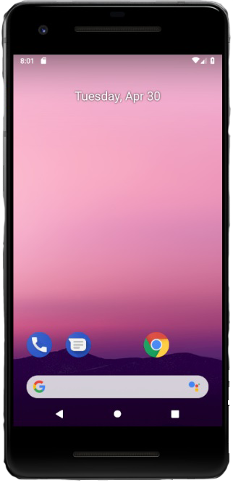
Expected inputs and outputs

Slide 9
Problem challenges
Object recognition
Information system
Navigation
Recognize real objects and natural markers
Use AR to present information
Calculate user’s current position

Slide 10
Techniques required
Techniques | Support
AR | combine virtual object
AI | recognize the object
Web Page and database | provide a web entry for building managers

Slide 11
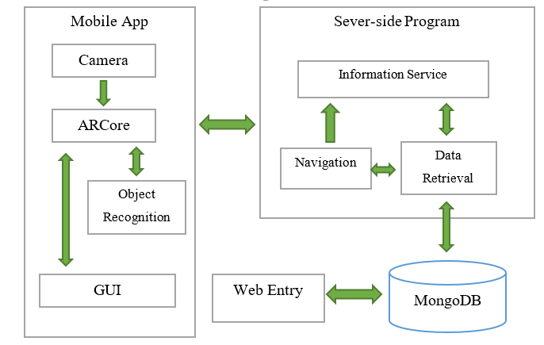
System design

Slide 12
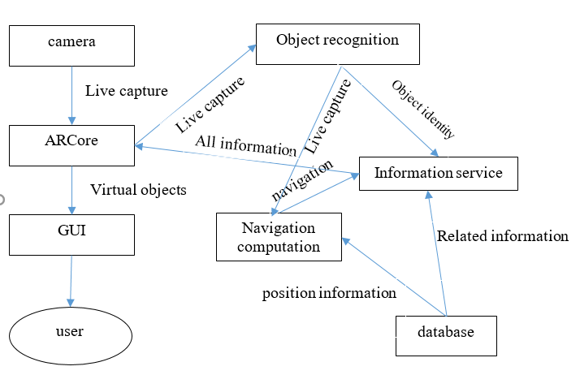
System data flow

Slide 13
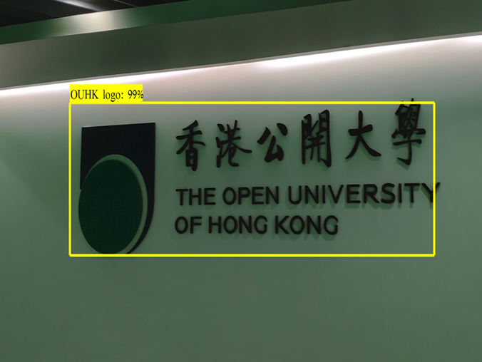
Evaluation – AI training

Slide 14
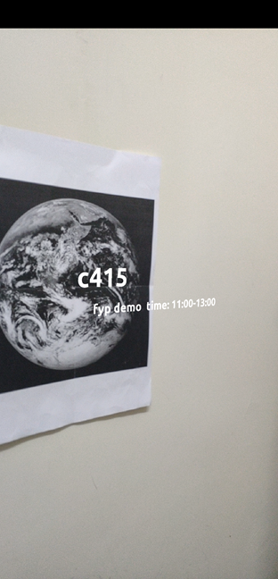
Evaluation – Accuracy
The mobile app can register text information to makers(e.g. post)

Slide 15
Current Project Achievement
A web entry for building manager has been implemented.

Slide 16
Future Work
Functions | Status
Object detection | 90%, it still needs more training
AR information display | 100%
Web entry | 100%
Navigation | 0%
Evaluation | 0%

Slide 17
References
[1] M. Neges, C. Koch, M. König, and M. Abramovici, “Combining visual natural markers and IMU for improved AR based indoor navigation,” Advanced Engineering Informatics, vol. 31, pp. 18–31, 2017.
[2] Zhu, Wei, Charles B. Owen, Hairong Li, and Joo-Hyun Lee. "Personalized in-store e-commerce with the promopad: an augmented reality shopping assistant." Electronic Journal for E-commerce Tools and Applications 1, no. 3, pp. 1-19, 2004

