Slide 1
WeiqiDB
Chieu Le Heng
CS6131 Project

Slide 2
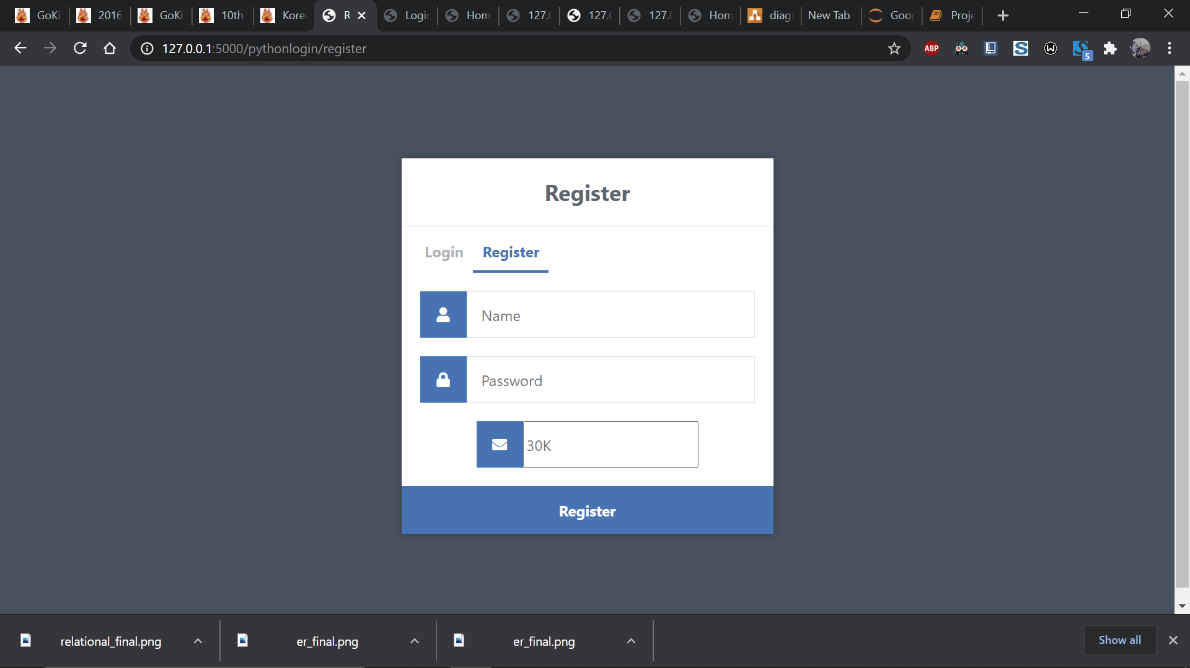

Slide 3


Slide 4
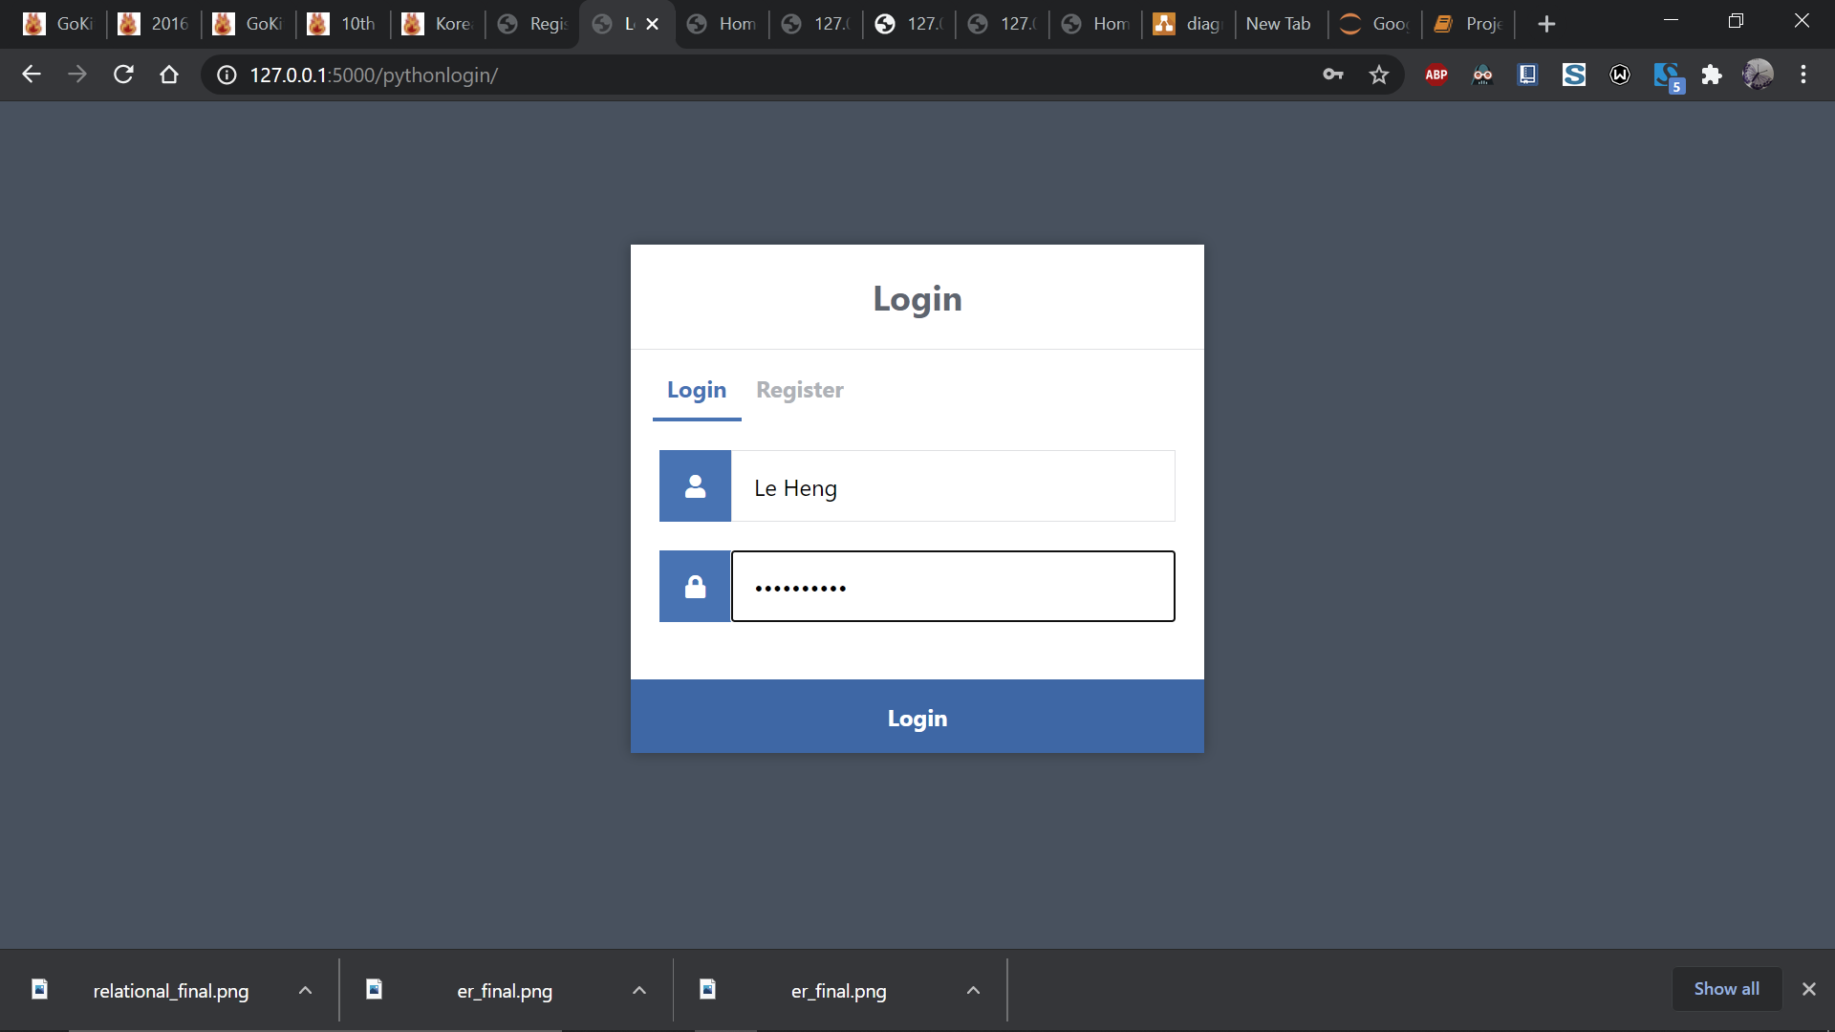

Slide 5
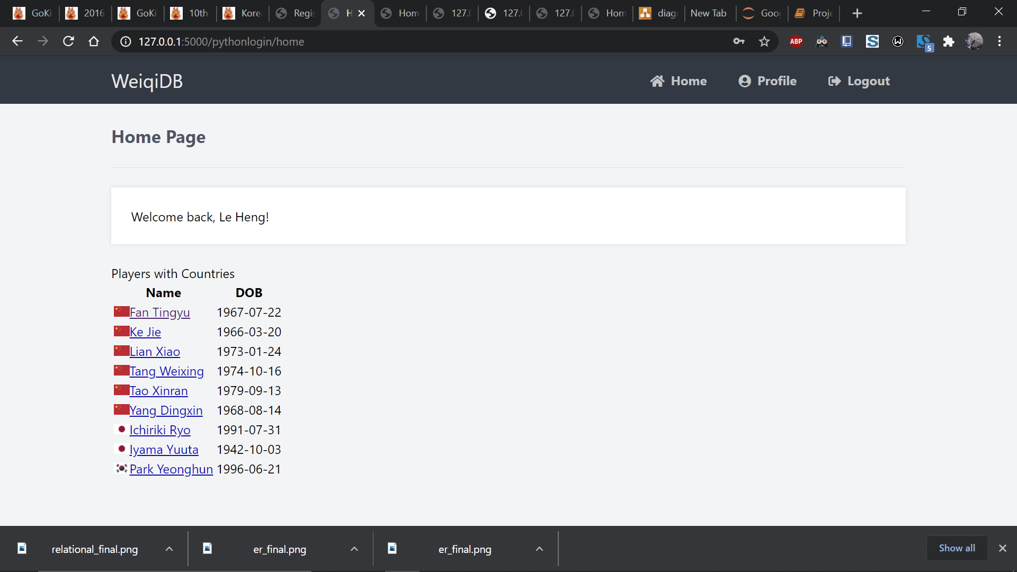
Home

Slide 6
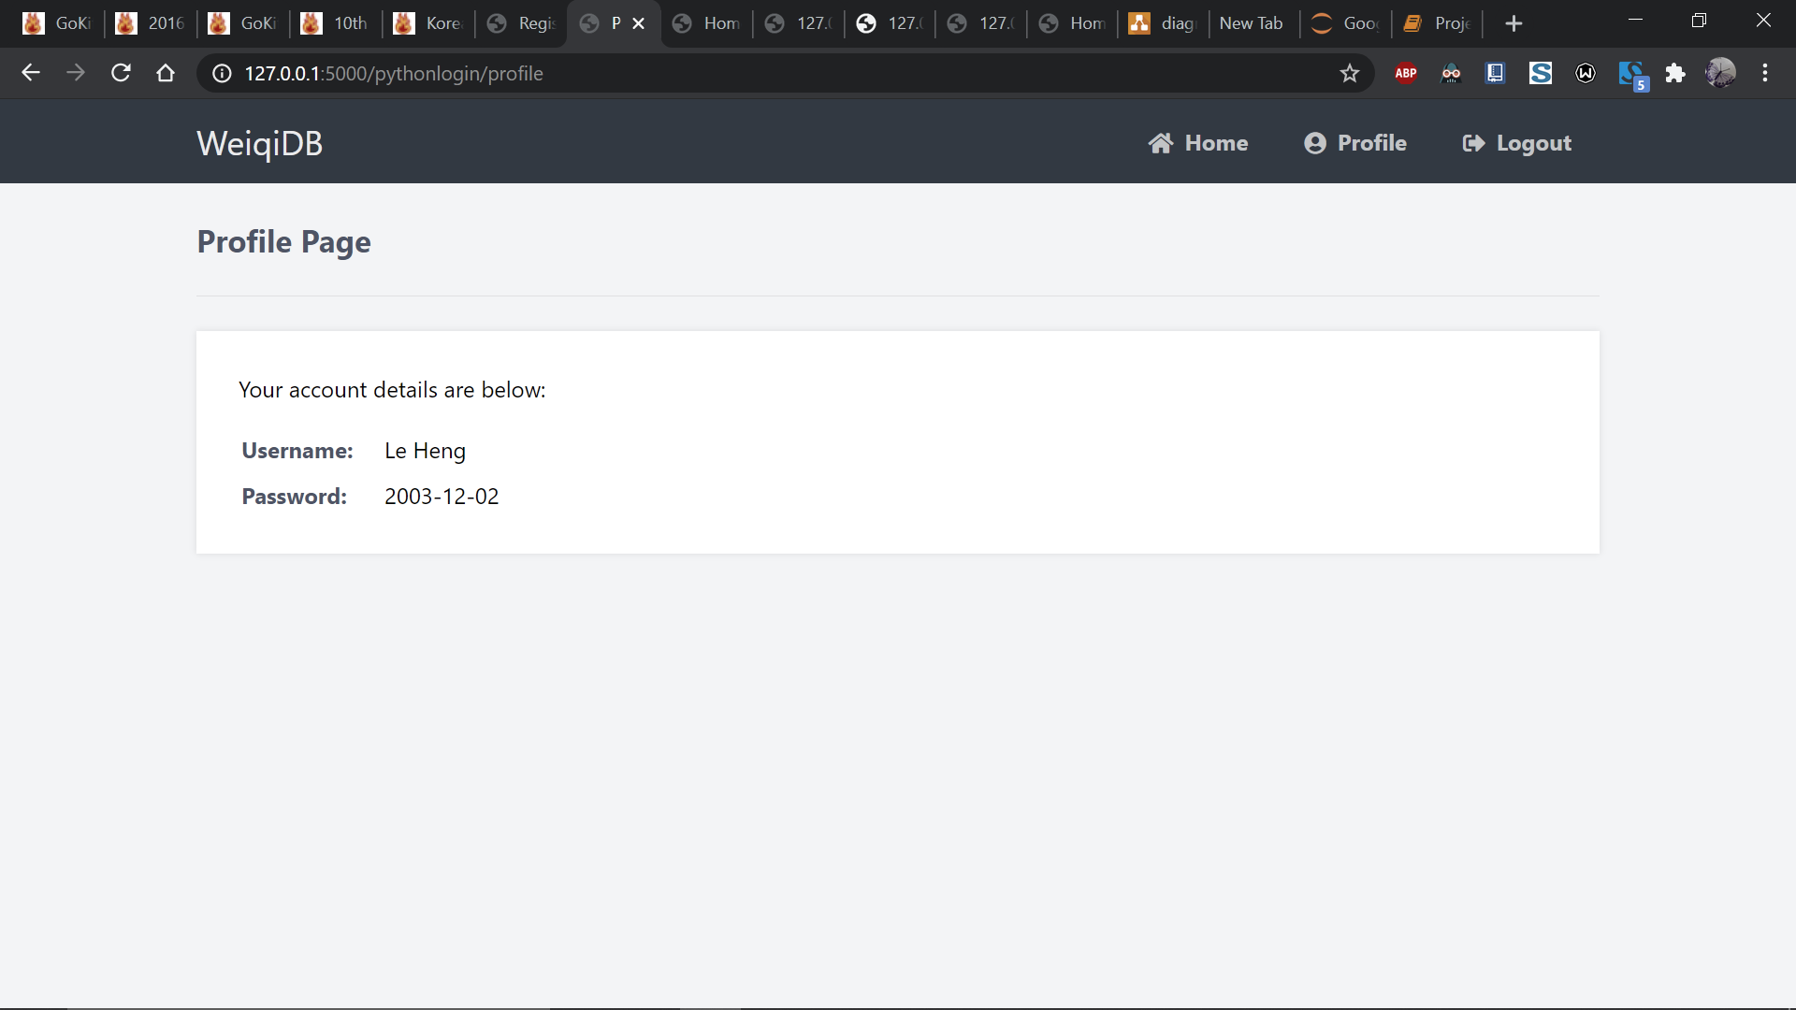
Profile

Slide 7
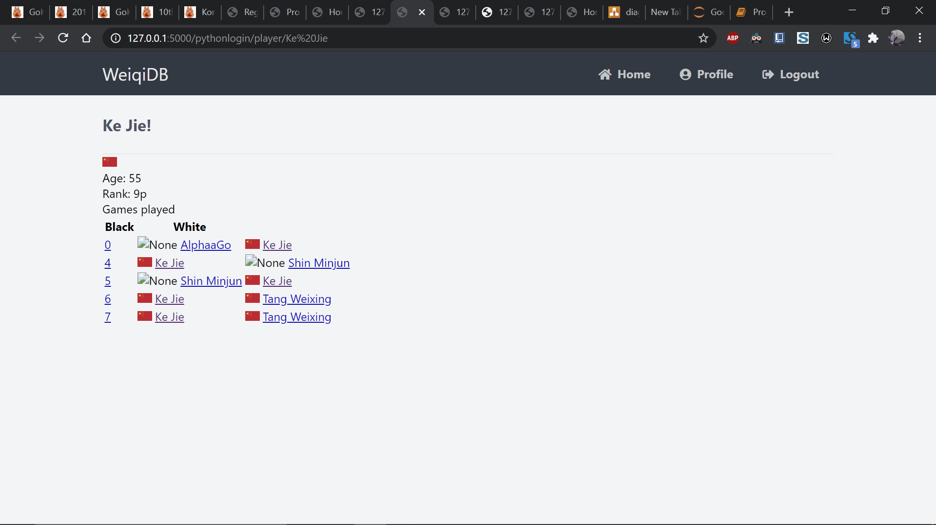
Player

Slide 8
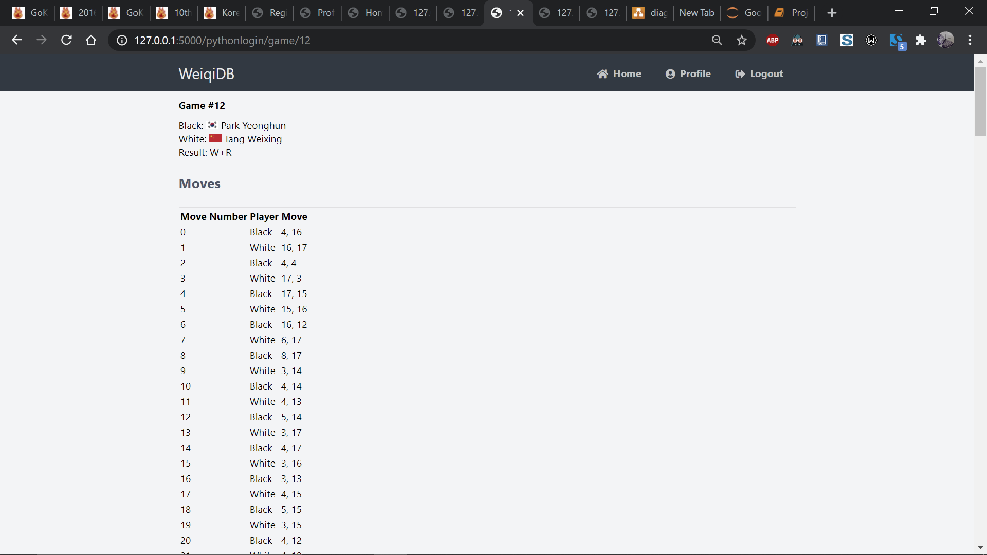
Moves

Slide 9
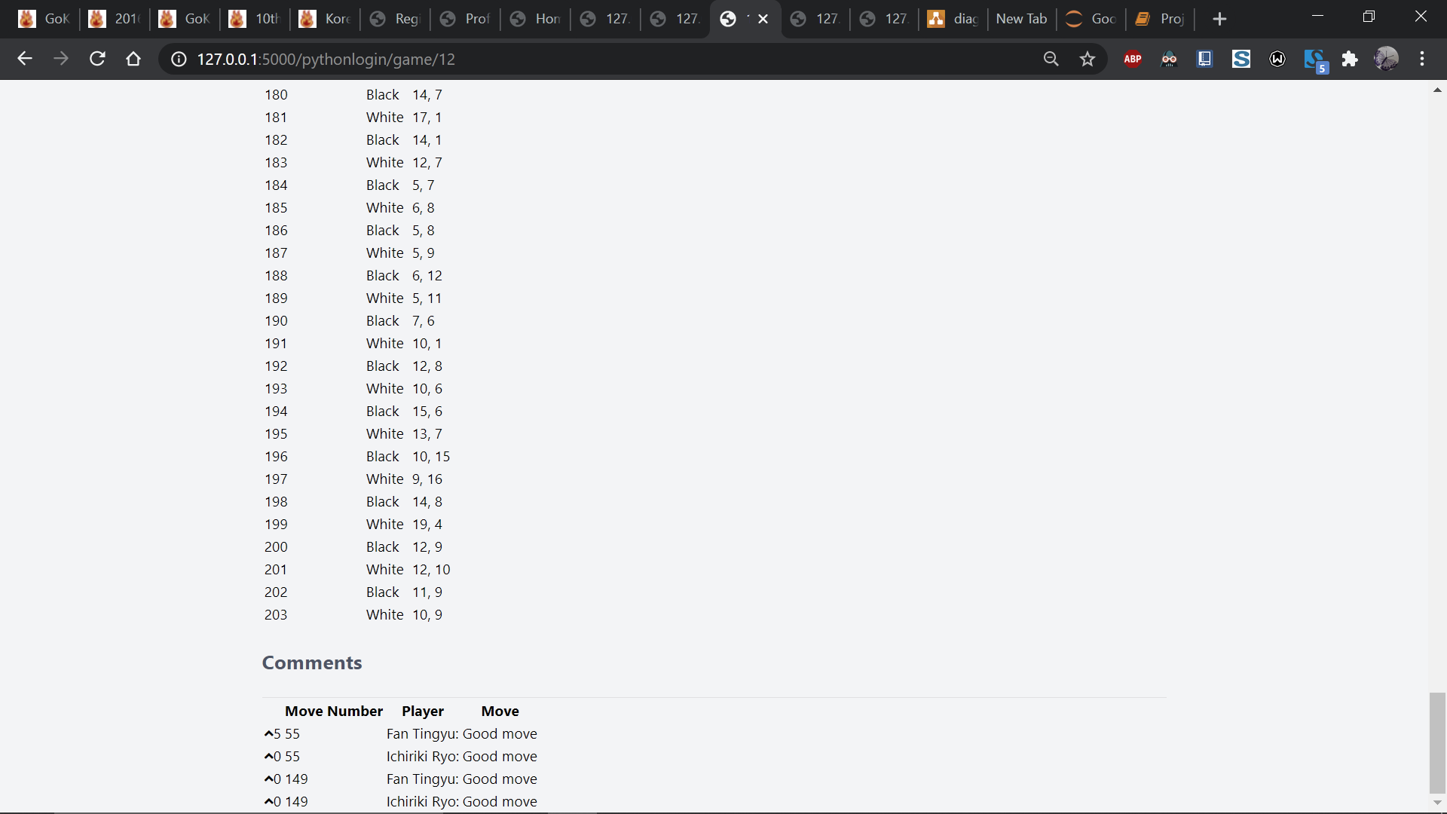
Moves

Slide 10
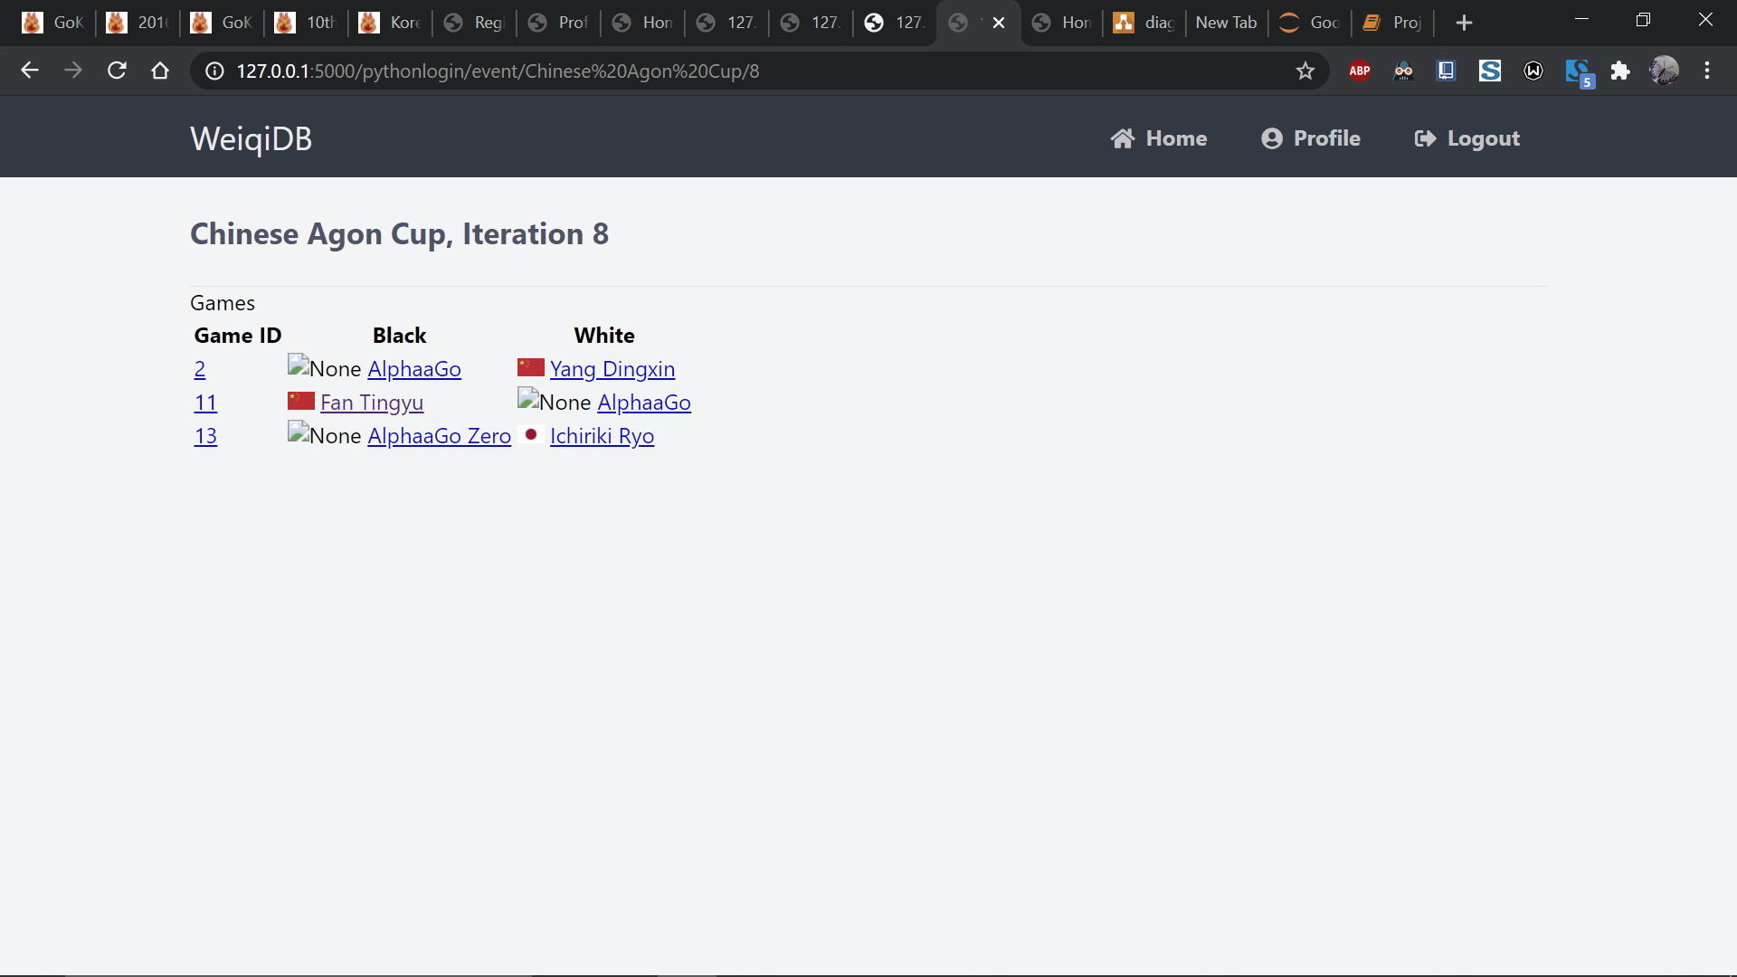

Slide 11
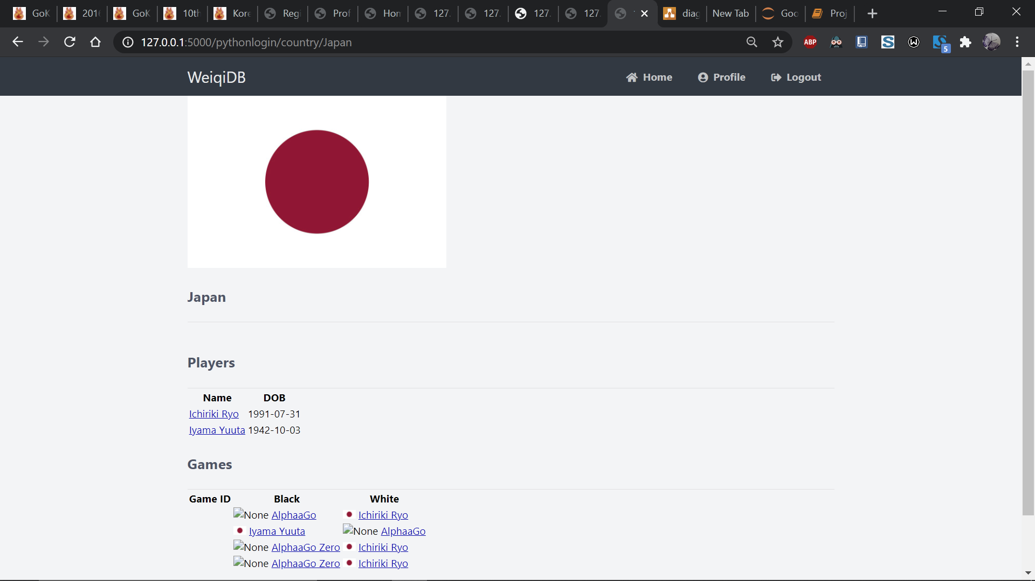
Country

Slide 12

Thanks
https://github.com/c-j-lh/weiqi

