Slide 1
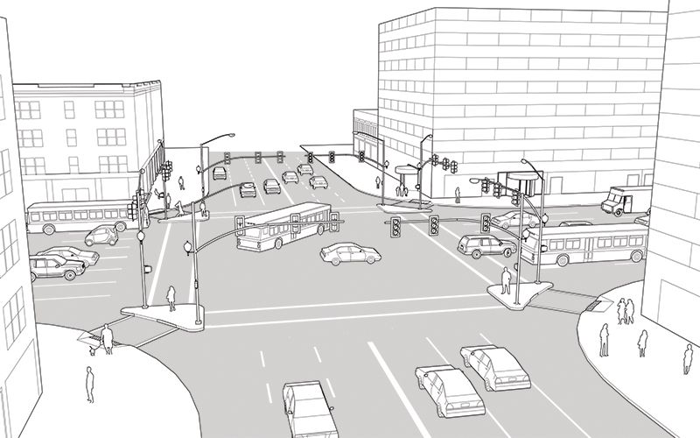



URBAN TRAFFIC ANALYSIS of
Prayagraj
MindMatrix
SHIV SHARAN SHUKLA
CHINMAY JAIN
SNOIHIK CHAKRABORTY

Slide 2














CURRENT SCENARIO
SUMMARY OF URBAN TRAFFIC AT PRAYAGRAJ
CURRENT SCENARIO
IDENTIFICATION OF ISSUES RECOMMENDATIONS
IMPLEMENTATION ROAD-MAP
111
Total vehicles passing through each intersection
33.62
Average speed of vehicles at intersection in km/hr
51.67
Average wait time of vehicles at intersection in s
2.21
Average pollution level at each intersection in ug/m^3
KATRA
Busiest Intersection with highest average of vehicles present at intersection
HEAVY RAIN
Weather having least traffic and pollution
THINGS TO BE NOTICED
Sources: UMRA , MyGov.in,, URBANEMISSION.INFO
1 Overview : Traffic
2
Insights : About vehicles
3
Analysis of Pollution
The city experiences significant traffic congestion, especially in areas like Civil Lines, Chowk, and Jhonstonganj.
Cars: High private car density contributes to traffic congestion, especially at major intersections in urban areas.
Vehicle Count
Pollution (ug/m^3)
TYPE OF VEHICLE
AVERAGE COUNT
Place
Allahabad Junction
111
2.22
PM 2.5 Levels: Allahabad’s air quality is often affected by high levels of PM2.5, especially due to vehicle emissions
CAR
Trucks: Prayagraj, as a major transit point, has substantial truck traffic, particularly on highways and ring roads
11
Chowk
112
2.24
Civil Lines
112
2.24
BUS
Jhunsi
109
2.19
Security and Accessibility: Traffic safety has been a focus, with increased CCTV surveillance
67
Buses: Both state-run and private buses are prevalent, with the UPSRTC introducing electric buses to promote eco-friendly travel ahead of major events like Mahakumbh 2025
Katra
113
2.26
MOTORCYCLE
MNNIT Gate
107
2.14
Noise Pollution: The noise levels in central areas frequently exceed the CPCB's standard of 75 dB.
22
Minto Park
111
2.22
Motorcycles: Motorcycles are among the most common forms of transport due to their affordability and ease of navigation in traffic.
TRUCK
Naini Bridge
110
2.19
Public Transport Modernization: –Allahabad is expanding e-rickshaws, electric buses, and bus routes to ease private vehicle use.
Phaphamau
108
2.17
Tagore Town
112
2.23

Slide 3

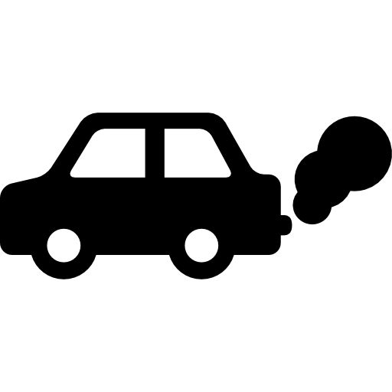
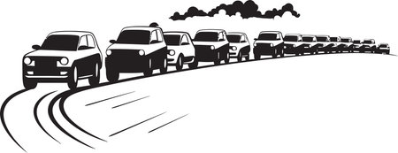

KEY ADDRESSABLE ISSUES
POLLUTION LEVELS OF THE CITY TRAFFIC CONGESTION
High volume of traffic at intersections
High vehicle counts at major intersections cause bottlenecks during peak hours, leading to longer travel times, frequent stops, and increased fuel consumption and emissions.
Bus and trucks emit a a significant amount of toxic wastes
Lack of smart traffic measures
Vehicle Count: Ranges from 0 to 438 across intersections, with an average of about 111 vehicles per record, indicating heavy congestion at peak times.
Average pollution at each intersection is 2.21 ug/m^3
Average Speed: With an average speed of 33.6 km/h and a minimum of 8.2 km/h, traffic flow is often slow, contributing to delays.
Air pollution in Prayagraj contributes to thousands of hospitalization
Waste: Congestion wastes time and fuel, leading to economic losses as workers, goods, and services are delayed.
City’s air quality often exceeds safe limits, with PM 2.5 levels.
ROAD SAFTEY CONCERNS
Car, Bus, and Truck Counts: Car count averages around 66 per record, with bus and truck counts averaging 11 each. A high presence of mixed vehicle types can increase accident risk, especially in congested intersections.
Signal Timing: Green times average around 63 seconds, with red times around 51 seconds. Shorter green signals during peak hours could contribute to pedestrian and vehicle crossing risks.
Motorcycle Count: With an average of 22 motorcycles per record and a peak of 93, these vehicles add to road complexity and accident risk in mixed traffic.

Slide 4



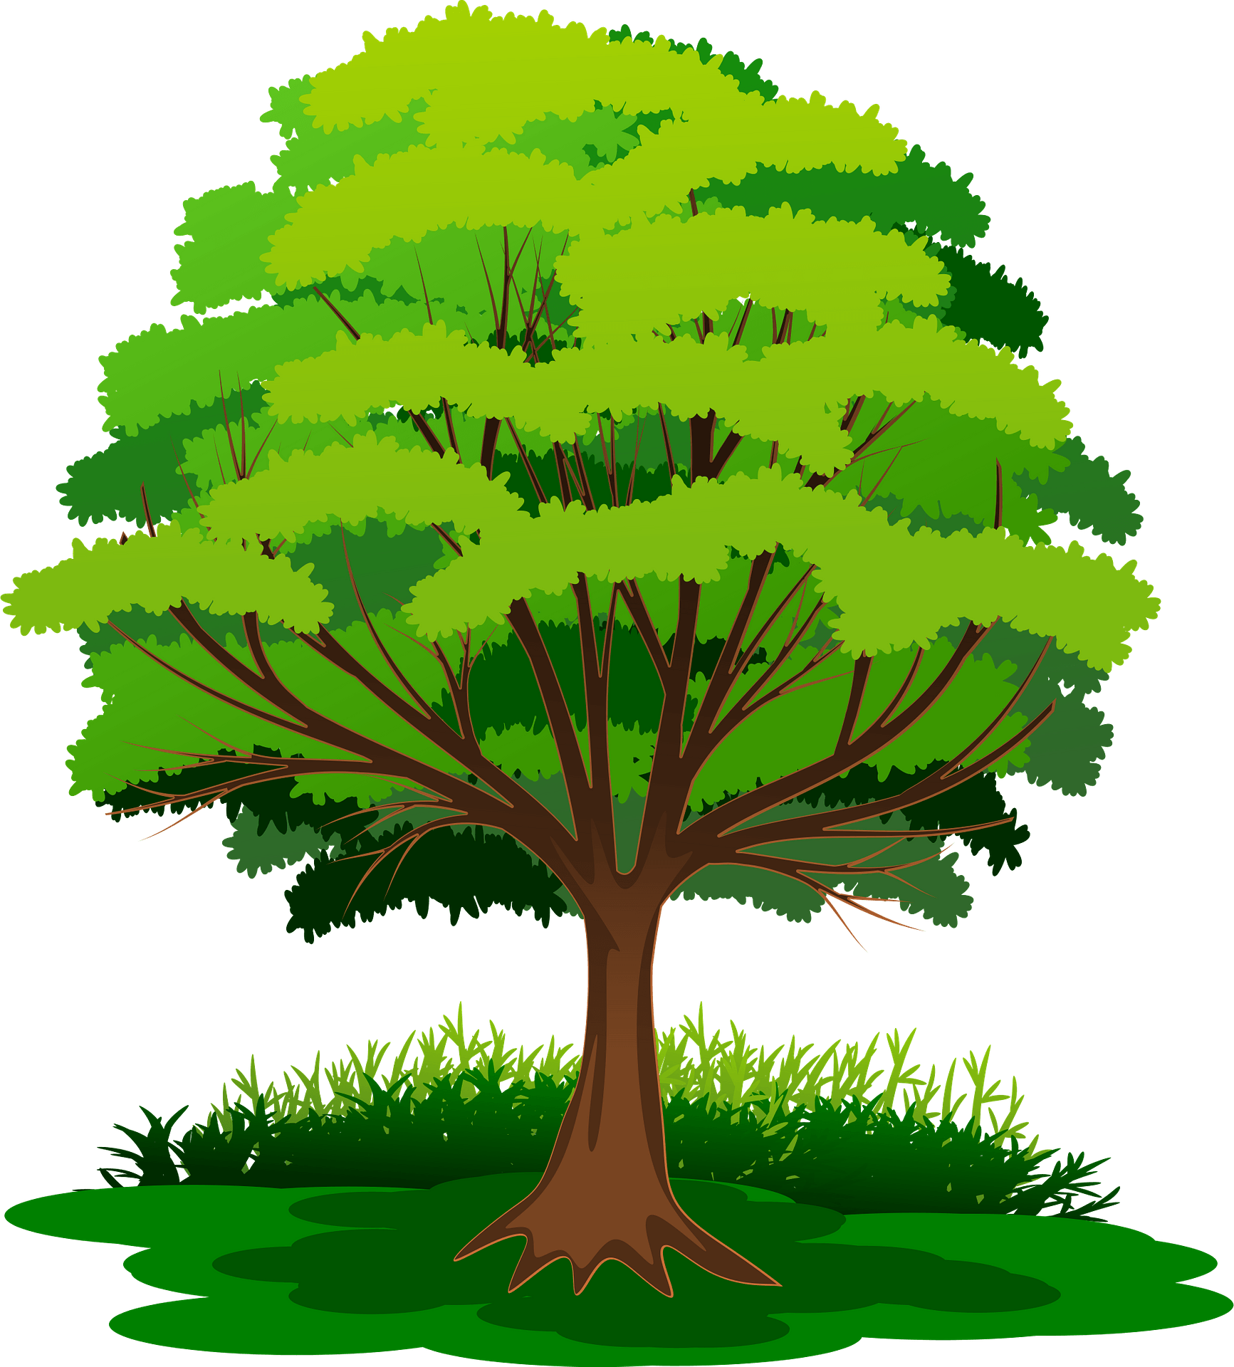


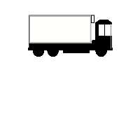

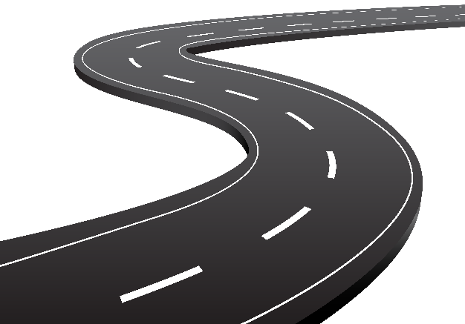
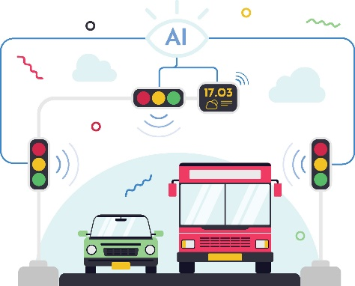
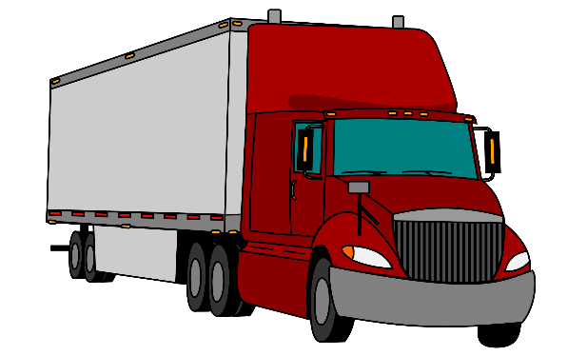
RECOMMENDATIONS AND IMPLEMENTATION
FOR POLLUTION , CONGESTION , SAFETY
5
GREEN SPACES
7
REVENUE TO LOCAL GOVERNMENT
Green Urban Planning
Fuel ! Your Revenue Surge
Developing green spaces, planting trees along roads, and creating “green belts” around the city can help absorb pollutants and improve air quality
Increased Reach: Billboards in high-traffic areas maximize public message visibility and engagement.
Water Conservation: Reducing sprinklers in less busy zones minimizes water waste.
Resource Efficiency: Prioritizing billboards in high-traffic areas cuts maintenance costs and optimizes resources.
Allowing space for community gardens and urban farming initiatives not only fosters community engagement but also provides local produce, reducing the carbon footprint.
6
Change in Timing
8
AI in Traffic
Entry timing for trucks
Real life monitoring of traffic
Trucks will be assigned specific entry times to prevent congestion and ensure efficient loading/unloading at logistics centers.
Real-Time Signal Control: AI will monitor traffic flow and adjust green light durations dynamically to ease congestion.
Improved Efficiency and Lower Emissions: Adaptive signals will reduce idle times, resulting in smoother traffic flow and fewer emissions.
Entry timings will be regulated to reduce traffic disruption, minimize pollution, and comply with local laws, particularly during peak hours.

Slide 5

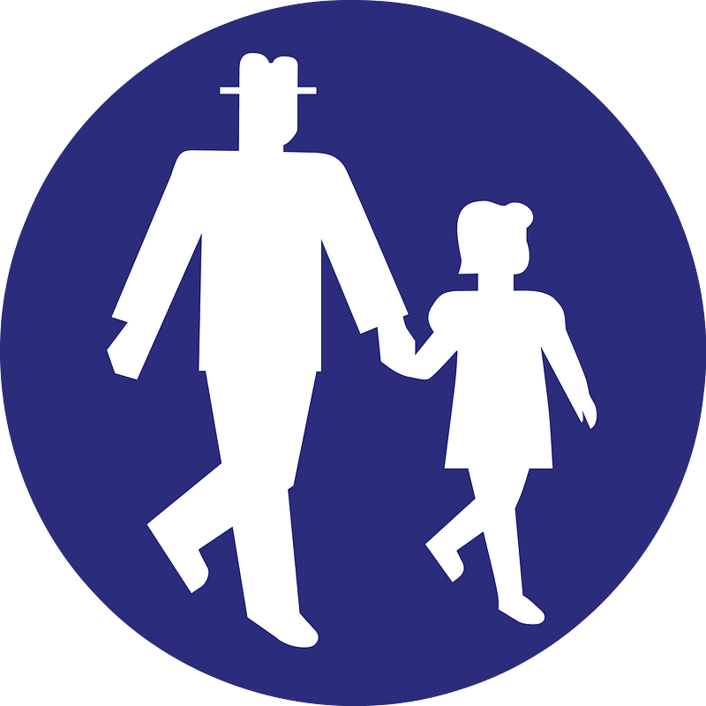
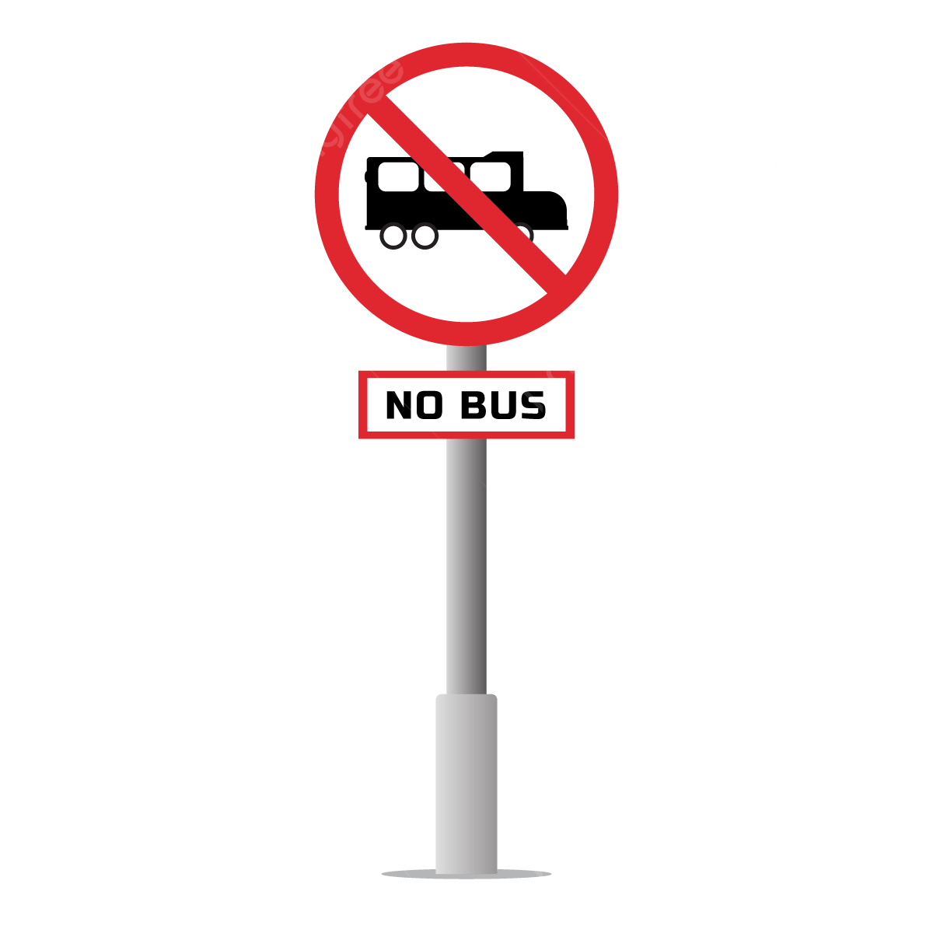

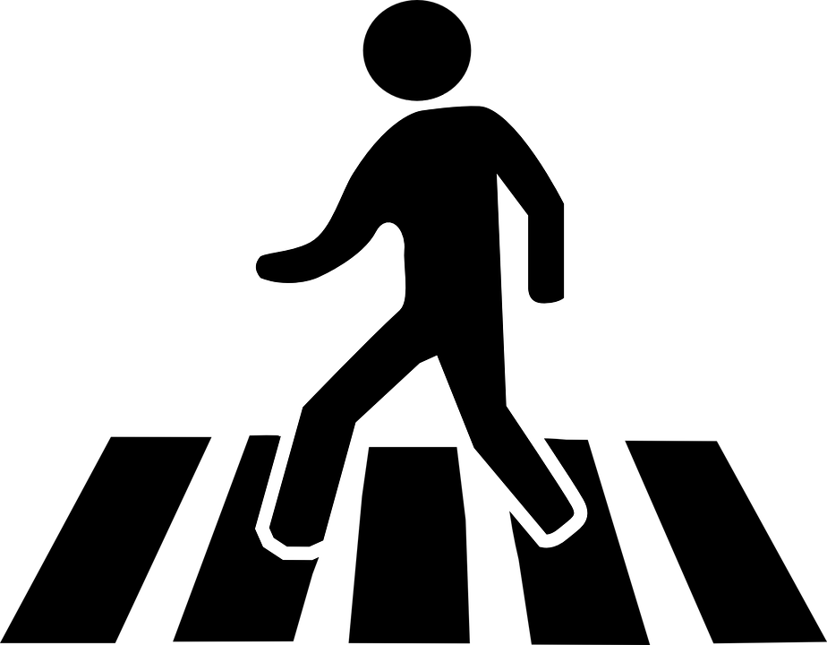


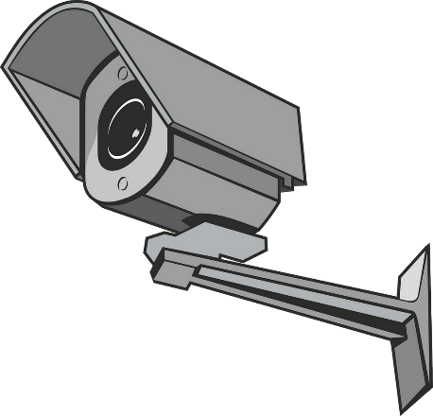
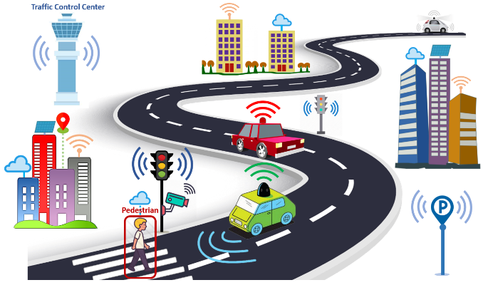
RECOMMENDATIONS AND IMPLEMENTATION
FOR POLLUTION , CONGESTION , SAFETY
9
Designated Lanes
11
Walkovers
Seperating lanes for bigger vehicles
Overhead walkovers reduce congestion
Dedicated Lanes: Special lanes for buses and carpools will reduce delays by allowing them to bypass regular traffic.
Reduced Congestion: Encouraging shared rides will lower single-occupancy vehicles, improving traffic flow and reducing travel times.
Improved Safety: Pedestrian overpasses or underpasses will separate foot traffic from vehicles, reducing accident risk at busy intersections.
Better Traffic Flow: Diverting pedestrians away from intersections will allow vehicles to move more smoothly, easing congestion.
10
CCTV
12
Traffic flow
Cameras for speeding
Integrating softwares
Speeding Deterrence: Speed cameras will discourage drivers from speeding, improving safety.
Increased Safety: Cameras will reduce accidents by enforcing speed limits at high-risk intersections.
AI-Driven Traffic: Optimization: AI software adjusts signals and routes to prevent congestion, reducing the need for road expansions.
Maximized Road Efficiency: Optimizing traffic flow uses existing infrastructure more effectively, lowering maintenance and expansion costs.

Slide 6
THANKS
“Together, let’s build a future where tradition meets innovation”
SHIV SHARAN SHUKLA
CHINMAY JAIN
SNOIHIK CHAKRABORTY

