Slide 1
‘Vegan’ Package
Candice Kasahara

Slide 2

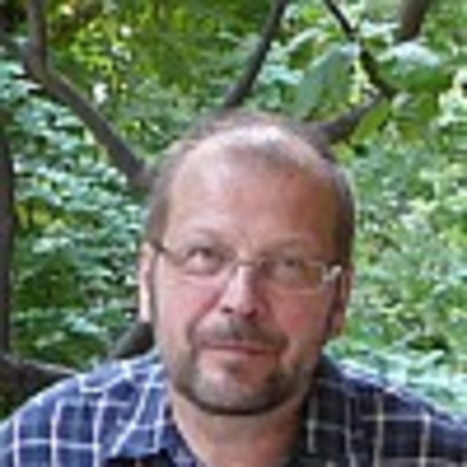
Lead Author: Jari Oksanen
Lead Author: Jari Oksanen
Professor in biology and environmental sciences
Affiliated with:
University of Helsinki (1997-2000)
University of Oulu (2001-present)
Ecologist studying forest and wetland landscapes as well as species communities in Finland
Oksanen’s most recent article is from 2021, “Gradient, Species Richness and Communities in Eastern Finnish Sloping Fens”
Created and continues to maintain the Vegan Package

Slide 3
What is Vegan?
What is Vegan?
Vegan provides the tools needed for descriptive community ecology.
Diversity analysis
Taxonomic diversity, abundance distribution
Community ordination
Vegan is especially efficient at running NMDS ordination models - condense information from multiple dimensions (communities, sites, etc.) into just a few, for better visualization and interpretation
Dissimilarity analysis
Exploring variability in community composition
Notes:
Non-metric multidimensional scaling

Slide 4
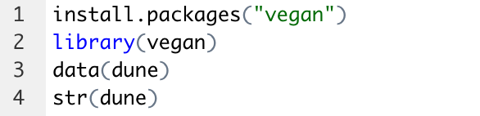
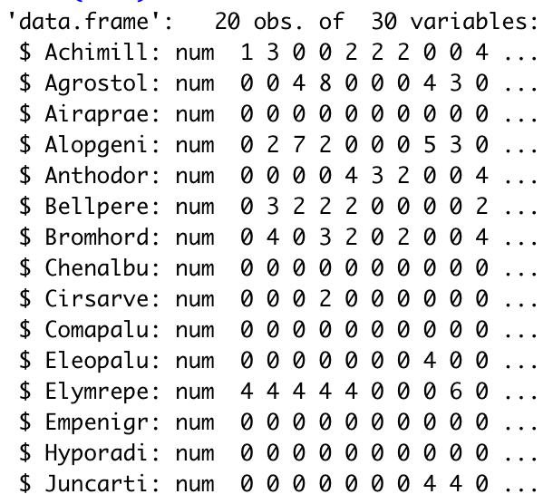
Install Vegan and Overview Dataset
Install Vegan and Overview Dataset
Using the ‘dune’ dataset
Vegetation and environment in Dutch dune meadows
Notes:
The dune dataset being used is an example set used for Vegan demonstrations.
As seen in the image to the right, the set includes 30 different species in 20 locations
Observations looking at plant cover

Slide 5
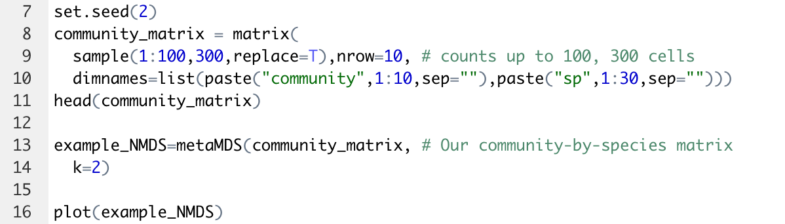
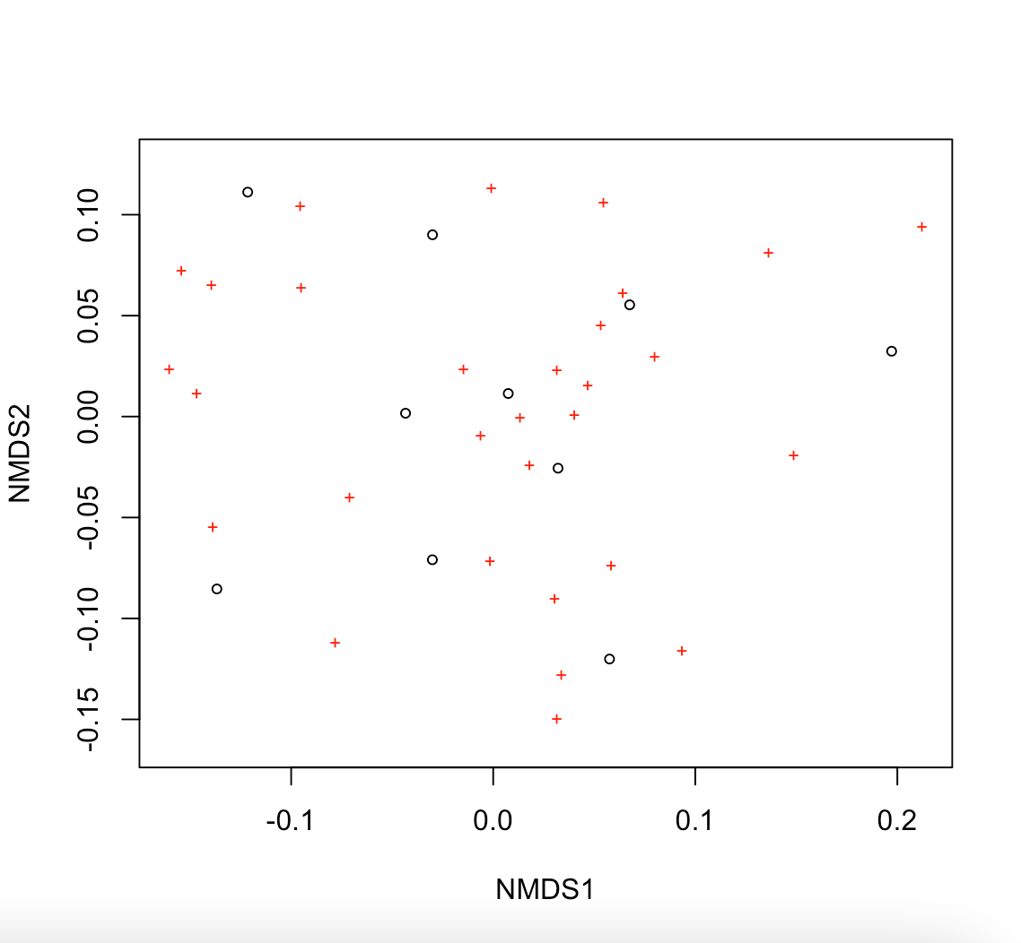
Non-Metric Multidimensional Scaling
Non-Metric Multidimensional Scaling
* Sites are the open circles
* Species are the red plus symbols

Slide 6
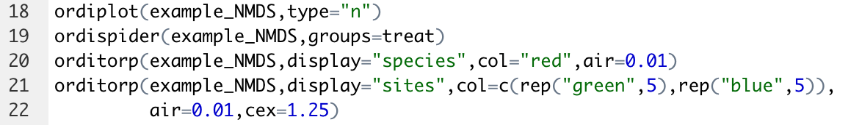
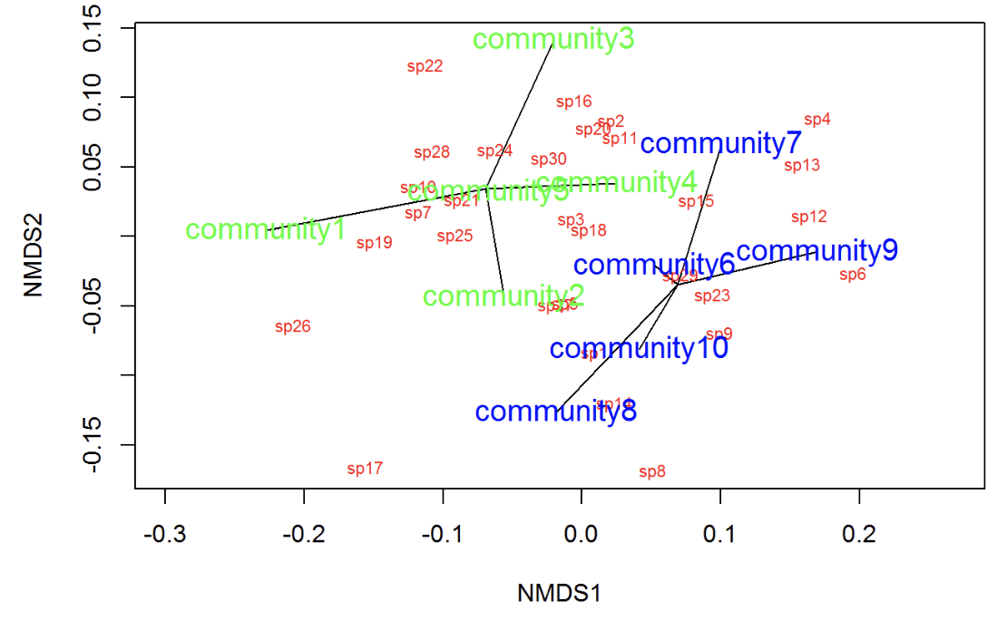
Creating a spider plot
Creating a Spider Plot
Notes:
Ordiplot and orditorp is used to add text to the plot in place of points to make sense of the relationships between the species and the communities
Ordispider creates the black lines on the graph to show the connections amongst the communities and species

Slide 7
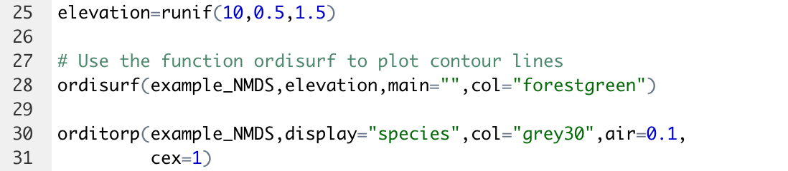
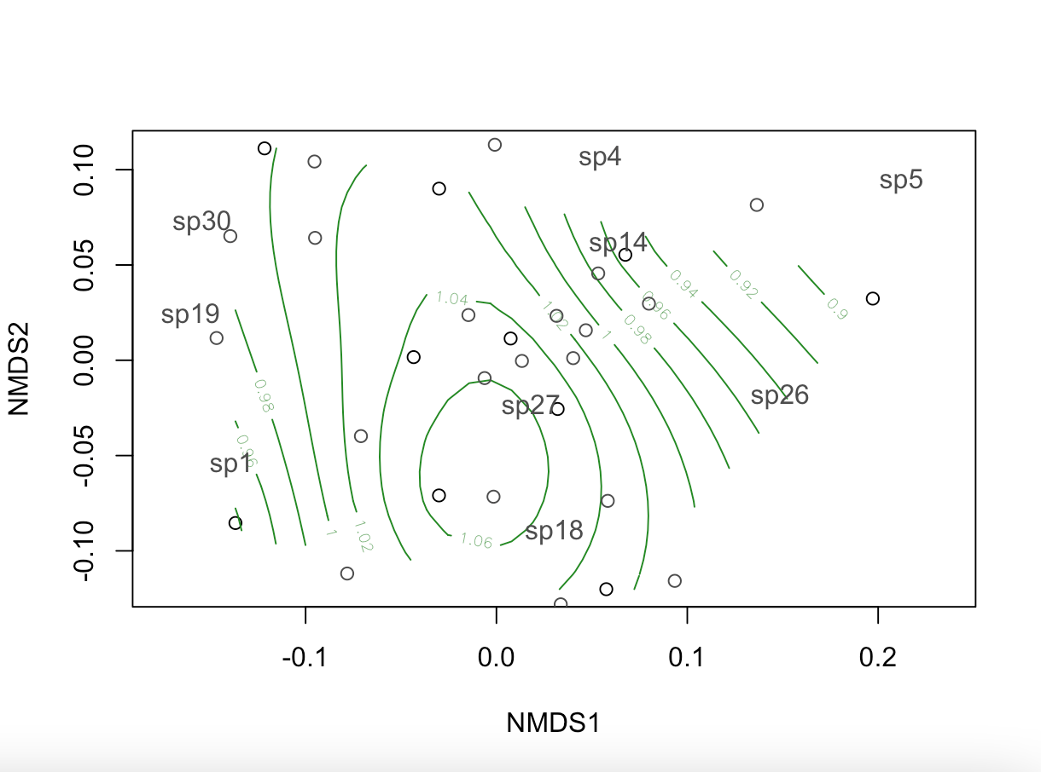
Overlaying species on elevation
Overlaying Species Location on Elevation

