Slide 1
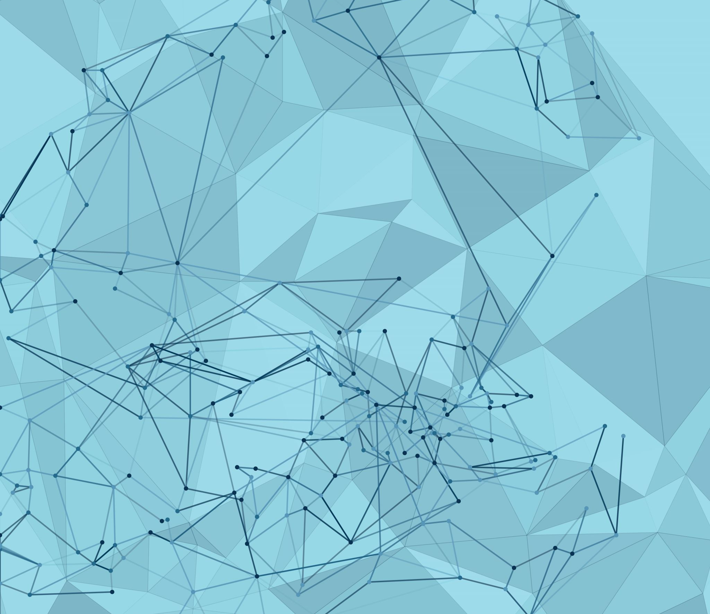
UNI-TAGGER: A U.I. FOR ALPHAFOLD EVALUATION OF RECOMBINANT TAG INDUCED CONFORMATIONAL SHIFTING
CHRIS KONG & HENRY SCOTT
BP219: FALL 2022
Notes:
Consider changing title slide to something that incorporates output structures?

Slide 2






Problem: protein affinity/fusion tags…necessary- but can represent blackboxes
How do I choose the right tag?
I picked the right tag and have my construct design!
Purification and Experimentation
Where’d my protein go!?
Why is my protein acting so abnormally ???
Solution: Uni-Tagger

Slide 3

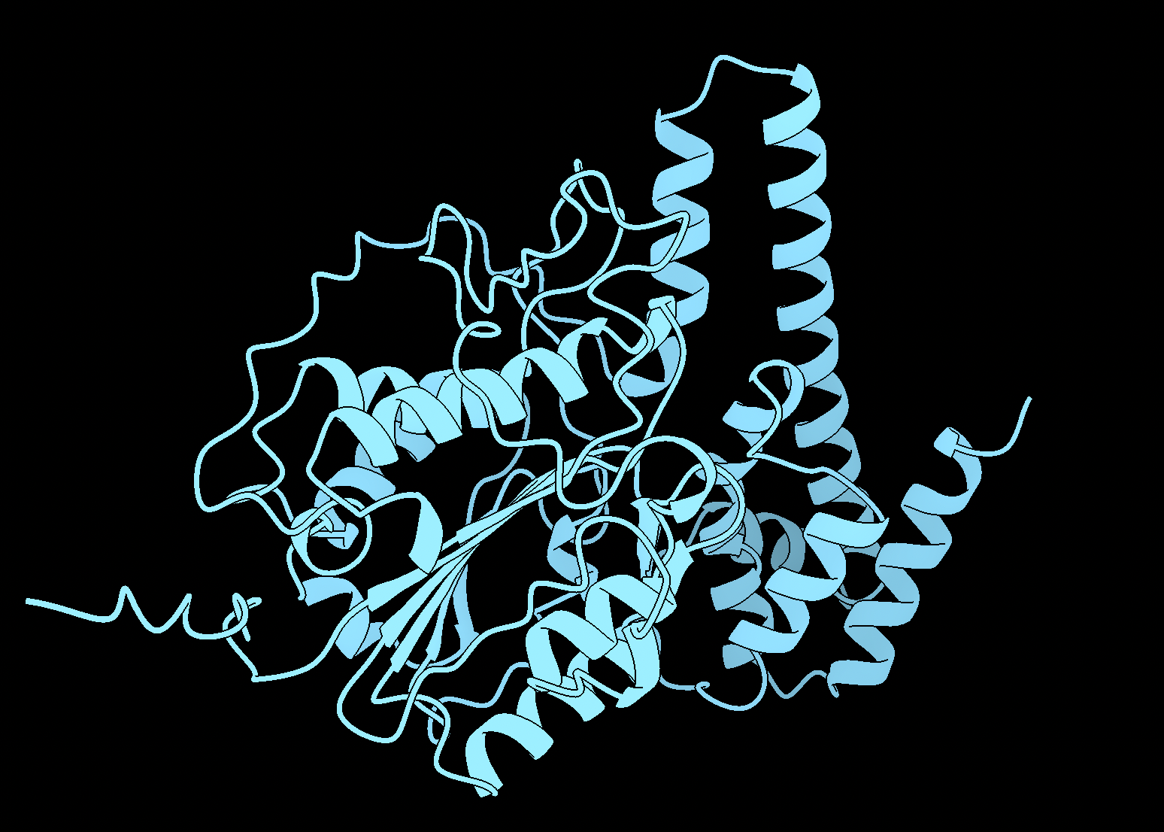
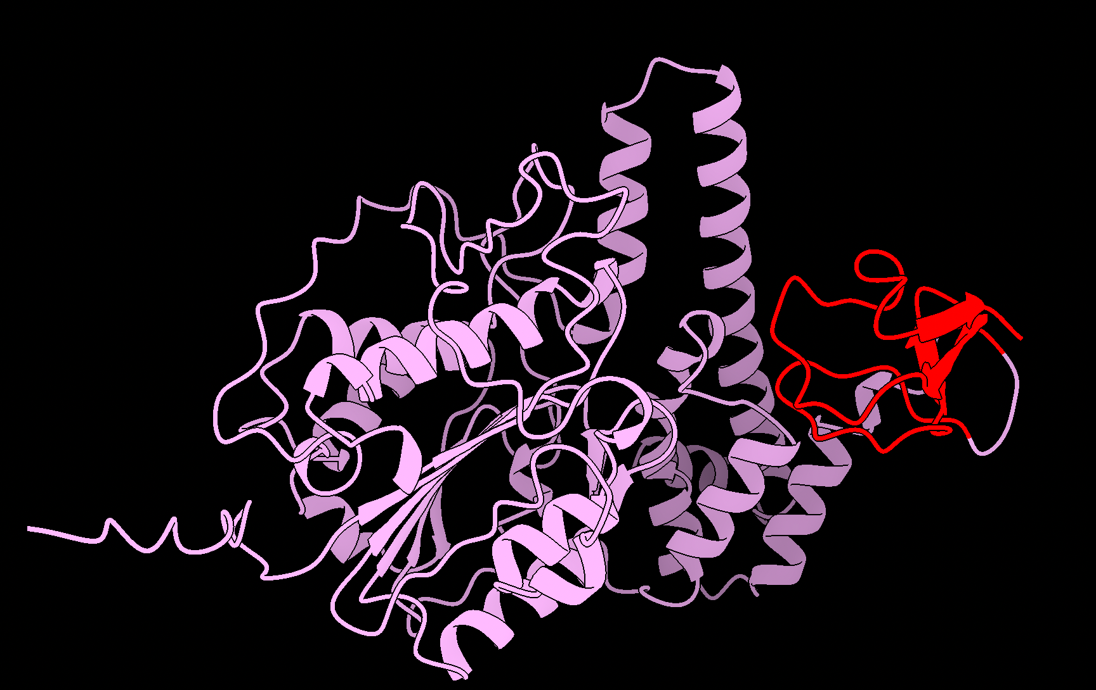
Uni-Tagger: A UI for evaluation of conformational changes to native structure induced by the
introduction of a recombinant tag or fusion protein.
Protein
Protein-tag
&
base operation
Functionality
Where:
Alphafold2
structure prediction
= native protein
Parallel evaluation of multiple tags
UI grad.io
= tags
Parallel evaluation of multiple proteins
Rigid-body alignment of resultant structure predictions
Biopython
RMSD measurement of aligned protein vs protein-tag
output
aligned .pdb coordinates
graph(s) of global RMSD values
Notes:
Logic: By comparing structure predictions of native protein Vs. protein-tag maybe we can spot probable

Slide 4
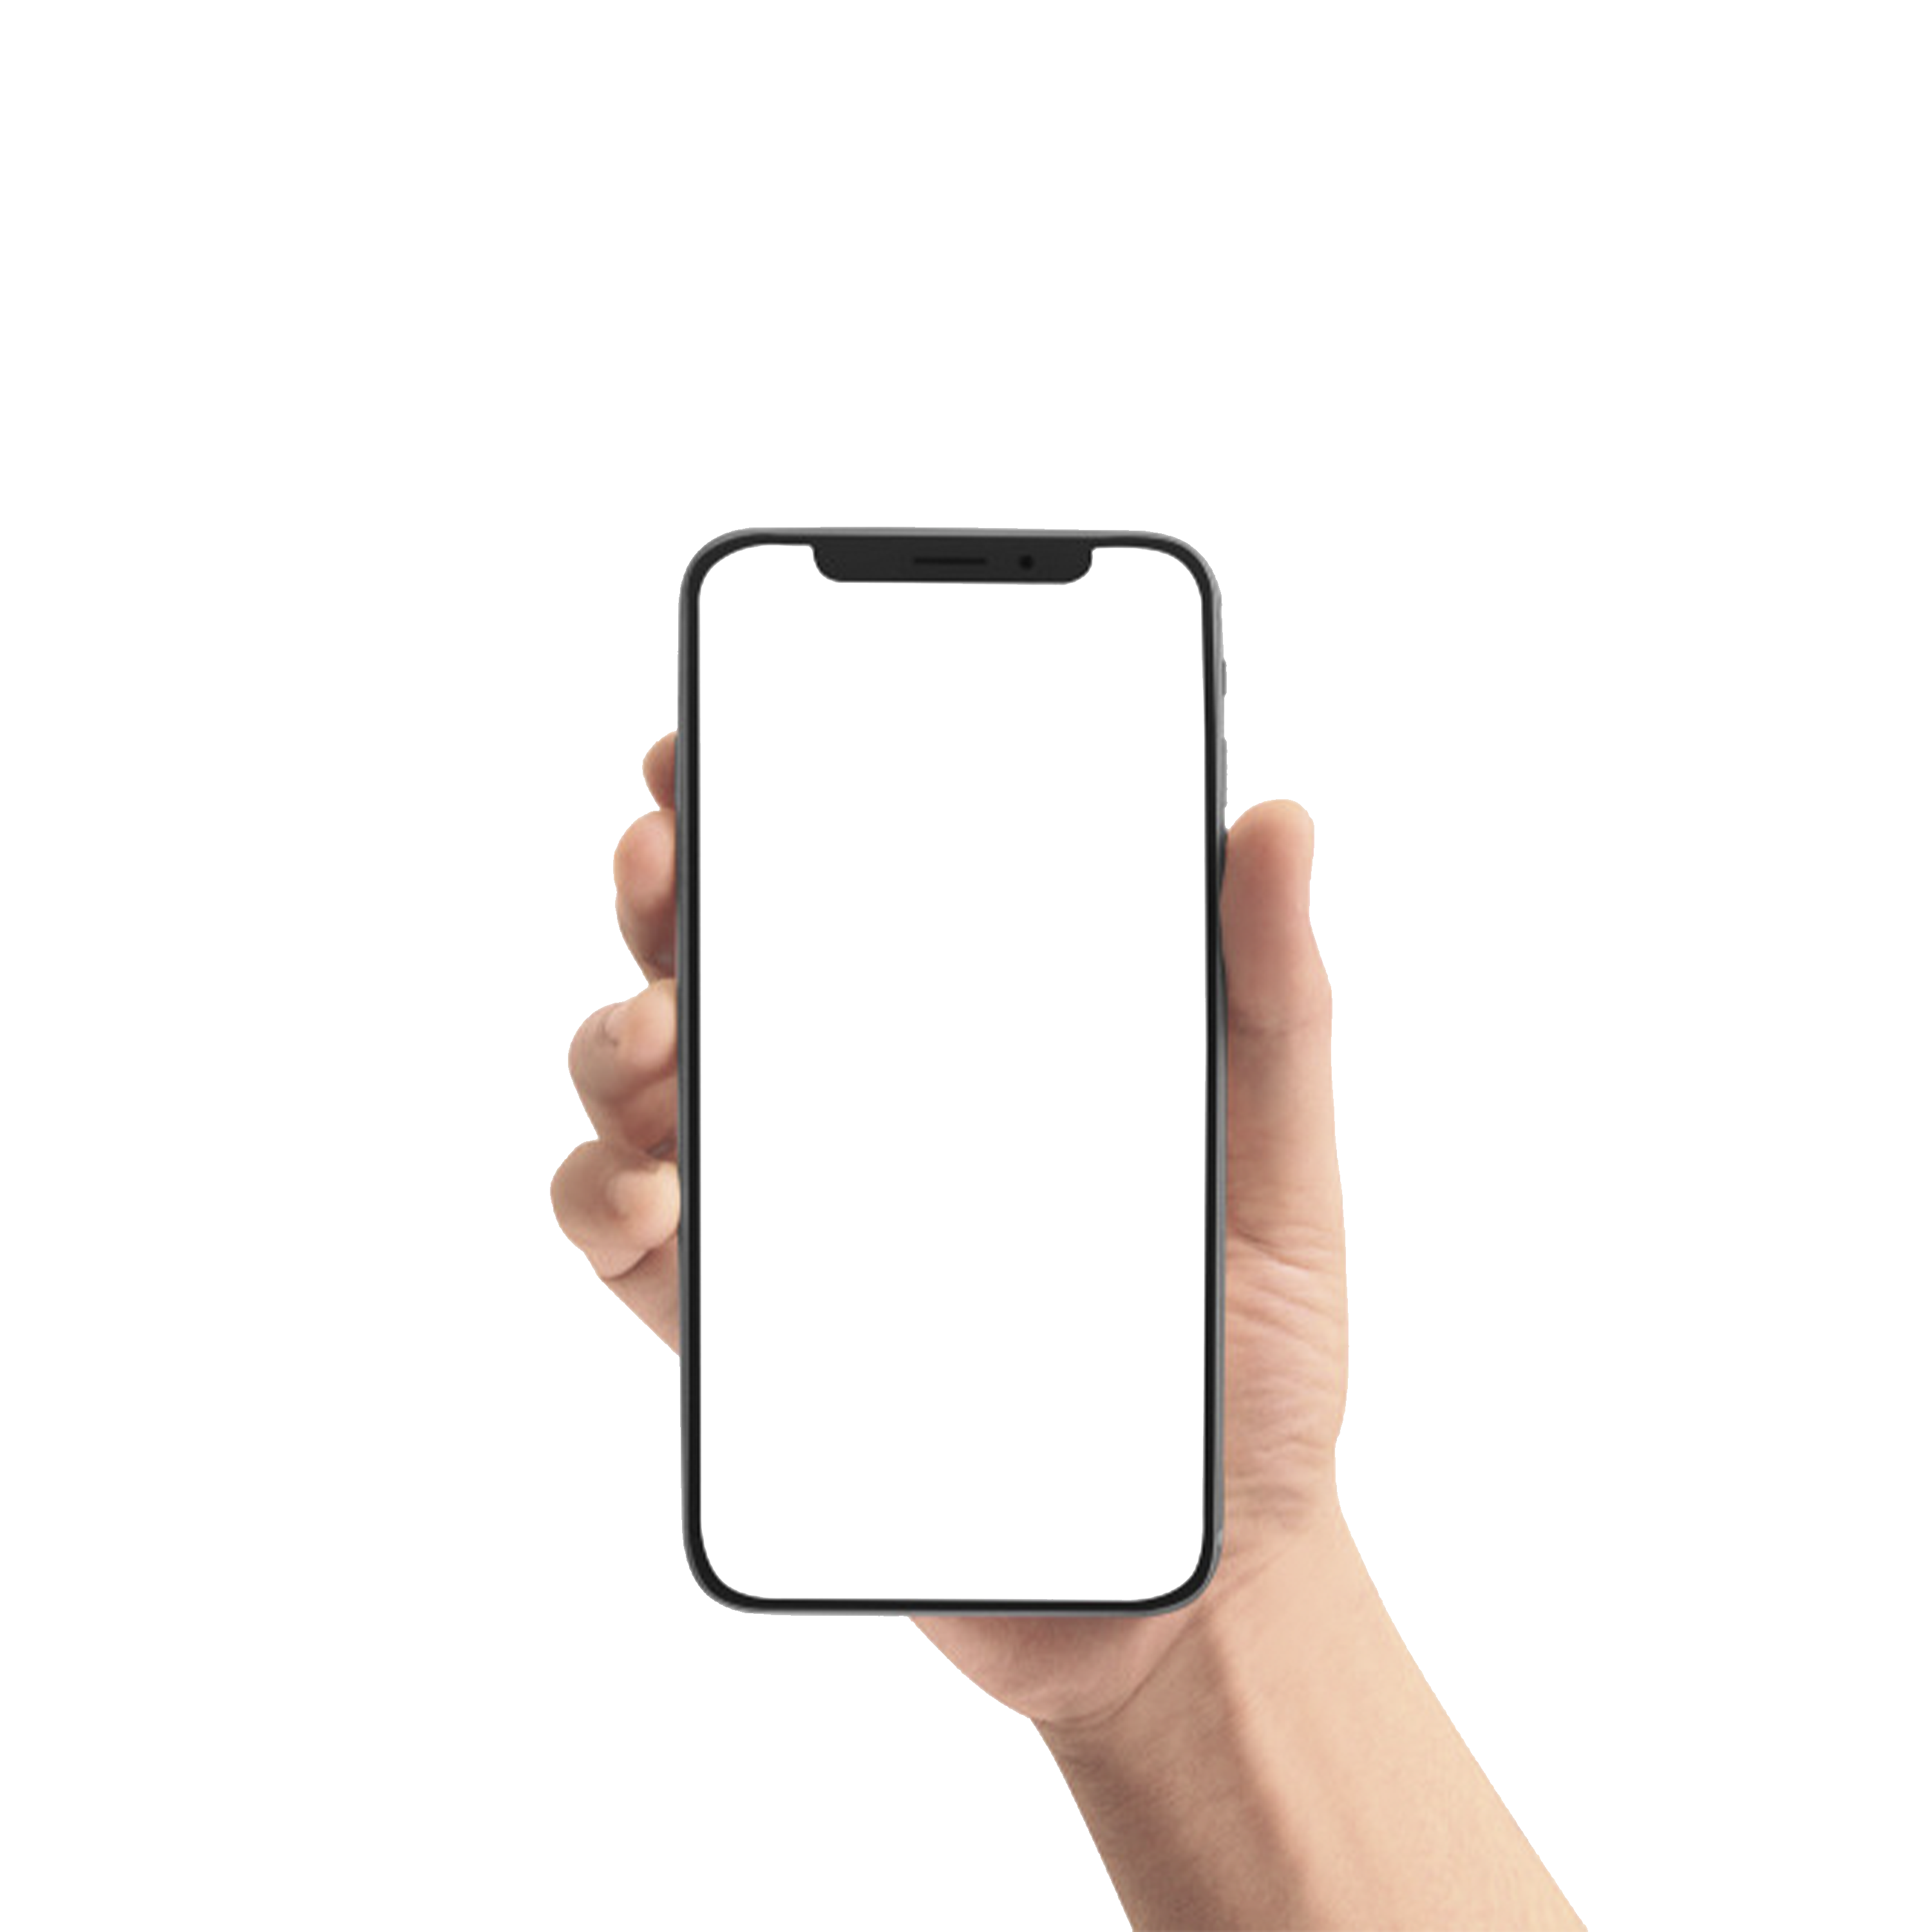

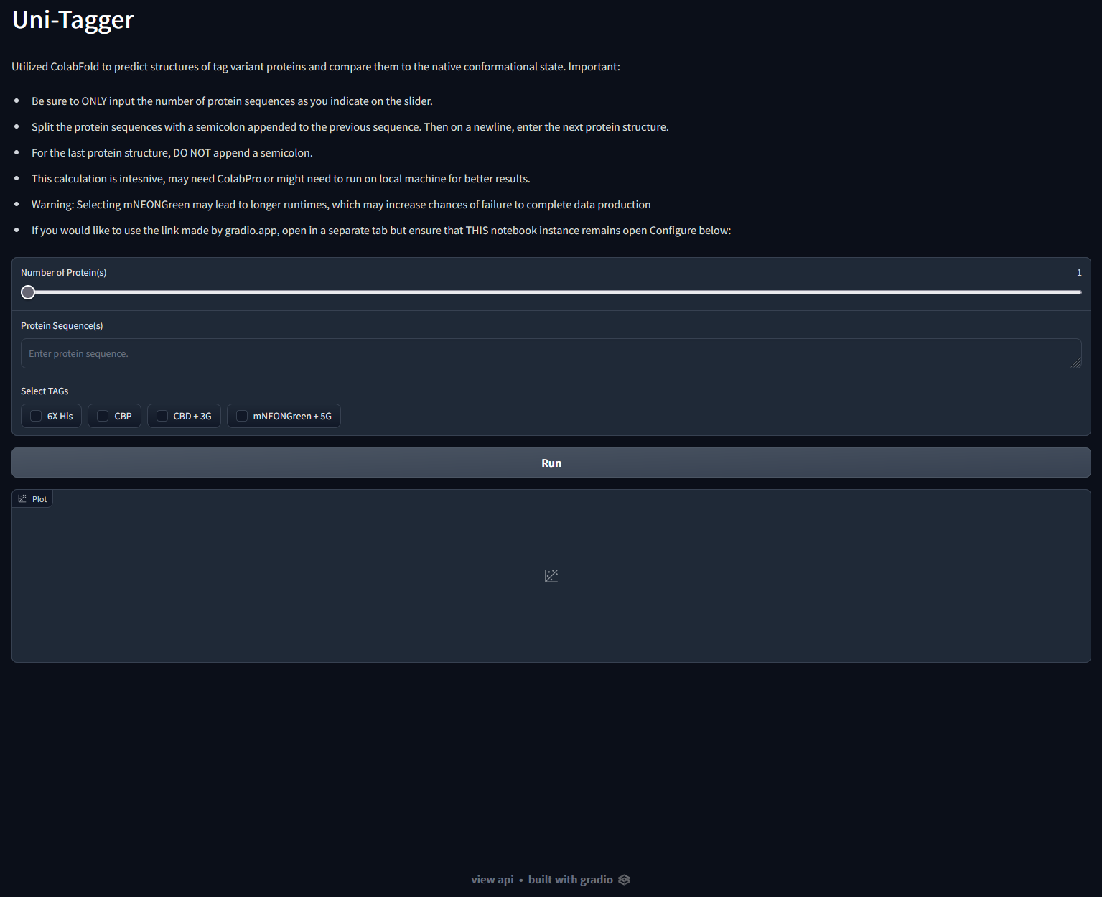

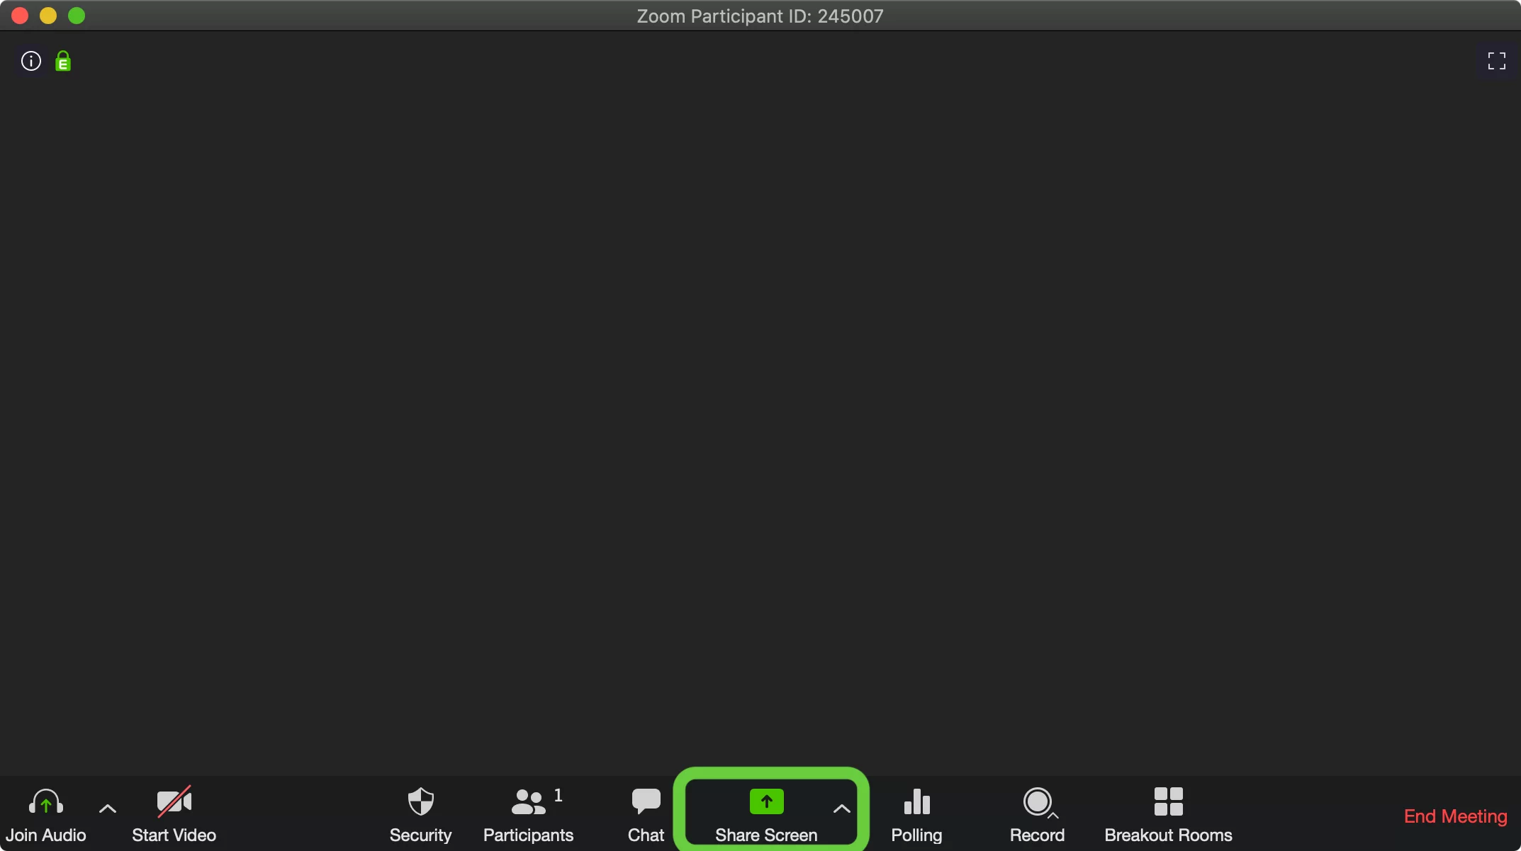

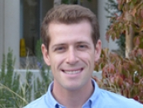
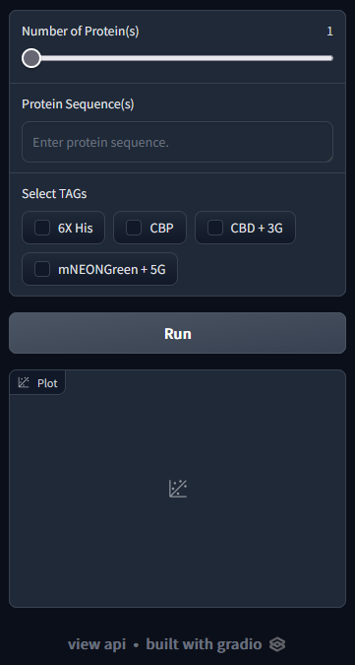
User Interface: Never judge a book (interface) by its cover
Purpose:
Incorporate a front-end/back-end implementation
Very intuitive, simple design
Universal device

Slide 5
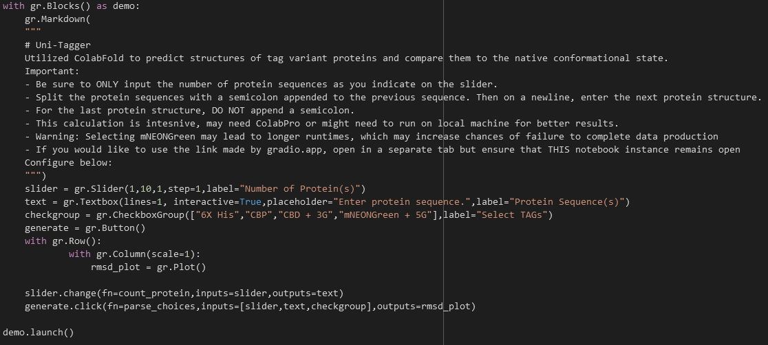
User Interface: Never judge a book (interface) by its cover

Slide 6
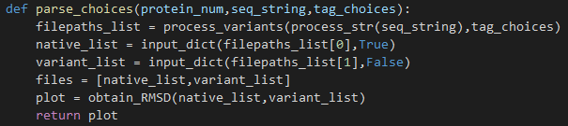
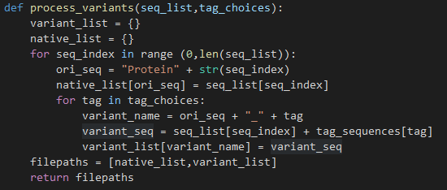

User Interface: Never judge a book (interface) by its cover
“How do I specify the amount of protein sequences?”
“How do I get the aligned variant pdb(s)… what about the RMSD plot(s)?
“How do I generate all variants and store them?”
“How can I process the sequences given?”

Slide 7
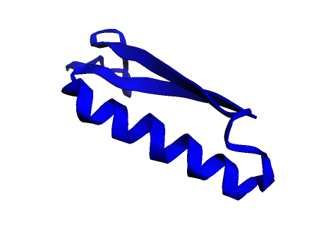


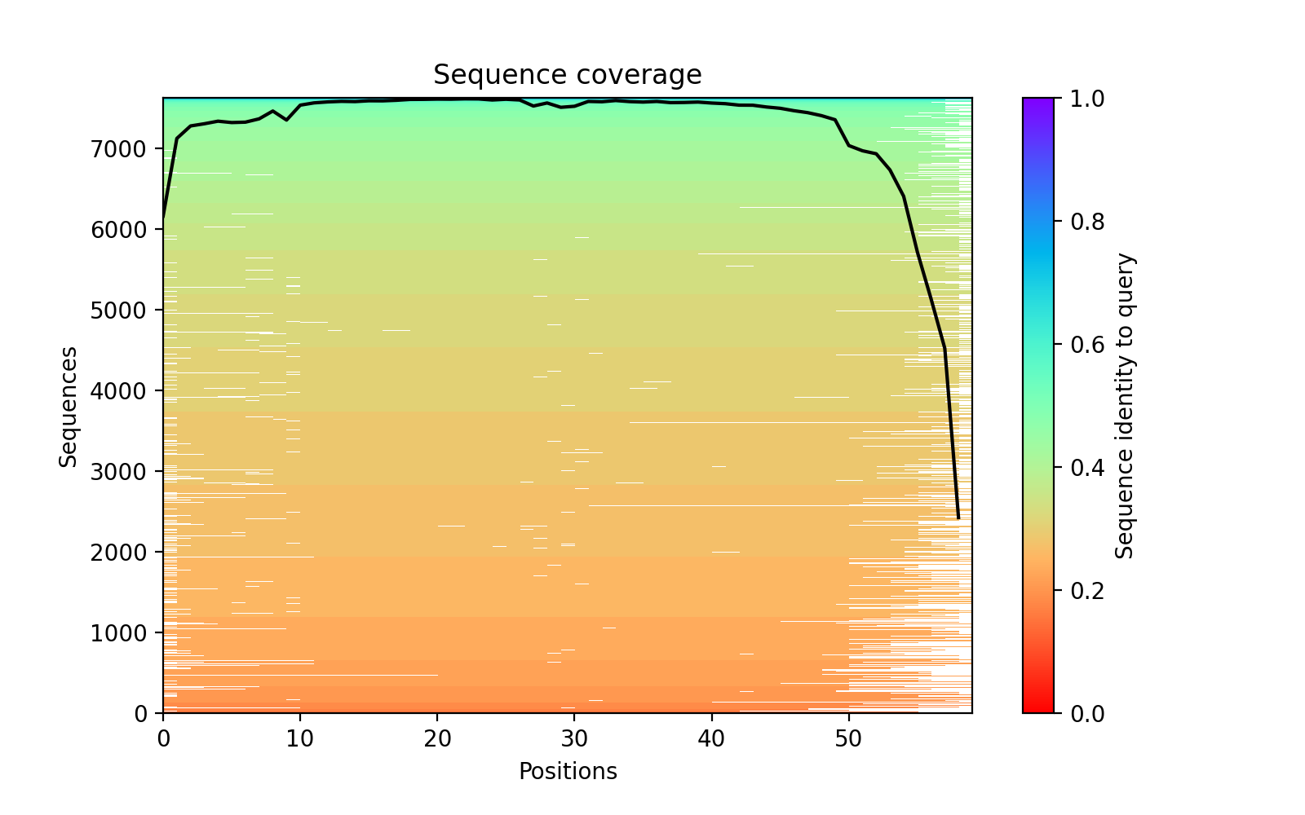
Structure Prediction: Go fetch! Now fetch again…
Now that I have all these sequences, how can I iterate through all of them and obtain the structures?
XXXXXXXXXX…CBP
XXXXXXXXXXX…His
XXXXXXXXXX…CBP
XXXXXXXXXXX…His
Uni-tagger ColabFold
(AlphaFold Structure Prediction)
Best Ranked PDB
ColabFold
(AlphaFold Structure Prediction)
Native and Tag Variant
Sequences

Slide 8
Structure Prediction: Go fetch! Now fetch again…
Similarities | Differences
Install Dependencies Import Modules/Packages Prediction Callback Run Prediction | Sequence input -> dictionary of inputs Save locally in the colab notebook Separation of best ranked PDB Returning a reference to the filepaths

Slide 9

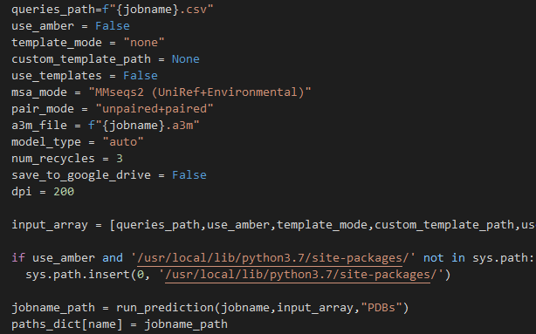
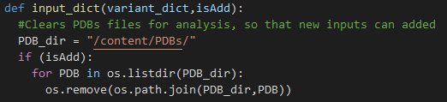
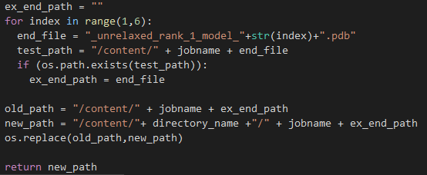
Structure Prediction: Go fetch! Now fetch again…
How do I
calculate RMSDs?
“What parameters are you sending to AF2?”
“Where are PDBs stored?”
“How do you select for best ranked PDBs?”

Slide 10
Future Directions
AlphaFold2 Functionality to run in parallel?
Additional tags
Screen if sequence is in PDB database… if so, what can I do to manipulate it?
Display alignment (pymol)

