Slide 1
NCMS CONNECT · COMPLIANCE PACKAGE BUILDER
UI States Review Deck
Every distinct screen and interaction state captured from the live prototype — Package Library, published package detail, and the 3-step Package Builder (Basic Info → Events & Modules → Review & Publish). Leave comments directly on the slide(s) that need changes.
Source: package-builder-prototype.html · Prepared by Swovo Design

Slide 2
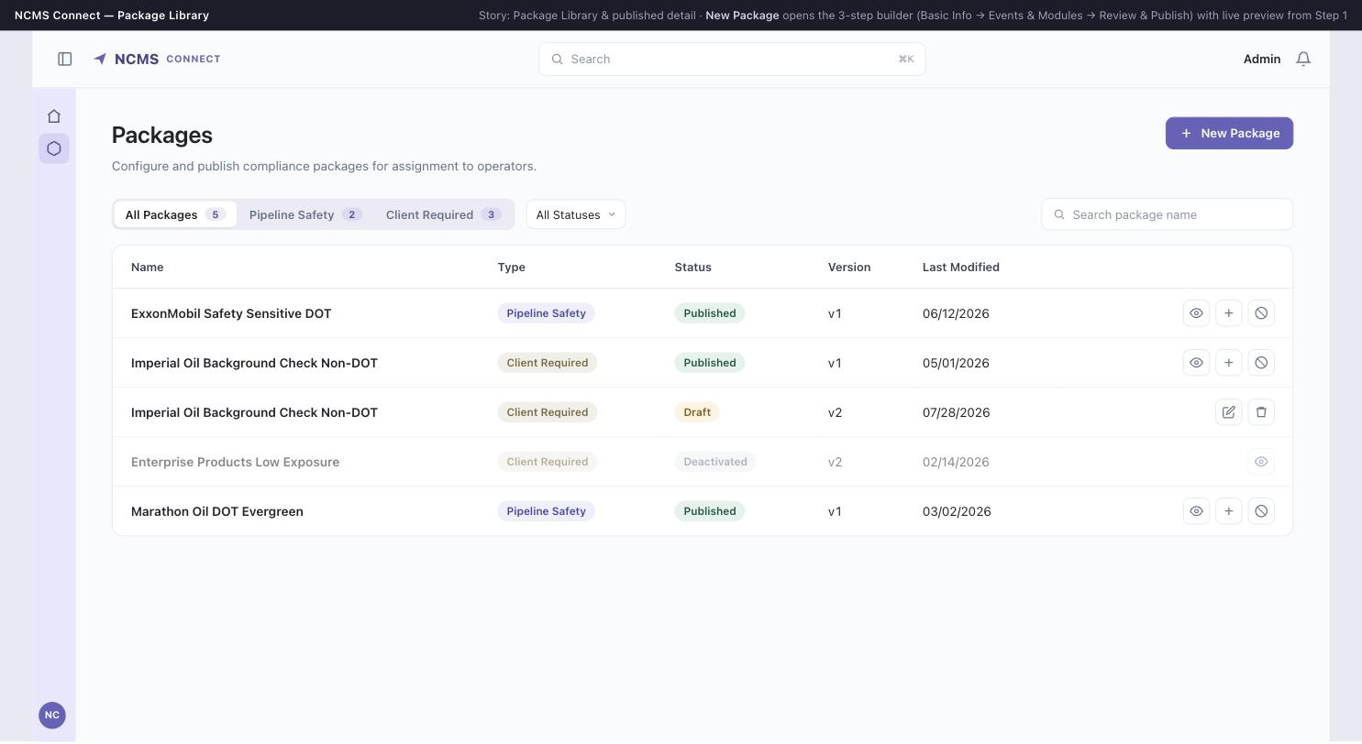
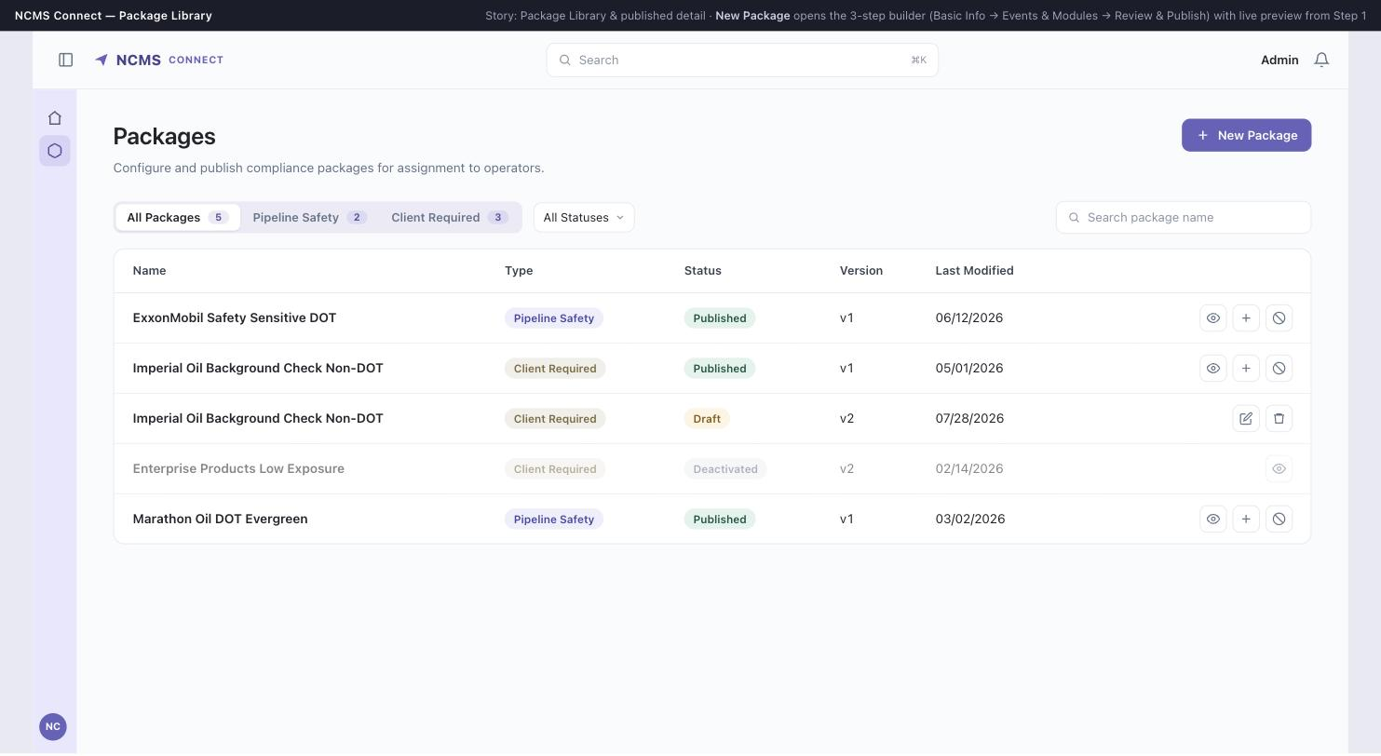
PACKAGE LIBRARY
Default view — All Packages
Entry point for NCMS Admin. Shows all compliance packages across both programme types.

Slide 3
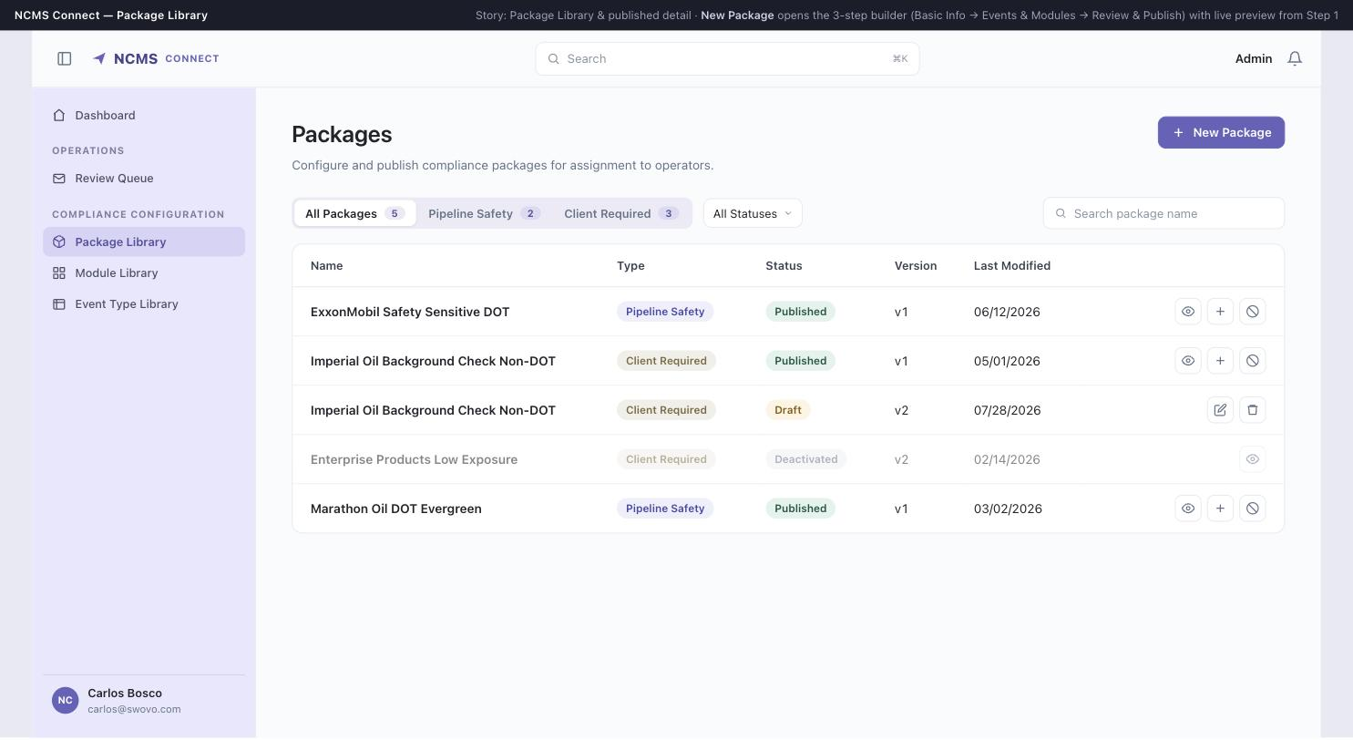
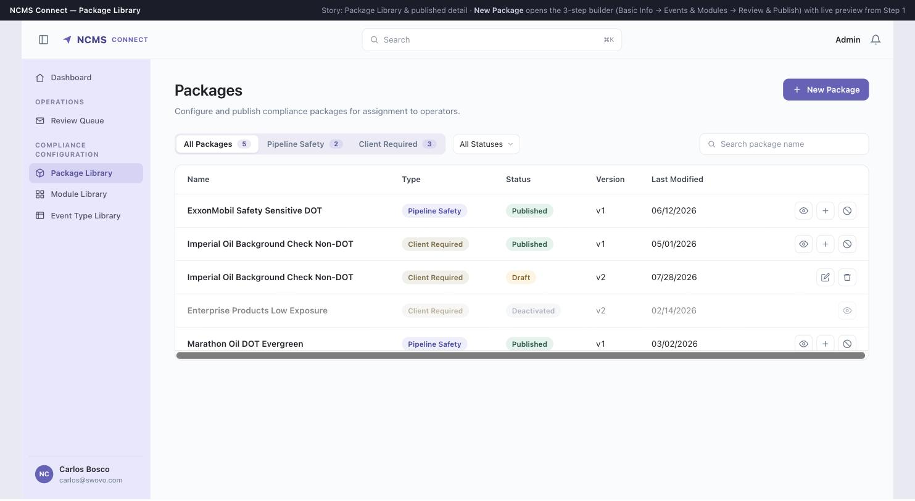
PACKAGE LIBRARY
Sidebar navigation expanded
Full nav labels: Dashboard, Review Queue, Package Library, Module Library, Event Type Library.

Slide 4
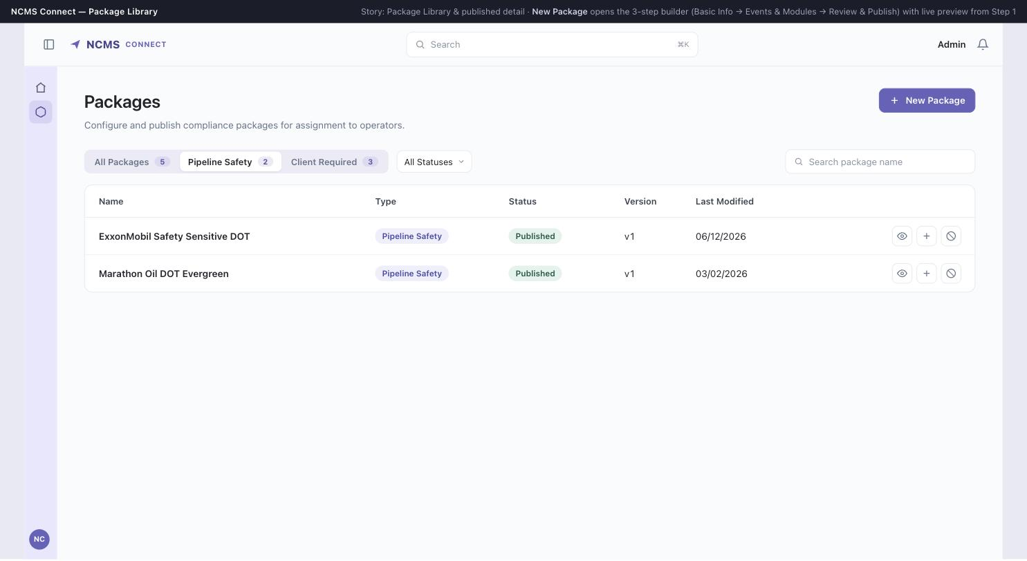
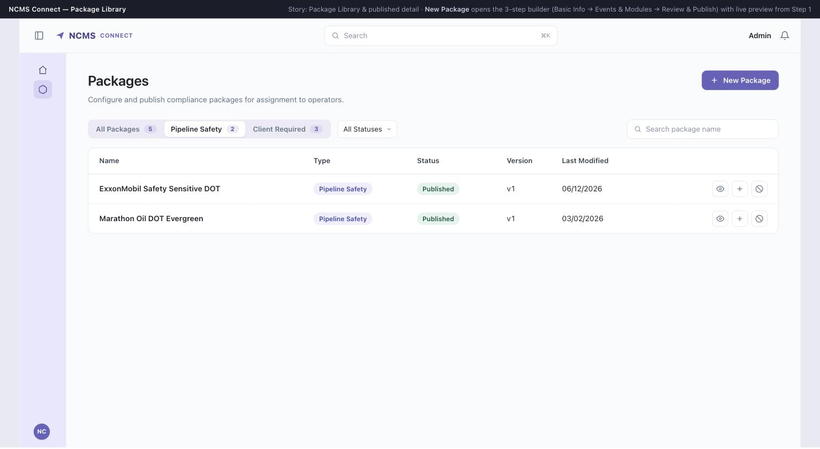
PACKAGE LIBRARY
Filter — Pipeline Safety (DOT)
Type filter as primary tabs, matching the Module/Event Type library pattern.

Slide 5
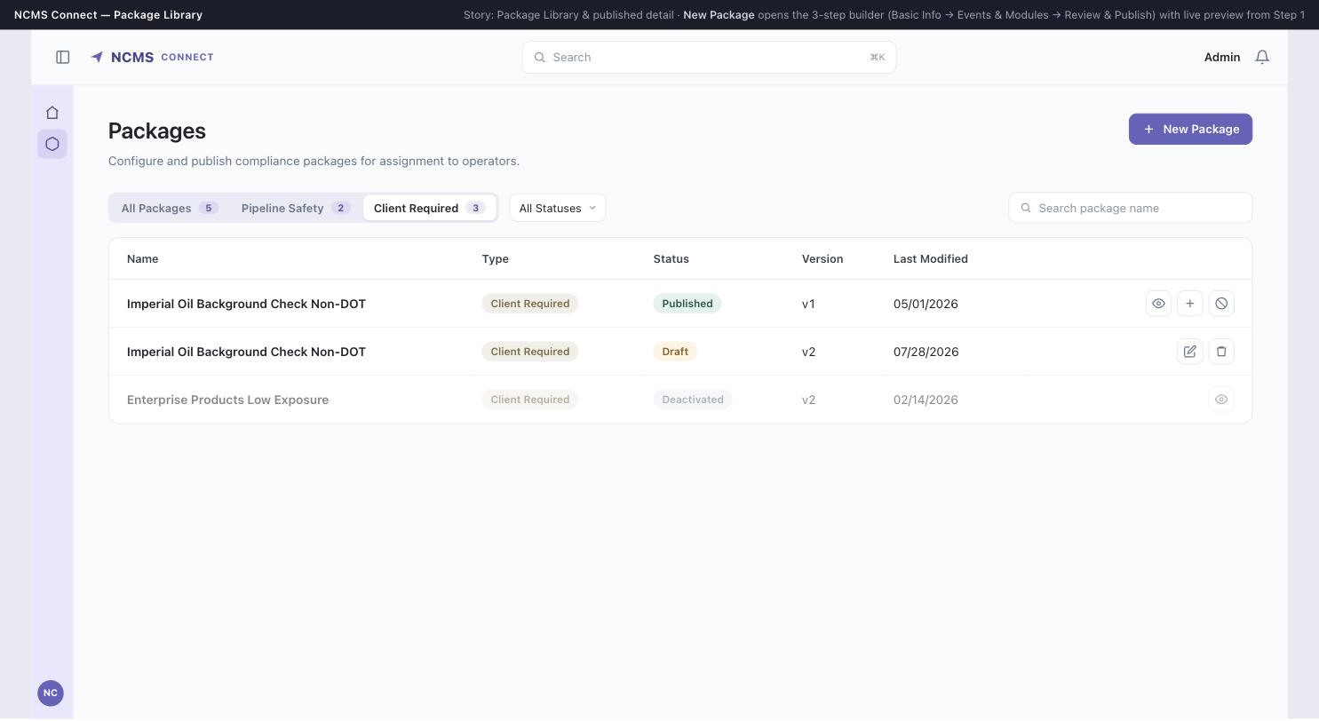

PACKAGE LIBRARY
Filter — Client Required (Non-DOT)

Slide 6
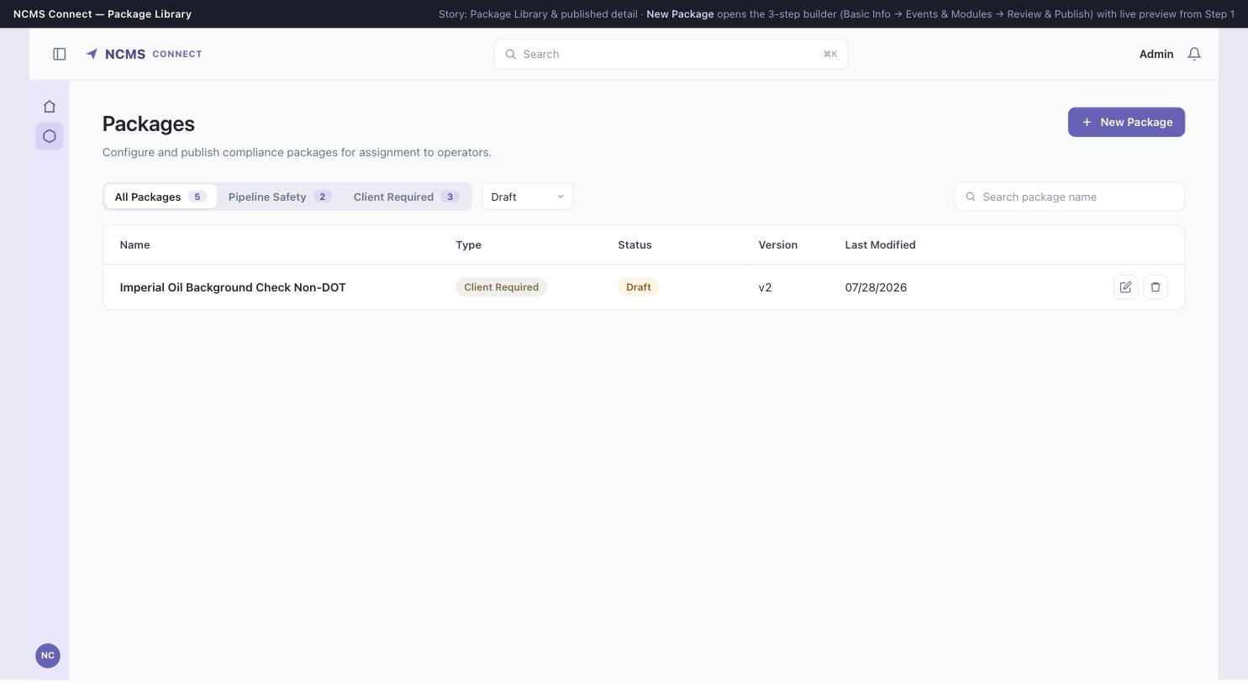

PACKAGE LIBRARY
Status filter — Draft
Status moved to a secondary select per Aug 4 feedback.

Slide 7
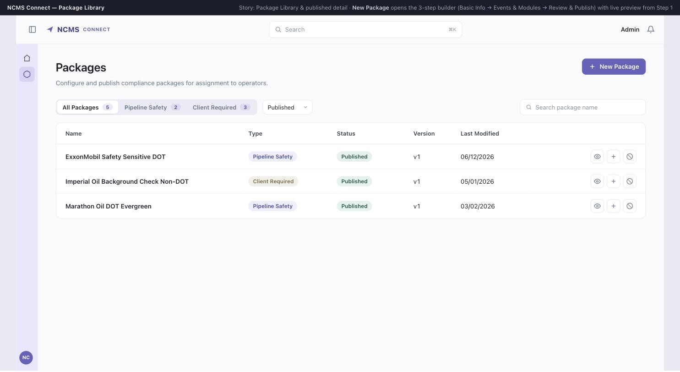
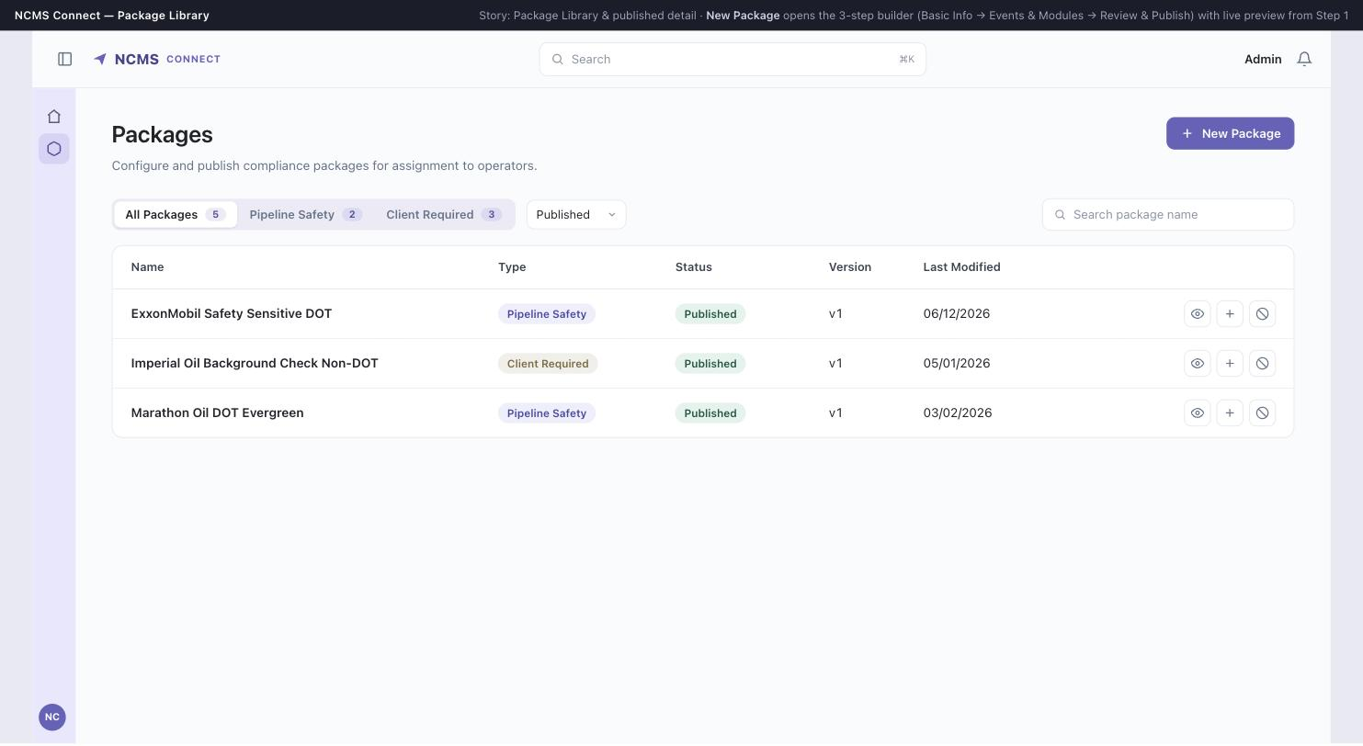
PACKAGE LIBRARY
Status filter — Published

Slide 8
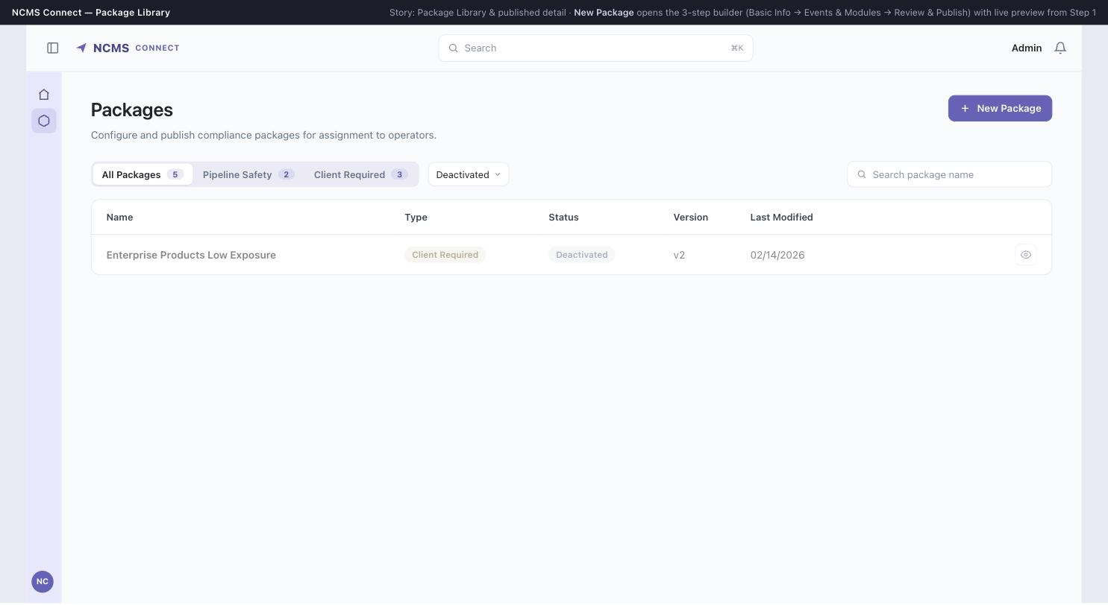

PACKAGE LIBRARY
Status filter — Deactivated
Deactivated packages are read-only — no edit action, view only.

Slide 9
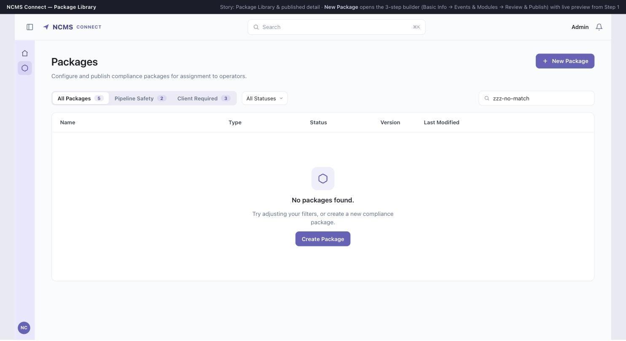
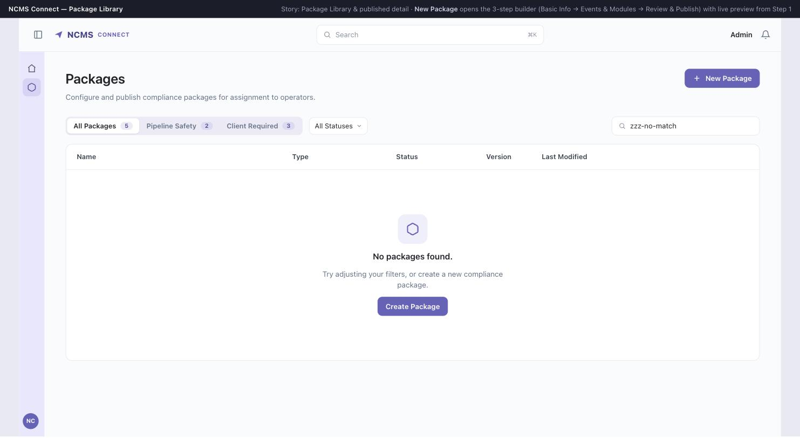
PACKAGE LIBRARY
Empty state — no search results

Slide 10
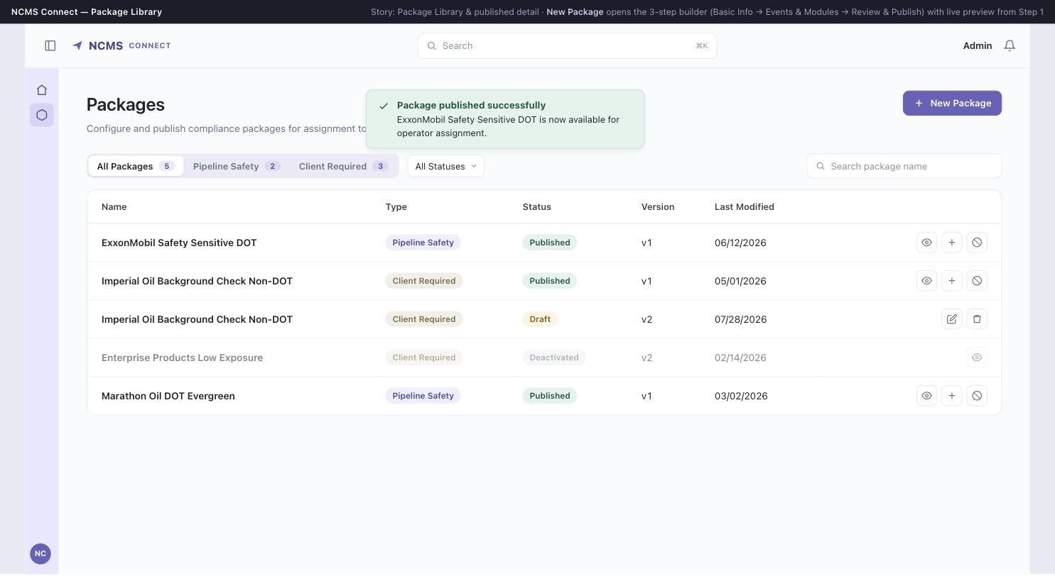
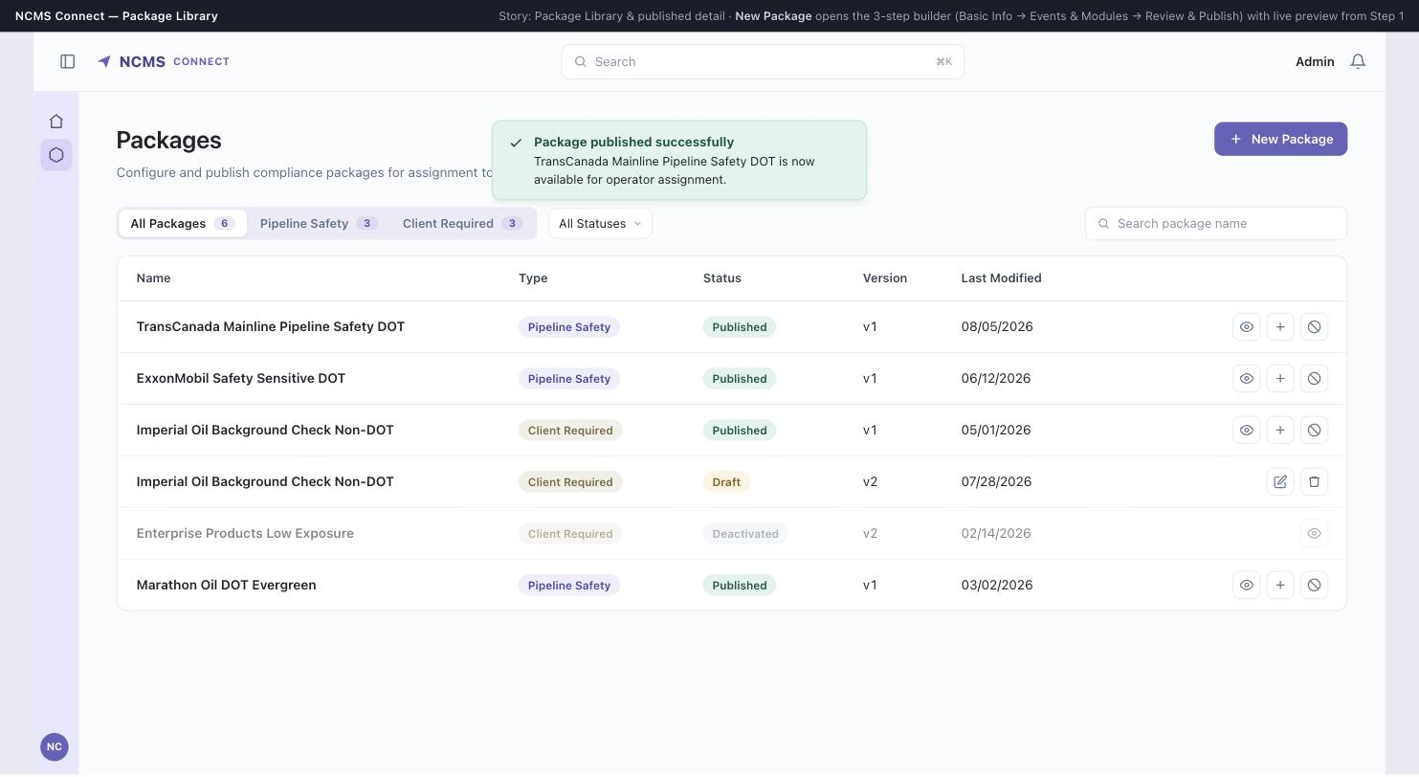
PACKAGE LIBRARY
Publish success toast
Confirmation banner shown after a package is published, auto-dismisses after 5s.

Slide 11
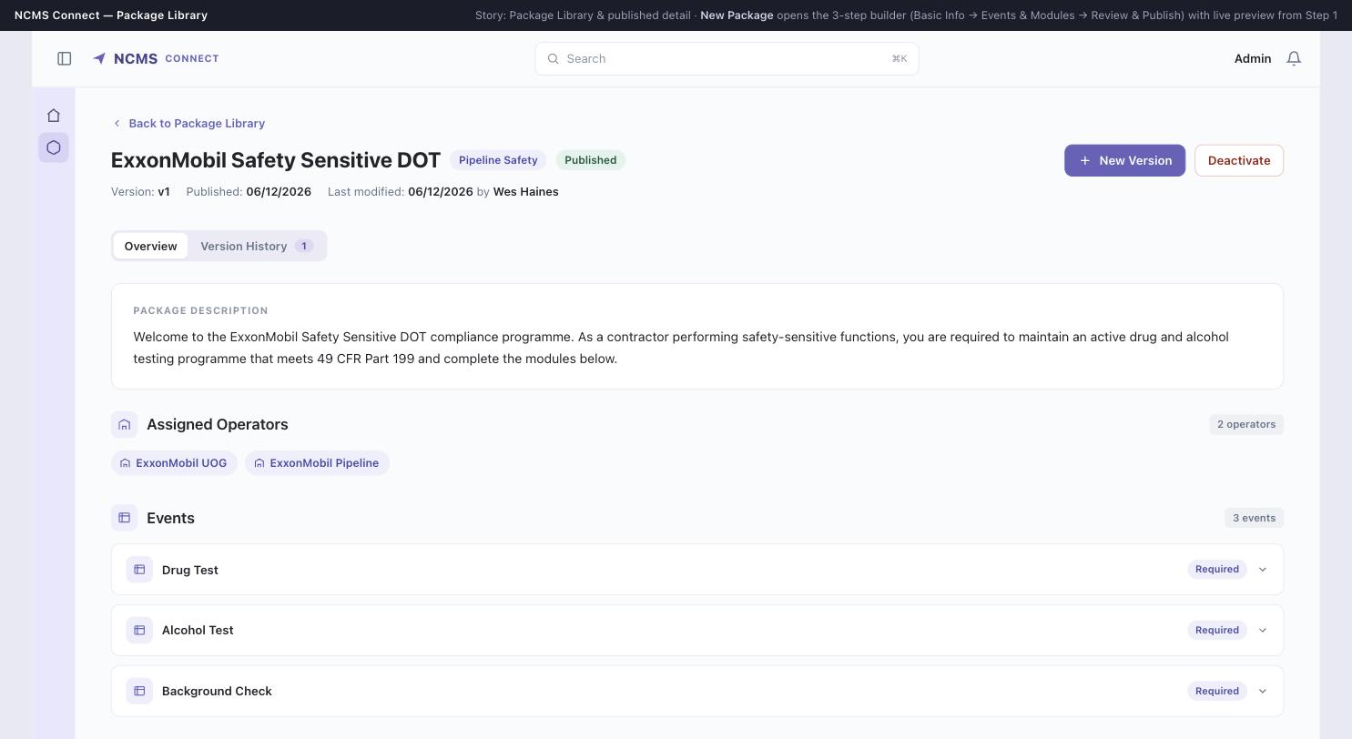
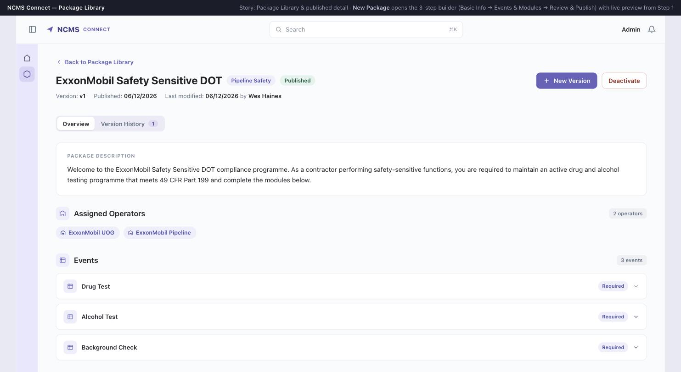
PACKAGE DETAIL (READ-ONLY)
Overview tab — collapsed
Published package detail: description, assigned operators, events, modules.

Slide 12
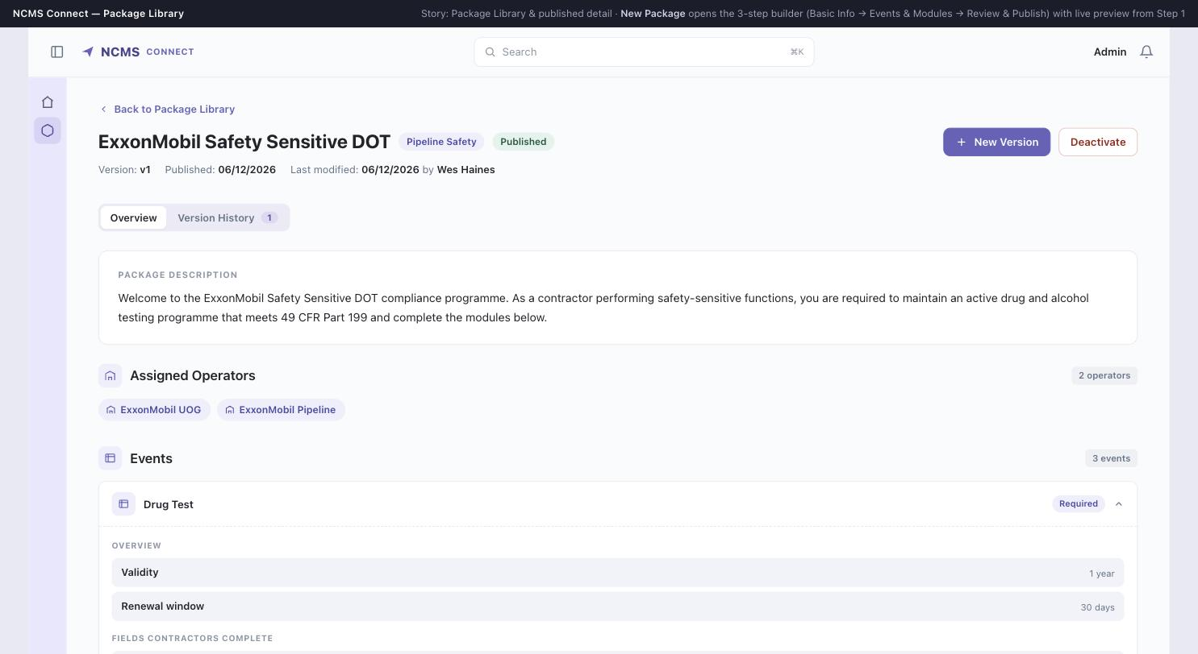

PACKAGE DETAIL (READ-ONLY)
Event expanded — Drug Test
Shows validity, renewal window, contractor-facing fields, and prerequisite (“Depends On”).

Slide 13
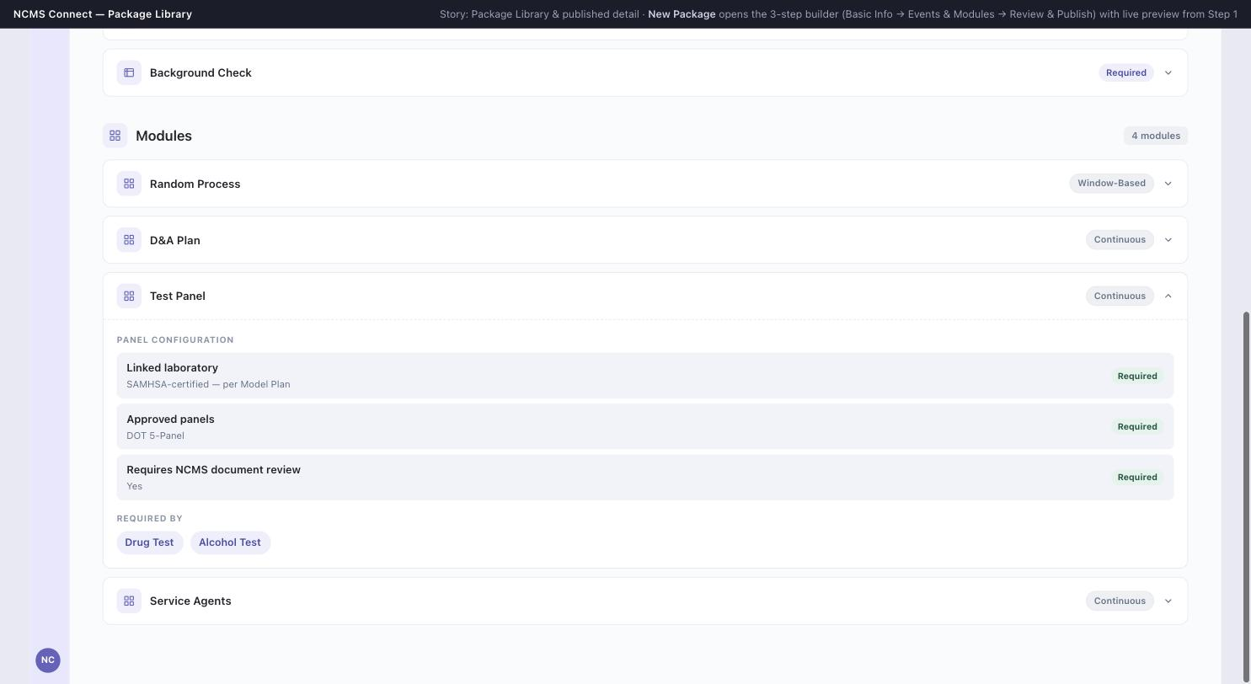
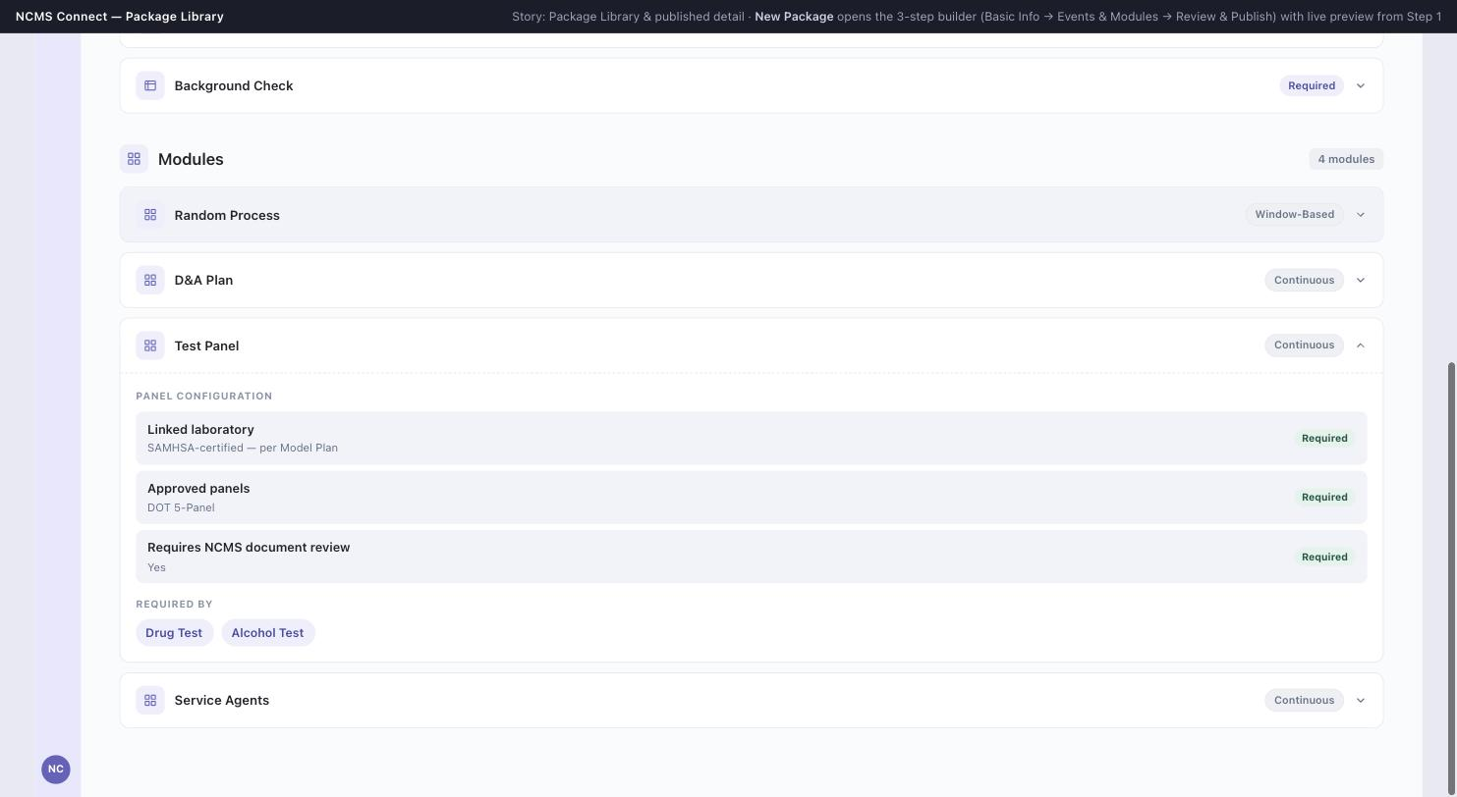
PACKAGE DETAIL (READ-ONLY)
Module expanded — Test Panel
Shows panel configuration and “Required By” — which events depend on this module.

Slide 14
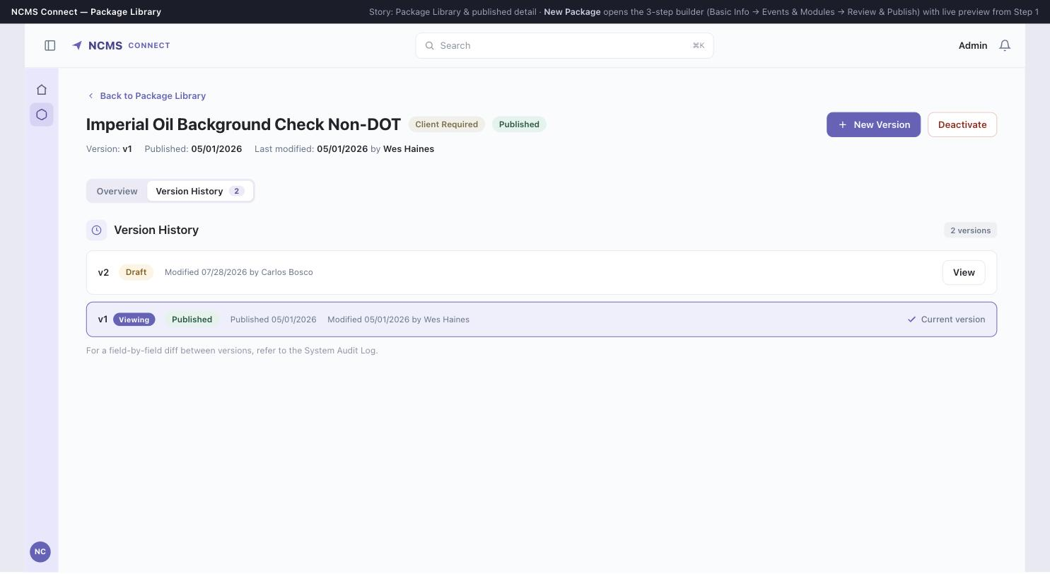
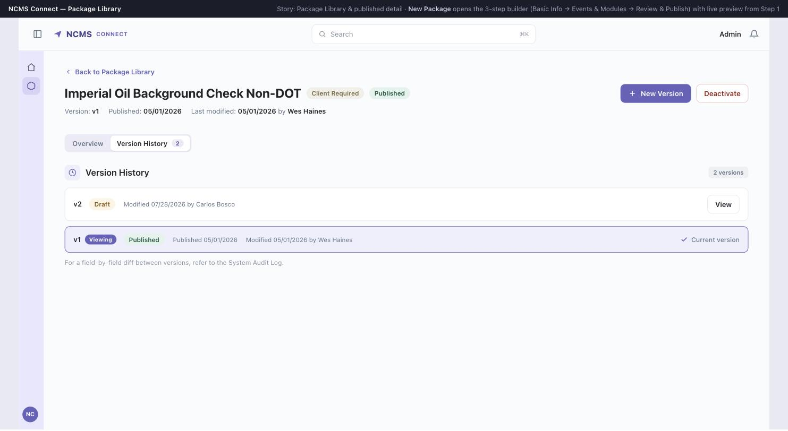
PACKAGE DETAIL (READ-ONLY)
Version History tab
Full version chain with status, publish date, and current-version indicator.

Slide 15
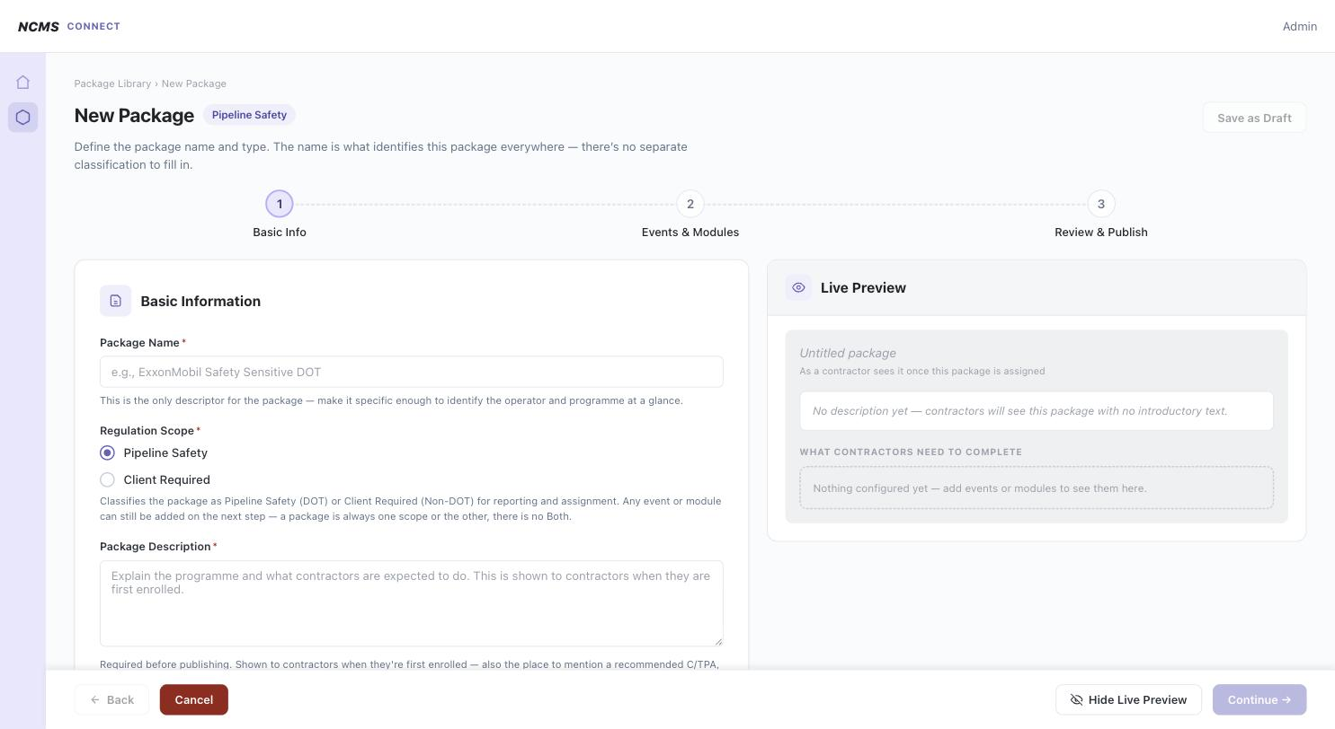
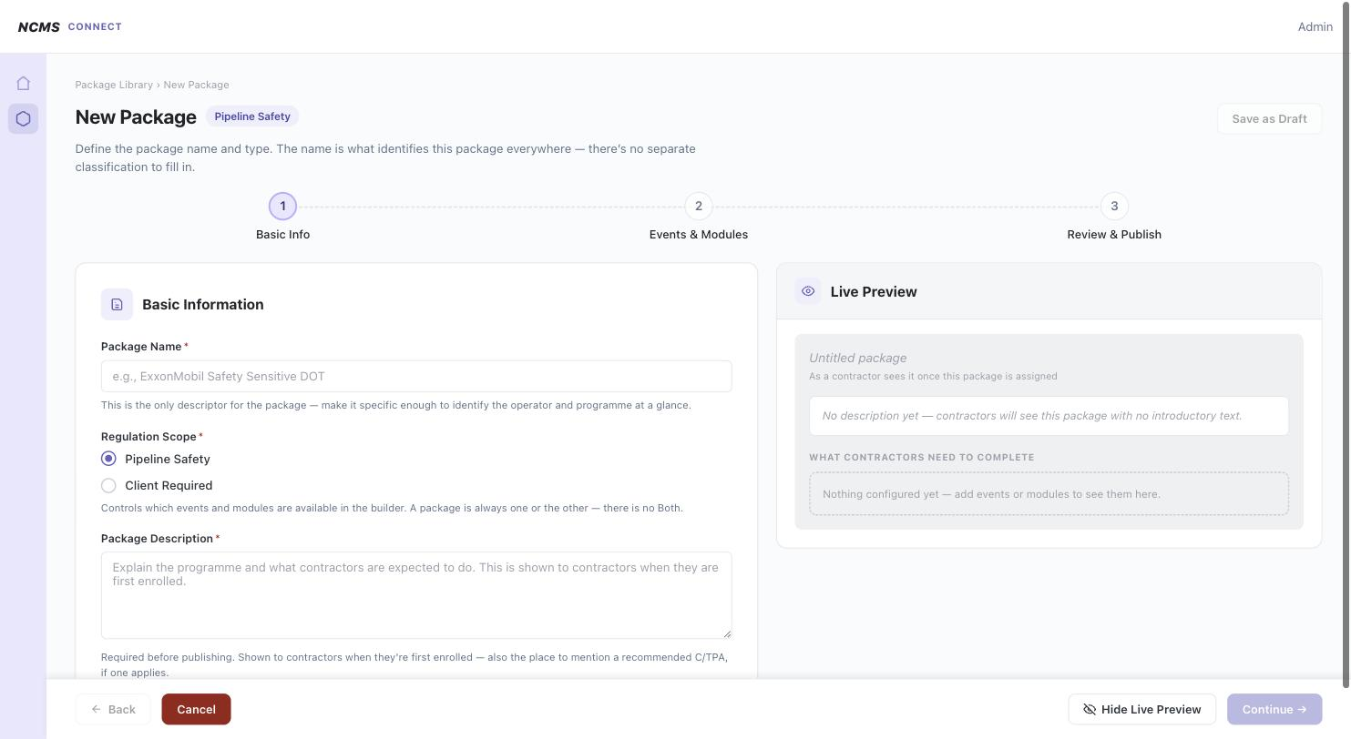
BUILDER — NEW PACKAGE · STEP 1: BASIC INFO
Blank form + live preview
Continuous 3-step builder (Basic Info → Events & Modules → Review & Publish); preview visible from Step 1.

Slide 16
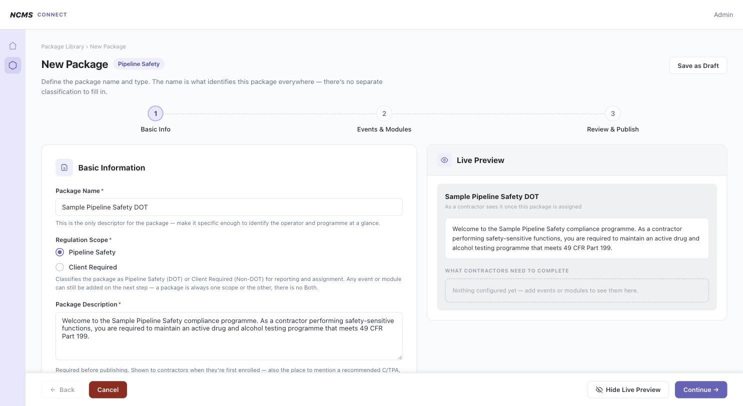
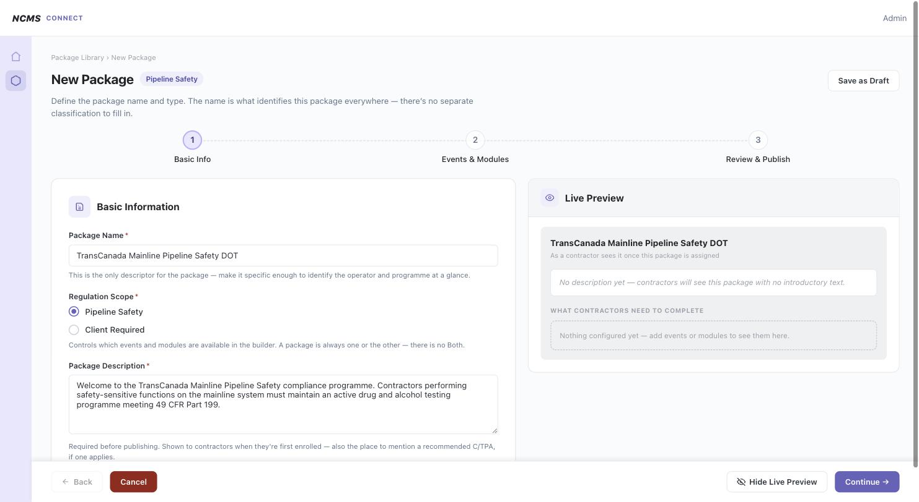
BUILDER — NEW PACKAGE · STEP 1: BASIC INFO
Filled in — live preview updates
Name and description reflected instantly in the contractor-facing preview panel.

Slide 17
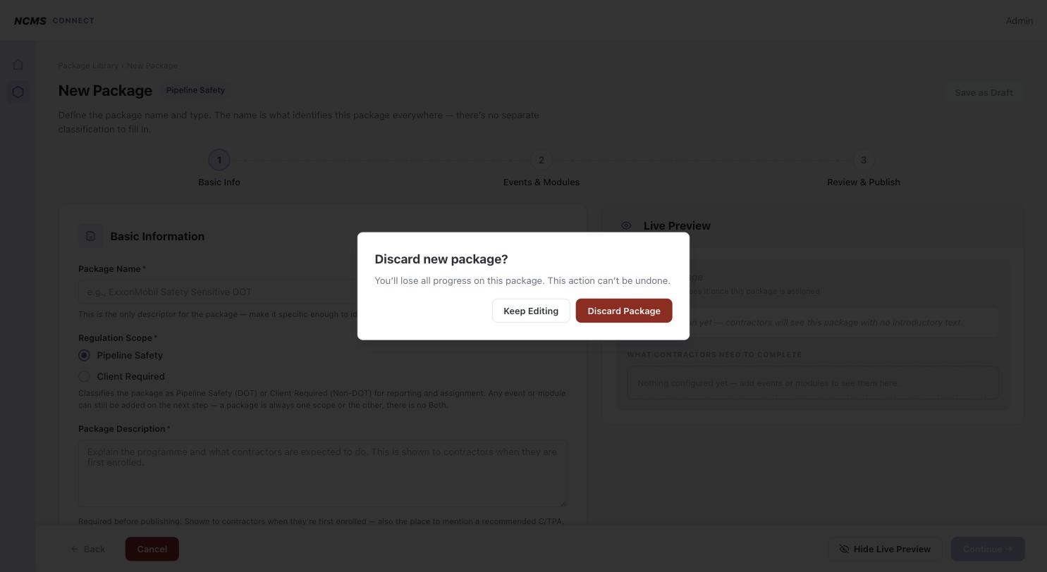
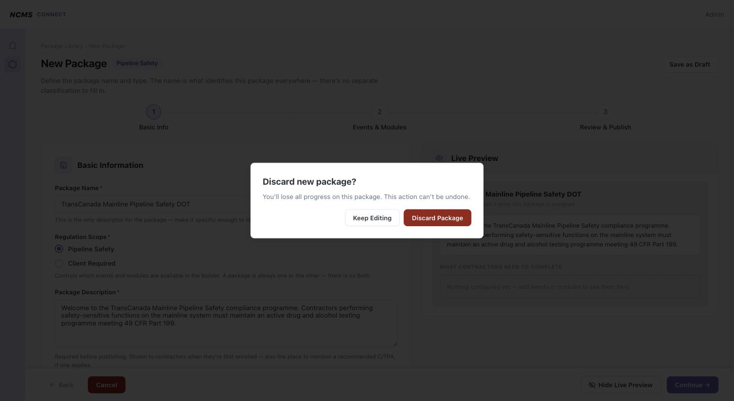
BUILDER — NEW PACKAGE · STEP 1: BASIC INFO
Discard confirmation dialog
Cancel on Step 1 (uncommitted package) prompts to discard — matches Module Builder pattern.

Slide 18
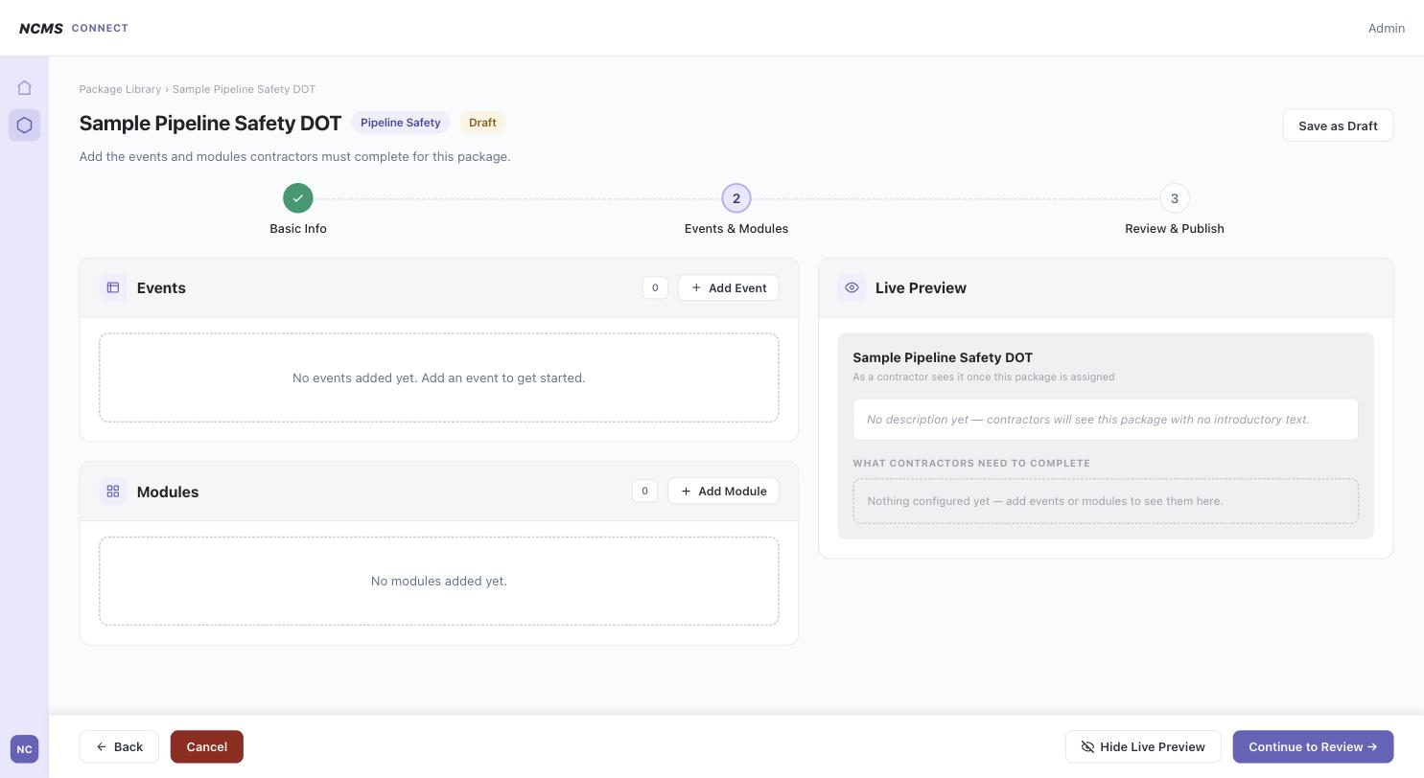
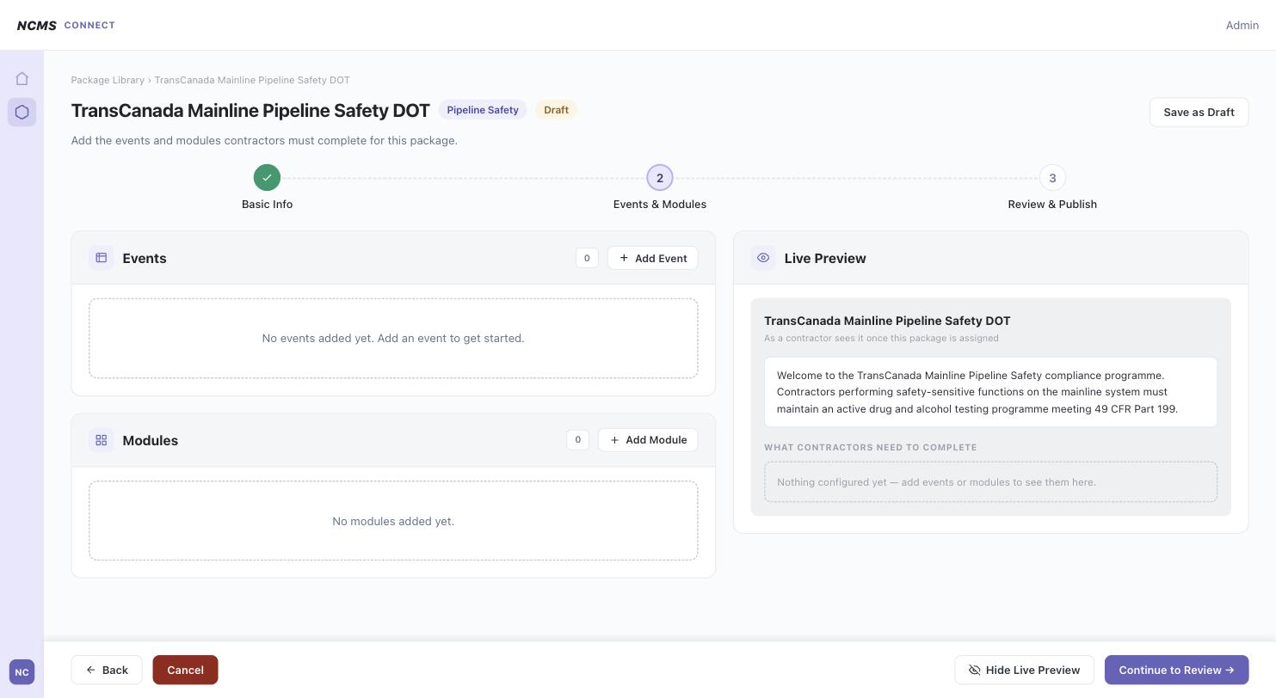
BUILDER — STEP 2: EVENTS & MODULES
Empty state
No events or modules added yet.

Slide 19
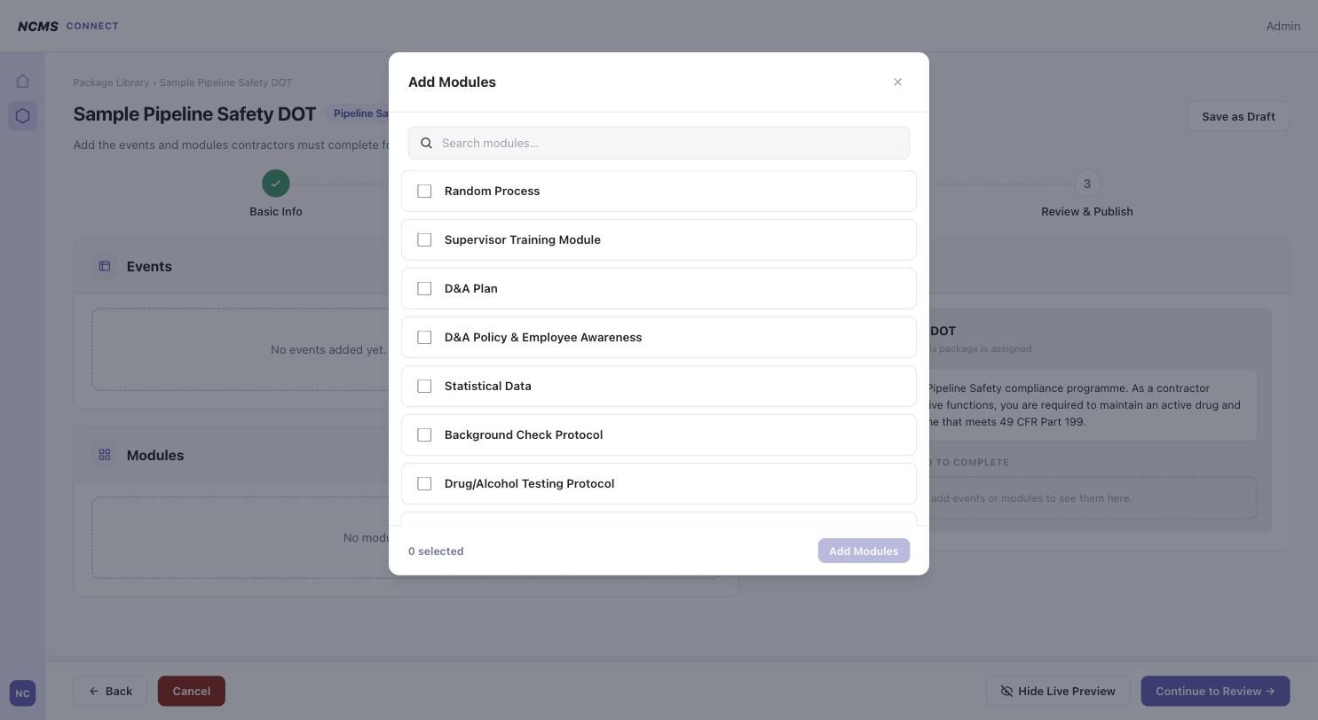
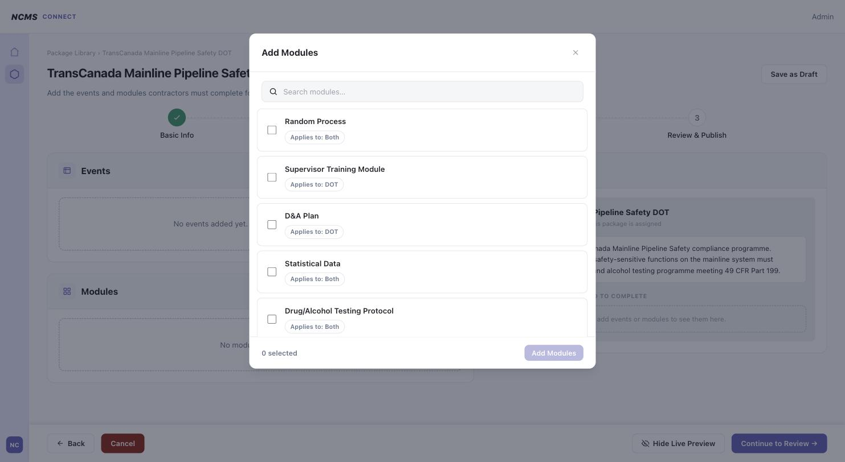
BUILDER — STEP 2: EVENTS & MODULES
Add Module picker — none selected
Bulk selection (checkboxes) added per Aug 4 feedback.

Slide 20
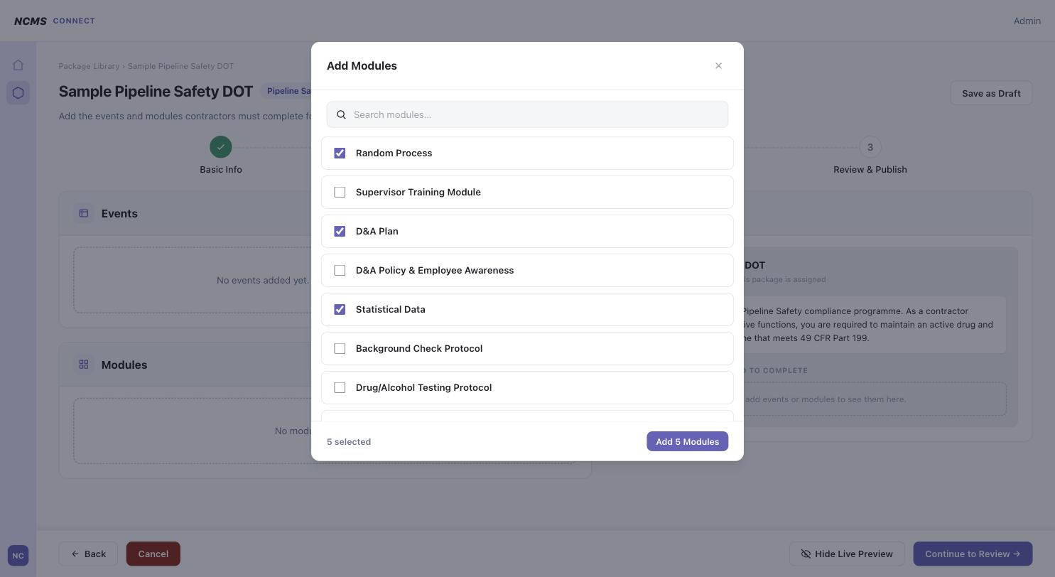
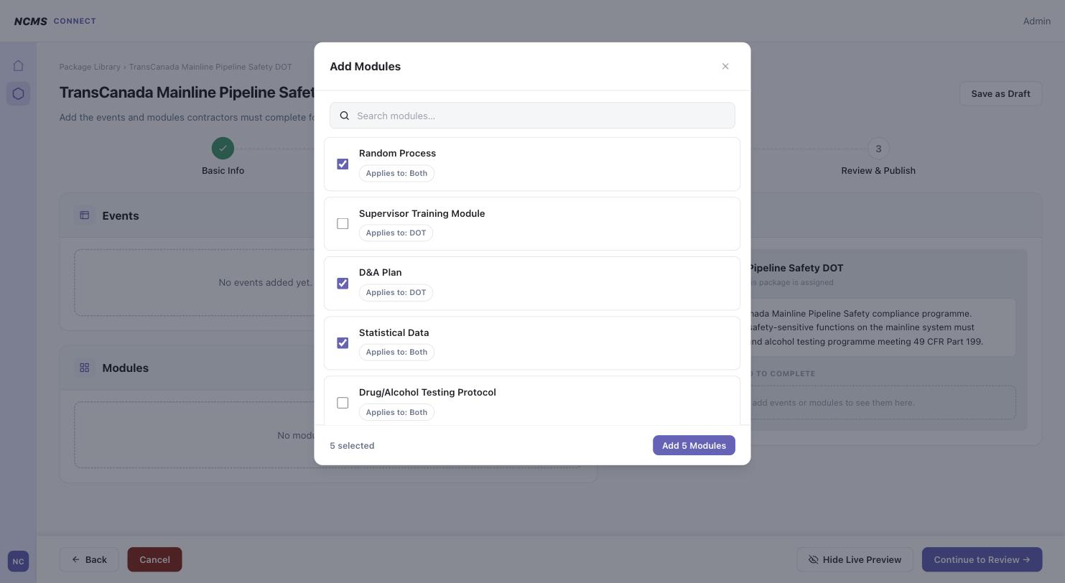
BUILDER — STEP 2: EVENTS & MODULES
Add Module picker — 5 selected
“Add N” bulk-add button.

Slide 21
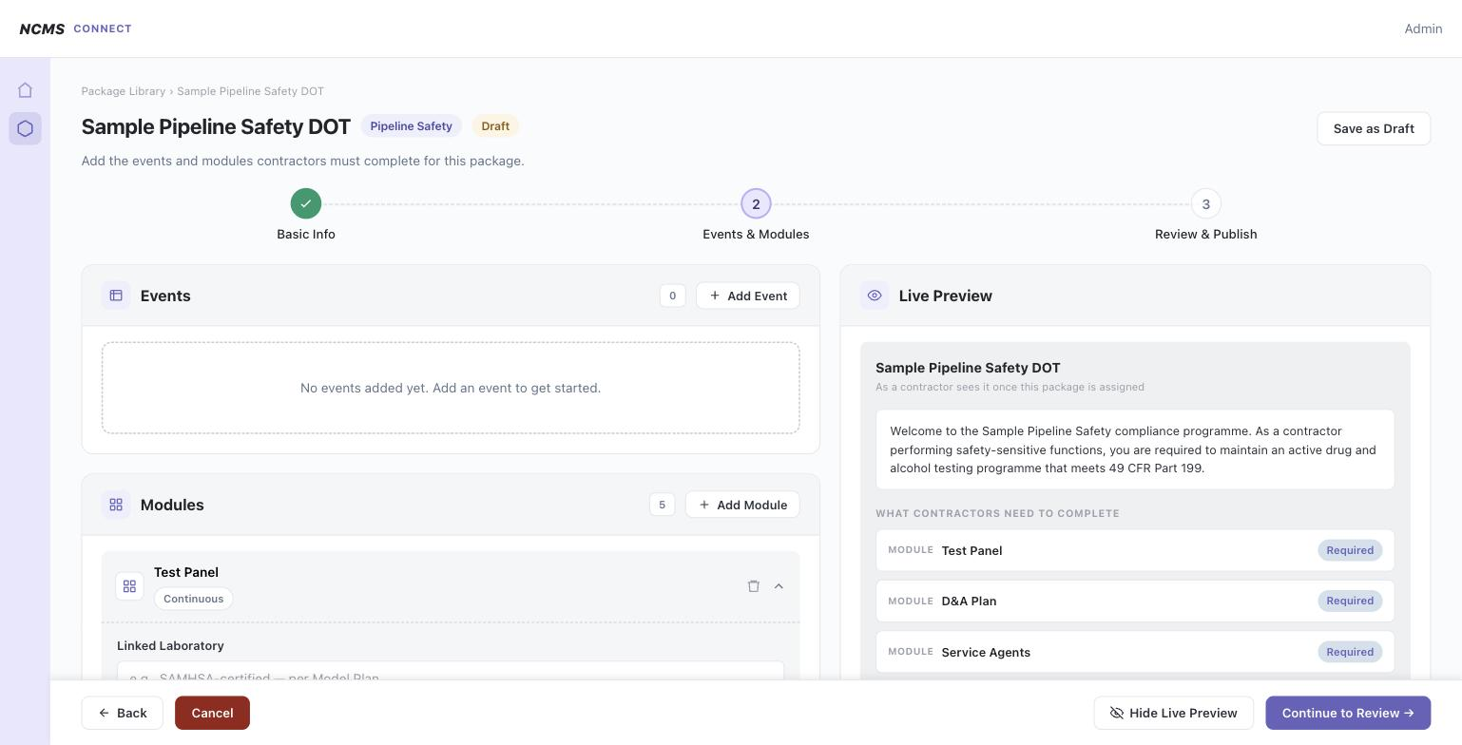
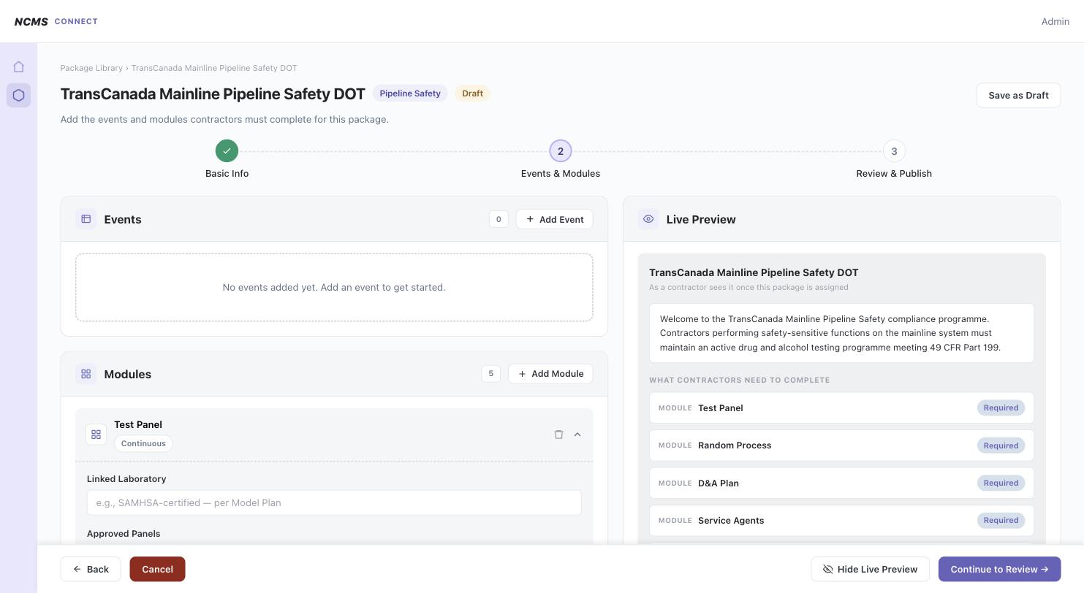
BUILDER — STEP 2: EVENTS & MODULES
Modules added — Test Panel editor
Newly added modules auto-expand into their configuration editor.

Slide 22
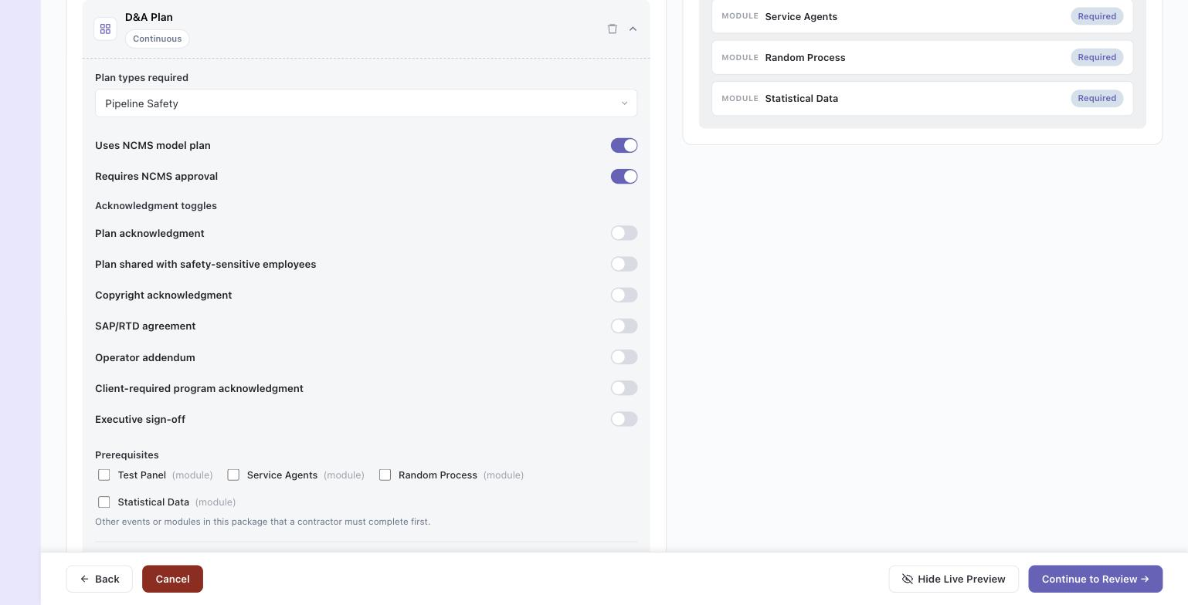
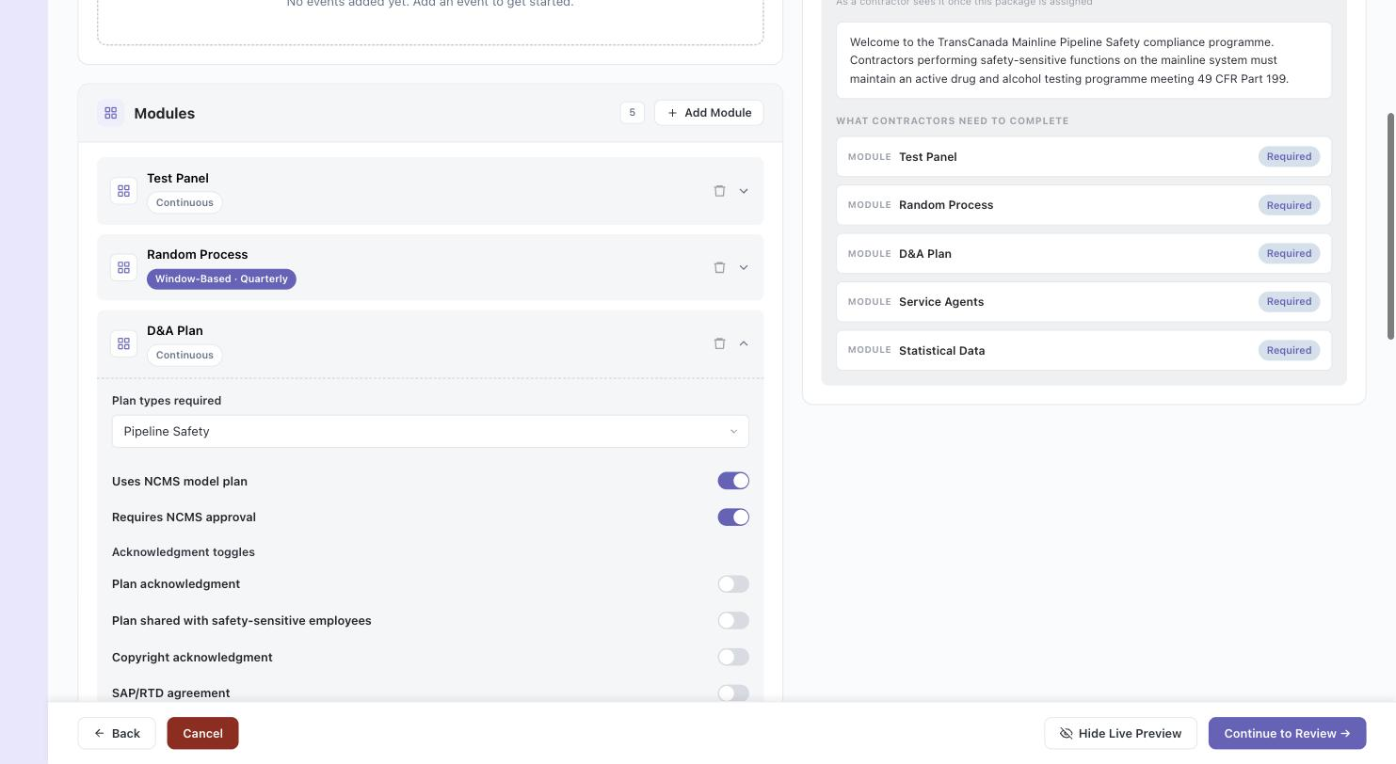
BUILDER — STEP 2: EVENTS & MODULES
Module editor — D&A Plan
Plan requirements + per-item acknowledgment toggles.

Slide 23
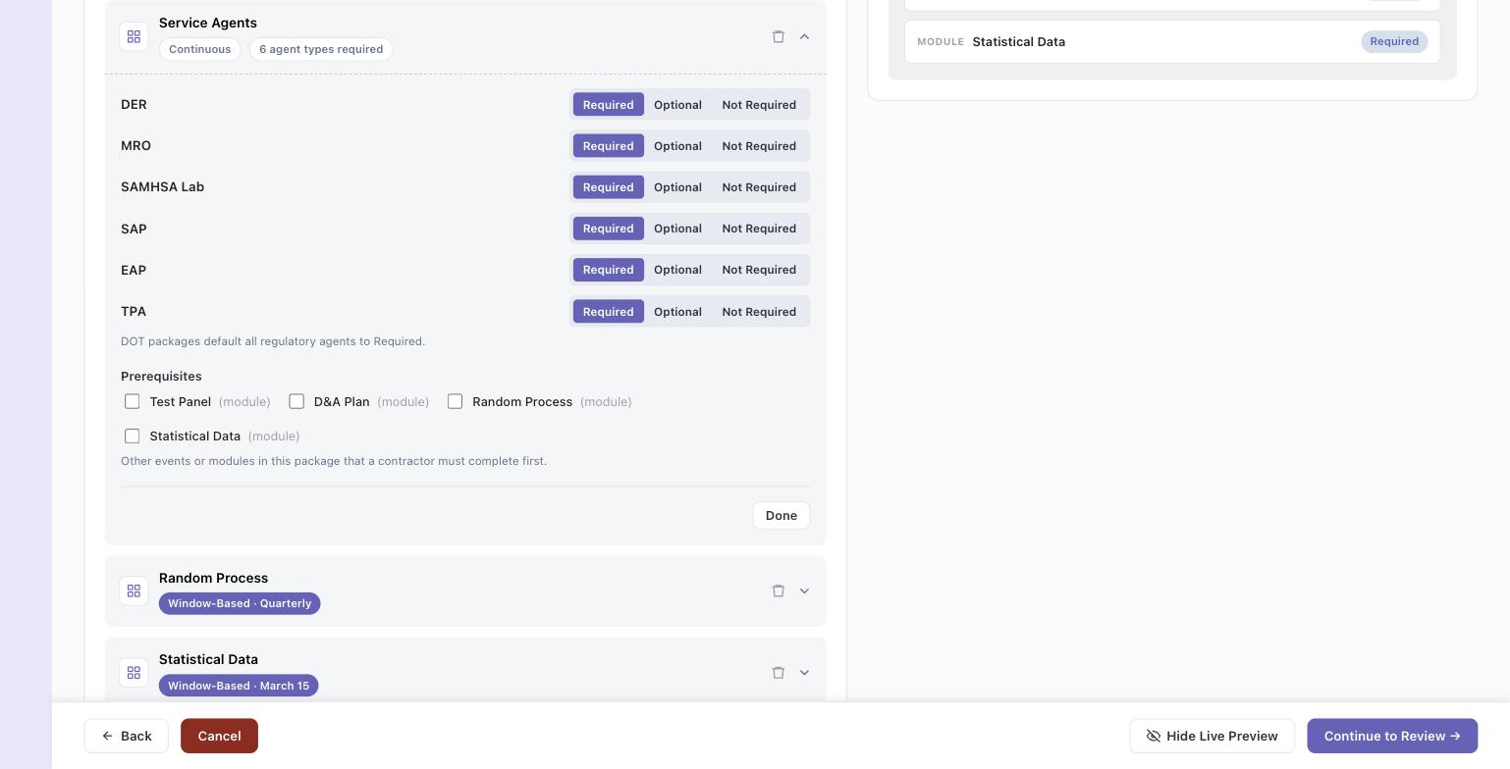
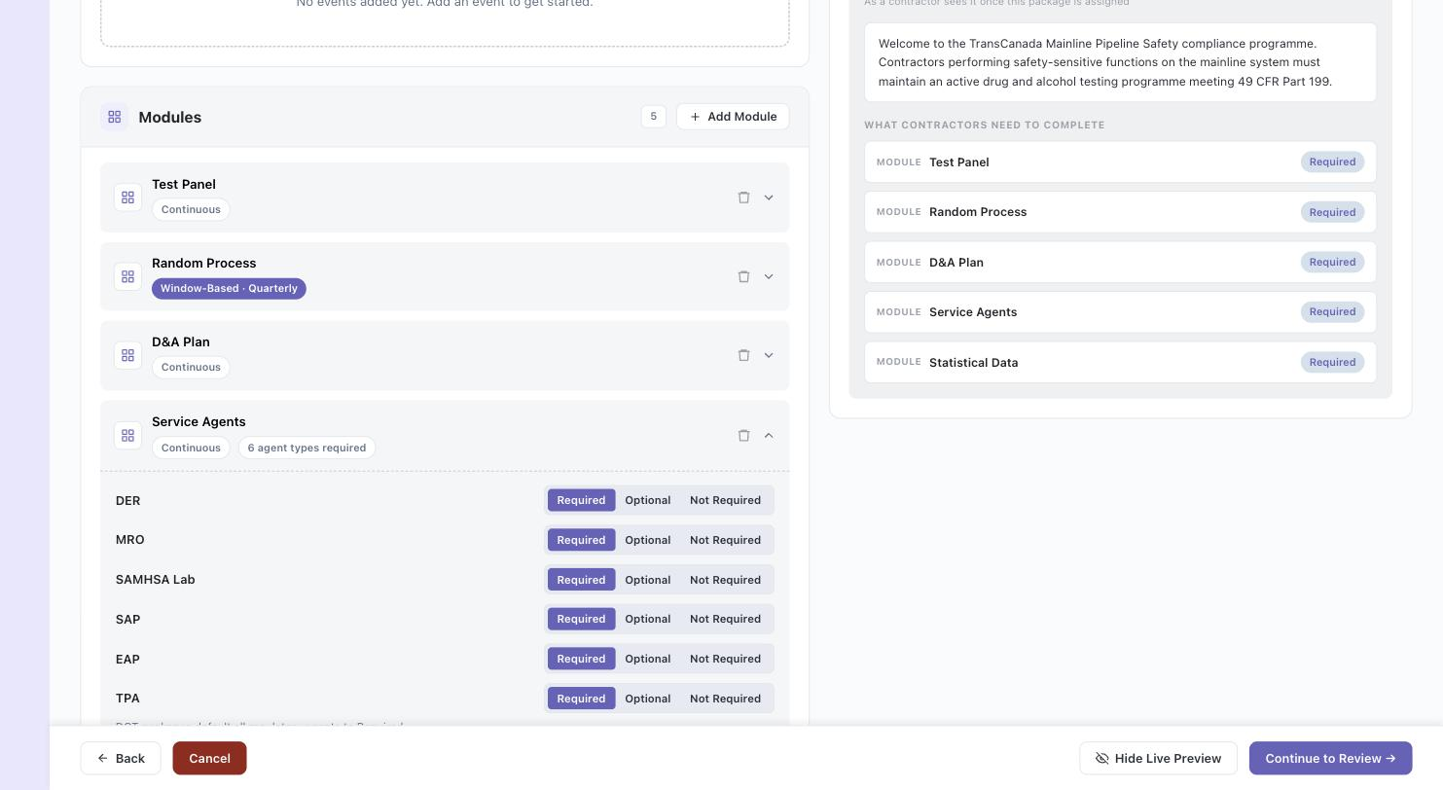
BUILDER — STEP 2: EVENTS & MODULES
Module editor — Service Agents
Tri-state Required / Optional / Not Required per agent type (DER, MRO, Lab, SAP, EAP, TPA).

Slide 24
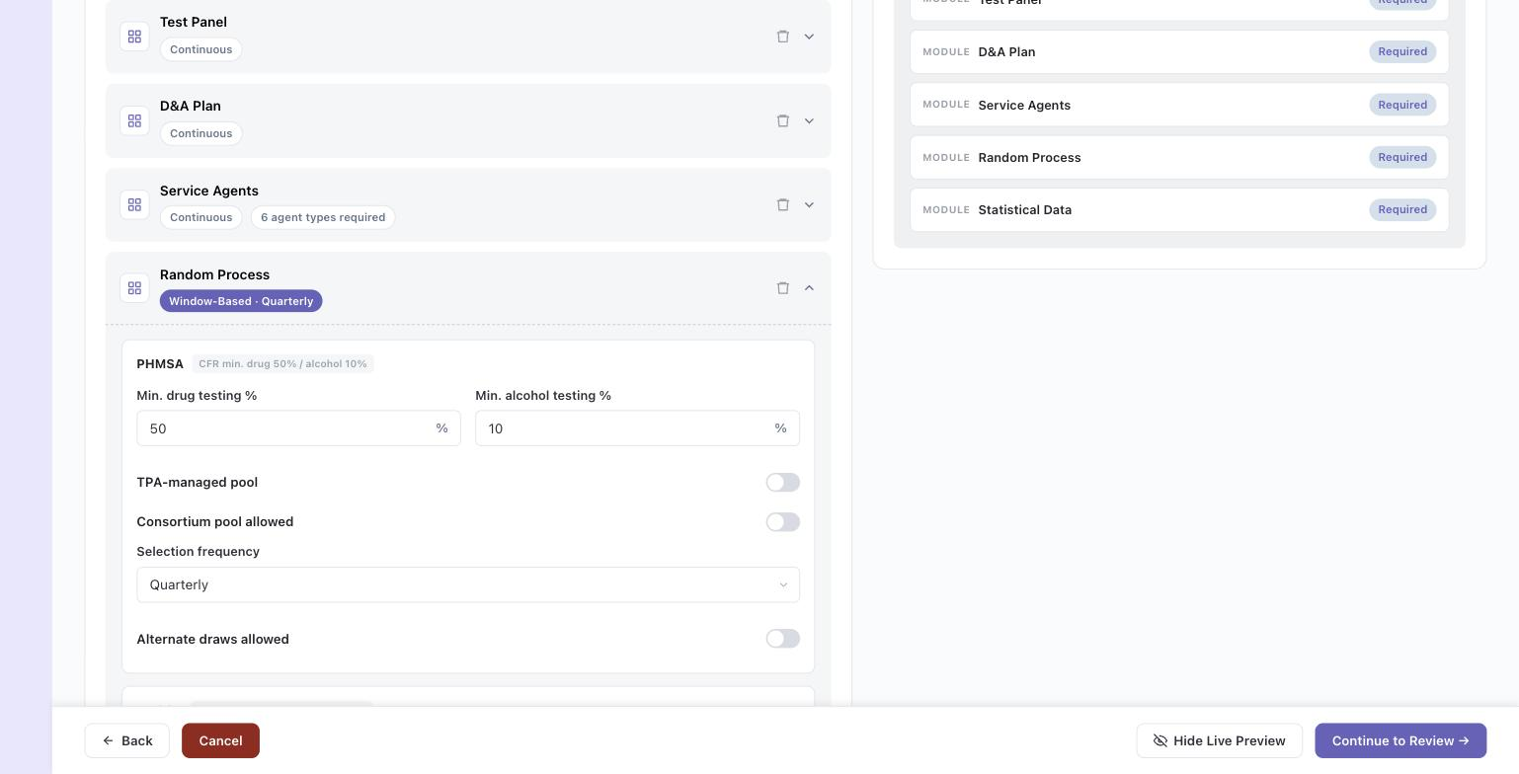
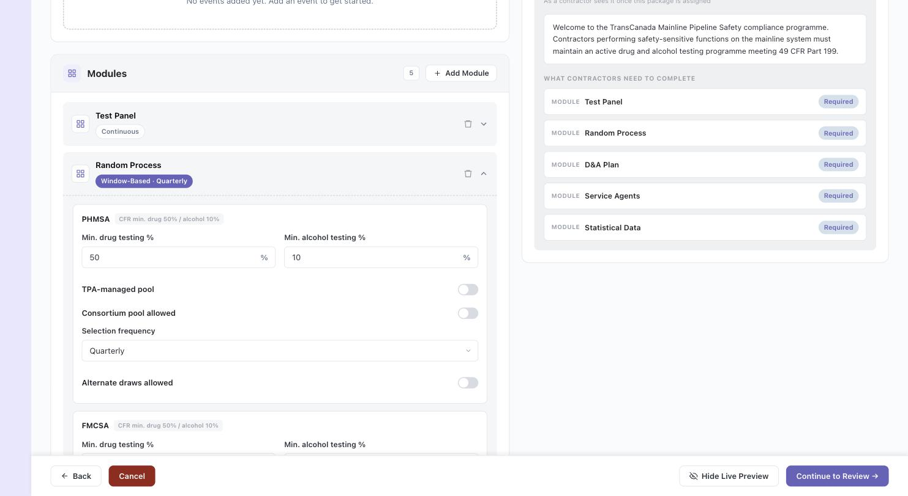
BUILDER — STEP 2: EVENTS & MODULES
Module editor — Random Process (DOT)
Per-regulatory-agency blocks (PHMSA, FMCSA, …) with CFR minimums shown as reference.

Slide 25
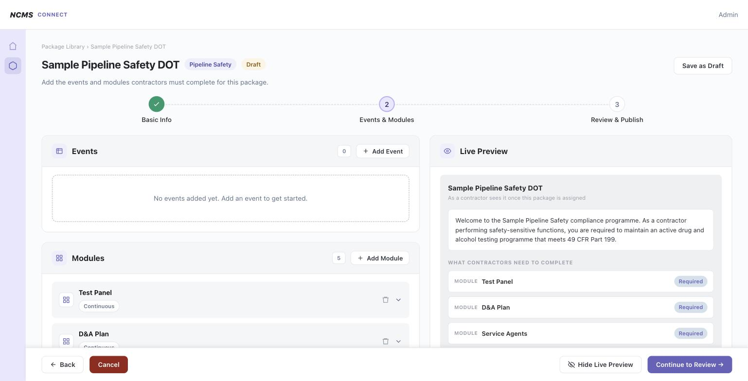
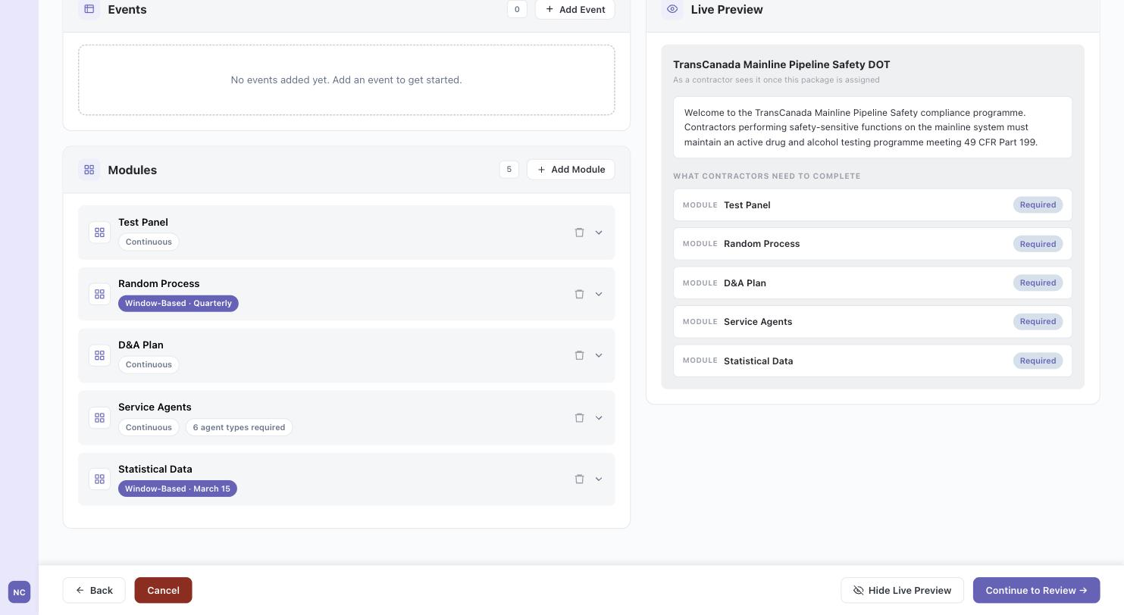
BUILDER — STEP 2: EVENTS & MODULES
All 5 modules — collapsed overview
Collapsed row summary with time-based badges; Live Preview reflects every module added.

Slide 26
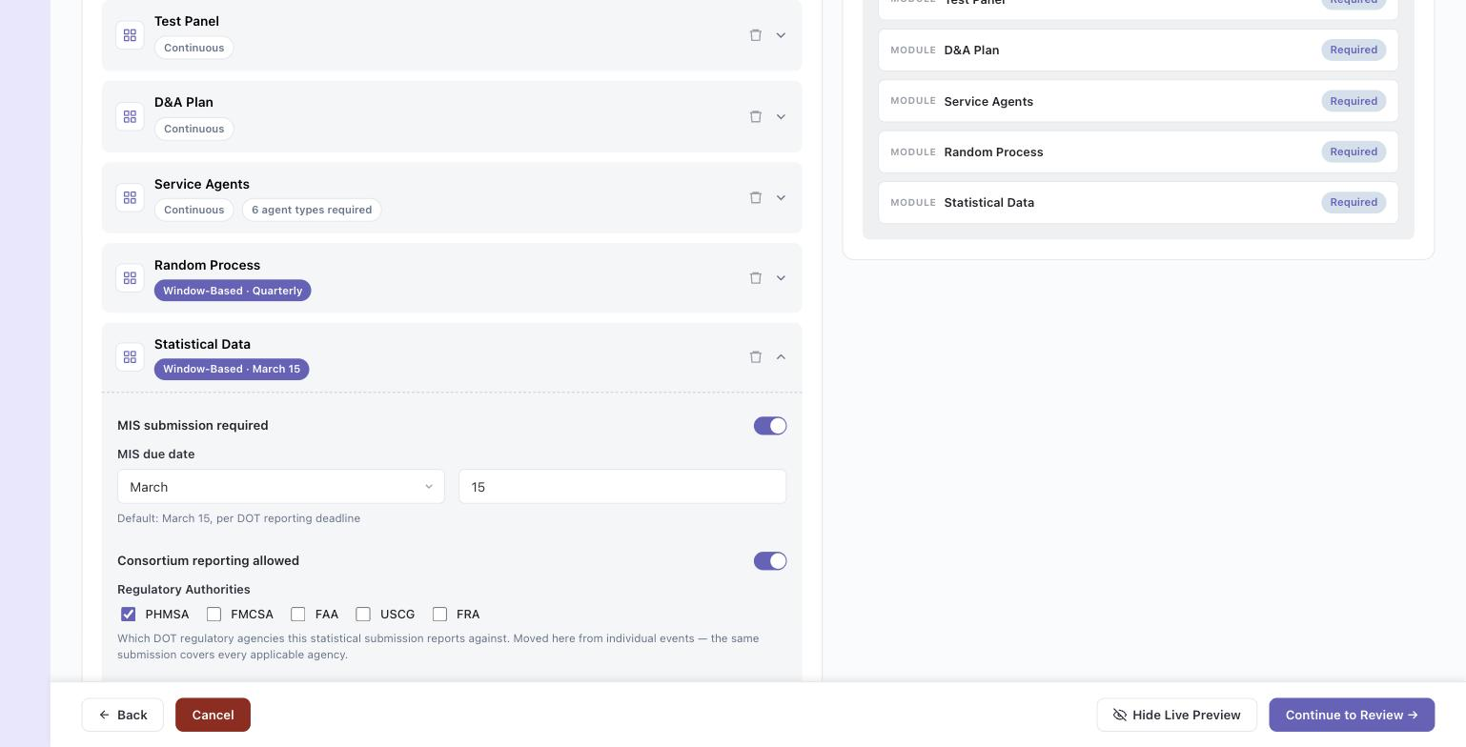
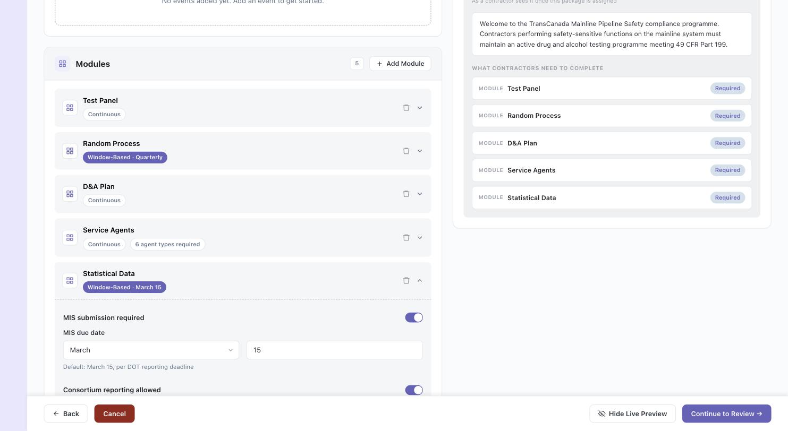
BUILDER — STEP 2: EVENTS & MODULES
Module editor — Statistical Data
MIS submission toggle and due date.

Slide 27
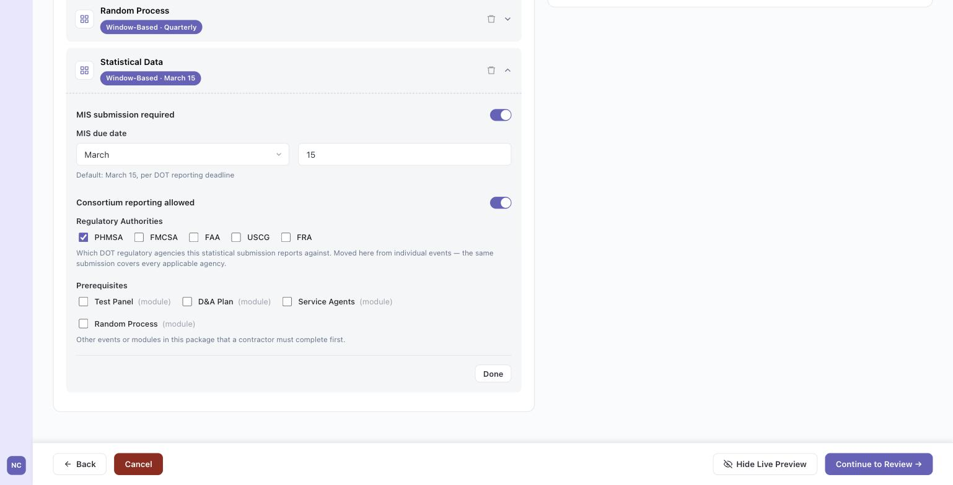
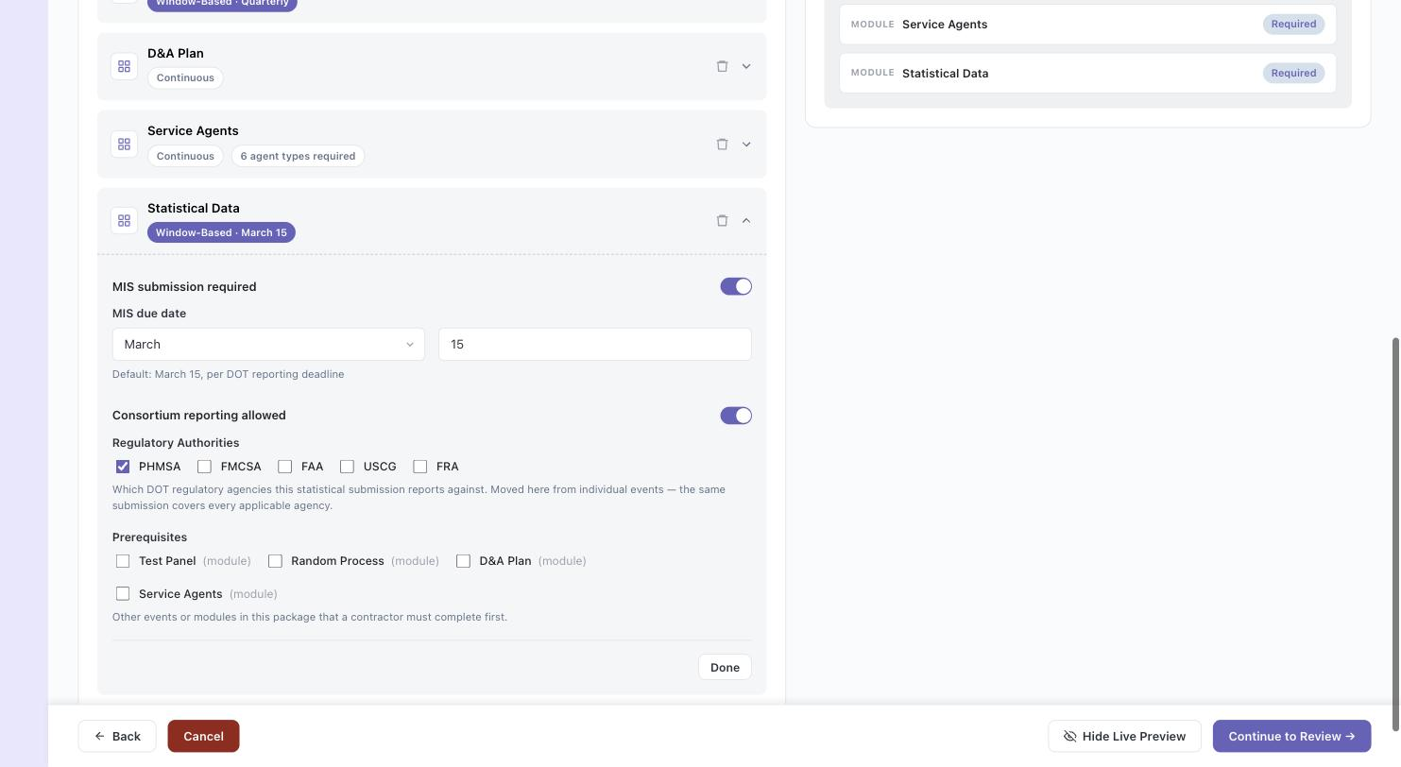
BUILDER — STEP 2: EVENTS & MODULES
Statistical Data — Regulatory Authorities + Prerequisites
Regulatory Authority field relocated here from individual events per Aug 4 feedback.

Slide 28
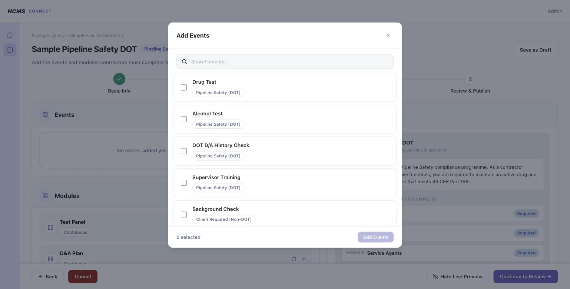
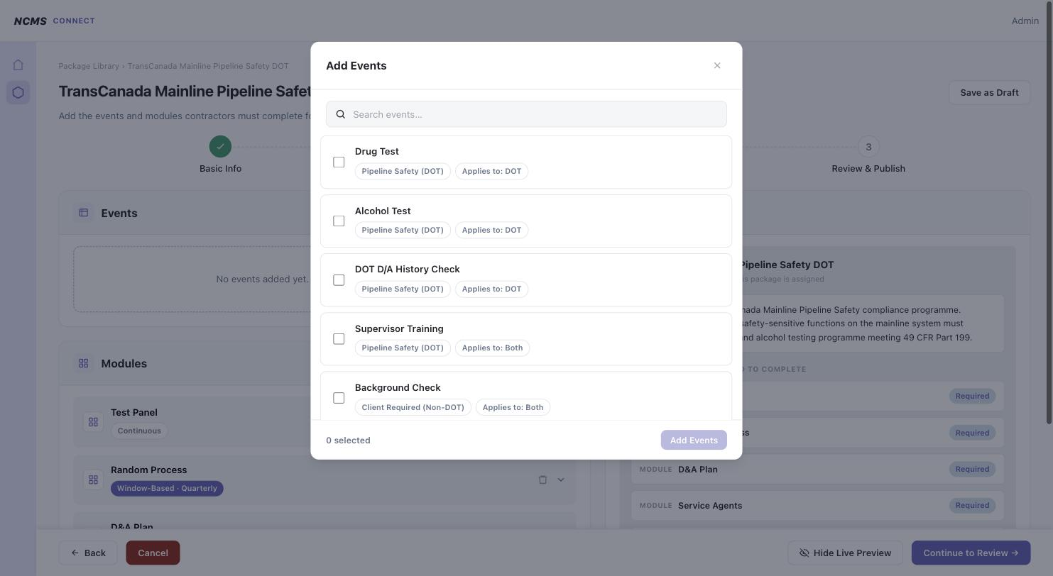
BUILDER — STEP 2: EVENTS & MODULES
Add Event picker — none selected

Slide 29


BUILDER — STEP 2: EVENTS & MODULES
Add Event picker — 2 selected
Drug Test + Alcohol Test queued for bulk add.

Slide 30


BUILDER — STEP 2: EVENTS & MODULES
Drug Test event editor
Validity, renewal window, Required toggle, and prerequisite picker.

Slide 31


BUILDER — STEP 2: EVENTS & MODULES
Prerequisite linked — “Depends on: Test Panel”
Dependency badge on the event + reciprocal “Required by: Drug Test” chip on the Test Panel module in Live Preview.

Slide 32


BUILDER — STEP 2: EVENTS & MODULES
Alcohol Test event editor (Drug Test collapsed)
Drug Test row shows its dependency badge collapsed; Alcohol Test open for configuration.

Slide 33


BUILDER — STEP 3: REVIEW & PUBLISH
Review & Publish summary
Irreversible-action warning, package metadata, and expandable Events/Modules list.

Slide 34


BUILDER — STEP 3: REVIEW & PUBLISH
Review card expanded — Drug Test
Same badge set shown in the builder, surfaced again for final review.

Slide 35


BUILDER — STEP 3: REVIEW & PUBLISH
Blocked publish — missing description
Soft (optional) warnings shown inline; hard blocks disable Confirm and Publish with no visible reason banner — flagged for design follow-up.

Slide 36


BUILDER — EDITING AN EXISTING DRAFT (V2)
Step 2 — Employee Applicability (collapsed)
New section, v2+ packages only. Background Check event already shows a per-event “Grandfathering: Old Employees” badge.

Slide 37


BUILDER — EDITING AN EXISTING DRAFT (V2)
Employee Applicability — Apply to all events (on)
Package-level grandfathering scope + effective date, with a one-click “Apply to All Events Now” action.

Slide 38


BUILDER — EDITING AN EXISTING DRAFT (V2)
Per-event Grandfathering controls
Individual event can still override applies-to scope and effective date after a package-level apply.

Slide 39


BUILDER — EDITING AN EXISTING DRAFT (V2)
“Draft saved” confirmation
Save as Draft now saves in place with an inline confirmation instead of returning to the Library.

