Slide 1
Crime Comparisons and Trends before and after Marijuana Legalization
Marijuana has been legal in Colorado since 2012. El Paso county and Teller county only allow medical
marijuana licensing. The task for this project is to see how the crime rates have changed and what crime
trends have been predicted for these two counties after marijuana became legal by studying Crime Statistics
data published by the Colorado Bureau of Investigation.
All crimes are grouped into three categories:
Property – 'Arson' 'Burglary' 'Larceny/Theft' 'Motor Vehicle Theft'
Violent – 'Aggravated Assault' 'Forcible rape' 'Murder/Manslaughter' 'Robbery'
Drug – 'Drug Violations'
Due to the population increases every year, that will be true comparisons to predict the trends for property crimes, violent crimes, and drug crime by looking at percentage changes among these three categories.

Slide 2
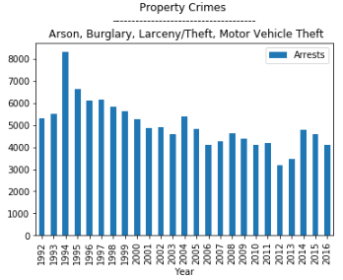
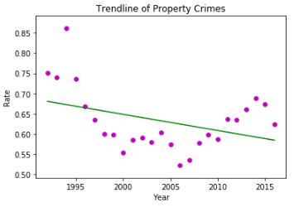
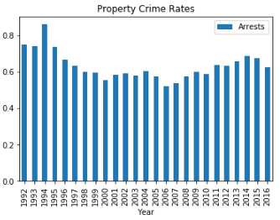
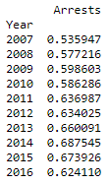
Property – 'Arson' 'Burglary' 'Larceny/Theft' 'Motor Vehicle Theft'
The trendline prediction shows the property crimes will be going down. It may be because getting a medical card is relatively onerous so medical marijuana sales continue to bottom out as a result of reducing the property crimes in the El Paso and Teller counties.

Slide 3
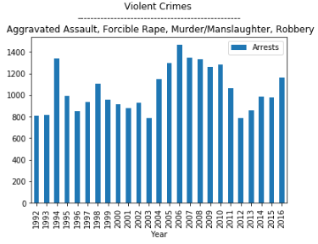
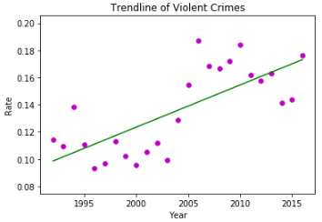
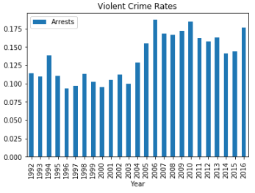
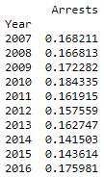
Violent – 'Aggravated Assault' 'Forcible rape' 'Murder/Manslaughter' 'Robbery'
The trendline prediction shows the violent crimes will be going up. It may be because more and more people go to recreational stores in other counties for their cannabis needs and cause violent crimes after they consume marijuana.

Slide 4
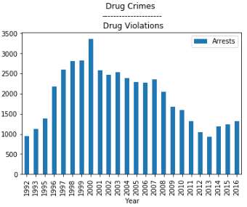
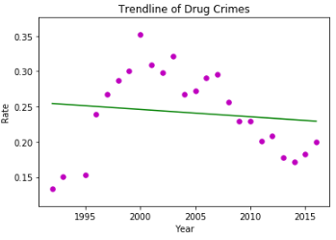
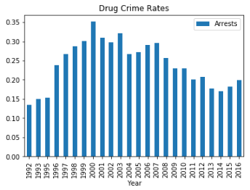
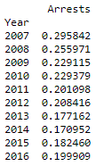
Durg – 'Drug Violation'
The trendline prediction shows the drug crimes will be slowing going down. It may be because marijuana legalization is driving people to buy recreational marijuana in other counties without violating the law in the El Paso and Teller counties.

