Slide 1

Waypoint Navigation System using Android App: Target_Setter
by
CHHENG Lydiya
Date: 20 February 2026

Slide 2
Contents
Background
Objective(s)
Scope of work
Approach(es)
Result & Discussion
Conclusion & Next Steps

Slide 3
Background
Semi-autonomous waypoint navigation system using custom Android app
The system has 2 packages: Target_Setter (Android app) and Robot’s control package
Target_Setter is developed to enable navigation without using gamepad as controller

Slide 4
Objectives
Develop and implement waypoint navigation system including edit and return functionalities
Test and evaluate system performance and accuracy
Implement Android interface for semi-autonomous navigation

Slide 5
Scope of work
This project covers:
Android application development (Target_Setter)
Communication system
Robotic software development (ROS2)
System integration and testing

Slide 6
Scope of work
This project does not include:
Full autonomous robot navigation
Sensor fusion beyond basic odometry and IMU integration
Algorithm optimization
Low-level communication protocol
Hardware-level motor driver design
Network security mechanism

Slide 7
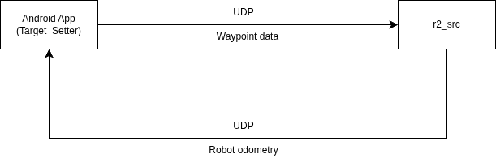
Approach
System Architecture
This is the high-level architecture of the system

Slide 8
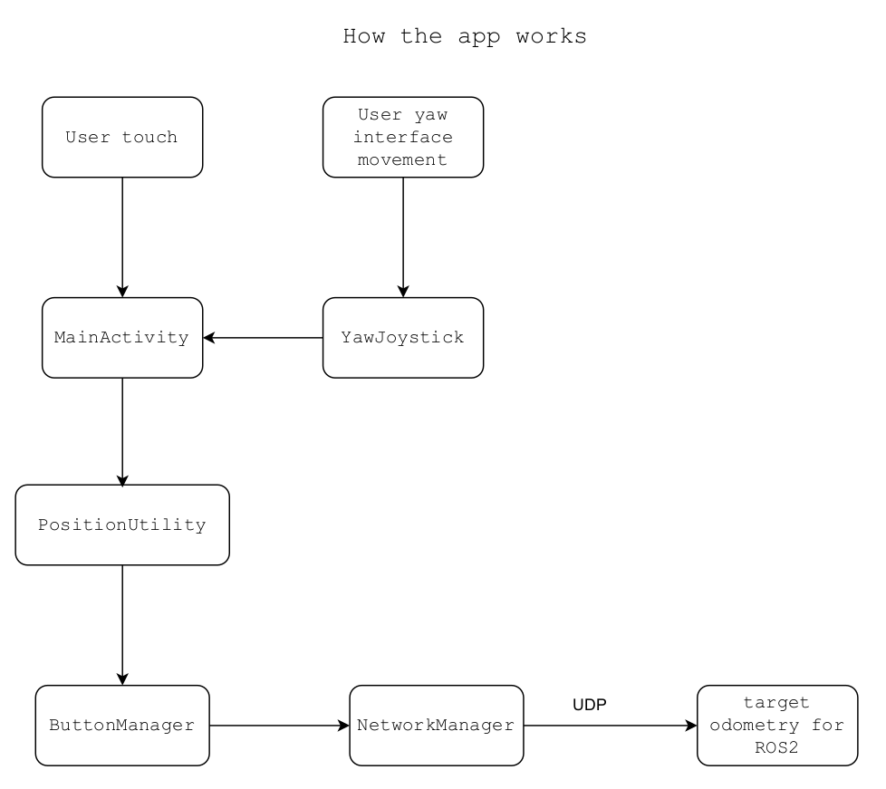
Approach: version 0.1
System Architecture: Android app
Works based on touch input
Implemented virtual joystick for yaw control
Used MVC architectural pattern
Communicated with ROS2 via UDP
Android app handled all gamefield scaling and waypoints calculation

Slide 9
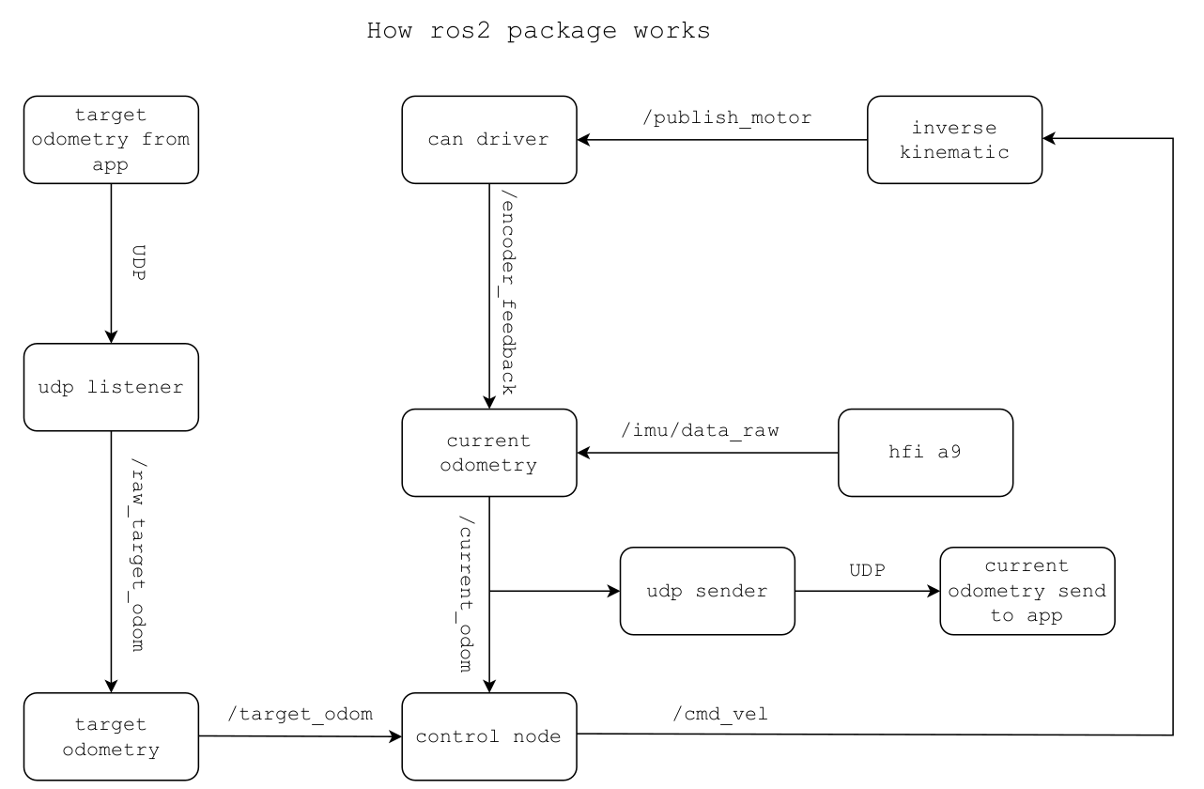
Approach: version 0.1
System Architecture: ROS2 package
Takes inputs from Android app
Implemented PD controller
Used ROS2 framework to operate
Communicated with app via UDP
Handled all control logic, feedback, and navigation

Slide 10
Approach: version 0.1
Android app design
MVC architecture
Percentage-based coordinate storage
ConstraintLayout for scalability
Initial version didn’t include edit and return functionalities, just basic waypoints input

Slide 11
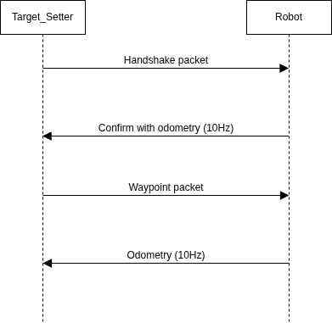
Approach: version 0.1
Communication system
UDP-based communication protocol (low latency)
JSON array UDP packet
Handshake mechanism

Slide 12
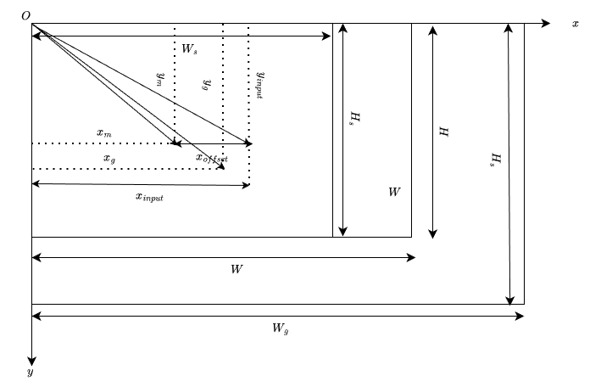
Approach: version 0.1
Coordinate scaling: Target_Setter
The waypoint in global reference frame is given by:
$x_{g}=\frac{W_{g}}{W_{s}}\left(x_{input}−x_{offset}\right),y_{g}=\frac{H_{g}}{H_{s}}\left(y_{input}−y_{offset}\right),θ=arctan2\frac{y_{input}−y_{odom}}{x_{input}−x_{odom}}$
This is obtained by applying frame transformation and scaling in Cartesian coordinate system

Slide 13
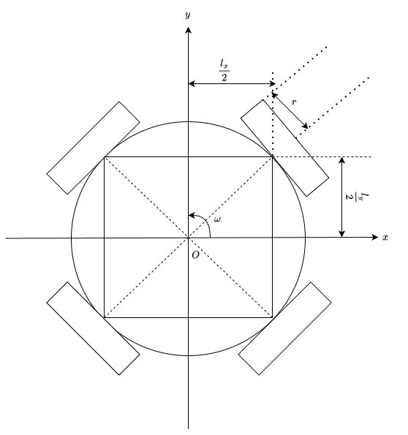
Approach: version 0.1
Kinematics: ROS2 package
The wheel velocities are given by:
$\left[\begin{matrix}ω_{1}\left[n\right] \\ ω_{2}\left[n\right] \\ ω_{3}\left[n\right] \\ ω_{4}\left[n\right]\end{matrix}\right]=\frac{1}{r}\left[\begin{matrix}1 & −1 & −R \\ 1 & 1 & R \\ 1 & 1 & −R \\ 1 & −1 & R\end{matrix}\right]\left[\begin{matrix}v_{x}\left[n\right] \\ v_{y}\left[n\right] \\ ω\left[n\right]\end{matrix}\right],R=\frac{l_{x}}{2}+\frac{l_{y}}{2}$
The robot velocities are given by:
$\left[\begin{matrix}v_{x}\left[n\right] \\ v_{y}\left[n\right] \\ ω\left[n\right]\end{matrix}\right]=\frac{r}{4}\left[\begin{matrix}1 & 1 & 1 & 1 \\ −1 & 1 & 1 & −1 \\ −\frac{1}{R} & \frac{1}{R} & −\frac{1}{R} & \frac{1}{R}\end{matrix}\right]\left[\begin{matrix}ω_{1}\left[n\right] \\ ω_{2}\left[n\right] \\ ω_{3}\left[n\right] \\ ω_{4}\left[n\right]\end{matrix}\right]$
This is obtained by applying kinematics on a rigid body

Slide 14
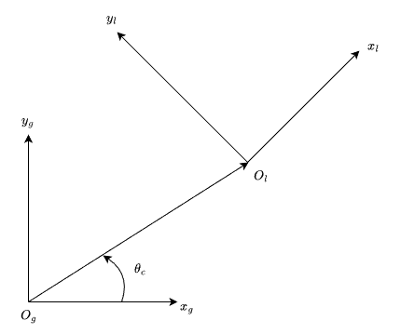
Approach: version 0.1
Frame transformation: ROS2 package
The linear velocities in local frame are given by:
$\left[\begin{matrix}v_{x}^{l}\left[n\right] \\ v_{y}^{l}\left[n\right]\end{matrix}\right]=\left[\begin{matrix}cosθ_{c}\left[n\right] & sinθ_{c}\left[n\right] \\ −sinθ_{c}\left[n\right] & cosθ_{c}\left[n\right]\end{matrix}\right]\left[\begin{matrix}v_{x}^{g}\left[n\right] \\ v_{y}^{g}\left[n\right]\end{matrix}\right]$
The linear velocities in global frame are given by:
$\left[\begin{matrix}v_{x}^{g}\left[n\right] \\ v_{y}^{g}\left[n\right]\end{matrix}\right]=\left[\begin{matrix}cosθ_{c}\left[n\right] & −sinθ_{c}\left[n\right] \\ sinθ_{c}\left[n\right] & cosθ_{c}\left[n\right]\end{matrix}\right]\left[\begin{matrix}v_{x}^{l}\left[n\right] \\ v_{y}^{l}\left[n\right]\end{matrix}\right]$
This is obtained by applying rotation matrix on linear velocities in global frame and local frame respectively

Slide 15
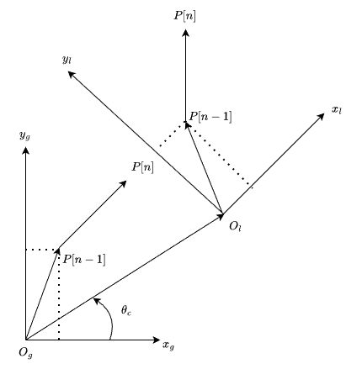
Approach: version 0.1
Odometry: ROS2 package
The robot odometry is defined as:
$P_{\left[n+1\right]}=P\left[n\right]+R\left[\begin{matrix}v_{x}\left[n\right]T_{s} \\ v_{y}\left[n\right]T_{s}\end{matrix}\right]⇒{\left[\begin{matrix}x_{odom} \\ y_{odom}\end{matrix}\right]}_{n+1}={\left[\begin{matrix}x_{odom} \\ y_{odom}\end{matrix}\right]}_{n}+\left[\begin{matrix}cosθ_{c}\left[n\right] & −sinθ_{c}\left[n\right] \\ sinθ_{c}\left[n\right] & cosθ_{c}\left[n\right]\end{matrix}\right]\left[\begin{matrix}v_{x}\left[n\right]T_{s} \\ v_{y}\left[n\right]T_{s}\end{matrix}\right]$
$θ_{c}\left[n\right]=θ\left[n\right]−θ_{offset},θ\left[n\right]=arctan2\left[\frac{2\left(ω\left[n\right]x\left[n\right]+x\left[n\right]y\left[n\right]\right)}{1−2\left(y^{2}\left[n\right]+z^{2}\left[n\right]\right)}\right],θ_{offset}=θ_{initial}$

Slide 16
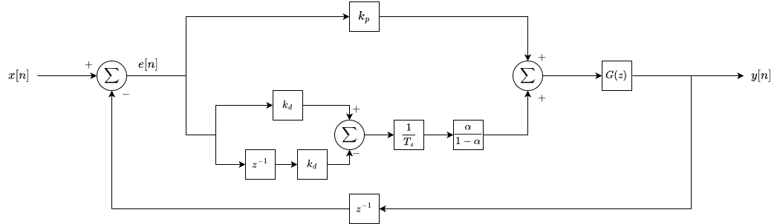
Approach: version 0.1
Control logic: ROS2 package
The velocities in global reference frame is given by:
$u\left[n\right]=\left[\begin{matrix}v_{x}^{l}\left[n\right] \\ v_{y}^{l}\left[n\right] \\ ω\left[n\right]\end{matrix}\right]$
The global velocities is given by the PD controller:
$\left[\begin{matrix}v_{x}^{g}\left[n\right] \\ v_{y}^{g}\left[n\right]\end{matrix}\right]=\left[\begin{matrix}k_{p} & 0 \\ 0 & k_{p}\end{matrix}\right]\left[\begin{matrix}e_{x}\left[n\right] \\ e_{y}\left[n\right]\end{matrix}\right]+\left[\begin{matrix}k_{d} & 0 \\ 0 & k_{d}\end{matrix}\right]\left[\begin{matrix}\overset{˙}{e_{x,filtered}}\left[n\right] \\ \overset{˙}{e_{y,filtered}}\left[n\right]\end{matrix}\right]$
Where
$\left[\begin{matrix}\overset{˙}{e_{x,filtered}}\left[n\right] \\ \overset{˙}{e_{y,filtered}}\left[n\right]\end{matrix}\right]=α_{d}\left[\begin{matrix}\overset{˙}{e_{x}}\left[n\right] \\ \overset{˙}{e_{y}}\left[n\right]\end{matrix}\right]+\left(1−α_{d}\right)\left[\begin{matrix}\overset{˙}{e_{x}}\left[n−1\right] \\ \overset{˙}{e_{y}}\left[n−1\right]\end{matrix}\right]$
$\left[\begin{matrix}e_{x}\left[n\right] \\ e_{y}\left[n\right]\end{matrix}\right]=\left[\begin{matrix}x_{d}\left[n\right]−x_{c}\left[n\right] \\ y_{d}\left[n\right]−y_{c}\left[n\right]\end{matrix}\right],\left[\begin{matrix}\overset{˙}{e_{x}}\left[n\right] \\ \overset{˙}{e_{y}}\left[n\right]\end{matrix}\right]=\left[\begin{matrix}\frac{e_{x}\left[n\right]−e_{x}\left[n−1\right]}{T_{s}} \\ \frac{e_{y}\left[n\right]−e_{y}\left[n−1\right]}{T_{s}}\end{matrix}\right]$
And
Then, we calculate local velocities:
$\left[\begin{matrix}v_{x}^{l}\left[n\right] \\ v_{y}^{l}\left[n\right]\end{matrix}\right]=\left[\begin{matrix}cosθ_{c}\left[n\right] & sinθ_{c}\left[n\right] \\ −sinθ_{c}\left[n\right] & cosθ_{c}\left[n\right]\end{matrix}\right]\left[\begin{matrix}v_{x}^{g}\left[n\right] \\ v_{y}^{g}\left[n\right]\end{matrix}\right]$

Slide 17
Approach: version 0.1
Control logic: ROS2 package
The angular velocity is given by the PD controller:
$ω\left[n\right]=k_{p}e_{θ}\left[n\right]$
Where
$e_{θ}\left[n\right]=θ_{d}\left[n\right]−θ_{c}\left[n\right]$
The deadzone can be applied:
$if\left|v\right|<ϵ,v=0$
For safety reason, we limit the robot velocities:
$\left|v\right|≤v_{max},\left|ω\right|≤ω_{max}$

Slide 18
Approach: version 0.2
Updates
Version 0.2 is an updates over version 0.1 to improve usability and performance of the system. The update includes:
Target_Setter UI update
Communication protocol redefinition
Addition of return and edit functionalities
Minor system architecture improvement
Navigation logic addition
Coordinate scaling update on Target_Setter

Slide 19
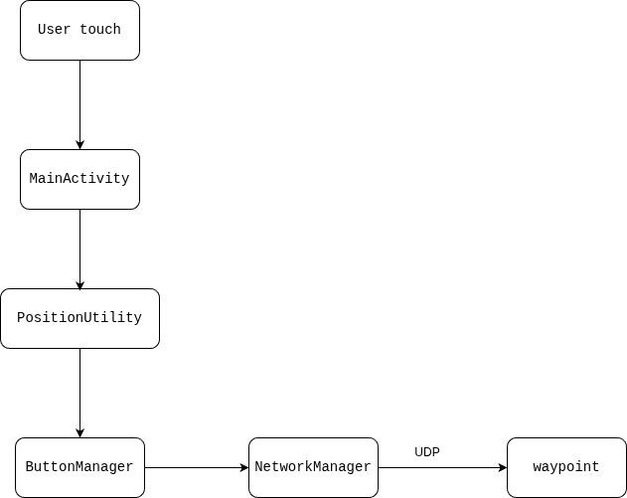
Approach: version 0.2
System architecture: Target_Setter update
YawJoystick is removed from Target_Setter app because:
App doesn’t actually need to calculate yaw because yaw can be inferred from the position inputs
We assume that the robot is in a planar (2D) environment
Reduce computational load from the app

Slide 20
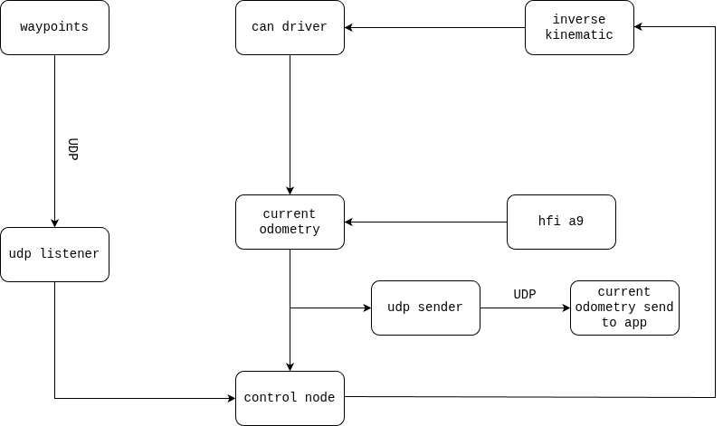
Approach: version 0.2
System architecture: ROS2 package update
target_odometry node is removed from package because:
After redefining communication protocol, target_odometry node is redundant with the udp_listener node
UDP packets can be processed directly in the udp_listener node

Slide 21
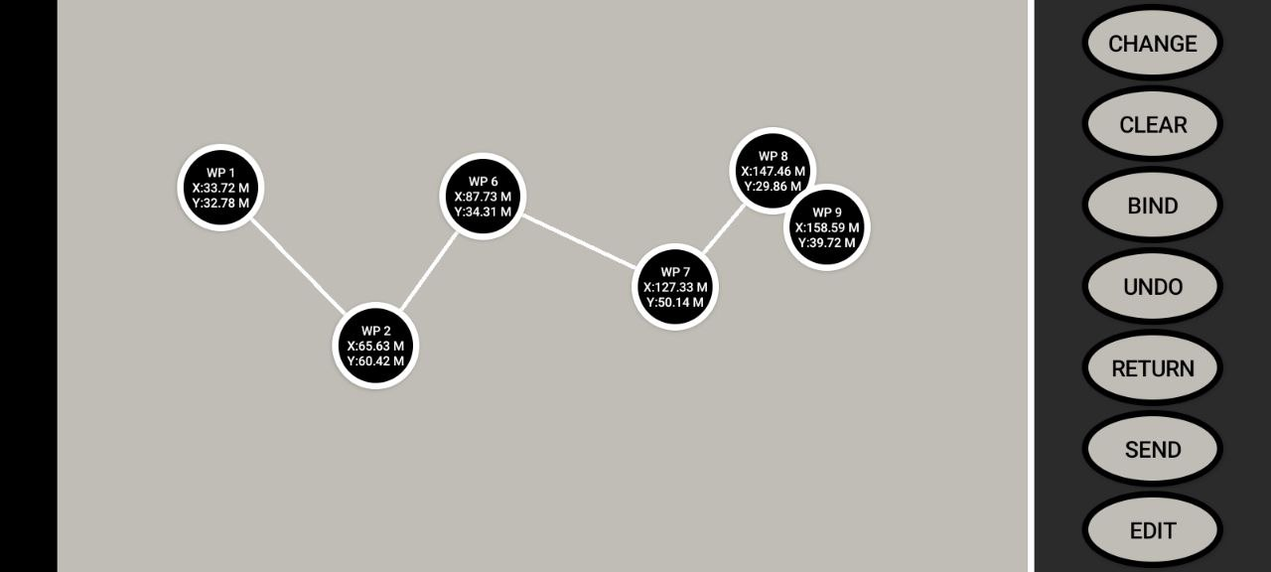
Approach: version 0.2
Android app design update
Add lines connecting from one waypoint to another for better readability
Allows users to input gamefield parameters (dimension) for scalability and modularity
Removed virtual joystick
Add Edit and Return buttons

Slide 22
Approach: version 0.2
Coordinate scaling
Since we removed yaw input from the UI, the app can no longer provides yaw input. After this change, the waypoints in global frame is provided as:
$x_{g}=\frac{W_{g}}{W_{s}}\left(x_{input}−x_{offset}\right),y_{g}=\frac{H_{g}}{H_{s}}\left(y_{input}−y_{offset}\right)$
Yaw correction is handled by the ROS2 package using positions input from app and IMU quaternion readings.
$θ_{d}\left[n\right]=arctan2\left(\frac{y_{d}\left[n\right]−y_{c}\left[n\right]}{x_{d}\left[n\right]−x_{c}\left[n\right]}\right)$

Slide 23
Approach: version 0.2
Communication protocol redefinition
Different packet types for different messages (structure problem)
Implement binary UDP packet with Little Endian byte order to decrease transmission latency
Update communication flow by including edit and return functionalities
udp_listener node update to process the packets properly before publishing decision

Slide 24
Approach: version 0.2
Navigation logic addition
To properly navigate the robot, we add arrival detection.
We can check the distance using this equation
Then, we compare the distance with the predefined threshold.
The robot is considered to be arrived at the waypoint if the distance is less than or equal to the threshold.
$d\left[n\right]=\sqrt{{\left(x_{d}\left[n\right]−x_{c}\left[n\right]\right)}^{2}+{\left(y_{d}\left[n\right]−y_{c}\left[n\right]\right)}^{2}}$

Slide 25
Approach: version 0.2
Addition of return and edit functionalities
The app send the return and edit packets. Each packet contains flag that signals ROS2 to return or edit the waypoint.
udp_listener node process these packets, then forward it to the control node.
robot_control node implements the logic required for the navigation operation.

Slide 26
Approach: version 0.2
Addition of return and edit functionalities: edit
If the edited waypoint is not active, the robot continues its navigation normally, otherwise, we implement complementary filter to smooth robot navigation, avoiding sudden jumps in trajectory that could cause instability.
This is done using these equations:
Or in matrix form
$x_{active}\left[n\right]=\left(1−α\right)x_{active}\left[n\right]+αx_{edit}\left[n\right],y_{active}\left[n\right]=\left(1−α\right)y_{active}\left[n\right]+αy_{edit}\left[n\right]$
$θ_{active}\left[n\right]=\left(1−α\right)θ_{active}\left[n\right]+αθ_{edit}\left[n\right],θ_{edit}\left[n\right]=arctan2\left(\frac{x_{edit}\left[n\right]−x_{active}\left[n\right]}{y_{edit}\left[n\right]−y_{active}\left[n\right]}\right)$
$\left[\begin{matrix}x_{active}\left[n\right] \\ y_{active}\left[n\right] \\ θ_{active}\left[n\right]\end{matrix}\right]=\left(1−α\right)\left[\begin{matrix}x_{active}\left[n\right] \\ y_{active}\left[n\right] \\ θ_{active}\end{matrix}\left[n\right]\right]+α\left[\begin{matrix}x_{edit}\left[n\right] \\ y_{edit}\left[n\right] \\ θ_{edit}\left[n\right]\end{matrix}\right]$

Slide 27
Approach: version 0.2
Addition of return and edit functionalities: return
To implement return functionality, we need to store waypoints that the robot has gone to. We store it in a stack after the robot has reached the waypoint. It is stored sequentially until the return flag is detected.
If the return flag is detected, we pop the stack. The previous waypoint becomes the active waypoint.

Slide 28
Approach: version 0.3
Updates
Version 0.3 is an update over version 0.2 on navigation logic. The update includes:
Introduction of state machine
Yaw correction improvement by adding derivative term with filter
For this version, there is no major update on any module except the robot_control node. System architecture, Android app, and communication protocol remains the same.

Slide 29
Approach: version 0.3
Introduction of state machine
To enable the robot to navigate properly with the addition of return and edit functionalities, we introduce state machine to avoid undefined behaviors. There are 5 states:
IDLE: default state
NAVIGATING: when the robot is moving toward waypoint
EDIT: when the active waypoint is edited
PAUSED: when all the motion is stopped either automatically or manually
RETURN: when the robot is returning to a previous waypoint due to return flag detected

Slide 30
Approach: version 0.3
Yaw correction improvement
Proportional controller alone wasn’t sufficient for yaw correction. This version introduces PD controller for yaw with derivative filter. Angular velocity is given by:
$ω\left[n\right]=k_{p}e_{θ}\left[n\right]+k_{d}\overset{˙}{e_{θ,filtered}}\left[n\right]$
$e_{θ}\left[n\right]=θ_{d}\left[n\right]−θ_{c}\left[n\right],\overset{˙}{e_{θ}}\left[n\right]=\frac{e_{θ}\left[n\right]−e_{θ}\left[n−1\right]}{T_{s}}$
$\overset{˙}{e_{θ,filtered}}\left[n\right]=α_{d,θ}\overset{˙}{e_{θ}}\left[n\right]+\left(1−α_{d,θ}\right)\overset{˙}{e_{θ}}\left[n−1\right]$

Slide 31
Result & Discussion
Data collection
Although no quantitative data is recorded from the tests, the repeated qualitative observations were recorded and focused on:
Robot trajectory and waypoint assignment
Linear and angular velocity profiles
State transitions
Behavior near waypoint boundaries
Target_Setter performance
Communication system performance

Slide 32
Result & Discussion
Analysis: version 0.1
Communication system behavior: Target_Setter lagged under high sampling rate
Control logic behavior:
Robot converges toward waypoint
Oscillation occurred due to high-frequency noise

Slide 33
Result & Discussion
Analysis: version 0.2
Control logic performance: system stability was improved due to:
Low-pass filtering on D term
Deadzone implementation
Localization drift: localization drift over long distance because:
Actuator deadzone causes small cumulative error leads to micro-correction
Mismatches between odometry-based yaw and IMU-based yaw
Undefined state behavior: unintended movement is caused by state transition conflict
Insufficiency of MVC architectural pattern: race conditions and state conflicts occurred on the app because of more sophisticated communication system
The system code is developed up to version 0.3. However, the evaluation for this version is still pending.

Slide 34
Result & Discussion
System evaluation
PD controller with derivative filtering and deadzone exhibits critically damped response, achieving smooth waypoint convergence.
Velocity capping, deadzone compensation, and state machine supervision are necessary to prevent unsafe acceleration and drift.
Odometry drift, deadzone effects, incremental errors, and distance-based waypoint inference introduce yaw micro-corrections, causing mild oscillations over long distances.
At a 10 Hz control loop, the system adapts to waypoint modifications dynamically with minimal observable latency.
The Android MVC implementation becomes prone to race conditions and state conflicts as asynchronous complexity increases.

Slide 35
Result & Discussion
Improvement suggestions
Verify version 0.3
Implement a persistent data logging method
Integrate sensor fusion for localization
Implement adaptive PD gains
Enhance state management in Target_Setter app
Consider using MVVM architectural pattern for Target_Setter app

Slide 36
Conclusion & Next Step(s) / Future work
PD controller enables stable, smooth motion for omnidirectional robot.
Velocity limits & state machine ensure safe navigation.
Minor oscillations from IMU/waypoint errors are well managed.
Future work: sensor fusion, adaptive gains, logging, and drift reduction.

Slide 37
References
Singh, S., “MVC Framework: A Modern Web Application Development Approach and Working,” International Research Journal of Engineering and Technology (IRJET), vol. 7, no. 1, pp. 51–55, Jan. 2020. [Online]. Available: https://www.irjet.net/archives/V7/i1/IRJET-V7I111.pdf
Nandwanya, A., “ConstraintLayout, Demystified – How It Really Works and When You Should Reach for It,” Android Engineers, Sep. 2, 2025. [Online]. Available: https://androidengineers.substack.com/p/constraintlayout-demystified-how. [Accessed: Feb. 12, 2026].
“MVC Framework – Architecture,” TutorialsPoint, n.d. [Online]. Available: https://www.tutorialspoint.com/mvc_framework/mvc_framework_architecture.htm. [Accessed: Feb. 13, 2026].
“Model-View-ViewModel (MVVM),” Microsoft Learn, n.d. [Online]. Available: https://learn.microsoft.com/en-us/dotnet/architecture/maui/mvvm. [Accessed: Feb. 13, 2026].
“Build a Responsive UI with ConstraintLayout,” Android Developers, n.d. [Online]. Available: https://developer.android.com/develop/ui/views/layout/constraint-layout. [Accessed: Feb. 13, 2026].
“Unidirectional Link vs. Bidirectional Link vs. Loopback Link,” CCNA Classes, May 27, 2021. [Online]. Available: https://ccna-classes.com/ccna-study-resources/unidirectional-link-vs-bidirectional-link-vs-loopback-link/. [Accessed: Feb. 13, 2026].
Cisco Network Academy, CCNAv7: Introduction to Networks Companion Guide. Indianapolis, IN, USA: Cisco Press, 2020.

Slide 38
References
Dordal, P. L., “UDP Transport,” in An Introduction to Computer Networks, Desktop ed. 2.0.11, 2012. [Online]. Available: https://intronetworks.cs.luc.edu/current/html/udp.html [Accessed: Feb. 14, 2026].
Verschelde, J., “Client/Server Interactions,” Programming Tools and File Management 0.7.5 Documentation, Part VI: Network Programming, 2017. [Online]. Available: https://homepages.math.uic.edu/~jan/mcs275/mcs275notes/lec27.html. [Accessed: Feb. 14, 2026].
Narayana, S., “CS 352: User Datagram Protocol, Lecture 8.1,” Rutgers University, New Brunswick, n.d. [Online]. Available: https://people.cs.rutgers.edu/~sn624/352-S21/lectures/transport-udp-error-detection.pdf. [Accessed: Feb. 14, 2026].
“Robotic System, Section II: Modeling, Chapter 3: Coordinates and Transformations,” n.d. [Online]. Available: https://motion.cs.illinois.edu/RoboticSystems/CoordinateTransformations.html . [Accessed: Feb. 15, 2026].
Kutluca, H., “Robot Operating System 2 (ROS 2) Architecture,” Medium, Dec. 6, 2020. [Online]. Available: https://medium.com/software-architecture-foundations/robot-operating-system-2-ros-2-architecture-731ef1867776. [Accessed: Feb. 15, 2026].
“ROS 2: What Is DDS?” RTI Community, n.d. [Online]. Available: https://community.rti.com/page/ros-2-what-dds. [Accessed: Feb. 15, 2026].

Slide 39
References
Silberschatz, A., Galvin, P. B., and Gagne, G., Operating System Concepts, 10th ed. Hoboken, NJ, USA: Wiley, 2018.
Open Robotics, “Nodes,” ROS 2 Documentation: Humble, 2026. [Online]. Available: https://docs.ros.org/en/humble/Concepts/Basic/About-Nodes.html. [Accessed: Feb. 15, 2026].
Open Robotics, “Topics,” ROS 2 Documentation: Humble, 2026. [Online]. Available: https://docs.ros.org/en/humble/Concepts/Basic/About-Topics.html. [Accessed: Feb. 15, 2026].
Open Robotics, “Interfaces,” ROS 2 Documentation: Humble, 2026. [Online]. Available: http://docs.ros.org/en/humble/Concepts/Basic/About-Interfaces.html. [Accessed: Feb. 15, 2026].
Lipschutz, S., and Lipson, M. L., Schaum's Outline of Theory and Problems of Discrete Mathematics, 3rd ed. New York, NY, USA: McGraw-Hill, 2007. doi: 10.1035/0071470387.
Lee, E. A., and Varaiya, P., Structure and Interpretation of Signals and Systems. Pearson Education, 2003. [Online]. Available: https://ptolemy.berkeley.edu/projects/chess/eecs124/reading/LeeAndVaraiya3_4.pdf. [Accessed: Feb. 15, 2026].
Åström, K. J., “Control System Design,” 2002. [Online]. Available: https://www.cds.caltech.edu/~murray/courses/cds101/fa02/caltech/astrom-ch6.pdf. [Accessed: Feb. 16, 2026].

Slide 40
References
Boghossian, A., Brown, J., and Zak, S., “P, I, D, PI, PD, and PID Control,” LibreTexts Engineering, University of Michigan, n.d. [Online]. Available:https://eng.libretexts.org/Bookshelves/Industrial_and_Systems_Engineering/Chemical_Process_Dynamics_and_Controls_(Woolf)/09:_Proportional-Integral-Derivative_(PID)_Control/9.02:_P_I_D_PI_PD_and_PID_control. [Accessed: Feb. 16, 2026].
Oliveira, H. P., et al., “Dynamic Models for Omni-directional Robots with 3 and 4 Wheels,” in Proceedings of the International Conference on Informatics in Control, Automation and Robotics (ICINCO), 2008.
Phunopas, A., and Inoue, S., “Motion Improvement of Four-Wheeled Omnidirectional Mobile Robots for Indoor Terrain,” Journal of Robotics, Networking and Artificial Life, vol. 4, no. 4, pp. 275–282, Mar. 2018.
Karnopp, D. C., Margolis, D. L., and Rosenberg, R. C., System Dynamics: Modeling, Simulation, and Control of Mechatronic Systems. Hoboken, NJ, USA: John Wiley & Sons, 2012.
Lathi, B. P., Principles of Linear Systems and Signals, 2nd ed. Oxford University Press, 2009.
Simrock, S., “Control Theory,” DESY, Hamburg, Germany, n.d. [Online]. Available: https://cds.cern.ch/record/1100534/files/p73.pdfhttps://cds.cern.ch/record/1100534/files/p73.pdfhttps://cds.cern.ch/record/1100534/files/p73.pdf. [Accessed: Feb. 16, 2026].

