Slide 1
Reshaping data - Binary variables
Frank Edwards

Slide 2
Review HW 3

Slide 3
Reshaping data using the tidyverse

Slide 4
Grouping and summarizing

Slide 5
Evaluating the structure of the data
head(gapminder)
## # A tibble: 6 x 6 ## country continent year lifeExp pop gdpPercap ## <fct> <fct> <int> <dbl> <int> <dbl> ## 1 Afghanistan Asia 1952 28.8 8425333 779. ## 2 Afghanistan Asia 1957 30.3 9240934 821. ## 3 Afghanistan Asia 1962 32.0 10267083 853. ## 4 Afghanistan Asia 1967 34.0 11537966 836. ## 5 Afghanistan Asia 1972 36.1 13079460 740. ## 6 Afghanistan Asia 1977 38.4 14880372 786.
How is this data structured?
What natural groupings are present in this data?

Slide 6
Grouping and summarizing: by country
gapminder%>% group_by(country)%>% summarise(mean_lifeExp = mean(lifeExp))
## # A tibble: 142 x 2 ## country mean_lifeExp ## <fct> <dbl> ## 1 Afghanistan 37.5 ## 2 Albania 68.4 ## 3 Algeria 59.0 ## 4 Angola 37.9 ## 5 Argentina 69.1 ## 6 Australia 74.7 ## 7 Austria 73.1 ## 8 Bahrain 65.6 ## 9 Bangladesh 49.8 ## 10 Belgium 73.6 ## # … with 132 more rows

Slide 7
Grouping and summarizing: by country (cont.)
gapminder%>% group_by(country)%>% summarise(mean_lifeExp = mean(lifeExp), max_lifeExp = max(lifeExp), min_lifeExp = min(lifeExp))
## # A tibble: 142 x 4 ## country mean_lifeExp max_lifeExp min_lifeExp ## <fct> <dbl> <dbl> <dbl> ## 1 Afghanistan 37.5 43.8 28.8 ## 2 Albania 68.4 76.4 55.2 ## 3 Algeria 59.0 72.3 43.1 ## 4 Angola 37.9 42.7 30.0 ## 5 Argentina 69.1 75.3 62.5 ## 6 Australia 74.7 81.2 69.1 ## 7 Austria 73.1 79.8 66.8 ## 8 Bahrain 65.6 75.6 50.9 ## 9 Bangladesh 49.8 64.1 37.5 ## 10 Belgium 73.6 79.4 68 ## # … with 132 more rows

Slide 8
Grouping and summarizing: by continent and year
gapminder%>% group_by(continent, year)%>% summarise(mean_lifeExp = mean(lifeExp))
## # A tibble: 60 x 3 ## # Groups: continent [5] ## continent year mean_lifeExp ## <fct> <int> <dbl> ## 1 Africa 1952 39.1 ## 2 Africa 1957 41.3 ## 3 Africa 1962 43.3 ## 4 Africa 1967 45.3 ## 5 Africa 1972 47.5 ## 6 Africa 1977 49.6 ## 7 Africa 1982 51.6 ## 8 Africa 1987 53.3 ## 9 Africa 1992 53.6 ## 10 Africa 1997 53.6 ## # … with 50 more rows

Slide 9
Grouping and summarizing: by continent and year (cont.)
gapminder%>% group_by(continent, year)%>% summarise(mean_lifeExp = mean(lifeExp))%>% ggplot(aes(x=year, y=mean_lifeExp, col=continent)) + geom_line()

Slide 10
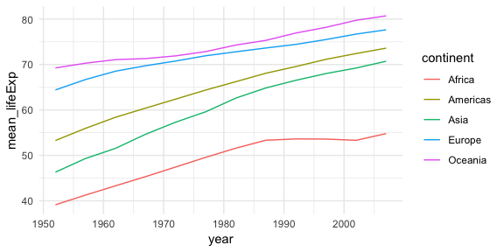

Slide 11
Reshaping: gather and spread (long<->wide)

Slide 12
Is this data long or wide?
dat<-gapminder%>% group_by(continent, year)%>% summarise(mean_lifeExp = mean(lifeExp)) head(dat)
## # A tibble: 6 x 3 ## # Groups: continent [1] ## continent year mean_lifeExp ## <fct> <int> <dbl> ## 1 Africa 1952 39.1 ## 2 Africa 1957 41.3 ## 3 Africa 1962 43.3 ## 4 Africa 1967 45.3 ## 5 Africa 1972 47.5 ## 6 Africa 1977 49.6

Slide 13
Use spread() to make it wide by continent
dat_wide<-dat%>% spread(key = continent, value = mean_lifeExp) head(dat_wide)
## # A tibble: 6 x 6 ## year Africa Americas Asia Europe Oceania ## <int> <dbl> <dbl> <dbl> <dbl> <dbl> ## 1 1952 39.1 53.3 46.3 64.4 69.3 ## 2 1957 41.3 56.0 49.3 66.7 70.3 ## 3 1962 43.3 58.4 51.6 68.5 71.1 ## 4 1967 45.3 60.4 54.7 69.7 71.3 ## 5 1972 47.5 62.4 57.3 70.8 71.9 ## 6 1977 49.6 64.4 59.6 71.9 72.9

Slide 14
Use spread() to make it wide by year
dat_wide<-dat%>% spread(key = year, value = mean_lifeExp) head(dat_wide)
## # A tibble: 5 x 13 ## # Groups: continent [5] ## continent `1952` `1957` `1962` `1967` `1972` `1977` `1982` `1987` `1992` ## <fct> <dbl> <dbl> <dbl> <dbl> <dbl> <dbl> <dbl> <dbl> <dbl> ## 1 Africa 39.1 41.3 43.3 45.3 47.5 49.6 51.6 53.3 53.6 ## 2 Americas 53.3 56.0 58.4 60.4 62.4 64.4 66.2 68.1 69.6 ## 3 Asia 46.3 49.3 51.6 54.7 57.3 59.6 62.6 64.9 66.5 ## 4 Europe 64.4 66.7 68.5 69.7 70.8 71.9 72.8 73.6 74.4 ## 5 Oceania 69.3 70.3 71.1 71.3 71.9 72.9 74.3 75.3 76.9 ## # … with 3 more variables: `1997` <dbl>, `2002` <dbl>, `2007` <dbl>

Slide 15
Use gather() to make wide data long
dat_long<-dat_wide%>% gather(key = "year", value = "mean_lifeExp", "1952", "1957", "1962", "1967", "1972", "1977", "1982", "1992", "1997", "2002", "2007") head(dat_long)
## # A tibble: 6 x 4 ## # Groups: continent [5] ## continent `1987` year mean_lifeExp ## <fct> <dbl> <chr> <dbl> ## 1 Africa 53.3 1952 39.1 ## 2 Americas 68.1 1952 53.3 ## 3 Asia 64.9 1952 46.3 ## 4 Europe 73.6 1952 64.4 ## 5 Oceania 75.3 1952 69.3 ## 6 Africa 53.3 1957 41.3

Slide 16
Use gather() to make wide data long with less code
dat_long<-dat_wide%>% gather(key = "year", value = "mean_lifeExp", -continent) head(dat_long)
## # A tibble: 6 x 3 ## # Groups: continent [5] ## continent year mean_lifeExp ## <fct> <chr> <dbl> ## 1 Africa 1952 39.1 ## 2 Americas 1952 53.3 ## 3 Asia 1952 46.3 ## 4 Europe 1952 64.4 ## 5 Oceania 1952 69.3 ## 6 Africa 1957 41.3

Slide 17
Break

Slide 18
Binary/Bernoulli data

Slide 19
Variables are sampled from probability distributions
Recall that a normally distributed random variable $y$ with mean $μ$ and variance $σ^{2}$ can be expressed as:
$$y∼Normal(μ,σ^{2})$$

Slide 20
Parameters and shape
norm_sim<-rnorm(10000, mean = 0, sd = 1) qplot(norm_sim) + coord_cartesian(xlim = c(-10,10))

Slide 21
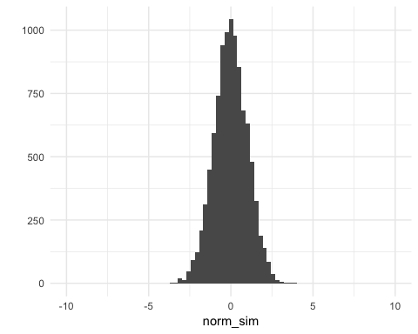

Slide 22
Parameters and shape
norm_sim<-rnorm(10000, mean = 0, sd = 3) qplot(norm_sim) + coord_cartesian(xlim = c(-10,10))

Slide 23
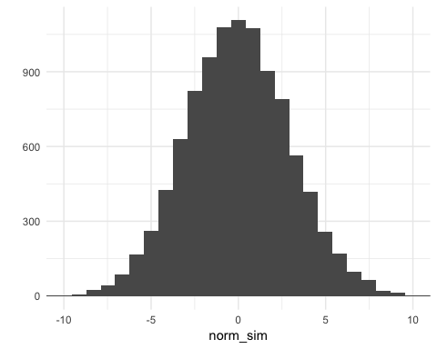

Slide 24
Parameters and shape
norm_sim<-rnorm(10000, mean = 2, sd = 3) qplot(norm_sim) + coord_cartesian(xlim = c(-10,10))

Slide 25
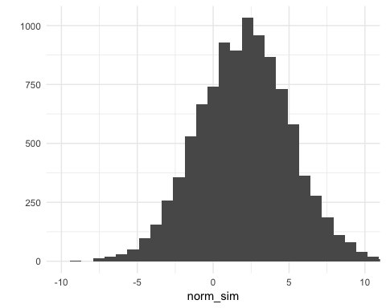

Slide 26
All regressions model outcomes as random variables
Recall that a linear regression treats $y$ as a random variable with mean expectation such that each $y_{i}$ can be modeled as
$$y_{i}=Xβ+ε$$
or
$$y∼Normal(Xβ,σ^{2})$$
So each observation $y_{i}$ is treated as a draw from a Normal distribution with $μ=Xβ$ and variance $σ^{2}$.

Slide 27
Does one size fit all?
Does the normal model describe all phenomena we study well?

Slide 28
An alternative: the Bernoulli distribution for binary data
The Bernoulli distribution for random variable $X$
$$\text{Pr}(X=1)=p=1−\text{Pr}(X=0)$$
Paramterization:
$$y∼Bernoulli(p)$$

Slide 29
Properties of random binary variables
If $y$ is an i.i.d. Bernoulli variable with probability $p$:
$$y∼Bernoulli(p)$$
$$E(y)=p$$
$$Var(y)=p(1−p)$$

Slide 30
Recall the central limit theorem

Slide 31
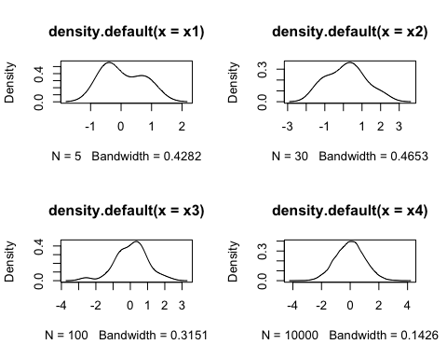

Slide 32
A Bernoulli variable as a coin flip
flip_n_coins<-function(n){ rbinom(n, 1, 0.5) } flip_n_coins(10)
## [1] 1 0 0 0 0 0 1 0 1 0

Slide 33
What does the distribution of a binary variable look like?
y<-flip_n_coins(5) hist(y) abline(v = mean(y), col = 2)

Slide 34
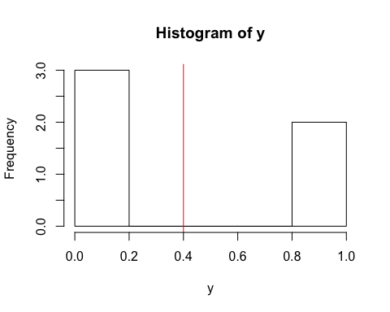

Slide 35
What does the distribution of a binary variable look like?
y<-flip_n_coins(10) hist(y) abline(v = mean(y), col = 2)

Slide 36
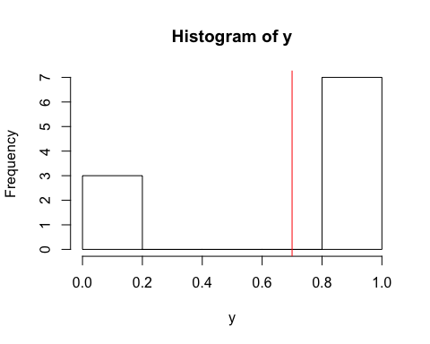

Slide 37
What does the distribution of a binary variable look like?
y<-flip_n_coins(100) hist(y) abline(v = mean(y), col = 2)

Slide 38
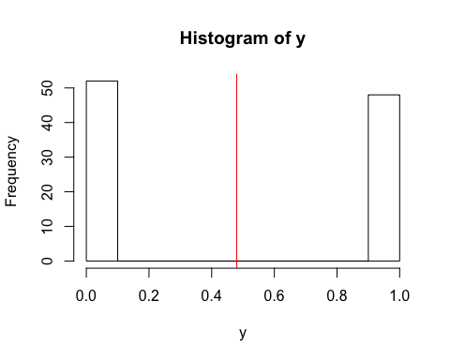

Slide 39
What does the distribution of a binary variable look like?
y<-flip_n_coins(100000) hist(y) abline(v = mean(y), col = 2)

Slide 40
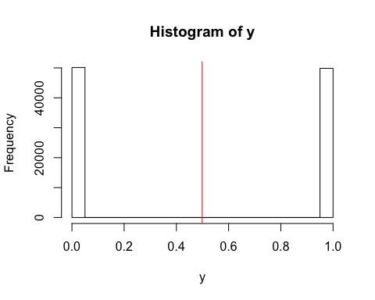

Slide 41
Recap
A binary variable $y$ takes on the values 1 or 0, with probability
$$Pr(y=1)=p$$

