Slide 1
InstantCITY
Group 1
Fabian Bloch & Christopher Mahn
HafenCity University Hamburg

Slide 3
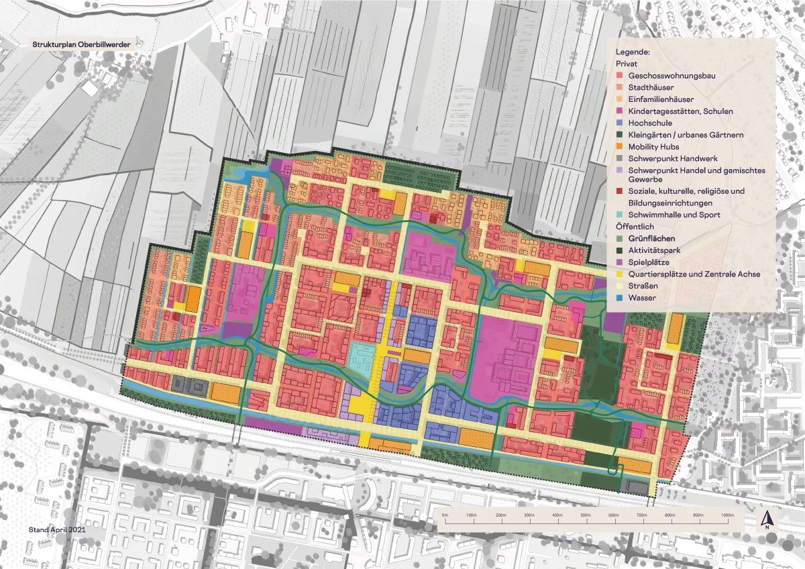
Approach - Goal
studying original repository ✅
exploring the provided examples ✅
digitize street layout of Oberbillwerder ⭕
train GAN on new city developments in Hamburg ⭕
apply GAN street layout of Oberbillwerder ❌
visually compare buildings with masterplan ❌
✅= done, ⭕= in progress, ❌= outstanding

