Slide 1


Homework Exercise 02
Geodetic Earth Observation, WS 2022/23
Christopher Mahn, Silas Teske, Joshua Wolf

Slide 2
Structure of the presentation
Introduction
Data processing
Selection of a region of interest
Pre-processing the monthly solutions
Calculation of unfiltered equivalent water heights (EWH)
Filtering of the spherical harmonic coefficients
Computation of a time series of region averages
Interpolation of missing GRACE months
Estimation of linear mass trend
Results and discussion
Conclusion and perspective
Bibliography
Christopher Mahn, Silas Teske, Joshua Wolf

Slide 3
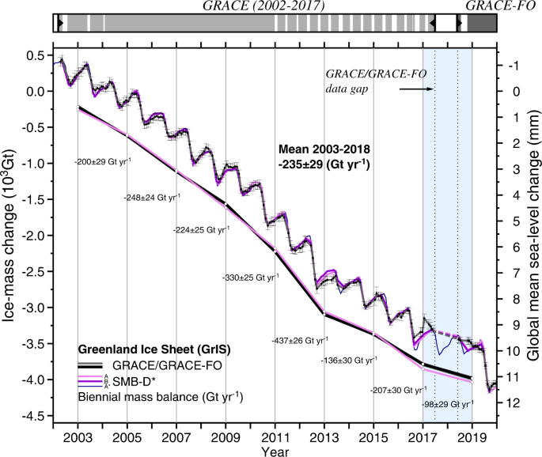
1. Introduction
The continental mass balance changes constantly
Seasonal changes
Changes due to global warming
Changes due to other human activity
These mass changes can be observed using 3 methods
input-output method
volumetric method
gravimetric method
Sasgen et al. (2020)
Christopher Mahn, Silas Teske, Joshua Wolf

Slide 4
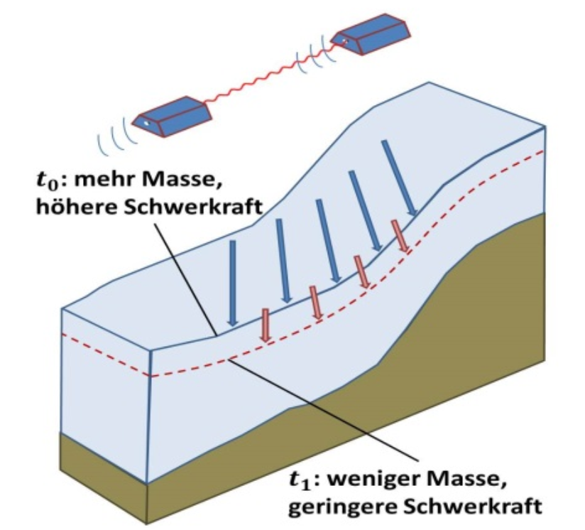
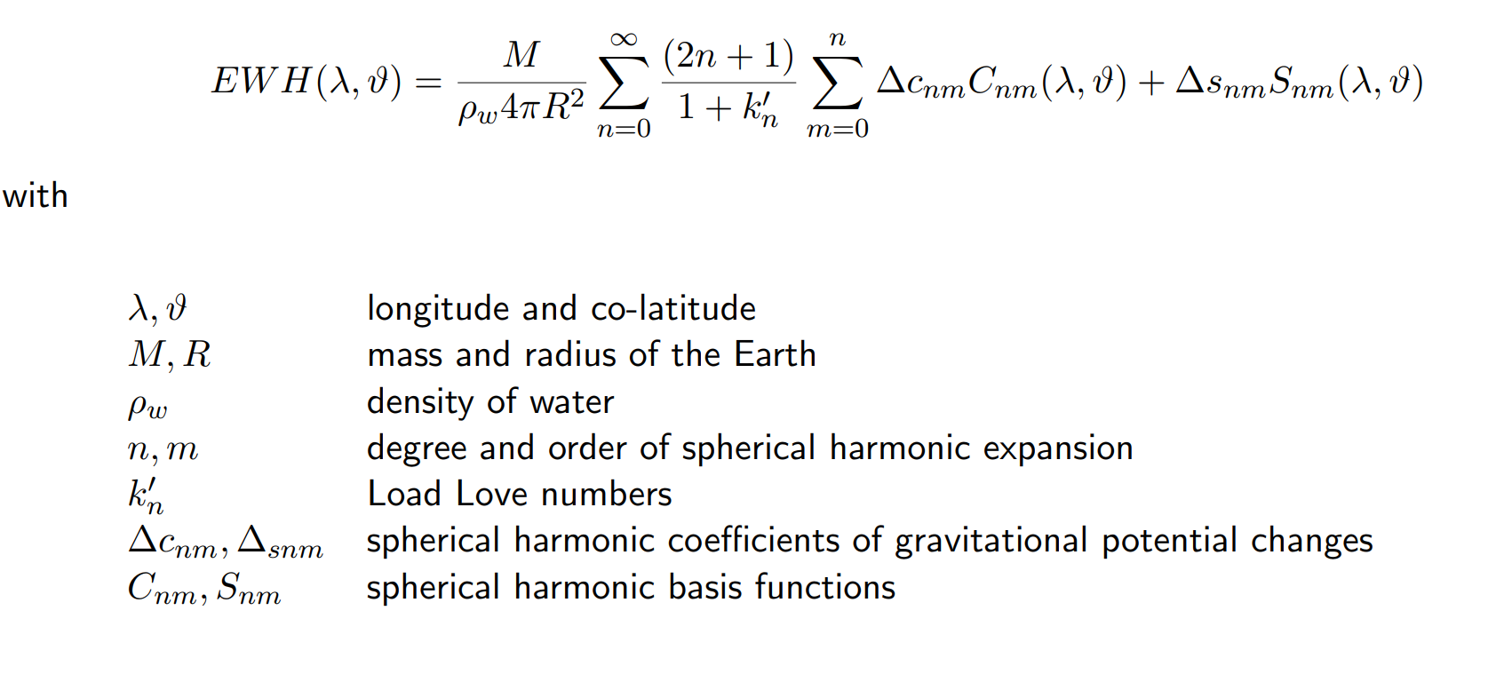
1. Introduction
Mass changes can be observed using gravimetric methods
t0 = more mass = higher gravitational force
t1 = less mass = lower gravitational force
Equivalent water heights (EWH)
Eicker (2022)
Christopher Mahn, Silas Teske, Joshua Wolf

Slide 5
1. Introduction
Necessary Steps while processing the data:
Removal of the static gravity field
Calculation of unfiltered equivalent water heights
Using the load love numbers for approximating the glacial isostatic adjustment (GIA)
Filtering of the spherical harmonic coefficients
Gaussian filter with various filter radii choose one
Computation of a time series of region averages
Interpolation of missing GRACE months by inserting the average of the previous and the successive mean EWH
Estimation of linear mass trend of the interpolated series
Christopher Mahn, Silas Teske, Joshua Wolf

Slide 6
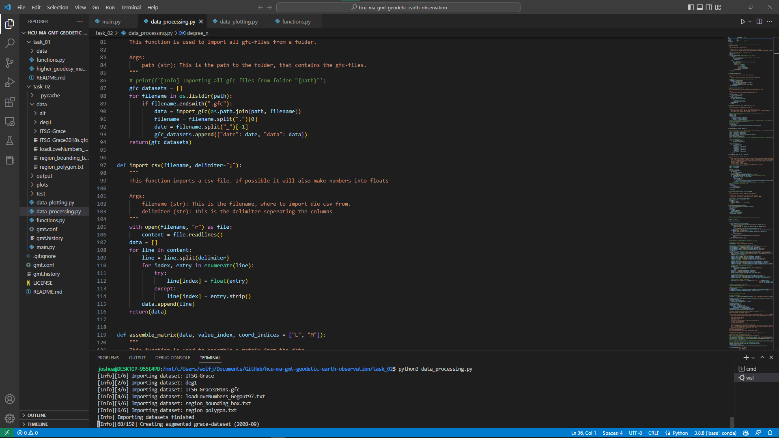
2. Data processing
Python scripts and a library for different sub-tasks:
main.py
data_processing.py
functions.py
data_plotting.py
Christopher Mahn, Silas Teske, Joshua Wolf

Slide 7
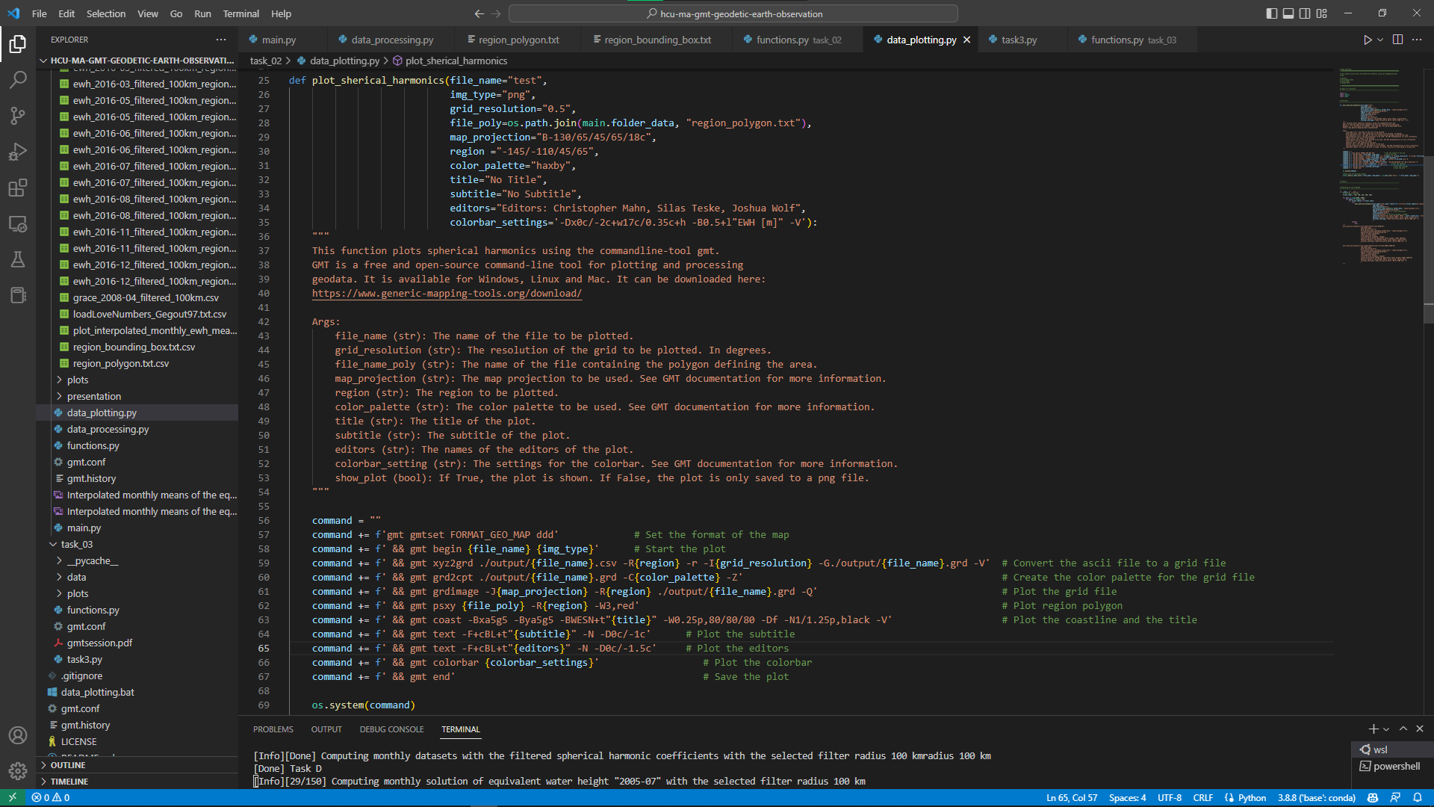
2. Data processing
Python scripts and a library for different sub-tasks:
main.py
data_processing.py
functions.py
data_plotting.py
Christopher Mahn, Silas Teske, Joshua Wolf

Slide 8
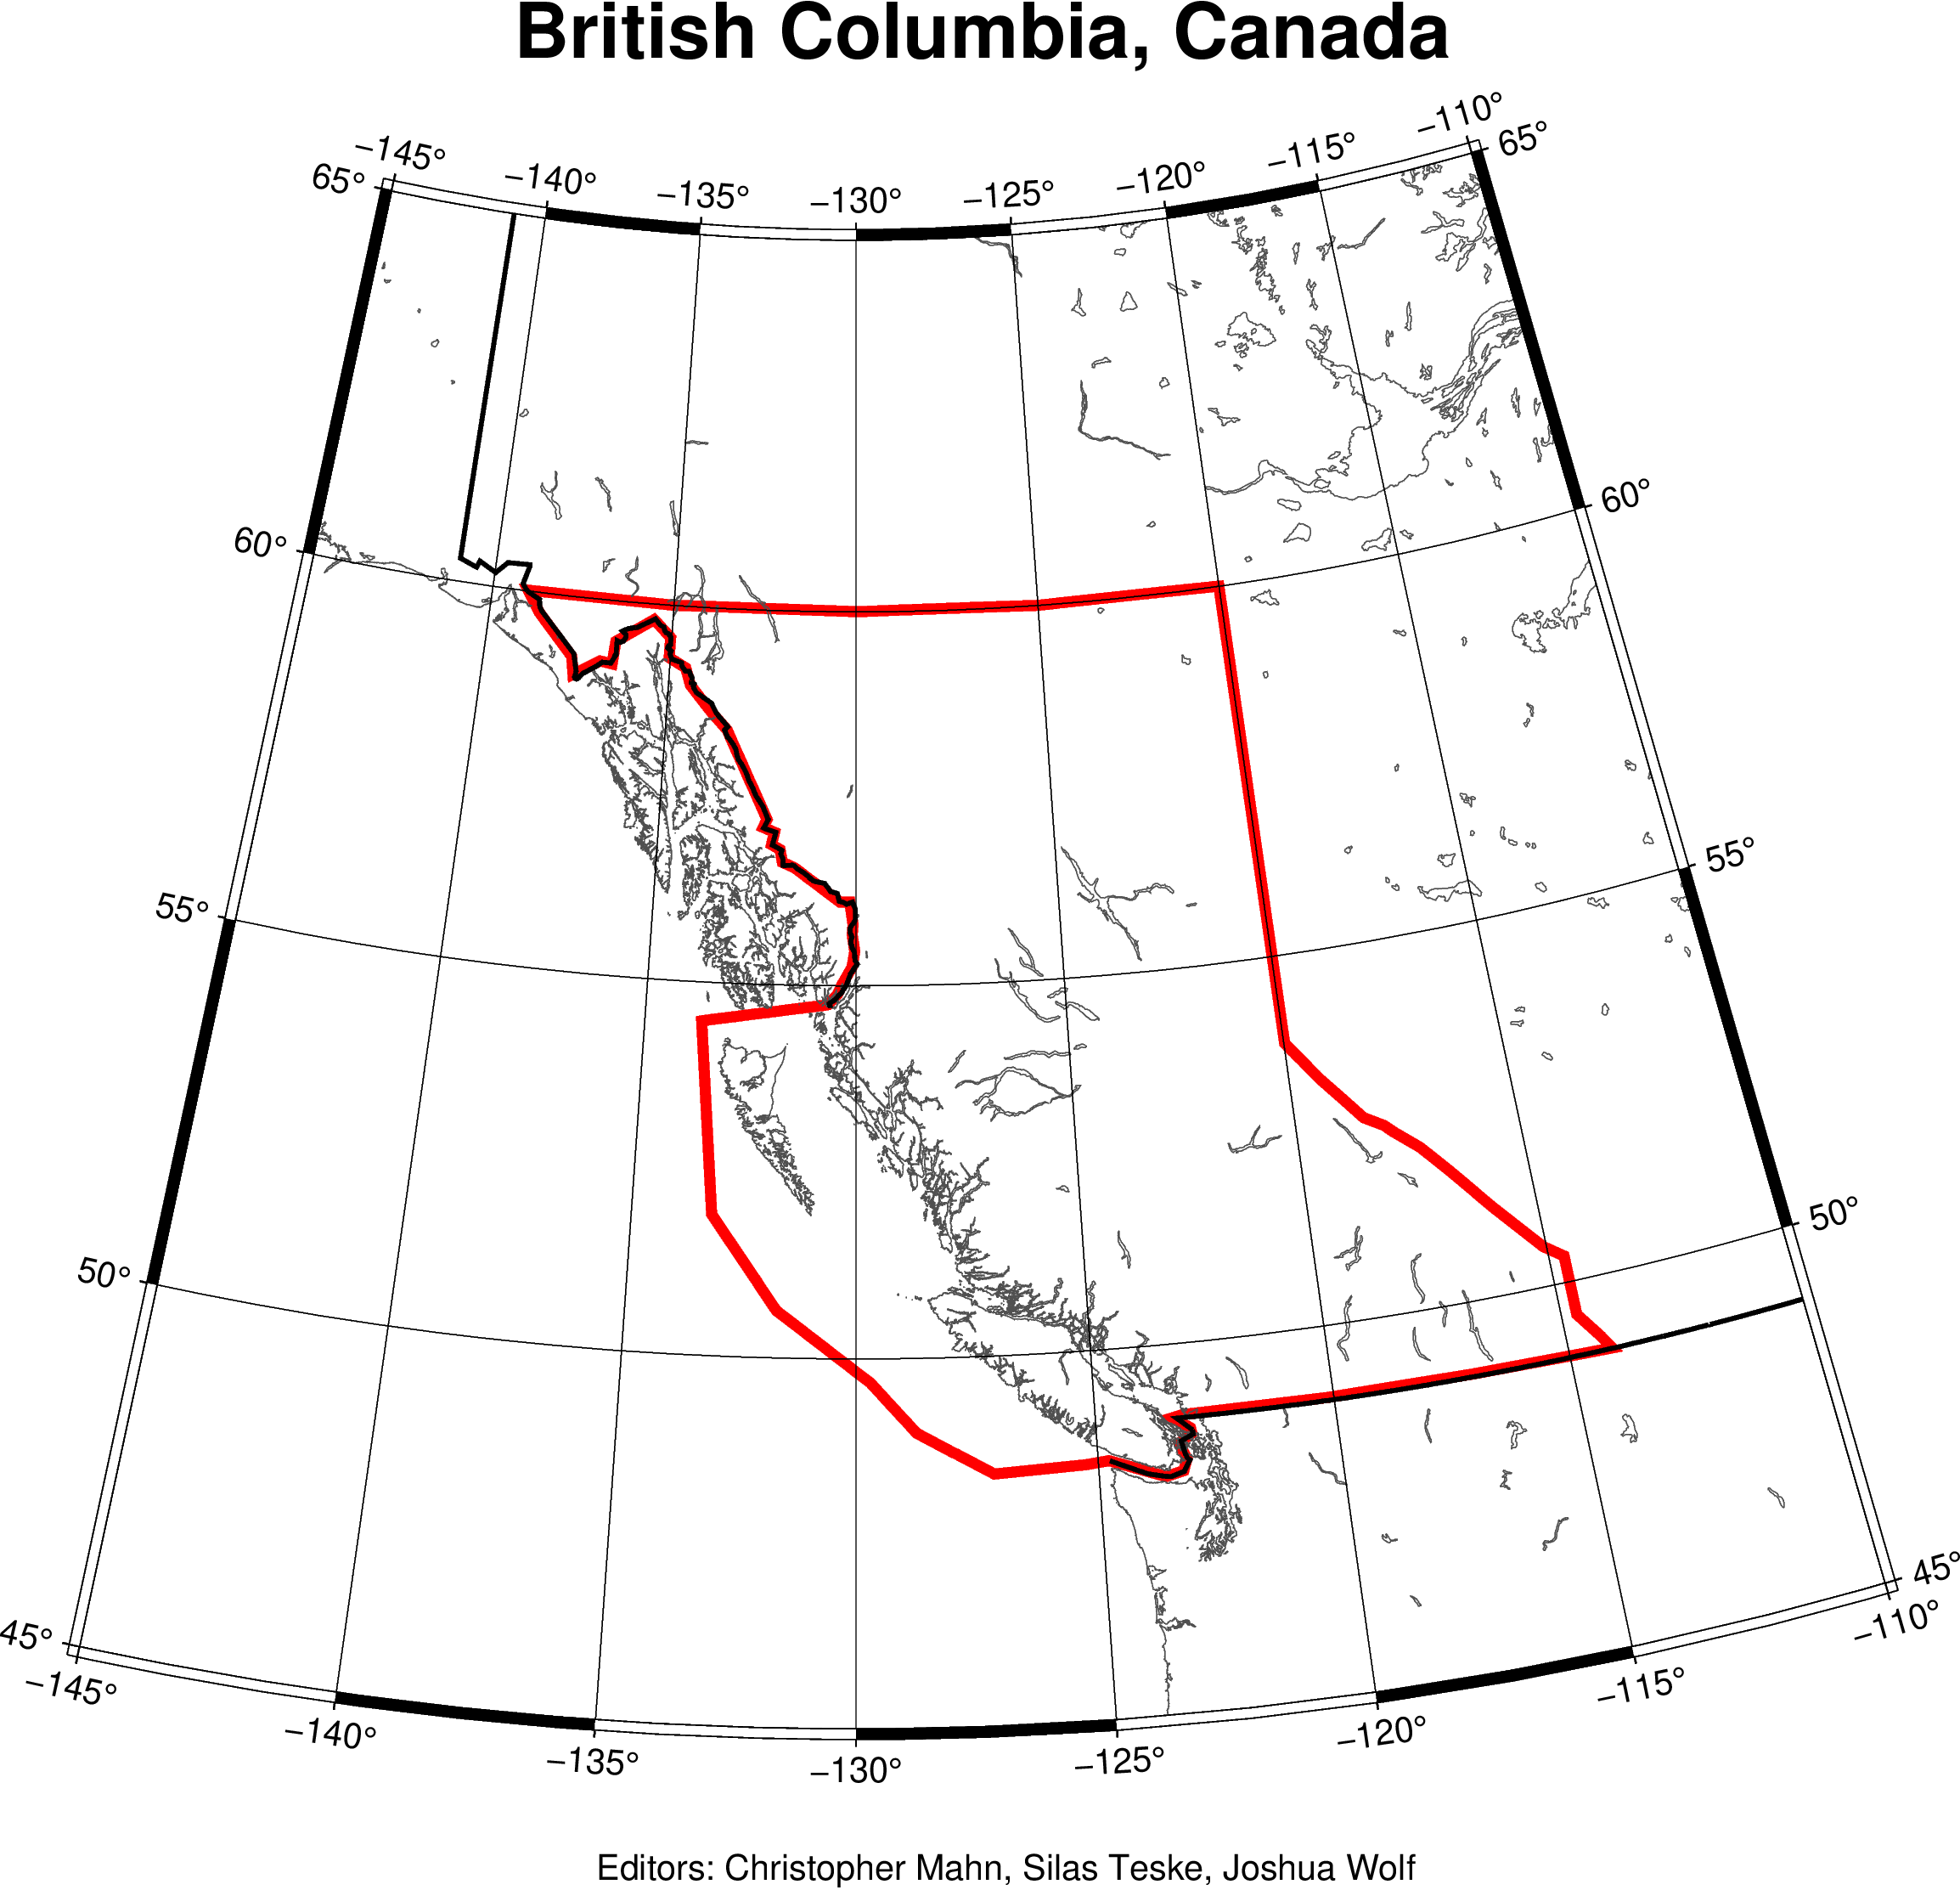
a) Selection of a region of interest
Canadian Province of British Columbia

Slide 9
b) Pre-processing the monthly solutions
Removed the static gravity field ITSG-Grace2018s.gfc
Christopher Mahn, Silas Teske, Joshua Wolf

Slide 10
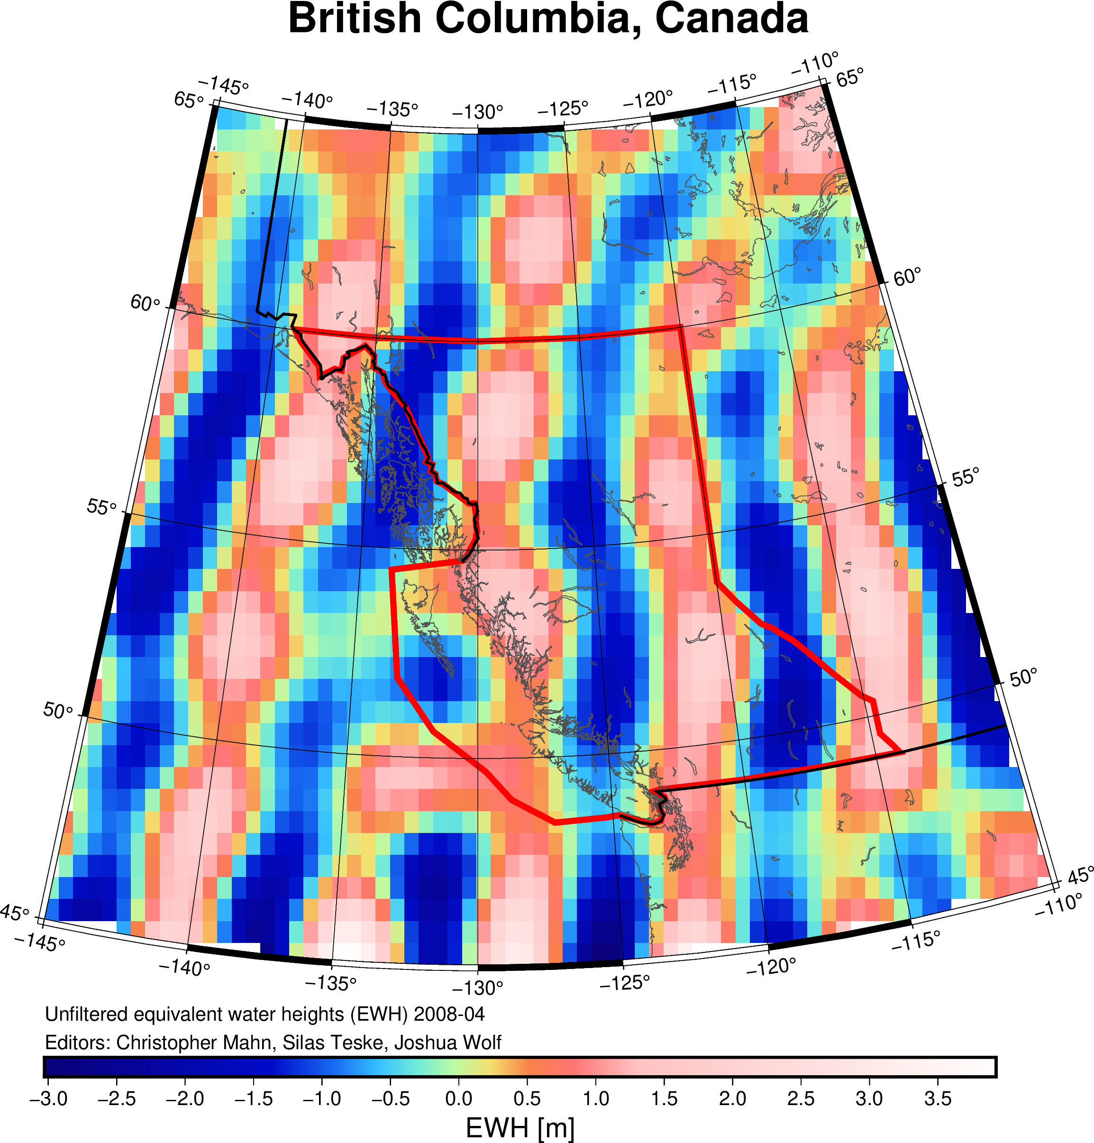
c) Calculation of unfiltered EWH
P
Christopher Mahn, Silas Teske, Joshua Wolf

Slide 11
d) Filtering of the spherical harmonic coefficients
P
Christopher Mahn, Silas Teske, Joshua Wolf

Slide 12
e) Computation of a time series of region averages
P
Christopher Mahn, Silas Teske, Joshua Wolf

Slide 13
f) Interpolation of missing GRACE months
P
Christopher Mahn, Silas Teske, Joshua Wolf

Slide 14
g) Estimation of linear mass trend
P
Christopher Mahn, Silas Teske, Joshua Wolf

Slide 15
3. Results and discussion
P
Christopher Mahn, Silas Teske, Joshua Wolf

Slide 16
4. Conclusion and perspective
P
Christopher Mahn, Silas Teske, Joshua Wolf

Slide 17
Bibliography
Sasgen, I., Wouters, B., Gardner, A.S. et al. (2020): Return to rapid ice loss in Greenland and record loss in 2019 detected by the GRACE-FO satellites. Communications Earth & Environment 1 (8). Springer Nature.
Christopher Mahn, Silas Teske, Joshua Wolf

Slide 18
1. Introduction ????
Mass changes can be observed using gravimetric methods
t0 = more mass = higher gravitational force
t1 = less mass = lower gravitational force
Problem: Glacial isostatic adjustment (GIA)
Viscoelastic reaction of earth‘s crust to changing loading masses
GIA is difficult to model
Ice cover of last glacial maximum is not exactly known
Dependent on the structure and physical characteristics of the earth’s mantle and crust
Eicker (2022)
Christopher Mahn, Silas Teske, Joshua Wolf

