Slide 1
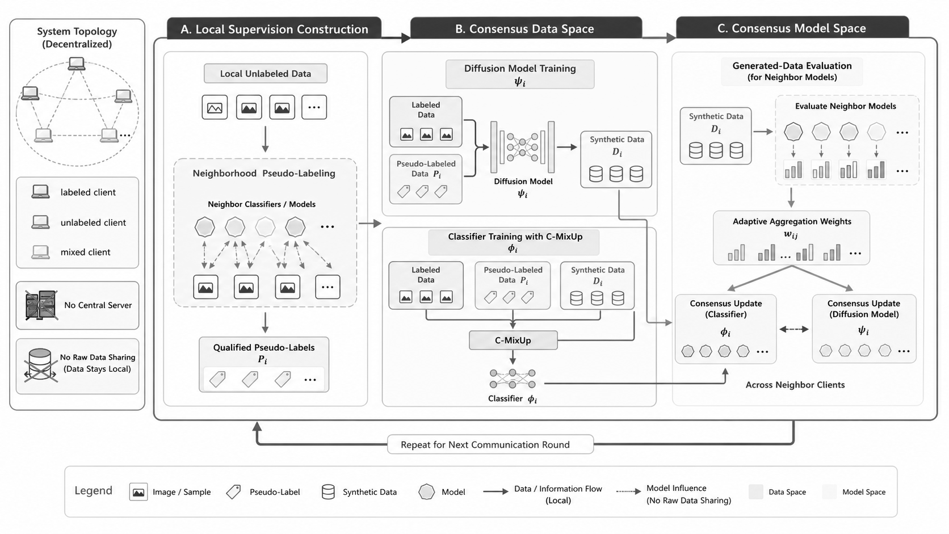
Gray Map of Selected Final Reference
Slide 1: grayscale map generated from the S6-FINAL-SELECT selected final architecture figure
Reference: outputs/S5-candidate-images/candidate-D1-A.png. SVG elements are extracted/redrawn from outputs/S7-foreground-image/rimg-no-texture-final-01.png.

Slide 2
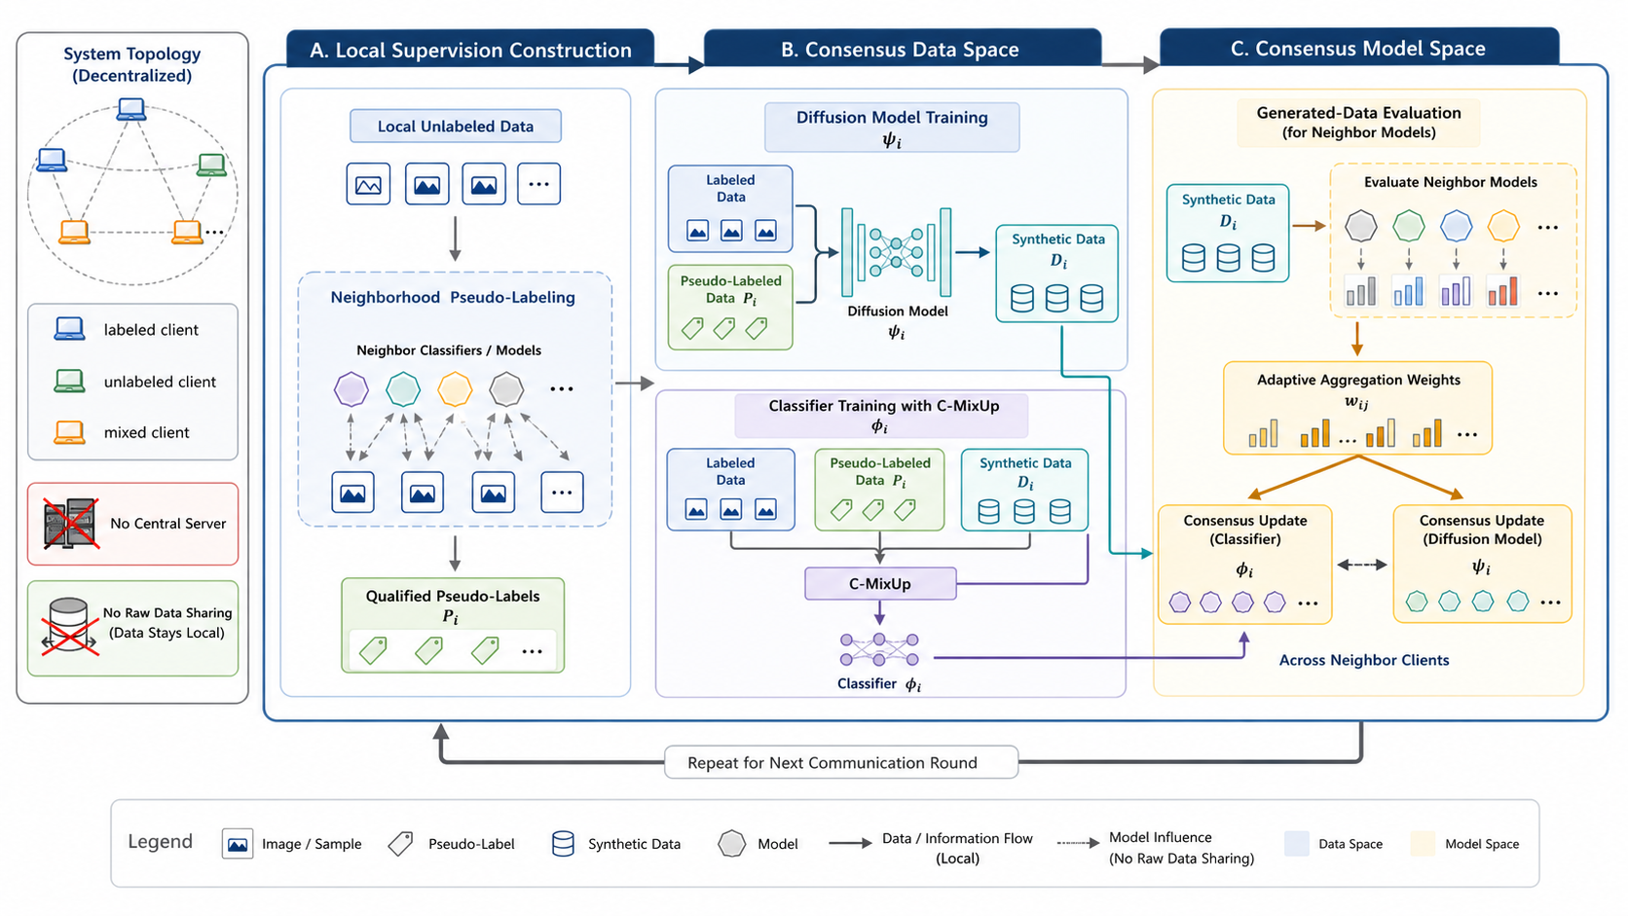
Selected Final Reference
Slide 2: S6-FINAL-SELECT selected final architecture figure original
22 standalone SVG elements follow. Titles and filenames are live PPT text; SVG media are embedded in the PPTX package.

Slide 3
Client and data elements
7 movable embedded SVG elements
1
2
3
4
Labeled client token
Unlabeled client token
Mixed client token
Local data cylinder
labeled_client_token.svg
unlabeled_client_token.svg
mixed_client_token.svg
local_data_cylinder.svg
5
6
7
Generated data cylinder
Sample card stack
Qualified pseudo-label tag
generated_data_cylinder.svg
sample_card_stack.svg
pseudo_label_tag.svg

Slide 4
Privacy and topology elements
5 movable embedded SVG elements
1
2
3
4
Decentralized topology
Neighbor model influence graph
Privacy shield lock
No central server icon
decentralized_topology.svg
neighbor_model_graph.svg
privacy_shield_lock.svg
no_server_icon.svg
5
No raw data sharing icon
no_raw_data_sharing.svg

Slide 5
Model and training elements
5 movable embedded SVG elements
1
2
3
4
Classifier model glyph
Diffusion model glyph
Consensus MixUp overlap
Synthetic token cluster
classifier_model.svg
diffusion_model.svg
c_mixup_overlap.svg
token_cluster.svg
5
Round-loop token
round_loop_token.svg

Slide 6
Evaluation and consensus elements
5 movable embedded SVG elements
1
2
3
4
Generated-data evaluation chart
Generated-data evaluation clipboard
Adaptive weight bars
Classifier consensus cluster
evaluation_barchart.svg
generated_eval_clipboard.svg
adaptive_weight_bars.svg
classifier_consensus_cluster.svg
5
Diffusion consensus cluster
diffusion_consensus_cluster.svg

Slide 7
Complete SVG Element Matrix
Generated from S8-SVG-PPT SVG catalog spec

