Slide 1
2022 CDC Clinical Practice Guideline
CDS for CDC Project
Semi-structured Artifact Collection
v.2

Slide 2
CDC Opioid Prescribing Guideline Trigger Overview
Patient select
Order select
Order sign
Recommendation 1
Recommendation 2
Recommendation 3
Recommendation 4
Recommendation 5
Recommendation 6
Recommendation 7
Recommendation 8
Recommendation 9
Recommendation 10
Recommendation 11
Recommendation 12
Notes:
Orange shapes represent trigger approaches currently available.

Slide 3
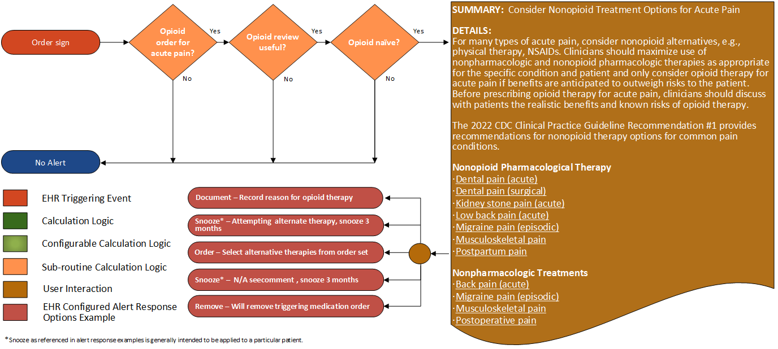
Recommendation 1
Nonopioid therapies are at least as effective as opioids for many common types of acute pain. Clinicians should maximize use of nonpharmacologic and nonopioid pharmacologic therapies as appropriate for the specific condition and patient and only consider opioid therapy for acute pain if benefits are anticipated to outweigh risks to the patient. Before prescribing opioid therapy for acute pain, clinicians should discuss with patients the realistic benefits and known risks of opioid therapy (recommendation category: B; evidence type: 3)
Notes:
Recommendation 1: Nonopioid therapies are at least as effective as opioids for many common types of acute pain. Clinicians should maximize use of nonpharmacologic and nonopioid pharmacologic therapies as appropriate for the specific condition and patient and only consider opioid therapy for acute pain if benefits are anticipated to outweigh risks to the patient. Before prescribing opioid therapy for acute pain, clinicians should discuss with patients the realistic benefits and known risks of opioid therapy (recommendation category: B; evidence type: 3).

Slide 4
Recommendation 1
Recommendation 1
Definition | Answer to Proceed | Details | Data (Terminology) Requirement
Opioid order for acute pain? | Yes | See sub-routine 5
Opioid review useful? | Yes | See sub-routine 1
Opioid naïve? | Yes | See sub-routine 2
Notes:
Recommendation 1: Nonopioid therapies are at least as effective as opioids for many common types of acute pain. Clinicians should maximize use of nonpharmacologic and nonopioid pharmacologic therapies as appropriate for the specific condition and patient and only consider opioid therapy for acute pain if benefits are anticipated to outweigh risks to the patient. Before prescribing opioid therapy for acute pain, clinicians should discuss with patients the realistic benefits and known risks of opioid therapy (recommendation category: B; evidence type: 3).

Slide 5
Recommendation 1
Recommendation 1 Guidance
SUMMARY: Consider Nonopioid Treatment Options for Acute Pain DETAILS: For many types of acute pain, clinicians should maximize the use of nonpharmacologic (for example, physical therapy) and nonopioid pharmacologic therapies (for example, NSAIDs), as appropriate for the specific condition and patient and only consider opioid therapy for acute pain if benefits are anticipated to outweigh risks to the patient. Before prescribing opioid therapy for acute pain, clinicians should discuss with patients the realistic benefits and known risks of opioid therapy. The 2022 CDC Clinical Practice Guideline Recommendation #1 provides recommendations for non-opioid therapy options for common pain conditions. Nonopioid Pharmacological Therapy Dental pain (acute) Dental pain (surgical) Kidney stone pain (acute) Low back pain (acute) Migraine pain (episodic) Musculoskeletal pain Postpartum pain Nonpharmacologic Treatments Back pain (acute) Migraine pain (episodic) Musculoskeletal pain Postoperative pain
Notes:
Recommendation 1: Nonopioid therapies are at least as effective as opioids for many common types of acute pain. Clinicians should maximize use of nonpharmacologic and nonopioid pharmacologic therapies as appropriate for the specific condition and patient and only consider opioid therapy for acute pain if benefits are anticipated to outweigh risks to the patient. Before prescribing opioid therapy for acute pain, clinicians should discuss with patients the realistic benefits and known risks of opioid therapy (recommendation category: B; evidence type: 3).

Slide 6
Sub-routine 1: Opioid Review Useful
Notes:
Sub-Routine 1: Opioid Review Useful. Multiple recommendations use this sub-routine. The primary goal is to determine if the patient has a condition indicating end-of-life, thereby indicating that opioids use is most likely due to palliative care. The sub-routine provides several options that individual sites may decide to implement but it provides local implementations to address only those data elements deemed appropriate by local clinical review panels and for which workflow to obtain the required structured data are feasible and reliable. The six data retrievals determine (a) age < 18 years, and five data retrievals that represent indication of (b) sickle cell disease, (b) evidence of sickle cell anemia, (c) conditions indicating limited life expectancy, (d) an order for opioid agents used for end of life treatment which may be configured for local use, (e) an order for palliative care, and (f) malignancies that indicate end-stage disease with options for configuring a local system for more restrictive set of terminal cancer diagnoses, or a more expansive set of cancer diagnoses. Information from pilots suggests that some physicians may not trust EHR data to determine disease activity; hence, in some implementations, providers may prefer to manually request to turn off alerts for a given patient rather than systematically excluding all patients with potentially active disease. Further, local implementations may wish to change age criteria based on local factors and local consideration.

Slide 7
Sub-routine 1: Opioid Review Useful
Sub-routine 1: Opioid Review Useful
Definition | Answer to Proceed | Details | Data (Terminology) Requirement
Age < 18 years? | No | Calculate age from date of birth; exclude patients with age less than 18 years at the time of the prescription | Date of birth
Evidence of sickle cell disease | No | Look for patients with a diagnosis or problem list entry indicating sickle cell disease | Sickle cell disease condition
Limited life expectancy conditions present? | No | Look for documented findings consistent with those listed in the limited life expectancy value set (terminal illness, bad prognosis, pre-terminal) | Limited life expectancy conditions
Order for therapies indicating end of life care in past 90 days? | No | Look for patients with an existing order for therapies indicating end of life care written within past 90 days | Therapies indicating end of life care
Active cancer treatment? | No | See sub-routine 3 | See sub-routine 3
Conditions Likely Terminal for opioid prescribing present? | No | Look for patients with active conditions in the value set end-of-life-conditions | Conditions likely terminal for opioid prescribing
Notes:
Sub-Routine 1: Opioid Review Useful. Multiple recommendations use this sub-routine. The primary goal is to determine if the patient has a condition indicating end-of-life, thereby indicating that opioids use is most likely due to palliative care. The sub-routine provides several options that individual sites may decide to implement but it provides local implementations to address only those data elements deemed appropriate by local clinical review panels and for which workflow to obtain the required structured data are feasible and reliable. The six data retrievals determine (a) age < 18 years, and five data retrievals that represent indication of (b) sickle cell disease, (b) evidence of sickle cell anemia, (c) conditions indicating limited life expectancy, (d) an order for opioid agents used for end of life treatment which may be configured for local use, (e) an order for palliative care, and (f) malignancies that indicate end-stage disease with options for configuring a local system for more restrictive set of terminal cancer diagnoses, or a more expansive set of cancer diagnoses. Information from pilots suggests that some physicians may not trust EHR data to determine disease activity; hence, in some implementations, providers may prefer to manually request to turn off alerts for a given patient rather than systematically excluding all patients with potentially active disease. Further, local implementations may wish to change age criteria based on local factors and local consideration.

Slide 8
Sub-routine 2: Opioid Naïve
Notes:
Sub-routine 2: Opioid naive. This sub-routine searches for evidence of opioid usage within the page 90-days (based on evidence of prescriptions, dispensing events or patient-reported opioid usage. Individual implementing organizations may have access to all or, only some of these data sources; therefore, local implementations may only use parts of this sub-routine. Those for whom the expression concludes true are considered opioid naïve; those for whom the expression concludes false are considered more chronic. Local implementations may choose to consider frequency for review of prior opioid use with shorter or longer time frames than 90 days.
Note: Implement one global configuration point to set all past medication queries at each particular site: “Can the implementing EHR support queries for past medications by date range? Yes or No”
An evaluation to determine if a patient is opioid naive is not possible when a EHR system does not support queries for past medications by date range.

Slide 9
Sub-routine 2: Opioid Naive
Sub-routine 2: Opioid Naive
Definition | Answer to Proceed | Details | Data (Terminology) Requirement
Opioid analgesics with ambulatory misuse potential prescription in past 90 days excluding the last 24 hours | No | Look for an existing prescription (order) for opioid that is in the value set for opioid with ambulatory misuse potential authored within the past 90 days (excluding the last 24 hours) | Opioid analgesics with ambulatory misuse potential
Opioid analgesics with ambulatory misuse potential reported as being taken excluding the last 24 hour* | No | Look for evidence of active medication on the medication list that is in the value set for opioid with ambulatory care misuse potential (excluding the last 24 hours) | Opioid analgesics with ambulatory misuse potential
Opioid analgesics with ambulatory misuse potential dispensing event in past 90 days excluding the last 24 hours* | No | Look for evidence of a dispensing event for medication that is in the value set for opioid with ambulatory use potential occurring within the past 90 days (excluding the last 24 hours) | Opioid analgesics with ambulatory misuse potential
* Future consideration: Current algorithm addresses only orders (prescriptions).
1 – Implement one global configuration point to set all past medication queries at each particular site: “Can the implementing EHR support queries for past medications by date range? Yes or No”. An evaluation to determine if a patient is opioid naive is not possible when a EHR system does not support queries for past medications by date range.
2 – orders use RxNorm, but medication lists and dispensed medication will require an NDC value set and/or local mapping of NDC to RxNorm to enable this element
Notes:
Sub-routine 2: Opioid naive. This sub-routine searches for evidence of opioid usage within the page 90-days (based on evidence of prescriptions, dispensing events or patient-reported opioid usage. Individual implementing organizations may have access to all or, only some of these data sources; therefore, local implementations may only use parts of this sub-routine. Those for whom the expression concludes true are considered opioid naïve; those for whom the expression concludes false are considered more chronic.
Note: Implement one global configuration point to set all past medication queries at each particular site: “Can the implementing EHR support queries for past medications by date range? Yes or No”
An evaluation to determine if a patient is opioid naive is not possible when a EHR system does not support queries for past medications by date range.

Slide 10
Sub-routine 3: Active Cancer Treatment
Notes:
Sub-Routine 3: Active Cancer Treatment. The sub-routine requires two office visits during the previous 12 months to assure the patient is a member of the practice. Further, it addresses office visits with an oncology specialist, OR a visit for a known malignant cancer condition defined by the CDC value set.

Slide 11
Sub-routine 3: Active Cancer Treatment
Sub-routine 3: Active Cancer Treatment
Definition | Answer to Proceed | Details | Data (Terminology) Requirement
Two office visits within the past 12 months | No | Look for a minimum of two distinct encounters within 12 months of the date of the current visit for which each of the following is true: the encounter diagnosis (primary or secondary or co-morbidity diagnosis) is listed in the CDC Malignant Cancer Conditions value set | Office Visit
Office visits with an oncology specialist present | No | The encounter is performed by an oncologist as defined in the oncology specialty designations using the National Uniform Claim Committee (NUCC) classifications. | Oncology specialty designations (NUCC)
Office visits including CDC malignant cancer condition | No | The encounter diagnosis (primary or secondary or co-morbidity diagnosis) is listed in the CDC Malignant Cancer Conditions value set | CDC malignant cancer conditions
Notes:
Sub-Routine 3: Active Cancer Treatment. The sub-routine requires two office visits during the previous 12 months to assure the patient is a member of the practice. Further, it addresses office visits with an oncology specialist, OR a visit for a known malignant cancer condition defined by the CDC value set.

Slide 12
Sub-routine 4: Opioid order for subacute or chronic pain
Notes:
Sub-Routine 4: Opioid Order for Chronic Pain. The algorithm defines a patient with chronic pain as a patient for whom practitioners prescribe opioid analgesics for a duration greater than or equal to 28 days.

Slide 13
Sub-routine 4: Opioid order for subacute or chronic pain
Sub-routine 4: Opioid order for subacute or chronic pain
Definition | Answer to Proceed | Details | Data (Terminology) Requirement
Order for opioid analgesic with expected supply duration >= 28 days | Yes | Order for opioid analgesics with ambulatory misuse potential with a supply duration of >= 28 days Subacute definition = order for opioid analgesics with ambulatory misuse potential with a supply duration of one to two months. Chronic pain definition = order for opioid analgesics with ambulatory misuse potential with a supply duration of >= two months. | Opioid analgesics with ambulatory misuse potential
Notes:
Sub-Routine 4: Opioid Order for Chronic Pain. The algorithm defines a patient with chronic pain as a patient for whom practitioners prescribe opioid analgesics for a duration greater than or equal to 28 days.
Updated 5April2022

Slide 14
Sub-routine 5: For acute pain
Notes:
Sub-Routine 5. For acute pain. The algorithm defines a patient with acute pain as a patient for whom practitioners prescribe opioid analgesics for a duration less than 28 days.

Slide 15
Sub-routine 5: For acute pain
Sub-routine 5: For acute pain
Definition | Answer to Proceed | Details | Data (Terminology) Requirement
Order for opioid analgesics with ambulatory misuse potential of duration < 28 days | Yes | Look for an existing prescription (order) for opioid analgesics with ambulatory misuse potential of duration < 28 days | Opioid analgesics with ambulatory misuse potential
Notes:
Sub-Routine 5. For acute pain. The algorithm defines a patient with acute pain as a patient for whom practitioners prescribe opioid analgesics for a duration less than 28 days.

Slide 16
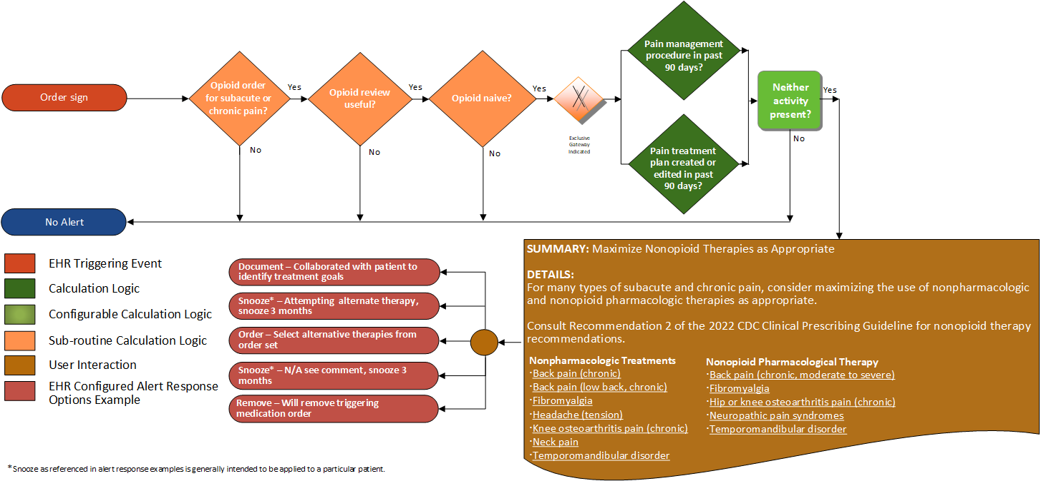
Recommendation 2
Nonopioid therapies are preferred for subacute and chronic pain. Clinicians should maximize use of nonpharmacologic and nonopioid pharmacologic therapies as appropriate for the specific condition and patient and only consider initiating opioid therapy if expected benefits for pain and function are anticipated to outweigh risks to the patient. Before starting opioid therapy for subacute or chronic pain, clinicians should discuss with patients the realistic benefits and known risks of opioid therapy, should work with patients to establish treatment goals for pain and function, and should consider how opioid therapy will be discontinued if benefits do not outweigh risks (recommendation category: A; evidence type: 2).
Notes:
Recommendation 2: Nonopioid therapies are preferred for subacute and chronic pain. Clinicians should maximize use of nonpharmacologic and nonopioid pharmacologic therapies as appropriate for the specific condition and patient and only consider initiating opioid therapy if expected benefits for pain and function are anticipated to outweigh risks to the patient. Before starting opioid therapy for subacute or chronic pain, clinicians should discuss with patients the realistic benefits and known risks of opioid therapy, should work with patients to establish treatment goals for pain and function, and should consider how opioid therapy will be discontinued if benefits do not outweigh risks (recommendation category: A; evidence type: 2).

Slide 17
Recommendation 2
Recommendation 2
Definition | Answer to Proceed | Details | Data (Terminology) Requirement
Opioid order for subacute and chronic pain? | Yes | See sub-routine 4
Opioid review useful? | Yes | See sub-routine 1
Opioid naïve? | Yes | See sub-routine 2
Pain treatment plan created or edited in past 90 days? | No | Look for a pain treatment plan that has been established or edited within the past 90 days (including the day of the visit). The following criteria should be met: the treatment plan has an initiation date or an edited date within the past 90 days. the treatment plan should have been created or reviewed within the past 90 days by the same individual who is writing the new prescription. | Pain treatment plan
Pain management procedure in past 90 days? | No | Look for a pain management procedure (including the procedure to review a pain management treatment plan) that occurred within the past 90 days (including the day of the visit). | Pain management procedure
Notes:
Recommendation 2: Nonopioid therapies are preferred for subacute and chronic pain. Clinicians should maximize use of nonpharmacologic and nonopioid pharmacologic therapies as appropriate for the specific condition and patient and only consider initiating opioid therapy if expected benefits for pain and function are anticipated to outweigh risks to the patient. Before starting opioid therapy for subacute or chronic pain, clinicians should discuss with patients the realistic benefits and known risks of opioid therapy, should work with patients to establish treatment goals for pain and function, and should consider how opioid therapy will be discontinued if benefits do not outweigh risks (recommendation category: A; evidence type: 2).

Slide 18
Recommendation 2
Recommendation 2 Guidance
SUMMARY: Maximize Nonopioid Therapies as Appropriate DETAILS: For many types of subacute and chronic pain, consider maximizing the use of nonpharmacologic and nonopioid pharmacologic therapies as appropriate. Consult Recommendation 2 of the CDC 2022 Clinical Prescribing Guideline for nonopioid therapy recommendations. Nonopioid Pharmacological Therapy Back pain (chronic, moderate to severe) Fibromyalgia Hip or knee osteoarthritis pain (chronic) Neuropathic pain syndromes Temporomandibular disorder Nonpharmacologic Treatments Back pain (chronic) Back pain (low back, chronic) Fibromyalgia Headache (tension) Knee osteoarthritis pain (chronic) Neck pain Temporomandibular disorder
Notes:
Recommendation 2: Nonopioid therapies are preferred for subacute and chronic pain. Clinicians should maximize use of nonpharmacologic and nonopioid pharmacologic therapies as appropriate for the specific condition and patient and only consider initiating opioid therapy if expected benefits for pain and function are anticipated to outweigh risks to the patient. Before starting opioid therapy for subacute or chronic pain, clinicians should discuss with patients the realistic benefits and known risks of opioid therapy, should work with patients to establish treatment goals for pain and function, and should consider how opioid therapy will be discontinued if benefits do not outweigh risks (recommendation category: A; evidence type: 2).

Slide 19
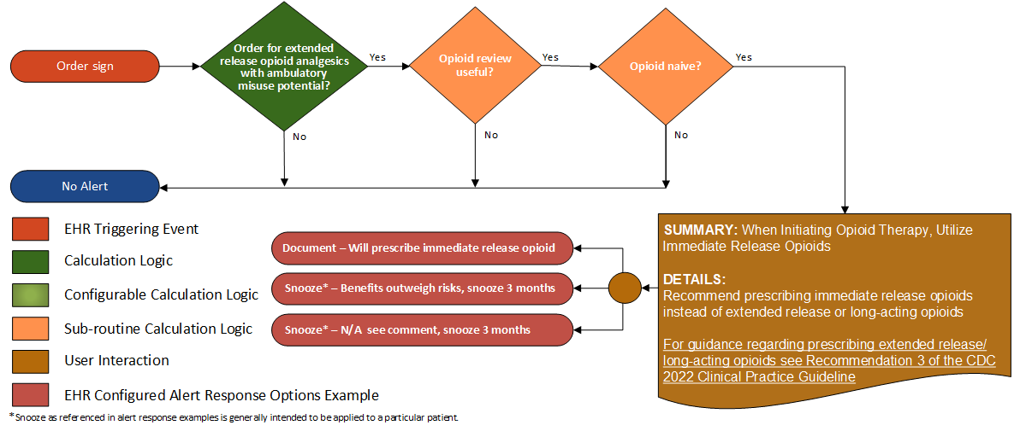
Recommendation 3
When starting opioid therapy for acute, subacute, or chronic pain, clinicians should prescribe immediate-release opioids instead of extended-release and long-acting (ER/LA) opioids (recommendation category: A; evidence type: 4).
Notes:
Recommendation 3: When starting opioid therapy for acute, subacute, or chronic pain, clinicians should prescribe immediate-release opioids instead of extended-release and long-acting (ER/LA) opioids (recommendation category: A; evidence type: 4).

Slide 20
Recommendation 3
Recommendation 4
Definition | Answer to Proceed | Details | Data (Terminology) Requirement
Is this order for extended-release opioid analgesics with ambulatory misuse potential? | Yes | Look for a new prescription for extended-release opioids. [Ideally the order should be selected prior to being committed to the system] | Extended-release opioid analgesics with ambulatory misuse potential
Opioid review useful? | Yes | See sub-routine 1
Opioid naïve? | Yes | See sub-routine 2
Notes:
Recommendation 3: When starting opioid therapy for acute, subacute, or chronic pain, clinicians should prescribe immediate-release opioids instead of extended-release and long-acting (ER/LA) opioids (recommendation category: A; evidence type: 4).

Slide 21
Recommendation 3
Recommendation 3 Guidance
SUMMARY: When Initiating Opioid Therapy, Utilize Immediate Release Opioids DETAILS: Recommend prescribing immediate release opioids instead of extended release or long-acting opioids For guidance regarding prescribing extended release/ long-acting opioids, see Recommendation 3 of the 2022 CDC Clinical Practice Guideline
Notes:
Recommendation 3: When starting opioid therapy for acute, subacute, or chronic pain, clinicians should prescribe immediate-release opioids instead of extended-release and long-acting (ER/LA) opioids (recommendation category: A; evidence type: 4).

Slide 22
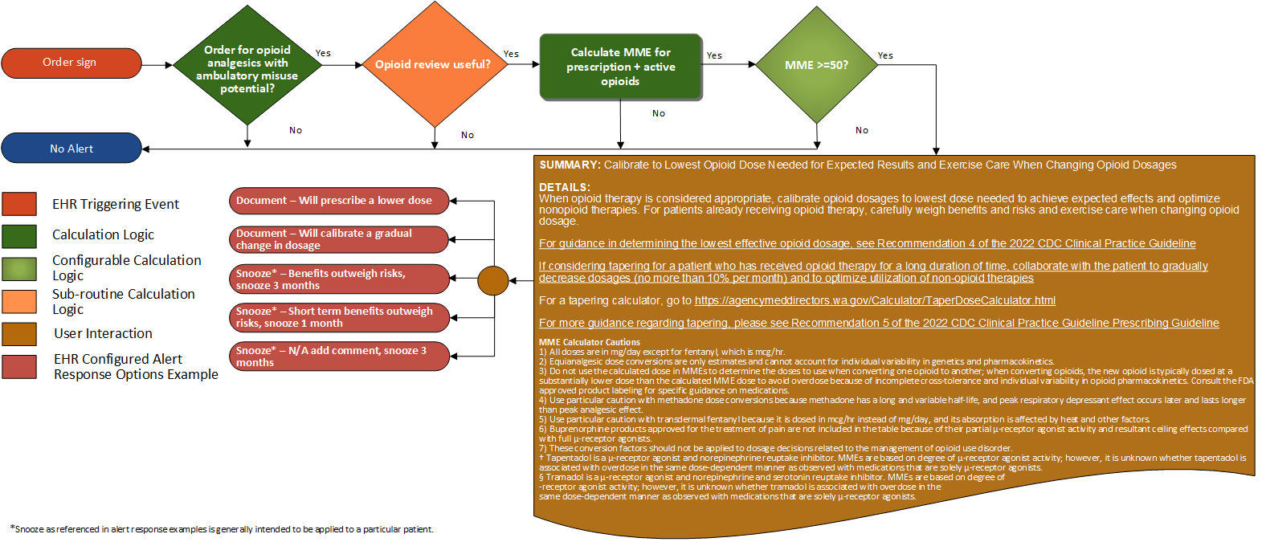
Recommendations 4-5
4: When opioids are initiated for opioid-naïve patients with acute, subacute, or chronic pain, clinicians should prescribe the lowest effective dosage. If opioids are continued for subacute or chronic pain, clinicians should use caution when prescribing opioids at any dosage, should carefully evaluate individual benefits and risks when considering increasing dosage, and should avoid increasing dosage above levels likely to yield diminishing returns in benefits relative to risks to patients (recommendation category: A; evidence type: 3)
5: For patients already receiving opioid therapy, clinicians should carefully weigh benefits and risks and exercise care when changing opioid dosage. If benefits outweigh risks of continued opioid therapy, clinicians should work closely with patients to optimize nonopioid therapies while continuing opioid therapy. If benefits do not outweigh risks of continued opioid therapy, clinicians should optimize other therapies and work closely with patients to gradually taper to lower dosages or, if warranted based on the individual circumstances of the patient, appropriately taper and discontinue opioids. Unless there are indications of a life-threatening issue such as warning signs of impending overdose (e.g., confusion, sedation, or slurred speech), opioid therapy should not be discontinued abruptly, and clinicians should not rapidly reduce opioid dosages from higher dosages (recommendation category: B; evidence type: 4).
Notes:
Recommendations 4-5:
4: When opioids are initiated for opioid-naïve patients with acute, subacute, or chronic pain, clinicians should prescribe the lowest effective dosage. If opioids are continued for subacute or chronic pain, clinicians should use caution when prescribing opioids at any dosage, should carefully evaluate individual benefits and risks when considering increasing dosage, and should avoid increasing dosage above levels likely to yield diminishing returns in benefits relative to risks to patients (recommendation category: A; evidence type: 3)
5. For patients already receiving opioid therapy, clinicians should carefully weigh benefits and risks and exercise care when changing opioid dosage. If benefits outweigh risks of continued opioid therapy, clinicians should work closely with patients to optimize nonopioid therapies while continuing opioid therapy. If benefits do not outweigh risks of continued opioid therapy, clinicians should optimize other therapies and work closely with patients to gradually taper to lower dosages or, if warranted based on the individual circumstances of the patient, appropriately taper and discontinue opioids. Unless there are indications of a life-threatening issue such as warning signs of impending overdose (e.g., confusion, sedation, or slurred speech), opioid therapy should not be discontinued abruptly, and clinicians should not rapidly reduce opioid dosages from higher dosages (recommendation category: B; evidence type: 4).

Slide 23
Recommendations 4-5
Recommendation 5
Definition | Answer to Proceed | Details | Data (Terminology) Requirement
Order for opioid analgesic with ambulatory misuse potential | Yes | Order for opioid analgesics with ambulatory misuse potential | Opioid analgesics with ambulatory misuse potential
Opioid review useful? | Yes | See sub-routine 1
Calculate MME for prescription + active opioids | NA | Current calculation uses known order (prescription) data. Note – for as needed (PRN) medication, the daily dose assumes the maximum dose the patient may take any given day if a range is present. Ideally, dispensed data could be used to determine the medication dispensed to the patient.
MME >=50? | Yes | MME result is >= 50
Notes:
Recommendations 4-5:
4: When opioids are initiated for opioid-naïve patients with acute, subacute, or chronic pain, clinicians should prescribe the lowest effective dosage. If opioids are continued for subacute or chronic pain, clinicians should use caution when prescribing opioids at any dosage, should carefully evaluate individual benefits and risks when considering increasing dosage, and should avoid increasing dosage above levels likely to yield diminishing returns in benefits relative to risks to patients (recommendation category: A; evidence type: 3)
5. For patients already receiving opioid therapy, clinicians should carefully weigh benefits and risks and exercise care when changing opioid dosage. If benefits outweigh risks of continued opioid therapy, clinicians should work closely with patients to optimize nonopioid therapies while continuing opioid therapy. If benefits do not outweigh risks of continued opioid therapy, clinicians should optimize other therapies and work closely with patients to gradually taper to lower dosages or, if warranted based on the individual circumstances of the patient, appropriately taper and discontinue opioids. Unless there are indications of a life-threatening issue such as warning signs of impending overdose (e.g., confusion, sedation, or slurred speech), opioid therapy should not be discontinued abruptly, and clinicians should not rapidly reduce opioid dosages from higher dosages (recommendation category: B; evidence type: 4).

Slide 24
Recommendations 4-5
Recommendation 4-5 Guidance
SUMMARY: Calibrate to Lowest Opioid Dose Needed for Expected Results and Exercise Care When Changing Opioid Dosages DETAILS: When opioid therapy is considered appropriate, calibrate opioid dosages to lowest dose needed to achieve expected effects. For patients already receiving opioid therapy, clinicians should carefully weigh benefits and risks and exercise care when changing opioid dosage. For guidance in determining the lowest effective opioid dosage, see Recommendation 4 of the CDC 2022 Clinical Practice Guideline For patients who have received opioid therapy for longer durations of time, if tapering, consider working closely with the patient to gradually taper dosages (no more than 10% per month) For a tapering calculator, go to https://agencymeddirectors.wa.gov/Calculator/TaperDoseCalculator.html For more guidance regarding tapering, please see Recommendation 5 of the CDC Clinical Practice Guideline Prescribing Guideline MME Calculator Cautions 1) All doses are in mg/day except for fentanyl, which is mcg/hr. 2) Equianalgesic dose conversions are only estimates and cannot account for individual variability in genetics and pharmacokinetics. 3) Do not use the calculated dose in MMEs to determine the doses to use when converting one opioid to another; when converting opioids, the new opioid is typically dosed at a substantially lower dose than the calculated MME dose to avoid overdose because of incomplete cross-tolerance and individual variability in opioid pharmacokinetics. Consult the FDA approved product labeling for specific guidance on medications. 4) Use particular caution with methadone dose conversions because methadone has a long and variable half-life, and peak respiratory depressant effect occurs later and lasts longer than peak analgesic effect. 5) Use particular caution with transdermal fentanyl because it is dosed in mcg/hr instead of mg/day, and its absorption is affected by heat and other factors. 6) Buprenorphine products approved for the treatment of pain are not included in the table because of their partial µ-receptor agonist activity and resultant ceiling effects compared with full µ-receptor agonists. 7) These conversion factors should not be applied to dosage decisions related to the management of opioid use disorder. † Tapentadol is a µ-receptor agonist and norepinephrine reuptake inhibitor. MMEs are based on degree of µ-receptor agonist activity; however, it is unknown whether tapentadol is associated with overdose in the same dose-dependent manner as observed with medications that are solely µ-receptor agonists. § Tramadol is a µ-receptor agonist and norepinephrine and serotonin reuptake inhibitor. MMEs are based on degree of µ-receptor agonist activity; however, it is unknown whether tramadol is associated with overdose in the same dose-dependent manner as observed with medications that are solely µ-receptor agonists.
Notes:
Recommendations 4-5:
4: When opioids are initiated for opioid-naïve patients with acute, subacute, or chronic pain, clinicians should prescribe the lowest effective dosage. If opioids are continued for subacute or chronic pain, clinicians should use caution when prescribing opioids at any dosage, should carefully evaluate individual benefits and risks when considering increasing dosage, and should avoid increasing dosage above levels likely to yield diminishing returns in benefits relative to risks to patients (recommendation category: A; evidence type: 3)
5. For patients already receiving opioid therapy, clinicians should carefully weigh benefits and risks and exercise care when changing opioid dosage. If benefits outweigh risks of continued opioid therapy, clinicians should work closely with patients to optimize nonopioid therapies while continuing opioid therapy. If benefits do not outweigh risks of continued opioid therapy, clinicians should optimize other therapies and work closely with patients to gradually taper to lower dosages or, if warranted based on the individual circumstances of the patient, appropriately taper and discontinue opioids. Unless there are indications of a life-threatening issue such as warning signs of impending overdose (e.g., confusion, sedation, or slurred speech), opioid therapy should not be discontinued abruptly, and clinicians should not rapidly reduce opioid dosages from higher dosages (recommendation category: B; evidence type: 4).

Slide 25
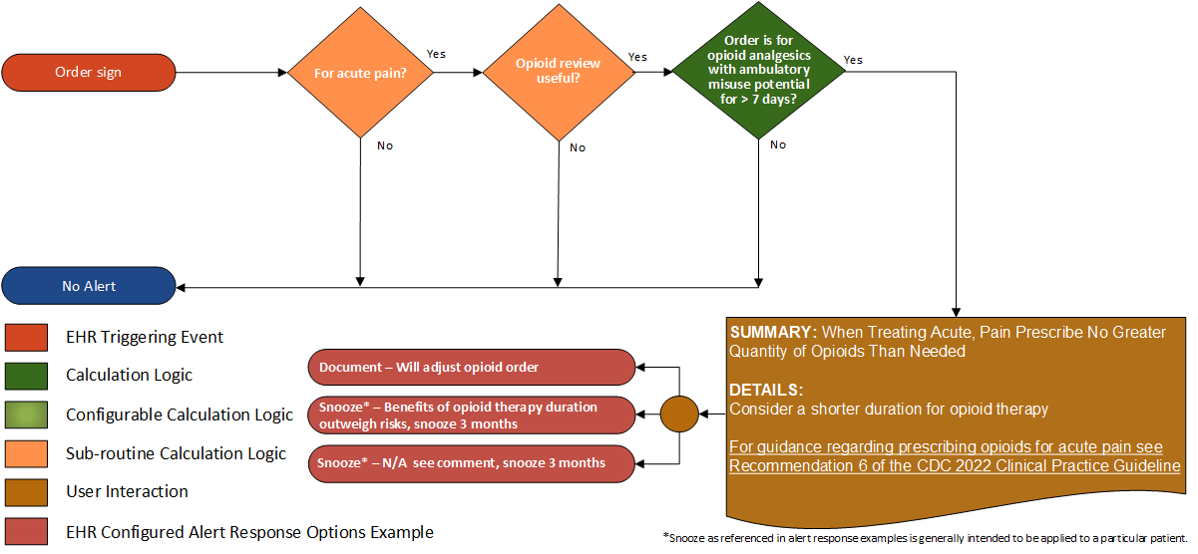
Recommendation 6
When opioids are needed for acute pain, clinicians should prescribe no greater quantity than needed for the expected duration of pain severe enough to require opioids (recommendation category: A; evidence type: 4)
Notes:
Recommendation 6: When opioids are needed for acute pain, clinicians should prescribe no greater quantity than needed for the expected duration of pain severe enough to require opioids (recommendation category: A; evidence type: 4)

Slide 26
Recommendation 6
Recommendation 6
Definition | Answer to Proceed | Details | Data (Terminology) Requirement
Order for opioid analgesics with with ambulatory misuse potential? | Yes | Trigger based on a new prescription (order) for opioids in the relevant value set – ideally the prescription should be selected prior to being committed to the system | Opioid analgesics with ambulatory misuse potential
For acute pain | Yes | See sub-routine 5
Opioid review useful? | Yes | See sub-routine 1
Order for opioid analgesics with ambulatory misuse potential for > 7 days? | Yes | Determine if the new prescription (order) has an intended duration of > 7 days | Opioid analgesics with ambulatory misuse potential
Notes:
Recommendation 6: When opioids are needed for acute pain, clinicians should prescribe no greater quantity than needed for the expected duration of pain severe enough to require opioids (recommendation category: A; evidence type: 4)

Slide 27
Recommendation 6
Recommendation 6 Guidance
SUMMARY: When Treating Acute Pain, Prescribe No Greater Quantity Than Needed DETAILS: Consider a shorter duration for opioid therapy For guidance regarding prescribing opioids for acute pain see Recommendation 6 of the CDC 2022 Clinical Practice Guideline
Notes:
Recommendation 6: When opioids are needed for acute pain, clinicians should prescribe no greater quantity than needed for the expected duration of pain severe enough to require opioids (recommendation category: A; evidence type: 4)

Slide 28
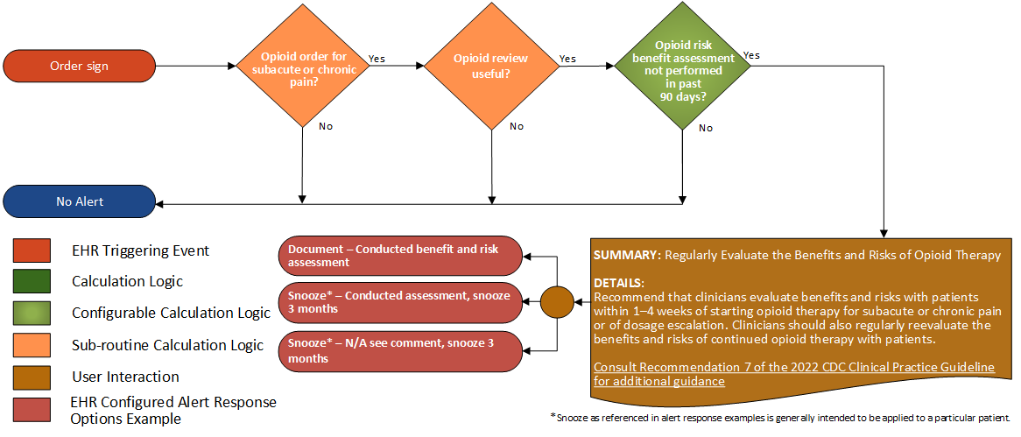
Recommendation 7
Clinicians should evaluate benefits and risks with patients within 1–4 weeks of starting opioid therapy for subacute or chronic pain or of dosage escalation. Clinicians should regularly reevaluate benefits and risks of continued opioid therapy with patients (recommendation category: A; evidence type: 4).
Notes:
Recommendation 7: Clinicians should evaluate benefits and risks with patients within 1–4 weeks of starting opioid therapy for subacute or chronic pain or of dosage escalation. Clinicians should regularly reevaluate benefits and risks of continued opioid therapy with patients (recommendation category: A; evidence type: 4).

Slide 29
Recommendation 7
Recommendation 7
Definition | Answer to Proceed | Details | Data (Terminology) Requirement
Opioid order for subacute or chronic pain? | Yes | See sub-routine 4
Opioid review useful? | Yes | See sub-routine 1
Opioid risk - benefit assessment procedure not performed in last 90 days? | Yes | Absence of an opioid treatment assessment procedure in the last 90 days | Opioid treatment assessment procedure
Notes:
Recommendation 7: Clinicians should evaluate benefits and risks with patients within 1–4 weeks of starting opioid therapy for subacute or chronic pain or of dosage escalation. Clinicians should regularly reevaluate benefits and risks of continued opioid therapy with patients (recommendation category: A; evidence type: 4).

Slide 30
Recommendation 7
Recommendation 7 Guidance
SUMMARY: Regularly Evaluate the Benefits and Risks of Opioid Therapy DETAILS: Recommend that clinicians evaluate benefits and risks with patients within 1–4 weeks of starting opioid therapy for subacute or chronic pain or of dosage escalation. Clinicians should also regularly reevaluate the benefits and risks of continued opioid therapy with patients. Consult Recommendation 7 of the 2022 CDC Clinical Practice Guideline for additional guidance
Notes:
Recommendation 7: Clinicians should evaluate benefits and risks with patients within 1–4 weeks of starting opioid therapy for subacute or chronic pain or of dosage escalation. Clinicians should regularly reevaluate benefits and risks of continued opioid therapy with patients (recommendation category: A; evidence type: 4).

Slide 31
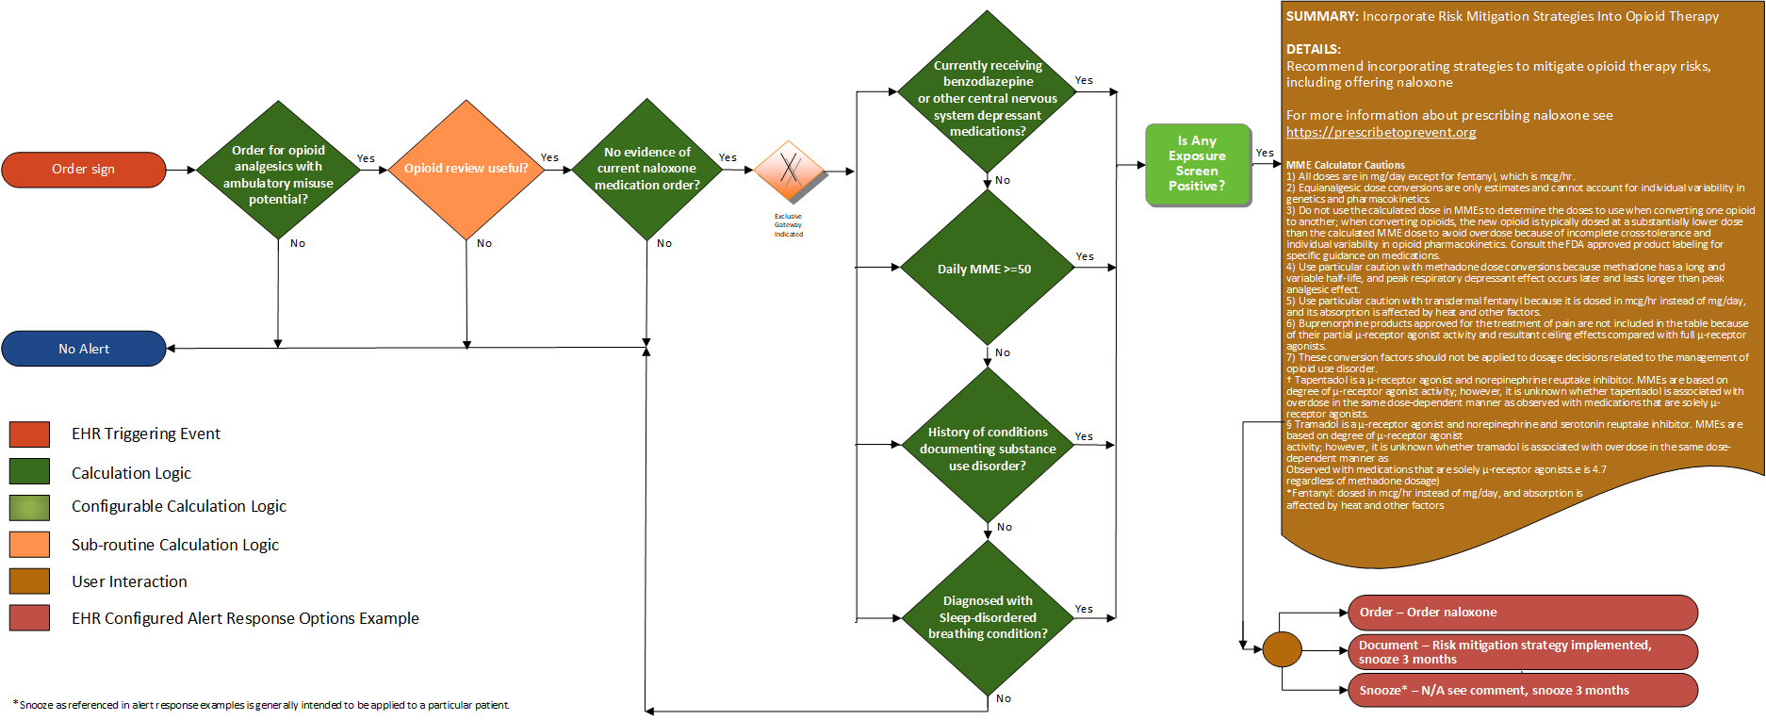
Recommendation 8
Before starting and periodically during continuation of opioid therapy, clinicians should evaluate risk for opioid-related harms and discuss risk with patients. Clinicians should work with patients to incorporate into the management plan strategies to mitigate risk, including offering naloxone (recommendation category: A; evidence type: 4).
Notes:
Recommendation 8: Before starting and periodically during continuation of opioid therapy, clinicians should evaluate risk for opioid-related harms and discuss risk with patients. Clinicians should work with patients to incorporate into the management plan strategies to mitigate risk, including offering naloxone (recommendation category: A; evidence type: 4).

Slide 32
Recommendation 8
Recommendation 8
Definition | Answer to Proceed | Details | Data (Terminology) Requirement
Order for opioid analgesic with ambulatory misuse potential | Yes | Order for opioid analgesics with ambulatory misuse potential | Opioid analgesics with ambulatory misuse potential
Opioid review useful? | Yes | See sub-routine 1
No evidence of current naloxone medications? | Yes | Find evidence of naloxone medication prescription (An active medication order for naloxone) | Naloxone medications
Currently receiving benzodiazepine or other central nervous system depressant medications? | Yes | Find evidence of benzodiazepine prescription (An active medication order for benzodiazepine or other central nervous system depressant medications) | Benzodiazepine or other central nervous system depressant medications
MME (morphine milligram equivalents >50) | Yes | Determine MME from existing active prescriptions (Recommendation 5), or future scope: dispensed medications, or patient-reported medications
History of conditions documenting substance use disorder? | Yes | Find evidence of conditions documenting substance use in the problem list or past medical history, including history of overdose | Conditions documenting substance misuse disorder
Diagnosed with a sleep-disordered breathing condition? | Yes | Find documentation of an active sleep-disordered breathing condition | Conditions documenting sleep-disordered breathing
Notes:
Recommendation 8: Before starting and periodically during continuation of opioid therapy, clinicians should evaluate risk for opioid-related harms and discuss risk with patients. Clinicians should work with patients to incorporate into the management plan strategies to mitigate risk, including offering naloxone (recommendation category: A; evidence type: 4).

Slide 33
Recommendation 8
Recommendation 8 Guidance
SUMMARY: Incorporate Risk Mitigation Strategies Into Opioid Therapy DETAILS: Recommend incorporating strategies to mitigate opioid therapy risks, including offering naloxone For more information about prescribing naloxone see https://prescribetoprevent.org MME Calculator Cautions 1) All doses are in mg/day except for fentanyl, which is mcg/hr. 2) Equianalgesic dose conversions are only estimates and cannot account for individual variability in genetics and pharmacokinetics. 3) Do not use the calculated dose in MMEs to determine the doses to use when converting one opioid to another; when converting opioids, the new opioid is typically dosed at a substantially lower dose than the calculated MME dose to avoid overdose because of incomplete cross-tolerance and individual variability in opioid pharmacokinetics. Consult the FDA approved product labeling for specific guidance on medications. 4) Use particular caution with methadone dose conversions because methadone has a long and variable half-life, and peak respiratory depressant effect occurs later and lasts longer than peak analgesic effect. 5) Use particular caution with transdermal fentanyl because it is dosed in mcg/hr instead of mg/day, and its absorption is affected by heat and other factors. 6) Buprenorphine products approved for the treatment of pain are not included in the table because of their partial µ-receptor agonist activity and resultant ceiling effects compared with full µ-receptor agonists. 7) These conversion factors should not be applied to dosage decisions related to the management of opioid use disorder. † Tapentadol is a µ-receptor agonist and norepinephrine reuptake inhibitor. MMEs are based on degree of µ-receptor agonist activity; however, it is unknown whether tapentadol is associated with overdose in the same dose-dependent manner as observed with medications that are solely µ-receptor agonists. § Tramadol is a µ-receptor agonist and norepinephrine and serotonin reuptake inhibitor. MMEs are based on degree of µ-receptor agonist activity; however, it is unknown whether tramadol is associated with overdose in the same dose-dependent manner as observed with medications that are solely µ-receptor agonists.
Notes:
Recommendation 8: Before starting and periodically during continuation of opioid therapy, clinicians should evaluate risk for opioid-related harms and discuss risk with patients. Clinicians should work with patients to incorporate into the management plan strategies to mitigate risk, including offering naloxone (recommendation category: A; evidence type: 4).

Slide 34
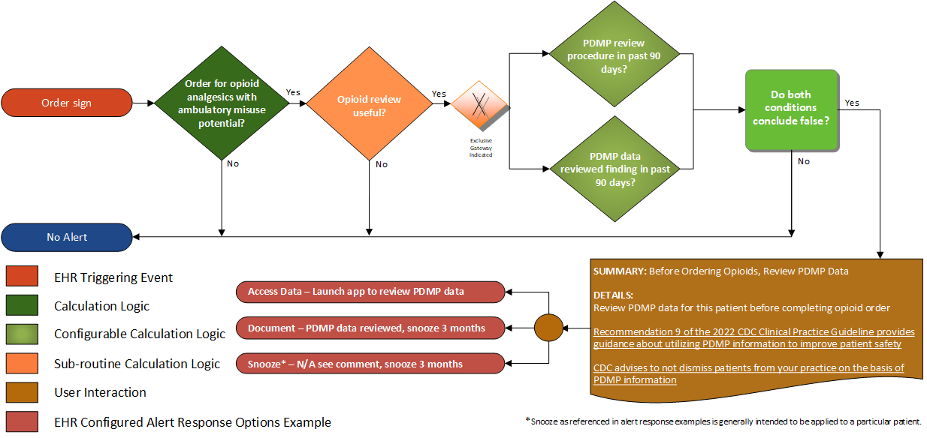
Recommendation 9
When prescribing initial opioid therapy for acute, subacute, or chronic pain, and periodically during opioid therapy for chronic pain, clinicians should review the patient’s history of controlled substance prescriptions using state prescription drug monitoring program (PDMP) data to determine whether the patient is receiving opioid dosages or combinations that put the patient at high risk for overdose (recommendation category: B; evidence type: 4).
Notes:
Recommendation 9: When prescribing initial opioid therapy for acute, subacute, or chronic pain, and periodically during opioid therapy for chronic pain, clinicians should review the patient’s history of controlled substance prescriptions using state prescription drug monitoring program (PDMP) data to determine whether the patient is receiving opioid dosages or combinations that put the patient at high risk for overdose (recommendation category: B; evidence type: 4).

Slide 35
Recommendation 9
Recommendation 9 Guidance
Definition | Answer to Proceed | Details | Data (Terminology) Requirement
Order for opioid analgesic with ambulatory misuse potential | Yes | Order for opioid analgesics with ambulatory misuse potential | Opioid analgesics with ambulatory misuse potential
Opioid review useful? | Yes | See sub-routine 1
PDMP review procedure in past 90 days? | No | Look for evidence of a prescription drug monitoring program (PDMP) review procedure (may need to modify time interval for review based on local practice / regulation) [Evidence for the PDMP review procedure may potentially originate in a PDMP Smart App that provides the code once PDMP review procedure has been completed.] | PDMP review procedure
PDMP data reviewed finding in past 90 days? | No | Documentation (i.e., a finding) that PDMP review has occurred) in last 90 days (may need to modify time interval for review based on local practice / regulation) | PDMP data reviewed finding
Notes:
Recommendation 9: When prescribing initial opioid therapy for acute, subacute, or chronic pain, and periodically during opioid therapy for chronic pain, clinicians should review the patient’s history of controlled substance prescriptions using state prescription drug monitoring program (PDMP) data to determine whether the patient is receiving opioid dosages or combinations that put the patient at high risk for overdose (recommendation category: B, evidence type: 4).

Slide 36
Recommendation 9
Recommendation 9 Guidance
SUMMARY: Before Ordering Opioids, Review PDMP Data DETAILS: Review PDMP data for this patient before completing an opioid order Recommendation 9 of the 2022 CDC Clinical Practice Guideline provides guidance about utilizing PDMP information to improve patient safety CDC advises not to dismiss patients from your practice on the basis of PDMP information
Notes:
Recommendation 9: When prescribing initial opioid therapy for acute, subacute, or chronic pain, and periodically during opioid therapy for chronic pain, clinicians should review the patient’s history of controlled substance prescriptions using state prescription drug monitoring program (PDMP) data to determine whether the patient is receiving opioid dosages or combinations that put the patient at high risk for overdose (recommendation category: B, evidence type: 4).

Slide 37
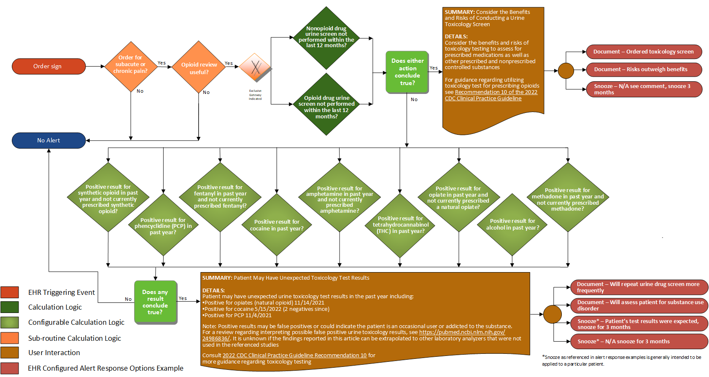
Recommendation 10
When prescribing opioids for subacute or chronic pain, clinicians should consider the benefits and risks of toxicology testing to assess for prescribed medications as well as other prescribed and nonprescribed controlled substances (recommendation category: B; evidence type: 4).
Notes:
Recommendation 10: When prescribing opioids for subacute or chronic pain, clinicians should consider the benefits and risks of toxicology testing to assess for prescribed medications as well as other prescribed and nonprescribed controlled substances (recommendation category: B; evidence type: 4).

Slide 38
Recommendation 10
Recommendation 10
Definition | Answer to Proceed | Details | Data (Terminology) Requirement
Opioid order for subacute or chronic pain? | Yes | See sub-routine 4
Opioid review useful? | Yes | See sub-routine 1
Non-opioid drug urine screen test not performed within the last 12 months | Yes | No urine screening test performed within the last 12 months. | Non-opioid drug urine screen
Opioid drug urine screen test not performed within the last 12 months? | Yes | No opioid drug urine screening test performed within the last 12 months. | Opioid drug urine screen
Urine drug screen results contain cocaine? | Yes | Urine drug screen result contains cocaine | Cocaine urine toxicology test result
Urine drug screen results contain phencyclidine (PCP)? | Yes | Urine drug screen result contains phencyclidine (PCP) | Phencyclidine (PCP) urine toxicology test result
Urine drug screen results contain amphetamine and no active amphetamine medication? | Yes | Urine drug screen result contains amphetamine and patient does not have an active prescription for amphetamine | Amphetamine urine toxicology test result Amphetamine medication
Urine drug screen results contain opiate and no active opiate medication? | Yes | Urine drug screen result contains opiate and patient does not have an active prescription for opiate | Opiate urine toxicology test result Opiate medication
Urine drug screen results contain methadone and no active methadone medication? | Yes | Urine drug screen result contains methadone and patient does not have an active prescription for methadone | Methadone urine toxicology test result Methadone medication
Urine drug screen results contain synthetic opioid and no active synthetic opioid medication? | Yes | Urine drug screen result contains synthetic opioid and patient does not have an active prescription for synthetic opioid | Synthetic opioid urine toxicology test result Synthetic opioid medication
Urine drug screen results contain fentanyl and no active fentanyl medication? | Yes | Urine drug screen result contains fentanyl and patient does not have an active prescription for fentanyl | Fentanyl urine toxicology test result Fentanyl medication
Urine drug screen results contain tetrahydrocannabinol (THC)? | Yes | Urine drug screen result contains tetrahydrocannabinol (THC) | Tetrahydrocannabinol urine toxicology test result
Urine drug screen results contain alcohol? | Yes | Urine drug screen result contains alcohol | Alcohol urine toxicology test result
Notes:
Recommendation 10: When prescribing opioids for subacute or chronic pain, clinicians should consider the benefits and risks of toxicology testing to assess for prescribed medications as well as other prescribed and nonprescribed controlled substances (recommendation category: B; evidence type: 4).

Slide 39
Recommendation 10
Recommendation 10 Alert 1 Guidance
SUMMARY: Consider the Benefits and Risks of Conducting a Urine Toxicology Screen DETAILS: Consider the benefits and risks of toxicology testing to assess for prescribed medications as well as other prescribed and nonprescribed controlled substances For guidance regarding utilizing toxicology tests when prescribing opioids, see Recommendation 10 of the 2022 CDC Clinical Practice Guideline
Notes:
Recommendation 10: When prescribing opioids for subacute or chronic pain, clinicians should consider the benefits and risks of toxicology testing to assess for prescribed medications as well as other prescribed and nonprescribed controlled substances (recommendation category: B; evidence type: 4).

Slide 40
Recommendation 10
Recommendation 10 Alert 2 Guidance
SUMMARY: Patient May Have Unexpected Toxicology Test Results DETAILS: Patient may have unexpected urine toxicology test results in the past year including: Positive for opiates (natural opioid) 11/14/2021 Positive for cocaine 5/15/2022 (2 negatives since) Positive for PCP 11/4/2021 Note: Positive results may be false positives or could indicate the patient is an occasional user or addicted to the substance. For a review regarding interpreting possible false positive urine toxicology results, see https://pubmed.ncbi.nlm.nih.gov/24986836/. It is unknown if the findings reported in this article can be extrapolated to other laboratory analyzers that were not used in the referenced studies. Consult 2022 CDC Clinical Practice Guideline Recommendation 10 for more guidance regarding toxicology testing.
Notes:
Recommendation 10: When prescribing opioids for subacute or chronic pain, clinicians should consider the benefits and risks of toxicology testing to assess for prescribed medications as well as other prescribed and nonprescribed controlled substances (recommendation category: B; evidence type: 4).

Slide 41
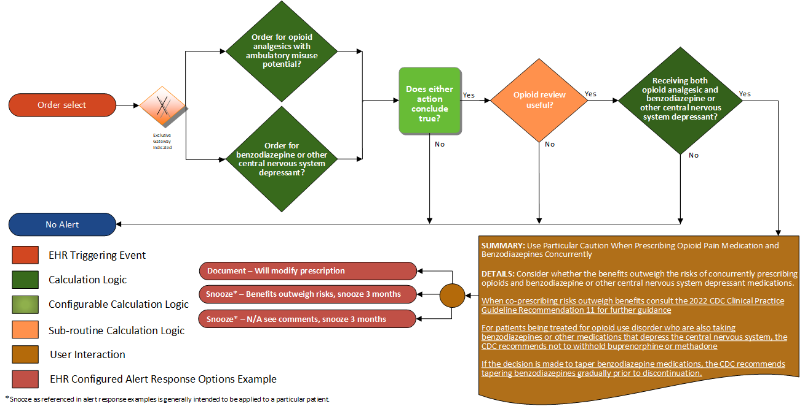
Recommendation 11
Clinicians should use particular caution when prescribing opioid pain medication and benzodiazepines concurrently and consider whether benefits outweigh risks of concurrent prescribing of opioids and other central nervous system depressants (recommendation category: B; evidence type: 3).
Notes:
Recommendation 11: Clinicians should use particular caution when prescribing opioid pain medication and benzodiazepines concurrently and consider whether benefits outweigh risks of concurrent prescribing of opioids and other central nervous system depressants (recommendation category: B; evidence type: 3).

Slide 42
Recommendation 11
Recommendation 11
Definition | Answer to Proceed | Details | Data (Terminology) Requirement
Order for opioid analgesics with ambulatory misuse potential? | Yes | Trigger based on a new prescription (order) for opioid analgesics with ambulatory misuse potential – ideally the prescription should be selected prior to being committed to the system. | Opioid analgesics with ambulatory misuse potential
Order for benzodiazepine medication or other central nervous system depressant? | Yes | Trigger based on a new prescription (order) for opioids, benzodiazepines, or other central nervous system depressants in the relevant value sets – ideally the prescription should be selected prior to being committed to the system. | Benzodiazepine and other central nervous system depressant medications
Opioid review useful? | Yes | See sub-routine 1
Receiving both opioid with ambulatory use potential and benzodiazepine or other central nervous system depressant? | Yes | New prescription is for an opioid and existing use of benzodiazepine or other central nervous system depressant evident, OR New prescription is for benzodiazepine or other central nervous system depressant and existing use of opioids evident. | Opioid analgesics with ambulatory misuse potential Benzodiazepine and other central nervous system depressant medications
Notes:
Recommendation 11: Clinicians should use particular caution when prescribing opioid pain medication and benzodiazepines concurrently and consider whether benefits outweigh risks of concurrent prescribing of opioids and other central nervous system depressants (recommendation category: B; evidence type: 3).

Slide 43
Recommendation 11
Recommendation 11 Guidance
SUMMARY: Use Particular Caution When Prescribing Opioid Pain Medication and Benzodiazepines Concurrently DETAILS: Consider whether the benefits outweigh the risks of concurrently prescribing opioids and benzodiazepines, or other central nervous system depressant medications. When co-prescribing risks outweigh benefits, consult the 2022 CDC Clinical Practice Guideline Recommendation 11 for further guidance. For patients being treated for opioid use disorder who are also taking benzodiazepines or other medications that depress the central nervous system, the CDC recommends not withholding buprenorphine or methadone. If the decision is made to taper benzodiazepine medications, the CDC recommends tapering benzodiazepines gradually prior to discontinuation.
Notes:
Recommendation 11: Clinicians should use particular caution when prescribing opioid pain medication and benzodiazepines concurrently and consider whether benefits outweigh risks of concurrent prescribing of opioids and other central nervous system depressants (recommendation category: B; evidence type: 3).

Slide 44
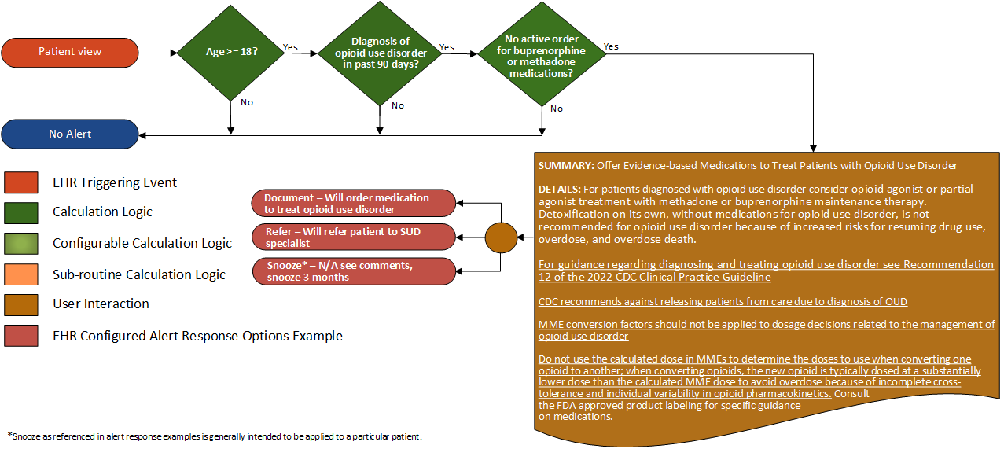
Recommendation 12
Clinicians should offer or arrange treatment with evidence-based medications to treat patients with opioid use disorder. Detoxification on its own, without medications for opioid use disorder, is not recommended for opioid use disorder because of increased risks for resuming drug use, overdose, and overdose death (recommendation category: A; evidence type: 1).
Notes:
Recommendation 12: Clinicians should offer or arrange treatment with evidence-based medications to treat patients with opioid use disorder. Detoxification on its own, without medications for opioid use disorder, is not recommended for opioid use disorder because of increased risks for resuming drug use, overdose, and overdose death (recommendation category: A; evidence type: 1).

Slide 45
Recommendation 12
Recommendation 12
Definition | Answer to Proceed | Details | Data (Terminology) Requirement
Age >= 18 | Yes | Age greater than or equal to 18 years
Presence of diagnosis of opioid misuse disorders in past 90 days? | Yes | Look for an active condition of opioid misuse disorder | Opioid misuse disorders
Active order for buprenorphine or methadone medications | No | An active prescription (order) for buprenorphine or methadone medications | Buprenorphine and methadone medications
Notes:
Recommendation 12: Clinicians should offer or arrange treatment with evidence-based medications to treat patients with opioid use disorder. Detoxification on its own, without medications for opioid use disorder, is not recommended for opioid use disorder because of increased risks for resuming drug use, overdose, and overdose death (recommendation category: A; evidence type: 1).

Slide 46
Recommendation 12
Recommendation 12 Guidance
SUMMARY: Offer Evidence-based Medications to Treat Patients with Opioid Use Disorder DETAILS: For patients diagnosed with opioid use disorder, consider opioid agonist or partial agonist treatment with methadone or buprenorphine maintenance therapy. Detoxification on its own, without medications for opioid use disorder, is not recommended for opioid use disorder because of increased risks of resuming drug use, overdose, and overdose death. For guidance regarding diagnosing and treating opioid use disorder, see Recommendation 12 of the 2022 CDC Clinical Practice Guideline. CDC recommends against releasing patients from care due to diagnosis of OUD. MME conversion factors should not be applied to dosage decisions related to the management of opioid use disorder. Do not use the calculated dose in MMEs to determine the doses to use when converting one opioid to another; when converting opioids, the new opioid is typically dosed at a substantially lower dose than the calculated MME dose to avoid overdose because of incomplete cross-tolerance and individual variability in opioid pharmacokinetics. Consult the FDA approved product labeling for specific guidance on medications.
Notes:
Recommendation 12: Clinicians should offer or arrange treatment with evidence-based medications to treat patients with opioid use disorder. Detoxification on its own, without medications for opioid use disorder, is not recommended for opioid use disorder because of increased risks for resuming drug use, overdose, and overdose death (recommendation category: A; evidence type: 1).

