Slide 1
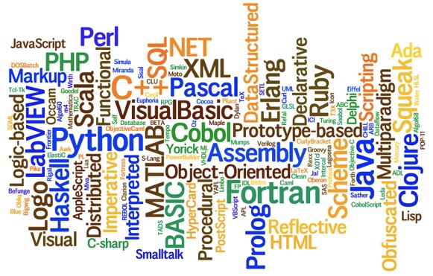
Com S 342: Principles of Programming Languages
Thank Prof Hridesh Rajan for the Lecture Materials

Slide 2
Functional Programming
A development of a functional language: Scheme
arithlang: arithmetics
varlang: variables
funclang: control structure, function
reclang: recursive function
reang: reference
typelang: types
….
Formal computational model: lambda calculus
Other programming paradigms: logic programming, imperative
programming, object-oriented programming

Slide 3
Design a Language
Arithlang: An Arithmetic Language

Slide 4
Programs in Arithlang
Arithlang(prefix)
1
(+ 1 1)
(- (+ 2 2) 1)
(* (+ 1 1) (- 3 2))
(/ (* (- 6 1) 2) (+ 1 1))
Math (infix)
1
(1 + 1)
((2 + 2) - 1)
((1 + 1) * (3 - 2))
(((6 - 1) * 2) / (1 + 1))

Slide 5
Legal Programs
Legal programs are defined by the grammar of the programming language
Grammar: a specification that dictates legal strings in the language
Different classes of grammars (c.f. Com S 331)
Different styles/forms of writing grammars
Rajan’s PL book: use extended Backus-Naur Form (EBNF)
The grammar itself will follow the format used by ANTLR, a tool for constructing programming language implementations

Slide 6
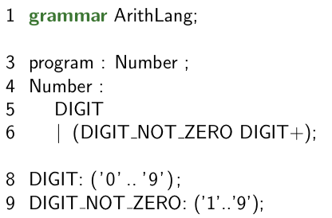
Grammars

Slide 7
Grammar Terms
Terminal symbols (terminals)?
Non-terminal symbols (non-terminals)?

Slide 8
Grammar Terms
Production Rule?

Slide 9
Grammars
Are “0”, “1” valid programs?

Slide 10
Derivation
Are “0”, “1” valid programs?
program
-> Number
-> DIGIT
-> ‘0’

Slide 11
Grammars
Is “10” a valid program?

Slide 12
Grammars
Is “10” a valid program?
program -> Number
-> DIGIT_NOT_ZERO DIGIT +
-> ‘1’ DIGIT +
-> ‘1’ DIGIT
-> ‘1’ ‘0’

Slide 13
Leftmost Derivation
Is “10” a valid program?
program -> Number
-> DIGIT_NOT_ZERO DIGIT +
-> ‘1’ DIGIT +
-> ‘1’ DIGIT
-> ‘1’ ‘0’

Slide 14
Grammars
Are “01”, “001” valid programs?

Slide 15
Grammars
Are “01”, “001” valid programs?
program
-> Number
-> ?

Slide 16
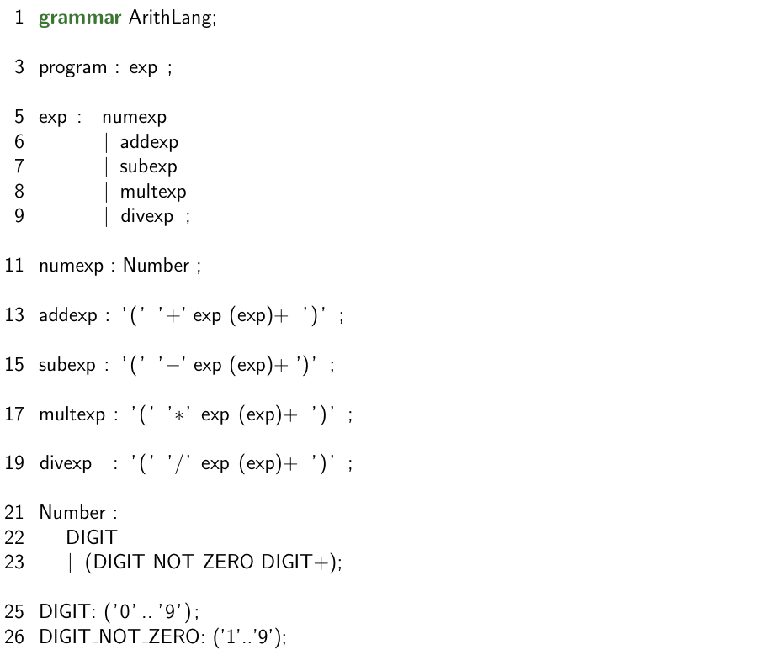
Arithlang Full Grammar

Slide 17
Arithlang Full Grammar

Slide 18
Arithlang Full Grammar

Slide 19
Semantics of Arithlang READING: PL DSL Chapter 2
From syntax to values…

Slide 20
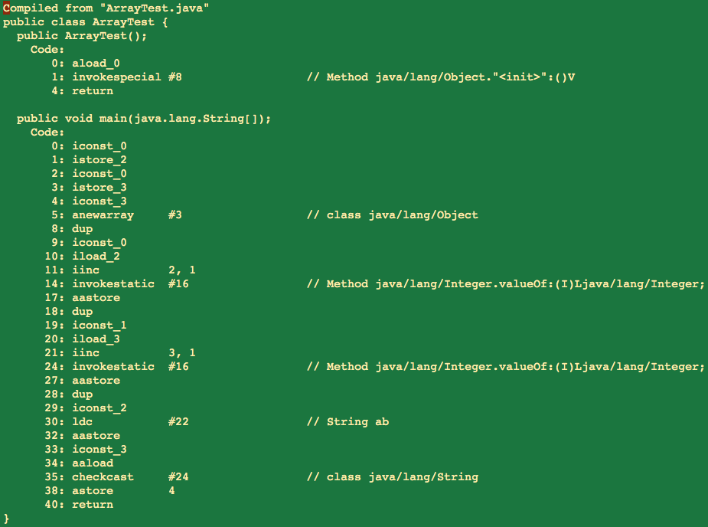
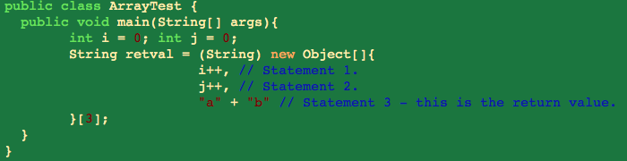
PL Implementation Strategy
Compilers
Translator from one PL to another PL, e.g., gcc
Does not produce value of the program
javac
Notes:
csc translates from C# to MSIL
gcc translates from C, … to Machine Language
- Now here you have to understand the meaning of the abstract machine that your program will run on ..

Slide 21
PL Implementation Strategy
Compilers
Translator from one PL to another PL, e.g. gcc
Parts: Scanner (Tokenizer), Parser, Checker, Optimizer, Code Generator
javac
Notes:
csc translates from C# to MSIL
gcc translates from C, … to Machine Language

Slide 22
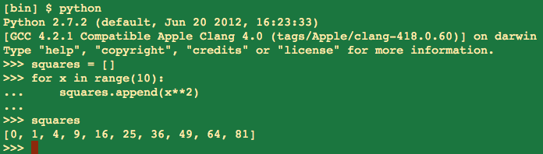
PL Implementation Strategy
Interpreters
Evaluate a program to its value or error.
Parts: Read, Eval, Print, Main REP loop
In 342 we will use interpreters.
Simpler, focus on semantics issues.

Slide 23
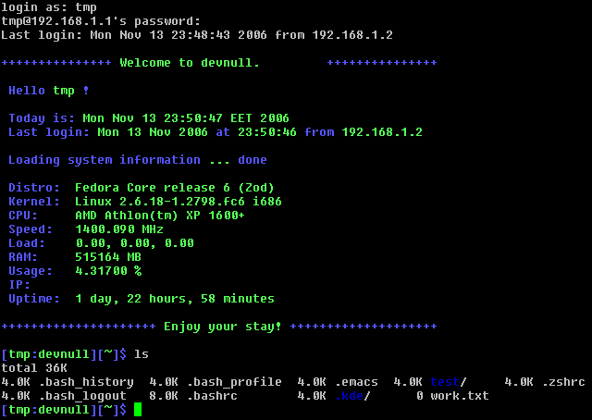
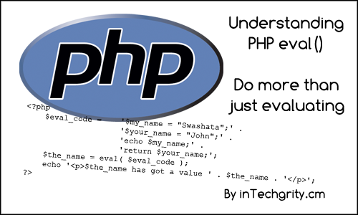


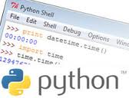
Interpreters
Coming up…

