Slide 1

Web Programming
Responsive Web Design and JavaScript

Slide 2
Overview
Responsive Web Design
JavaScript

Slide 3
Responsive Web Design

Slide 4
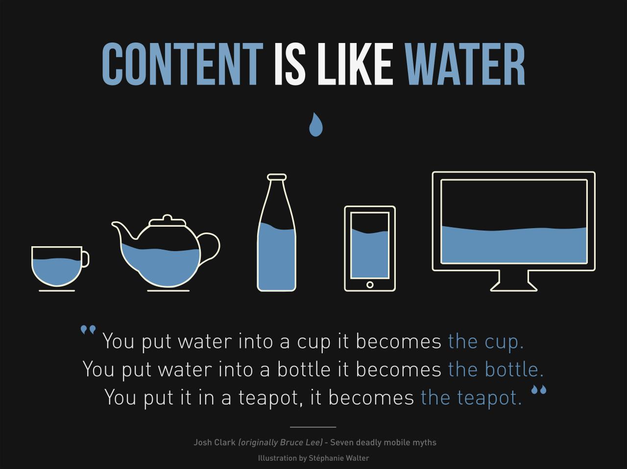
RWD

Slide 5
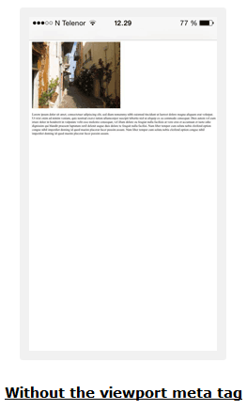
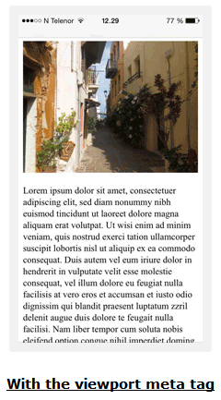
RWD-Viewport
<meta name="viewport" content="width=device-width, initial-scale=1.0">

Slide 6
RWD - Media Queries
SYNTAX
@media not|only mediatype and (expressions) { CSS-Code; }
EXAMPLE
@media screen and (min-width: 480px) { body { background-color: lightgreen; } }

Slide 7
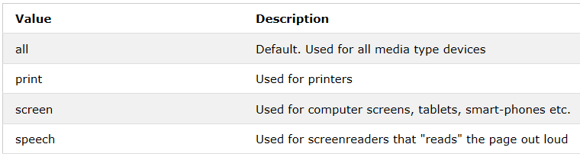
Media Types

Slide 8
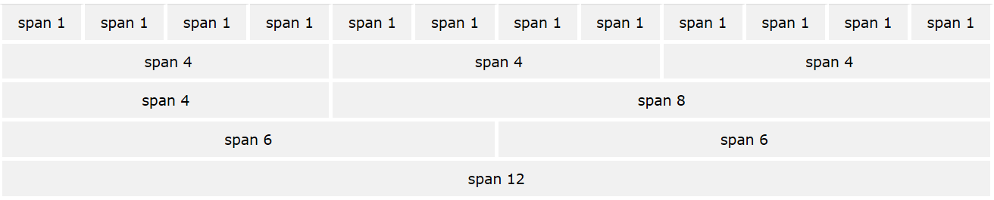
RWD-Grid View

Slide 9
RWD-Grid View
The entire body is to be placed in a div which contains rows that are in turn made up of columns
The count of columns in a row should total to 12 and their width to 100%
col-1 {width: 8.33%;} through col-12 {width: 100%;}

Slide 10

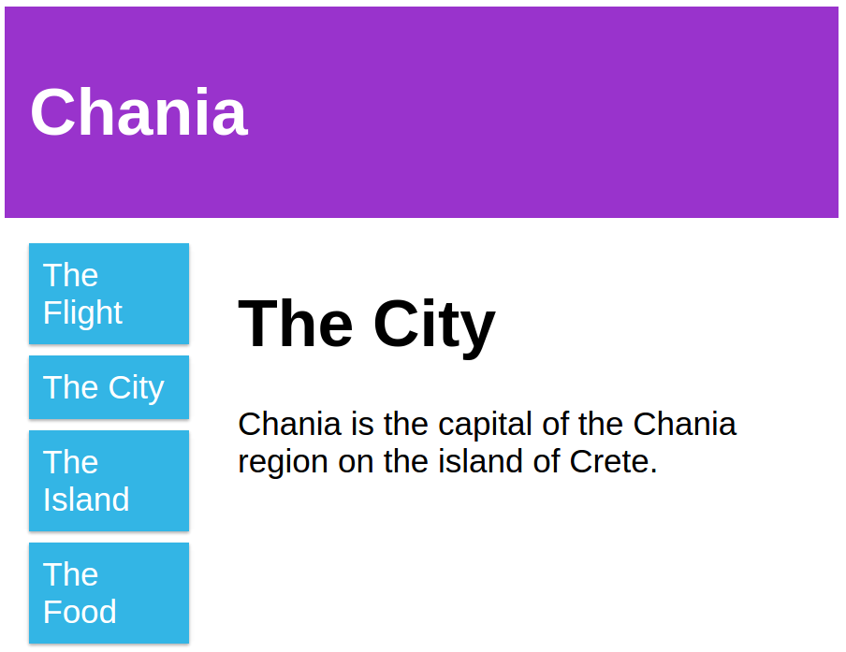
RWD-Web Page

Slide 11
With CSS (Without Bootstrap)
CSS
<meta name="viewport" content="width=device-width, initial-scale=1.0">
<style>
* {
box-sizing: border-box;
}
.row::after {
content: "";
clear: both;
display: table;
}
[class*="col-"] {
float: left;
padding: 15px;
}
.col-1 {width: 8.33%;}
.col-2 {width: 16.66%;}
.col-3 {width: 25%;}
.col-4 {width: 33.33%;}
.col-5 {width: 41.66%;}
.col-6 {width: 50%;}
HTML
<div class="header">
<h1>Chania</h1>
</div>
<div class="row">
<div class="col-3 menu">
<ul>
<li>The Flight</li>
<li>The City</li>
<li>The Island</li>
<li>The Food</li>
</ul>
</div>
<div class="col-9">
<h1>The City</h1>
<p>Chania is the capital of the
Chania region on the island of Crete.</p>
</div>
</div>

Slide 12
CSS
.col-7 {width: 58.33%;}
.col-8 {width: 66.66%;}
.col-9 {width: 75%;}
.col-10 {width: 83.33%;}
.col-11 {width: 91.66%;}
.col-12 {width: 100%;}
html {
font-family: "Lucida Sans", sans-serif;
}
.header {
background-color: #9933cc;
color: #ffffff;
padding: 15px;
}
.menu ul {
list-style-type: none;
margin: 0;
padding: 0;
}
.menu li {
padding: 8px;
margin-bottom: 7px;
background-color: #33b5e5;
color: #ffffff;
box-shadow: 0 1px 3px rgba(0,0,0,0.12), 0 1px 2px rgba(0,0,0,0.24);
}
.menu li:hover {
background-color: #0099cc;
}

Slide 13
With Bootstrap
HTML
<div class="container">
<div class="row">
<div class="col-md-12"> <h1>Chania</h1>
</div>
</div>
<div class="row">
<div class="col-md-3 menu">
<ul>
<li>The Flight</li>
<li>The City</li>
<li>The Island</li>
<li>The Food</li>
</ul>
</div>
<div class="col-md-9">
<h1>The City</h1>
<p>Chania is the capital of the
Chania region on the island of Crete.</p>
</div>
</div>

Slide 14
Bootstrap
Developed at Twitter and open sourced in 2011
HTML, CSS, and JS framework for developing responsive, mobile first projects on the web
Grid view in bootstrap CSS is the same as in normal CSS except that we have predefined class names.

Slide 15
Where to Get Bootstrap?
There are two ways to start using Bootstrap on your own web site.
Download Bootstrap from https://getbootstrap.com/
Include Bootstrap from a CDN

Slide 16
Bootstrap-Grid View
Rows must be placed within a .container or .container-fluid for proper alignment and padding.
Use rows to create horizontal groups of columns.
Content should be placed within columns, and only columns may be immediate children of rows.

Slide 17
Bootstrap-Grid View
As bootstrap has classes defined already, we don’t need to specify any styling for the grid explicitly in our code
This makes bootstrap very useful for responsive web development

Slide 18
Bootstrap-Grid View
The Bootstrap grid system has below classes:
xs (screens less than 576px wide)
sm (for phones - screens equal to or greater than 576px wide)
md (for tablets - screens equal to or greater than 768px wide)
lg (for small laptops - screens equal to or greater than 992px wide)
xl (for laptops and desktops - screens equal to or greater than 1200px wide)
The classes above can be combined to create more dynamic and flexible layouts.

Slide 19
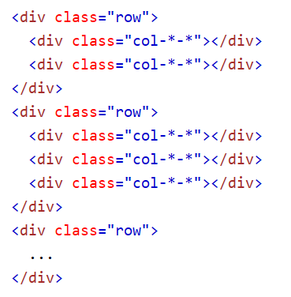
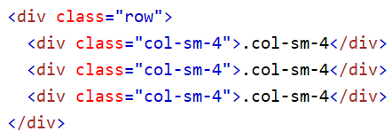
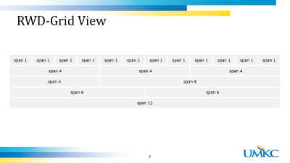

Bootstrap-Basic Structure of Grid
Example

Slide 20
Bootstrap
Tables | Pager
Images | List Groups
Alerts | Panels
Buttons | Dropdowns
Button Groups | Collapse
Glyphicons | Tabs/Pills
Badges/Labels | Navbar
Progress Bars | Forms
Pagination | Input
https://getbootstrap.com/docs/4.2/getting-started/introduction/

Slide 21
JavaScript Basics

Slide 22
JavaScript
HTML and CSS are used to define the content and layout of web pages
JavaScript is to program the behavior of web pages
It can change HTML content, attribute, style of any element

Slide 23
JavaScript
JavaScript was invented by Brendan Eich in 1995, and became an ECMA standard in 1997.
ECMAScript (ES) is the official name of the language.

Slide 24



Changing Content
Output:

Slide 25
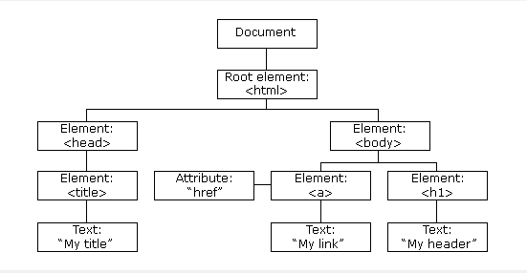
Document Object Model (DOM)
Presents an HTML document as a tree structure

Slide 26
DOM
Everything in an HTML document is a node
Document Node: Entire Document
Element Node: HTML tags
Text Node: Texts in the element node
Attribute Node: HTML attribute
Comment Nodes
Defines a standard way for accessing and manipulating HTML documents

Slide 27
Variables
Containers for storing data values.
Syntax:
var <variableName> = <someValue>
Example:
var age=23;
var firstName ="bob";
'var' declares new variable for all data types

Slide 28
Arithmetic and Assignment Operators
var x=5%2; // x value is 1
var x= "cs" +"5590"// x value is "cs5590"
var x=10;// x value is 10
x+=5; // x value is 15
x++ // x value is 16
x--// x value is 15

Slide 29
Comparison Operators
Operator | Description
== | equal to
=== | equal value and equal type
!= | not equal
!== | not equal value or not equal type
> | greater than
< | less than
>= | greater than or equal to
<= | less than or equal to
? | ternary operator

Slide 30
Logical Operators
Operator | Description
&& | Logical and
|| | Logical or
! | Logical not

Slide 31
Data types
Primitive Data
string
number
boolean
null
undefined
Complex Data
object
function

Slide 32
Strings
var carName = "Volvo XC60";
var carName = 'Volvo XC60';
var answer = "It's alright";
var x = 16 + 4 + "Volvo";-->20Volvo
var x = "Volvo" + 16 + 4;-->Volvo164

Slide 33
Numbers
only one type of numbers.
can be written with, or without decimals
var x1 = 34.00;
var x2 = 34;
var y = 123e5; // 12300000 var z = 123e-5; // 0.00123

Slide 34
Booleans
can only have two values: true or false.
var x = true; var y = false;

Slide 35
Booleans
Evaluates to 'true' | Evaluates to 'false'
true | false
Non zero number | zero
string | “”
objects | undefined
arrays | null
functions | Not a Number

Slide 36
Undefined, Null
var person; // Value is undefined
var person = null;
// Value is null, but type is still an object
Undefined vs Null
typeof undefined // undefined typeof null // object null === undefined // false null == undefined // true

Slide 37
== Vs ===
== is used to check if two values are equal irrespective of their data types
=== is used to check if two values are equal based on both value and data type
x== "5" //returns true (if x=5)
x=== "5" //returns false (if x=5)

Slide 38
Arrays ,Objects
var cars = ["Saab", "Volvo", "BMW"];
Array indexes are zero-based
var person = {
firstName: "John",
age: 50,
}
Objects are name:value pairs, separated by commas.

Slide 39
pop(), push ()
var fruits = ["Banana", "Apple", "Mango"];
var x = fruits.pop(); // value of x is "Mango"
var fruits = ["Banana", "Apple"]
var x = fruits.push("Kiwi"); // x=3
Push returns the new length of array

Slide 40
toString(), length
toString() converts array to string
var fruits = ["Banana", "Orange", "Kiwi"];
var s = fruits.toString();
//s value is "Banana,Orange,Kiwi"
Length property gives length of array
var lth1 = fruits.length // lth1 value is 3
var lth2 =s.length // lth2 value is 18

Slide 41
splicing()
var fruits = ["Banana", "Mango", "Kiwi"];
fruits.splice(1, 1, "berry"); → it returns ["Mango"]
//fruits value is ["Banana", "berry", "Kiwi"];
1-->position where new element is added
1-->how many elements should be removed
Rest of parameters-->elements to be added

Slide 42
Type Conversion
String()->converts given datatype to string
String(false) // returns "false"
toString()
(100 + 23).toString()// returns "123"
Number("3.14")// returns 3.14
parseFloat()-> String to float
parseFloat("10.5")/ returns 10.5
parseInt()->String to integer
parseInt(“10.5”)// returns 10

Slide 43
Function
function myFunction(p1, p2) { return p1 * p2; // The function returns the product of p1 and p2 }
Function stops execution after return statement
myFunction(2,3)// returns 6 ->invocation

Slide 44
Conditions
If Statement
if (hour < 18) { greeting = "Good day"; }
else-if Statement
if (time < 10) { greeting = "Good morning"; } else if (time < 20) { greeting = "Good day"; } else { greeting = "Good evening"; }
If-else Statement
if (hour < 18) { greeting = "Good day"; } else { greeting = "Good evening"; }

Slide 45
Switch Statement
switch (new Date().getDay()) { case 0: day ="Sunday"; break; case 6: day = "Saturday";
break;
default:
day ="Working Day"; }

Slide 46
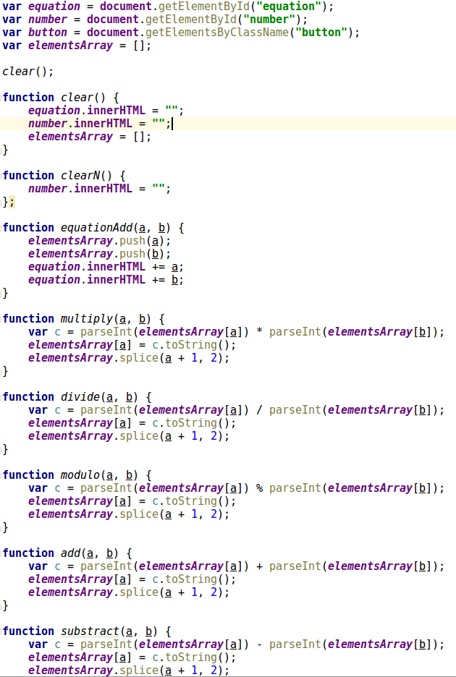
Use Case: Calculator

Slide 47
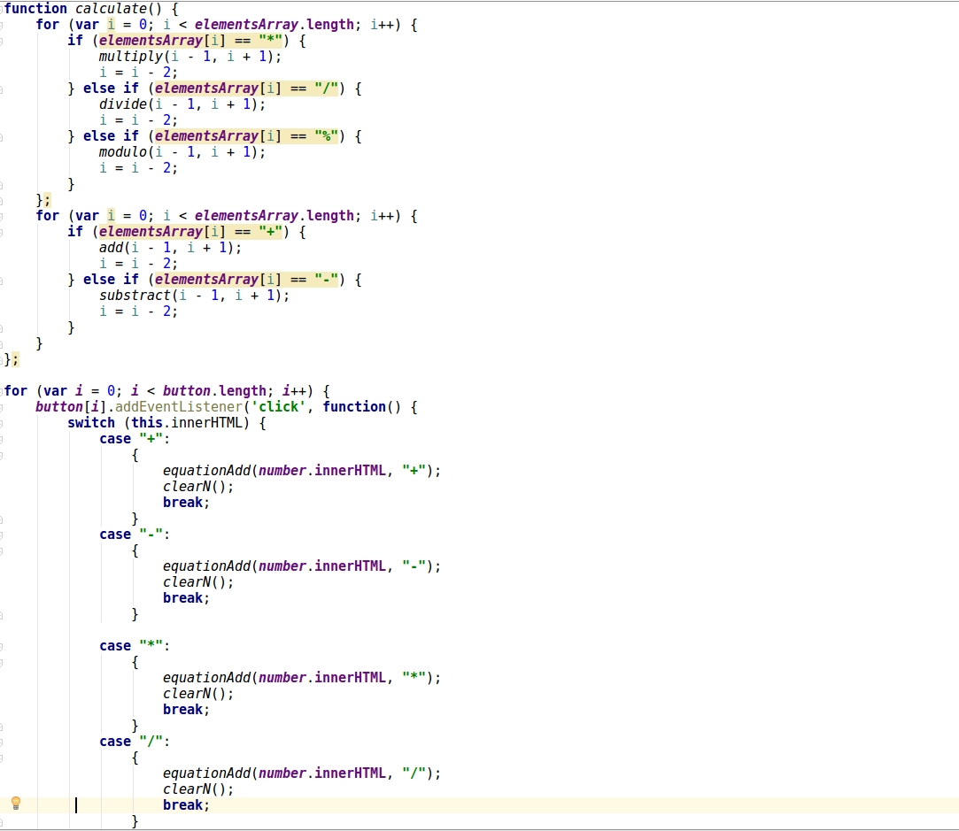
Use Case: Calculator

Slide 48
ICP
Please refer steps in the lesson plan

Slide 49
References
https://developer.mozilla.org/en-US/
https://developer.mozilla.org/en-US/docs/Web/JavaScript/Reference/Global_Objects/Math/random
https://www.w3schools.com
https://github.com/Annno/Calculator-VanillaJS
https://www.udacity.com/
http://www.hongkiat.com
https://ariya.io
https://css-tricks.com
http://www.corelangs.com
http://getbootstrap.com/

