Slide 1

Web Programming
Installation for MongoDB

Slide 2

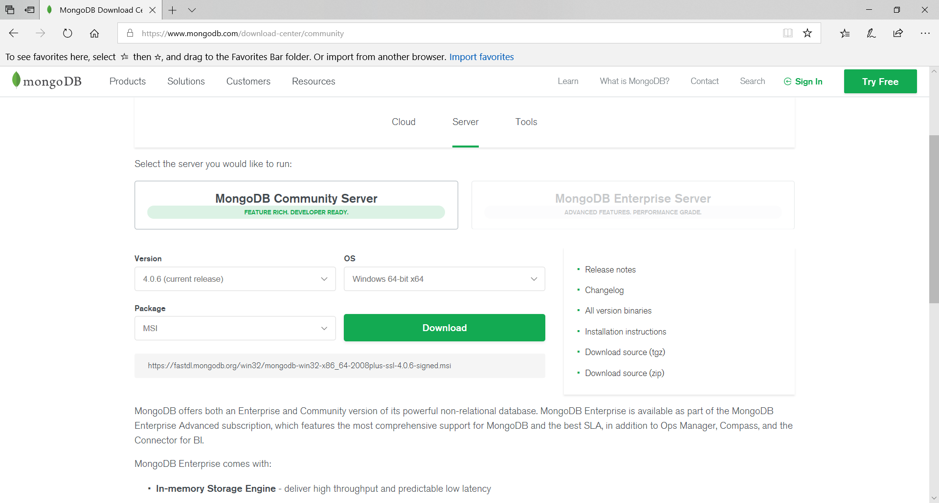
MongoDB Installation
https://www.mongodb.com/download-center/community

Slide 3
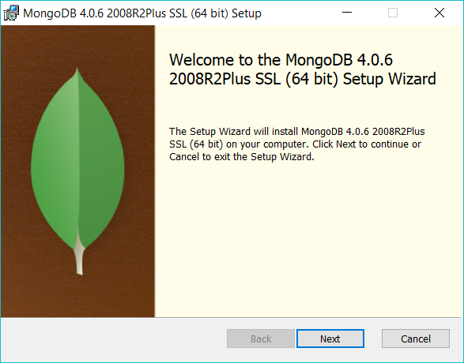
MongoDB Installation
Follow the installation wizard which will install the MongoDB successfully on your computer.

Slide 4
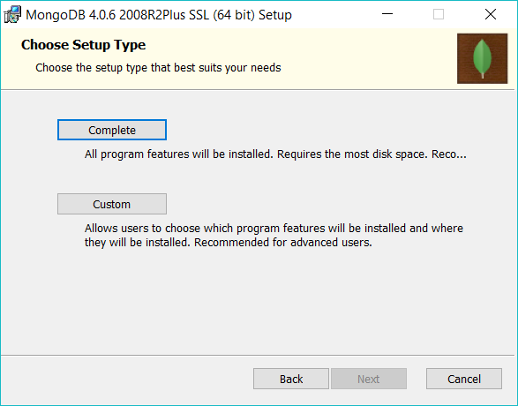
MongoDB Installation
Proceed and check for the following:

Slide 5
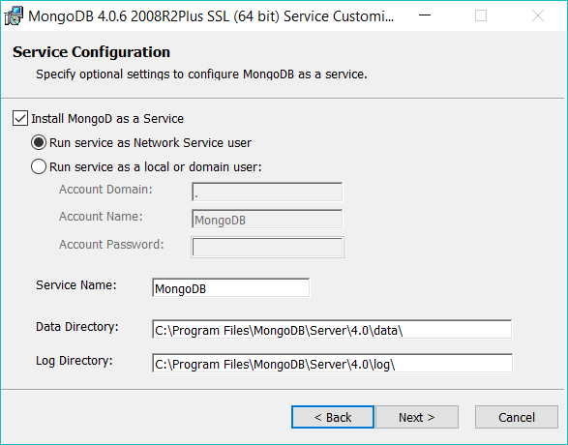
MongoDB Installation

Slide 6
MongoDB Installation

Slide 7
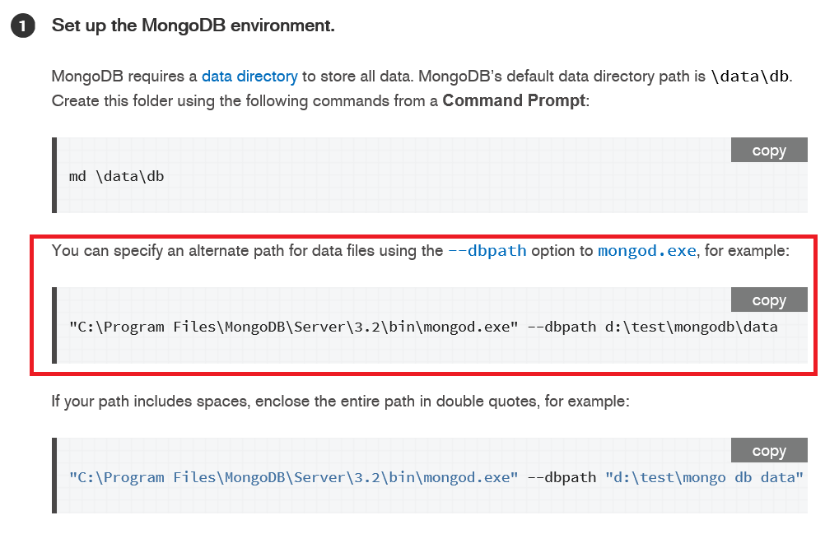
MongoDB - Setup local db path to store data
Check this link

Slide 8
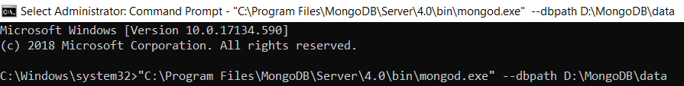
Set up the MongoDB environment
Run on command prompt (cmd):

Slide 9
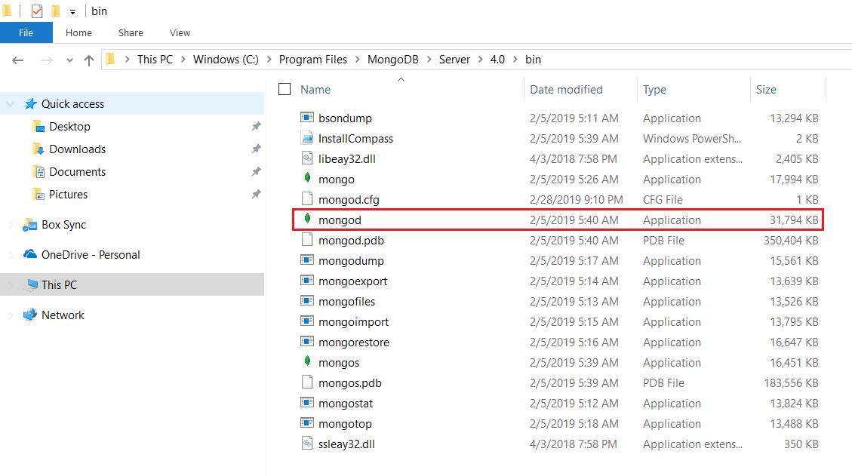
Start MongoDB
Go to ‘C:\Program Files\MongoDB\Server\4.0\bin’ and double click the ‘mongod.exe’
Source: https://docs.mongodb.com/v3.2/tutorial/install-mongodb-on-windows/

