Slide 1

CSEE5590/490: Web/Mobile Programming
Mobile App Development

Slide 2

Overview
RESTful Services
List View, Adapter, Recycling
Multi-Threading, Async Task

Slide 3
RESTful API
An API is an easy way of fetching information from a remote service
A RESTful API uses HTTP requests to GET, PUT, POST and DELETE data
A browser sends request to and receives response from a server through HTTP
Some great resources of APIs
Programmable Web API Directory
Google APIs Explorer
Data.gov
Resource: https://earthquake.usgs.gov/fdsnws/event/1/
Source: https://www.javatpoint.com/android-web-service
Notes:
What is Web Service?
A web service is a standard for exchanging information between different types of applications irrespective of language and platform. For example, an android application can interact with java or .net application using web services.
REST is web standards based architecture and uses HTTP Protocol.

Slide 4
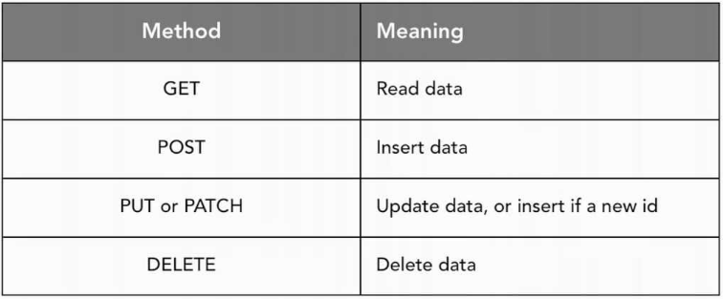
HTTP Verbs
Source: https://www.tutorialspoint.com/restful/restful_introduction.htm
Notes:
GET − Provides a read only access to a resource.
POST − Used to create a new resource.
DELETE − Used to remove a resource.
PUT − Used to update a existing resource or create a new resource.

Slide 5
JSON
JSON syntax is derived from JavaScript object notation syntax
Data is in name/value pairs
Data is separated by commas
Curly braces hold objects
Square brackets hold arrays
Source: http://www.tutorialspoint.com/android/android_json_parser.htm
Notes:
JSON stands for JavaScript Object Notation. It is an independent data exchange format and is the best alternative for XML.

Slide 6
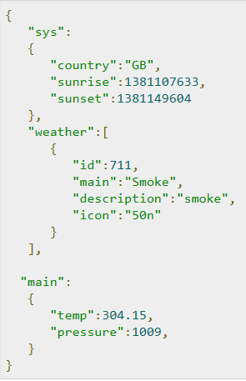

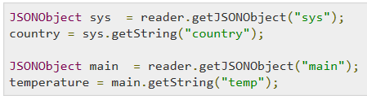
JSON
JSON - Parsing
The method getJSONObject returns the JSON object.
The method getString returns the string value of the specified key.
Source: http://www.tutorialspoint.com/android/android_json_parser.htm
https://developer.android.com/reference/org/json/JSONObject.html

Slide 7
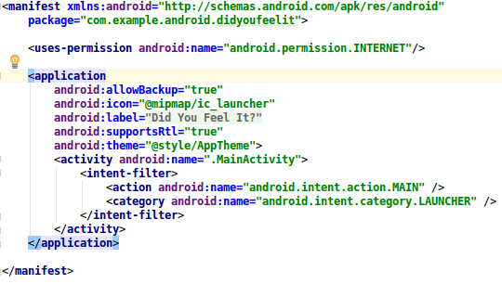
Internet Permission

Slide 8
Components of a URL
Uniform Resource Locator
A reference (an address) to a resource on the Internet.
E.g. http://example.com/home/users/profile?name=foo&age
protocol
domain/host
resource path
query
Source: https://docs.oracle.com/javase/tutorial/networking/urls/index.html
Notes:
Protocol: HTTP is the protocol here
Hostname: Name of the machine on which the resource lives.
File Name: The path name to the file on the machine.

Slide 9
Creating an URL Object
The easiest way to create an URL object is from a String that represents the human-readable form of the URL address.
The URL object created above represents an absolute URL.
An absolute URL contains all of the information necessary to reach the resource in question.
You can also create URL objects from a relative URL address.
Source: https://developer.android.com/reference/java/net/URL.html
https://docs.oracle.com/javase/tutorial/networking/urls/index.html

Slide 10
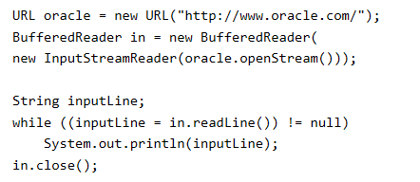
Reading Directly from a URL
After you've successfully created a URL, you can call the URL's openStream() method to get a stream from which you can read the contents of the URL.
Source: https://docs.oracle.com/javase/tutorial/networking/urls/index.html

Slide 11
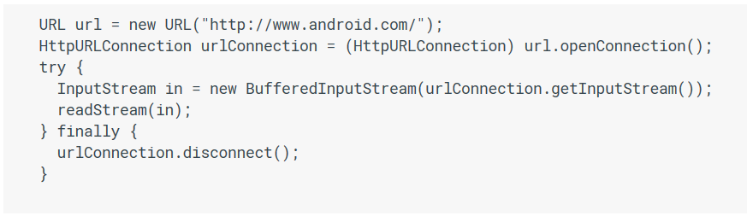
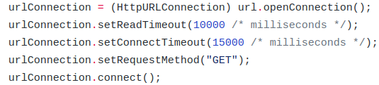
Connecting to a URL
After you've successfully created a URL object, you can call the URL object's openConnection method to get a URLConnection object
Source: https://docs.oracle.com/javase/tutorial/networking/urls/index.html

Slide 12
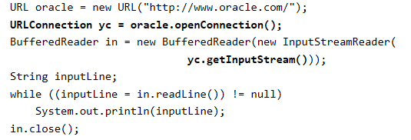
Reading from a URLConnection
Source: https://docs.oracle.com/javase/tutorial/networking/urls/index.html

Slide 13
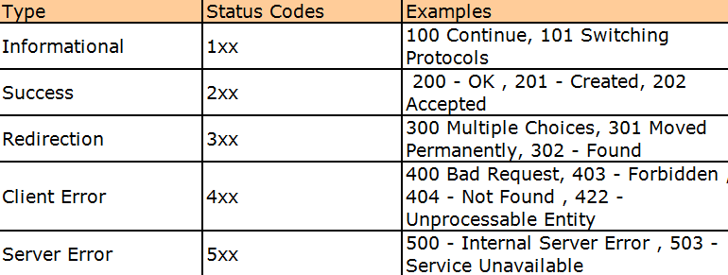
Response Codes
Source: https://www.steveschoger.com/status-code-poster/

Slide 14
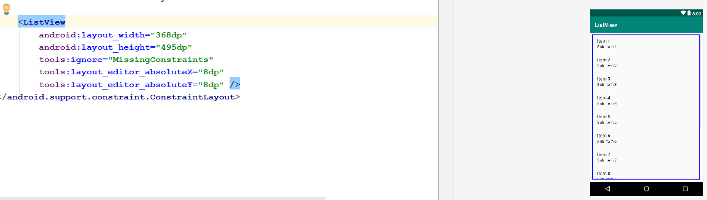
List View
ListView is a view group that displays a list of scrollable items.
The list items are automatically inserted to the list using an Adapter that pulls content from a source such as an array or database query and converts each item result into a view that's placed into the list.
Source: https://developer.android.com/guide/topics/ui/layout/listview

Slide 15
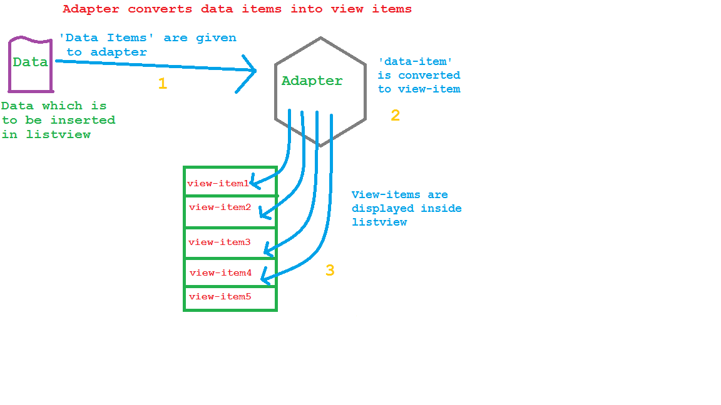
Adapter

Slide 16
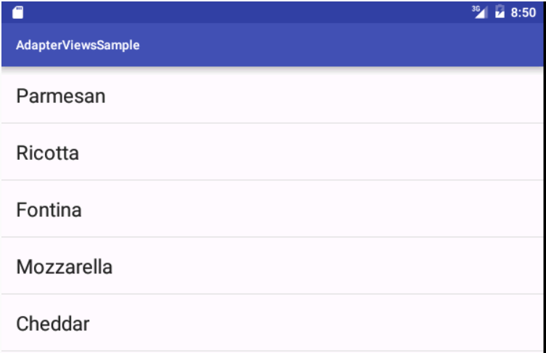
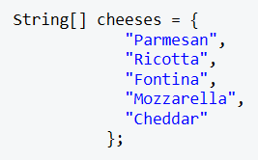
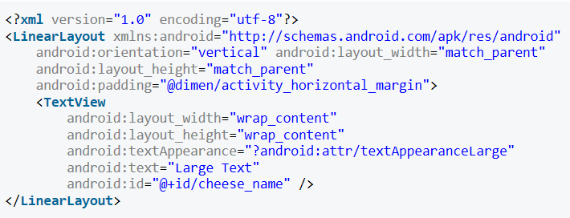
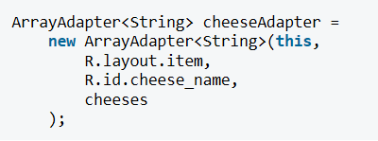



Adapter
Data
Adapter
Source: https://code.tutsplus.com/tutorials/android-from-scratch-understanding-adapters-and-adapter-views--cms-26646

Slide 17
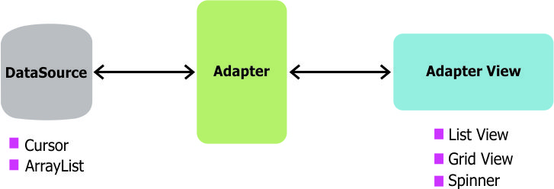
Adapter
Source: https://guides.codepath.com/android/Using-an-ArrayAdapter-with-ListView

Slide 18
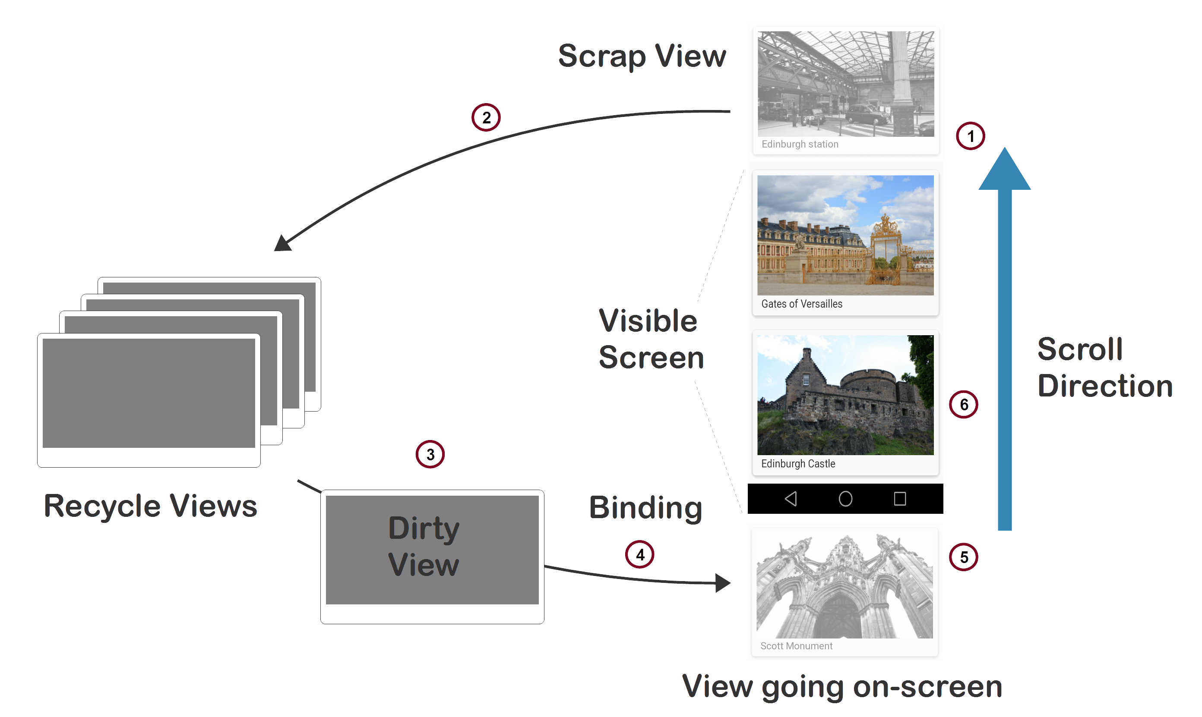
Recycling
Source: https://guides.codepath.com/android/Using-an-ArrayAdapter-with-ListView
https://stackoverflow.com/questions/11945563/how-listviews-recycling-mechanism-works

Slide 19
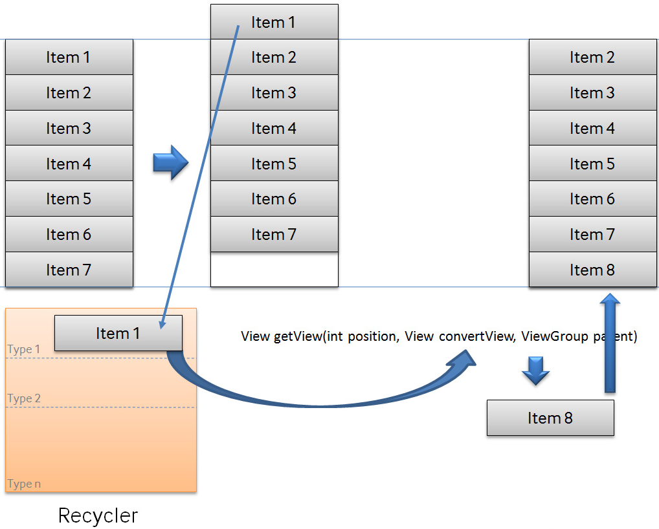
Recycling - List View

Slide 20
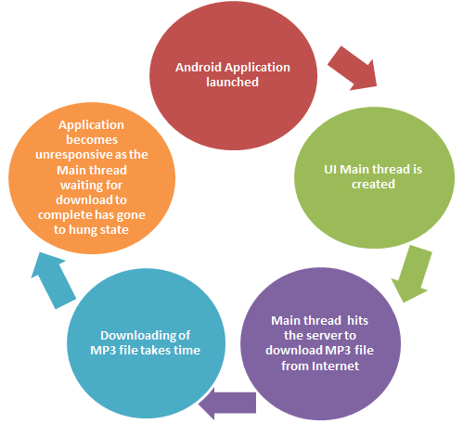
Multi-threading
Source: http://programmerguru.com/android-tutorial/what-is-asynctask-in-android/

Slide 21
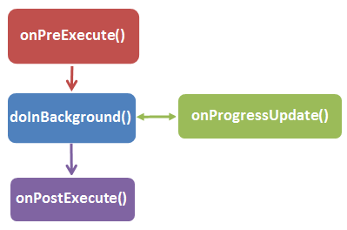
AsyncTask
Source: https://developer.android.com/reference/android/os/AsyncTask.html
http://programmerguru.com/android-tutorial/what-is-asynctask-in-android/
https://code.tutsplus.com/tutorials/android-from-scratch-using-rest-apis--cms-27117

Slide 22
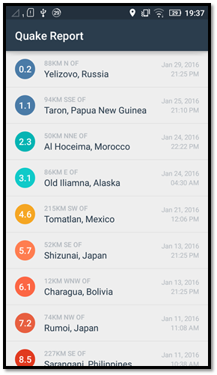
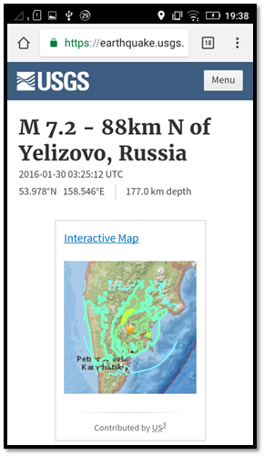
ICP
Please refer steps in the lesson plan. See below example output.
Follow the TODO instructions given in the QueryUtils.java, EarthquakeActivity.java and the AndroidManifest.xml files

Slide 23
References
https://developer.android.com/index.html
https://developer.android.com/
https://developers.google.com/android/for-all/vocab-words/
https://developer.android.com/training/basics/firstapp/
https://classroom.udacity.com/courses/ud843
http://www.tutorialspoint.com/
https://docs.oracle.com/
https://developer.android.com/studio/write/tool-attributes#toolsignore

