Slide 1
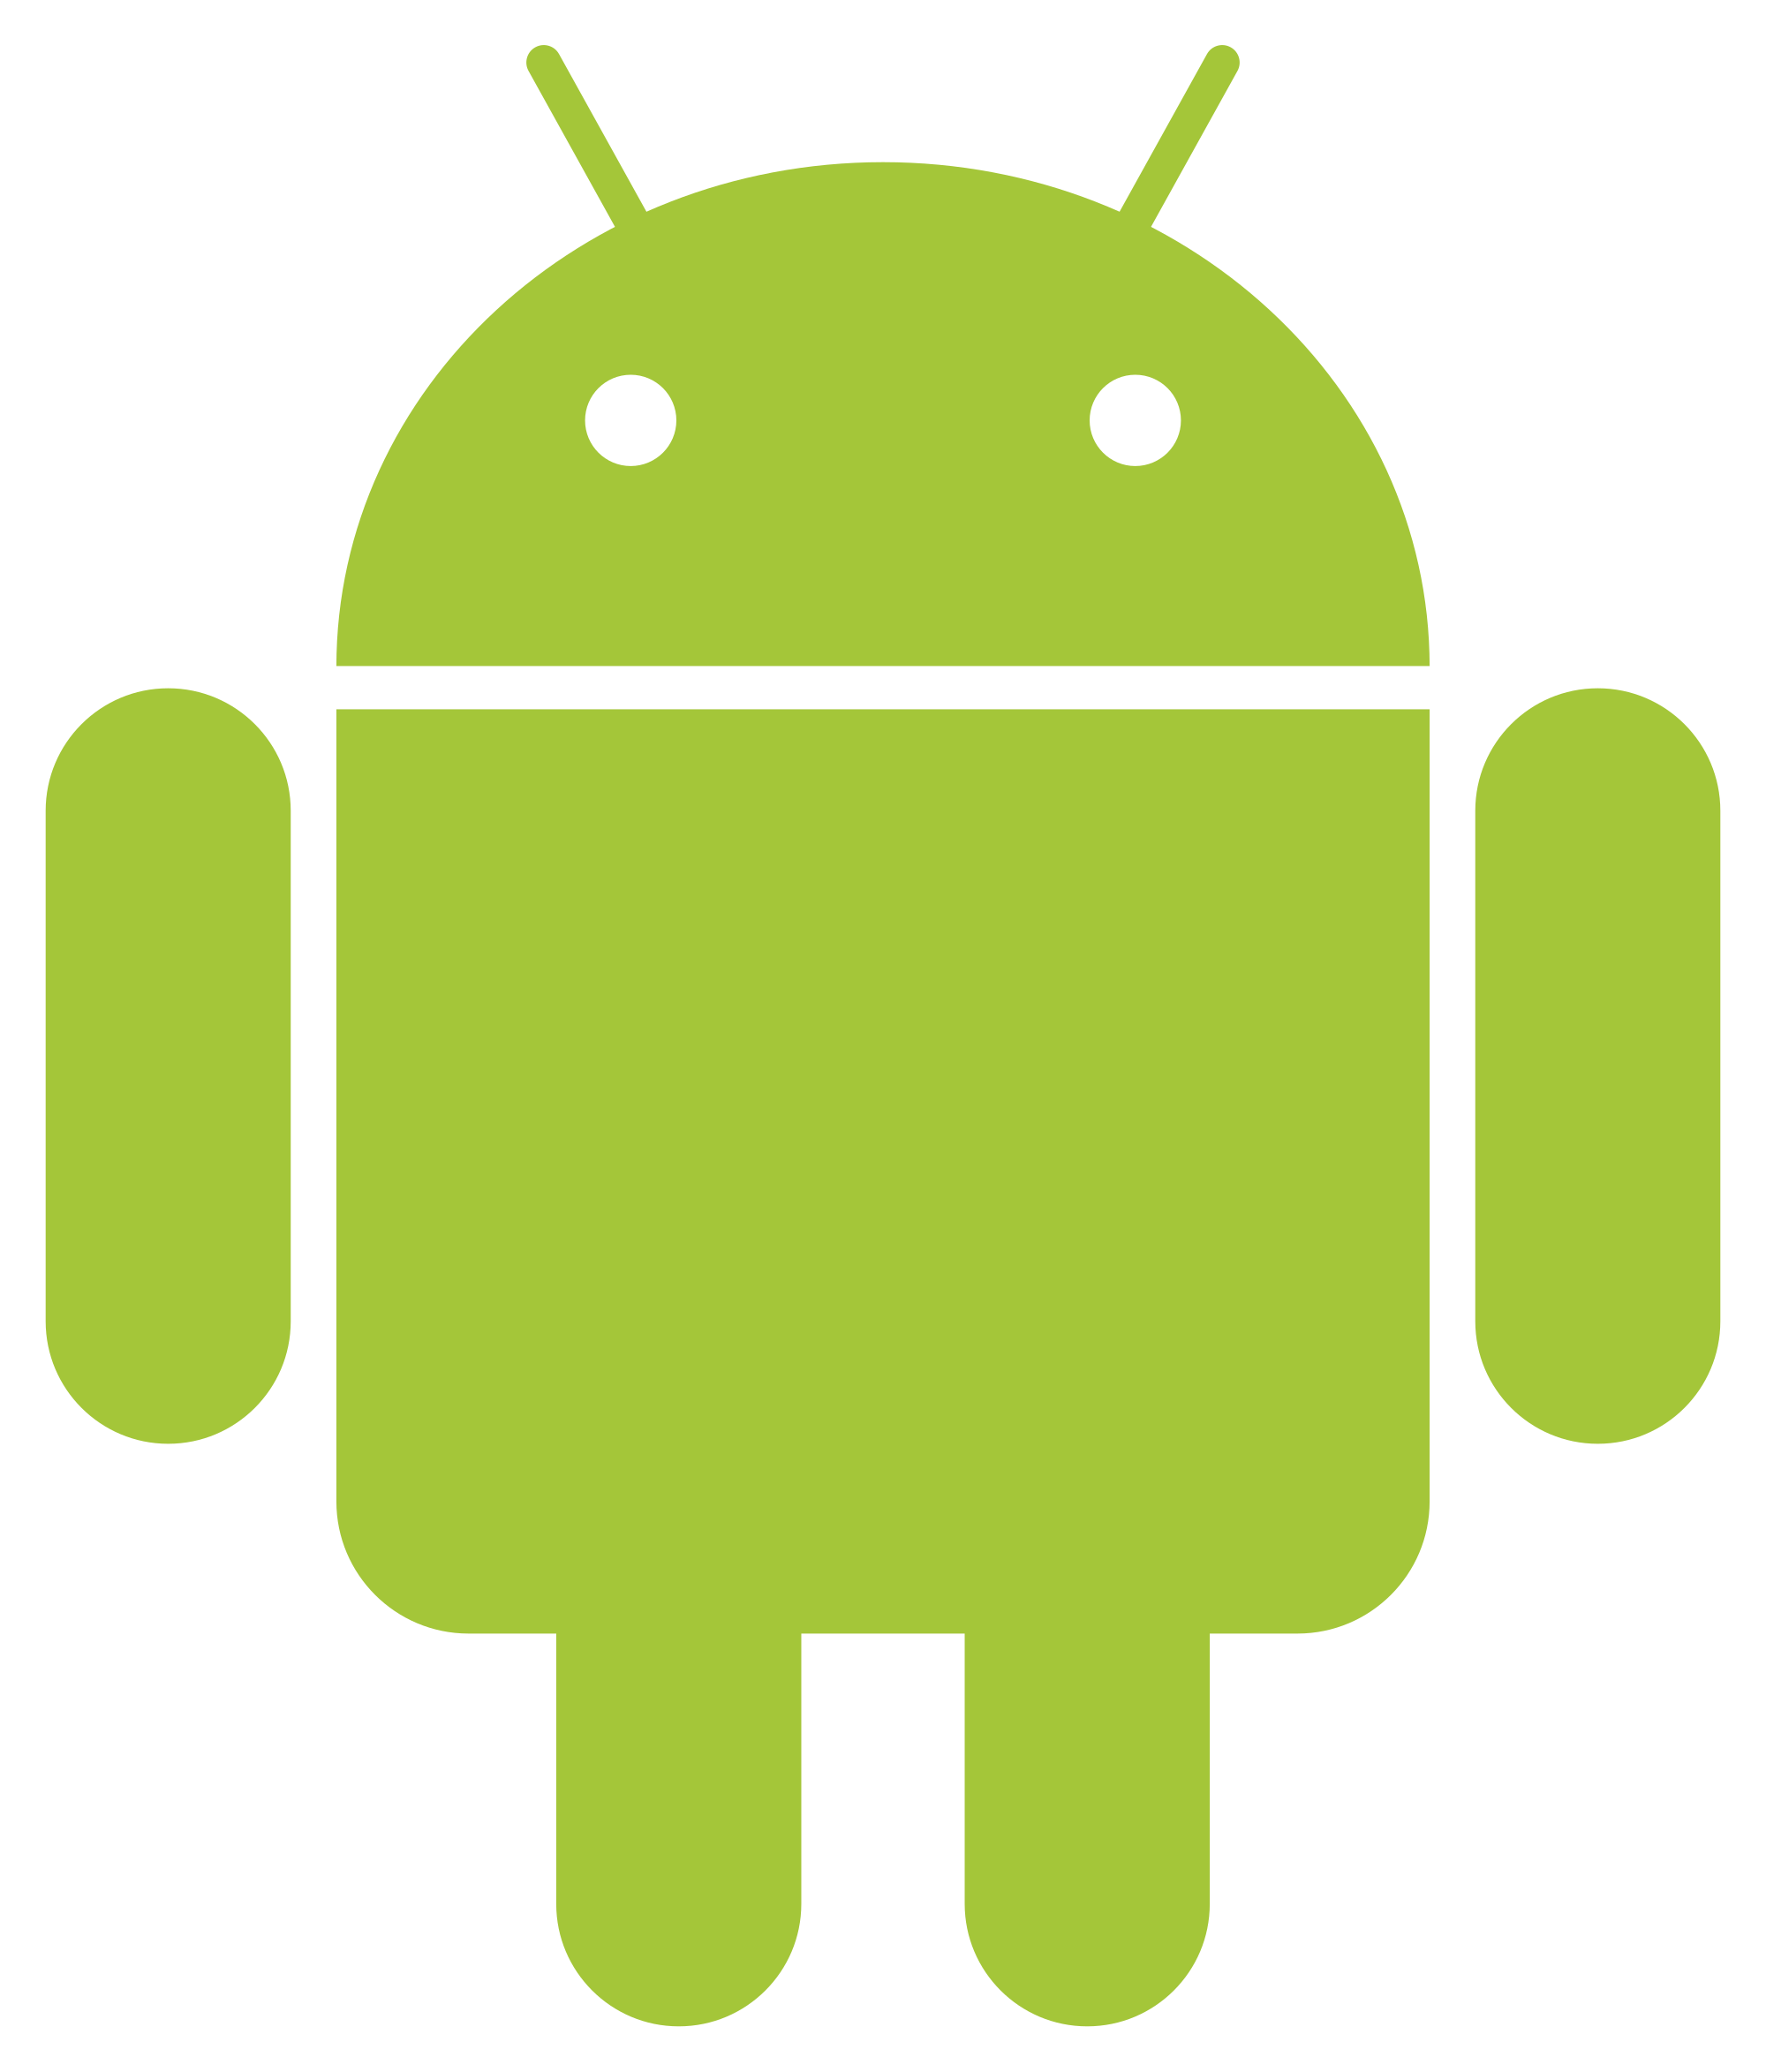
CSEE5590/490: Web/Mobile Programming
Mobile App Development

Slide 2
Overview
Notifications
Calendar API
Publishing apps to Google Play Store

Slide 3
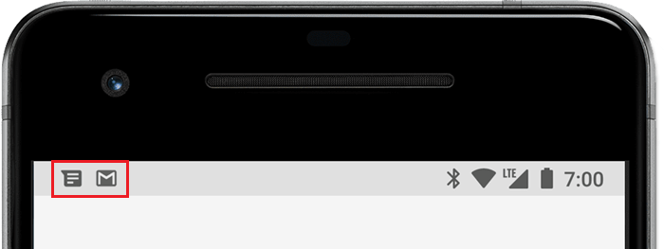
Notifications
A notification is a message that Android displays outside your app's UI to provide the user with reminders, communication from other people, or other timely information from your app.
Users can tap the notification to open your app or take an action directly from the notification.

Slide 4
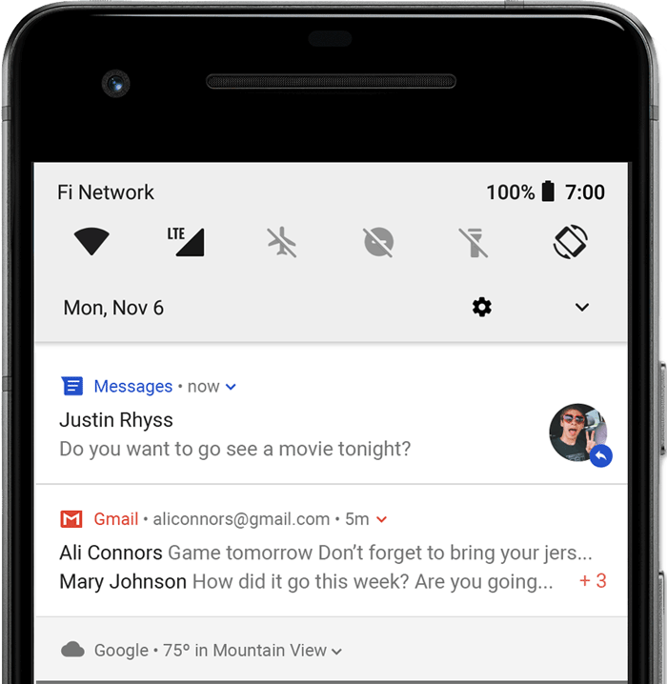
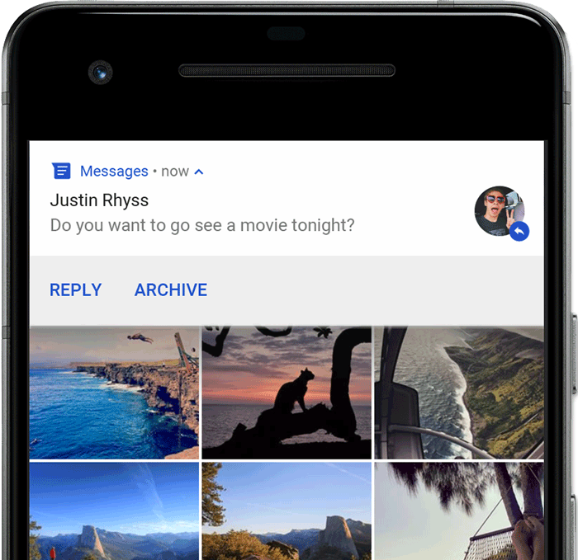
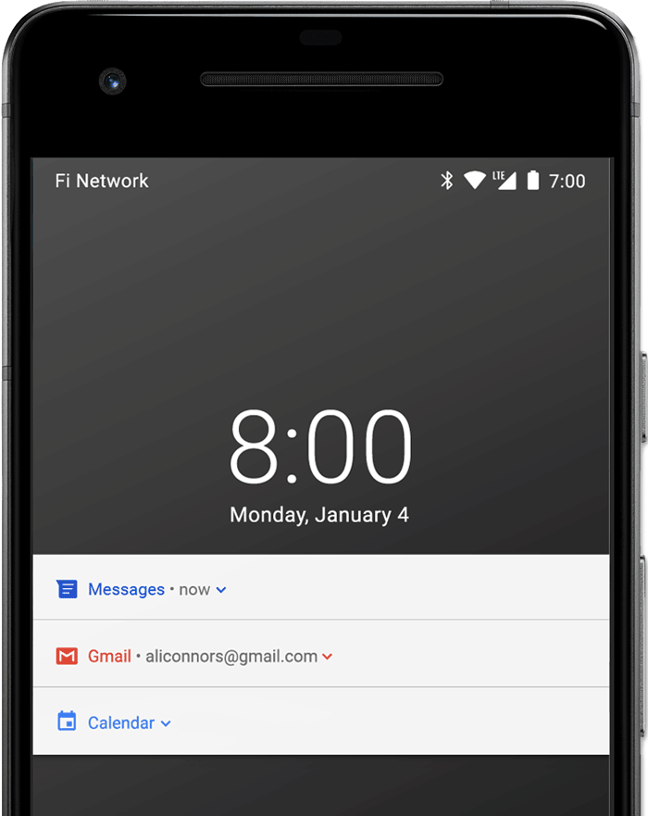
Appearances on a device
Notifications appear to users in different locations and formats, such as an icon in the status bar, a more detailed entry in the notification drawer, as a badge on the app's icon, and on paired wearables automatically.
Reference: https://developer.android.com/guide/topics/ui/notifiers/notifications

Slide 5
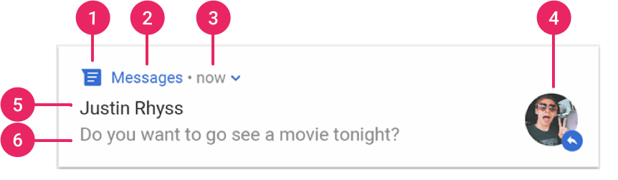
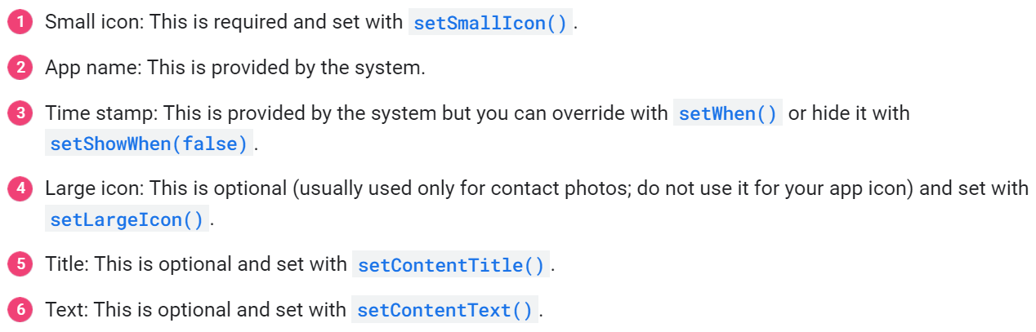
Notification Anatomy

Slide 6
Create a Notification
Add the support library
Create a basic notification
  Set the notification content
  Create a channel and set the importance
  Set the notification's tap action
  Show the notification
Reference: https://developer.android.com/guide/topics/ui/notifiers/notifications

Slide 7
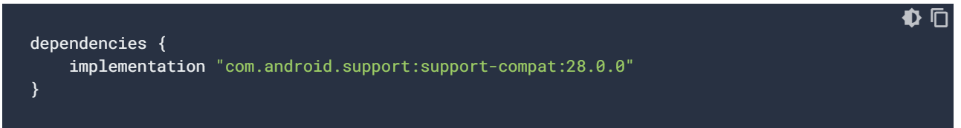
Add the support library

Slide 8
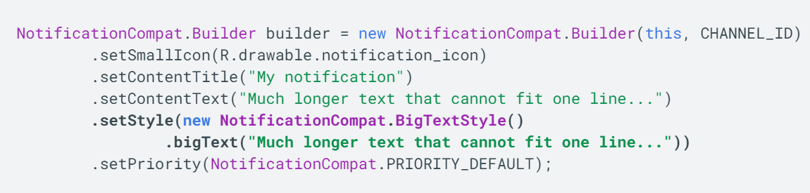
Set the notification content

Slide 9
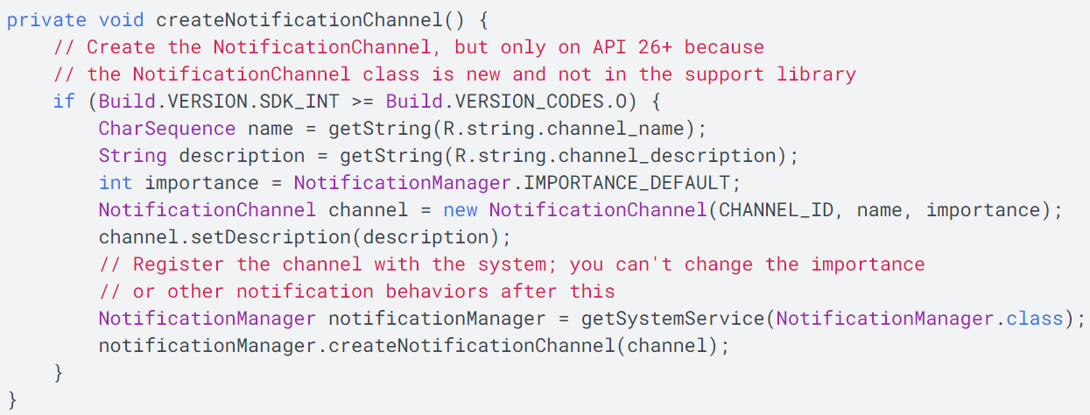
Create a channel and set the importance

Slide 10
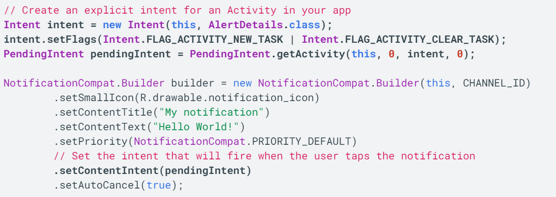
Set the notification's tap action

Slide 11
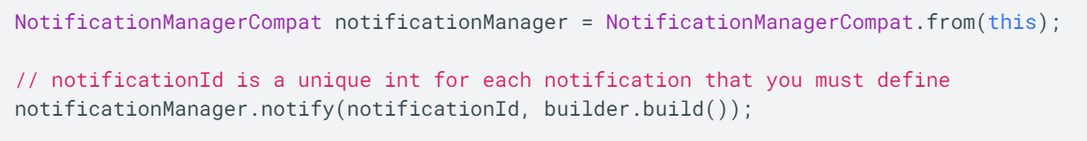
Show the notification

Slide 12
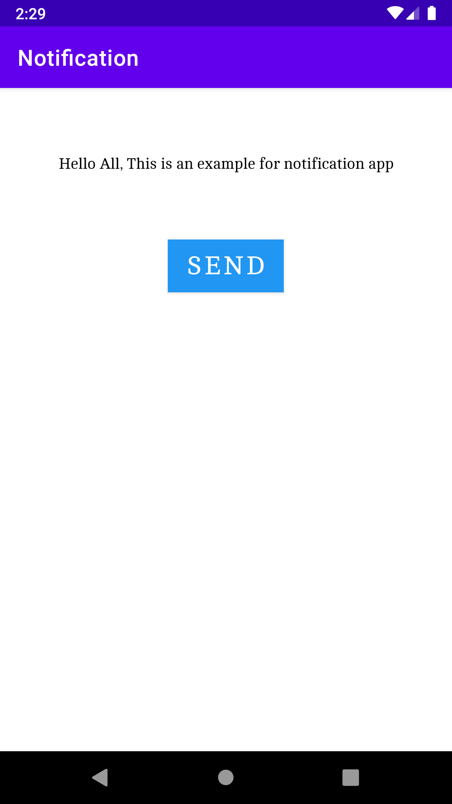
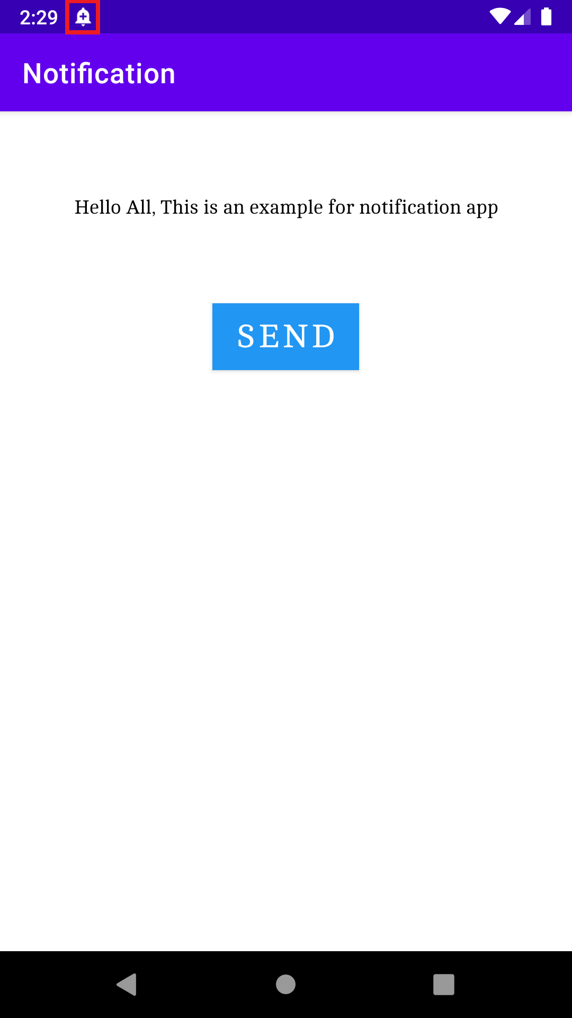
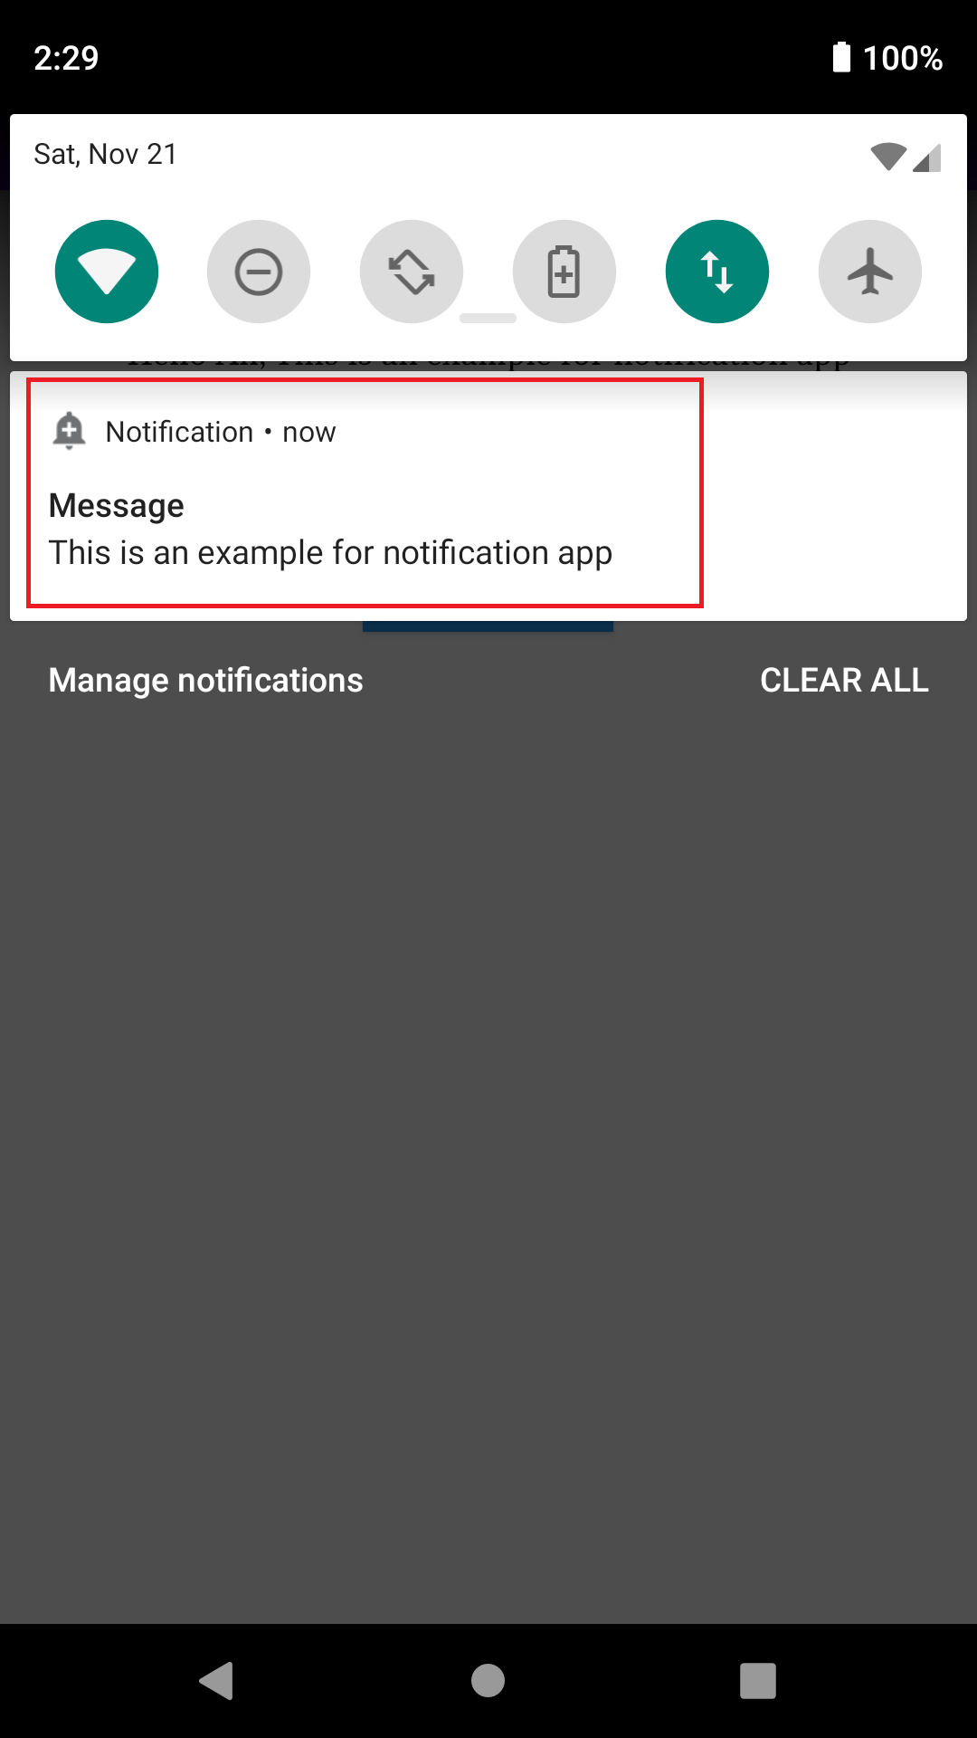
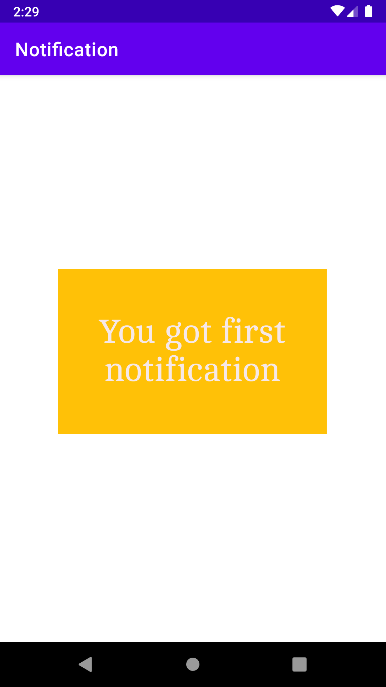
Example

Slide 13
Calendar View
Calendar View is available as of Android 4.0
Used for displaying and selecting dates
The supported range of dates of this calendar is configurable
User can select any date by taping/clicking on it and can scroll & find the calendar to a desired date
Also, Developer can also set minimum and maximum date shown in calendar view

Slide 14
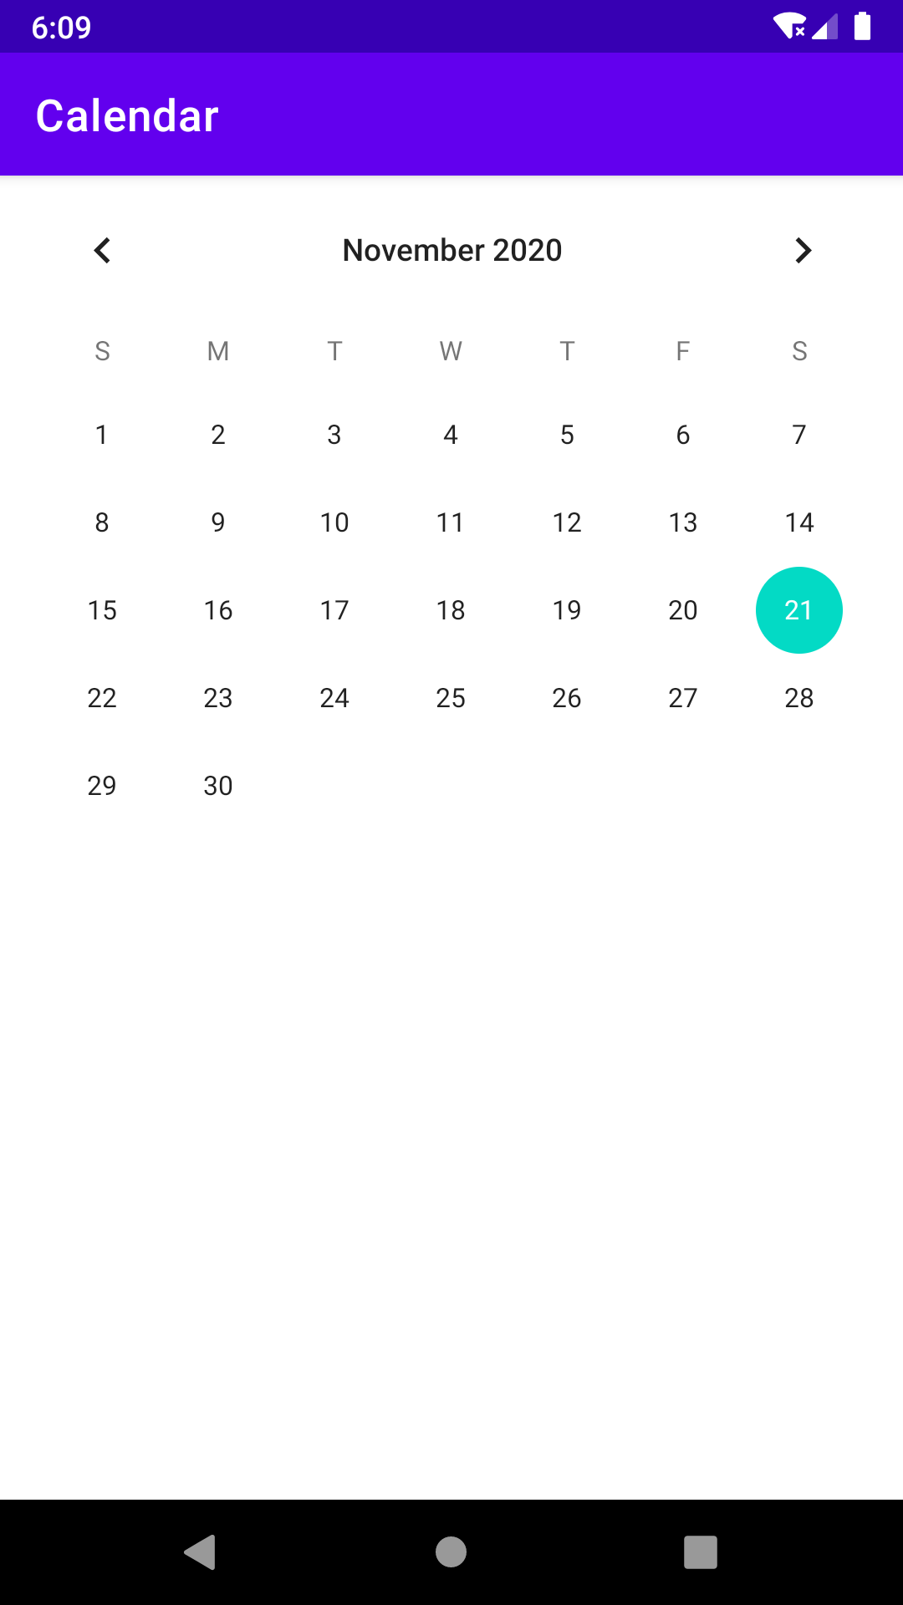
Basic Calendar View XML Code
<CalendarView
android:id="@+id/simpleCalendarView"
android:layout_width="fill_parent"
android:layout_height="fill_parent" />

Slide 15
Attributes of Calendar
id: id attribute is used to uniquely identify a CalendarView.
firstDayOfWeek: This attributes is used to set the first day of week according to Calendar. We can also set this programmatically means in java class using setFirstDayOfWeek(int firstDayOfWeek) method
focusedMonthDateColor: This attribute is used to set the color for the dates of the focused month. We can also set this programmatically means in java class using setFocusedMonthDateColor(int color) method.
unfocusedMonthDateColor: This attribute is used to set the color for the dates of the unfocused month. We can also set this programmatically means in java class using setUnfocusedMonthDateColor(int color) method
maxDate: This attribute is used to set the maximal date supported by this CalendarView. This attribute use mm/dd/yyyy format. We can also set this programmatically means in java class using setMaxDate(long maxDate)
minDate: This attribute is used to set the minimal date supported by this CalendarView. This attribute use mm/dd/yyyy format. We can also set this programmatically means in java class using setMinDate(long minDate)
Reference: https://developer.android.com/reference/android/widget/CalendarView

Slide 16
Attributes of Calendar
selectedDateVerticalBar: This attribute is used to set the drawable/color for the vertical bar shown at the beginning and at the end of the selected date. We can also set this programmatically means in java class using setSelectedDateVerticalBar(int resourceId) or setSelectedDateVerticalBar(Drawable drawable) method.
selectedWeekBackgroundColor: This attribute is used to set the color in the background of selected week of CalendarView. We can also set this programmatically in java class using setSelectedWeekBackgroundColor(int color) method.
showWeekNumber: This attribute is used to show or hide the week number of CalendarView. In this method we set Boolean type value means true or false. We can also set this programmatically means in java class using setShowWeekNumber(boolean showWeekNumber) method.
weekNumberColor: This attribute is used to set the color for the week numbers.
weekSeparatorLineColor: This attribute is used to set the color for the week separator line. We can also set this programmatically means in java class using setWeekSeparatorLineColor(int color) method.

Slide 17
Important Methods Of Calendar View
getDate(): This method is used to get the selected date of CalendarView in milliseconds since January 1, 1970 00:00:00 in user’s preferred time zone. This method returns long type value for selected date.
setDate(long date): This method is used to set the selected date in milliseconds since January 1, 1970 00:00:00 in user’s preferred time zone.
setFirstDayOfWeek(int firstDayOfWeek): This method is used to set the first day of the week.
getFirstDayOfWeek(): This method is used to get the first day of week. This method returns an int type value.
setMaxDate(long maxDate): This method is used to set the maximal date supported by thisCalendarView in milliseconds since January 1, 1970 00:00:00 in user’s preferred time zone.
getMaxDate(): This method is used to get the maximal date supported by this CalendarView in milliseconds since January 1, 1970 00:00:00 in user’s preferred time zone. This method returns long type value for maximal date supported by this CalendarView.

Slide 18
Important Methods Of Calendar View
setMinDate(long minDate): This method is used to to set the minimal date supported by this CalendarView in milliseconds since January 1, 1970 00:00:00 in user’s preferred time zone.
getMinDate(): This method is used to to get the minimal date supported by thisCalendarView in milliseconds since January 1, 1970 00:00:00 in user’s preferred time zone. This method returns long type value for minimal date supported by this CalendarView.
setShowWeekNumber(boolean showWeekNumber): This method is used to show or hide the week number of CalendarView.
getShowWeekNumber(): This method is used to check whether the week number are shown or not. This method returns Boolean type value means true or false. True indicates week numbers are shown and false indicates week numbers are currently hidden.
getSelectedDateVerticalBar(): This method is used to get the drawable i.e used for the vertical bar shown at the beginning and at the end of the selected date. This method was deprecated in API level 23 so no longer used by Material style CalendarView.

Slide 19
Important Methods Of Calendar View
setSelectedDateVerticalBar(Drawabledrawable): This method is used to set the drawable for the vertical bar shown at the beginning and at the end of the selected date. This method was deprecated in API level 23 so no longer used by Material style CalendarView.
setSelectedDateVerticalBar(int resourceId): This method is used to set the color for the vertical bar shown at the beginning and at the end of the selected date. This method was deprecated in API level 23 so no longer used by Material style CalendarView.
setSelectedWeekBackgroundColor(int color): This method is used to set the color in the background of selected week of CalendarView. This method was deprecated in API level 23 so no longer used by Material style CalendarView.
getSelectedWeekBackgroundColor(): This method is used to get the background color of selected week of CalendarView. This method returns an int type value. This method was deprecated in API level 23 so no longer used by Material style CalendarView.
getWeekNumberColor(): This method is used to get the color of week numbers. This method returns an int type value. This method was deprecated in API level 23 so no longer used by Material style CalendarView.

Slide 20
Important Methods Of Calendar View
setWeekNumberColor(int color): This method is used to set the color for the week numbers. This method was deprecated in API level 23 so no longer used by Material style CalendarView.
setWeekSeparatorLineColor(int color): This method is used to set the color for the week separator line. This method was deprecated in API level 23 so no longer used by Material style CalendarView.
getWeekSeparatorLineColor(): This method is used to get the color of week separator line. This method returns an int type value. This method was deprecated in API level 23 so no longer used by Material style Calendar View.
setUnfocusedMonthDateColor(int color): This method is used to set the color for the dates of an unfocused month. This method was deprecated in API level 23 so no longer used by Material style Calendar View.
getUnfocusedMonthDateColor(): This method is used to get the color for the dates of an unfocused month. This method returns int type value. This method was deprecated in API level 23 so no longer used by Material style CalendarView.
setFocusedMonthDateColor(int color): This method is used to set the color for the dates of an focused month. This method was deprecated in API level 23 so no longer used by Material style CalendarView.

Slide 21
Important Methods Of Calendar View
getFocusedMonthDateColor(): This method is used to get the color for the dates of an focused month. This method returns int type value. This method was deprecated in API level 23 so no longer used by Material style CalendarView.
setOnDateChangeListener(OnDateChangeListenerlistener): This method is used to set the listener to be notified upon selected date change.

Slide 22
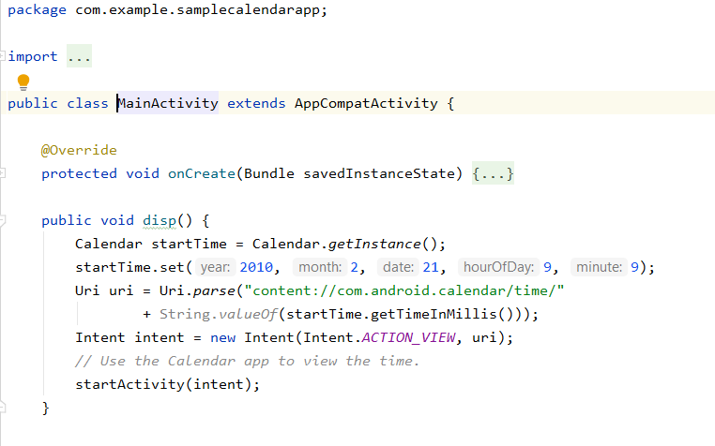
Use case 1- Display Event
Calling calendar on click using Intent

Slide 23
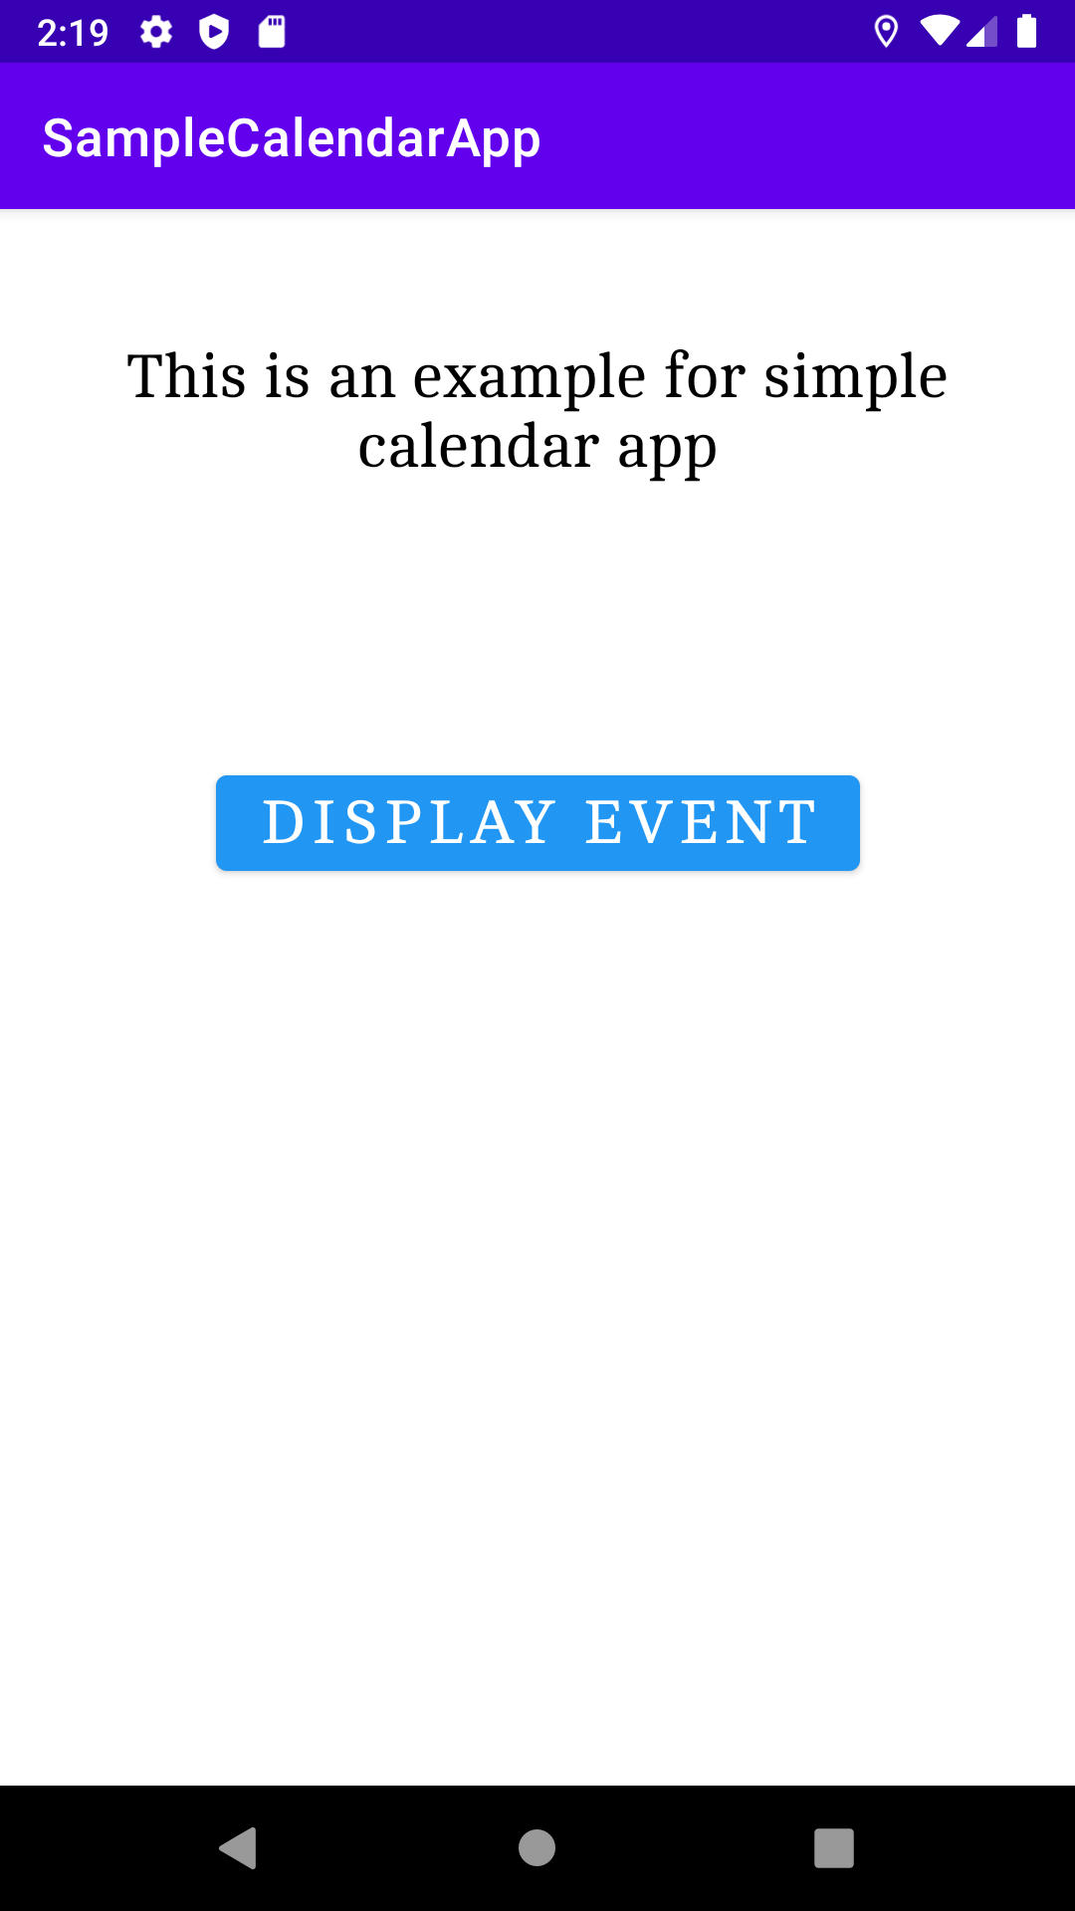
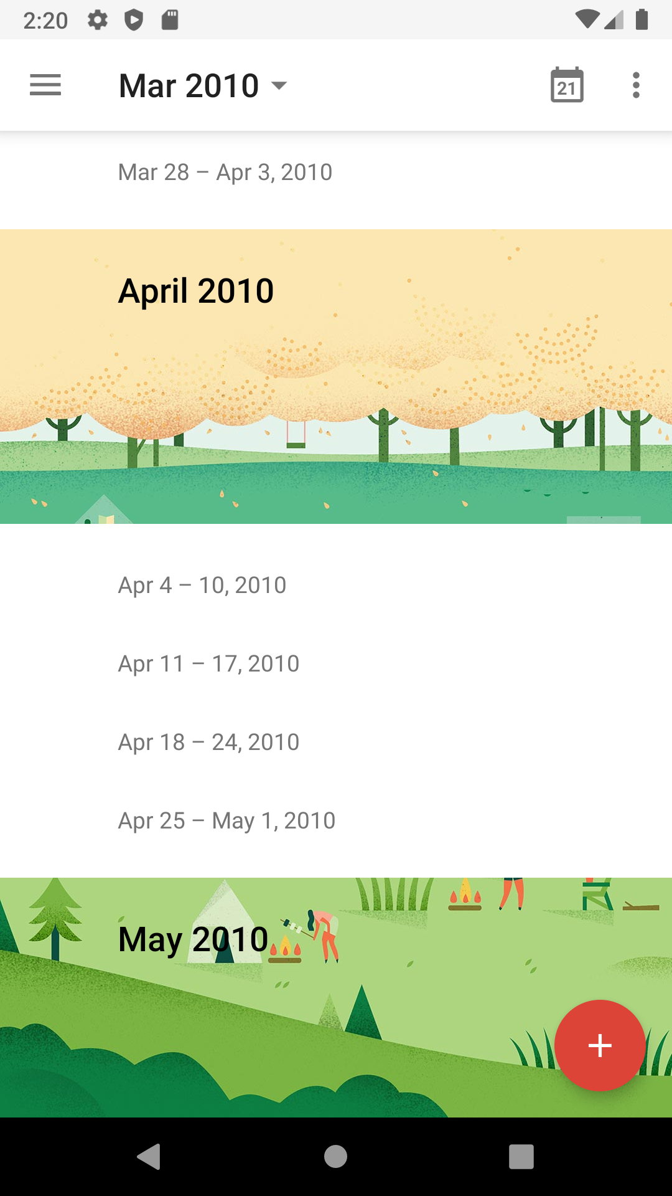
Output

Slide 24
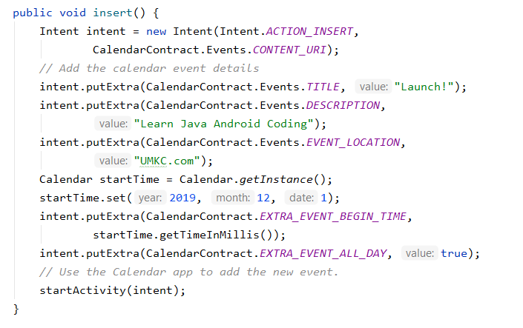
Use case 2- Insert Event

Slide 25
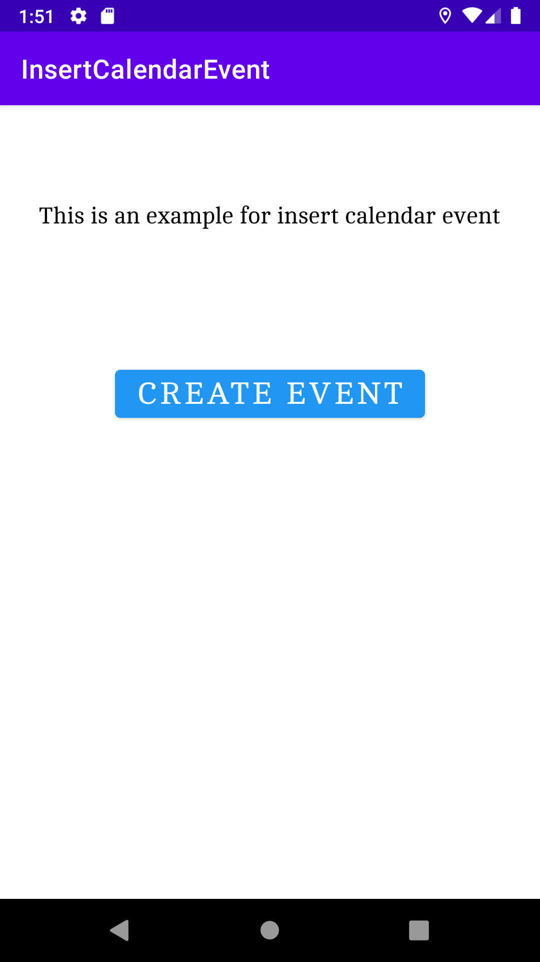
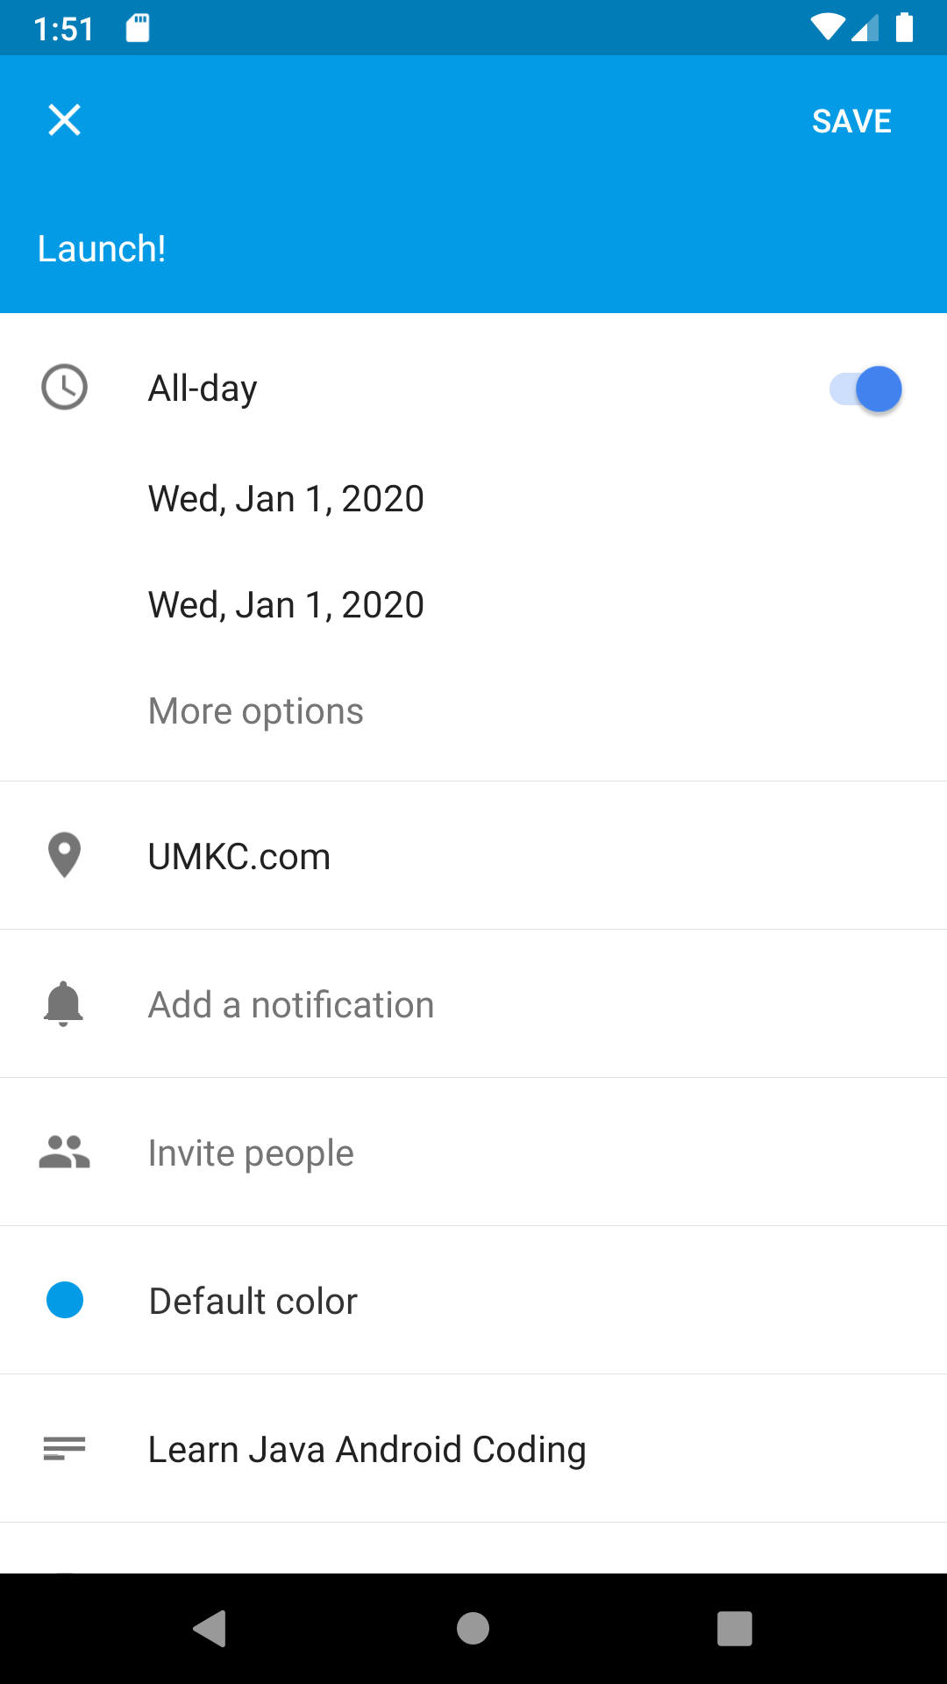
Output- Creating Event

Slide 26
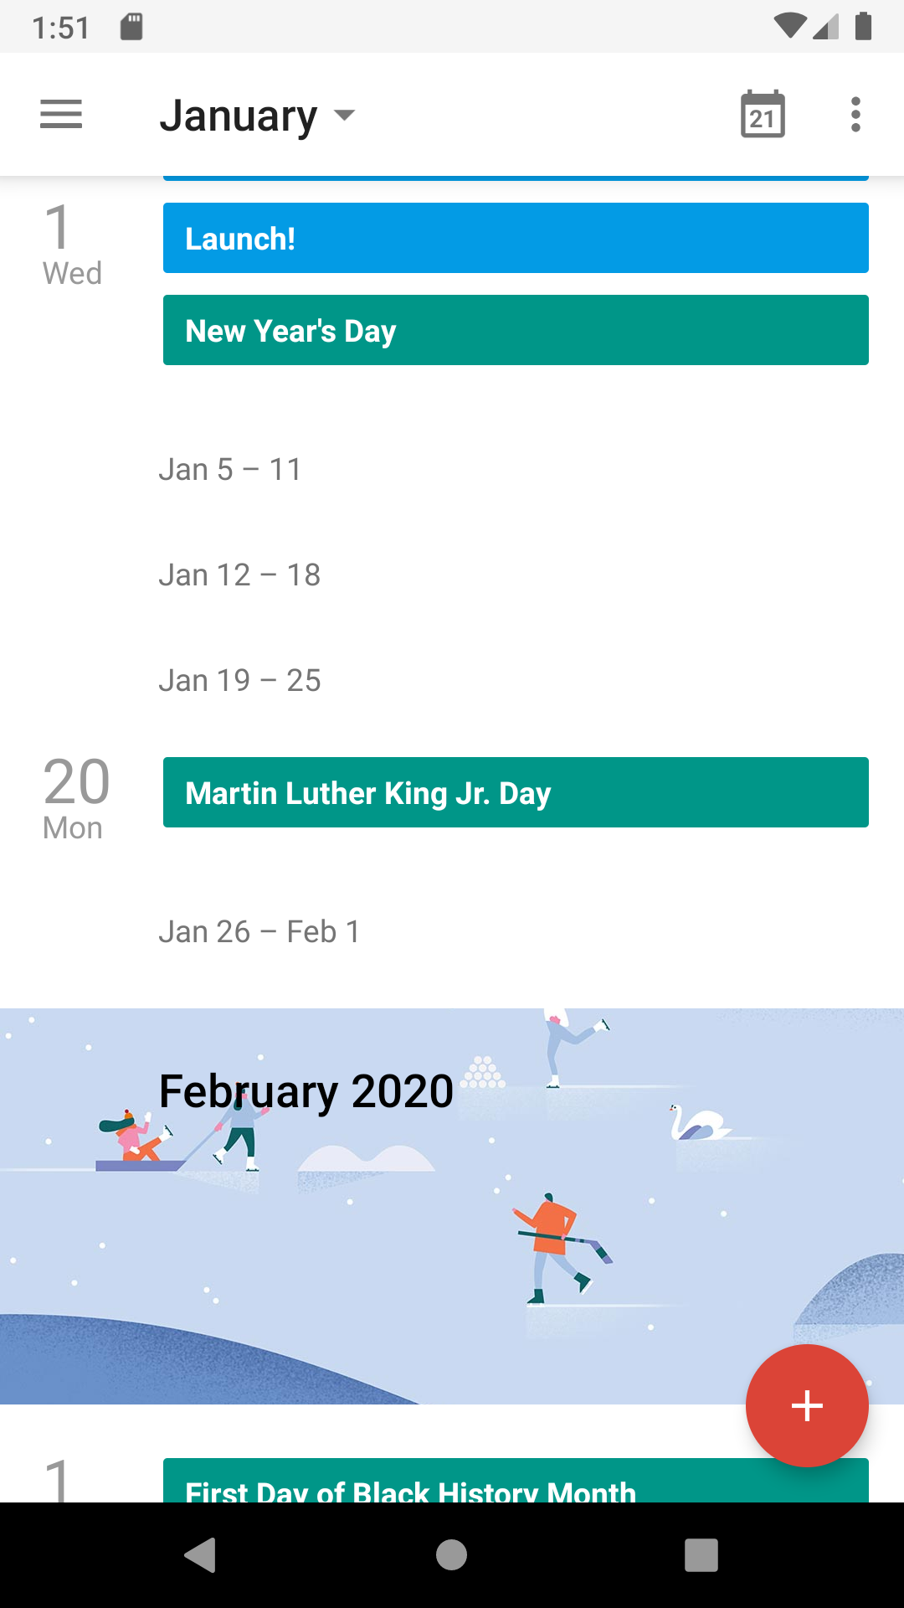
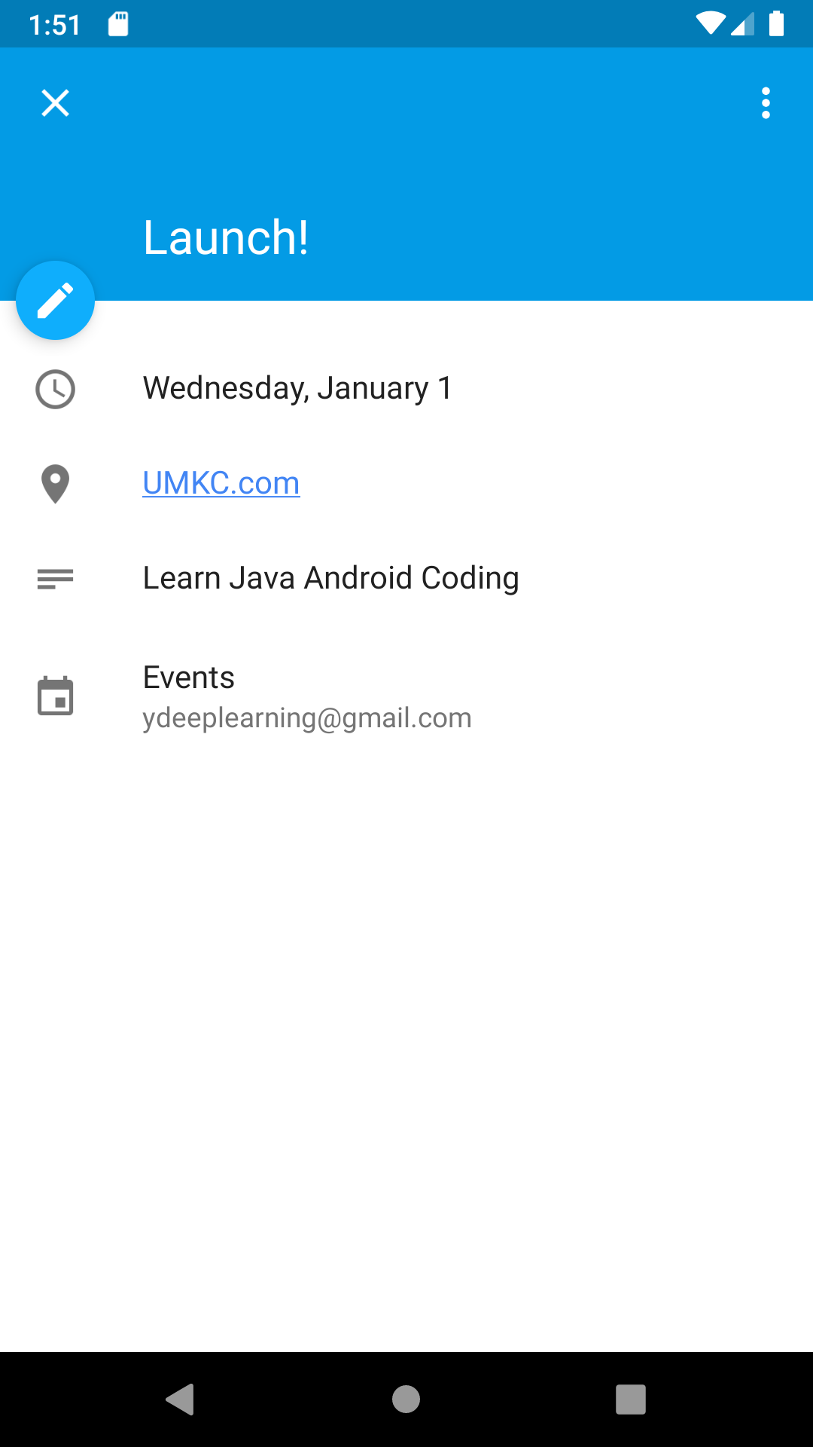
See Event Details

Slide 27
References
https://developer.android.com/
https://www.slideshare.net/ravalketan/publishing-an-app-for-google-play-store
http://abhiandroid.com/ui/calendarview
https://www.youtube.com/watch?v=YWRLxgZej6s
https://www.tutorialspoint.com/android
http://www.sanfoundry.com/java-android-program-insert-new-calendar-event-intent/

Slide 28
ICP
Please refer steps in the lesson plan

Slide 29
Publishing Apps
Android application publishing is a process that makes your Android applications available to users.
Apps developed are sold and distributed using Google Play store
Another way is directly sending to users using your website (least preferred as there is inbuilt cost of maintaining your host website)
You will need to export your application as an APK (Android Package) file before you upload it Google Play marketplace.

Slide 30
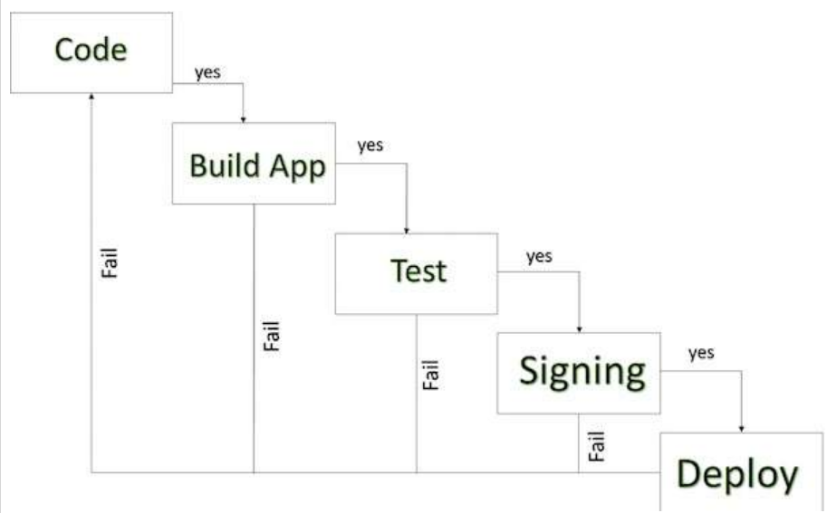
Android Development Life Cycle

Slide 31
Steps for Deployment
Regression Testing | Test on all the devices you want the target
Application Rating | When you will publish your application at Google Play, you will have to specify a content rating for your app, which informs Google Play users of its maturity level. Currently available ratings are (a) Everyone (b) Low maturity (c) Medium maturity (d) High maturity.
Targeted Regions | What countries and territories where your application will be sold. Take care of setting up time zone, localization or any other specific requirement as per the targeted region.
Application Size | The maximum size for an APK published on Google Play is 50 MB. If your app exceeds that size, or if you want to offer a secondary download, you can use APK Expansion Files, which Google Play will host for free on its server infrastructure and automatically handle the download to devices.

Slide 32
Cont.
SDK and Screen Compatibility | App is designed to run properly on the Android platform versions and device screen sizes that you want to target.
Application Pricing | Deciding whether you app will be free or paid is important because, on Google Play, free app's must remain free. If you want to sell your application then you will have to specify its price in different currencies.
Promotional Content | Supply a variety of high-quality graphic assets to showcase your app or brand. After you publish, these appear on your product details page, in store listings and search results, and elsewhere.
Build and Upload release ready APK | The release-ready APK is what you will upload to the Developer Console and distribute to users. You can check complete detail on how to create a release-ready version of your app: Preparing for Release.

Slide 33
Cont.
Finalize application Detail | Google Play gives you a variety of ways to promote your app and engage with users on your product details page, from colorful graphics, screen shots, and videos to localized descriptions, release details, and links to your other apps. So you can decorate your application page and provide as much as clear crisp detail you can provide.

Slide 34
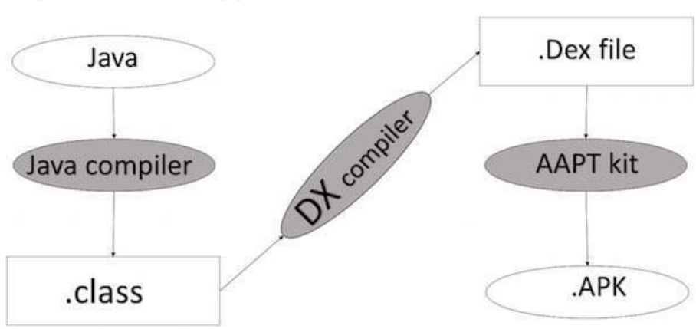
Export Android Application Process

Slide 35
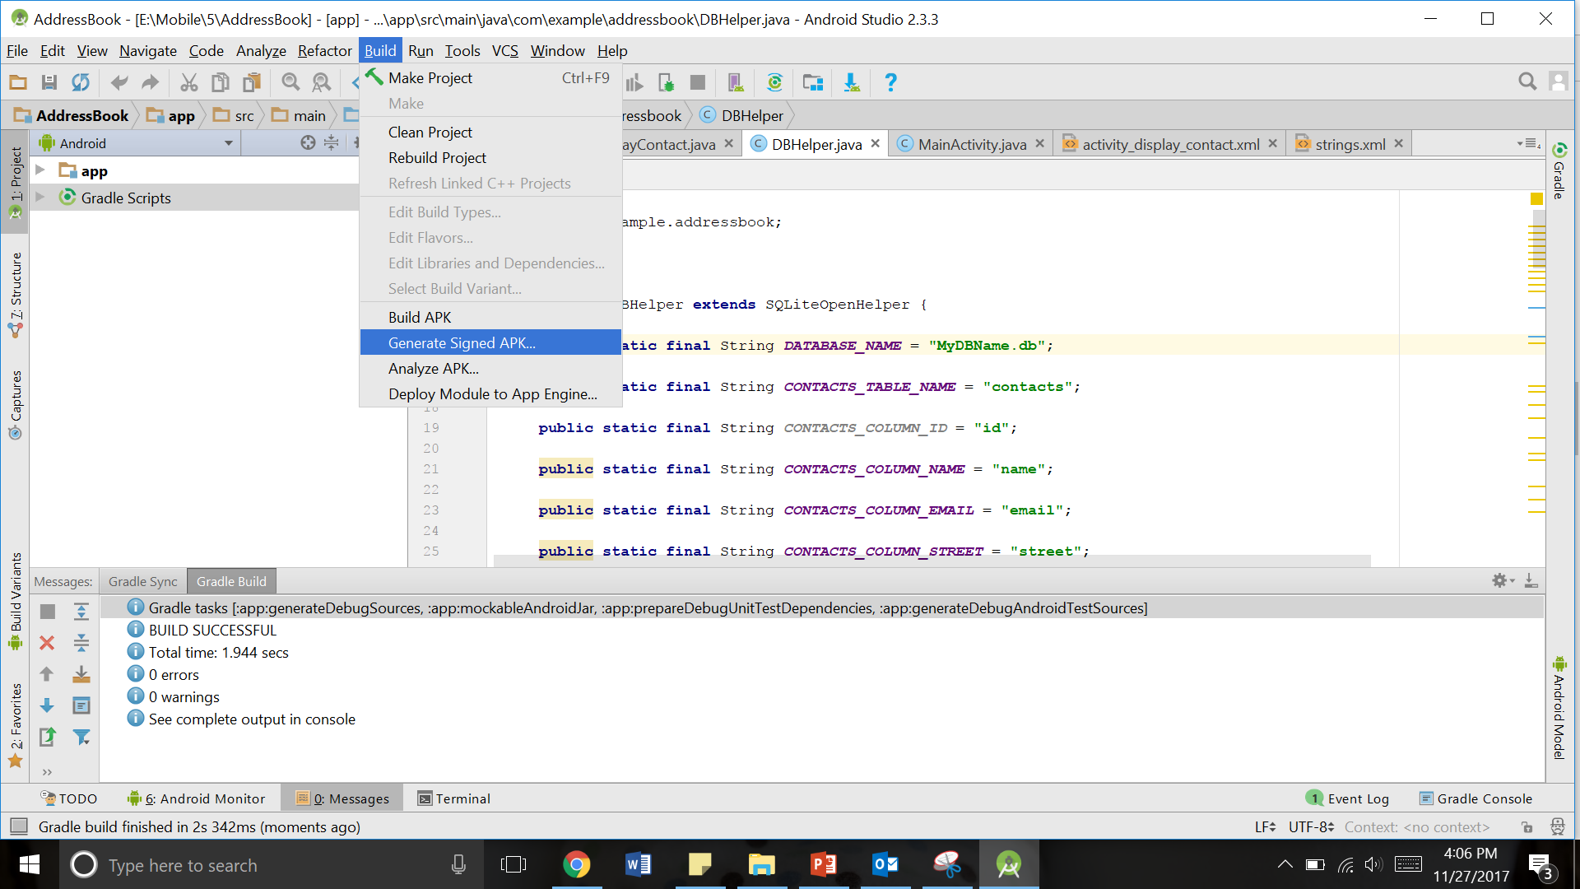
Using Android Studio
Select Build → Generate Signed APK(Android Packaging Kit) from your Android studio
Source: https://developer.android.com/studio/publish/app-signing

Slide 36
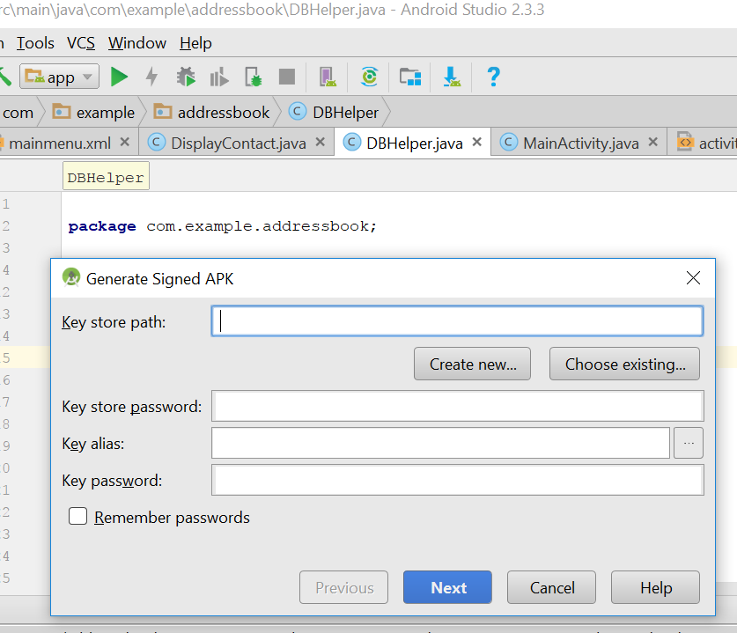
Choose Create new key store to store your application

Slide 37
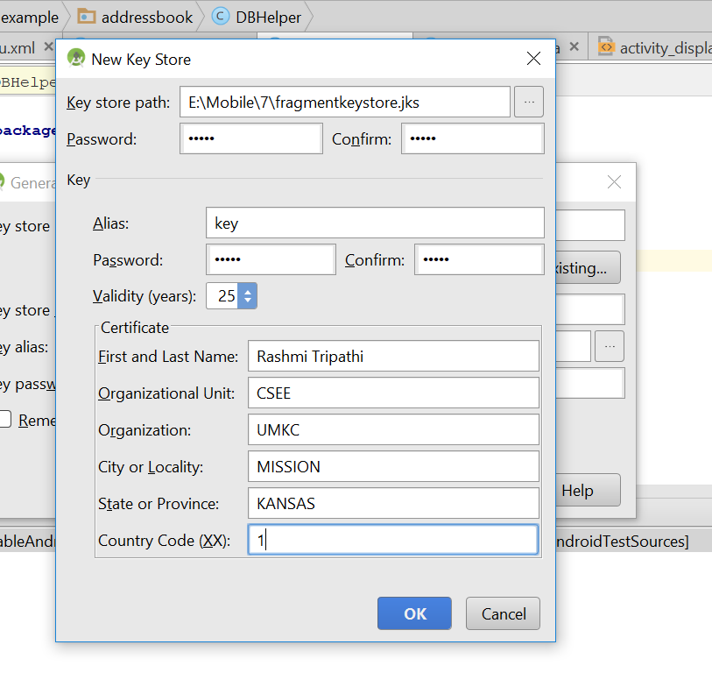
Mention all the details
Give File name for key store Path

Slide 38
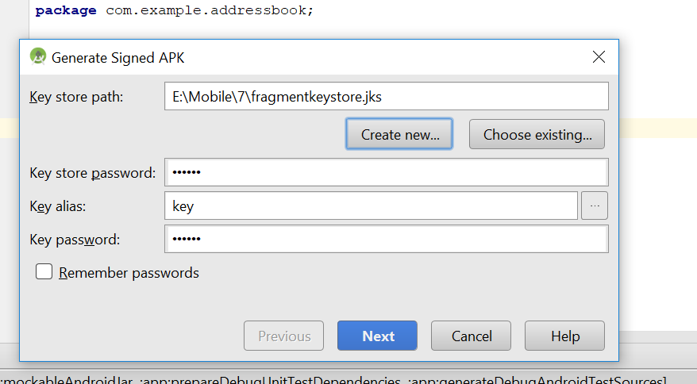
Click Next

Slide 39
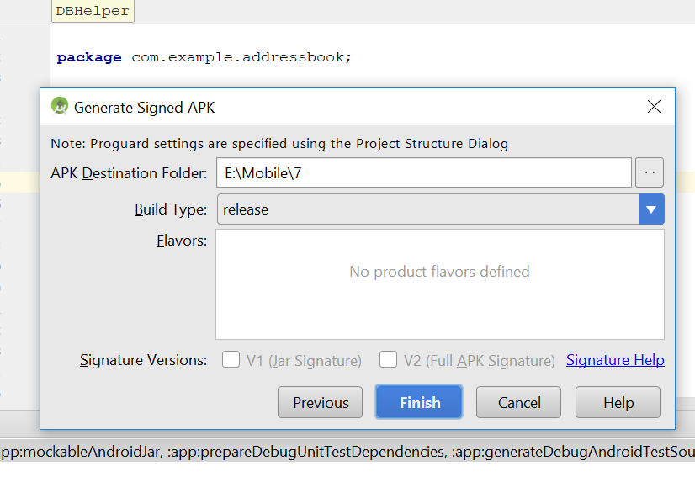
Click Finish

Slide 40
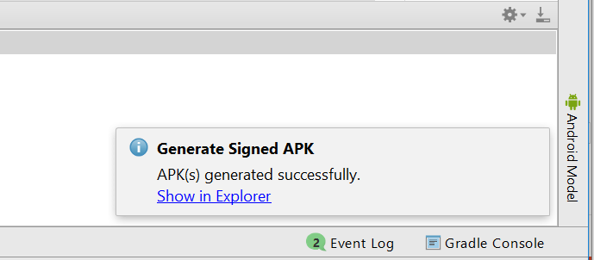
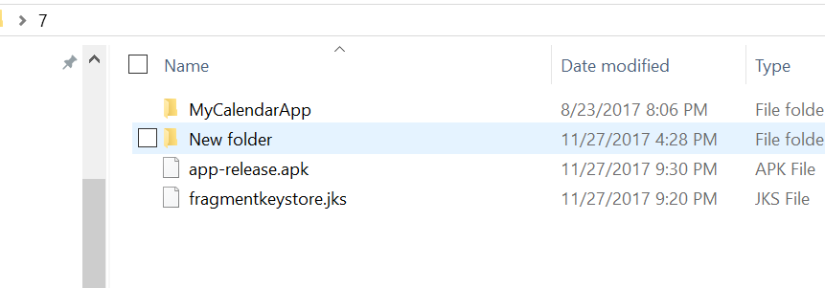
Final Result

Slide 41
Using Eclipse

Slide 42
First Lets Look How to Export APK :
Right click the project click on Export.
Double Click on the Android folder and click on EXPORT ANDROID APPLICATION.
Select project do you want to export.
Generate a new key if we are exporting for the first time and show the path where you need to store the key and provide a password for its encryption.
When you click next a dialog appears where the details for key comes where you can enter alias, validity for key password etc. Then click Next where the dialog asks for the destination where you want to store the apk file and Bingo….
Its Done. APK is generated.

Slide 43
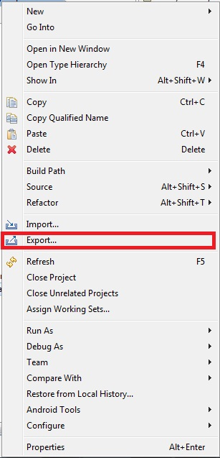
Step 1:
Right click on a project, Go To EXPORT option that is highlighted on the image.

Slide 44
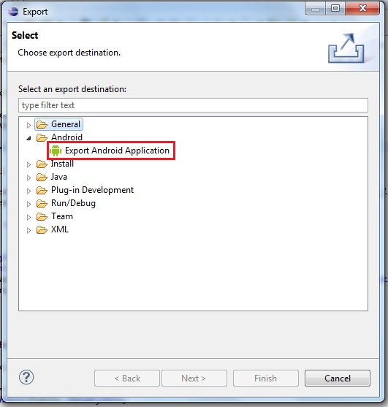
Step 2:
Double click on the Android folder below General Folder and select the EXPORT TO ANDROID APPLICATION as shown in figure.

Slide 45
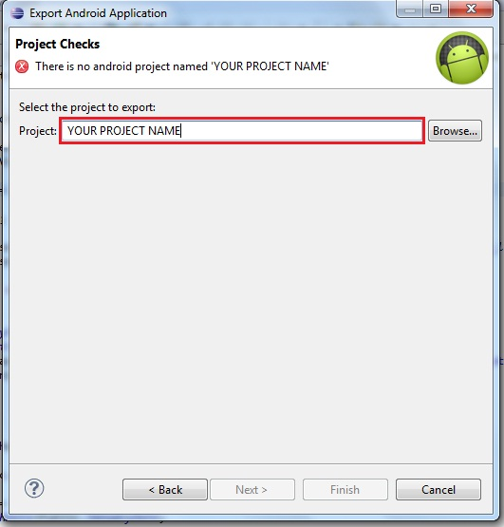
Step 3:
Enter name of the project in the highlighted area or browse and show the project path.

Slide 46
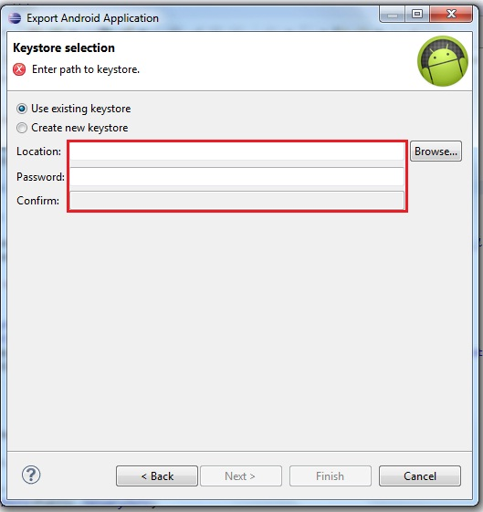
Step 4:
KeyStore Selection
create new key for a fresh project specify the location where we want to store the key and a password for its encryption.
Note: Keep this key that is generated to a very safe place as it is the only authentication for your code to be yours.

Slide 47
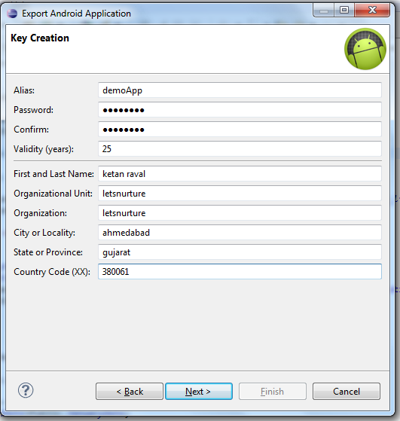
Step 5:
Enter All Details for keys creation
click Next store the apk file and Bingo….
Its Done. APK is generated.

Slide 48
Google Play Registration

Slide 49
Things Required to Publish an App
There are few things that you need to provide with your application while publishing it.
Such as:
  Listing details
  Store Graphics
  Screenshots (Minimum 2)
  Videos (Optional)

Slide 50
Listing Details
App Name :- Give suitable app name for your application.
App Description :- Write suitable description for your app, not exceeding 4000 characters.
Category :- It is required that you select an appropriate category for you application.
Application Type :- It is also required that you set a category for your application. This could be either set as application or game
Organization Name :- It is also required that you mention the name of organization while filling up the details.
Support information :- This includes URL , Email, Phone number etc.

Slide 51
Store Graphics
App Icon
  512 x 512 px
  32-bit PNG
  Max size 1024KB
  Transparency allowed
Promo graphic
  180 x 120 px
  24-bit PNG
  No border
  No Transparency
Feature graphic This is also optional but is required to get your app featured anywhere. This image has the following constraints
  1024 x 500 px
  safe frame of 924 x 400 px
  24-bit PNG
  No Transparency

Slide 52
Screenshots
Screenshots are important because people will see screenshot before installing app on phone. So it must convey your main functionality.
Constraints for the screenshots are
  6 additional optional
  480 x 800 px, or 480 x 854 px
  72dpi, RGB, flattened
  No transparency
  High quality JPEG or 24-bit PNG
  No borders
  Can show status bar

Slide 53
Video (Optional)
Finally you can even show how your app works through a video.
This can greatly increase the chances of popularity of your app as the viewer can get synopses of your application.
Google recommends the length of the video to be anything between 30 seconds to 2 minutes.

Slide 54
Final Check
Apart from this you need to set some other parameters as well. Like
  Size- the size of the app should not exceed 50 Mb
  Pricing- you need to decide whether your app should be free or priced.
  Country distribution- you get to decide which country or territories your app should be distributed.
  Rating- This is the maturity rating required of your app. You can set is as everyone, low maturity, medium maturity, high maturity.
At least once you need to read Google play store policies ☺
This APK is then uploaded. This includes
  Optimization
  Building
  signing with your release key
  Final testing.
All this and you are good to go.

Slide 55

Go to the URL:
Click on the following Button:

Slide 56
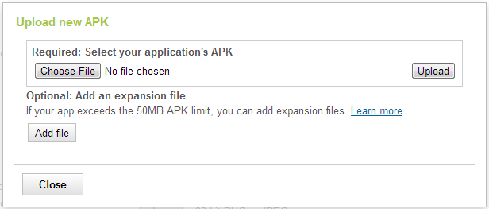
Give the path where your apk file is placed and click on upload Button:

Slide 57
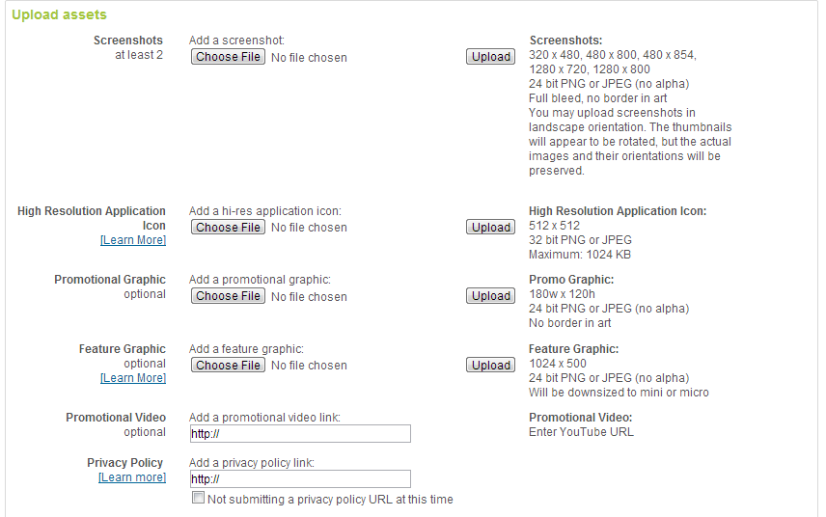
Attach assets of an Application

Slide 58
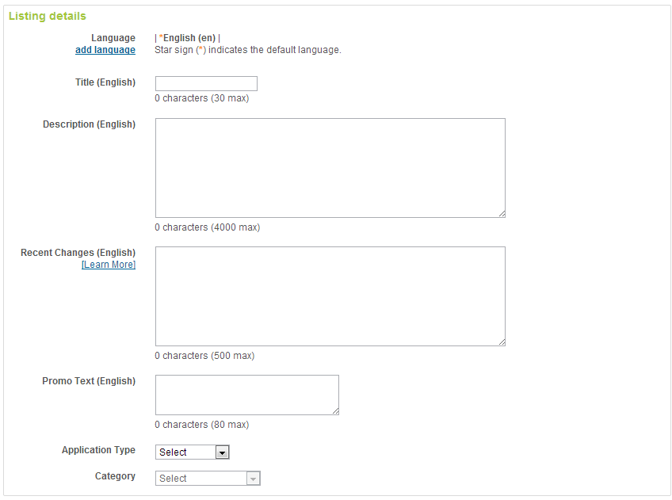
Fill up all Application Listing Details...
Part 1 of 4…

Slide 59
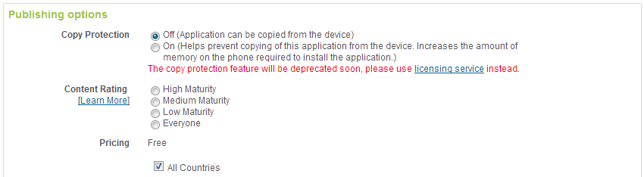
Choose the appropriate publishing options:
Part 2 of 4…

Slide 60
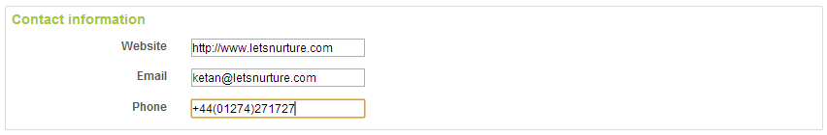
Contact Information
Part 3 of 4…

Slide 61
At last....
Once these all processes finished, You have to accept the agreements.
Finally, You can click on publish button to upload your app on play store.
Your App will be publish on market within 1-2 hours.

Slide 62
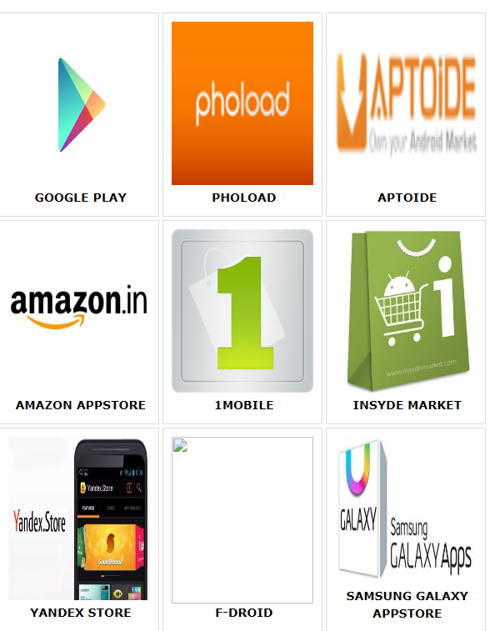
App Markets

