Slide 1
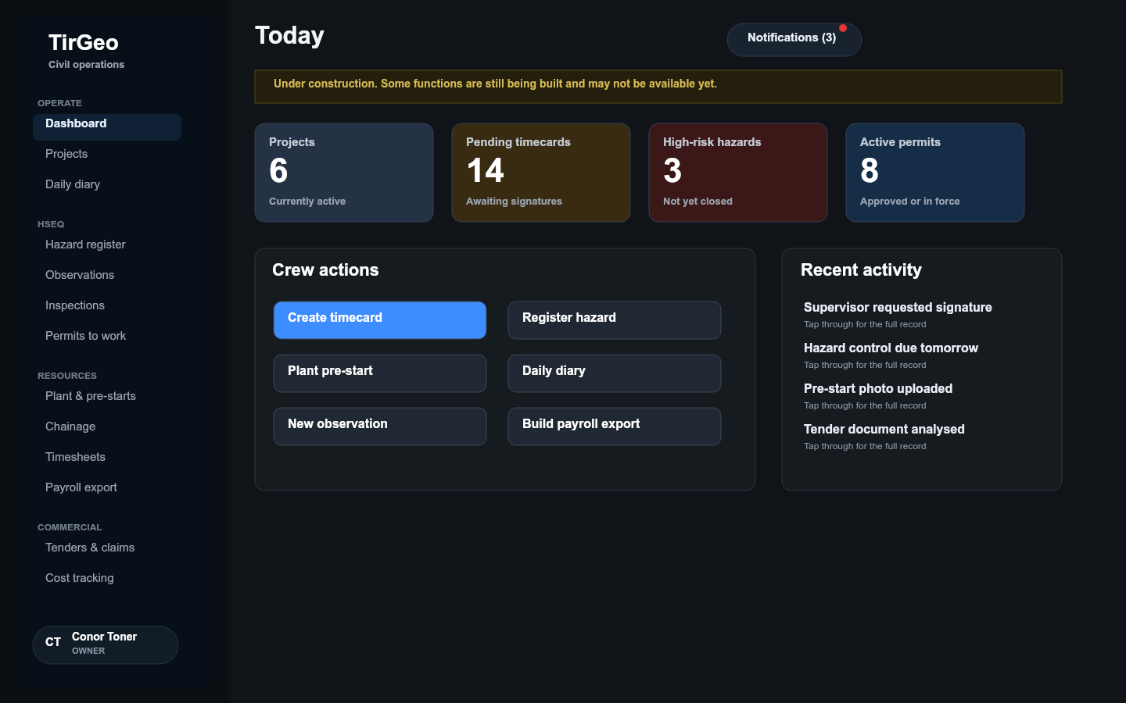
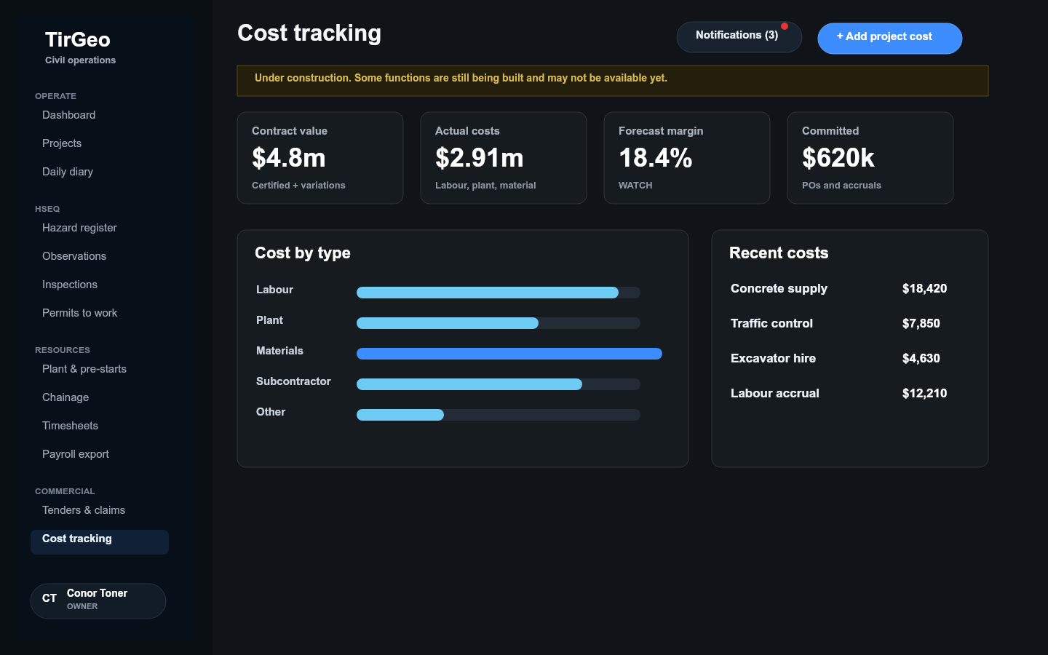
TirGeo
Civil operations platform
A field-to-office system for timecards, HSEQ, plant, chainage, payroll, commercial controls and audit-ready project history.
Current product walkthrough and roadmap
TirGeo civil operations platform
01

Slide 2
WHY THIS MATTERS
Civil jobs lose margin when field records and cost records drift apart
Project cost visibility
Labour, plant, materials, dockets, accruals and forecast risks need to land against the right project and cost code.
TirGeo's thesis
Keep the site team moving, while giving the office a structured, auditable record of cost, risk, labour and commercial position.
Field adoption
Workers need simple screens, obvious create buttons, and drill-down detail only when they ask for it.
Governance
Civil companies need signatures, photos, decisions and old records retained for later disputes, audits and lookups.
TirGeo civil operations platform
02

Slide 3
PRODUCT MAP
The current platform covers the main civil operating loop
Operate
HSEQ
Projects, daily diary, dashboard and notifications
Hazards, observations, inspections, permits, actions and safety sign-ons
Resources
Commercial
Plant, pre-starts, photos, chainage, timecards and payroll
Tenders, claims, variations, cost plans, actuals and forecasts
One common account, role and section model controls who sees what across the whole system.
TirGeo civil operations platform
03

Slide 4
SCREEN WALKTHROUGH
The dashboard gives office and field users a practical starting point
What users see
High-level counts for projects, timecards, hazards and permits sit beside fast actions for the daily work people actually need to do.
Notifications now live in the top bar on every page, with unread counts and a red dot, while users can handle items one by one or mark all as read.
TirGeo civil operations platform
04

Slide 5
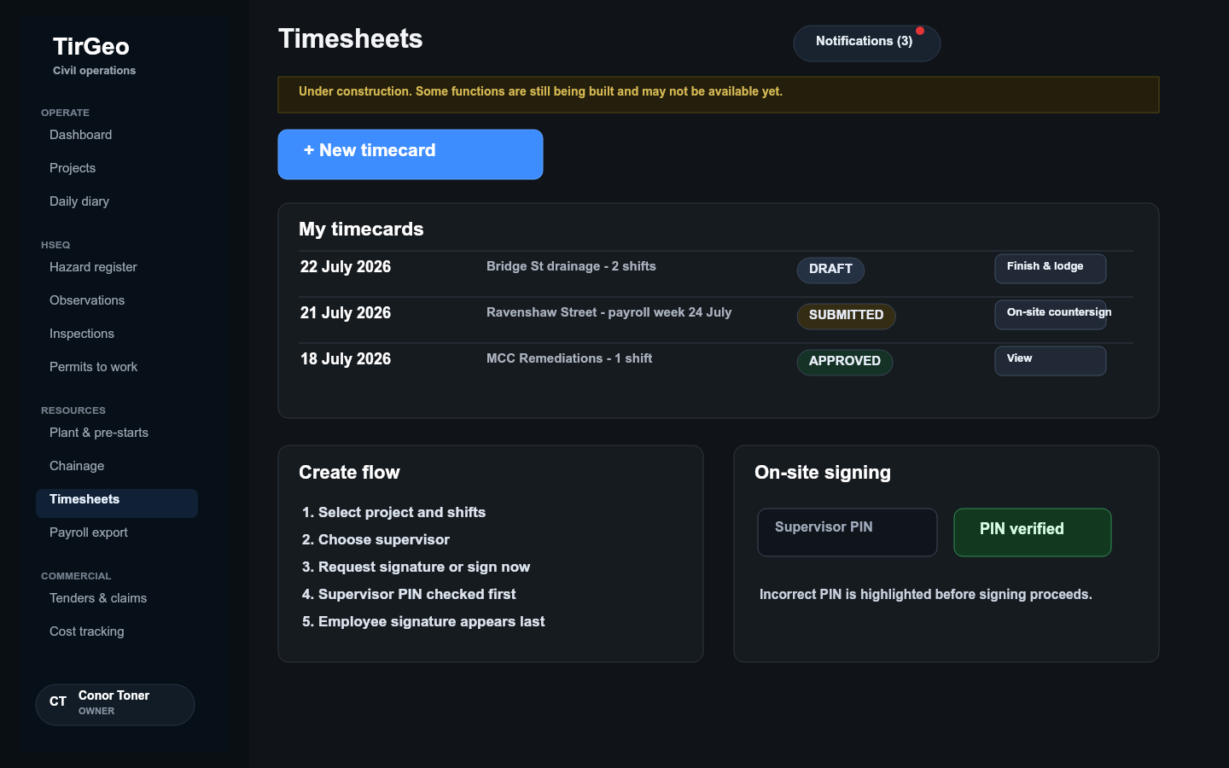
FIELD EXPERIENCE
Worker screens keep create actions obvious and drill-downs simple
Designed for low-friction field use
New timecard, register hazard and plant pre-start actions are prominent. Line items open full detail only when the user needs it.
The supervisor signing flow now checks the PIN before signature capture proceeds, reducing failed submissions and shared-device confusion.
TirGeo civil operations platform
05

Slide 6
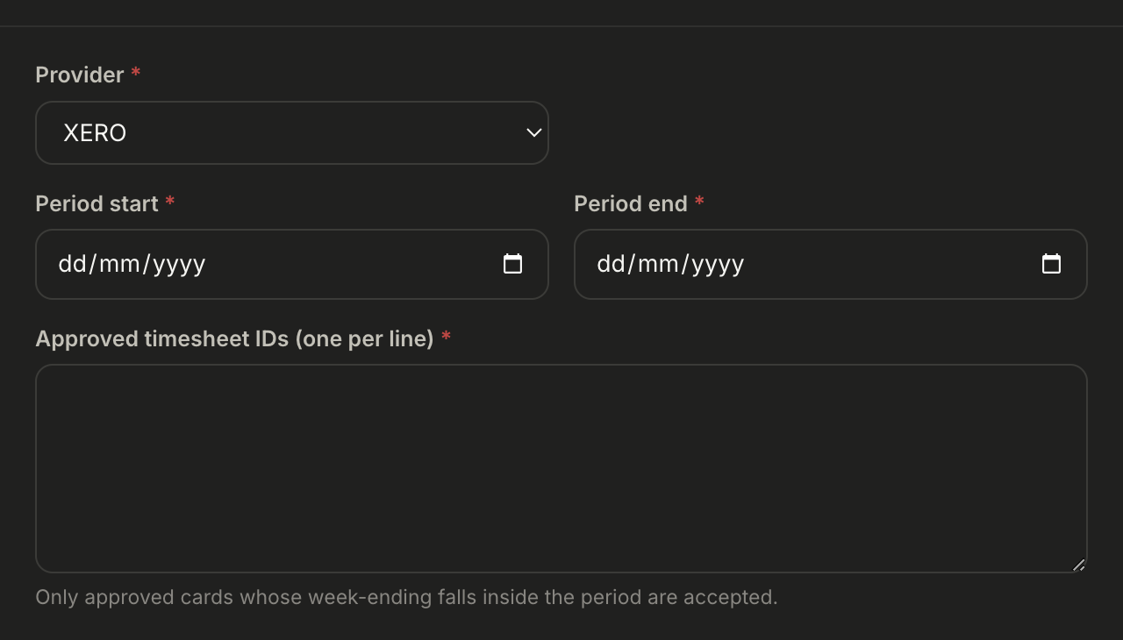
LABOUR AND PAYROLL
Timecards and payroll now support both simple selection and robust approval
Approvers can open the full timecard, sign, reject, or review detail from the same queue. Payroll exports can be built from approved cards using date ranges and explicit card selection.
TirGeo civil operations platform
06

Slide 7
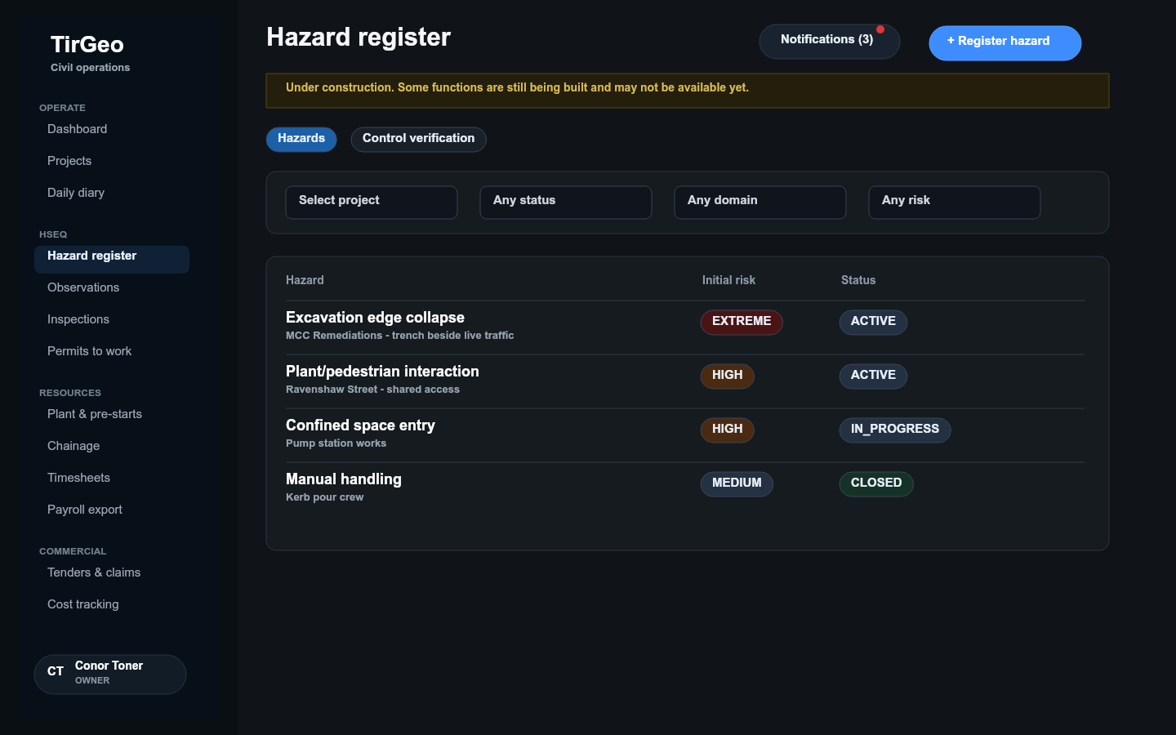
SAFETY MANAGEMENT
HSEQ work is structured without burying the site team in admin
Current coverage
Hazard register and controls
Safety observations and incidents
Inspections and corrective actions
Permits and safety document sign-ons
TirGeo civil operations platform
07

Slide 8
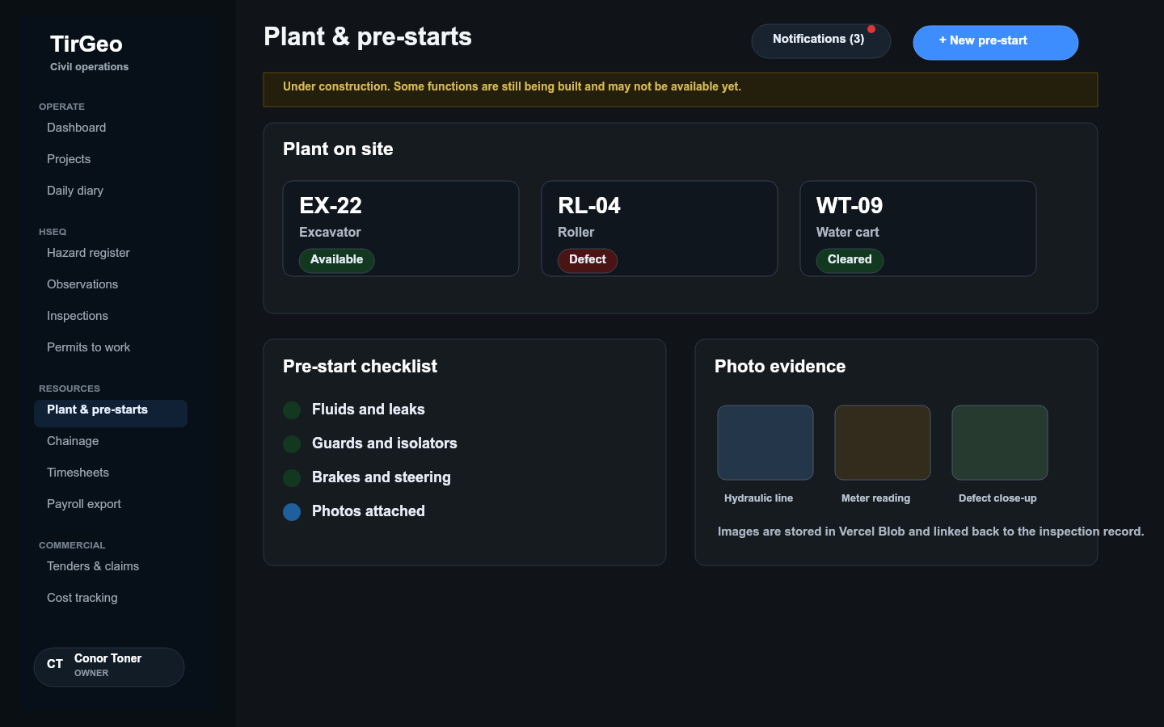
PLANT AND PRE-STARTS
Plant pre-starts connect equipment status, checklists and photo evidence
Photos are treated as records, not decoration
Pre-start images should be stored in Vercel Blob and referenced from the record, which keeps the database lean while preserving the actual evidence.
Future offline mode should queue image files locally on-device, upload on sync, then reconcile Blob URLs back to the inspection record.
TirGeo civil operations platform
08

Slide 9
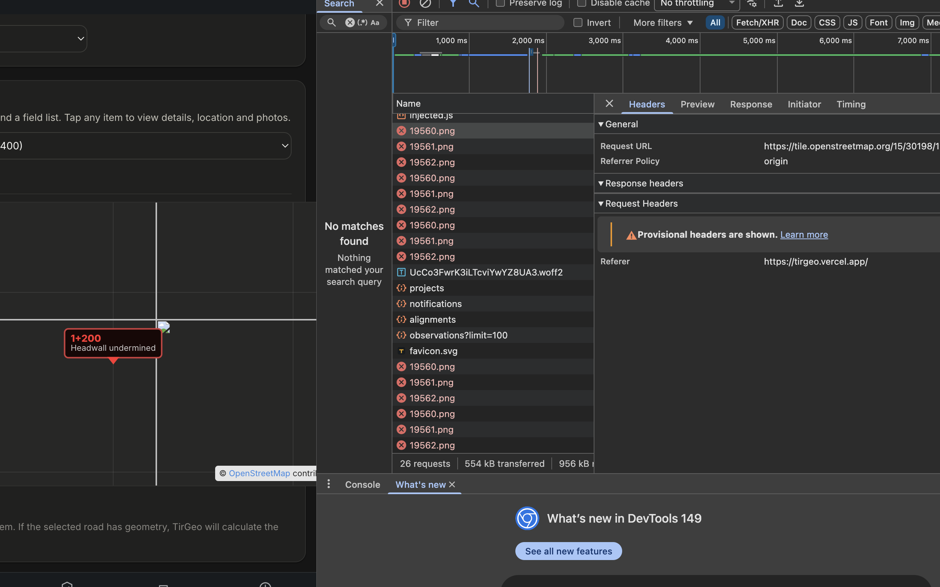
CHAINAGE AND FIELD LOCATION
Chainage brings map-based work items into the same operational record
The intended field behaviour
Users should pinch, zoom, pan and inspect the map like Google Maps, with work items placed against chainage and project geometry.
This is especially useful for linear assets: roads, drainage, utilities, remediation zones and progressive work fronts.
TirGeo civil operations platform
09

Slide 10
COST AND MARGIN MANAGEMENT
Commercial cost tracking turns daily project noise into margin control
Implemented commercial controls
Cost plans and contingency
Actual and committed cost entries
Forecast confidence
Margin status by project
Progress claims and variations
TirGeo civil operations platform
10

Slide 11
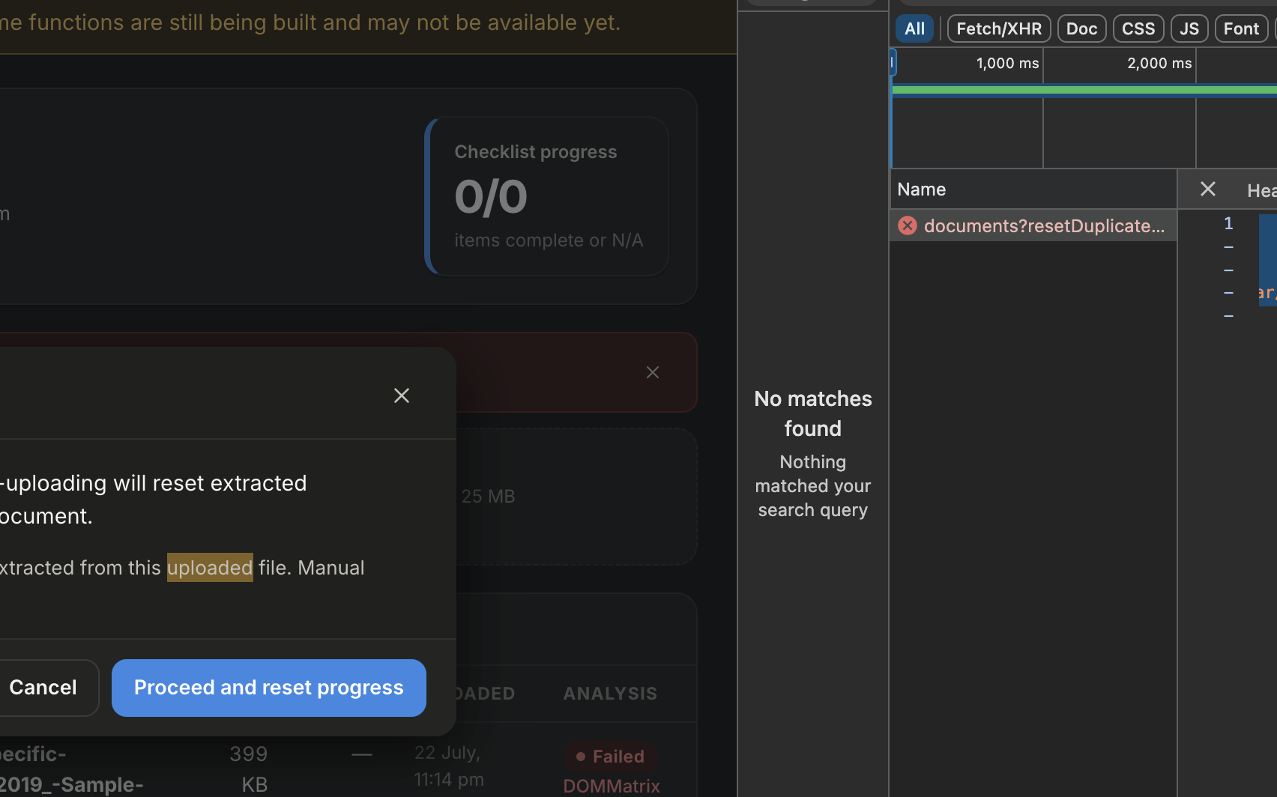
TENDERS AND DOCUMENTS
Tender document handling is becoming an auditable commercial workflow
Current behaviour
Users get a duplicate warning before re-uploading a tender document. Re-analysis resets active extracted progress, while historical requirements are superseded rather than deleted.
The PDF worker and server canvas fixes support Vercel deployment, so failed analysis can be surfaced clearly rather than looping the upload prompt.
TirGeo civil operations platform
11

Slide 12
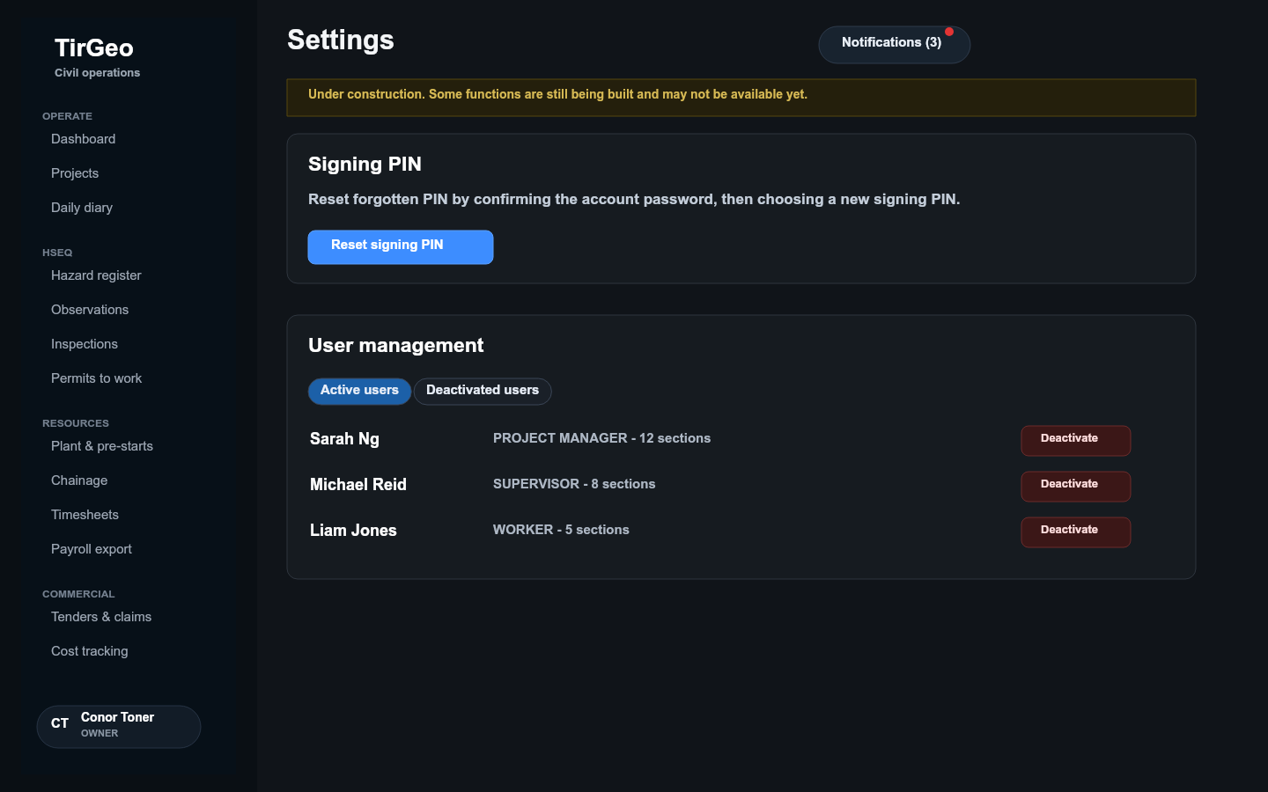
TRUST MODEL
Security and audit choices are being built into everyday flows
Role and section access
Owners and admins manage who can see each module.
Soft deactivation
Users are deactivated instead of deleted, preventing broken history.
Audit-safe deletion
Records and blobs are archived or superseded where history matters.
PIN recovery
Forgotten signing PINs can be reset by confirming the account password.
TirGeo civil operations platform
12

Slide 13
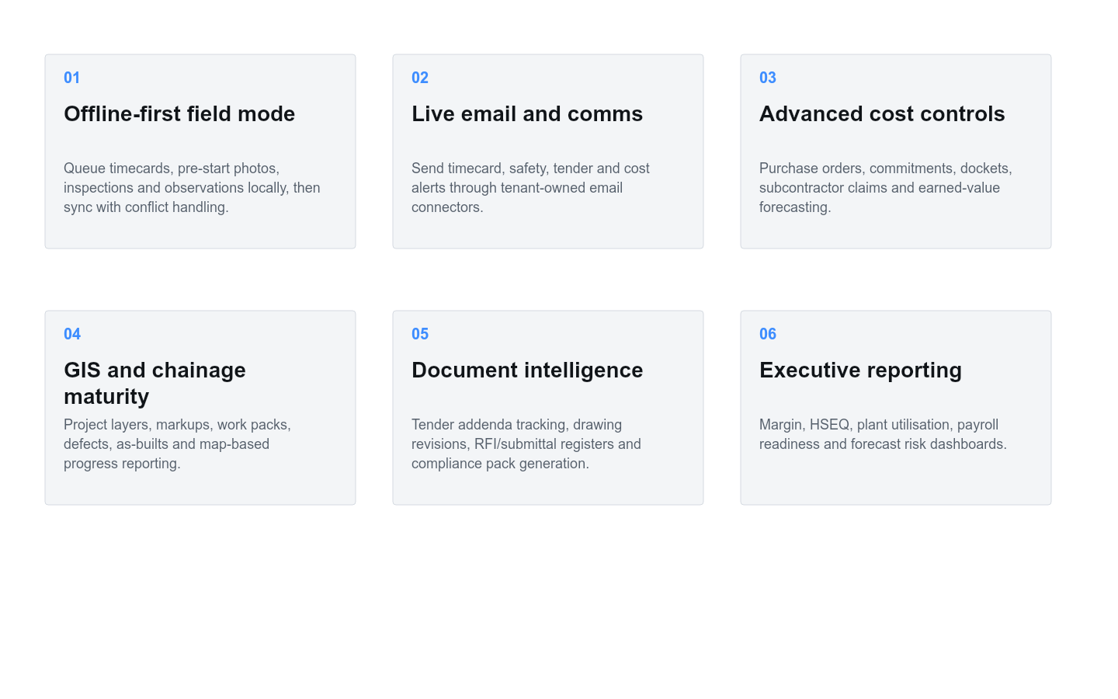
ROADMAP
The roadmap should deepen civil-specific control, not add generic software clutter
Priority should go to features that remove field friction, strengthen commercial confidence, and protect historical evidence.
TirGeo civil operations platform
13

Slide 14
NEAR-TERM RELEASE SHAPE
Recommended next build priorities
1
Offline capture and sync
Timecards, pre-start photos, hazards, observations and daily diary entries continue working on poor reception sites.
2
Email notifications
Send approval, safety, tender and payroll alerts through a verified organisation mailbox.
3
Cost commitment workflow
Purchase orders, delivery dockets, accruals and subcontractor claims flow into margin reporting.
4
Document register maturity
Drawing revisions, RFIs, submittals, addenda and tender clarifications become tracked records.
TirGeo civil operations platform
14

Slide 15
TirGeo is shaping into the civil company's daily control room.
The strongest next move is to make the field experience resilient offline, then tighten cost commitments, communications and document governance around the same audit-first record.
TirGeo civil operations platform
15

