Slide 2
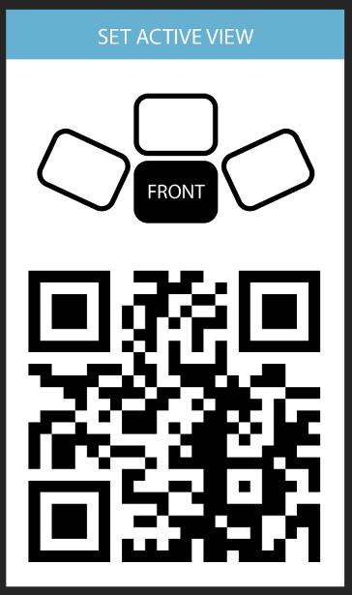
FRONT

Slide 3
STILL FRONT

Slide 4
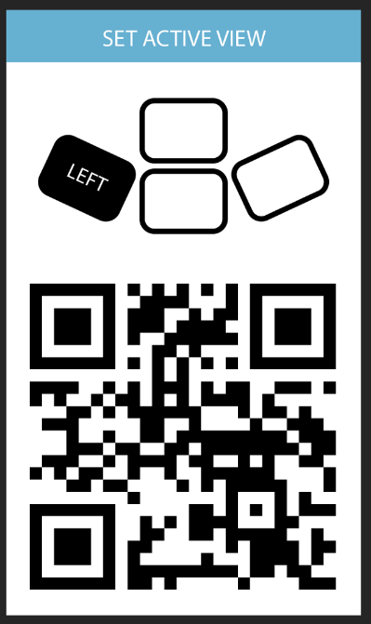
LEFT

Slide 5
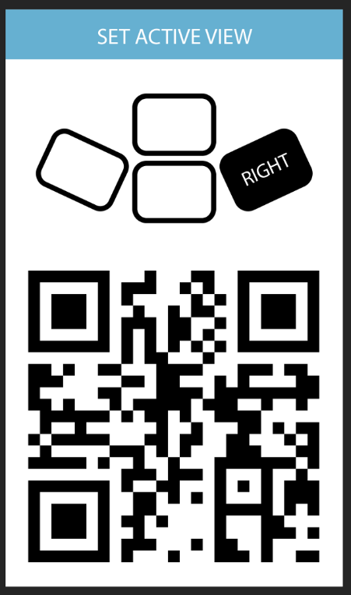
RIGHT

Slide 6
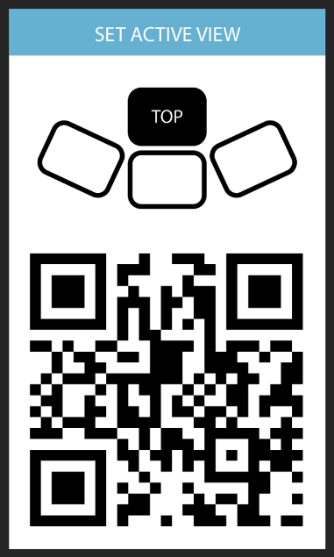
TOP

Slide 7
