Slide 1
The influence of risk group turnover in STI/HIV epidemics:
mechanistic insights from transmission modeling
Jesse Knight¹, Linwei Wang¹, Huiting Ma¹, Sheree Schwartz², Stefan Baral², Sharmistha Mishra^{1,3}
1 MAP Centre for Urban Health Solutions, Unity Health Toronto
2 Dept. Epidemiology, Johns Hopkins Bloomberg School of Public Health
3 Dept. Medicine, University of Toronto
2019 July 17
STI & HIV 2019 World Congress
Vancouver, BC, Canada
contact: knightje@smh.ca
code: github.com/c-uhs/turnover
Notes:
Hello ... etc. etc.

Slide 2






Disclosures
Acknowledgements
None
Notes:
First of all:
we have nothing to disclose,
and thanks to everybody who has supported this work.

Slide 3
Overview
Background & Definitions
Risk group “turnover”
Research Questions
Impact of turnover on model outputs
Experiments & Results
Implications
Notes:
To briefly overview the talk:
First, I’ll give the motivation for this work and some key definitions;
Next, I’ll summarize our research questions;
Then, I’ll walk through two of our experiments and their results;
And finally, I’ll discuss some of the implications of those results.

Slide 4
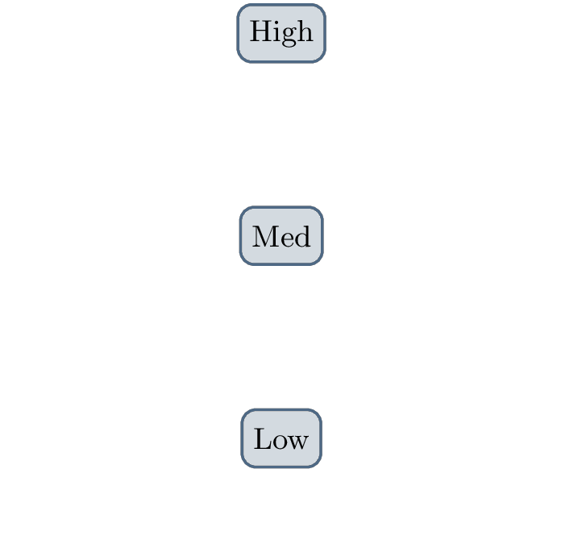
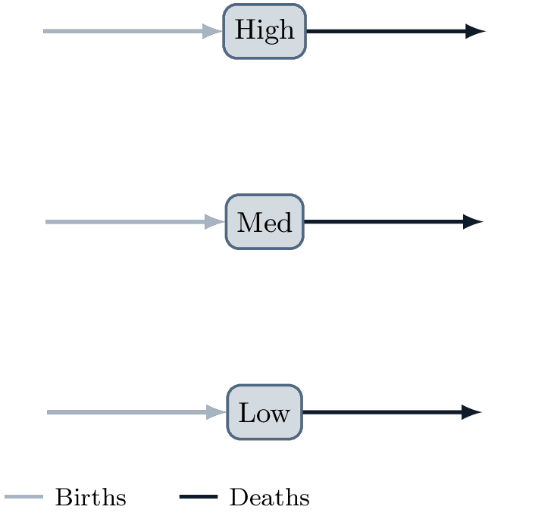
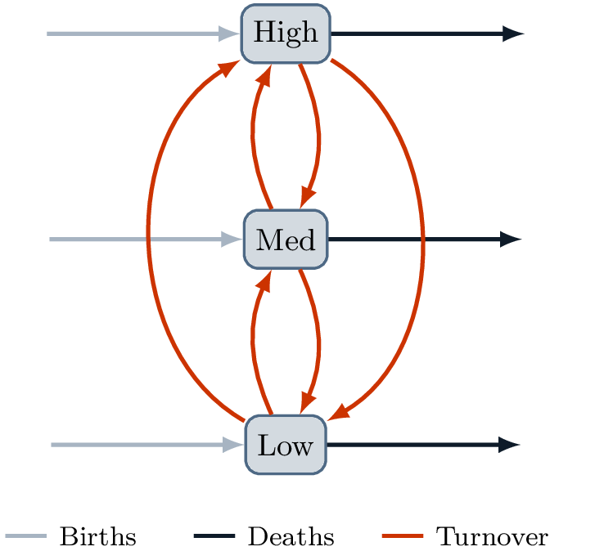
Background:
Epidemic Modeling to Prioritize Interventions
TPAF
Transmission Population Attributable Fraction
help prioritize intervention
Turnover
movement between risk groups
Notes:
Mathematical models of STI transmission are often used to quantify the contribution of high-risk groups to overall transmission.
We call this the “Transmission Population Attributable Fraction”, or TPAF:
the fraction of new infections that stem, directly & indirectly, from a failure to prevent that STI in a particular risk group.
The TPAF can be used to help guide “prioritized” or “targeted” interventions for groups who are most at risk.
Now, in most transmission models, individuals in a particular risk group are assumed to remain in that group for their entire life.
That is, we don’t often model movement of individuals between risk groups -- which we call “turnover”.
For example, individuals may enter sex work from a lower risk state, and then also retire from sex work and return to a lower risk state.
So, there is not a good understanding of how turnover affects simulated epidemics, or the estimated TPAF of risk groups.

Slide 5
Research Questions:
Influence of turnover on ...
Equilibrium STI prevalence
vs Increasing Turnover
Prevalence = ( I + R ) / N
TPAF of High-Risk group
No-Turnover vs Turnover
Notes:
So that really motivates our 2 Research Questions:
First, how does turnover influence the STI prevalence predicted for each group? (at equilibrium)
In order to understand trends in this influence, we explored a range of turnover rates:
from practically no movement between groups, to relatively high rates of movement.
Second, how does turnover influence the estimated TPAF of the high-risk group?
In this case, we compared the same model, with and without turnover a moderate amount of turnover.

Slide 6

Methods: mathematical model
Susceptible, Infectious, Recovered
e.g. treated HIV
Turnover:
relative sizes of risk groups stable
Notes:
To answer these questions, we built a simple compartmental transmission model,
where individuals move from susceptible to infectious to recovered.
Individuals in the recovered group are no longer susceptible nor infectious.
For example, this could simulate HIV with suppressed viral load under treatment.
We do not include disease-attributable mortality, nor re-infection in the model.
The model has 3 risk groups, and turnover was modeled as individuals moving among all groups at various rates.
The rates were chosen so that the risk groups do not change size over time,
and they were controlled by an assumed average duration in the highest risk group.
The rate of turnover of an individual was also not influenced by their health state.

Slide 7
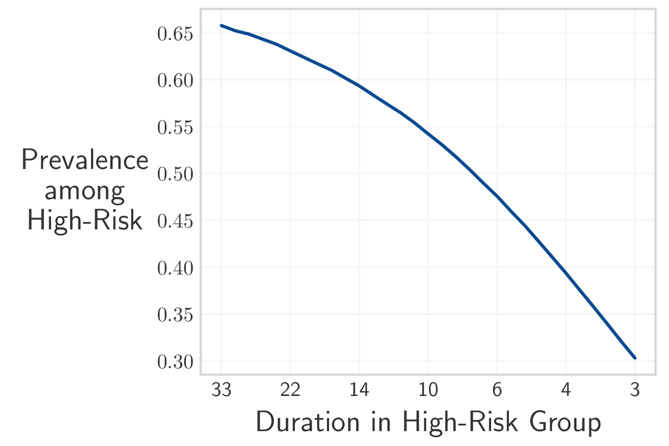
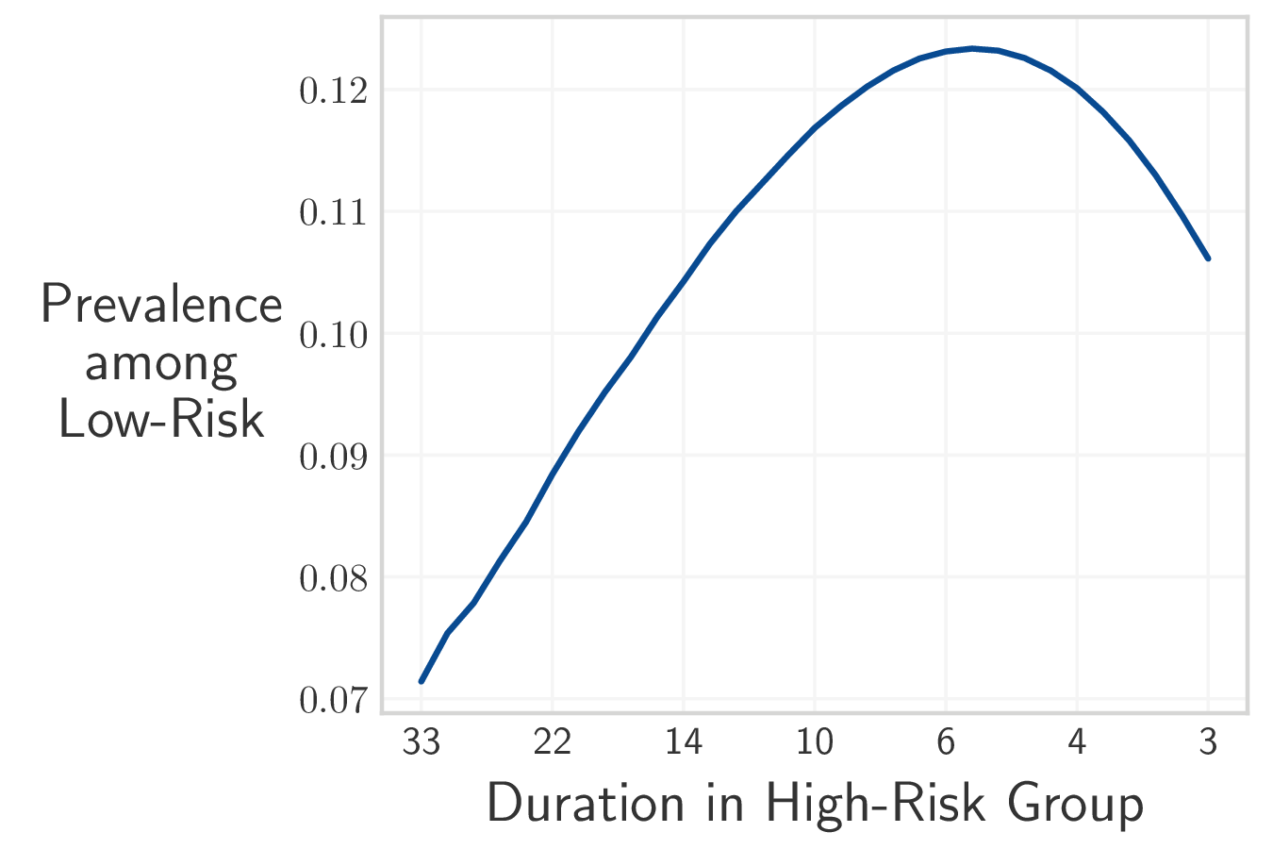
Increasing turnover ...
Prevalence = ( I + R ) / N
decreases High-Risk STI prevalence
increases, then decreases Low-Risk STI prevalence
Notes:
So, for Question 1:
First of all, please note that we define prevalence by including both infectious and recovered individuals in the numerator,
as in the case of HIV, but unlike some other STIs.
Now, we first consider the influence of increasing turnover on STI prevalence among the high-risk group.
In the figure, turnover increases left to right, as the duration in the high risk group decreases.
We can see that increasing turnover decreases STI prevalence among the high-risk group.
Among the low-risk group, for low rates of turnover, STI prevalence increases with turnover,
which brings the STI prevalence in both groups closer together.
However, after a transition point, further increasing turnover then decreases STI prevalence among the low-risk group.
In order to understand these results, we’ll briefly consider an even simpler system, with only two risk groups.

Slide 8
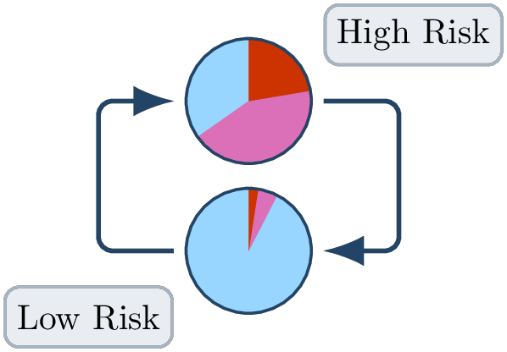
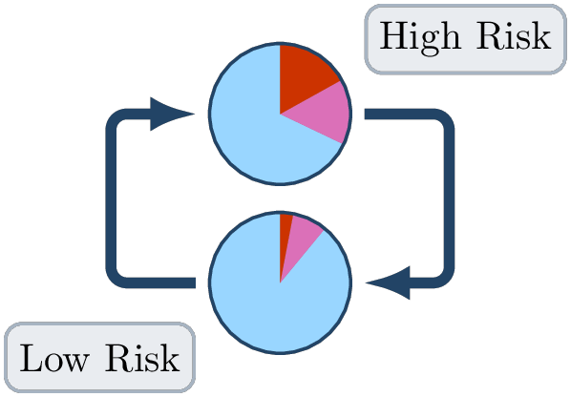
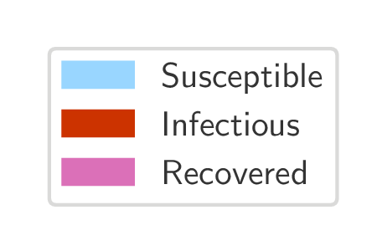
How turnover affects risk group STI prevalence
Slow Turnover
Fast Turnover
Turnover yields a net movement of infected: High → Low
Turnover homogenizes risk
Notes:
First, we show the system under slow rates of turnover.
STI prevalence is of course high among the high-risk group, and low among the low-risk group.
There is a low rate of movement of infected individuals from the high-risk group to the low-risk group,
and a low rate of movement of susceptible individuals in the other direction.
We contrast this with the system under fast rates of turnover.
In this case, many infected individuals from the high-risk group move into the low risk group via turnover,
and they are replaced mainly by susceptible individuals from the low risk group via turnover.
Therefore, increasing turnover yields a net movement of infected individuals from high to low risk.
This explains the results we observed: STI prevalence decreases among the high risk group, and increases among the low-risk group.
Furthermore, we note how increasing turnover decreases the time spent in the high-risk group, but increases the number of people exposed to high-risk conditions.
Therefore we can say that turnover acts to “homogenize” the risk experienced by individuals in the model.

Slide 9
Turnover & importance of reaching High-Risk group
Model
City
City A
No
Turnover
City B
Turnover
Model A
No
Turnover
Model B
Turnover
Estimate TPAF of High-Risk group (1 - 30 years)
Notes:
Now, we return to our original motivating question: How does turnover influence the TPAF of the high-risk group?
In fact, there are two ways of considering this question:
First, we can imagine two settings -- cities, for example -- which are identical, except that there is risk group turnover in one, and no turnover in the other.
In this case, the parameters between the cities are the same, but the STI prevalence may be different between the cities due to turnover.
Second, we could assume that we are trying to model one setting, and we have two models: one with turnover, and one without.
In this case, we fit the model parameters to ensure the model predicts the observed STI prevalence for the setting, but the fitted parameters may be different due to turnover.
Specifically, we fit the number of partners per year among individuals in the high and low risk groups.
In both cases, we then estimate and compare the TPAF of the high-risk group, over time horizons of 1 to 30 years.

Slide 10
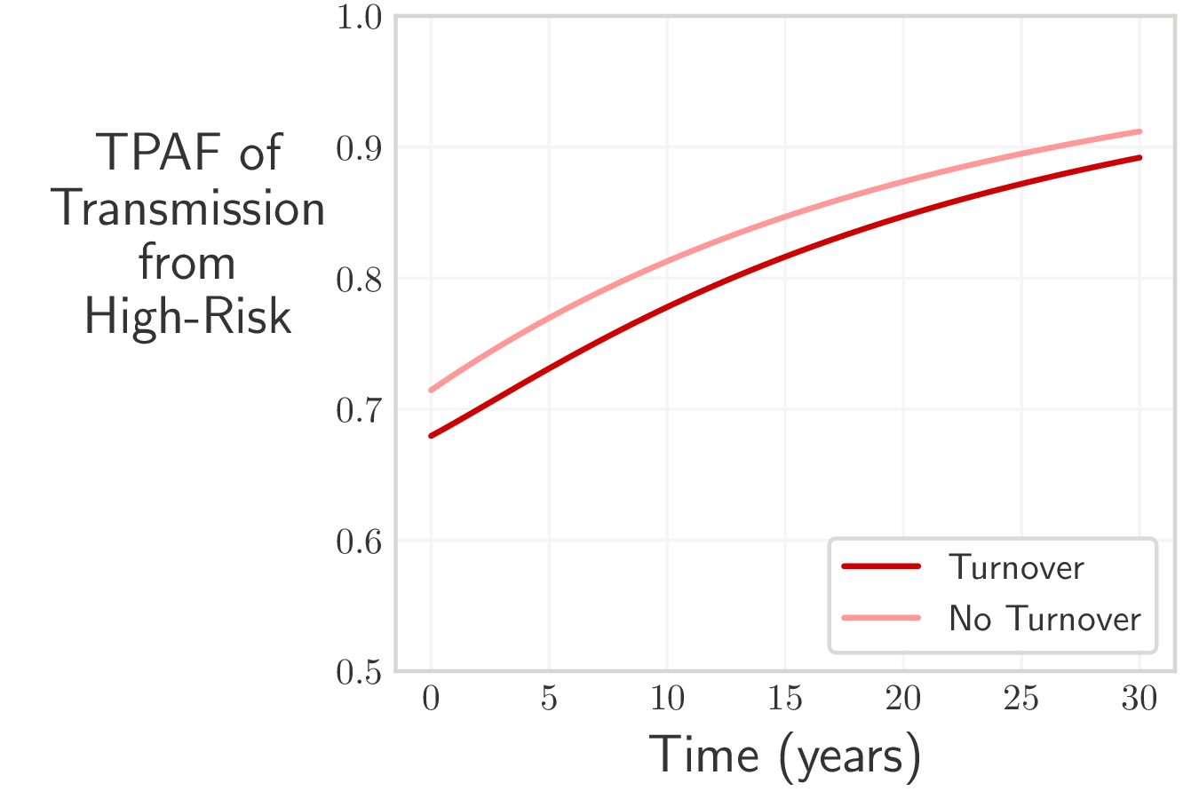
TPAF of High-Risk: same model, two settings
Model
City A
No
Turnover
City B
Turnover
Ratio ( High : Low )
25 ( 25 : 1 ) | Partners per Year | 25 ( 25 : 1 )
9.4 ( 66 : 7 ) | STI Prevalence | 3.5 ( 42 : 12 )
TPAF of High-Risk group ↓ in setting with Turnover
Notes:
In the first comparison,
The number of partners per year among the high and low risk groups are the same.
However, the STI prevalence ratio between the high and low risk groups is lower in the setting with turnover,
since (recall) turnover acts to homogenize risk.
As a result, the TPAF of the high-risk group -- the importance of reaching them with care --
is lower in the setting with turnover.
This is true over all time horizons from 1 to 30 years, as shown in the figure.

Slide 11
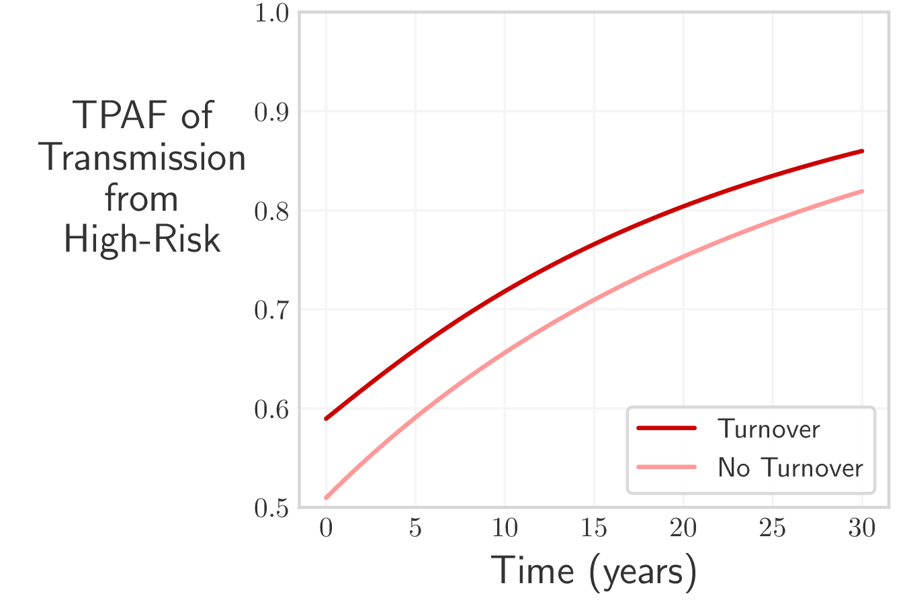
TPAF of High-Risk: same setting, two models
City
Model A
No
Turnover
Model B
Turnover
Ratio ( High : Low )
6.3 ( 16 : 2.5 ) | Partners per Year | 60 ( 17 : 0.3 )
5 ( 25 : 5 ) | STI Prevalence | 5 ( 25 : 5 )
TPAF of High-Risk group ↑ in model with Turnover
Notes:
In the second comparison,
Fitting the number of partners per year among high and low risk groups, ensures that they project the same STI prevalence for both risk groups.
However, in order to overcome the homogenizing effect of turnover,
the ratio of partners per year among high versus low risk must be higher in the model with turnover.
As a result, the TPAF of the high-risk group is higher in the model with turnover.
And again, this is true over all time horizons.
Now, here we considered the ratio of partners per year among high vs low risk groups,
but we could have used any parameter controlling the level of group-specific risk.
What we’re really representing is the level of risk heterogeneity in the population.

Slide 12
Implications
Limitations: Results conditional on model assumptions
Turnover influences equilibrium STI prevalence
“homogenizes” risk groups
Fitting without turnover: TPAF of High-Risk can be underestimated
may underestimate impact of interventions focused on High-Risk
Prioritize data to parameterize turnover
e.g. duration in sex work
contact: knightje@smh.ca | code: github.com/c-uhs/turnover
Notes:
There are several important implications of these results.
However, first we acknowledge that there are several limitations to this work.
For example: we do not consider disease-attributable mortality, which must be considered for HIV, nor do we consider re-infection, which must be considered be considered for STIs such as syphilis. These will be the subject of future work.
Regarding implications:
- First, we’ve shown how turnover acts to homogenize the equilibrium STI prevalence projected across risk groups.
- Second, when fitting model parameters to group-specific prevalence data,
the inferred risk heterogeneity in a model without turnover will be lower than in a model with turnover,
because, in order to predict the same prevalence ratio, the “homogenizing” effect of turnover must be overcome by other risk parameters.
As a result, the TPAF of the high-risk group can be underestimated if turnover present in reality is not captured in the model.
This then implies that the importance of key populations interventions may be underestimated by fitted models which don’t include turnover.
- Finally, considering the importance of modelling turnover which we highlight here,
efforts to collect data to help parameterize turnover systems should be prioritized.
Thank you,

Slide 13
References
Hein Stigum, W. Falck, and P. Magnus. “The core group revisited: The effect of partner mixing and migration on the spread of gonorrhea, chlamydia, and HIV”. In: Mathematical Biosciences 120.1 (1994), pp. 1–23.
Marie Claude Boily and Benoı̂t Mâsse. “Mathematical models of disease transmission: A precious tool for the study of sexually transmitted diseases”. In: Canadian Journal of Public Health 88.4 (1997), pp. 255–265.
Sharmistha Mishra et al. “Data and methods to characterize the role of sex work and to inform sex work programs in generalized HIV epidemics: evidence to challenge assumptions”. In: Annals of Epidemiology 26.8 (2016), pp. 557–569.
Xinyu Zhang et al. “Episodic HIV Risk Behavior Can Greatly Amplify HIV Prevalence and the Fraction of Transmissions from Acute HIV Infection”. In: Statistical Communications in Infectious Diseases 4.1 (2012).
Shah Jamal Alam et al. “Detectable signals of episodic risk effects on acute HIV transmission: Strategies for analyzing transmission systems using genetic data”. In: Epidemics 5.1 (2013), pp. 44–55.
Christopher J. Henry and James S. Koopman. “Strong influence of behavioral dynamics on the ability of testing and treating HIV to stop transmission”. In: Scientific Reports 5.1 (2015), p. 9467.
Notes:
Questions
How is turnover parameterized; what data is needed?
Actually we have a paper coming soon which should explain in more detail. But in general, we make assumptions which constrain the rates of turnover, based on available data; and then we “solve” for the turnover rates using linear algebra. The main pieces of data that we need are: the relative sizes of the groups, the average duration spent in the group, the distribution of risk groups in the “entering” population, and then, for individuals currently in one risk group, whether they were previously part of a different risk group.
How would results change given STI-attributable mortality? -- such as in HIV
Including STI-attributable mortality would reduce the size of the high-risk group, due to unequal burden. For fixed parameters, decreasing the group size will decrease the TPAF of a group. However, turnover would help maintain the high-risk group size via supply of individuals from lower-risk groups, and counteract this reduction in TPAF. Therefore, in the two cities comparison, the TPAF in both cities would be more similar, while in the two-models comparison, the gap would be even larger. That is, the model without turnover would underestimate the TPAF of the high risk group even more when STI-attributable mortality is considered. -- JK: verified in code :)
How would results change with re-infection? -- such as in syphilis, gonorrhea
So, we explored this briefly, and for both the prevalence trends and TPAF results, the results are really not affected. We think this is because the system is at equilibrium for a lot of our results. However, we really have not done a sensitivity analysis for the rates of recovery and immunity loss. -- JK: verified in code :)
How is sexual mixing modelled? How would result change if assortative?
Individuals in the model choose partners “proportionally” - so there is no preference of high-risk forming partnerships with other high-risk individuals. If we did consider that kind of “assortative” partner selection, it would contain more transmission within the higher-risk group, decreasing the TPAF of the group. However, since turnover acts to redistribute individuals into other risk groups after infection, it would counteract this effect. [similar to mortality] Therefore, in the two cities comparison, the TPAF in both cities would be more similar, while in the two-models comparison, the gap would be even larger. That is, the model without turnover would underestimate the TPAF of the high risk group even more when assortative mixing is considered. -- JK: verified in code :)

