Slide 1
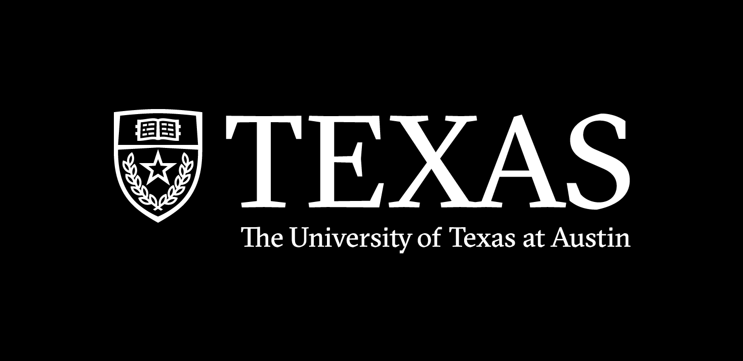
Spring 2023
Bias vs. variance,
train / test split,
& cross validation
Programming and Data Analysis for Modern Neuroscience
NEU 365P/385L
Marcel Goldschen-ohm
Assistant Professor in the Department of Neuroscience, The University of Texas at Austin

Slide 2
data
preprocess
train model
A measure of how well the model predicts the data.
model error

Slide 3
data
preprocess
train model A
train model B
model A error
Choose the model with the lowest error?
model B error

Slide 4
data
preprocess
train model A
train model B
model A error
Choose the model with the lowest error?
model B error
This is a VERY BAD IDEA.

Slide 5
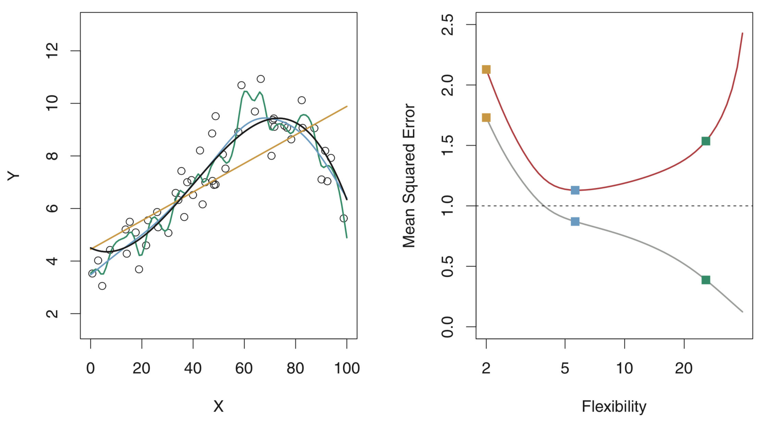
The most flexible model will always fit the training data best.
True relationship
Linear fit
Smooth fit
Rough fit
training error

Slide 6
Models that overfit the training data will poorly predict new test data.
True relationship
test error
Linear fit
Smooth fit
Rough fit
training error

Slide 7
Bias vs. Variance tradeoff
True relationship
under fitting
(high bias)
test error
Linear fit
Smooth fit
Rough fit
best
over fitting
(high variance)
training error

Slide 8
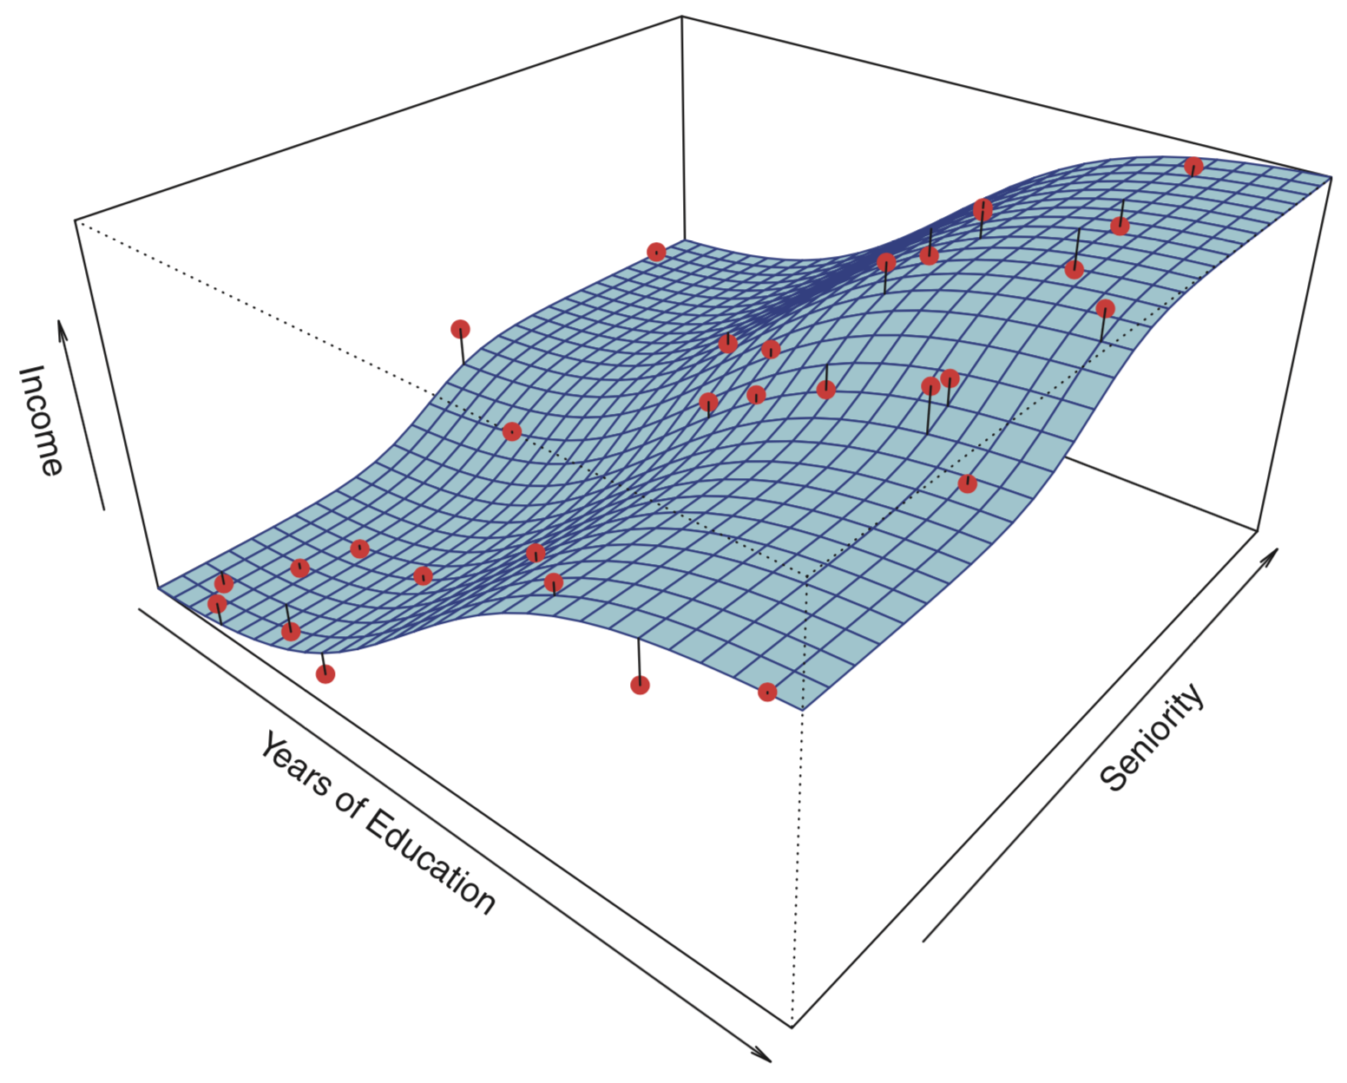
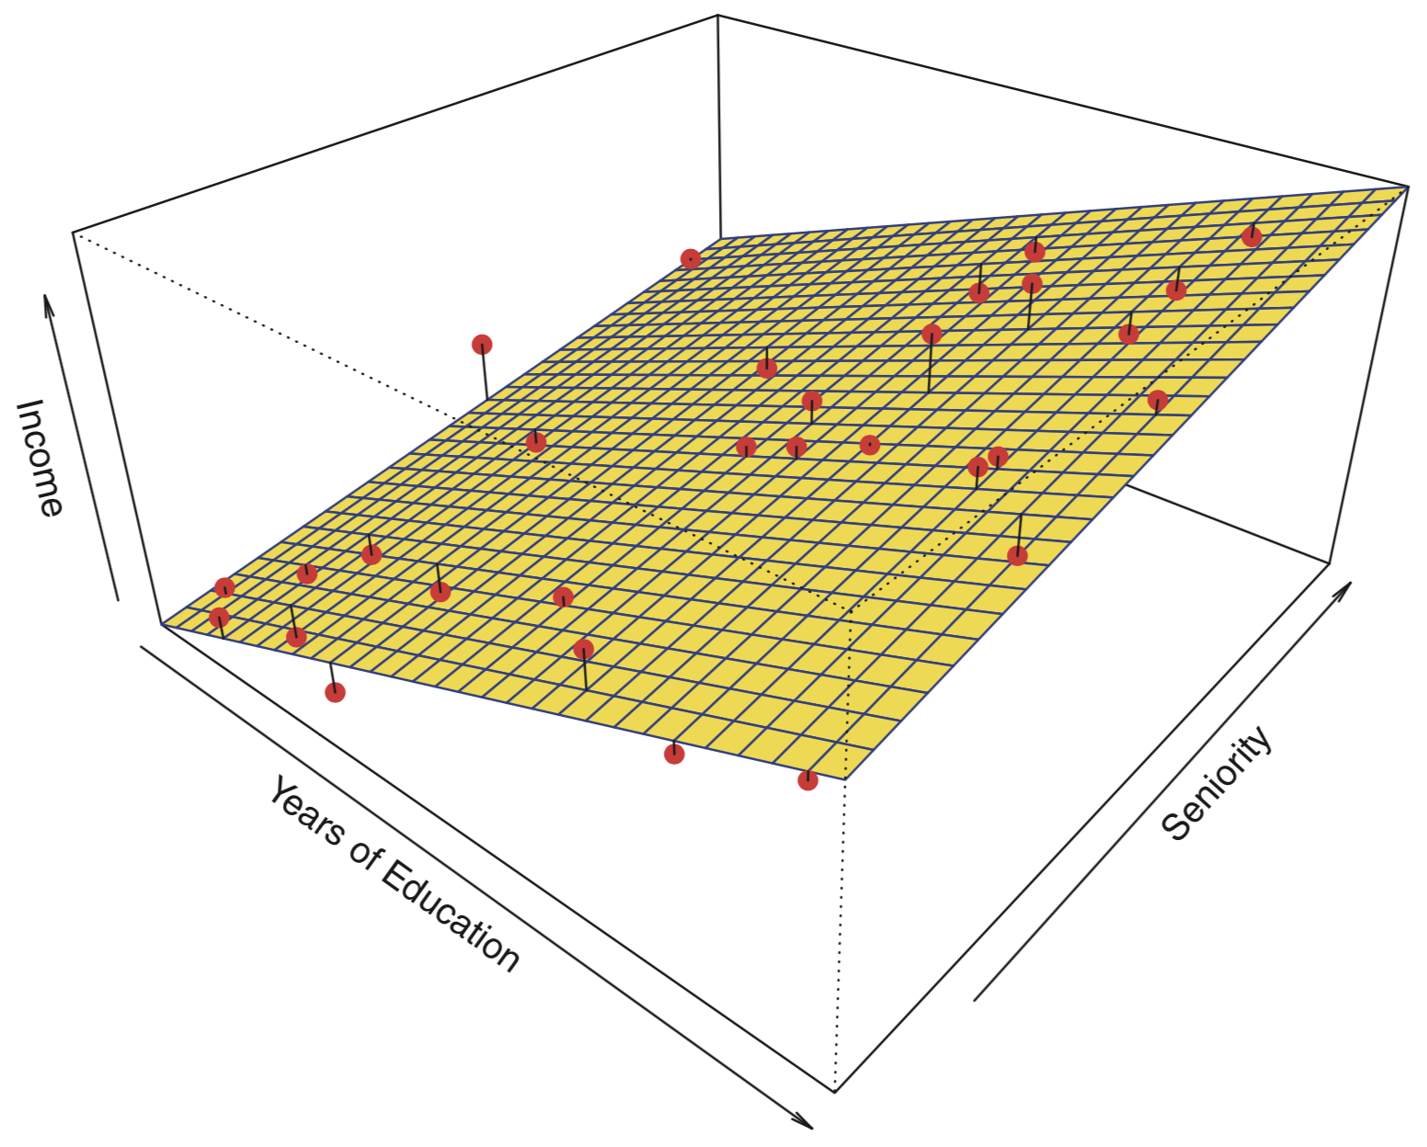
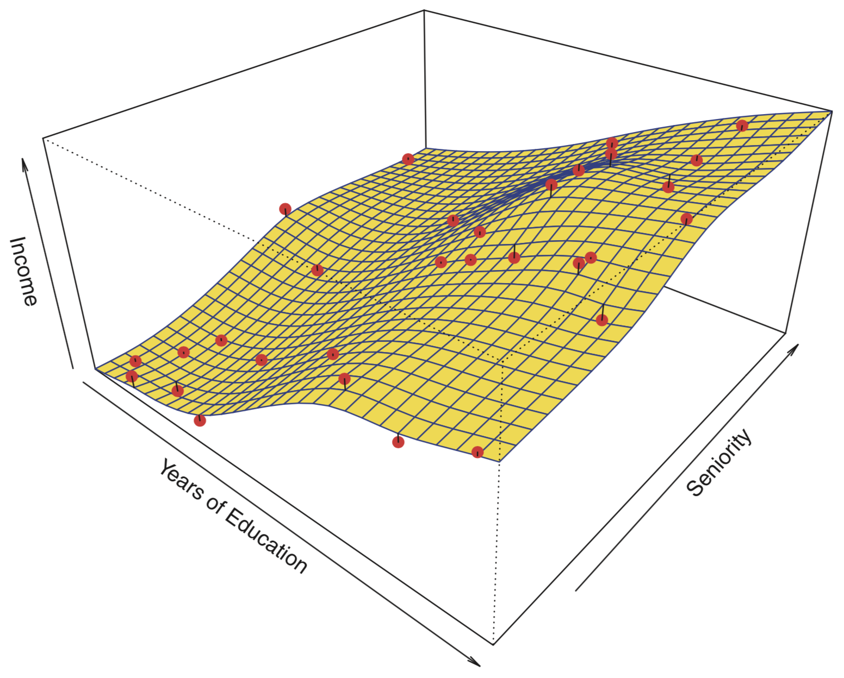
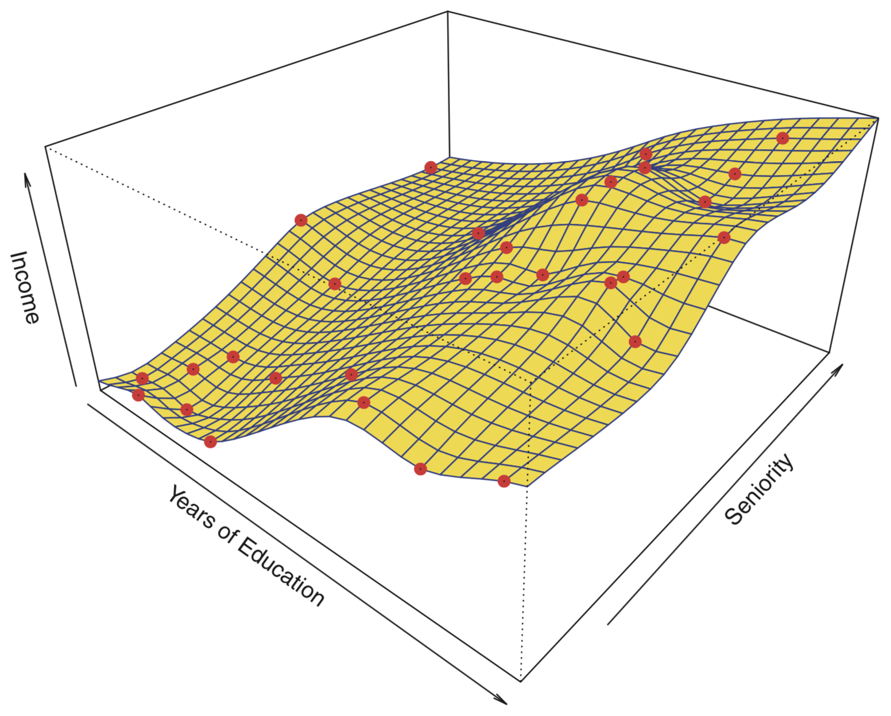
Bias vs. Variance tradeoff
True relationship
Linear model
Smooth Spline model
Rough Spline model
Model Flexibility
low
high
Bias
high
low
Variance
low
high

Slide 9
data
train
test
Split data into train vs. test sets.

Slide 10
data
train
test
How the data is split can matter, but there is no a priori single right way to do it.
train
test
train
test

Slide 11
data
Artifacts may not be uniformly distributed in the dataset.
e.g., Subject was briefly tired or distracted during a few trials.
train
test

Slide 12
data
Shuffle data before splitting to randomly distribute any artifacts.
train
test

Slide 13
data
train
test
Shuffle and split.
Preprocess all data, but determine preprocessing based ONLY on the training set.
preprocess
train model A
error A
Choose the model with the lowest error?
train model B
error B

Slide 14
data
train
test
Shuffle and split.
Preprocess all data, but determine preprocessing based ONLY on the training data.
preprocess
train model A
error A
Choose the model with the lowest error?
train model B
error B
This can still depend heavily on the exact train/test split.

Slide 15
data
preprocess
Model Selection
Evaluate overall performance for multiple different splits to find the model that best generalizes to data it was not trained on.
test
train
error
Model A
train
test
train
error
error stats
train
test
error
e.g., Select model with lowest mean error.
test
train
error
Model B
train
test
train
error
error stats
train
test
error

Slide 16
data
preprocess
Cross Validation
All the data sets used to evaluate the error were also used to train the model, so they are referred to as validation rather than test sets.
validate
train
error
Model A
train
validate
train
error
error stats
train
validate
error
e.g., Select model with lowest mean error.
validate
train
error
Model B
train
validate
train
error
error stats
train
validate
error

Slide 17
data
preprocess
validate
train
error
Model Selection
Cross validation to
select model that best generalizes to data it was not trained on.
Model A
train
validate
train
error
error stats
train
validate
error
Best model has low error and variation.
validate
train
error
Model B
train
validate
train
error
error stats
train
validate
error
A
Which model would you choose?
A, B, C, or D
cross validation error
D
B
C
model flexibility

Slide 18

data
preprocess
validate
train
error
Model Selection
Cross validation to
select model that best generalizes to data it was not trained on.
Model A
train
validate
train
error
error stats
train
validate
error
Best model has low error and variation.
validate
train
error
Model B
train
validate
train
error
error stats
train
validate
error
train selected model
error stats
e.g., mean $±$ stdev
e.g., mean $±$ 95% CI

Slide 19
data
train
test
Shuffle and split.
Preprocess all data, but determine preprocessing based ONLY on the training data.
preprocess
validate
train
error
Model A
train
validate
train
error
error stats
train
validate
error
Best model has low error and variation.
validate
train
error
Model B
train
validate
train
error
error stats
train
validate
error
Evaluate error for test set that was never used to select or train the model.
train selected model
error

Slide 20
data
train
test
Shuffle and split.
Preprocess all data, but determine preprocessing based ONLY on the training data.
preprocess
validate
train
error
Model A
train
validate
train
error
error stats
train
validate
error
Best model has low error and variation.
validate
train
error
Model B
train
validate
train
error
error stats
train
validate
error
Evaluate error for test set that was never used to select or train the model.
train selected model
error
train final model

Slide 21
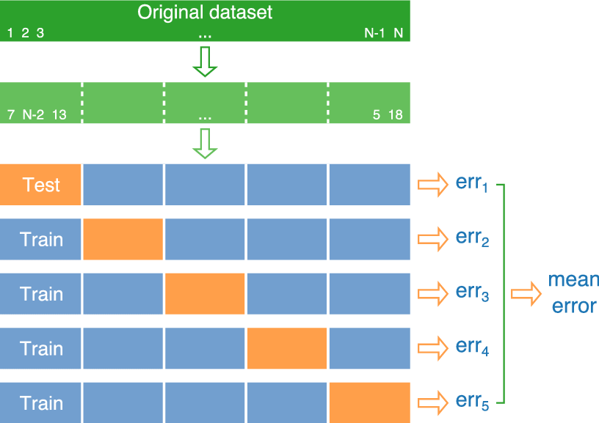
K-fold Cross Validation
K = 5

Slide 22
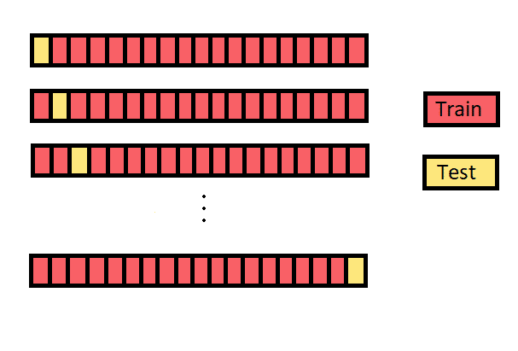
Leave-One-Out Cross Validation

