Slide 1
Distance

Slide 2
First law of geography
Everything is related to everything else, but near things are more related than distant things”
~ Waldo Tobler

Slide 3
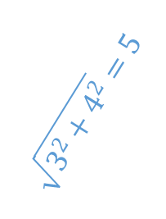
Distance between two points
7
6
(4, 5)
Coordinates must be in units of distance (or you need to be able to convert them to units of distance).
5
4
$$\sqrt{3^{2}+4^{2}}=5$$
5 – 1 = 4
3
2
1
(2, 1)
4 – 2 = 3
0
1
2
3
4
5
6
7

Slide 4
Distance between things that aren’t points

Slide 5
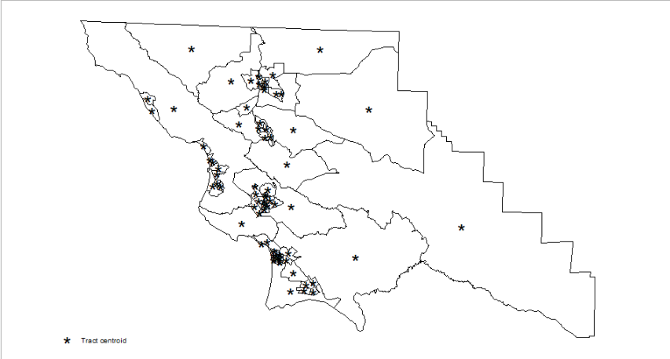
Centroids
Reasonable approximation of the average distance from point A to any location in tract A
Point A
Tract A
Reasonable approximation of the average distance from any point in Tract A to any point in Tract B.
Bonus: Centroids are also handy for placing labels!

Slide 6
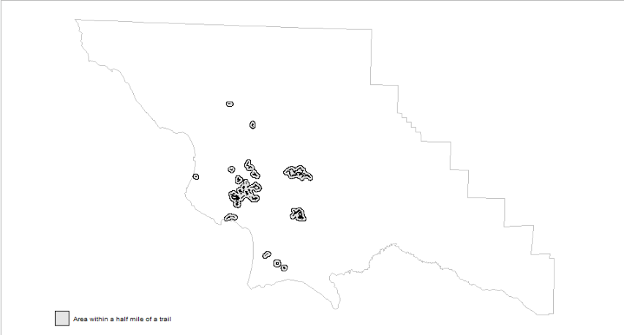
Buffers

Slide 7
The danger of thresholds

Slide 8
The danger of thresholds
7 nearby dots
7 nearby dots
4 nearby dots

Slide 9
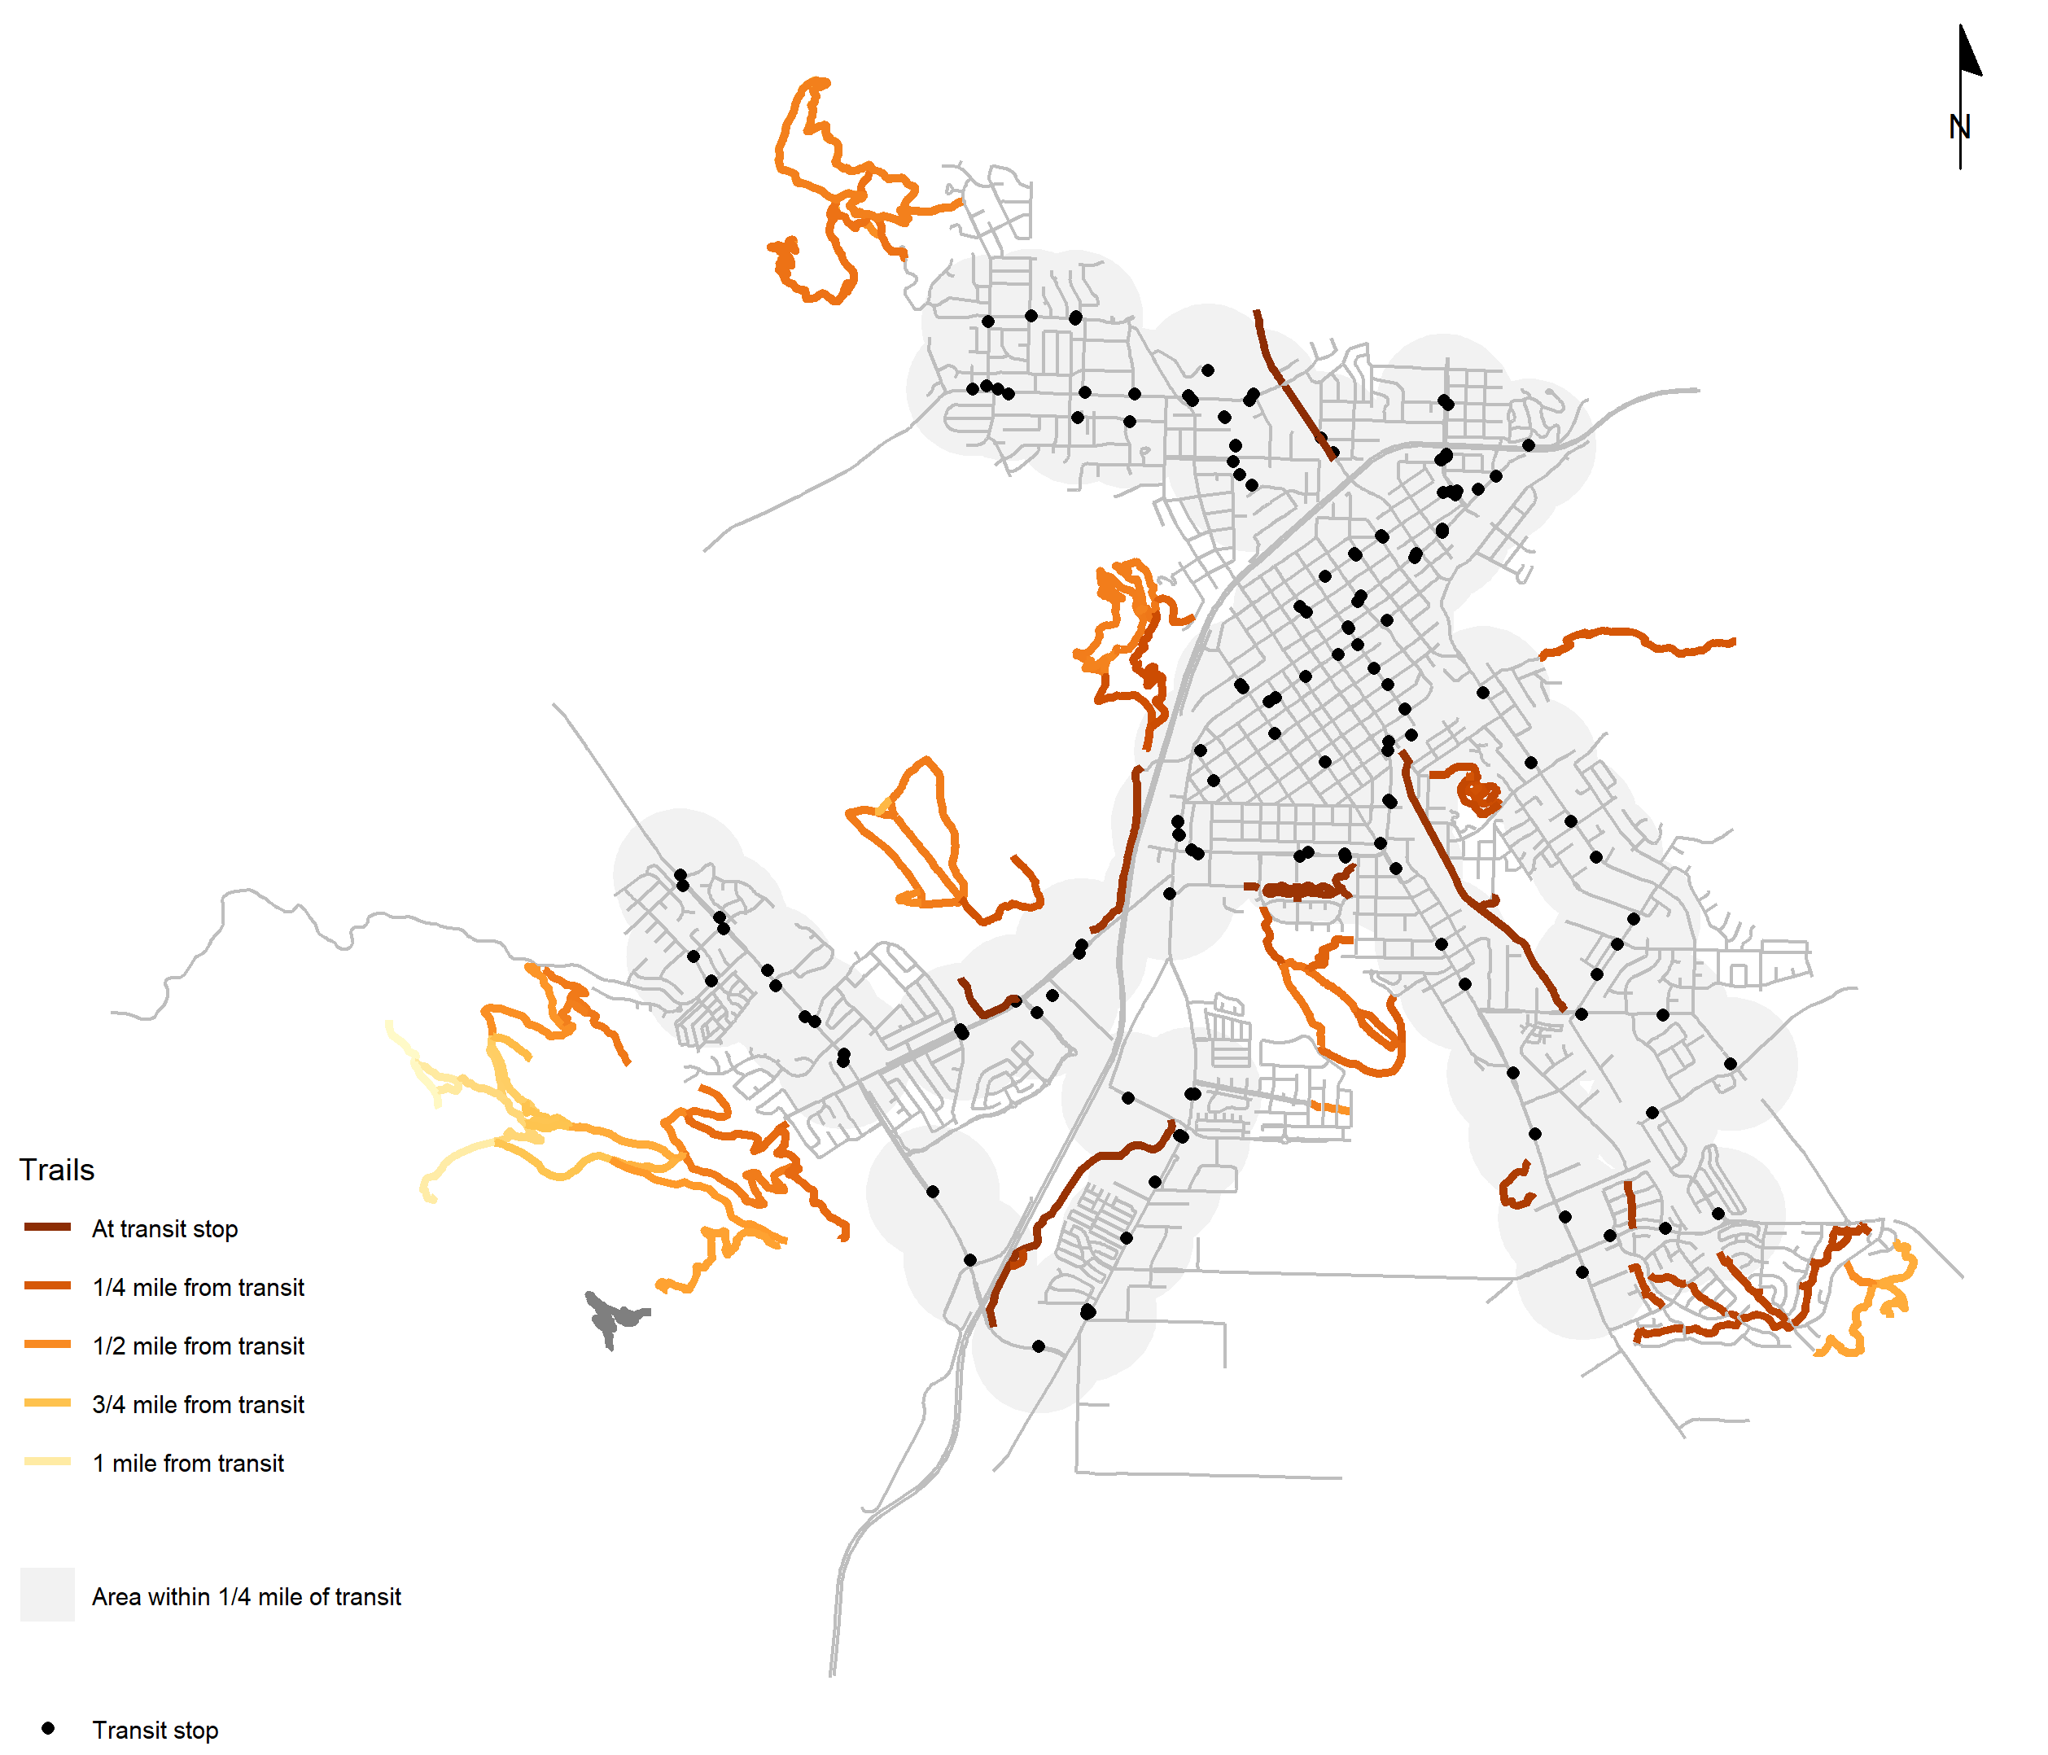
Distance as a characteristic of a feature

Slide 10
Write down two or three questions you could answer about your datasets by calculating distances.

Slide 11
What steps would be involved in answering your questions?

