Slide 1
Transit Funding in the United States
Carole Turley Voulgaris
Associate Professor of Urban Planning
Harvard Graduate School of Design

Slide 2
Transit agencies
Largest transit agencies
(by miles of fixed-route service provided)
New York MTA (18% of all fixed-route service in the United States)
New Jersey Transit (4%)
WMATA (4%)
Chicago Transit Authority (4%)
LA Metro (3%)
SF BART (2%)
All other transit agencies combined (65%)
There are 2,292 Public Transit Agencies in the United States
1,333 offer fixed-route service
 | With fixed-route | Demand-response only
Local government agency | 637 | 513
Independent Agency | 371 | 49
Private non-profit | 99 | 267
Tribe | 81 | 56
MPO, COG, or planning agency | 45 | 27
State agency | 32 | 1
Private firm | 22 | 1
University | 21 | 1
Other | 25 | 44
Total | 1333 | 959

Slide 3
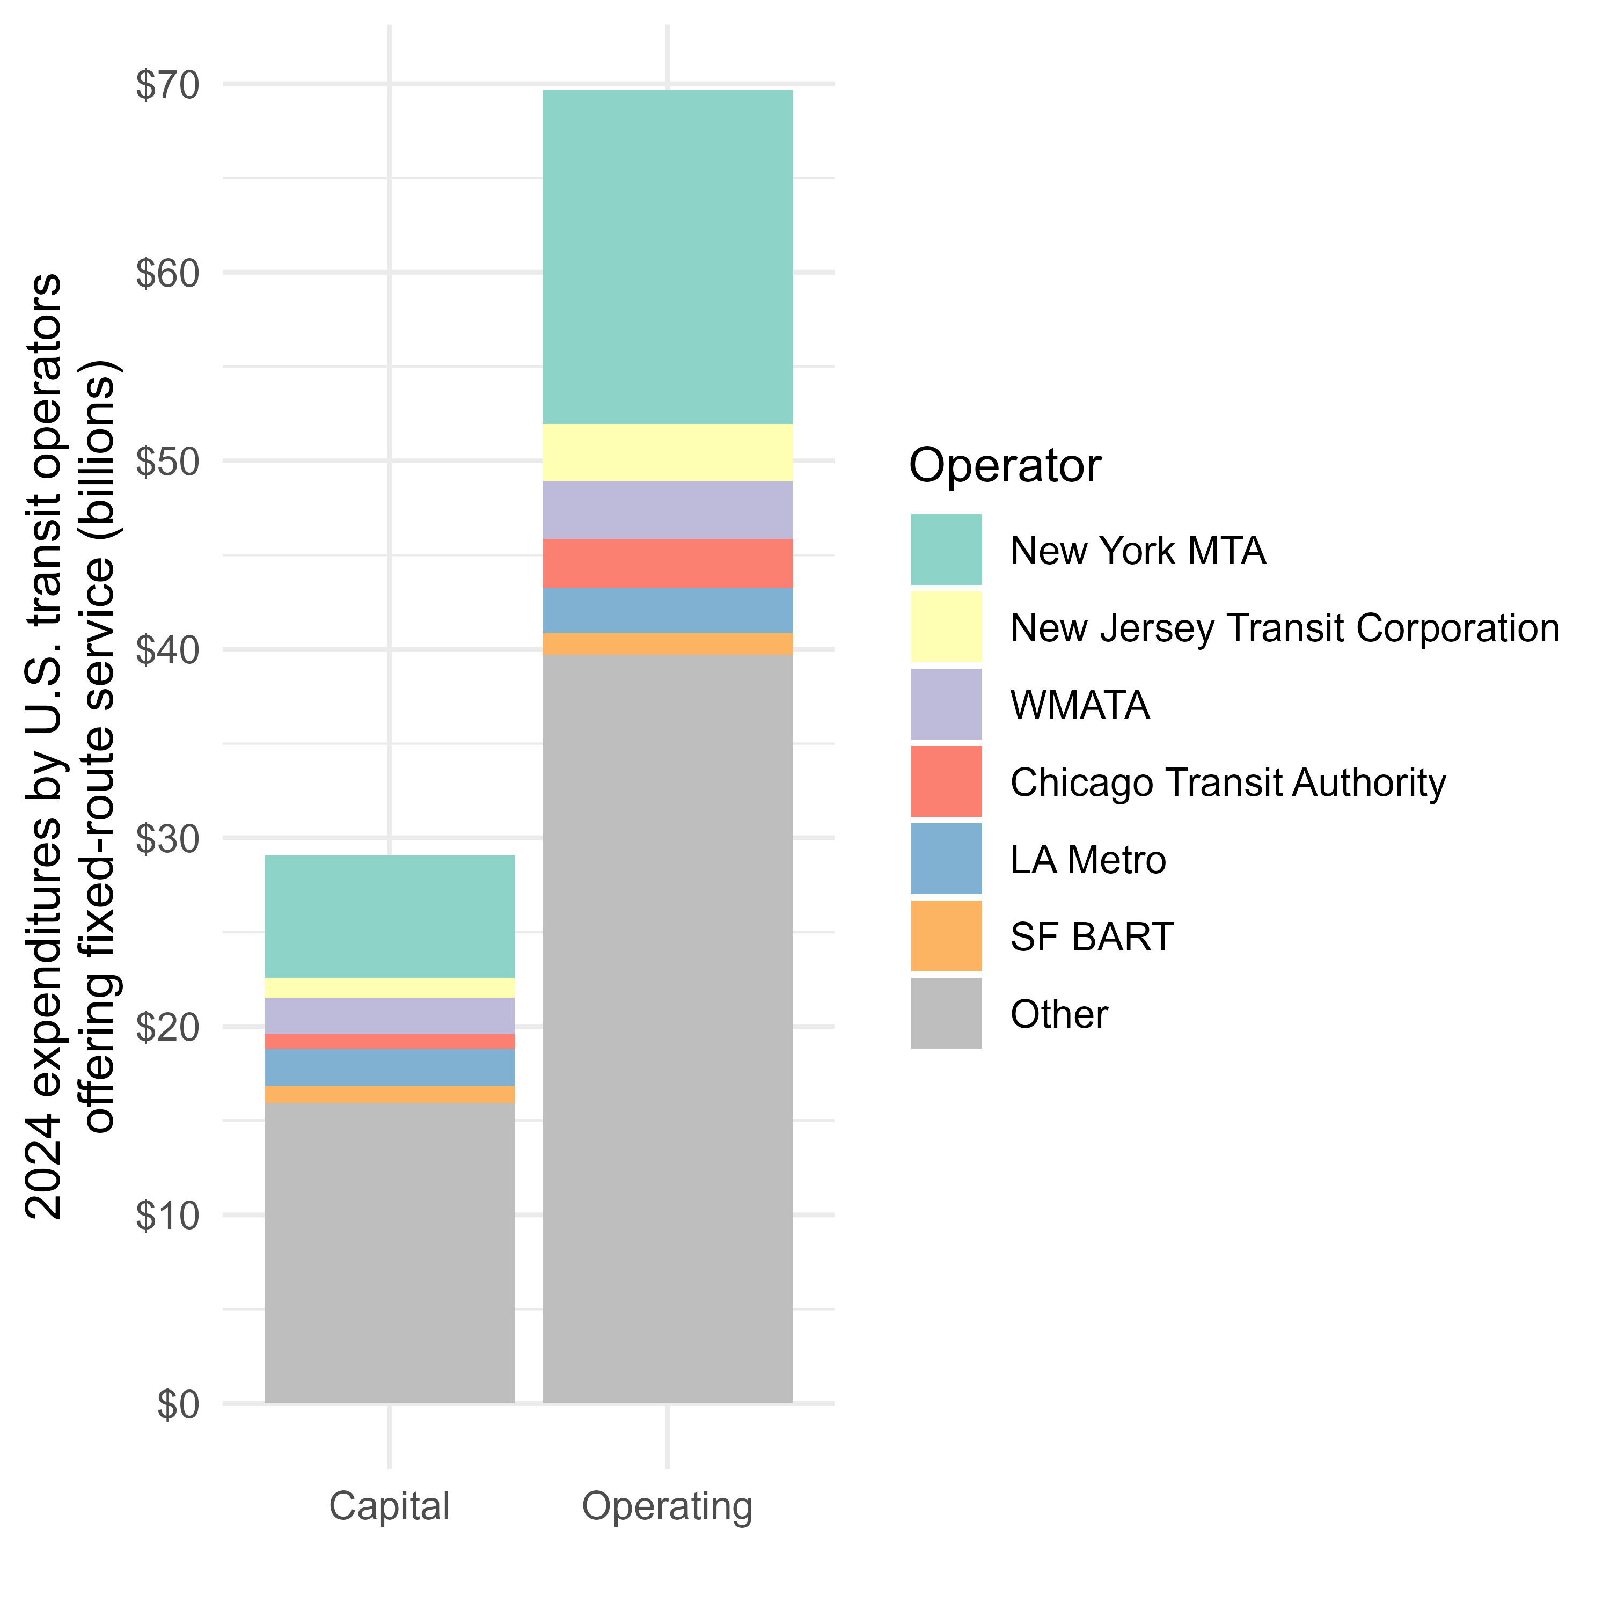
Capital and operating expenditures
Capital expenditures: The purchase, construction, and maintenance of vehicles and facilities
Operating expenditures: Salaries associated with operating the service and purchase of fuel

Slide 4
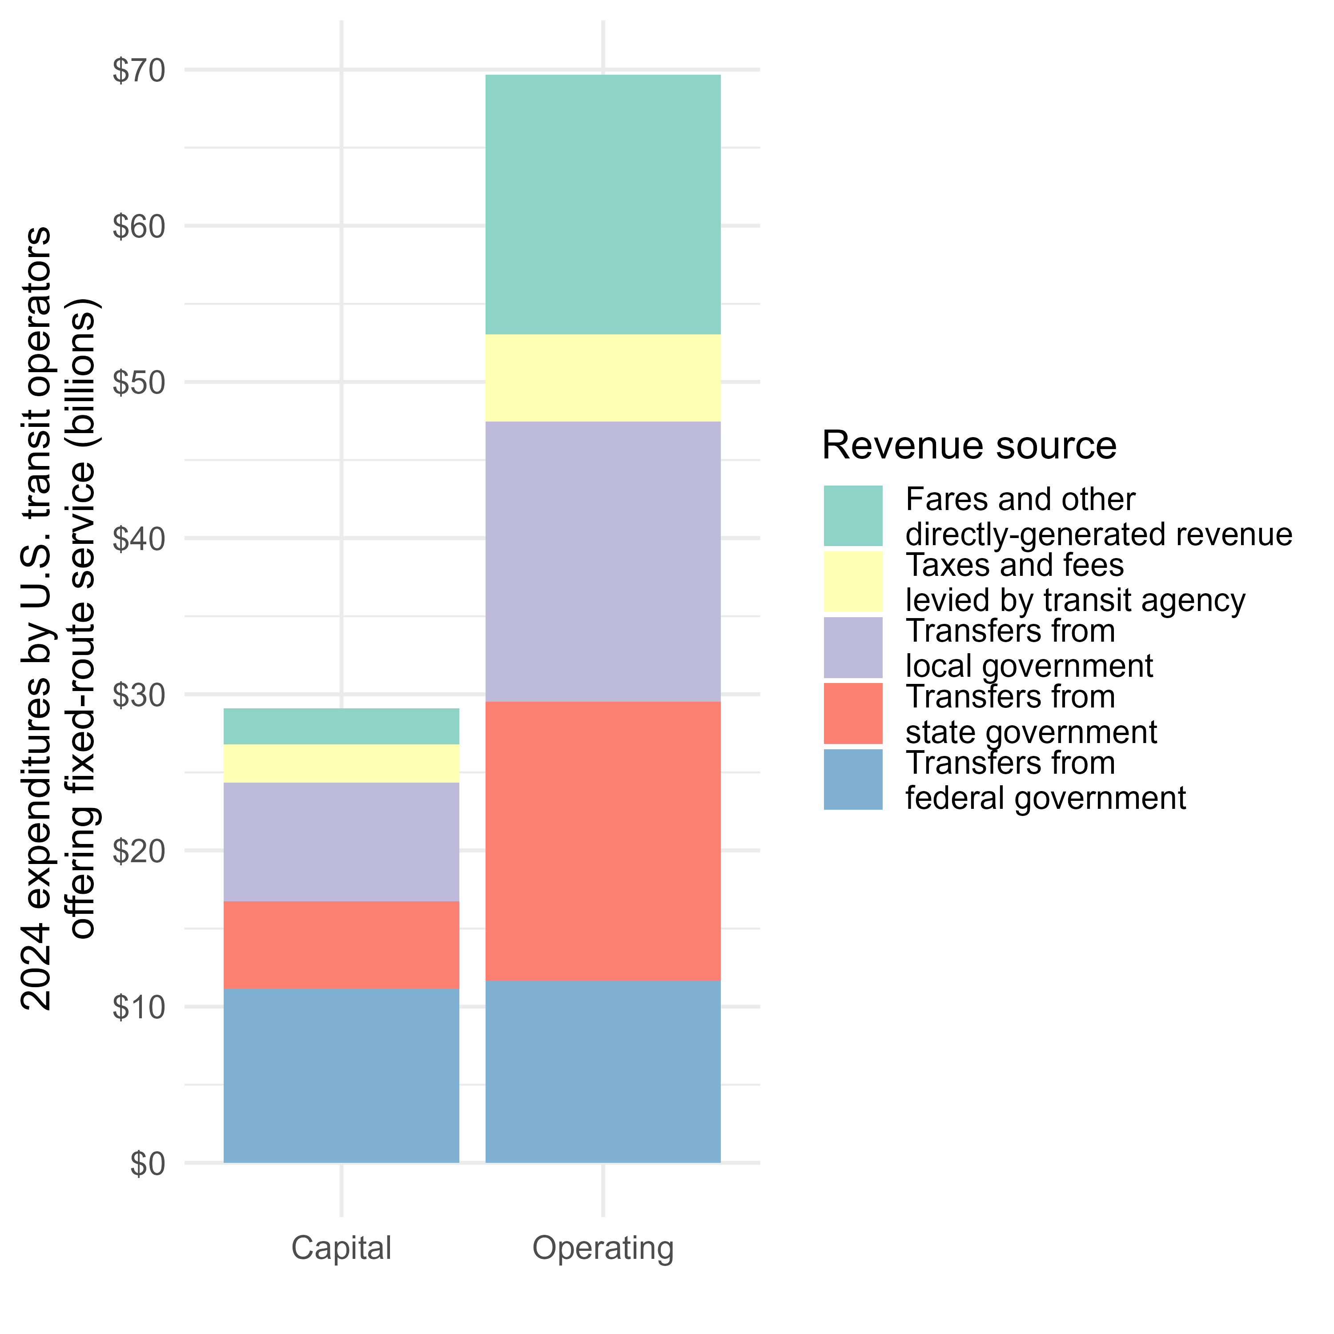
Revenue Sources

Slide 5
Federal Funding

Slide 6
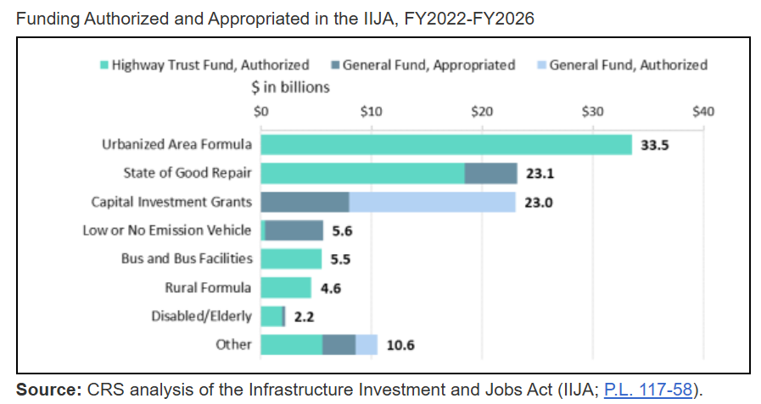
Federal funding
Highway trust fund
2.86₵/gallon of the federal gas tax (18.4₵/gallon since 1993) goes into the Mass Transit Account.
Remaining federal spending on transit comes from the general fund.
https://www.congress.gov/crs-product/R47002

Slide 7
Federal grant programs
Available for operating costs
Only for capital costs
5307 Funding (Urbanized Area Formula)
Formula funding
For transit agencies serving urban areas with populations greater than 200,000 people
Less funding to support operating expenses
5311 Funding (Rural Formula)
Formula funding
For transit agencies serving rural areas and urban areas with populations less than 200,000 people
More funding to support operating expenses
5337 Funding (State of Good Repair)
Formula funding
  Plus competitive Rail Vehicle Replacement grants
For transit agencies serving urban areas
Exclusively for capital maintenance
5309 Funding (Capital Investment Grants)
Competitive funding
All transit agencies are eligible
Exclusively for fixed-guideway capital projects

Slide 8
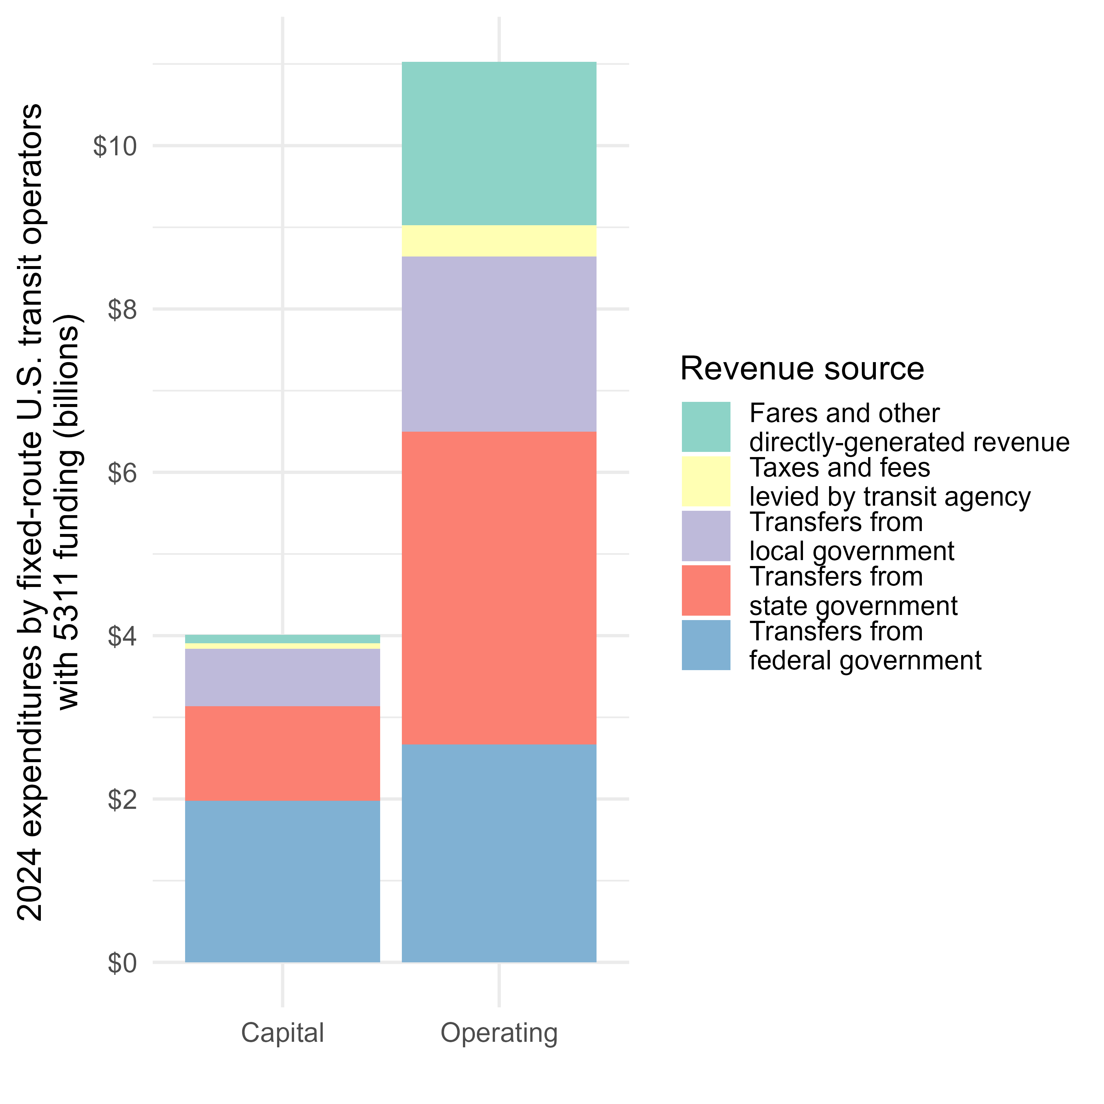
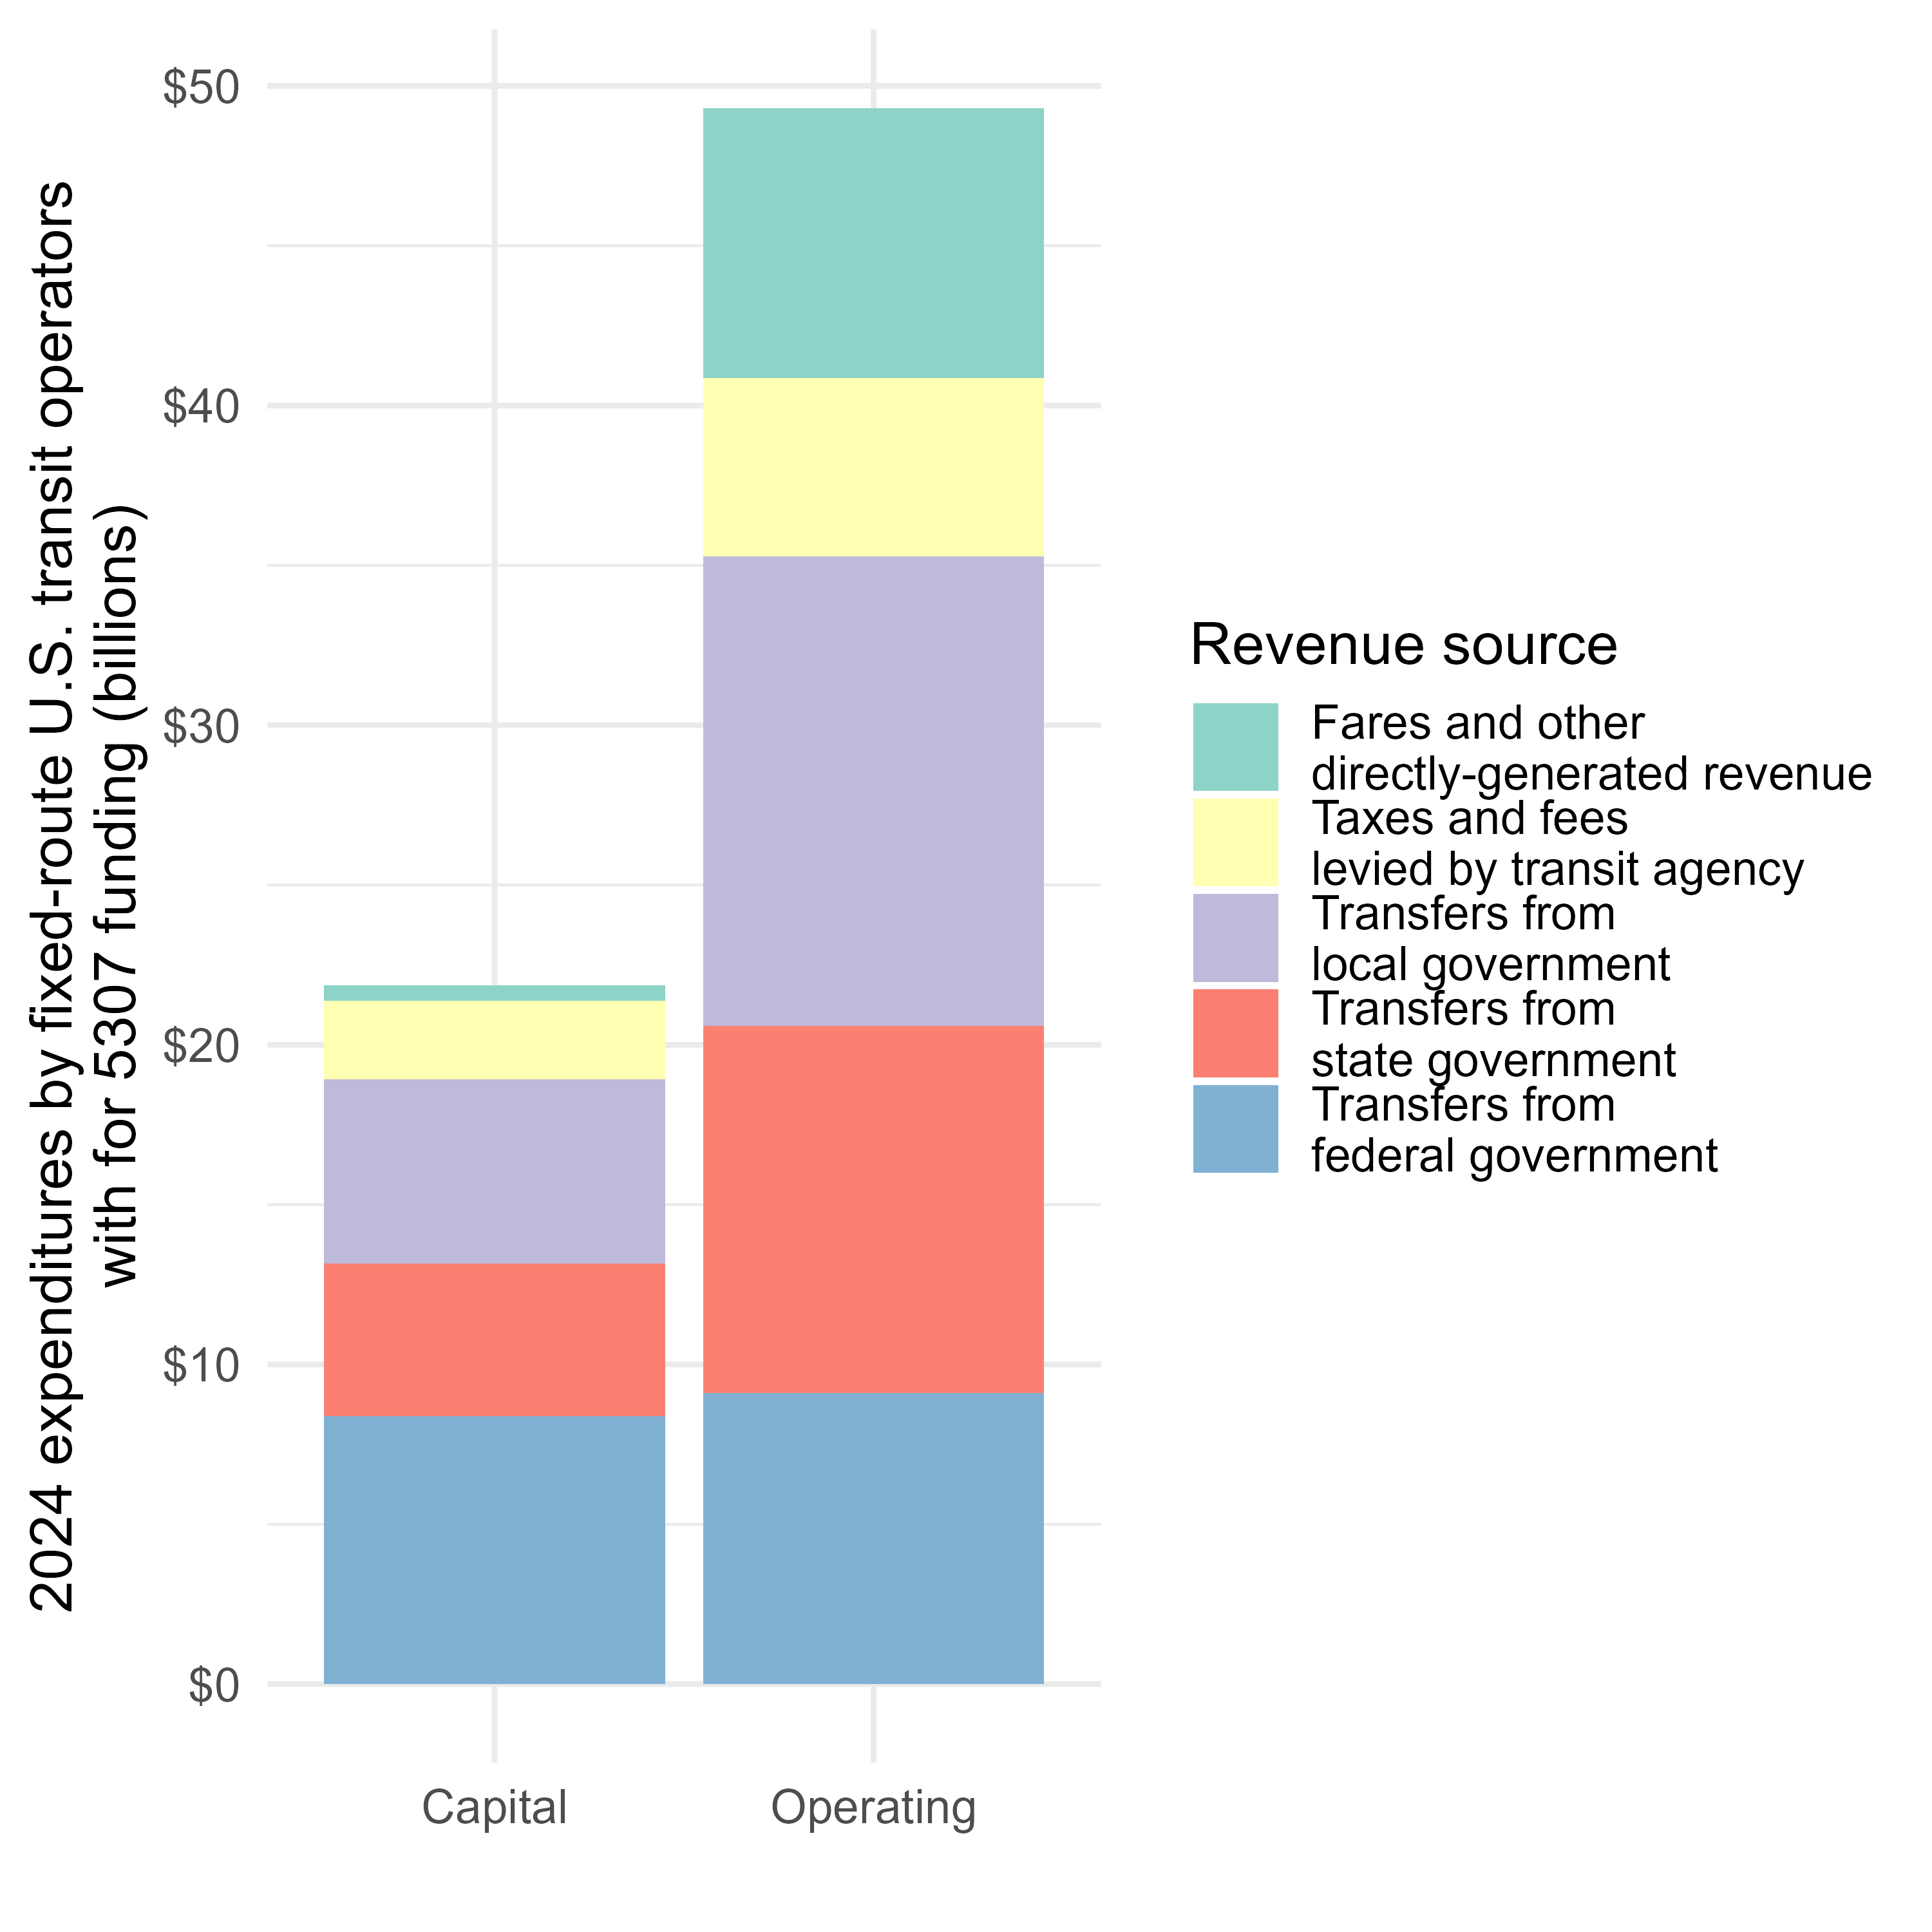
Differences by funding eligibility
(overlapping categories)

Slide 9
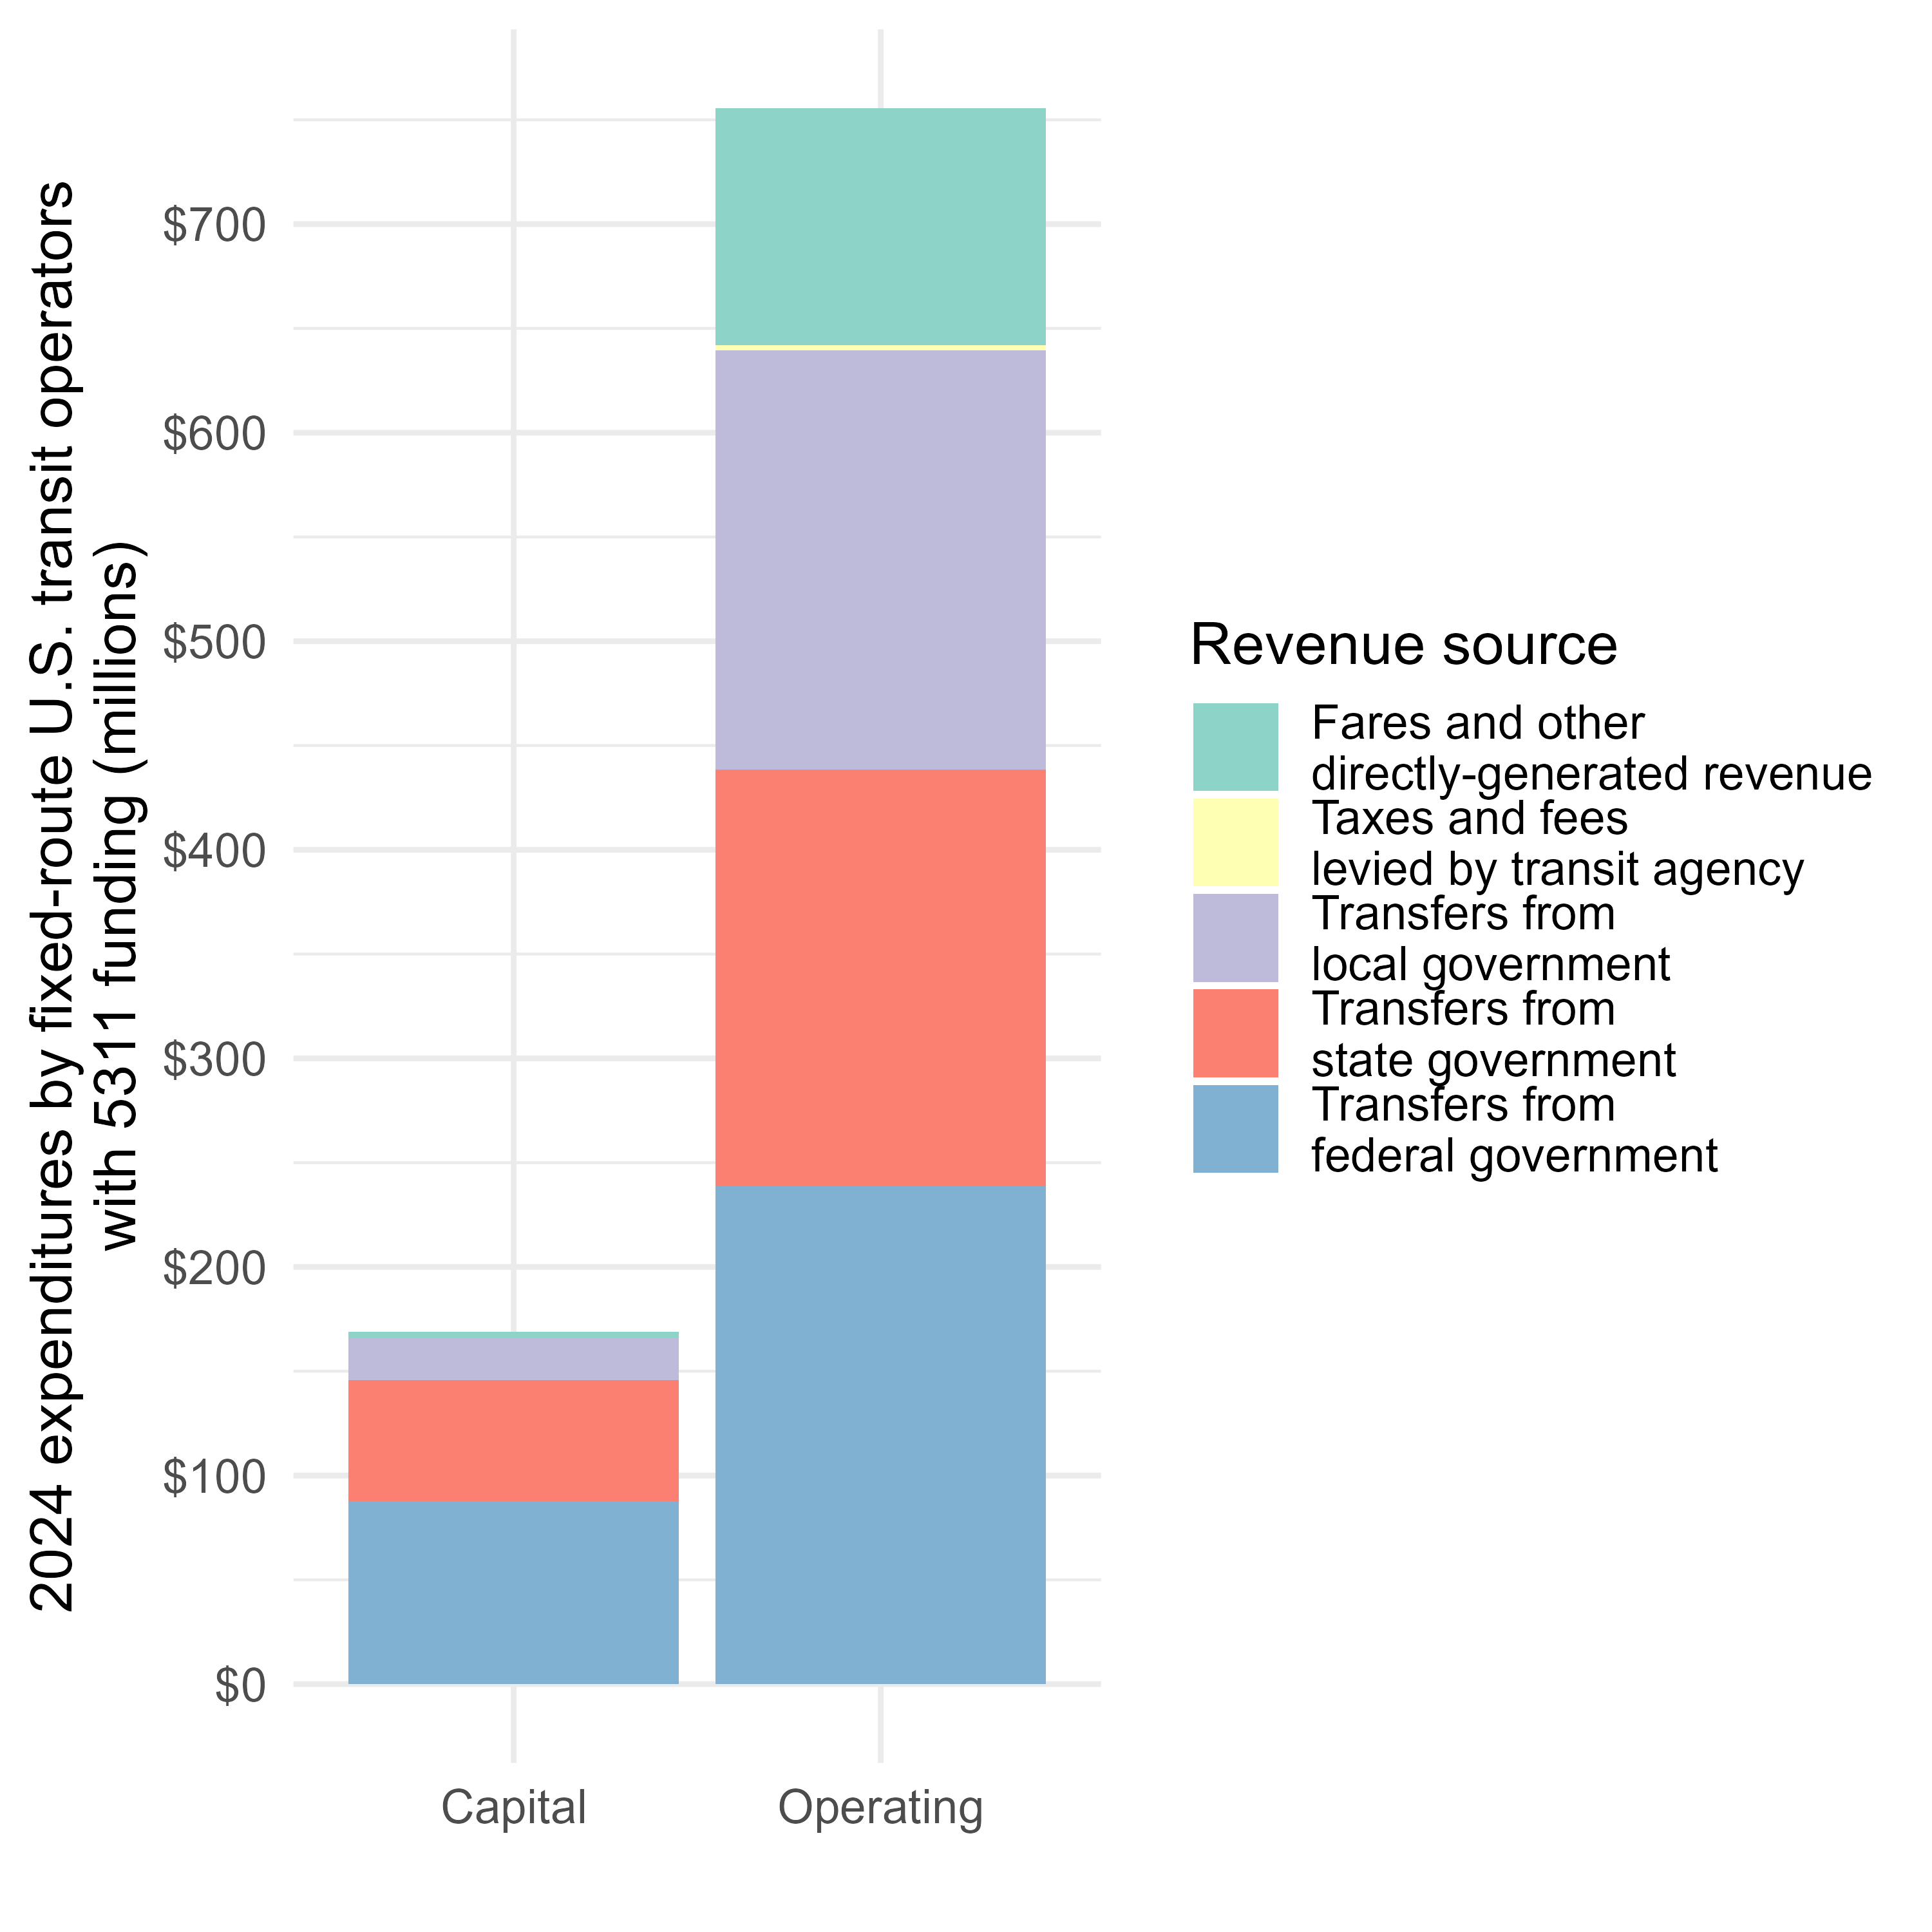
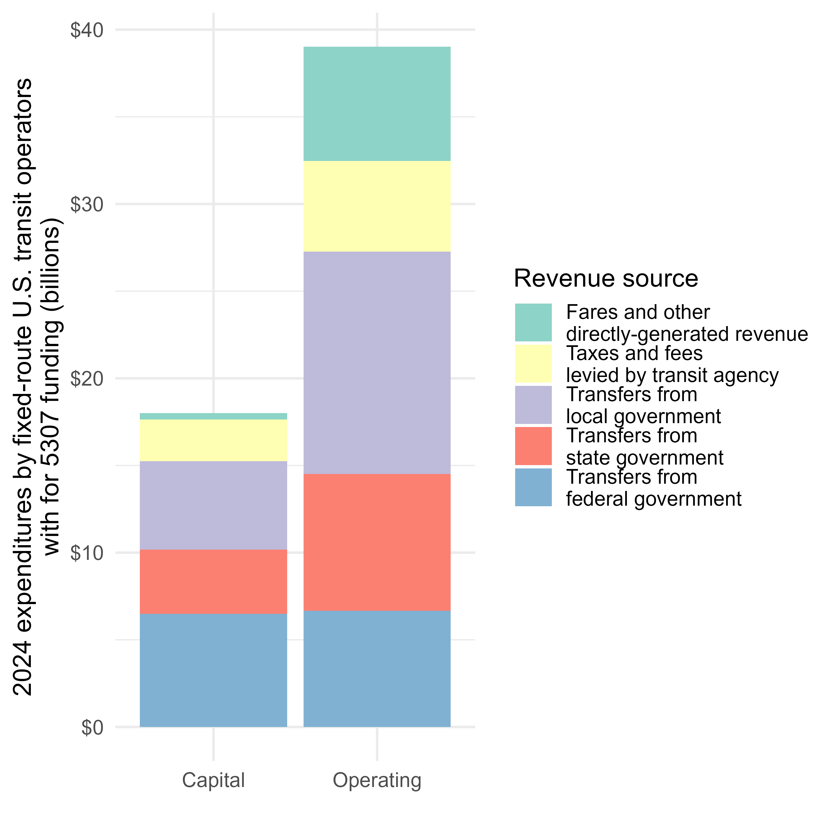
Differences by funding eligibility
(exclusive categories)

Slide 10
State and local funding

Slide 11
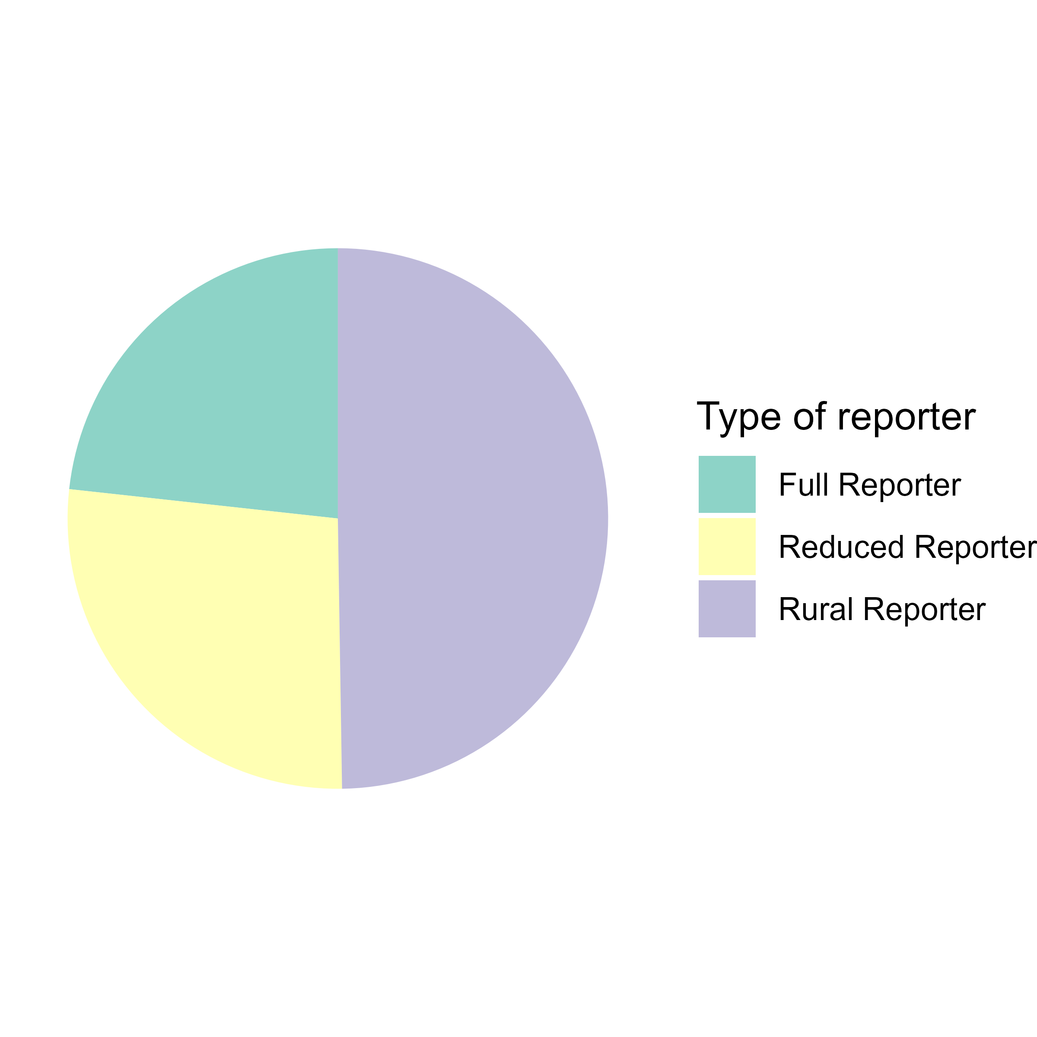
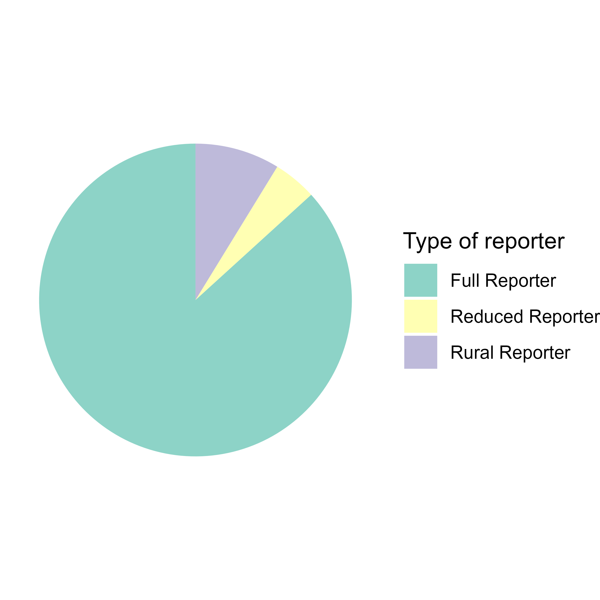
Full, Reduced, and Rural Reporters
Full reporters: Receive 5307 funding and operate at least 30 vehicles at a time during their busiest time (vehicles operating in maximum service)
Reduced reporters: Receive 5307 funding, but operate fewer than 30 vehicles in maximum service.
Rural reporters: Receive 5311 funding, but not 5307 funding
By number of agencies
By amount of service (VRM)

Slide 12
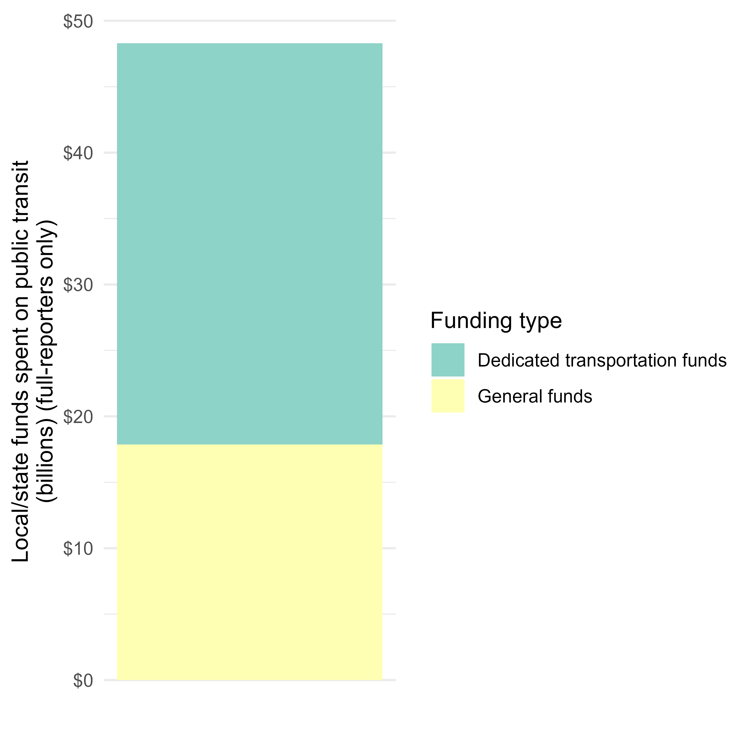
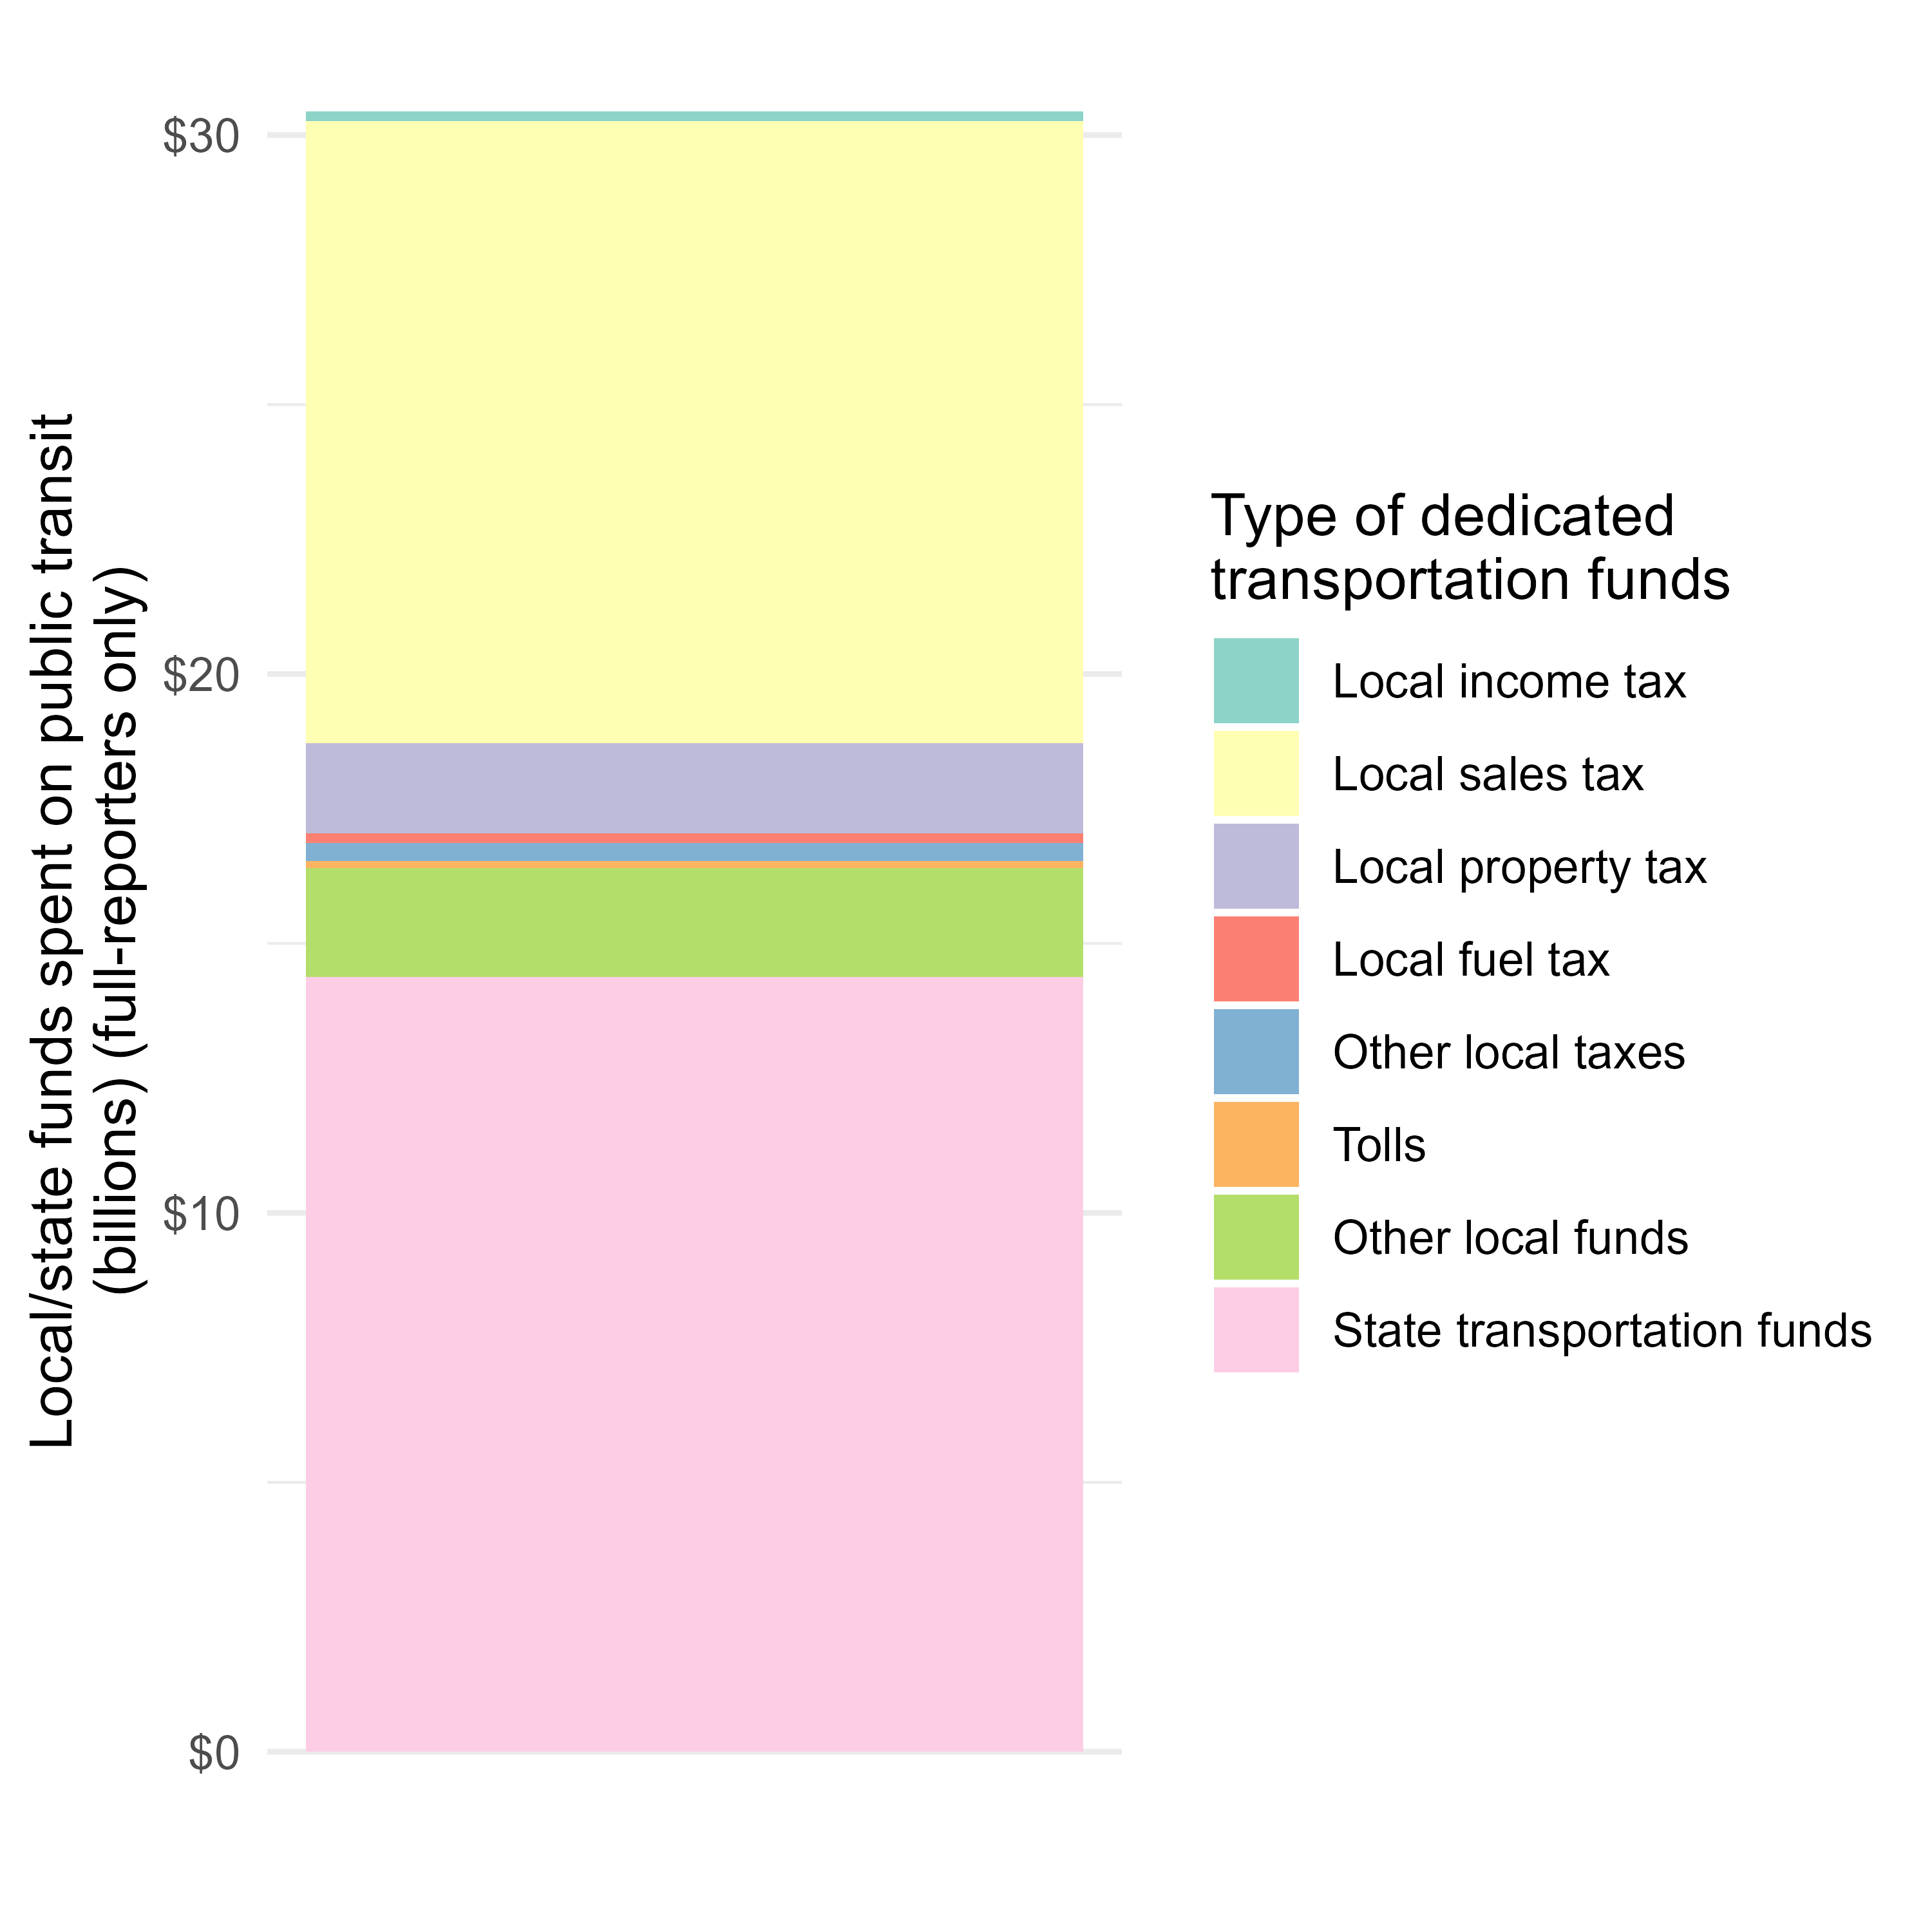
General and dedicated funds
General funds are typically allocated through an annual budgeting process.
127 agencies only use dedicated funds funds
23 agencies use exclusively
8 agencies use exclusively
13 agencies use exclusively
162 agencies use exclusively
101 agencies only use general funds
Out of 527 full reporters

Slide 13
Taxes levied by transit agencies

Slide 14
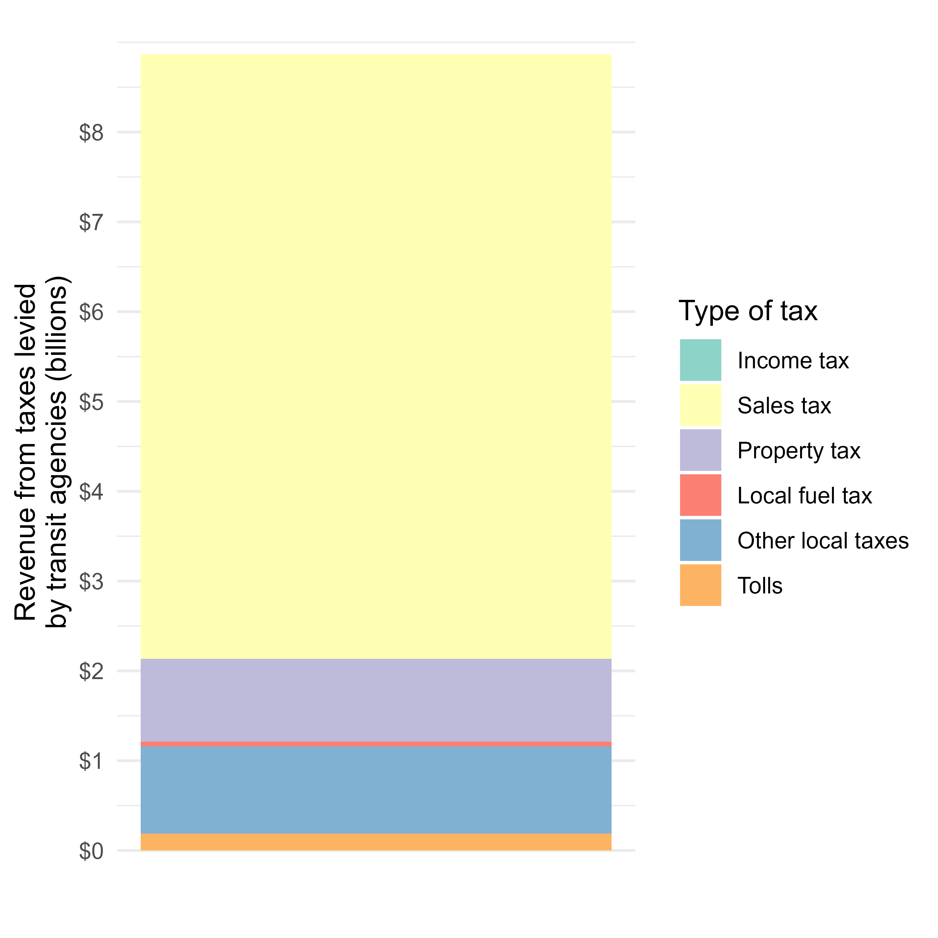
Types of taxes levied by agencies
68 agencies levy taxes
63 use a single type of tax

Slide 15
Fares and directly-generated revenue

Slide 16
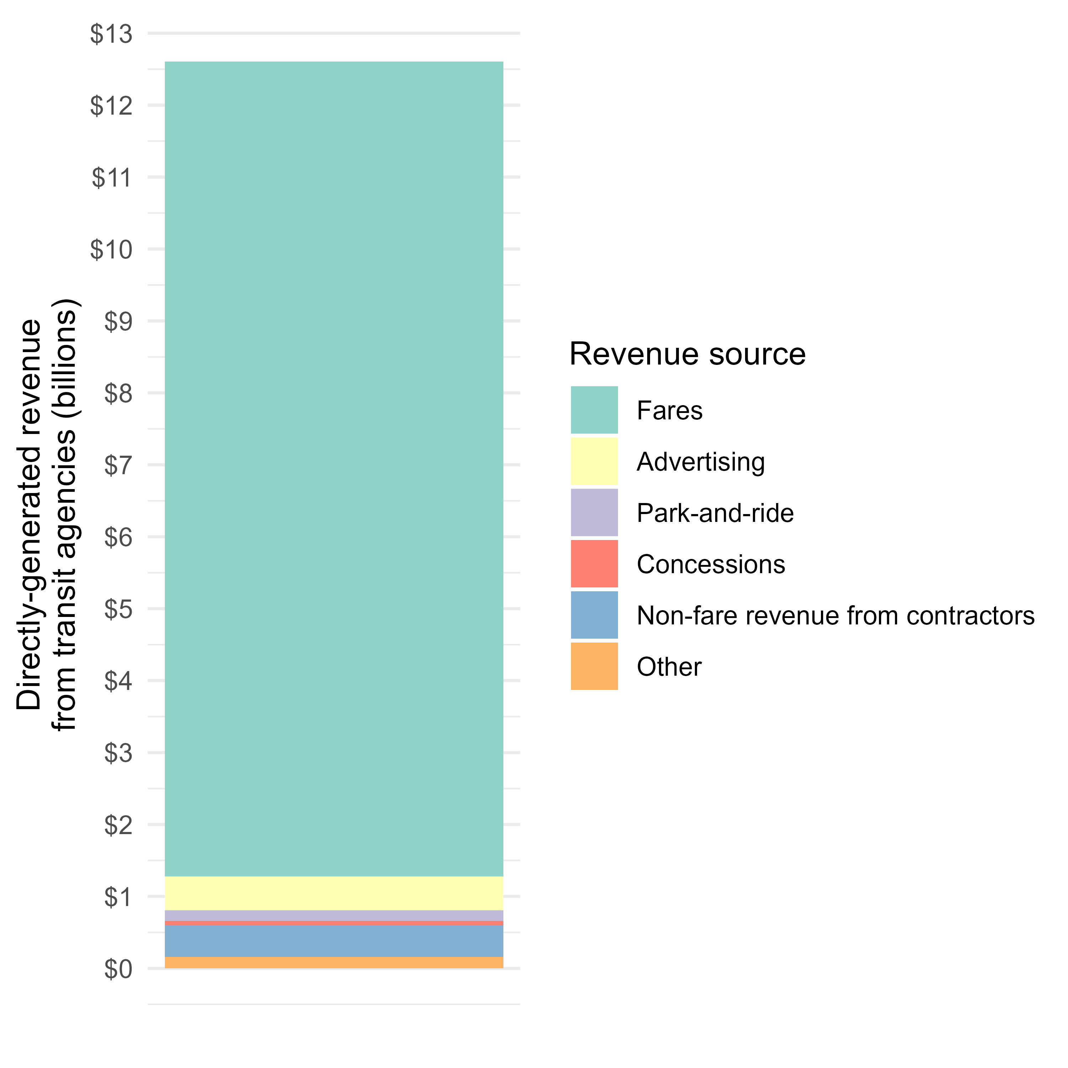
Sources of directly-generated revenue
351 out of 2,292 transit operators collect no fare revenue

Slide 17
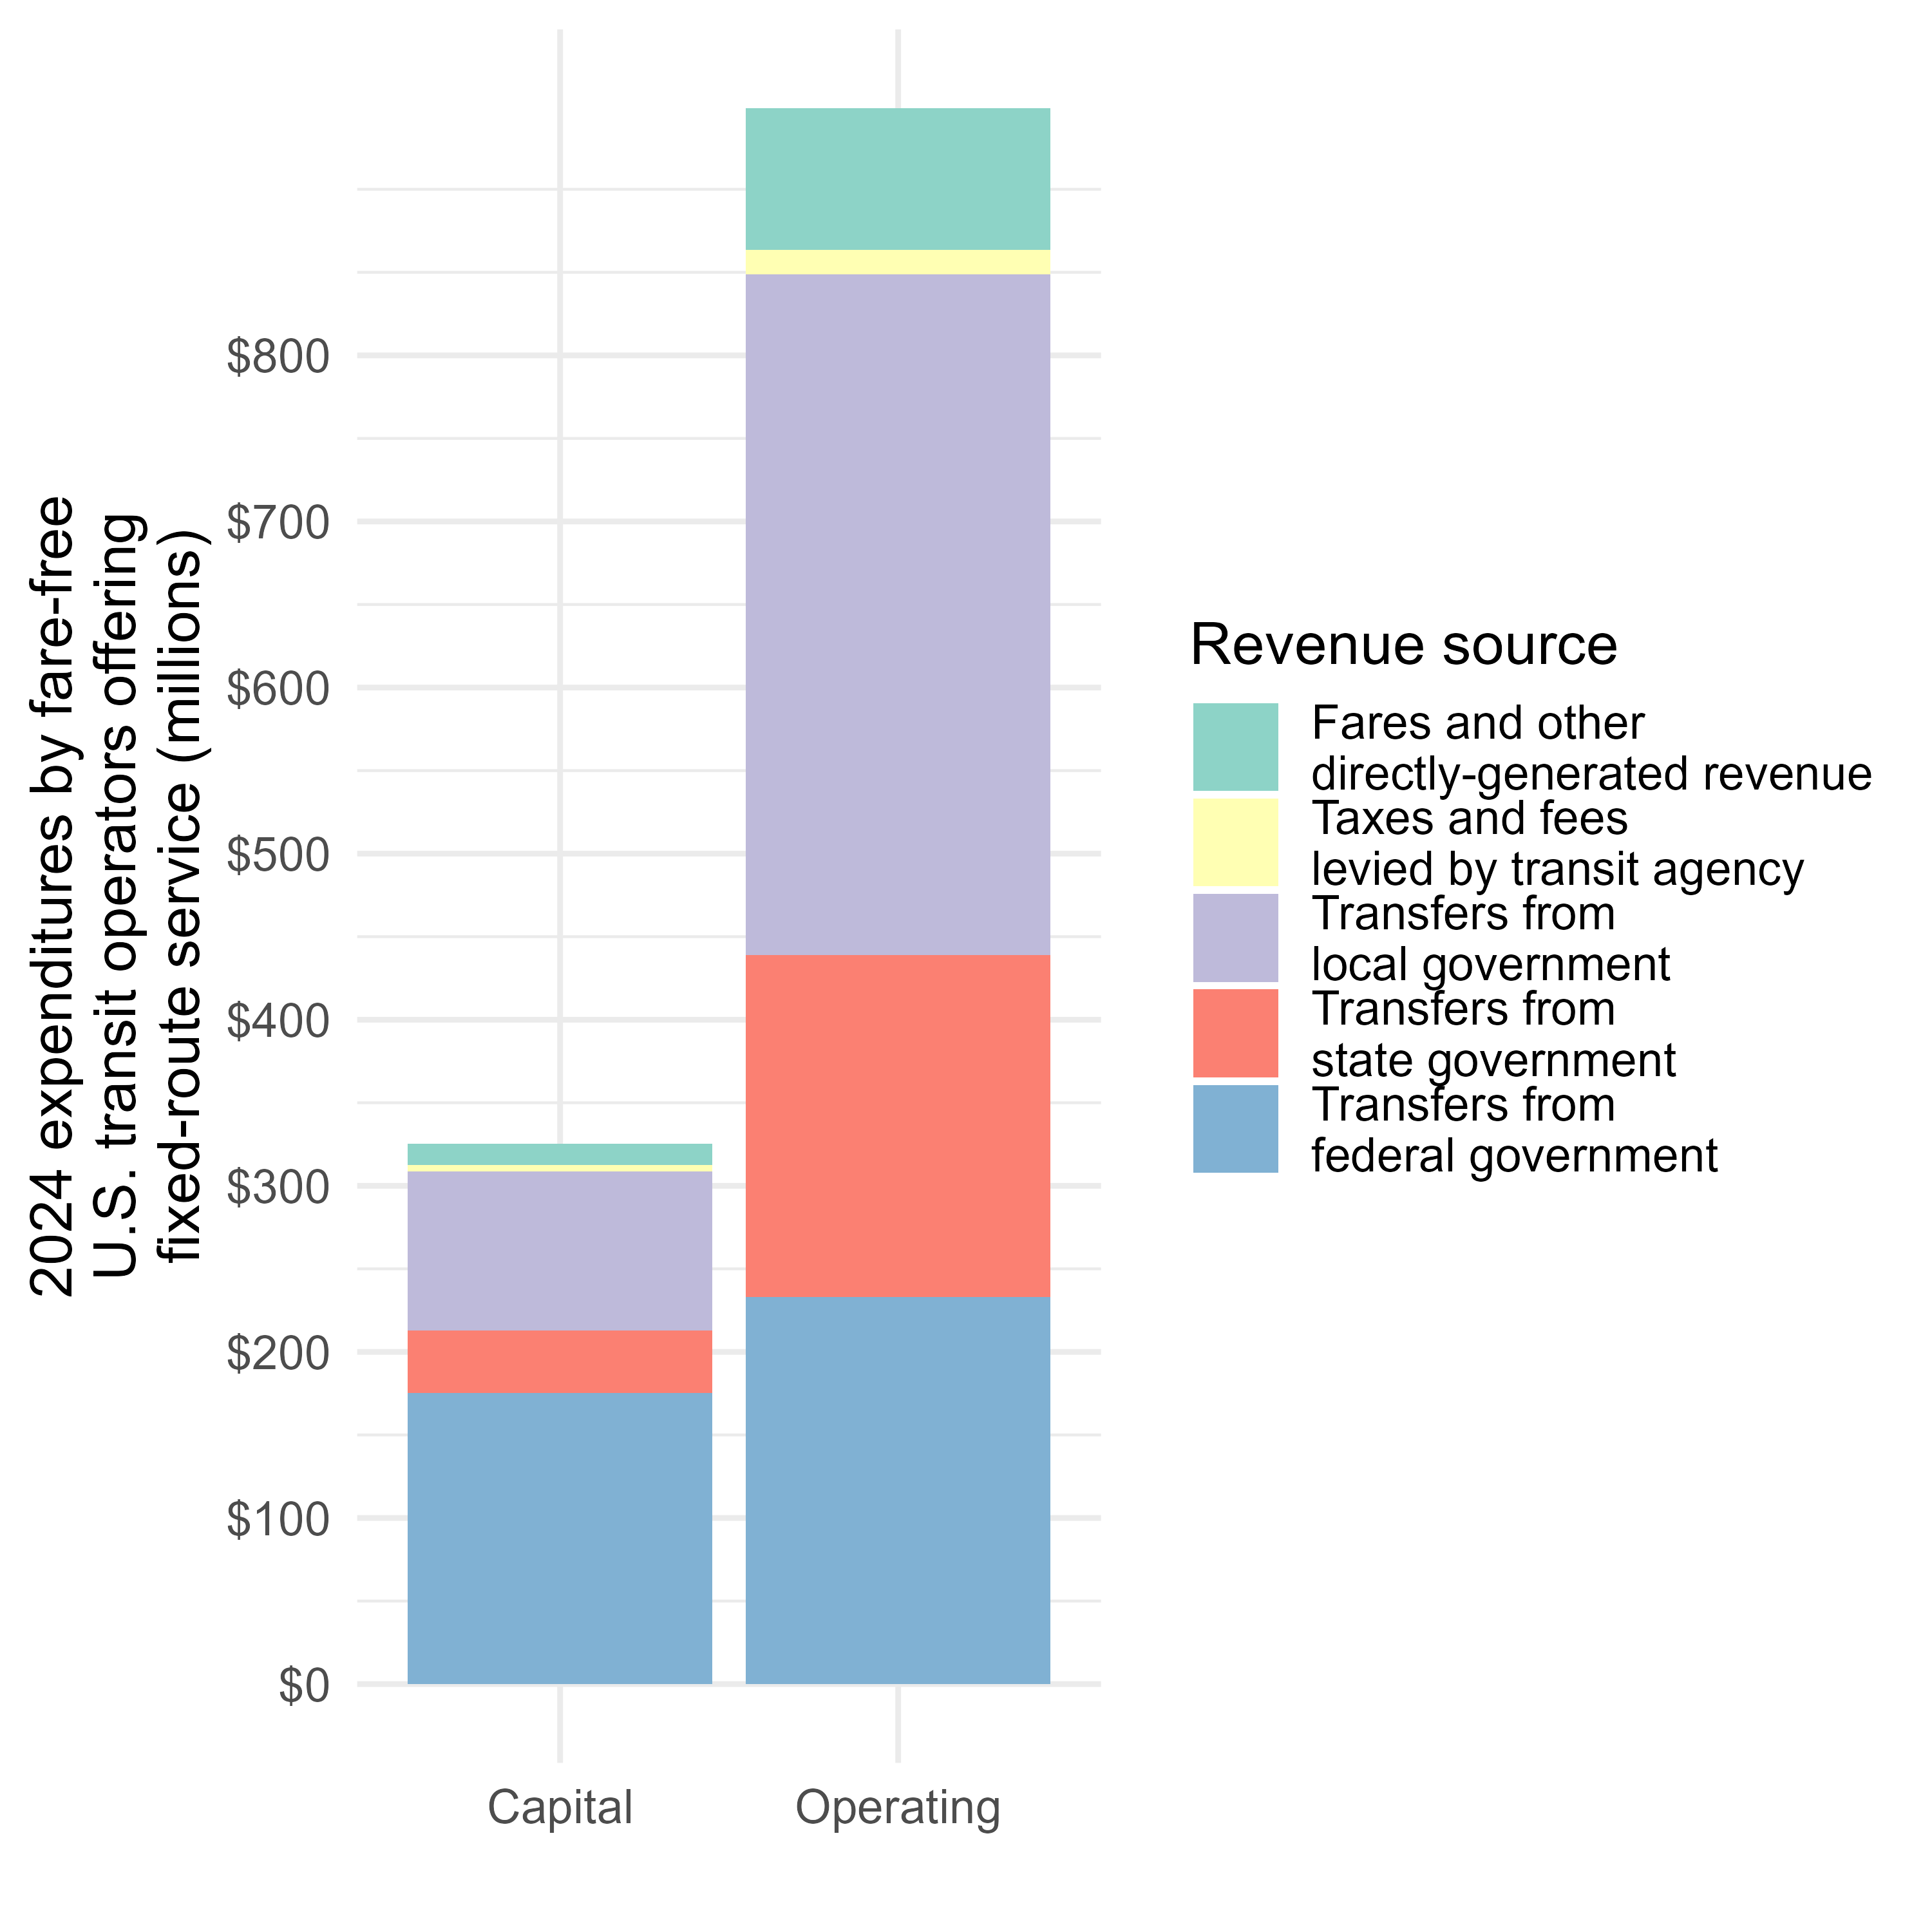
Fare-free transit:
All revenue sources

Slide 18
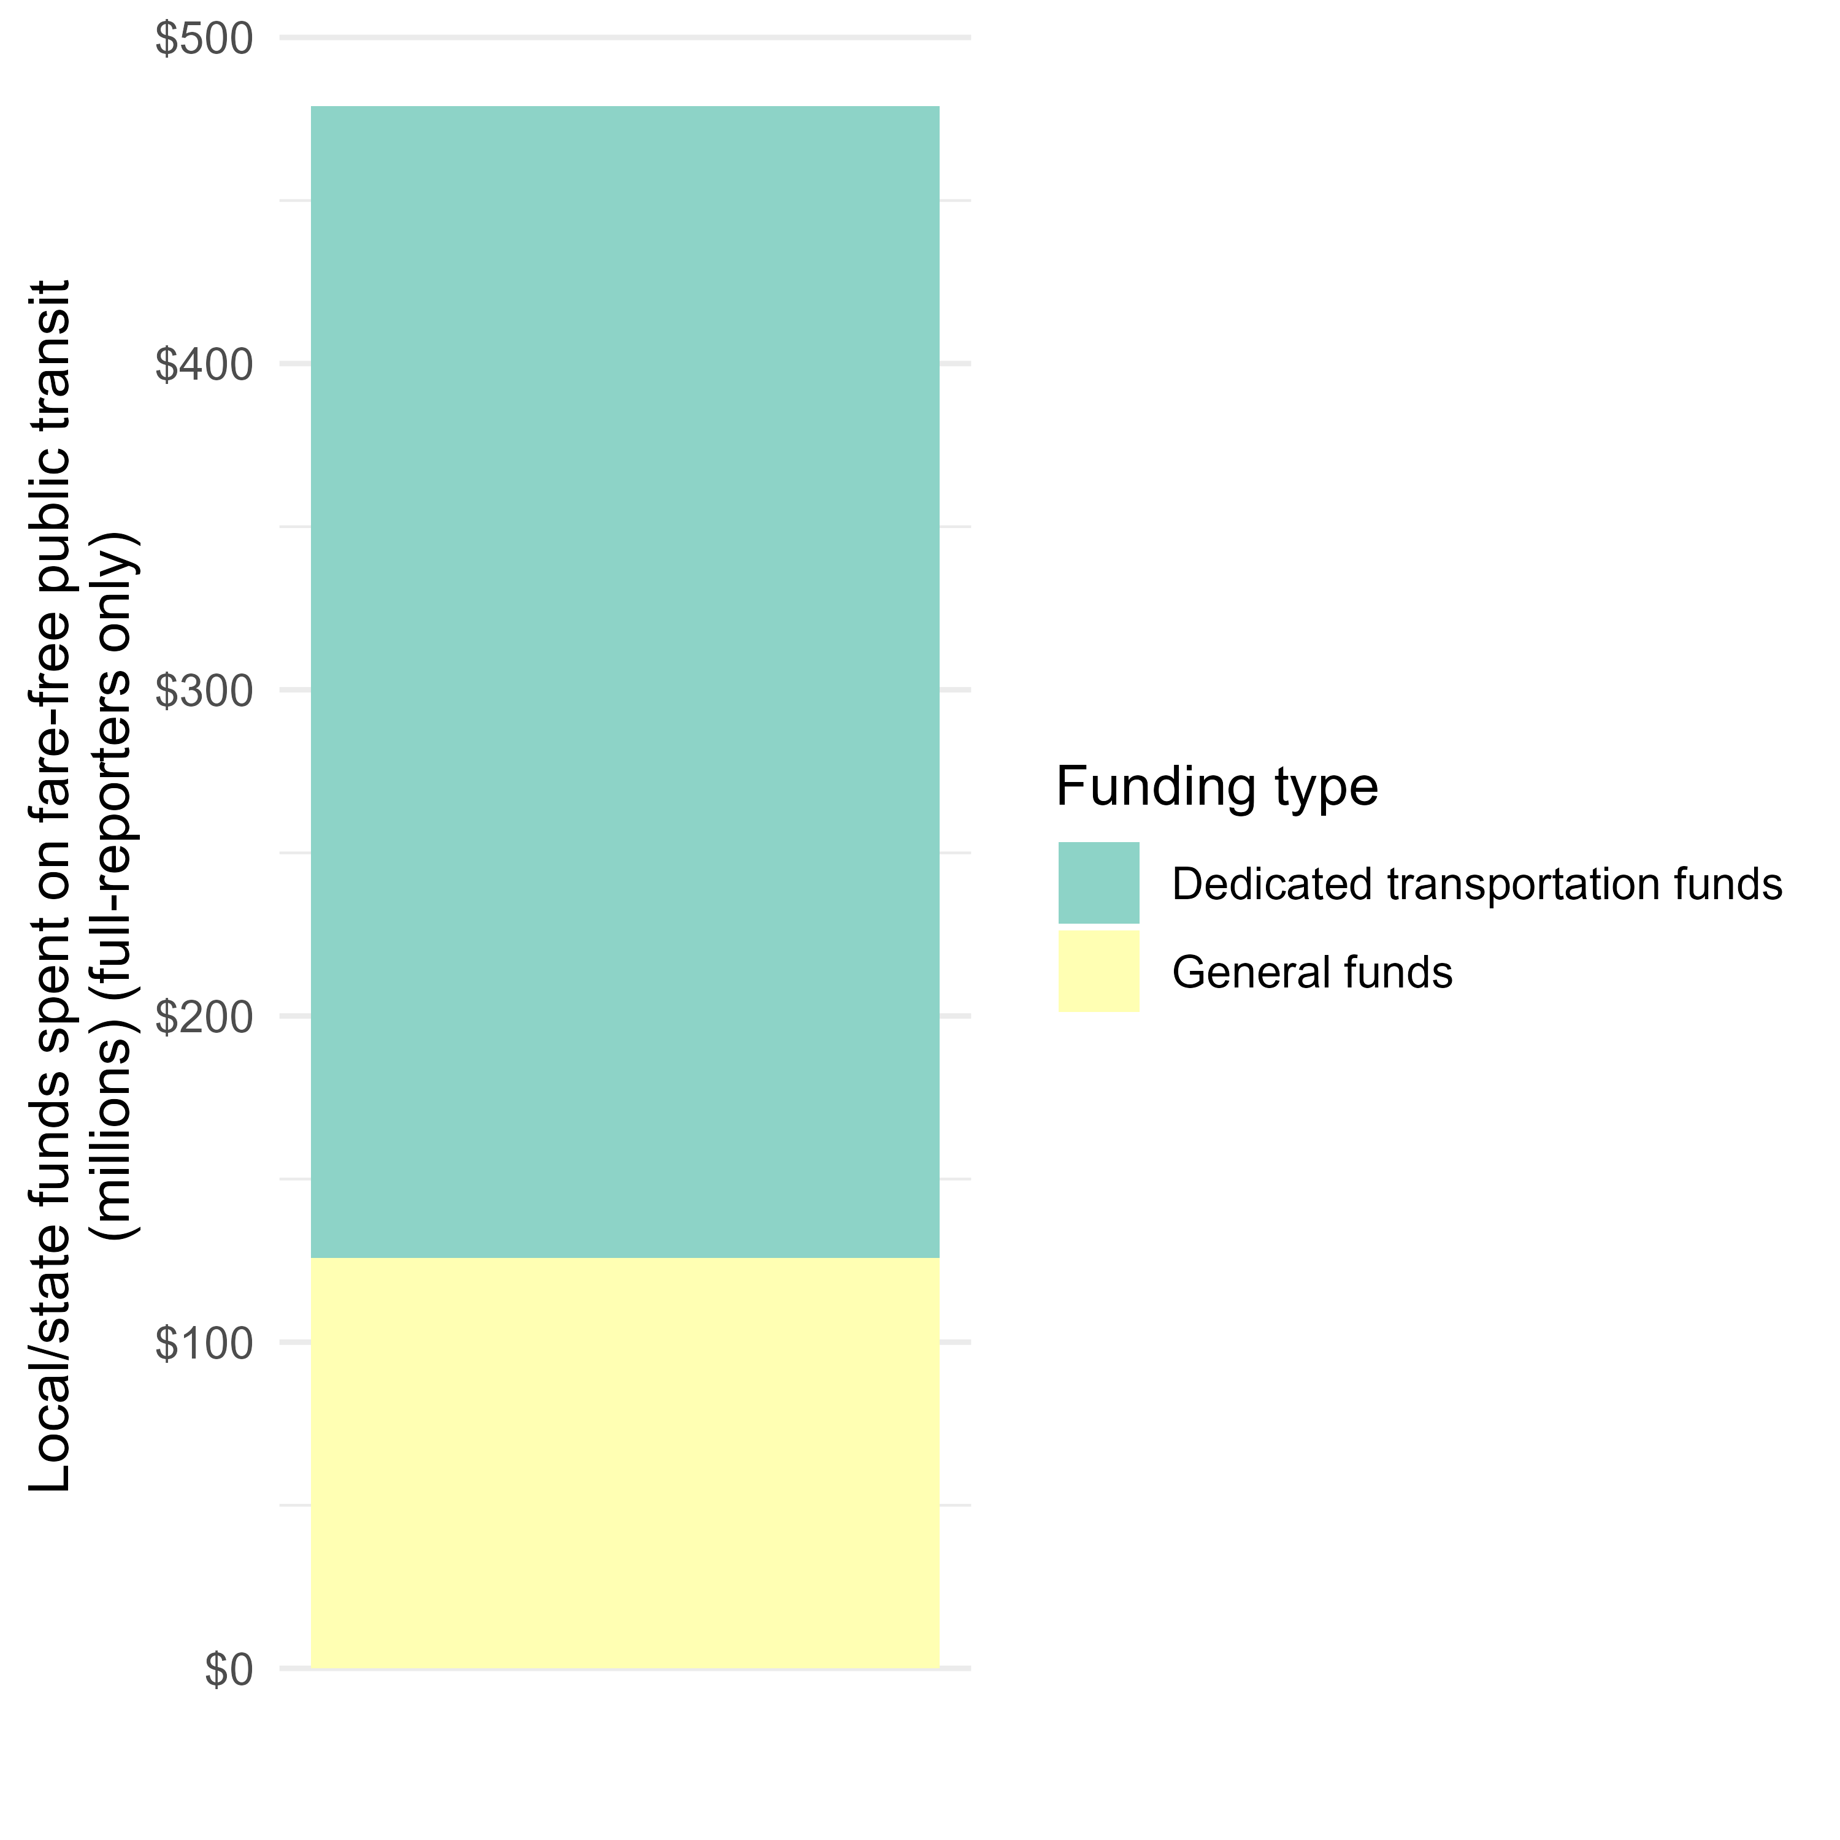
Fare-free transit:
Reliance on state and local general funds

Slide 19
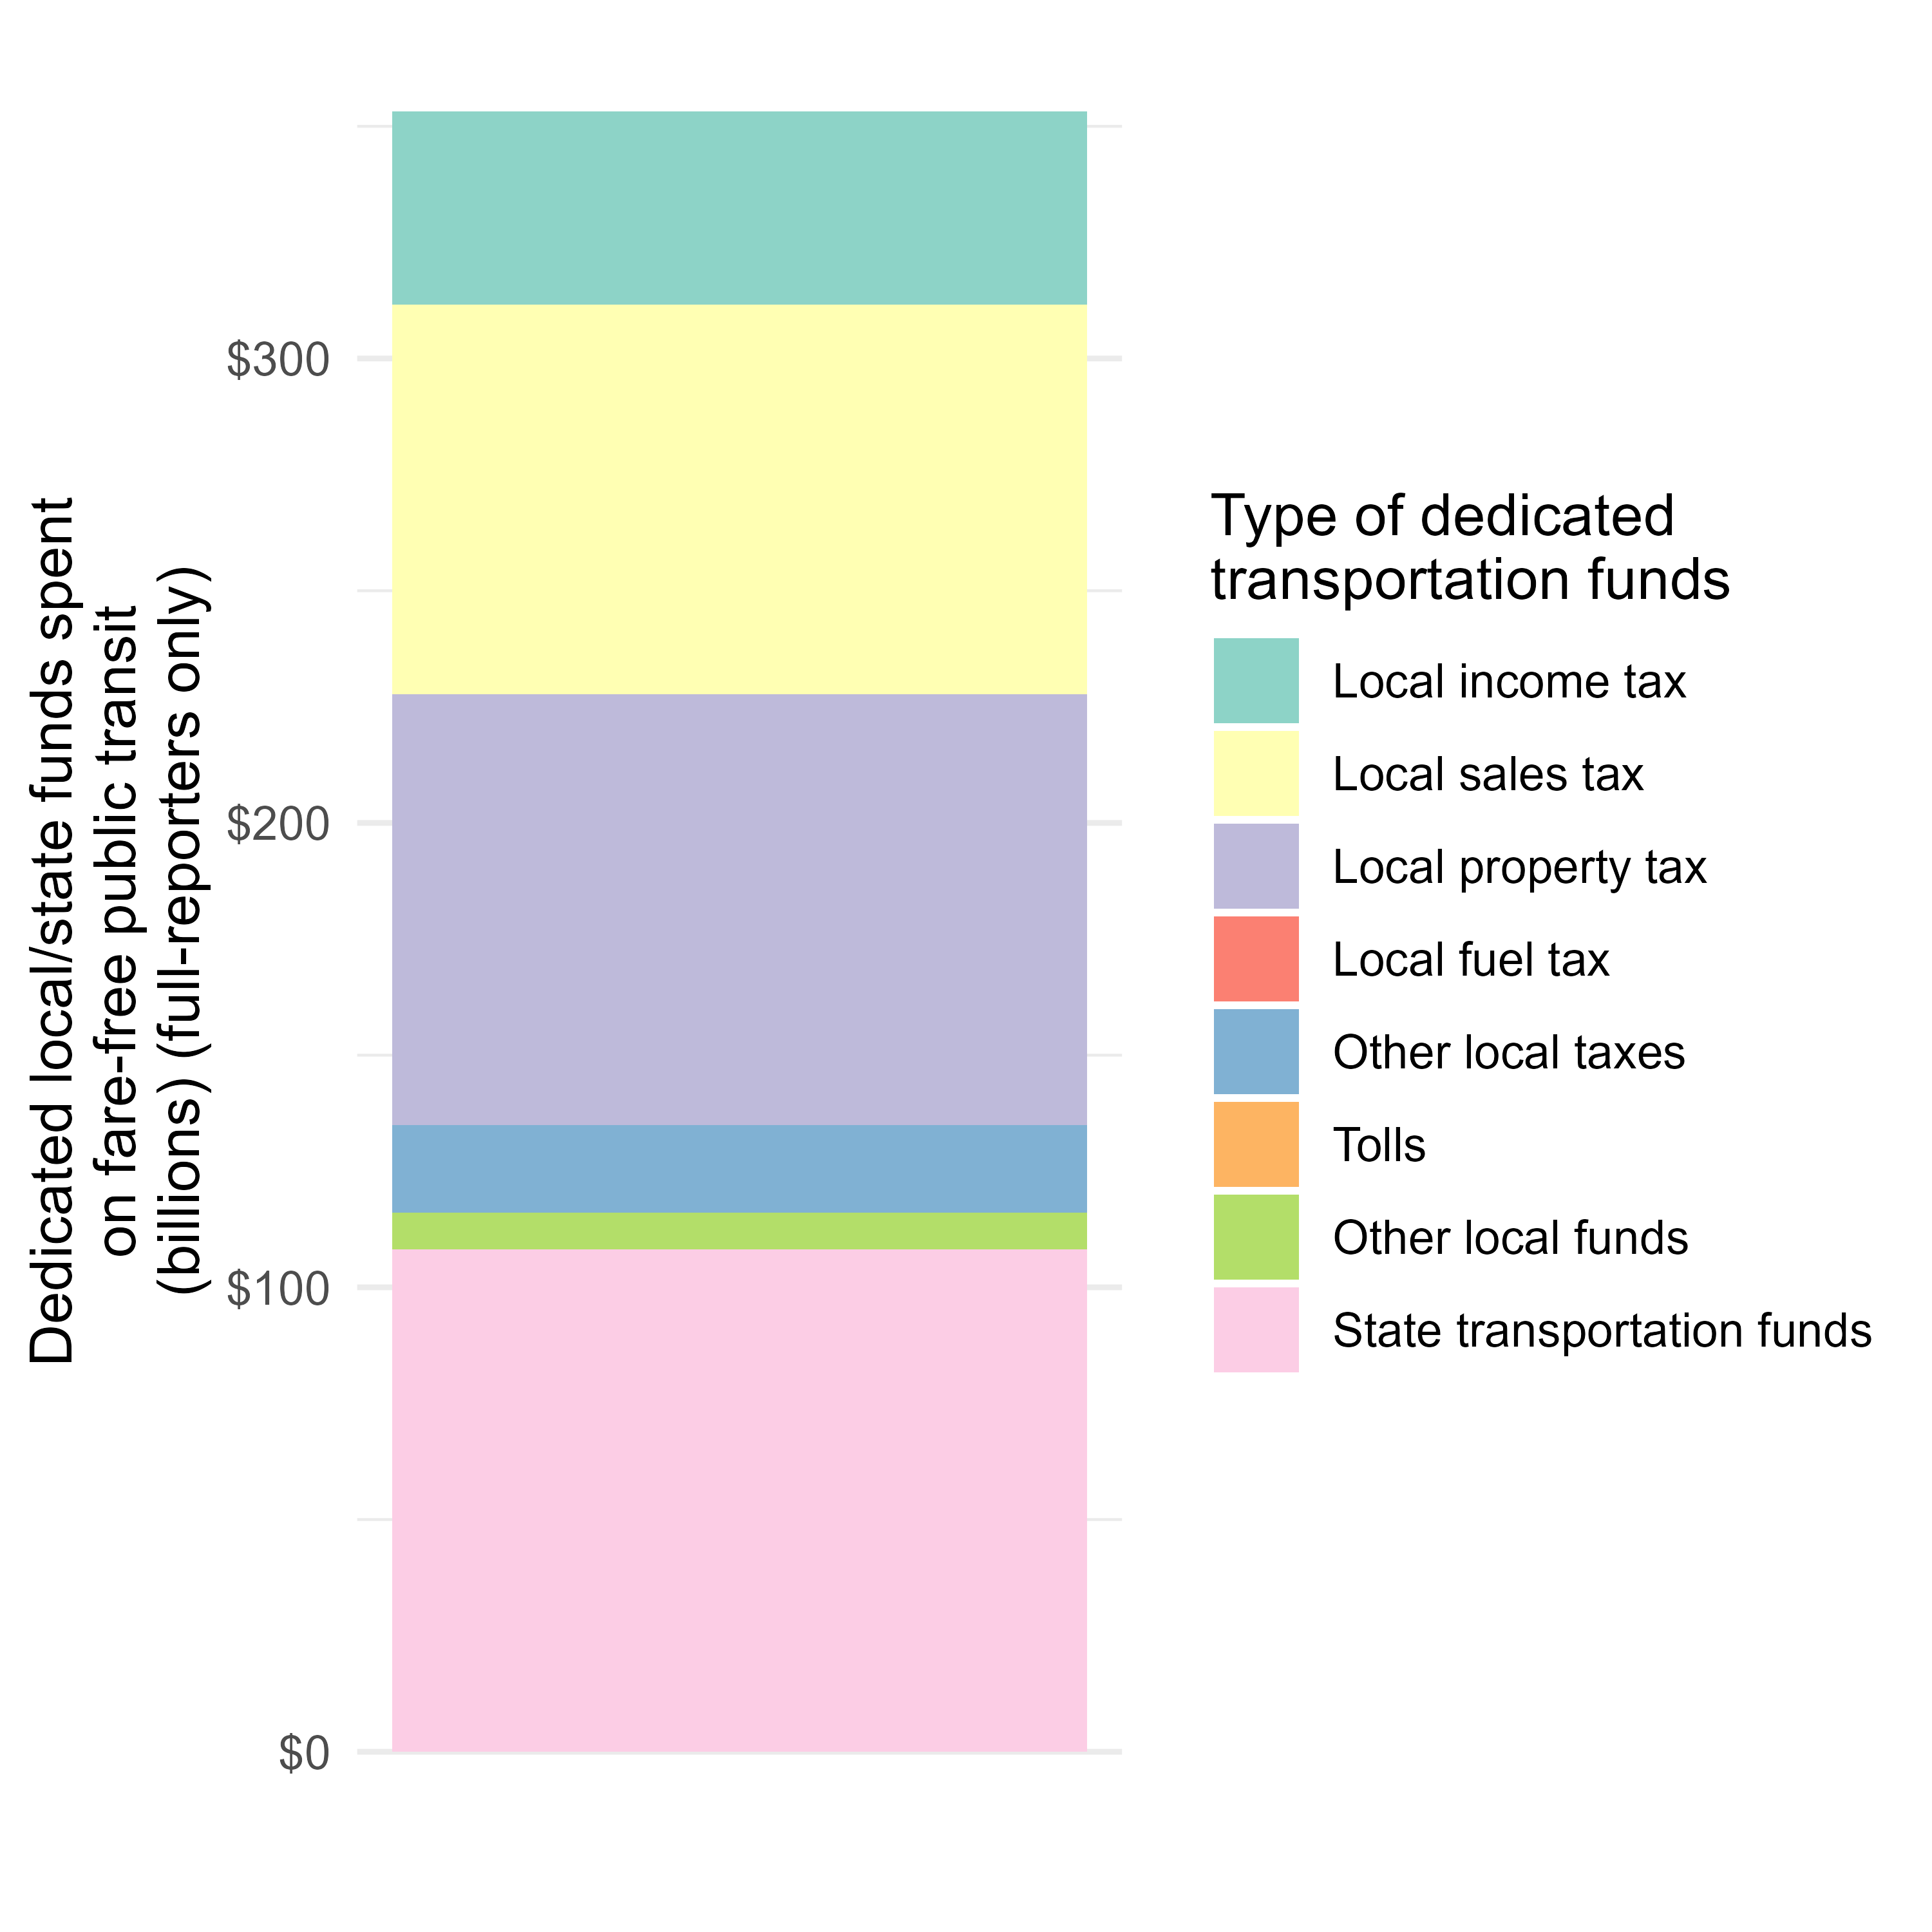
Fare-free transit:
Types of dedicated transportation funds from local/state

Slide 20
Fare-free transit:
Taxes levied by transit agencies
Only two fare-free systems levy taxes (both income tax):
Connect Transit (Logan, Utah)
Western Reserve Transit Authority (Youngstown, Ohio)

Slide 21
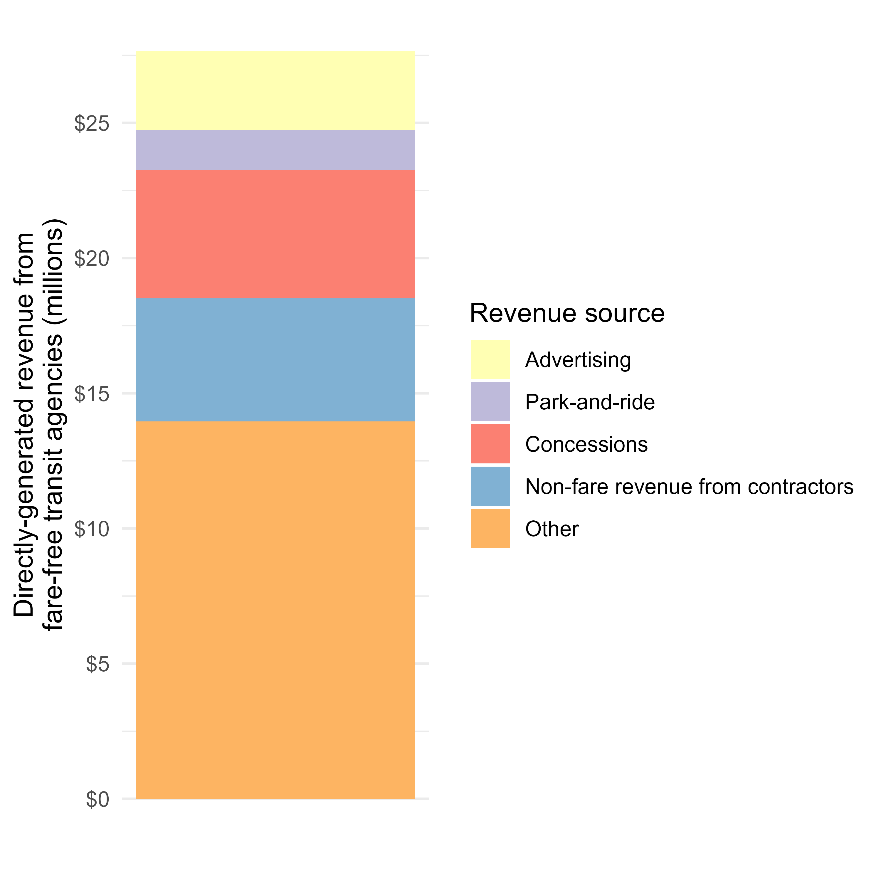
Fare-free transit:
Directly-generated revenue

Slide 22
Thank you!
Carole Turley Voulgaris
cvoulgaris@gsd.harvard.edu

