Slide 1
A: Getting Organized

Slide 2
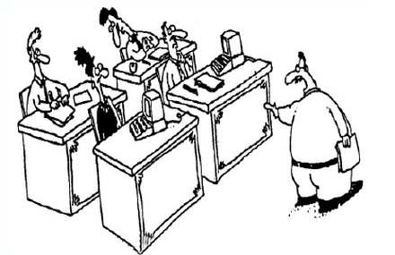
The Fuzzy Front End
Sometimes a development effort starts like this:
You lot start coding!
I’ll go and find out what they want.

Slide 3

The Fuzzy Front End
And sometimes it starts with a formal, complete specification containing
charter,
context, and
theory of operation.
Every requirement is:
Identified
Unique
Coherent
Unambiguous
Testable

Slide 4

Abstraction
To build models, you have to be able to gather enough information to make good abstractions.
Learning
Doing
Planning

Slide 5
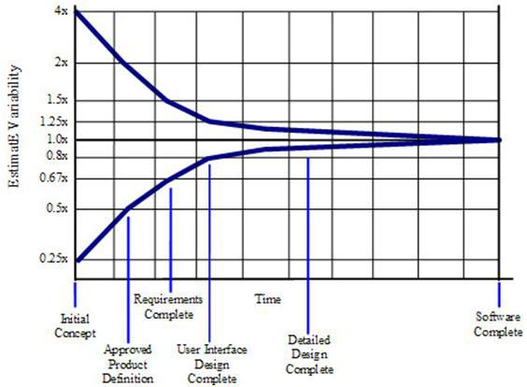
Cone of Uncertainty
Software Development's Cone of Uncertainty
Steve McConnell, Construx Software
Notes:
#ConeofUncertainty

Slide 6
Levels of Commitment
Consequently, we must commit incrementally.
Natural language and informal diagrams
Use cases
Activity diagrams
Sequence diagrams
Structural models
Components & Interfaces
Class models
Data types
Behavioral models
State models
Activities
}
This course

Slide 7
Requirements Clarification Process
The process is:
Find all your people, resources, practices, etc.
Find out what the system-as-a-whole does
Determine the precise behavior of each use case
And establish how it communicates with others
But it’s really all about learning about the problem.
Get Organized
Use Cases
Activity Diagrams
Sequence Diagrams

Slide 8
Requirements Clarification Process
It’s a bootstrapped process
We’ll show you how to:
determine what you have, and
how well it meets your needs
gather information to build executable models
investigate questionable use cases
organize information ready to build executable models
Get Organized
Use Cases
Activity Diagrams
Sequence Diagrams

Slide 9
Why Are You Here?
Depends.
System and project managers need to understand the process, even if they do not need to know all the details.
Architects need to understand the problem space.
Designers and programmers need to understand what they will receive as inputs to building executable models.

Slide 10
Table of Contents
Getting Organized
Get Started
Working Together
Practices
Understanding (II)
Activity Diagram
Sequence Diagram
Information Gathering
Packaging the Materials
Understanding (I)
Assimilation
Process
Use Cases
Finding Use Cases
Defining Use cases
Factoring Use Cases
Wrap Up
What We Did
What's Next

Slide 11
1. Get Started
1

Slide 12
Get Started
To start the project, we need to know:
Charter
Constraints
Context
Resources, including the Functional Specification, if any
Team and Stakeholders
Infrastructure
Practices
}
More on these here
}
More on these later
aka
Blast Off
Inception
Iteration Zero

Slide 13
Charter
The charter tells everyone why the project is being undertaken.
It is usually short:
A paragraph or two
plus some bullets
It may also contains numbers about:
Revenues
Units to be sold
‘C’-suite information needed to decide whether to proceed.
aka
Goals
Business Case

Slide 14
Constraints
Constraints and their rationales
time
money
intermediate targets
Costs
budgets for development
unit cost
memory cost
etc etc etc

Slide 15
Context
The context document (usually 1~10 pages) captures what the product is supposed to do.
It may also have a context diagram that has:
One big bubble for the system
External Entities
Incoming and Outgoing …
… Data and Control flows
aka
Background
Product Vision
Context (Diagram)

Slide 16
Resources: Requirements
There’s often a statement of the functions required of the system.
You need to ensure they are all:
Identified
Unique
Coherent
Unambiguous
Testable
You also need to learn and regularize the vocabulary.
aka
Requirements
Functional Specification
Functional Requirements Specification

Slide 17
Resources: Terms
To learn the vocabulary:
Identify existing
documents
files
listings
Identify experts
Make an inventory.
It may be helpful to visit the plant or see prior/similar systems
bk.1 ISO Standard xxx
bk.2 User Manual for xxx
bk.3 Code Listing for xxx
bk.4 Configuration file
Sven@myCo.co.se Elevator Expert
Mark@myVendor.com Knows I/O

Slide 18
Naming and Packaging
Different organizations have different names for the same thing.
And different organizations package up the elements differently.
Charter
Constraints
Context
Requirements
Project Background
Everything
Functional Specification

Slide 19

Steps
List what you have and where it is
Work out how complete it is
Work out what you need to play back what the system does to the people who know what they want

Slide 20
Workshop
What do you call?
Charter
Constraints
Context
Requirements

Slide 21

2. Working Together

Slide 22
Customer Team
The customer team comprises:
Product management
Systems engineering
Acceptance testing
Business/Product analysts
Marketing
Customer service specialist
etc etc etc
We want this.
The duty of the customer team is to speak with one voice.

Slide 23
Development Team
The development team comprises:
software engineers
hardware engineers
mechanical engineers
system engineers
The duty of the development team is to:
implement the features demanded by the customer
advise the customer team on feasibility
especially on dependencies

Slide 24
Experts
An expert is someone who knows the technical details of how something works.
They are often:
Hard to reach
Assume too much or too little
A little impatient
Sometimes you are the technical expert.
Write things down, to transmit your understanding.
I know all about alarms
It does not change the process.
It just makes it a little easier.

Slide 25
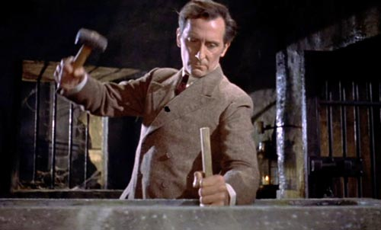
Stakeholders
Stakeholders include anyone who has an interest in the project:
Regulators
Competitors
Other divisions
Other managers
People who want you to fail
People on the team
You need to know who they are and why they care….
… because they are the difference between success and failure

Slide 26
Issues List
Write down:
Action Items
Questions for experts
Issues to be resolved
in an issues list on a database.
You need an issue tracker and you need to use it!
Establish at least:
What needs to be done
Who owns it
Disposition
Issues
Each issue should be a single, cohesive actionable item

Slide 27

Long-lifecycle Products
A long-lifecycle product will outlive the team.
So think about what they might need:
Framework
Ability to learn quickly
Data files
System construction
Build scripts
Build executables (and executable models) where possible!

Slide 28
Long-lifecycle Products
Define Theory of Operation
Build executables where possible
Tests
Build scripts
Code generation
Capture the rationale:
the “design not chosen” does NOT appear in the code
Now why did they did they do it that way? Why don’t we just …. ?

Slide 29
Geographical Distribution
Meet other teams in person to get to know them. (Best done early.)
Establish regular communication for full duplex (a weekly telecon, WebEx etc)
A single task list to maintain momentum.
Schedule meetings (WebEx, F2F, phone) to address specific issues
Establish a whiteboard for broad, asynchronous communication

Slide 30
Modes of Communication
Instant messaging | Two people Nearly full duplex Asynchronous
Group chat | Multiple people At will Asynchronous
Web meetings | Multiple people Full multiplex Scheduled
Shared screens | Few people Full duplex Synchronous
Virtual whiteboard | Multiple people At will Asynchronous

Slide 31

Infrastructure
You will need document infrastructure, but it must be:
cheap,
incremental,
only “as-needed”
low learning curve
easy to use
A wiki enables asynchronous conversations.

Slide 32
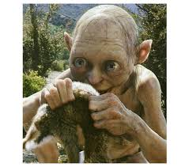

Transparency
Information needs to be public, because:
It belongs to the company, not you
It is expensive to find information in locked drawers
Duplication is less likely
Others can usually improve on what you have
It’s easier to start with something that exists already

Slide 33
3. Practices
3

Slide 34
Team Practices
The team should agree on their practices (eg):
Test-driven development (i.e., when to run tests)
Continuous review
Continuous integration
Build procedures etc
How long will an iteration be?
When will you meet?
Learning goals:
What additional skills will you have at the end?
And then how to fit in this “requirements clarification” process.

Slide 35
Where Are You?
You lot start coding!
I’ll go and find out what they want.
No requirements at all Complete set

Slide 36

Daily Stand Up
A short daily coordination meeting for developers(*) covering:
What did I do yesterday?
What do I plan to do today?
What is in my way?
Take problem solving and tangents offline.
Focus on meeting team goals.
(*) You’ll also need to decide how to meet with customers etc
Notes:
http://hdw.eweb4.com/wallpapers/1459/

Slide 37
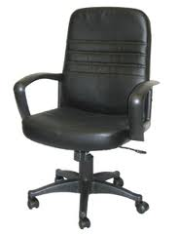
Weekly Sit Down
Or perhaps a weekly group meeting is preferable.
Start on time—no matter what
End on time (or before)—no matter what
Don’t repeat what someone missed—no matter what
Take problem solving and tangents offline.
Focus on meeting team goals.

Slide 38
Collective Ownership
Collective ownership means the artifacts look as if they were produced by a single mind.
This means:
standards
anyone can change anything, anytime
everyone is responsible for the final product
You’ll need to learn about other disciplines.

Slide 39
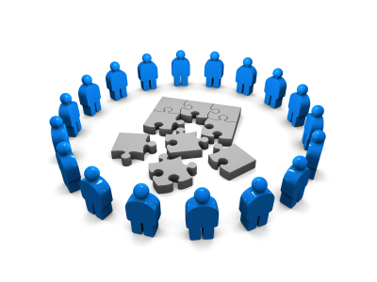
Revisit the Team
Do we have the:
right stakeholders?
regulatory?
other business units?
right technical skills?
OS?
domain knowledge
right customers and experts?
are the customers empowered to make decisions?
do you need more expert knowledge?

Slide 40
Workshop
List your team practices.

Slide 41
B: Understanding

Slide 42
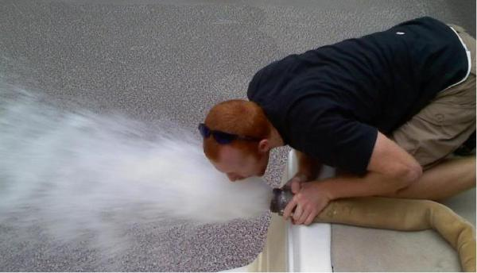
4. Assimilation
5
Notes:
http://www.scenicreflections.com/media/456071/Borg_Cube_Wallpaper/
http://coarpk.wordpress.com/2014/05/02/drinking-from-the-firehose/

Slide 43
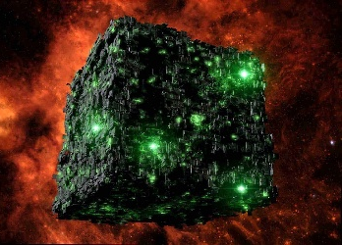
Resistance is Futile
Now that you know:
Who is on the team
What it is you’re trying to do
How you’ll work together
How you’ll record information, and
All the resources….
it’s time to go to work!
How will you assimilate the materials?

Slide 44
Find Requirements
Read the specification to find requirements.
They must be:
Identified
Unique
Coherent
Unambiguous
Testable

Slide 45
Find & Identify Your Requirements
Find each requirement and ensure it’s identified.
Req’t 1: The door must open if it is obstructed.
Req’t 2: A passenger must be able to get an elevator to a floor.
Req’t : A passenger must be able to open the door.

Slide 46
Coherent and Unambiguous
Each requirement must be coherent and unambiguous.
Req’t 1: The door must open if it is obstructed.
Req’t 2.A: A passenger must be able to order the elevator he occupies to a floor.
Req’t 2.B: A passenger must be able to request an elevator moving in a specified direction to a floor.
Req’t 3: A passenger must be able to open the door.

Slide 47
Testable
Each requirement should be testable.
You must be able to know if the requirement has been met.
Req’t 10: The administrator must be able to define a mode.
Req’t 10: The administrator must be able to switch between modes.
Req’t 10A: “AM mode” takes all unused elevators to the lobby
Req’t 10B: “PM mode” takes all unused elevators to the top floor.
Req’t 11: The elevator must be able to service many floors
Req’t 11: The elevator must be able to service a maximum of 100 floors.

Slide 48
Testable
Each requirement must be testable. You must be able to say:
what is true before the requirement executes
what is true after the requirement has executed
Req’t 1: The door must open if it is obstructed.
Pre: Obstruction in door
Post: Door open
Req’t 2: A passenger must be able to order the elevator he occupies to a floor.
Pre: None
Post: Order to move elevator to floor queued

Slide 49
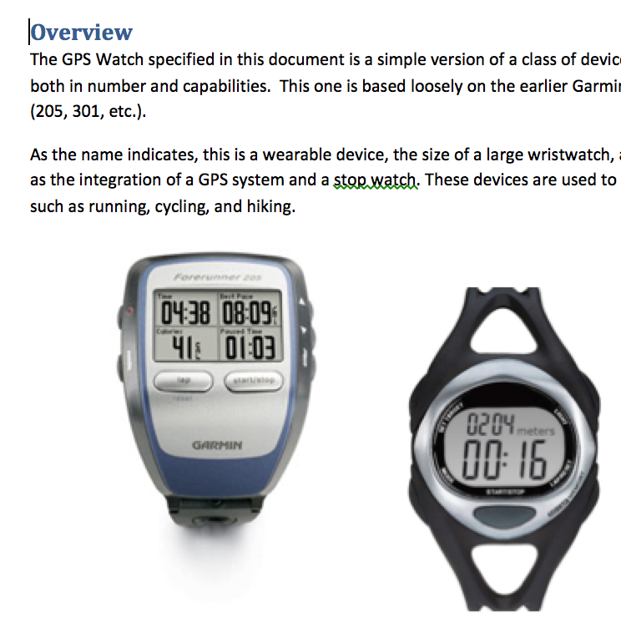
Workshop
Read the description for the case study.
Identify the requirements,
and decide if they are:
Identified
Unique
Coherent
Unambiguous
Testable
If not, write down your questions
to ask your customer.

Slide 50
5. Process
5

Slide 51

Overall Process
The purpose of building Requirements-Clarification models is to understand the problem space enough that you:
get it in your head (so you can build the solution)
can write the functional spec. (to bound the problem)
The purpose of the functional spec. is to
bound the problem so you
can build executable models
Both outputs are required.
RC
FS
Notes:
http://blog.hubspot.com/customers/bid/124007/Pouring-In-the-Ideas-at-HUGS-2011-Customer-Story

Slide 52
Starting on RC Models
If you don’t know the problem space ==>
Learn about it
If you do know the problem space, but need to bound it ==>
talk to users and experts and
read any existing functional spec
Then you can build Requirements-Clarification Models

Slide 53
Building RC Models
The process for building the RC models is to:
Identify lots of use cases
Don’t worry too much about duplication
Try to capture them “all” for this release and a few core, representative ones for future releases
• If there are gaps in scope, build more use cases
Build activity diagram to make sure you understand it
Stop when you have specified
All the use cases and
All the activity diagrams that must be supported for the next release.

Slide 54
Starting on the Functional Spec.
Complete the requirements-clarification models
Find the existing functional spec., if it exists
Work each requirement whether it’s
non-existent,
unclear, or
poorly factored
till it’s good
Then build executable models
This course provides criteria for a good requirements specification, but it does not seek to teach how to build one in detail

Slide 55
Sequence
Learn about the problem
Build requirements-clarification models
Build the functional spec.
Load it all in your brain
Build executable models
RC
FS

Slide 56
6. Use Cases
6

Slide 57
Use Cases
A use case says how a role uses a system to meet some goal.
Examples:
A passenger requests elevator
A passenger orders an elevator to a floor
A system administrator sets elevator mode
At 08:00, free elevators return to the ground floor.
aka
“usage case”

Slide 58
Actors
An actor is anything that interacts with the system:
people
machines and sensors
other systems
timers
We name the role, not the person or thing.
Fred → Administrator
Fred → Passenger
Mary → Passenger

Slide 59
Interaction
An interaction between an actor and system is shown as an association, thus:
It crosses the system boundary and consists of:
data flows
control flows
or a complex interaction comprising multiple flows
Other relationships exist within the system boundary.

Slide 60
Use Case
The use case is everything the system does for the actor.
A passenger requests elevator → Bring an elevator to the requesting floor
A system administrator sets elevator mode → Change mode from ‘Normal’ to ‘Evening’
At 08:00, free elevators return to the ground floor →
Change mode from ‘Evening’ to ‘Morning’
When the door reaches the floor, the door opens →
Open the door
It can include complex interactions back and forth

Slide 61
Use Case Diagram
Request
Elevator
Initiate
Close Door
Initiate
Open Door
Passenger
Order Elevator

Slide 62
7: Finding Use Cases
7

Slide 63
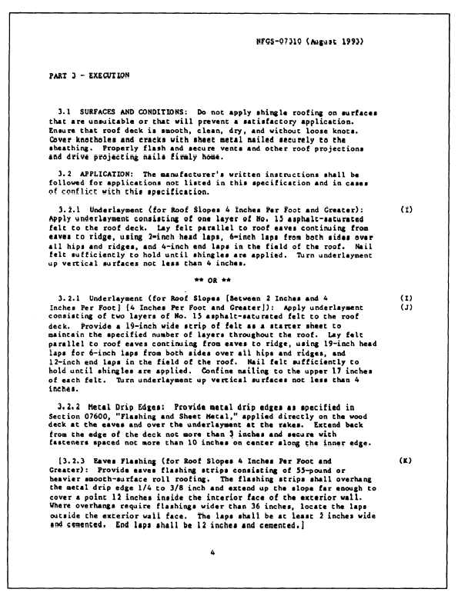

Read the Materials!
15
1
16
11
12
41
31
Notes:
http://www.q-lab.com/resources/standards/

Slide 64
Identify Personnel
The people that know the subject matter best are usually the experts and the customers.
Invite them to the initial sessions, and be prepared to ask them for more detail later.

Slide 65

Blitz
A blitz is a technique for getting started.
Write down the ones you know.
There are no wrong answers.
We don’t categorize
We don’t organize
We don’t evaluate
We just enumerate
The purpose is to provide a starting point.
Notes:
Taken from http://www.maperformance.com/blitz-fatt-advance-boost-sensor-set-for-touch-brain-fatt-advance-plus-blz_19240.html
“Blitz Fatt Advance Boost Sensor Set for Touch Brain and Fatt Advance Plus”

Slide 66
Actors
Who or what interacts with the system?
People (as roles)
Machines and devices
Other systems
Time
Ask what each one wants to do.
Passenger
Administrator

Slide 67
Interaction
Look for data and control inputs to the system.
Keep your mind on the logical intent of the interaction, not the specific physical flows.
Request
Elevator
Initiate
Close Door
Initiate
Open Door
Passenger
Order Elevator

Slide 68
Scope
Be clear about your scope.
The business and environment
What you are building
Just the software
Work
Requirements Gathering
Requirements Clarification
Product Construction
System
✔
Software

Slide 69
Feature vs Function
✔
Features Functions
Request
Elevator
Initiate
Close Door
Request
Elevator
Stop Elevator
Initiate
Open Door
Initiate
Open Door
Order Elevator
Move
Elevator

Slide 70
Back-and-Forth
Generally, a use case involves “back-and-forth” across the system boundary.
This suggests alternate paths:
What if the door fails to close?
What if a passenger requests an intervening floor?
Order Elevator to Floor
Close door
When door closed, accelerate
On approach to specified floor, slow down
On arrival at floor, open door

Slide 71
Alternatives
Consider what can “go wrong.”
Build them as separate use cases.
Order Elevator to Floor with Idiot in Door
Close door
If blocked, reopen door
When completely reopened (and <3 tries, go to Step 1)
If 3 tries, make annoying beeping sound
……

Slide 72
Workshop
Identify and name the use cases in the Case Study.
Draw a diagram, if you want.

Slide 73
8. Defining Use Cases
8

Slide 74
Defining Use Cases
To define a use case, follow this pattern:
<Use Case Number>: <Use Case Name>
Pre-conditions: What must be true before the use case can execute
Post-conditions: What must be true after the use case has executed
Scenario: A description of just what happens

Slide 75
Pre- and Post-Conditions
Pre- and post-conditions say what must be true:
before some use case, and
after the use case is completed.
Elevator arrives at floor
Precondition: Door closed and elevator stopped
Postcondition: Door open
Idiot in Door
Precondition: Door closing and obstruction detected
Postcondition: Door open

Slide 76
Pre- and Post-Conditions
You may split them.
Note that the state is now embedded within the name.
Request Elevator with Elevator at Floor
Precondition: Elevator at floor with door closed
Postcondition: Door open initiated
Request satisfied
Request Elevator with no Elevator at Floor
Precondition: No elevator at requested floor
Postcondition: Request queued for arbitrary elevator

Slide 77
Scenario
A scenario is a list of steps describing the interaction between an actor and the system to effect some goal.
Write down the scenario in natural language.
Scenario: Passenger Enters Elevator
Create order for elevator to floor
Close door
Elevator moves
Elevator arrives at floor
Open door
Scenario: Passenger requests Elevator
Select elevator in requested direction
Create order for elevator to floor
Close door
Move elevator
Elevator arrives at floor
Open door

Slide 78
Scenario
A scenario is a list of steps describing the interaction between an actor and the system to effect some goal.
WARNING: Scenarios are procedural and can lead to brittle systems if implemented directly.
They are used to elucidate the system’s response ONLY.

Slide 79
Test Cases
Most test cases should take the form:
establish pre-conditions
inject stimulus to initiate
verify actual post-conditions against expected
issue a pass/fail indication
Hmmm….
Where would I find these?
Test Harness

Slide 80
Workshop
Write:
Pre-conditions
Post-conditions
Scenario
for
1: Simple Workout
2: Multi-Lap Workout
3: Achieve Pace Over Distance Goal

Slide 81
9. Factoring Use Cases
9

Slide 82
Duplication and Refactoring
Our goal is a normalized requirements specification.
A focus on gaining an understanding of the subject matter, may have led to duplication in the use cases. Does it matter?
Reasons to refactor use cases include:
You wish to maintain the use cases throughout the lifetime of the project, and duplication is a maintenance issue
Likelihood that the common piece will change
Frequency of commonality
Readability
Notes:
When specifying use cases and the activity diagrams associated with them, often information is duplicated across multiple UCs, creating a maintenance hazard. We need to provide guidance for managing this duplicated information. Initial thoughts on that guidance follow.
a. Build obvious, most visible, most useful, most meaningful use cases first. b. Feel free to copy/paste when building others. c. Duplication of information should ordinarily be avoided because it’s a maintenance hazard d. But, in this case, it’s important to remain focused on gaining an understanding of the subject matter and clarifying the requirements and avoid expending effort factoring and normalizing artifacts e. Remember, the assumption here is that we are employing use cases to clarify requirements, not for specifying them. Therefore, the use cases need not be properly normalized, but the requirements specification should be. f. If the goal is to maintain the use cases throughout the lifetime of the project, then there is likely value in making a subsequent pass over them, after they are complete, to factor common pieces into separate use cases that can then be included/extended. Do this only if you see value in doing it. Things to consider include: i. Likelihood that the common piece will change. If it’s high, then it makes sense to factor it out and maintain it in one place. If not, leaving copies of the common bits sprinkled throughout the use cases might be acceptable. ii. Frequency of commonality. If the common piece occurs in only two use cases, perhaps it’s not worth the trouble to factor it out, but if it occurs in 12, it’s worth considering factoring it out. iii. Readability. Does factoring out the common piece impact the readability? It’s possible that the top-level use cases become unreadable or difficult to understand with lots of factoring of common parts.

Slide 83
The Whole
Now that we have the use cases, it pays to look at them as a whole to see if we can find:
inconsistencies in terms
inconsistencies in abstraction level
duplication of requirements
elements that can be factored out

Slide 84
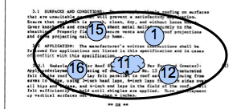
Size Matters
A single use case may encompass several of the original candidate requirements.

Slide 85
Use Case Diagram
Use cases can be:
Very big, involving multiple elements
Big, involving a single, complex interaction
Single requirement
Very small (and very useless)
}
want to be
We are here

Slide 86
Feature vs Function
✔
Features Functions
Request
Elevator
Initiate
Close Door
Request
Elevator
Stop Elevator
Initiate
Open Door
Initiate
Open Door
Order Elevator
Move
Elevator

Slide 87

Inconsistent Abstraction Level
Check that terms used in the use cases are at the same abstraction level.
4
8
Passenger pushes button.
3
7
2
6
Passenger orders elevator to floor.
1
5
閉
開

Slide 88
Factor Out Common Elements
When you find common elements, factor them out.
Scenario UC07: Passenger Enters Elevator
Create order for elevator to floor
Close door
Elevator moves
Elevator arrives at floor
Open door
Scenario UC14: Passenger requests Elevator
Select elevator in requested direction
Create order for elevator to floor
Close door
Move elevator
Elevator arrives at floor
Open door
UC07: Call any elevator to floor
UC14: Order selected elevator to floor

Slide 89
Normalize Terms
Ensure that the terms used in the use cases are either:
exactly those you have defined, or
can be replaced by those you have defined, or
you provide a definition
Correlate them to existing requirements for
identification
completeness
But do not rewrite them.
Pace Workout
Lap Log
Multi-lap Heart-rate
Device
Track …..

Slide 90
Normalize Verbs
Ensure that the verbs used in the use case use cases are:
limited (i.e. there are but a few of them), and
clear, and if special to the subject matter…
… correlate them to existing requirements for
identification
completeness
But do not rewrite them.
Add Display
Delete Alert
Read Clear
Find Log
Show …..

Slide 91
Additional Constructs
Other relationships exist within the system boundary.
They are:
«includes»
«extends»
and generalizes (deprecated)

Slide 92
Includes
Scenario UC07: Passenger Enters Elevator
Create order for elevator to floor
Close door
Elevator moves
Elevator arrives at floor
Open door
UC07: Passenger Enters Elevator
«includes»
UC14: Passenger requests Elevator
Scenario UC14: Passenger requests Elevator
Select elevator in requested direction
Include UC07
Notes:
All or some of the UC

Slide 93
Extends
Scenario UC07: Passenger Enters Elevator
Create order for elevator to floor
Close door
Elevator moves
Elevator arrives at floor
Open door
UC07: Passenger Enters Elevator
«extends»
UC24: Passenger Adds Order
Scenario UC24: Passenger Adds Order
Duplicates UC07 Steps 1~3
Create additional order, if not past floor
Repeat UC07 Steps 2~5 for each order
Notes:
All or some of the UC

Slide 94
One More Time…
Each requirement is | if not
Identified | Identify it
Unique | Reconcile it with duplicates
Coherent | Clean up the writing
Unambiguous | Disambiguate
Testable | Revisit the pre/postconditions

Slide 95
Workshop
Reconstruct the existing use cases and verify the terms are consistent.

Slide 96
10. Activity Diagram
10

Slide 97
Activity Diagrams
The purpose of building an activity diagram is to
capture shared understanding of sequencing and processing,
and make obvious the opportunity for concurrency.

Slide 98
Basics of Activities
Activity diagrams can show:
Activities
Transitions
Initial node
Final node
The transitions indicate the sequencing.
Drink Beer
Fall Over

Slide 99
Decisions
Activity diagrams may also make decisions.
Decision node (diamond) shows decision
[guards] indicate conditions that must be true
Decision node also used for merge
[Insensible?]
Drink Beer
Fall Over
Go Home
[Sensible?]

Slide 100
Parallel Activities
Several actions make take place in parallel.
Arrive in Hostelry
Synchronization Fork
Drink Beer
Play Snooker

Slide 101
Parallel Activities
Parallel activities may need to terminate before another activity can take place.
Arrive in Hostelry
Synchronization Fork
Drink Beer
Play Snooker
Synchronization Join
Fall Over

Slide 102
Swimlanes
To clarify actors’ roles, activities are aligned inside swimlanes.
Patron
Barkeep
Places Order
Takes Money
Drinks Beer
Pours Drink
Fall Over

Slide 103
Signals
Actions may send signals and accept the corresponding event.
Patron
Barkeep
Shout Order
Hears Order
Pours Drink

Slide 104
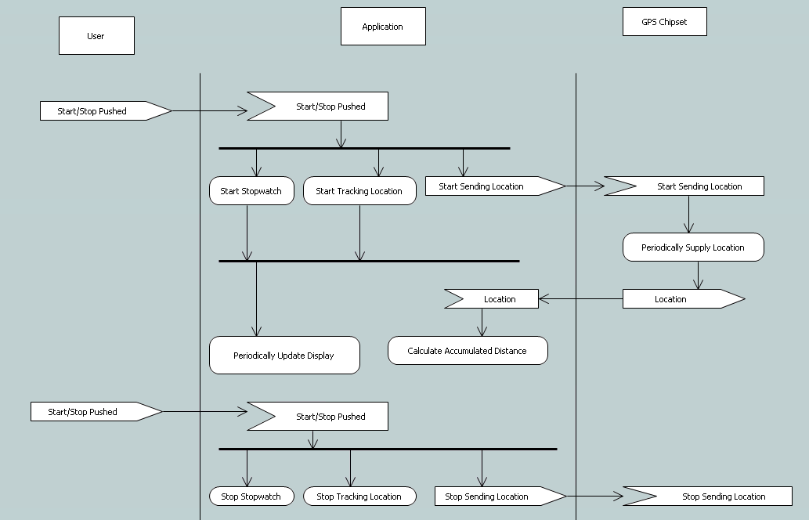
Activity Diagram

Slide 105
Workshop
Draw an activity diagram for use case #5.

Slide 106
11. Sequence Diagrams
11

Slide 107
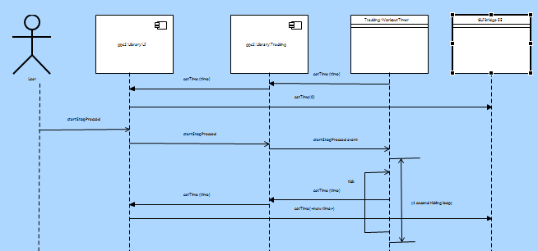
(Message) Sequence Diagrams
A sequence diagram shows how processes operate with one another and in what order.
Among other elements, a sequence diagram has:
Lifelines
Messages
Timing

Slide 108
Lifelines
Anything that has its own behavior, that can occur concurrent with others, can be said to have a lifeline.
The lifeline shows how its owner behaves over time.
A lifeline can be a:
Actor
Component
Instance
External Entity
Class
It can send messages to others.
These are informal, though they may be connected to formal things later.

Slide 109
Messages
Messages can be
Synchronous (wait for return )
Return ( )
Asynchronous (send and forget )

Slide 110
Timing
Timing elements include:
Marks and
Spans
Mark
Span
10 ms
20 ms

Slide 111
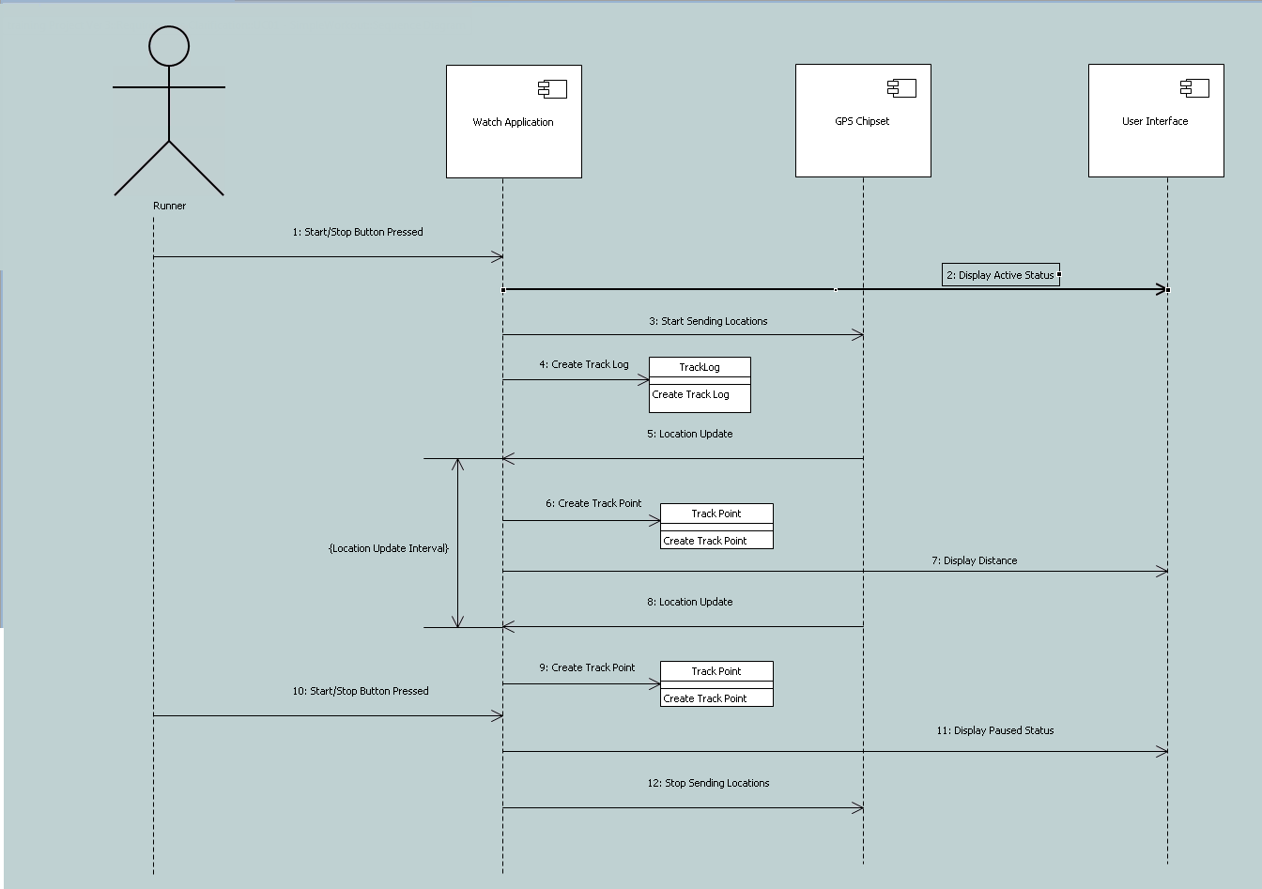
Sequence Diagrams
Build a sequence diagram if it helps detail your understanding.

Slide 112
12. Information Gathering
12

Slide 113
Confirming Understanding
What do you do if you don’t have enough information?
Create an issue in the issue tracking database (though you should have already!)
Identify the expert
Walk through the use case as you understand it
Break the issue apart for esier understanding (amd create new issues in the issue tracking database
Confirm your revised understanding

Slide 114
Confirming Understanding
To gather more information, talk to the technical experts:
Limit meetings to one hour
Check constantly
Write down what you learned
Ask the expert to check your understanding
Do it again
So each robot has one arm that can move in two dimensions, not three? Right?

Slide 115
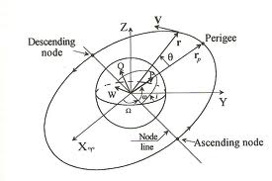
Technical Notes
Writing is not “extra.” It forces you to organize your thoughts.
Technical notes capture any topic of interest.
Informal
Short
Common understanding
Always incorporated into the executable models somehow
They will also avoid having the same interview again.
And again…. and again…. and again…. and again…. and ...
Orbital Mechanics for Dummies

Slide 116
Technical Notes
Descriptions drafted in the technical notes will end up in the executable models as:
Class descriptions
Attribute descriptions
Association descriptions
Etc
Orbital Mechanics for Dummies

Slide 117
Intermediate Review
The systems engineers/experts should review your:
technical notes
definitions of mysterious terms
factoring requirements
and answer your questions as you proceed.
The cost of using faulty information is high and the cost increases exponentially the longer you continue to use faulty information!

Slide 118
13. Packaging the Materials
13

Slide 119
Organizing the Elements
The result of all this work is mostly
UNDERSTANDING
but the work must be packaged up for
review and
ease of access.

Slide 120
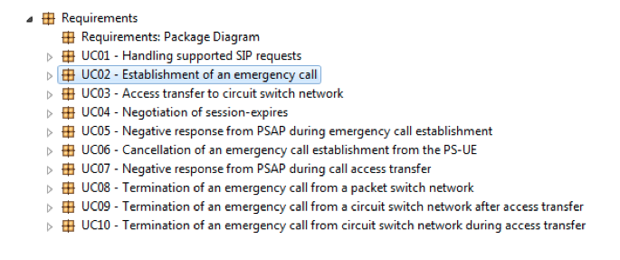
Requirements
We create a package named “Requirements”, with the use cases listed underneath.

Slide 121
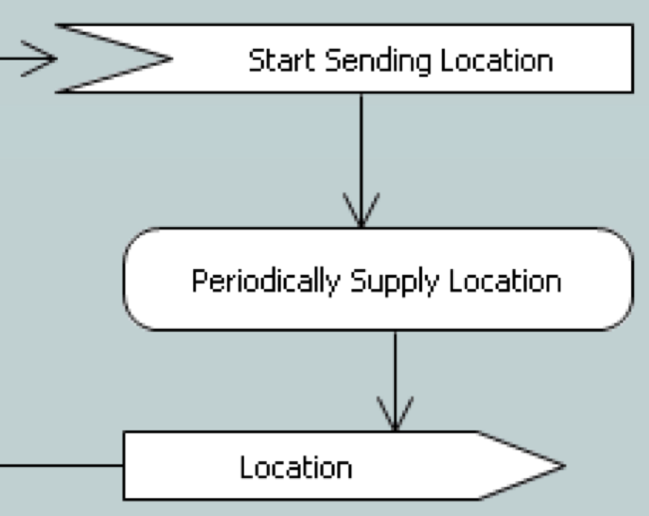
Use Cases
Each use case shall contain:
a description
an activity diagram, and optionally
a sequence diagram
Use Case Name/Number
Pre-conditions:
Post-conditions:
Scenario:

Slide 122
Use Case Description
The use case description shall contain the description
and could cross-reference to the requirements it implements.
Use Case Name/Number
Pre-conditions:
Post-conditions:
Scenario:
15
1
16
11
12

Slide 123
Activity Diagram
The Activity Diagram captures the sequencing and processing.

Slide 124
Sequence Diagram
And the Sequence Diagram captures detailed message flow.

Slide 125
Review
All of this needs to be reviewed by the customers and their experts.
Use Case Name/Number
Pre-conditions:
Post-conditions:
Scenario:

Slide 126
Lifespan
The executable models (we’ll build next) are the solution to the problem stated in the requirements-clarification models.
Therefore:
Changes in the executable models would not require changes to the requirements-clarification models
Changes in the requirements would cause you to go back through the flow anyway, updating the requirements-clarification models as you go.
If you’re pressed for time and you understand the requirements, feel free to batch or skip updating the requirements-clarification models and get on with the real work of modifying the executable models.
Notes:
Add one or more slides to explain the expected lifespan of the requirements-clarification models: a. Under what circumstances should we maintain them or allow them to atrophy? b. What causes them to become down-level? Changes in the executable models (no, the executable models are a solution to the problem). Changes in the requirements (yes, so you should go back through the flow anyway, updating the requirements-clarification models, but if you’re pressed for time and you understand the requirements, feel free to batch or skip updating the requirements-clarification models and get on with the real work of modifying the executable models).

Slide 127
Also Keep
Functions
Keep the descriptions of the:
Requirements, and
Terms
You’ll need them for the next stage.
Action Items
Questions for experts
Issues
should be empty!
Terms
Action Items
Questions
Issues

Slide 128
C: Wrap Up

Slide 129
14. What We Did
14

Slide 130
Levels of Commitment
We must commit incrementally.
Natural language and informal diagrams
Use cases
Activity diagrams
Sequence diagrams
Structural models
Components & Interfaces
Class models
Data types
Behavioral models
State models
Activities
}
This course

Slide 131
Requirements Clarification Process
The process is:
Find all your people, resources, practices, etc.
Find out what the system-as-a-whole does
Determine the precise behavior of each use case
And establish how it communicates with others
But it’s really all about learning about the problem.
Get Organized
Use Cases
Activity Diagrams
Sequence Diagrams

Slide 132
Requirements Clarification Process
It’s a bootstrapped process
We’ll show you how to:
determine what you have, and
how well it meets your needs
gather information to build executable models
investigate questionable use cases
organize information ready to build executable models
Get Organized
Use Cases
Activity Diagrams
Sequence Diagrams

Slide 133
Table of Contents
Getting Organized
Get Started
Working Together
Practices
Understanding (II)
Activity Diagram
Sequence Diagram
Information Gathering
Packaging the Materials
Understanding (I)
Assimilation
Process
Use Cases
Finding Use Cases
Defining Use cases
Factoring Use Cases
Wrap Up
What We Did
What's Next

Slide 134
15. What’s Next
15

Slide 135
Abstraction
Now that we have approved use cases, and it’s all in our heads, it time to:
THINK
From that thinking, we create abstractions.

Slide 136
Levels of Commitment
Build executable models to capture those abstractions:
Natural language and informal diagrams
Use cases
Activity diagrams
Sequence diagrams
Structural models
Components & Interfaces
Class models
Data types
Behavioral models
State models
Activities
}
Next course

Slide 137
THE END

