Slide 1
A: Recap

Slide 2
Levels of Commitment
Natural language and informal diagrams
Use cases
Activity diagrams
Sequence diagrams
Structural models
Components & Interfaces
Class models
Data types
Behavioral models
State models
Activities
}
Prior course

Slide 3
Requirements Clarification Process
The process was:
Find all your people, resources, practices, etc.
Find out what the system-as-a-whole does
Determine the precise behavior of each use case
And establish how it communicates with others
But it was really all about learning about the problem.
Establish Baseline
Use Cases
Activity Diagrams
Sequence Diagrams

Slide 4
Abstraction
Now that everything is:
reviewed,
signed off, and
it’s all in our heads,
it time to
THINK
And from that thinking, we create, and commit to, abstractions.

Slide 5
Levels of Commitment
We represent our abstractions in models of various types.
Natural language and informal diagrams
Use cases
Activity diagrams
Sequence diagrams
Structural models
Components & Interfaces
Class models
Data types
Behavioral models
State models
Activities
}
This course

Slide 6
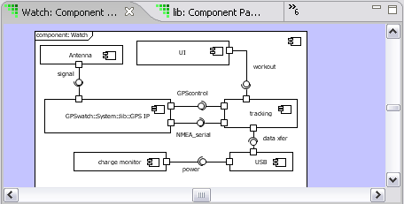
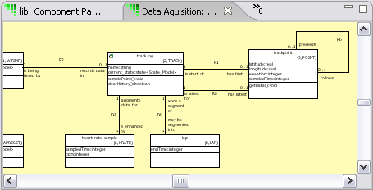
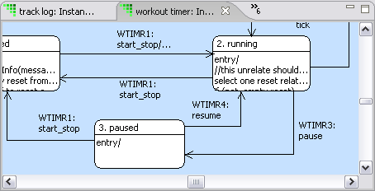
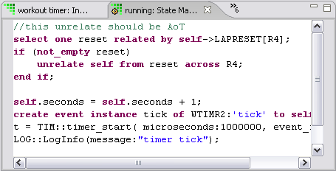
Executable Model Hierarchy
High level
Component Diagram
Decompose the application
Define Interfaces
Class Diagram
Abstractions,
Operations
State Diagram
Lifecycle
Event handling
Activities.
Processing
Low level
Notes:
xtUML defines an order of construction in building models. Moving from high-level to the low-level through the four core diagrams and their respective purposes:
Component diagram: Structure
Class diagram: Data
State diagram: Control
Action specifications: Processing
Notice all diagrams are placed on different color backgrounds for ease of comprehension

Slide 7
ToC

Slide 8
B: Classes

Slide 9
1. Classes
1

Slide 10
Class Diagram
A class diagram consists of:
classes
attributes, and
associations
We shall examine each in turn.
«Need CD»

Slide 11
Class
A class is a conceptual entity within the subject matter at hand.
conceptual |kənˈsep ch oōəl|
adjective
of, relating to, or based on mental concepts
entity |ˈentitē|
noun ( pl. -ties)
a thing with distinct and independent existence
subject matter |ˈsəbjəkt ˈmatər|
topic under consideration

Slide 12
Class
A class represents a set of instances that all:
have the same behavior
are described in the same way
“Set” means that each instance is unique.
“Same behavior” means that each instance behaves in the same way as the other instances.
“Described in the same way” means that any data describing the instance applies uniformly to each one.

Slide 13
Start with the Requirements!
Re-read the requirements.
«Insert three-box use case/activity/sequence diagram»

Slide 14

Blitz
A blitz is a technique for getting started.
There are no wrong answers.
We don’t categorize
We don’t organize
We don’t evaluate
We just enumerate
The purpose is to provide a starting point.
Notes:
Taken from http://www.maperformance.com/blitz-fatt-advance-boost-sensor-set-for-touch-brain-fatt-advance-plus-blz_19240.html
“Blitz Fatt Advance Boost Sensor Set for Touch Brain and Fatt Advance Plus”

Slide 15
Class Blitz
Look at all the candidates and categorize them.
Definitely a class
Maybe a class
Definitely not a class

Slide 16
Finding Classes
Tangible things
Roles
Incident:
Interaction
Specification
Don’t classify classes.
These are just guides for places to look.
Notes:
The Discovered category includes conceptual classes; things which represnt entities that are in the real word but which cannot be touched, e.g. ”Account’.

Slide 17
Tangible Classes
«Elevator, door, shaft»
«airplane, runway, airport»
airplane | message
valve | robot
circuit breaker | power supply
dog | dog owner
elevator | switch
Examples
airplane | phone

Slide 18
Roles as Classes
«Passenger»
«Pilot, ATC»
broker | client
landlord | tenant
customer | account holder
passenger | administrator
pilot | air traffic controller

Slide 19
Incident Classes
performance | visit
system crash | event
breakdown | service call
request | order
flight | landing
«Request, order»
«Flight, landing request»

Slide 20
Interaction Classes
«?»
«Landing (plane/runway), Take-off etc»
cable | pipe connection
birth | link
purchase | marriage
order | sale
command | landing

Slide 21
Specification Classes
«Morning mode»
«Pilot qualification, Aircraft type
policy type
protocol | configuration def’n
phone spec. | account type
product spec. | vehicle model
qualification | aircraft type

Slide 22
Finding Classes
We may observe that a number of instances in the subject matter have similar behavior and data.
«bunch of dogs, one or two of which don’t belong»
This is called “extension.”

Slide 23
Finding Classes
Or we may observe, identify or define a concept with specific qualification criteria.
«same bunch of dogs»
This is called “intension.”
THE FOLLOWING ARE THE QUALIFICATIONS A DOG MUST HAVE FOR ENTRY AT CRUFTS

Slide 24
Workshop
Using the clarified requirements, identify at least half-a-dozen classes.
Compare them with your team.

Slide 25
Class Definitions
Write a class definition that explains the basis for abstraction for each class.
«You know what an “aircraft” is. So does she. (Use pics)
But are they the same? Draw as he said/ she said»

Slide 26
Definitions
Write definitions for each thing you find.
“An Aircraft is anything that flies that must be monitored by the air traffic control system. The aircraft may carry anything: passengers, freight, nothing. The rules for what constitutes something that must be monitored are described in ….”
“A Message is a single coherent piece of information sent between two applications. It consists of a header describing the sender and receiver, and a body that can be anything.

Slide 27
Realms
Distinguish the thing in the system-under-study from the abstraction.
System-Under-Study Model
«Real aircraft» «idealized aircraft»
aircraft Aircraft

Slide 28
Testing Classes
There are several tests you can apply to classes.
The OR test
The More-than-a-list test
The Table test
The –er test

Slide 29
The Or Test
If your class description contains ‘or’ in a disjunctive way, you probably have two classes.
An airplane is an aircraft with a minimum take-off speed, or a helicopter.
An airplane is a passenger or cargo aircraft.
An airplane is run by a commercial airline, such as Laos Airways or LAN Ecuador.

Slide 30
The More-Than-a-List Test
If your class description contains just a list, without any abstraction, you need to search for the basis of abstraction.
A commercial airline is Laos Airways or LAN Ecuador.
A regional airline is an airline that takes short trips, such as Laos Airways or LAN Ecuador.
A regional commercial airline is an airline that takes paying passengers for trips under 500km.

Slide 31
The Table Test
You should be able to fill in a table with candidate instances.
«Table with missing attributes and weird IDs»

Slide 32
The –er Test
Classes should represent real “things” in the physical, hypothetical or abstract world.
They should not be:
implementation oriented
vague –er names
These “classes” tend to be functionality wrappers.
Handler
Controller
Manager

Slide 33
Workshop
Write two class descriptions from the classes you identified earlier.
Apply the tests
Reconcile your description of the classes with the team

Slide 34
2. ATTRIBUTES
2

Slide 35
Attributes
An attribute is an abstraction of a single, relevant characteristic that every instance of the class must have.
Each instance of the class may have a different value for the attribute.
«Table with instance of aircraft (or Recipe or oven) »
“Relevant” depends on the subject matter.
Aircraft.color may be relevant to fitting out, but not to air traffic control.

Slide 36
roles of Attributes
Attributes may take on one or more roles. They may be:
descriptive: describes an instance of a class
eg latitude
naming: names an instance of a class
eg, body number
referential: refers to an instance of another class
eg myOwner
It’s possible for an attribute to be all three.
«find example»

Slide 37
Descriptive Attributes
A descriptive attribute provides some information about an instance.
The attribute must be able to have a value at some point in the instance’s lifecycle.
If the attribute value for an instance is “not applicable” you need to factor your class.
If it doesn’t have a value yet, that’s OK.

Slide 38
Naming Attributes
A naming attribute provides a label for an instance.
License Number
WayPoint ID
Ticket Number
Highlighting these attributes helps understanding of the subject matter being modeled.
The label may also be descriptive.
eg Control Station.North Station
The label may be arbitrary.
eg Employee.EmployeeNumber
At implementation time, a handle performs the same function.

Slide 39
Identifiers
An identifier is one or more attributes that, taken together uniquely identify an instance of a class.
It may comprise one or more attributes.
Each attribute that makes up an identifier is an “identifying attribute.”

Slide 40
Referential Attributes
A referential attribute is an attribute that refers to an identifying attribute of another class.
A referential attribute “formalizes an association.”

Slide 41
Finding Descriptive Attributes
The terms you defined during requirements clarification are good candidates.
«Find whichever ones we have and use the class notation»

Slide 42

Finding Naming Attributes
Don’t just slap down “ID”!
Ask if there’s anything that properly represents the abstraction.
What describes a phone?

Slide 43
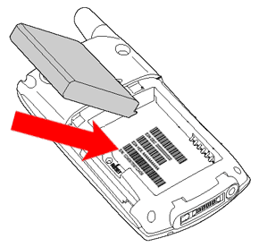

Finding Identifiers
Pick the identifier that captures the abstraction you intend.

Slide 44
Finding Identifiers
An identifier may comprise more than one attribute.
A “compound identifier” is an identifier comprising many (identifying) attributes.

Slide 45
Data Types
Every attribute has a domain-specific data type.
It has a value in the context of the subject matter.
Aircraft.Altitude: real
Aircraft.Altitude: height
Body.Length: char
Body.Length: number of bytes

Slide 46
How much more about types?
Range and all that?
Core data types?
Initial values?

Slide 47
Workshop
Identify the attributes for the classes for which you have descriptions.
Identify the types of the attributes.

Slide 48
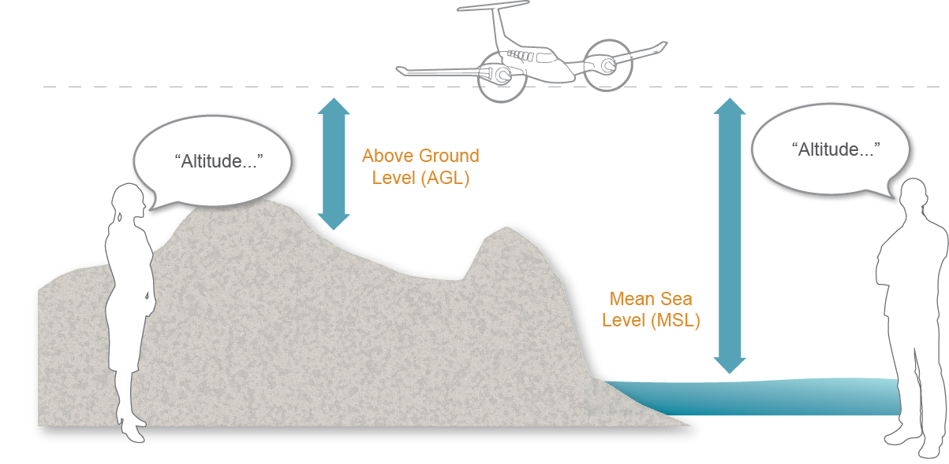
Attribute Definitions
Write an attribute definition that explains the basis for abstraction for every class.

Slide 49
Examples
The speed of the aircraft is how fast it’s going.
“The speed of the aircraft is relative to the air through which it travels, measured in knots, between zero and 700.”
units
range

Slide 50
Examples
Lovely. It also excludes artichokes.
The length of the message excludes the header.
units
“The length of a message is measured in bytes. It may be between 0 to 256K-1. It is initially zero.
initial value
range

Slide 51
Testing Attributes
There are several tests you can apply to attributes.
The Applies-to-All-Instances Test
The Valid-Value Test
The Multiple-Value Test
The Compound-Value Test
They are all based on an attribute having a single potential value that has meaning in the subject matter.

Slide 52
Applies-to-All-Instances Test
Check that each attribute applies to all instances.
Aircraft Specification
Model | Weight | Range | Runway | Speed
A380 | 276.8 | 15.7 | Group V | 900
B747 | 178.8 | 13.45 | Group IV | 830
Sikorsky H19 | 0.4795 | 0.652 | N/A | 163
Dash 8 | 14.7 | 1.889 | Group II | 500
Notes:
Empty operating weight in megagrams. range in megameters, speed in kmh

Slide 53
Valid-Value Test
Check that each attribute has a valid value at some point in its lifecycle.
Flight
Number | Start | End | Price | Paid
XL1541 | UIO | CUE | $44 | $44
QF5 | SYD | SIN | $814 | $82
My 10th | GLO | GLO | N/A | £150
XL516 | UIO | MIA | $1095

Slide 54
Multiple-Value Test
Check that each attribute has a single value.
Flight
Booking | Start | End | Number | Price
HPFGYI | UIO | MIA | XL516 | $1095
JKLOIP | SYD | SIN | QF5 | $814
HPFGYI | BKK | LPQ | QV634/633 | $631
GHJKLP | EZE | IGR | AR1724 | $244

Slide 55
Compound-Value Test
Check that each attribute is treated as a single unit.
«Aircraft.Position»
You (in your subject matter) cannot break it apart. Someone else might though.

Slide 56
Workshop
Write two attribute descriptions from the attributes you identified earlier.
Reconcile your description of the attributes with the team
Apply the tests

Slide 57
3. Associations
3

Slide 58
Binary Associations
A binary association is an abstraction of a relationship between two things that were abstracted as classes.
Each ‘end’ of the binary association has a:
name that captures the meaning of the association
multiplicity that captures the number of instances that participate
conditionality that captures whether the instances must participate in the association
«dog/dogowner pic, I reckon» TWO PAGES?

Slide 59
Names
The name captures the role the “target” class plays with respect to the other end.
These are written:
Many books use roles instead of verb phrases.
Ignore them.
Roles won’t tell you what you need to know.
Dog
owns
Dog Owner
is owned by

Slide 60
Multiplicity
The multiplicity captures the number of instances that participate in the association.
Dog
owns
1
Dog Owner
1..*
is owned by
Station
manages
1
Station Manager
1
is managed by

Slide 61
Conditionality
The conditionality captures whether an instance is required to participate in the association.
Dog
owns
1
Person
0..*
is owned by
Station
is managing
1
Station Manager
0..1
is managed by

Slide 62
Association Identifiers
Names at the ends of associations may not be unique.
Therefore each association has a unique identifier.
Dog
owns
R1
1
Dog Owner
1..*
is owned by
R3
Station
is managing
1
On-Duty
Station Manager
1
is managed by

Slide 63
Workshop
Build associations between the classes you have so far.
Be sure to note:
name
multiplicity
conditionality
for each end, and the
association ID
for the association as a whole.

Slide 64
Finding Associations
Capture the meaning of the association.
Be certain to name both ‘ends’ and check their multiplicity and conditionality.
«Examples»
R3
Station
is managing
1
On-Duty
Station Manager
1
is managed by

Slide 65
Association Descriptions
Each association must have a description that captures its meaning, multiplicity and conditionality.
R1: A dog owner must have a license for each owned dog. Each dog has a owner with exactly one license. The association is created when the dog is acquired and deleted when the dog is given or sold to a new owner or when the dog or the owner cease to exist.
Don’t repeat what is on the diagram.
That’s a waste of time.

Slide 66
Multiplicity Test
Check that the class is defined in such a way that it justifies the multiplicity.
Can a Dog have multiple owners?
At one time?
Over time?
Do we need to know:
What dogs were owned in the past?
Is that a separate association?
Dog
Dog Owner
These decisions define the time scope of the model.

Slide 67
Conditionality Test
Check that the class is defined in such a way that it justifies the conditionality.
When is a dog owner a Dog Owner?
When he has a dog?
When he has a license?
Once a dog owner, always a dog owner?
When is a dog a Dog?
At birth?
When ‘owned’?
When a license is issued?
Dog Owner
Dog
These decisions define the time scope of the model.

Slide 68
Time Scope
The model captures the instance population at any given instant in time.
Be sure:
the conditionality and
multiplicity
reflect that fact.
R2
managed
1..*
Station
Station Manager
1..*
has been managed
is managing
1
1
is managed by
R3

Slide 69
Workshop
Write two association descriptions from the association you identified earlier.
Reconcile your description of the association with the team
Apply the tests
Rev: Change to: complete… this will uncover two assocs between the same two classes

Slide 70
Association Classes
An association class is a class that comes about as a result of an association.
The association may have:
attributes that do not describe either participating class
behavior of its own
to manage contention between the participating classes
Notes:
Association classes are used to contain attributes that hold data that isn’t properly part of either of the participating classes. An associative class is denoted by a dashed line drawn from another relationship line.
Instances of an association class come into existence when a relationship is created between the other two classes. Every pairing spawns one instance of an associative class. When the participating classes are unrelated, the association class is destroyed.
This type of class association is very common in communications.

Slide 71
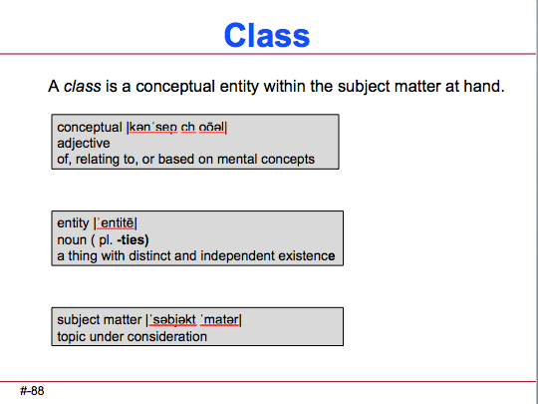
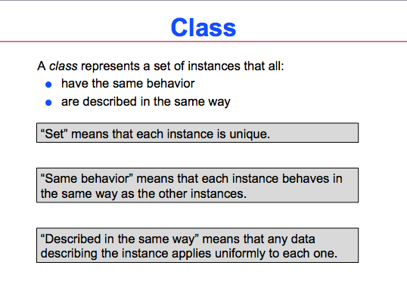
Association Class
An association class is a class like any other.
«Get right once pages are considered correct»

Slide 72
Association Class
An association class is an association like any other.
Hence the name!
Dog
owns
R1
1
Dog Owner
1..*
is
owned
by
Dog License

Slide 73
Finding Association Classes
Association classes come about when:
the association has data that describes it
the association has behavior of some sort

Slide 74
Defining Association Classes
Define and test the ‘class’ bit as you would any class:
«List from tests, maybe split»
Define and test the association bit as part of the association descriptions.
«List from tests, maybe split»

Slide 75
4. Class Modeling
4

Slide 76
Class Modeling
Class modeling is rarely about the classes.
It’s easy to find:
tangible classes
classes derived from terms during clarification
components of various sorts
But they often hide behavior of other classes.
Consider this example:

Slide 77
A Phone Class
A Phone class could hide the behavior of :
the phone itself (on/off hook)
the making of a call
managing call-waiting
creating a conference call
etc
etc
etc
Better to split it up into multiple classes.
another example….

Slide 78
What are the Classes?

Slide 79
What are the Classes?
Your job is to move fluid between storage tanks and cooking tanks.
What are the classes?
How are they associated?

Slide 80
Simplistic Solution
Function OpenReservedPath(
StorageTank,
CookingTank);
OpenValve( StorageTank.Outlet);
If ( StorageTank.ID = 1 and
CookingTank.ID = 3 ) then
OpenValve( Middle );
OpenValve( CookingTank.Inlet);
EndFunction;
OpenReservedPath( Storage1, Cooking3 );
Hmmm, all storage tanks have an outlet valve, and an upper or lower manifold.
And all cooking tanks have an inlet valve and two manifolds. If we know which….
Then there’s valve 10-the middle one-that connects the top and bottom tanks.

Slide 81
Simplistic Class Model
What’s wrong with this picture?
Storage Tank
is connected to
R8
1..*
is isolated by
1
R7
outputs from
1..*
is connected to
1
Valve
is isolated by
1
Cooking Tank
1
is input to

Slide 82
What’s Wrong With That?
The classes (tanks, valve etc) have complex behavior
It’s not clear where the behavior belongs
Should the Storage Tank empty itself?
Or the Cooking Tank fill itself?
In short, it’s extremely brittle
Storage Tank
is connected to
R8
1..*
is isolated by
1
R7
1..*
is connected to
1
outputs from
Valve
is isolated by
1
Cooking Tank
1
is input to
What about the intermediate valves?

Slide 83
Possible Changes
… we make changes:
Add a valve in the middle of a pipe
Change target of product
Add a new tank
Delete a pump, etc
New Valve # 23!
4
11
20
Storage
Tank 1
1
17
Cooking
Tank 1
5
12
6
13
Storage
Tank 2
2
18
Cooking
Tank 2
21
7
10
14
3
8
16
19
Storage
Tank 3
Cooking
Tank 3
22

Slide 84
Simplistic Solution
Function OpenReservedPath(StorageTank,CookingTank);
OpenValve( StorageTank.Outlet);
If ( StorageTank.ID = 1 and CookingTank.ID = 3 ) then OpenValve( Middle );
If ( StorageTank.ID = 2 and CookingTank.ID = 2 and
Manifold.ID = Top)
then OpenValve( NewValve);
OpenValve( CookingTank.Inlet);
EndFunction;
New Valve # 23!
4
11
Storage
Tank 1
1
17
20
Cooking
Tank 1
5
12
2
6
13
18
21
Storage
Tank 2
Cooking
Tank 2
7
10
14
3
8
16
19
22
Storage
Tank 3
Cooking
Tank 3
Notes:
CORRECT UPDATED GRAPHIC

Slide 85
Invariants
Look for the invariants:
The facts of valve, pumps, tanks etc.
A closed pipe will always contain the same fluid
A pump can move fluid from one pipe to another
If a valve is open between two pipes, they behave like a single pipe
Closure
That is, the physics of fluids.
4
11
20
1
17
5
12
2
6
13
18
21
7
14
16
8
10
19
3
22
9
15

Slide 86
The Abstractions
1..*
1..*
1
Pipe Path
1..*
2
Tank
1
Inlet Valve
1
1..*
1..*
1
Pipe in Path
1
Outlet Valve
Valve
1..*
Pipe
1..*
Connection
1
1
Pipe Valve
1..*

Slide 87
The Behavior
Each Pipe shares a Connection with an adjoining Pipe.
Connection
Pipe Pipe Valve
A D 5
D J 10
J K 15
Each Connection has a Pipe Valve.
Pipe
1..*
Connection
1
1..*
4
B
11
1
17
20
A
C
D
5
12
13
2
6
18
E
F
G
21
I
14
16
7
10
19
3
8
22
H
J
K
9
15

Slide 88
Logic
To open a path from a storage tank to
a cooking tank:
Select a PipePath between the two tanks;
Find all the Pipes in the PipePath;
Find all the Connections between the
Pipes in each PipePath;
Find the PipeValve for each Connection;
Open each PipeValve;
Open the InletValve for the CookingTank;
Open the OutletValve for the StorageTank;

Slide 89
Resilient to Change?
In the world, the addition of new valve #23 is small.
In the old abstraction, the resulting change is huge.
In the new abstraction, only the data changes.
Pipe Pipe Valve
A D1 5
D1 D2 23
D2 J 10
J K 15
The change in the logic is none, absolutely none.
The dreaded new valve 23.
D1
D2

Slide 90
What Did We Learn?
Putting behavior in the tangible classes makes them large, duplicates behavior, hard to understand. «Pic of Phone and simple CD
«split»
To avoid that, we:
focus on associations
find the invariant
build classes that control dumb devices
Here’s another example:

Slide 91
Context
The motors in some pumps require a “gearing factor” depending on the desired final speed.
Type Speed Value
Acme 101 0-10 speed * 1.0
10-30 speed * 1.75
25-50 speed * 2
NewPumpCo No gearing
Pump ‘em 0-20 speed * 1
20-up speed * 3

Slide 92
Changes
The number of tiers
The start and stop of each of the set points
The variety and number of devices.
Further idiosyncrasies of certain devices
Good approach?
Pump
Acme Pump
NewPumpCo
Pump ‘em

Slide 93
Invariants
There are tiers
Each tier is a line (or a ray)
No sense in overlap
Gearing Ratio
3
Acme101
Pump ‘em
2
NewGearCo
1
10
20
30
40
50
Desired Speed

Slide 94
Abstractions
Abstract the tiers thus:
Tier
Structure Name
Start
Stop
Factor
Tier Structure
Name
1
1..*
Tier Structure
Tier
Name
Acme 101
NewGearCo
Pump’em
Structure Start Stop Factor
Acme101 0 10 1
Acme101 10 27 1.75
Acme101 27 50 2
Acme101 50 None 0
NewGearCo 0 None 1
Pump’em 0 …. …..
……...

Slide 95
The Behavior
Find the tier structure matching the pump type.
Find the tier that contains the desired speed
Compute desired speed * selected factor
Send to the device
Hmmm….wouldn’t tiers work for other devices?
Other computations?

Slide 96
Impact of Requirements Changes
Tier Structure
Tier
Name
Acme 101
NewGearCo
Pump’em
Nother Pump
Structure Start Stop Factor
Acme101 0 10 1
Acme101 10 27 1.75
Acme101 27 50 2
Acme101 50 None 0
NewGearCo 0 None 1
Pump’em 0 …. …..
Nother Pump 10 20 0.75
Nother Pump 20 45 1.75
Only if the tier concept fails do we need more code ☺

Slide 97
Impact of Requirements Changes
Pump
Acme Pump
NewPumpCo
Pump ‘em
‘NotherPump
The impact is dependent on the abstractions you select.
More pump types mean more code ☹

Slide 98
Remember!
Beware of “-er” classes (e.g. Handler, Manager…)
A good class model is simple and easily understandable even to the subject matter newbie
A more elaborate class diagram usually results in simpler state machines

Slide 99
Workshop
«This will be tough. Can you find anything even vaguely suitable there? It needs to focus on abstracting from the associations»

Slide 100
5. State Models
5

Slide 101
State Models
Some instances progress through stages during their lifetime.
The collection of stages and the order of progression constitutes its lifecycle.
It is represented as a state model, which may be captured as:
a state diagram
a state-event matrix
«Insert tiny diagram and tiny matrix»
Notes:
State machines handle the sequencing of the system over time.

Slide 102
State Models
A state diagram comprises:
States
Transitions
Events
Activities
We’ll talk about each in turn.
Open
Opening
Closing
Closed
Notes:
State machines handle the sequencing of the system over time.

Slide 103
States
A state is an abstraction of a stage in an instance’s lifecycle.
Open
Closed
Opening
Closing
WARNING: Many mathematical and object-oriented texts use “state” to mean the values of all the attributes.

Slide 104
Transitions
A transition is a change from one state to another (possibly the same) state.
Open
Closing
In Credit

Slide 105
Events
An event is a real-world incident that causes the instance to move from one state to another.
Open
Door opened
Button pushed
Opening
Closing
Arrive at floor
Door closed
Closed

Slide 106
Activities
An activity comprises a collection of actions that do something:
Create and delete instances
Read and write attributes
Create and delete links
Perform logic and arithmetic
Send events to other state machines
Activities may execute on the transition or on entry to the state.
activity
Open
Door opened
activity
Button pushed
activity
Opening
Closing
activity
activity
Arrive at floor
Door closed
activity
Closed
activity
activity

Slide 107
Finding States
Enumerate the states you know.
If necessary, write a comment to describe the state further.
Copy Blitz. “Which don’t belong?”
Open
Stuck
Closing
Idiot in Door
Closed

Slide 108
One State at a Time
An instance is in exactly one state at a time.
Choose states so that the instance is always in one state.
«Elevator opening and closing»
Open
Closing
Closed

Slide 109
Finding Transitions
Show the possible transitions from one state to another.
Stuck
Open
Closed
Opening
Closing

Slide 110
Finding Patterns
Cyclic
Reusable resource such as equipment, link etc.
Usually returns to an ‘Idle’ state
One shot
Manage an action that takes time to complete
No record of action is required (Born and Die)
Record of action is required (Born and Quiescent)

Slide 111
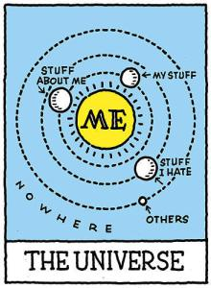
Anthropomorphize
Take the perspective of an instance:
How do I come into existence?
What happens to me to cause me to change state?
Where do I go from here?
Notes:
http://sarisl.wordpress.com/2013/07/28/egocentrism-is-not-the-same-as-narcissism/

Slide 112
Workshop
Find states and transitions

Slide 113
Identify Events
For each transition, identify the event.
Propose a name for the event
Check all other event names
If it’s the same (and means the same), good!
If it’s not the same, should it be?
Make event names consistent in structure
«Numbering/any more about events?»
Door opened = Open door = Door open =?????
Open
Door opened
Button pushed
Opening
Closing
D
Arrive
at floor
Door closed
Closed

Slide 114
Event Data
Events may carry data with them.
At floor
Floor Request(3)
No pending
requests
Moving
Floor Request( SelectedRequest.Floor)
Arrived at floor
Checking requests

Slide 115
Anti-Pattern
The state diagram should reflect a lifecycle, not a set of things to do.
Door opened
Button pushed
At rest
Arrive at floor
Door closed

Slide 116
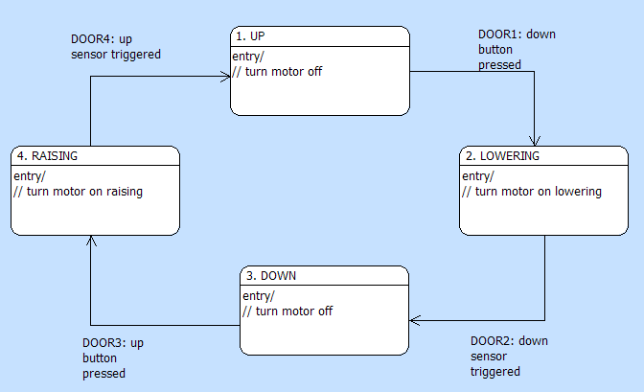
State Model
«Insert reference state model»

Slide 117
Workshop
Complete the state diagram for «blotz»
«What event drives this transition, and write description.
«make explicit the identification of events

Slide 118
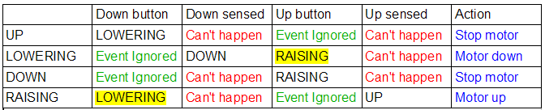
Testing the State Model
A state-event matrix is used to check for completeness of a state diagram.
It has:
columns for events
rows for states
references to the activities
Each cell contains the name of the new state.

Slide 119
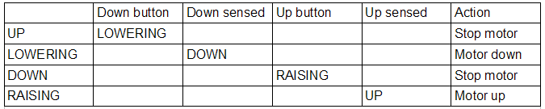
Testing the State Model
Establish whether there is a transition from each state to every other state.
Events
States

Slide 120
Fill in the State-Event Matrix
Examine each cell and fill in the destination state.
What about the empty cells?
WARNING: Do NOT look at the diagram

Slide 121
Empty Cells
The empty cells can be:
A transition you forgot ➔ Fill in the destination state
An event that occurs, but you don’t care ➔ Ignore it
A logical impossibility ➔ Something has gone horribly wrong

Slide 122
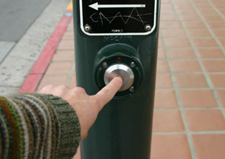
Event Ignored
An event can occur that you simply ignore.

Slide 123
Can’t Happen
An event can occur that is a logical impossibility if there is
a software error
a hardware error
etc
You can’t do anything about it.
If an undesirable event occurs, you have to handle it.
WARNING: “Can’t Happen” ≠ “Shouldn’t Happen”

Slide 124
Shouldn’t Happen
“Shouldn’t Happen” is a good starting point for error analysis.
«How much here? I favor a pointer to the Advanced course»

Slide 125
Filling the State Event Matrix

Slide 126
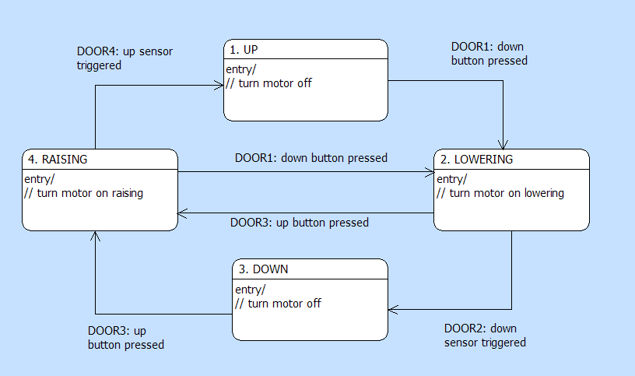
Completed Diagram

Slide 127
Workshop
Fill in the state-event matrix for the «xyz state model»
xyz must be incomplete (or maybe incomplete)
transition
ignore
can’t happen
shouldn’t happen

Slide 128
6. Activities
6

Slide 129
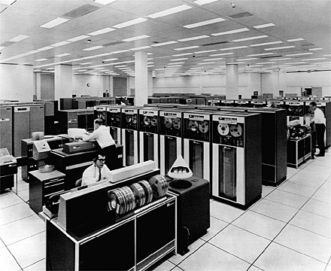
Activities
An activity is a block of model-level logic comprising a collection of actions that can:
Create and delete instances
Link and unlink associations between instances
Select instances across associations
Read and write attribute values
Compute new values
Generate events
Communicate with the outside world
Notes:
http://blog.softlayer.com/2013/virtual-magic-the-cloud

Slide 130
Executable Model Hierarchy
High level
Component Diagram
Decompose the application
Define Interfaces
Class Diagram
Abstractions,
Operations
State Diagram
Lifecycle
Event handling
Activities
Processing
Low level
Notes:
xtUML defines an order of construction in building models. Moving from high-level to the low-level through the four core diagrams and their respective purposes:
Component diagram: Structure
Class diagram: Data
State diagram: Control
Action specifications: Processing
Notice all diagrams are placed on different color backgrounds for ease of comprehension

Slide 131
Activities
You can place an activity anywhere.
In the context of a state model, that means
on a transition
on entry to a state
.
activity
Open
Door opened
activity
Button pushed
activity
Opening
Closing
activity
activity
Arrive at floor
Door closed
activity
Closed
activity
activity

Slide 132
Activities on Transitions
You can associate an activity with a transition.
Open
Button pushed
activity
It completes before any other activity is executed for this state machine.
Closing

Slide 133
Activities on Entry
You can associate an activity with entry to a state.
Open
Button pushed
activity
The activity executes on entry to the state.
After the transition activity, if any.
Closing
entry/
activity

Slide 134
Event Data
Activities are handed supplemental data with the event.
When the activity terminates, only object data remains.
At floor
You can think of an activity as a routine with input parameters and side-effects
only
No pending
requests
Floor Request(3)
Moving
Floor Request( SelectedRequest.Floor)
Checking requests
Arrived at floor

Slide 135
Execution Sequence
An activity is executed on the transition
Another activity is executed on entry to the state
Both activities must complete before accepting another event
Both activities must complete before the instance may be considered to be in the next state
This is commonly called run-to-completion semantics
Open
Button pushed
activity
Closing
entry/
activity

Slide 136
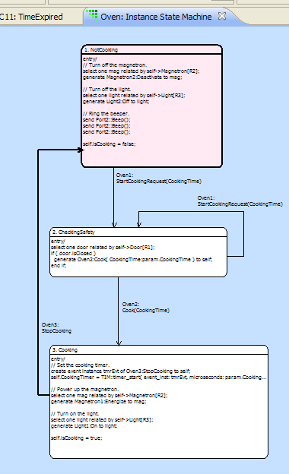
Event Dispatch
Event delivery causes one of:
Transition
Ignore
Can’t Happen
Transition:
Execute activity on transition
Execute activity within state
Change current state
Ignore:
Event is discarded, no state change, no actions
Can’t Happen:
System-level recovery invoked

Slide 137
Activities on SEMs
Each cell may contain a reference to the activity to be executed on the transition.

Slide 138
Activities on SEMs
Entry activities are already associated with their state.
Activity

Slide 139
Activities
Activities can be placed anywhere:
on transitions
on (entry to) states
on operations of classes
We describe the activity using an action language.
class diagram with operations»
Open
Button pushed
activity
Closing
entry/
activity

Slide 140
Workshop

Slide 141
7. Action Language
7

Slide 142
Object Action Language [OAL]
Object Action Language is a concrete syntax that implements the UML standard.
OAL is complete enough to be executable, but abstract enough that it does not prescribe implementation specifics.
create object instance request of REQ;
select one channel related by device->CHAN[R100];
assign device.priority = lastpriority + 1;
generate CHAN11:'host relinquish' to channel;
Notes:
Actions exist outside of the framework of a ‘main()’ function or routine, unlike conventional programming. Other purposes like file I/O, are left to the platform specific implementation of the model. xtUML is focused on the minimum set of specifications that form a functionally complete platform independent model.

Slide 143

OAL Does…
Object Action Language can:
Create and delete instances
Link and unlink associations between instances
Select instances across associations
Read and write attribute values
Compute new values
Generate events
Communicate with the outside world
And control when these actions take place.
Notes:
https://levels.io/100-to-0-things/servers-server-farm-engine-room/

Slide 144
Data Types
All data items are implicitly typed by the value assigned to them on their first use within an action. (Implicit Typing)
In addition to the usual arithmetic and logical types:
System Data Types
Date
Timestamp
Unique ID
Reference Types
Instance Handle
Instance Handle Set
Event Instance
Component Handle
This is commonly called “implicit typing”
Notes:
Rich datatypes allow flexibility in modeling.

Slide 145
Operators
In addition to the usual operators:
Assignment
assign x = 1;
x = 1;
Instance handles
comparison: == !=
existence: empty not_empty
cardinality (= returns number in set)
expired = (account.balance == 0.00) and ((TIM::get_current_time() - last_pay_time) >=max_wait) ;
Notes:
Comprehensive operator support.

Slide 146
Loops
Use FOREACH to iterate over a collection.
Use WHILE to implement a FOR loop.
Can be nested.
Defines a local scope.
for each mobile in mobiles
// do something
end for;
i = 0;
while (i < 4)
// do something
i = i + 1;
end while;
Notes:
No FOR loop available, only FOR EACH. Use the WHILE loop to implement, as is done in the example.

Slide 147
Parameters
Event and operations carry parameters
Parameters are tagged, not positional.
param is a pre-pended keyword to access arguments
select any probe from instances of SP where
selected.probe_ID == param.probe_id;
trackPoint.latitude = param.location.latitude;

Slide 148
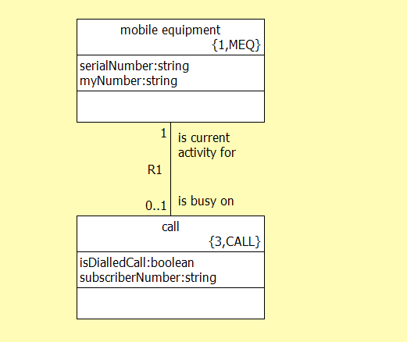
Relate / Unrelate Statement
Link specific instances of classes using relate.
relate mobile to call across R1;
Local instance reference variable
Association ID
unrelate mobile from call across R1;
Local instance reference variable
Notes:
Relationships are not instantiated as soon as the two involved classes are instantiated, they must be created using the ‘relate’ statement.
These relationships are a fundamental part of the model specification; can be used for selecting particular instances of classes.

Slide 149
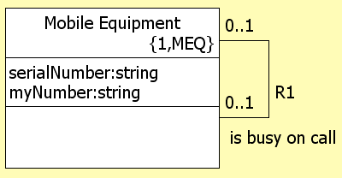
Select Any / Many
select any mobile from instances of MEQ;
Local instance reference variable
Key letters
select many mobiles from instances of MEQ
where selected.serialNumber > 10000;
Where clause
Notes:
The ‘select’ statement is a way to select instances of a class, either at random or instances that meet a certain qualification. These selections can be single objects, or a set of multiple objects, called an “object reference set”.
‘Selected’ refers to the current object, and serialNumber is an attribute of the object. For a set of selected objects, the ‘where selected…’ clause tests each object in succession.
‘select any’ returns a single object from the instances of the class. ‘select many’ returns all the objects of the class. Either can be combined with the ‘where’ clause to qualify the selection of objects.
First code example is known as a “blind” select. The local instance ref variable used should be tested for an empty reference after a blind select.
Test for empty anytime when selecting over a conditional relationship.

Slide 150
Select One / Many … Related By
Select one requires the use of the related by clause
Self is the instance of the class that originates an action
select one timer related by self->WorkoutTimer[R4];
Local instance reference variable
Key letters
Association label
Originating class instance
Notes:
The ‘select one/many … related by …’ statement is useful for selecting an instance of a class (or instances) that is related to a specific instance of the other participating class. The arrow points to the target class; in this example “call”.
The ‘select one’ construct is used when the target class (call) has a multiplicity of 1 or 0..1. Use the ‘select many’ construct when the multiplicity of the target class is 0..* or 1..*.
The ‘select one/many … related by …’ statement is useful for selecting an instance of a class (or instances) that is related to a specific instance of the other participating class. The arrow points to the target class; in this example “call”.

Slide 151
Workshop
Write OAL for something useful. Must include:
create an instance to get a handle
send a event
traversing an association
event data
Include Reference Manual

Slide 152
8. Model Execution
8
Notes:
Added new section, as discussed

Slide 153
Instances
An executable model operates on data about instances.
«Consider deleting»
Recipe
Recipe Name {I}
Cooking Time
Cooking Temperature
Heating Rate
Batch
Batch ID {I}
Amount of Batch
Recipe Name {R2}
Status
Notes:
Not tables

Slide 154
State Machines
A state machine is a copy of a state model for each instance, each of which has its own state..
Ready
startStep
interrupt
Executing
Oven
finishStep
finishStep
Complete
Not Cooking
start
start
Ready
Checking
cook
finish_step
startStep
interrupt
stop
Executing
Cooking
finishStep
finishStep
Complete

Slide 155
State Machines
Each class has a state model.
Each instance has a state machine.
Ready
startStep
interrupt
Executing
Oven
finishStep
finishStep
Complete
Not Cooking
start
start
Ready
Checking
cook
finish_step
startStep
interrupt
stop
Executing
Cooking
finishStep
finishStep
Complete

Slide 156
Executing the Model
The model executes in response to signals from:
the outside,
timers
other instances as they execute
Ready
startStep
interrupt
Executing
finishStep
finishStep
Complete

Slide 157
Communication
State machines drive each other through their lifecycles by sending each other events.
Events are reliable
Events do not interrupt executing activities
Oven
Cooking Step 1
Ready
Not Cooking
start
start
startStep
interrupt
Executing
Checking
finishStep
stop
cook
finish_step
finishStep
Complete
Cooking

Slide 158
Communication
Start in Checking and Ready states
Accept Event ‘Cook’
Change to Cooking State
Generate ‘startStep’ signal
Change to Executing state
Oven
Cooking Step 1
Ready
Not Cooking
start
start
startStep
interrupt
Executing
Checking
finishStep
stop
cook
finish_step
finishStep
Complete
Cooking

Slide 159

Time
There is no global clock
Time is relative to each observer
Oven
Cooking Step 1
Ready
Not Cooking
start
start
startStep
interrupt
Checking
Executing
stop
cook
finish_step
finishStep
finishStep
Cooking
Complete

Slide 160
Concurrent Execution
Oven
Not Cooking
All instances execute concurrently.
start
start
Checking
stop
cook
finish_step
Cooking
Cooking Step 1
Cooking Step 2
Ready
Ready
startStep
startStep
interrupt
interrupt
Executing
Executing
finishStep
finishStep
finishStep
finishStep
Complete
Complete

Slide 161
Synchronization
State machine instances are coordinated by sending signals.
B
instance
A2
B1
A
instance
A1
C
instance
The order of arrival of A1 and B1 at C is indeterminate,
even if A1 was generated first.
Notes:
If the instance A sends signals A1, then A2, then A3, what order are they received at C?
In a distributed system, there is no way to guarantee order with respect to A1 and B1 arriving at C (unless otherwise synchronized by additional signals).
These rules, strictly speaking, are outside the action semantics’ scope. However, the AS cannot rely on any ordering of the signals.

Slide 162
≠ Atomic!
Other state machines (and their activities) run concurrently
An activity can be pre-empted
One state machine may change the data accessed by another
Or, you can set a global switch so that activities are sequenced.
An object
Read
Activity A
Modify
Activity B
Which one will came first? No guarantees!

Slide 163
Workshop
«I do believe it’s time to resurrect the pennies on state machines» We’ll need at least:
Three state machines
Initial states

Slide 164
9. Distribution of Intelligence
9

Slide 165
Tangible Things
Tangible things rarely have interesting lifecycles.
They are driven by classes that capture behavior.
You must distribute intelligence among the classes.

Slide 166
Patterns
There are two control patterns that occur frequently:
Top-driven: where a user/operator drives behavior
Bottom-driven: where a device/hardware drives behavior
And two patterns based on factoring data:
Push-and-pull: Data is pushed in, and pulled out
Highest-common factor: Data (and with it, control) is pushed until the highest-common factor is reached Then pulled to create a larger entity

Slide 167
Top-Driven
In a top-driven pattern, a user/operator drives behavior.
Examples:
Microwave oven
Chemical plant operations
Phone calls
Cook
Start
Oven
StartStep
FinishStep
Cooking Step
TurnON
TurnOff
Magnetron

Slide 168
Bottom-Driven
In a bottom-driven pattern, a device/hardware drives behavior.
Examples:
Meter Reading
Alarm System
Satellite
Bill
PrintBill
EndOfMonth
Account
ReadingVerified
Reading
ReadingTaken
Meter

Slide 169
Push-and-Pull
In push-and-pull, data is
pushed so far, then
rests, then is
pulled the rest of the way
Examples:
Meter Reading
Order fulfillment
Message accumulation
Bill
PrintBill
EndOfMonth
Account
ReadingVerified
Reading
ReadingTaken
Meter

Slide 170
Pivot
The trick with push-and-pull is to find the pivot.
Reading
1..*
1
Account
1..*
1
Bill

Slide 171
Hierarchy of Control

Slide 172
Networked Control

Slide 173
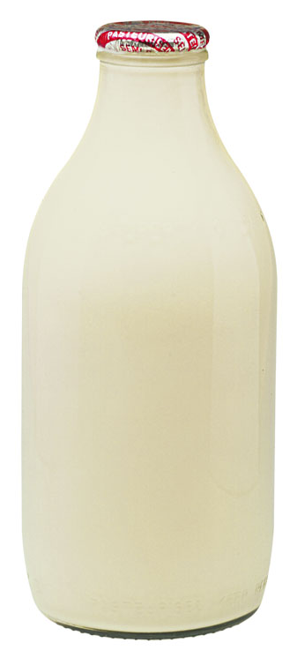
Associations
Associations often carry interesting behavior.
Does the cow demilk itself? Or the milk uncow itself?
Milking
Cow ID
Urn ID
Time

Slide 174
Completeness
Check the model for completeness.
Does every event have a source?
Does every event have a destination?
Does each state model have all the events it needs?

Slide 175
Workshop
Take the scenario from «blozt» and verify that the state machines

Slide 176
10. Components and Interfaces
10
Notes:
Added new section, as discussed

Slide 177
Components
A component is a encapsulated collection of content. It can be:
logical, or «examples?»
physical
«Anything more to say about the above?»
A component has ports. The outside world:
can see the port, but
not what’s inside.
«A component with ports and Interfaces.»
aka
Structured Class

Slide 178
Interfaces
An interface defines a collection of operations

Slide 179
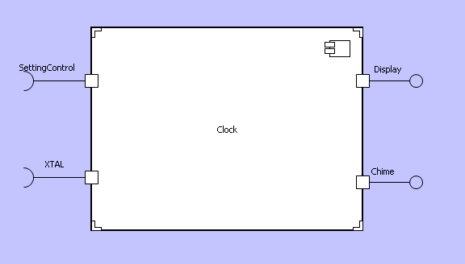
UML 2.0 Component Definition
A modular part of a system design that hides its implementation behind a set of external interfaces
Within a system, components satisfying the same set of interfaces may be substituted freely
Notes:
Components are similar to “black boxes” in system design. Their function is not visible from outside, and they must have a well defined set of interfaces at the boundary to facilitate cooperation with other components. There is no way of ‘seeing inside’ the component to access its individual model elements, all communication must be handled through those defined interfaces.
Being a “black box”, components that have the same interfaces at the boundary can be substituted for each other. This is called the “interface signature”.

Slide 180
Component Packages
Packages are a diagrammatic way to group modeling elements together and manage their hierarchy.
Components are defined in packages.
Packages can be nested.
Component packages may contain other component packages and/or interface packages.
Interfaces also are organized in packages.
This allows a level of organizational association between components and their interfaces.
Notes:
Components define structure and encapsulation, they formalize interfaces “into” the component. Interconnection between components are defined in the component package.

Slide 181
Interfaces
An interface is a declaration of a collection of synchronous and asynchronous messages
Managed separately from components
Components implement Interfaces
The separation also allows more than one component to implement (require or provide) any particular interface.
Interfaces can be resolved from a different hierarchical path in the project and reused.
Implementation can be specified at the individual component port and is unique for each component.
Notes:
Interfaces are the formal communications mechanism for components. Separating interfaces from components allows reuse and consistent implimentation.

Slide 182
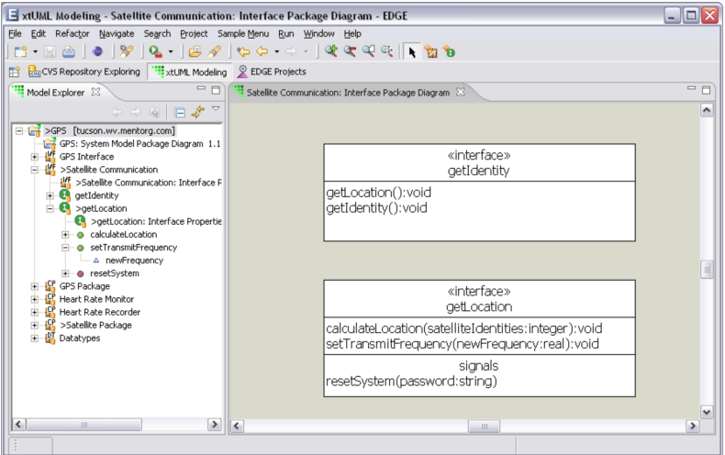
Interface Editor
Three sections in graphic
Name
Operations
Synchronous message
Operation completes before further execution
Can carry return values
Signals
Asynchronous message
Execution resumes immediately after signal sent
No return value

Slide 183
Provided vs. Required Interfaces
Provided Interface
“The Ball”
Allows a component to provide services to other components
Required Interface
“The Cup”
Allows a component to demand services from another component
Ports provide a name.
Necessary if an interface is multiply used.
Provided
Required

Slide 184
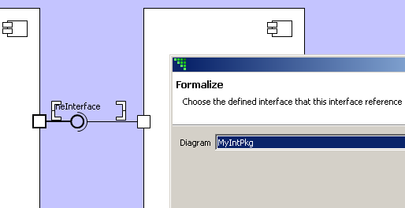
Formal Interfaces
When an interface is added it is not named or formalized.
Name interface for clarity
Formalize to interfaces declared in interface packages.
Interfaces must be formalized to pass messages.

Slide 185
Termination of Interface Messages
Signal (async message) between two connected components:
Class based state machine (mapped event), or
Receiving port
Signal sent from single component
Sending port
Operation (sync message) between two connected components:
Receiving port
Operation invoked from single component:
Sending port

Slide 186
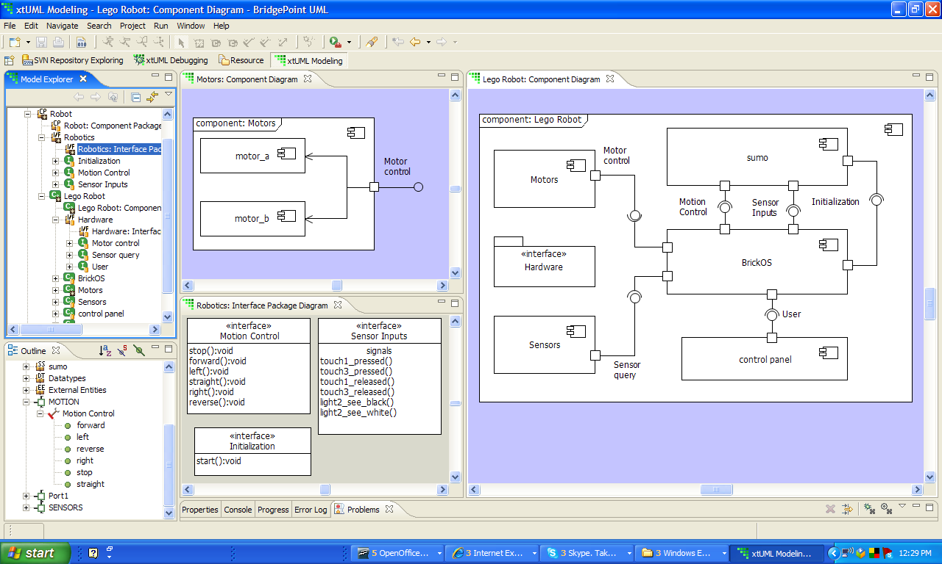
Component Views
Provided Interface
Non xtUML -Modeled
Components
Models
wired
graphically
Interfaces
on
Ports
Interface
Definition

Slide 187
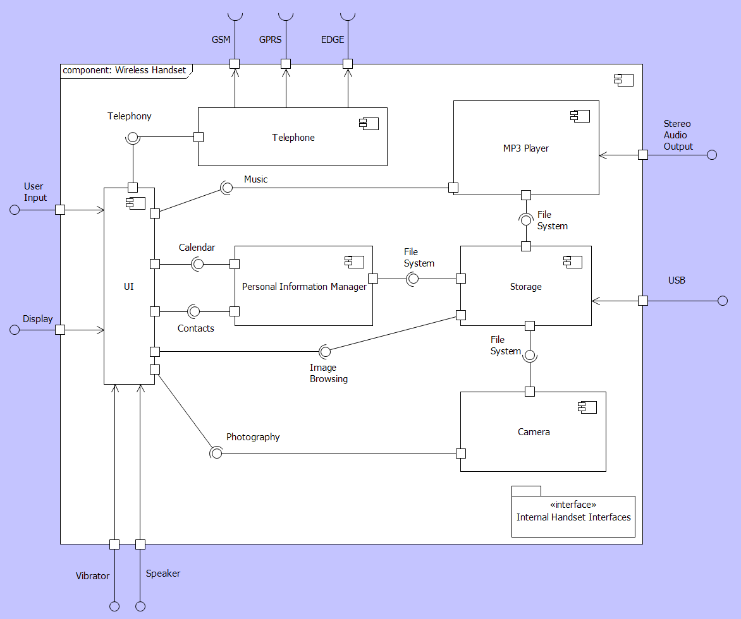
Nesting Components
Internal interfaces
Delegation
Provided and required interfaces to Parent Component
Leaf components:
xtUML models
Class,
State Machine
Actions
Legacy code
Notes:
Interfaces can be connected between components nested inside a top-level component, or can be assigned to the top level component.
Delegation satisfies the interface requirements by promoting a nested component’s interface to the top-level component’s boundary. Each non-leaf component can only contain other components and the interfaces between those components. No class diagrams, datatypes, or other xtUML model elements.
Leaf components can have classes, state machines, xtUML models…

Slide 188
12. Model-Driven Testing
11
Notes:
Added new section, as discussed

Slide 189
Model-Driven Testing
Model-driven testing is the notion that you can use models to build tests.
There are two types of test:
Black box
White box

Slide 190
Black-Box Testing
Black-box testing tests the system from the outside.
Black-box testing knows only:
what the actor wants from the system
the interface
It treats the system as a “black box”.
«fade out black box. Replace with system boundary/actors etc»

Slide 191
Use Cases
A use case captures what the actor wants from the system.
Therefore, the use case becomes the basis for building tests.
«Get exact language from XTR»
If you have big use cases, each may need more than one test for each.

Slide 192
Using Use Cases
Black-box testing requires:
Preconditions
Stimulus
Postconditions
A determination
You have these from the use cases.
Except for the last!

Slide 193
Testbench
A testbench simulates the outside world to:
establish the preconditions
generate the stimuli
examine the postconditions
generate a determination
We must model what is around the system.
«System boundary again»

Slide 194
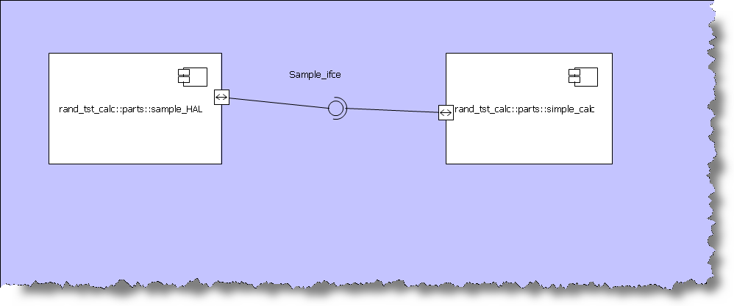
Testing Structure
Soooooo, create a:
test component, and a
system component

Slide 195


Use a Model
To create the testbench, build a model! It must:
establish the preconditions
generate the stimuli
examine the postconditions
generate a determination

Slide 196
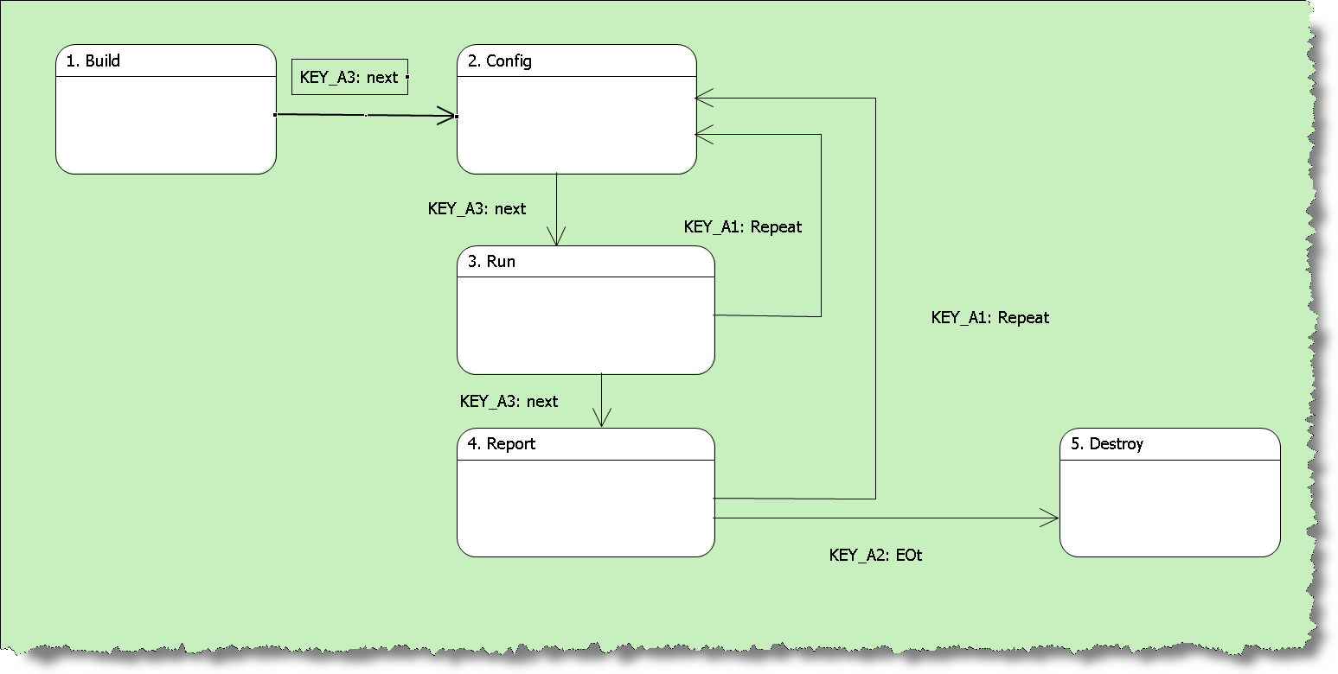
Test Component Phases

Slide 197
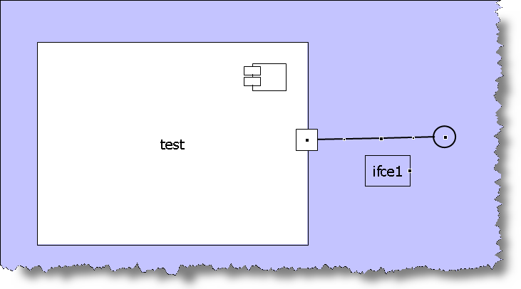
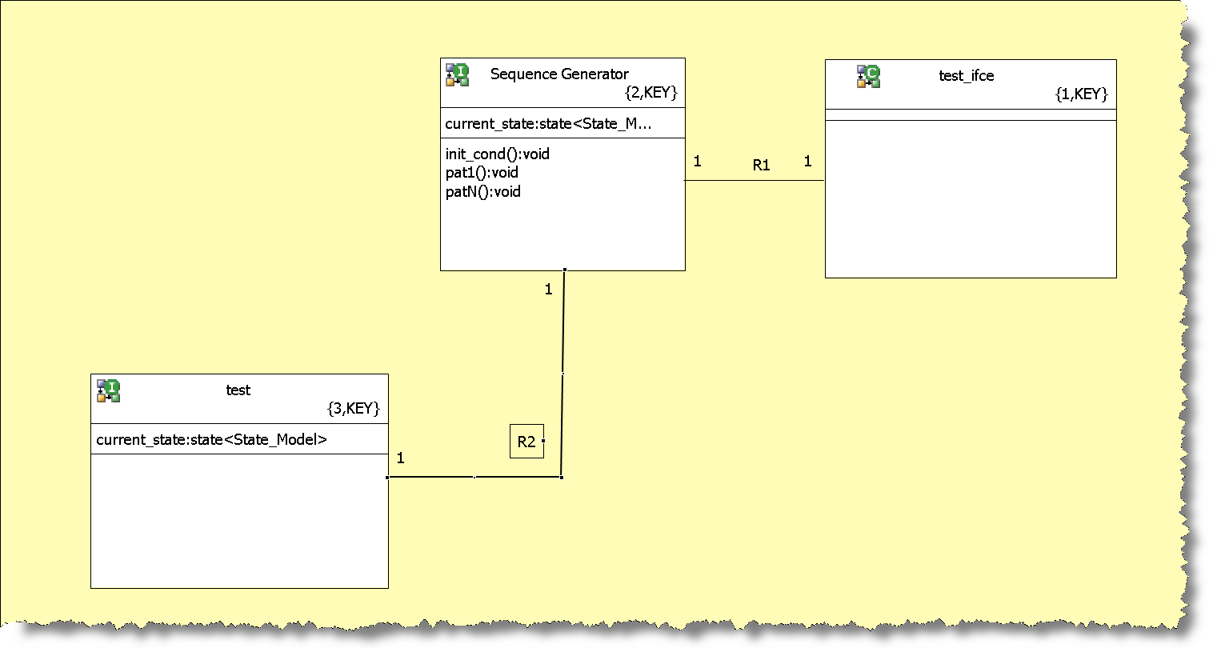
Structure of a Test

Slide 198
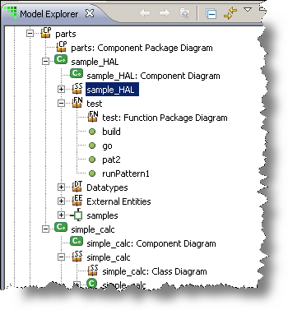
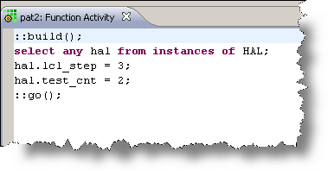
Test Component Phases

Slide 199
Ownership
The ‘owners’ of these black-box test cases are the people that check the system meets its requirements.
They verify that the system is what the customer want.
aka
«long list from JRW»

Slide 200
White-Box Testing
White-box testing tests the system from the inside.
White-box testing all about the models.
«fade out white box. Replace with xt Models»

Slide 201
White-Box Tests
White-box tests can:
Create and delete instances
Access attributes and association links
Look at states
«What else do you want?»

Slide 202
White-Box Tests
White-box tests should be developed early.
They are like unit tests.
«Do you want this term?
Is it right? Does it add anything?»
Test-driven development says to build the tests first.
Watch the test fail, then build the system.

Slide 203
Ownership
The ‘owners’ of these white-box test cases are the modelers.
«And ……????»
Modelers determine if it does what they think they built.
aka
«long list from JRW»

Slide 204
Workshop
Write a test.
«Black or white? Or both?»
«I have no idea what the stuff after this is trying to say»

Slide 205
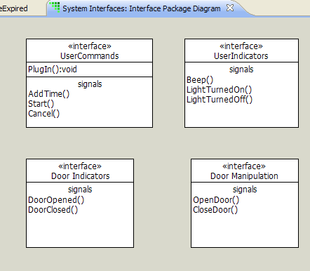
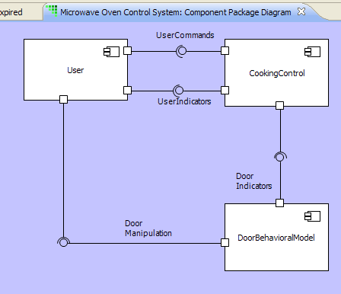
Interface Messages
Provide inter-component communication
Carry parameters
Asynchronous Signals
May be mapped to class-based events
Synchronous Operations
Future: May be mapped to class-based operations
Use actions in ports to define behavior

Slide 206
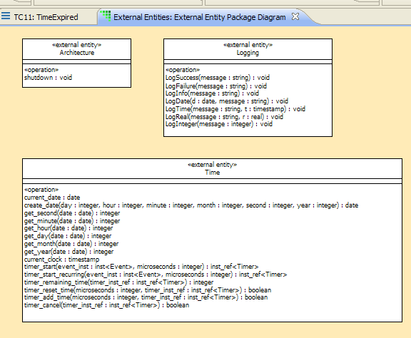
Bridges
Another form of synchronous operation
Takes parameters
Can be wired to external code or defined with OAL
Use for library functions
Time
Logging
Math
Use for scaffolding
OAL or Java for Verifier
Hand-written code for target

Slide 207
Summary
These rules represent a 'contract' between the world of analysis and the world of implementation
The architecture undertakes to implement dynamic behavior according to the agreed semantics.

Slide 208
13. What’s Next?
13
Notes:
Added new section, as discussed

Slide 209


www.mentor.com
BP Training 2 Components

