Slide 1
A: Getting Started

Slide 2
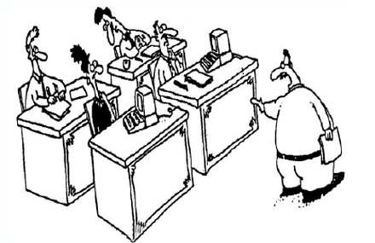
The Fuzzy Front End
Sometimes a development effort starts like this:
You lot start coding!
I’ll go and find out what they want.

Slide 3

The Fuzzy Front End
And sometimes it starts with a formal, complete specification containing
charter,
context, and
theory of operation.
Every requirement is:
Identified
Unique
Coherent
Unambiguous
Testable

Slide 4

Abstraction
To build models, you have to be able to gather enough information to make good abstractions.
Learning
Doing
Planning

Slide 5
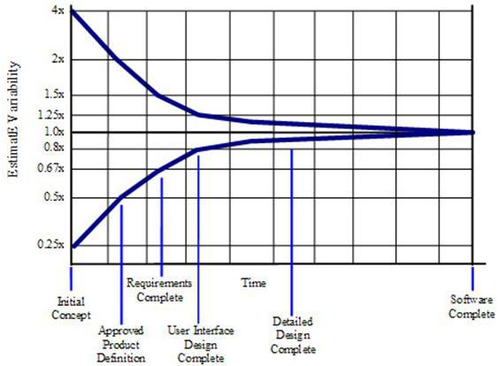
Cone of Uncertainty
Software Development's Cone of Uncertainty
Steve McConnell, Construx Software
Notes:
#ConeofUncertainty

Slide 6
Levels of Commitment
Consequently, we must commit incrementally.
Natural language and informal diagrams
Use cases
Activity diagrams
Sequence diagrams
Structural models
Components & Interfaces
Class models
Data types
Behavioral models
State models
Activities
}
This course

Slide 7
Requirements Clarification Process
The process is:
Find all your people, resources, practices, etc.
Find out what the system-as-a-whole does
Determine the precise behavior of each use case
And establish how it communicates with others
But it’s really all about learning about the problem.
Establish Baseline
Use Cases
Activity Diagrams
Sequence Diagrams

Slide 8
Requirements Clarification Process
It’s a bootstrapped process
We’ll show you how to:
determine what you have, and
how well it meets your needs
gather information to build executable models
investigate questionable use cases
organize information ready to build executable models
Establish Baseline
Use Cases
Activity Diagrams
Sequence Diagrams

Slide 9
Table of Contents
Getting Started
Kick Off
Teams
Communication
Practices
Assimilation
Process
Functional Behavior
Use Cases
Finding Use Cases
Defining Use cases
Factoring Use Cases
Information Gathering
Activity Diagram
Sequence Diagram
Wrap Up
Packaging the Materials
What We Did
What's Next

Slide 10
1. Kick Off
1

Slide 11
Kick Off
To start the project, we need to know:
Charter
Constraints
Context
Resources, including the Functional Specification, if any
Team and Stakeholders
Infrastructure
Practices
}
More on these here
}
More on these later
aka
Blast Off
Inception
Iteration Zero

Slide 12
Charter
The charter tells everyone why the project is being undertaken.
It is usually short:
A paragraph or two
plus some bullets
It may also contains numbers about:
Revenues
Units to be sold
‘C’-suite information needed to decide whether to proceed.
aka
Goals
Business Case

Slide 13
Constraints
Constraints and their rationales
time
money
intermediate targets
Costs
budgets for development
unit cost
memory cost
etc etc etc

Slide 14
Context
The context document (usually 1~10 pages) captures what the product is supposed to do.
It may also have a context diagram that has:
One big bubble for the system
External Entities
Incoming and Outgoing …
… Data and Control flows
aka
Background
Product Vision
Context (Diagram)

Slide 15
Resources: Requirements
There’s often a statement of the functions required of the system.
You need to ensure they are all:
Identified
Unique
Coherent
Unambiguous
Testable
You also need to learn and regularize the vocabulary.
aka
Requirements
Functional Specification
Functional Requirements Specification

Slide 16
Resources: Terms
To learn the vocabulary:
Identify existing
documents
files
listings
Identify experts
Make an inventory.
It may be helpful to visit the plant or see prior/similar systems
bk.1 ISO Standard xxx
bk.2 User Manual for xxx
bk.3 Code Listing for xxx
bk.4 Configuration file
Sven@myCo.co.se Elevator Expert
Mark@myVendor.com Knows I/O

Slide 17
Naming and Packaging
Different organizations have different names for the same thing.
And different organizations package up the elements differently.
Charter
Constraints
Context
Requirements
Project Background
Everything
Functional Specification

Slide 18

Steps
List what you have and where it is
Work out how complete it is
Work out what you need to play back what the system does to the people who know what they want

Slide 19
Workshop
What do you call?
Charter
Constraints
Context
Requirements

Slide 20

2. Team
2

Slide 21
Customer Team
The customer team comprises:
Product management
Systems engineering
Acceptance testing
Business/Product analysts
Marketing
Customer service specialist
etc etc etc
We want this.
The duty of the customer team is to speak with one voice.

Slide 22
Development Team
The development team comprises:
software engineers
hardware engineers
mechanical engineers
system engineers
The duty of the development team is to:
implement the features demanded by the customer
advise the customer team on feasibility
especially on dependencies

Slide 23
Experts
An expert is someone who knows the technical details of how something works.
They are often:
Hard to reach
Assume too much or too little
A little impatient
I know all about alarms
Sometimes you are the technical expert

Slide 24
Experts
When you are the expert, you must still write things down, because other people do not have your understanding.
You may, or may not, be:
Hard to reach
Assume too much or too little
A little impatient
I know all about alarms
It does not change the process.
It just makes it a little easier.
I know all about alarms

Slide 25
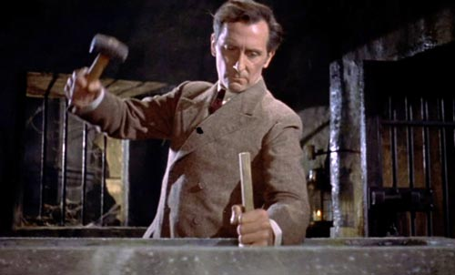
Stakeholders
Stakeholders include anyone who has an interest in the project:
Regulators
Competitors
Other divisions
Other managers
People who want you to fail
People on the team
You need to know who they are and why they care….
… because they are the difference between success and failure

Slide 26

Working Together
The most efficient and effective method of conveying information with and within a development team is face-to-face conversation.
But:
large development efforts
geographical distribution
long-lifecycle products

Slide 27
Large Development Efforts
As communication paths increase difficulties can arise
pairs
small teams
larger teams
Dunbar’s number
bureaucratic nightmare
Successful large development efforts are a set of small efforts.
n( n-1 ) / 2 = 6 * 5 /2 = 15

Slide 28
Geographical Distribution
Meet other teams in person to get to know them. (Best done early.)
Establish regular communication for full duplex (a weekly telecon, WebEx etc)
Establish a whiteboard for broad, asynchronous communication
Schedule meetings (WebEx, F2F, phone) to address specific issues

Slide 29

Long-lifecycle Products
A long-lifecycle product will outlive the team.
So think about what they might need:
Framework
Ability to learn quickly
Data files
System construction
Build scripts
Build executables (and executable models) where possible!

Slide 30
Modes of Communication
Instant messaging | Two people Nearly full duplex Asynchronous
Group chat | Multiple people At will Asynchronous
Web meetings | Multiple people Full multiplex Scheduled
Shared screens | Few people Full duplex Synchronous
Virtual whiteboard | Multiple people At will Asynchronous

Slide 31
Priority
You don’t want to interrupt other peoples’ thoughts.
But you do need answers.
Email
IM / SMS
Ring desk phone
Ring cell phone
Urgency
Interruption

Slide 32
Workshop
Which services do you use to:
Meet together in the different locations?
Ensure regular communication?
Let people know what you’re doing?
Ask questions to the team?

Slide 33
3. Communication
3

Slide 34
Face-to-Face Communication
The most efficient and effective method of conveying information with and within a development team is face-to-face conversation.
But:
long-lifecycle products
finding people at the right time
too many things to remember

Slide 35
Long-lifecycle Products
Define Theory of Operation
Build executables where possible
Tests
Build scripts
Code generation
Capture the rationale:
the “design not chosen” does NOT appear in the code
Now why did they did they do it that way? Why don’t we just …. ?

Slide 36
Finding People
Office | Cube & Conf | War Room | Team Room
Private | Not private | Choose to talk | Communal
Quiet | Noisy | Separated | Protocols
Open door vs Closed door | ‘Door’ always open | Dedicated to common use | Where do you think?
Scheduled | Serendipitous | Both | Constant

Slide 37
Multiple Locations
Geographical distribution requires other techniques:
Regular teleconferences (across time zones)
Reduce divergence
Maintain relationships
E-mail is a “pull” medium
Use e-mail for technical stuff only.
Never use e-mail for emotional subjects.
Sleep on “difficult” e-mails.
A single task list to maintain momentum.

Slide 38
Too Many Things to Remember
You will need to write down at least:
Action Items
Questions for experts
Issues
Background documents
Technical notes
among others.
Action Items
Questions
Issues

Slide 39
Tracking
You need to track ongoing items:
Whose responsibility is it? (“the owner”)
What state is it in?
open
pending reply from expert
in progress (current sprint)
closed
Action Items
Questions
Issues

Slide 40
Requirements
As you read background documents, you will encounter:
Well-defined requirements (even if people have slightly different interpretations of the exact meaning)
Multiple requirements in one
Mysteries
For “mystery requirements”,
Go back to the authors and have them rewrite it
For “multiples” ,
Go back to the authors and have them rewrite it
If that fails, factor it into “subrequirements”
Requirement 23 has been factored:
23.A
23.B
and 23.C

Slide 41
Terms
As you read background documents, you will encounter:
Well-defined terms, often defined in the relevant standards or texts
Well-understood terms (even if people have slightly different interpretations of the exact meaning)
Mysteries
For “mystery terms”,
List them
Identify (near) synonyms
List questions
Some terms are “abused.”
Everyone has their own (inconsistent) definitions.
Use “Fred,” instead.

Slide 42
Writing It Down
Requirements
Add any
Requirements
Terms
to your other documents.
Do not attempt the rewrite the background documents.
Terms
Action Items
Questions
Issues

Slide 43

Infrastructure
You will need document infrastructure, but it must be:
cheap,
incremental,
only “as-needed”
low learning curve
easy to use
A wiki enables asynchronous conversations.

Slide 44
Transparency
Information needs to be public, because:
It belongs to the company, not you
It is expensive to find information in locked drawers
Duplication is less likely
Others can usually improve on what you have
It’s easier to start with something that exists already

Slide 45
Workshop
What do you call …?
Requirements
Terms
Action Items
Questions
Issues

Slide 46
Workshop
And where do you keep them?
Requirements
Terms
Action Items
Questions
Issues

Slide 47
4. Practices
4

Slide 48
Recording
You need to come to agreement on how you write down:
Requirements
Terms
Action Items
Questions for experts
Issues
Technical notes
How detailed?
How will they managed?
Who “owns” the collection?

Slide 49

Daily Stand Up
A short daily coordination meeting for developers(*) covering:
What did I do yesterday?
What do I plan to do today?
What is in my way?
Take problem solving and tangents offline.
Focus on meeting team goals.
(*) You’ll also need to decide how to meet with customers etc
Notes:
http://hdw.eweb4.com/wallpapers/1459/

Slide 50
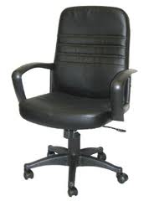
Weekly Sit Down
Or perhaps a weekly group meeting is preferable.
Start on time—no matter what
End on time (or before)—no matter what
Don’t repeat what someone missed—no matter what
Take problem solving and tangents offline.
Focus on meeting team goals.

Slide 51
Other Team Practices
The team should agree on their practices (eg):
Test-driven development (i.e., when to run tests)
Continuous review
Continuous integration
Build procedures etc
How long will an iteration be?
When will you meet?
Learning goals:
What additional skills will you have at the end?

Slide 52
Collective Ownership
Collective ownership means the artifacts look as if they were produced by a single mind.
This means:
standards
anyone can change anything, anytime
everyone is responsible for the final product
You’ll need to learn about other disciplines.

Slide 53

Revisit the Team
Do we have the:
right stakeholders?
regulatory?
other business units?
right technical skills?
OS?
domain knowledge
right customers and experts?
are the customers empowered to make decisions?
do you need more expert knowledge?

Slide 54
Workshop
List your team practices.

Slide 55
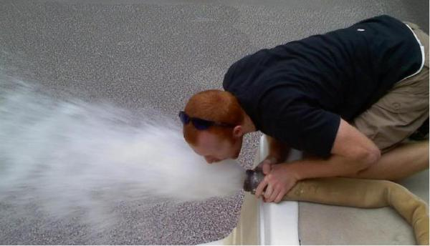
5. Assimilation
5
Notes:
http://www.scenicreflections.com/media/456071/Borg_Cube_Wallpaper/
http://coarpk.wordpress.com/2014/05/02/drinking-from-the-firehose/

Slide 56
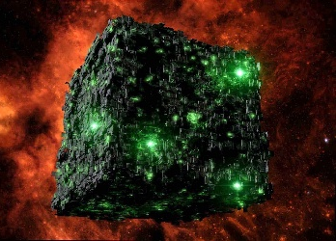
Resistance is Futile
Now that you know:
Who is on the team
What it is you’re trying to do
How you’ll work together
How you’ll record information, and
All the resources….
it’s time to go to work!
How will you assimilate the materials?

Slide 57
Find Requirements
Read the specification to find requirements.
They must be:
Identified
Unique
Coherent
Unambiguous
Testable

Slide 58
Find & Identify Your Requirements
Find each requirement and ensure it’s identified.
Req’t 1: The door must open if it is obstructed.
Req’t 2: A passenger must be able to get an elevator to a floor.
Req’t : A passenger must be able to open the door.

Slide 59
Coherent and Unambiguous
Each requirement must be coherent and unambiguous.
Req’t 1: The door must open if it is obstructed.
Req’t 2.A: A passenger must be able to order the elevator he occupies to a floor.
Req’t 2.B: A passenger must be able to request an elevator moving in a specified direction to a floor.
Req’t 3: A passenger must be able to open the door.

Slide 60
Testable
Each requirement should be testable.
You must be able to know if the requirement has been met.
Req’t 10: The administrator must be able to define a mode.
Req’t 10: The administrator must be able to switch between two modes. Morning mode brings all unused elevators to the ground floor. Normal mode leaves them where they are.
Req’t 11: The elevator must be able to service many floors
Req’t 11: The elevator must be able to service a maximum of 100 floors.

Slide 61
Testable
Each requirement must be testable. You must be able to say:
what is true before the requirement executes
what is true after the requirement has executed
Req’t 1: The door must open if it is obstructed.
Pre: Obstruction in door
Post: Door open
Req’t 2: A passenger must be able to order the elevator he occupies to a floor.
Pre: None
Post: Order to move elevator to floor queued

Slide 62

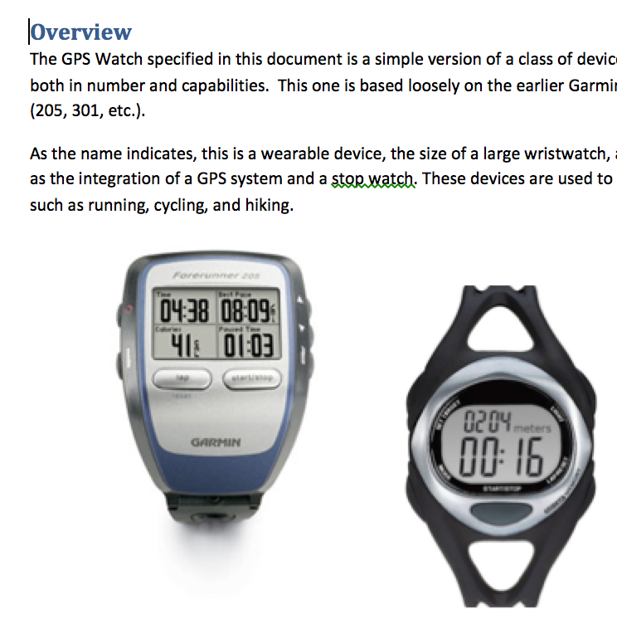
Workshop
Read the description for the case study.
Identify the requirements,
and decide if they are:
Identified
Unique
Coherent
Unambiguous
Testable
If not, ask your customer.
Handouts

Slide 63
6. Process
6

Slide 64
How Wide?
Do you need all the requirements, before you go into detail?
Number of Requirements
1 all
Depth of Understanding
None Complete

Slide 65
Depth of Understanding
Determine your depth of understanding.
Your mileage may vary!
Multi-
shaft
Elevator Control
Motor Control
Device I/O
“Enough” understanding?
→ Good to go!
“Enough” understanding?
→ Good enough for Device I/O!
“Enough” understanding?
→ Oh dear!

Slide 66
Risk et al.
Can Wait for Third release
Needed for customer visibility
Risky! Using new system
Hardware people screaming, but low risk
Multi-
shaft
Elevator Control
Motor Control
Device I/O

Slide 67
How Wide?
Go wide initially
Focus on specific areas, according to:
Risk
Staffing
Etc
Learn from going deep
Go wide again
Number of Requirements
1 all
Depth of Understanding
None Complete

Slide 68
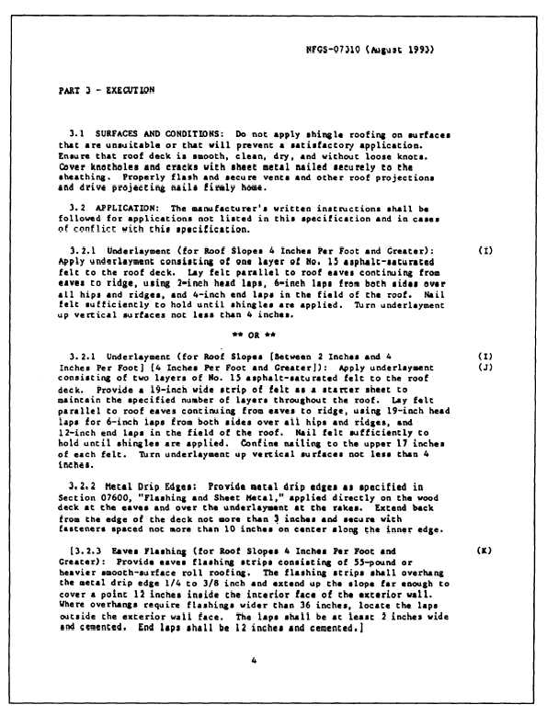
Details
Use Case 01
15
Use Case 01
1
16
11
12
Use Case 23
41
31
Use Case 03
Notes:
http://engineeringtraining.tpub.com/14070/css/14070_98.htm

Slide 69
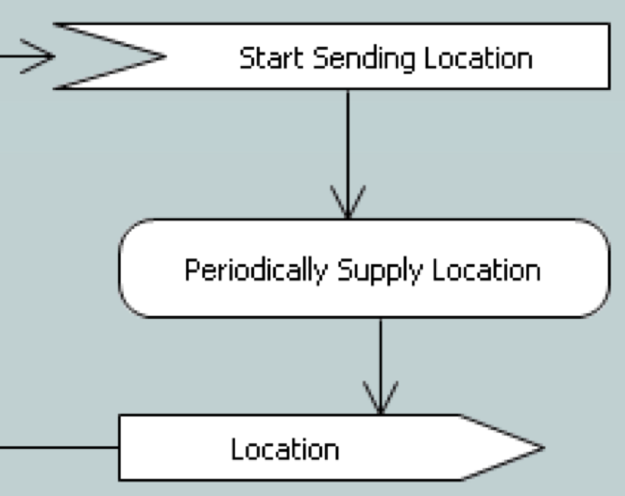
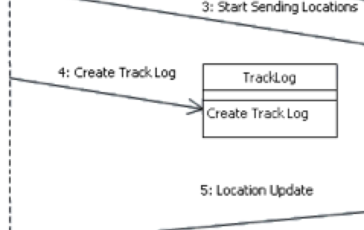
Specification
Actor:
Trigger:
Pre-conditions:
Post-conditions:
Scenario:
Requirements:

Slide 70
B: Functional Behavior

Slide 71
7. Use Cases
7

Slide 72
Use Cases
A use case says how a role uses a system to meet some goal.
Examples:
A passenger requests elevator
A system administrator sets elevator mode
At 08:00, free elevators return to the ground floor.
When the door reaches the floor, the door opens
aka
“usage case”

Slide 73
Actors
An actor is anything that interacts with the system:
people
machines and sensors
other systems
timers
We name the role, not the person or thing.
Fred → Administrator
Fred → Passenger
Mary → Passenger

Slide 74
Interaction
An interaction between an actor and system is shown as an association, thus:
It crosses the system boundary and consists of:
data flows
control flows
or a complex interaction comprising multiple flows
Other relationships exist within the system boundary.

Slide 75
Use Case
The use case is everything the system does for the actor.
A passenger requests elevator → Bring an elevator to the requesting floor
A system administrator sets elevator mode → Change mode from ‘Normal’ to ‘Evening’
At 08:00, free elevators return to the ground floor →
Change mode from ‘Evening’ to ‘Morning’
When the door reaches the floor, the door opens →
Open the door
It can include complex interactions back and forth

Slide 76
Use Case Diagram
Initiate
Close Door
Request
Elevator
Passenger
Stop Elevator
Initiate
Open Door
Motor Box
Door Sensor
Move
Elevator

Slide 77
8: Finding Use Cases
8

Slide 78
Read the Spec.!
15
1
16
11
12
41
31

Slide 79
Identify Personnel
The people that know the subject matter best are usually the experts and the customers.
Invite them to the initial sessions, and be prepared to ask them for more detail later.

Slide 80

Blitz
A blitz is a technique for getting started.
There are no wrong answers.
We don’t categorize
We don’t organize
We don’t evaluate
We just enumerate
The purpose is to provide a starting point.
Notes:
Taken from http://www.maperformance.com/blitz-fatt-advance-boost-sensor-set-for-touch-brain-fatt-advance-plus-blz_19240.html
“Blitz Fatt Advance Boost Sensor Set for Touch Brain and Fatt Advance Plus”

Slide 81
Actors
Who or what interacts with the system?
People (as roles)
Machines and devices
Other systems
Time
Ask what each one wants to do.
Passenger
Motor Box
Door Sensor

Slide 82
Interaction
Look for data and control inputs to the system.
Keep your mind on the logical intent of the interaction, not the specific physical flows.
Initiate
Close Door
use cases
Request
Elevator
Passenger
Stop Elevator
Initiate
Open Door
Motor Box
Door Sensor
Move
Elevator

Slide 83
Back-and-Forth
Generally, a use case involves “back-and-forth” across the system boundary.
This suggests alternate paths:
What if the door fails to close?
What if a passenger requests an intervening floor?
Write the alternate paths as separate use cases.
Order Elevator to Floor
Close door
When door closed, accelerate
On approach to specified floor, slow down
On arrival at floor, open door

Slide 84
Alternatives
Consider what can “go wrong.”
Build them as separate use cases.
Order Elevator to Floor with Idiot in Door
Close door
If blocked, reopen door
When completely reopened (and <3 tries, go to Step 1)
If 3 tries, make annoying beeping sound
……

Slide 85
Workshop
Identify and name the use cases in the Case Study.
Draw a diagram, if you want.

Slide 86
9. Defining Use Cases
9

Slide 87
Defining Use Cases
To define a use case, follow this pattern (long form):
Actor: What role causes the use case to execute?
Trigger: What causes the use case to execute
Pre-conditions: What must be true before the use case can execute
Post-conditions: What must be true after the use case has executed
Scenario: A description of just what happens
Requirements: A list of the requirements addressed by the use case

Slide 88
Defining Use Cases
To define a use case, follow this pattern (short form):
Actor: Adds little
Trigger: Adds little
Pre-conditions: What must be true before the use case can execute
Post-conditions: What must be true after the use case has executed
Scenario: A description of just what happens
Requirements: Captured elsewhere

Slide 89
Trigger
A trigger is a data or control flow that initiates the use case.
Identify what causes the use case to execute.
Always write down the logical meaning of the trigger.
aka
stimulus
Passenger orders elevator to floor

Slide 90
Pre- and Post-Conditions
Pre- and post-conditions say what must be true:
before some use case, and
after the use case is completed.
You may add a description.
Elevator arrives at floor
Precondition: Door closed and elevator stopped
Postcondition: Door open
Idiot in Door
Precondition: Door closing and obstruction detected
Postcondition: Door opened

Slide 91
Pre- and Post-Conditions
There may be several pairs of several conditions.
Request Elevator
Precondition: Elevator at floor with door closed
Postcondition: Door open initiated
Request satisfied
Precondition: No elevator at requested floor
Postcondition: Request queued for arbitrary elevator

Slide 92
Pre- and Post-Conditions
Or you may split them.
Note that the state is now embedded within the name.
Request Elevator with Elevator at Floor
Precondition: Elevator at floor with door closed
Postcondition: Door open initiated
Request satisfied
Request Elevator with no Elevator at Floor
Precondition: No elevator at requested floor
Postcondition: Request queued for arbitrary elevator

Slide 93
Scenario
A scenario is a list of steps describing the interaction between an actor and the system to effect some goal.
Write down the scenario in natural language.
Scenario: Passenger Enters Elevator
Create order for elevator to floor
Close door
Elevator moves
Elevator arrives at floor
Open door
Scenario: Passenger requests Elevator
Select elevator in requested direction
Create order for elevator to floor
Close door
Move elevator
Elevator arrives at floor
Open door

Slide 94
Scenario
A scenario is a list of steps describing the interaction between an actor and the system to effect some goal.
WARNING: Scenarios are procedural and can lead to brittle systems if implemented directly.
They are used to elucidate the system’s response ONLY.

Slide 95
Test Cases
Most test cases should take the form:
establish pre-conditions
inject stimulus to initiate
verify actual post-conditions against expected
issue a pass/fail indication
Hmmm….
Where would I find these?

Slide 96
Workshop
Write pre- and post-conditions for the following use cases:
1: Simple Workout
2: Multi-Lap Workout
3: Achieve Pace Over Distance Goal

Slide 97
10. Factoring Use Cases
10

Slide 98
The Whole
Now that we have the use cases, it pays to look at them as a whole to see if we can find:
inconsistencies in terms
inconsistencies in abstraction level
duplication of requirements
elements that can be factored out

Slide 99
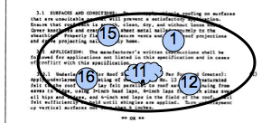
Size Matters
A single use case use case may encompass several of the original candidate requirements.

Slide 100
Use Case Diagram
Use cases can be:
Very big, involving multiple elements
Big, involving a single, complex interaction
Single requirement
Very small (and very useless)
}
want to be
We are here

Slide 101
Normalize Nouns
Ensure that the terms used in the use cases are either:
exactly those you have defined, or
can be replaced by those you have defined, or
you provide a definition
Correlate them to existing requirements for
identification
completeness
But do not rewrite them.
Pace Workout
Lap Log
Multi-lap Button
Device Heart-rate
Track …..

Slide 102
Normalize Verbs
Ensure that the verbs used in the use case use cases are:
limited (i.e. there are but a few of them), and
clear, and if special to the subject matter…
… correlate them to existing requirements for
identification
completeness
But do not rewrite them.
Add Display
Delete Alert
Read Clear
Find Log
Show …..

Slide 103

Inconsistent Abstraction Level
Check that terms used in the use cases are at the same abstraction level.
4
8
3
7
Passenger pushes button.
2
6
1
5
Passenger orders elevator to floor.
閉
開

Slide 104
Factor Out Common Elements
When you find common elements, factor them out.
Scenario UC07: Passenger Enters Elevator
Create order for elevator to floor
Close door
Elevator moves
Elevator arrives at floor
Open door
UC07: Call any elevator to floor
Scenario UC14: Passenger requests Elevator
Select elevator in requested direction
Create order for elevator to floor
Close door
Move elevator
Elevator arrives at floor
Open door
UC14: Order selected elevator to floor

Slide 105
Additional Constructs
Other relationships exist within the system boundary.
They are:
«includes»
«extends»
and generalizes (deprecated)

Slide 106
Includes
Scenario UC07: Passenger Enters Elevator
Create order for elevator to floor
Close door
Elevator moves
Elevator arrives at floor
Open door
UC07: Passenger Enters Elevator
«includes»
UC14: Passenger requests Elevator
Scenario UC14: Passenger requests Elevator
Select elevator in requested direction
Include UC07
Notes:
All or some of the UC

Slide 107
Extends
Scenario UC07: Passenger Enters Elevator
Create order for elevator to floor
Close door
Elevator moves
Elevator arrives at floor
Open door
UC07: Passenger Enters Elevator
«extends»
UC24: Passenger Adds Order
Scenario UC24: Passenger Adds Order
Duplicates UC07 Steps 1~3
Create additional order, if not past floor
Repeat UC07 Steps 2~5 for each order
Notes:
All or some of the UC

Slide 108
One More Time…
Each requirement is | if not
Identified | Identify it
Unique | Reconcile it with duplicates
Coherent | Clean up the writing
Unambiguous | Disambiguate
Testable | Revisit the pre/postconditions

Slide 109
Workshop
Reconstruct the existing use cases and verify the terms are consistent.

Slide 110
11. Information Gathering
11

Slide 111
Gathering Information
What do you do if you don’t have enough information?
You talk to the technical experts:
Limit meetings to one hour
Check constantly
Write down what you learned
Ask the expert to check your understanding
Do it again
So each robot has one arm that can move in two dimensions, not three? Right?

Slide 112
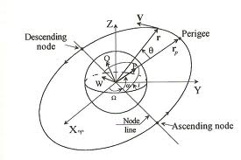
Technical Notes
Writing is not “extra.” It forces you to organize your thoughts.
Technical notes capture any topic of interest.
Informal
Short
Common understanding
Always incorporated into the executable models somehow
They will also avoid having the same interview again.
And again…. and again…. and again…. and again…. and ...
Orbital Mechanics for Dummies

Slide 113
As You Write …
Requirements
Note down additional:
Requirements
Terms
Action Items
Questions for experts
Issues
These are “living documents.”
Terms
Action Items
Questions
Issues

Slide 114
Intermediate Review
The systems engineers/experts should review your:
technical notes
definitions of mysterious terms
factoring requirements
and answer your questions as you proceed.
The cost of using faulty information is high and the cost increases exponentially the longer you continue to use faulty information!

Slide 115
12 Activity Diagram
12

Slide 116
Activity Diagrams
The purpose of building an activity diagram is to
capture shared understanding of sequencing and processing,
and make obvious the opportunity for concurrency.

Slide 117
Basics of Activities
Activity diagrams can show:
Activities
Transitions
Initial node
Final node
The transitions indicate the sequencing.
Drink Beer
Fall Over

Slide 118
Decisions
Activity diagrams may also make decisions.
Decision node (diamond) shows decision
[guards] indicate conditions that must be true
Decision node also used for merge
[Insensible?]
Drink Beer
Fall Over
Go Home
[Sensible?]

Slide 119
Parallel Activities
Several actions make take place in parallel.
Arrive in Hostelry
Drink Beer
Play Snooker

Slide 120
Parallel Activities
Parallel activities may need to terminate before another activity can take place.
Arrive in Hostelry
Synchronization Fork
Drink Beer
Play Snooker
Synchronization Join
Fall Over

Slide 121
Swimlanes
To clarify actors’ roles, activities are aligned inside swimlanes.
Patron
Barkeep
Places Order
Takes Money
Drinks Beer
Pours Drink
Fall Over

Slide 122
Signals
Actions may send signals and accept the corresponding event.
Patron
Barkeep
Shout Order
Hears Order
Pours Drink

Slide 123
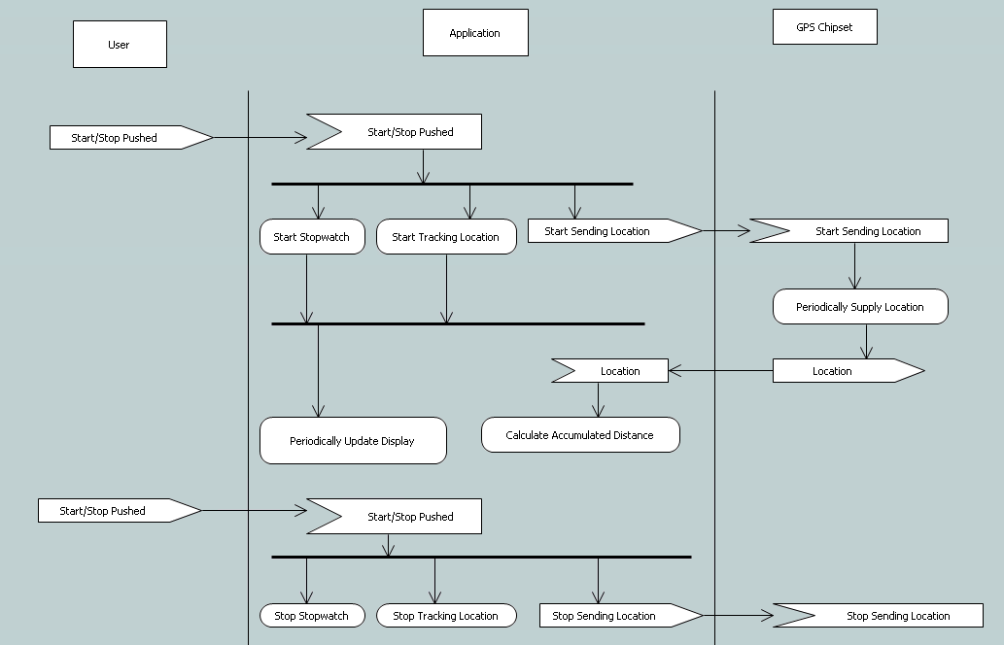
Activity Diagram

Slide 124
Workshop
Draw an activity diagram for use case #5.

Slide 125
13. Sequence Diagrams
13

Slide 126
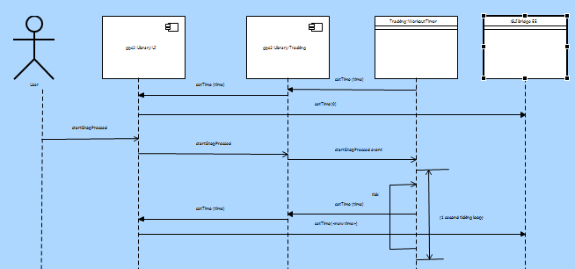
(Message) Sequence Diagrams
A sequence diagram shows how processes operate with one another and in what order.
Among other elements, a sequence diagram has:
Lifelines
Messages
Timing

Slide 127
Lifelines
Anything that has its own behavior, that can occur concurrent with others, can be said to have a lifeline.
The lifeline shows how its owner behaves over time.
A lifeline can be a:
Actor
Component
Instance
External Entity
Class
It can send messages to others.
These are informal, though they may be connected to formal things later.

Slide 128
Messages
Messages can be
Synchronous (wait for return )
Return ( )
Asynchronous (send and forget )

Slide 129
Timing
Timing elements include:
Marks and
Spans
10 ms
20 ms

Slide 130
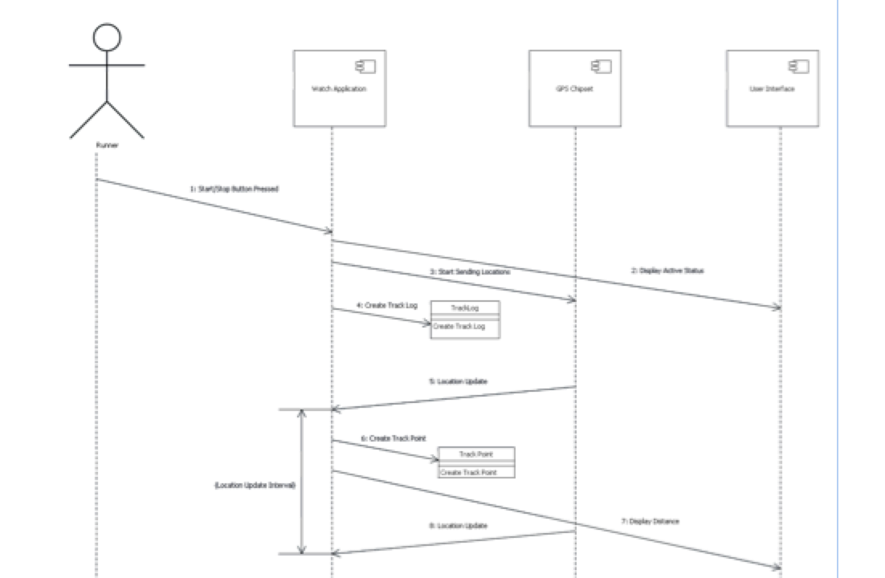
Sequence Diagrams
Build a sequence diagram if it helps detail your understanding.

Slide 131
14. Packaging the Materials
14

Slide 132
Organizing the Elements
The result of all this work is mostly
UNDERSTANDING
but the work must be packaged up for
review and
ease of access.

Slide 133
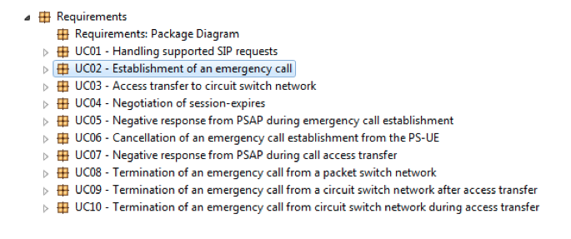
Requirements
We create a package named “Requirements”, with the use cases listed underneath.

Slide 134
Use Cases
Each use case shall contain:
a description
an activity diagram, and optionally
a sequence diagram
Use Case Name/Number
Pre-conditions:
Post-conditions:
Scenario:

Slide 135
Use Case Description
The use case description shall contain the description
and could cross-reference to the requirements it implements.
Use Case Name/Number
Pre-conditions:
Post-conditions:
Scenario:
15
1
16
11
12

Slide 136
Activity Diagram
The Activity Diagram captures the sequencing and processing.

Slide 137
Sequence Diagram
And the Sequence Diagram captures detailed message flow.

Slide 138
Review
All of this needs to be reviewed by the customers and their experts.
Actor:
Trigger:
Pre-conditions:
Post-conditions:
Scenario:
Requirements:

Slide 139
Also Keep
Functions
Keep the descriptions of the:
Requirements, and
Terms
You’ll need them for the next stage.
Action Items
Questions for experts
Issues
should be empty!
Terms
Action Items
Questions
Issues

Slide 140
C: Wrap Up

Slide 141
15. What We Did
15

Slide 142
Levels of Commitment
Consequently, we must commit incrementally.
Natural language and informal diagrams
Use cases
Activity diagrams
Sequence diagrams
Structural models
Components & Interfaces
Class models
Data types
Behavioral models
State models
Activities
}
This course

Slide 143
Requirements Clarification Process
The process is:
Find all your people, resources, practices, etc.
Find out what the system-as-a-whole does
Determine the precise behavior of each use case
And establish how it communicates with others
But it’s really all about learning about the problem.
Establish Baseline
Use Cases
Activity Diagrams
Sequence Diagrams

Slide 144
Requirements Clarification Process
It’s a bootstrapped process
We’ll show you how to:
determine what you have, and
how well it meets your needs
gather information to build executable models
investigate questionable use cases
organize information ready to build executable models
Establish Baseline
Use Cases
Activity Diagrams
Sequence Diagrams

Slide 145
Table of Contents
Getting Started
Kick Off
Teams
Communication
Practices
Assimilation
Process
Functional Behavior
Use Cases
Finding Use Cases
Defining Use cases
Factoring Use Cases
Information Gathering
Activity Diagram
Sequence Diagram
Wrap Up
Packaging the Materials
What We Did
What's Next

Slide 146
16. What’s Next
16

Slide 147
Abstraction
Now that we have approved use cases, and it’s all in our heads, it time to:
THINK
From that thinking, we create abstractions.

Slide 148
Build the Models
The following step is the build the models, and commit ourselves further.

Slide 149
Levels of Commitment
Natural language and informal diagrams
Use cases
Activity diagrams
Sequence diagrams
Structural models
Components & Interfaces
Class models
Data types
Behavioral models
State models
Activities
}
Next course

Slide 150
THE END

