Slide 1
4/8/2020

Slide 2
Died of Disease vs Alive

Slide 3
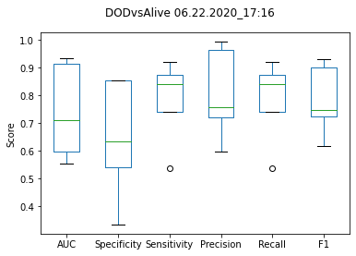
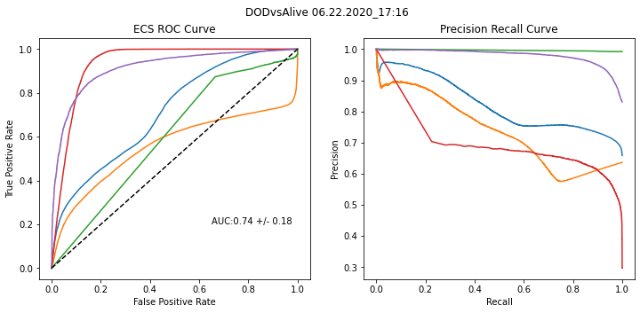
DODvsAlive - IR

Slide 4
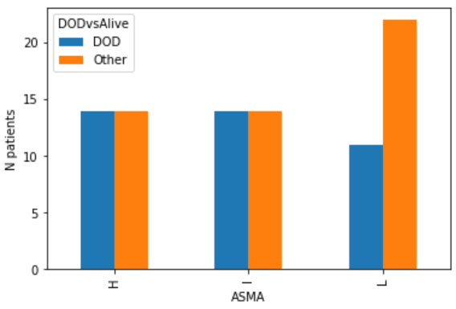
DODvsAlive- ASMA

Slide 5
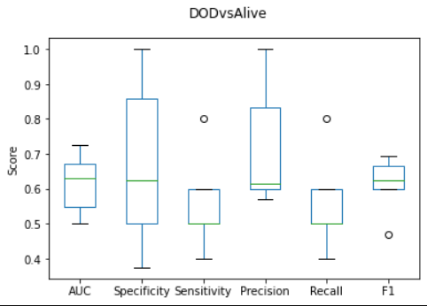
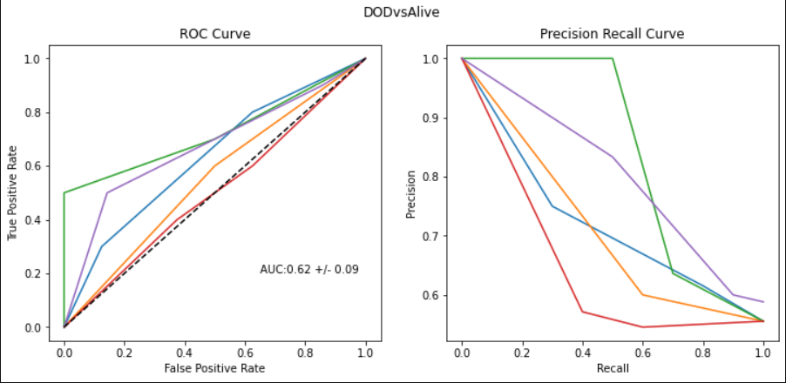
DODvsAlive - ASMA

Slide 6
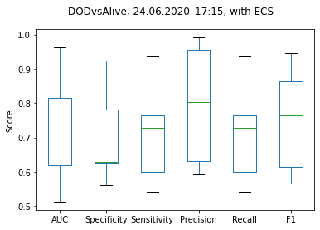
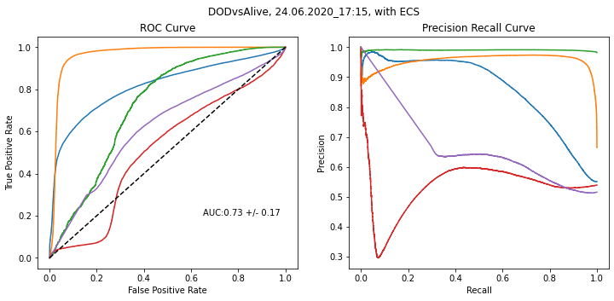
DODvsAlive – IR + ECS

Slide 7
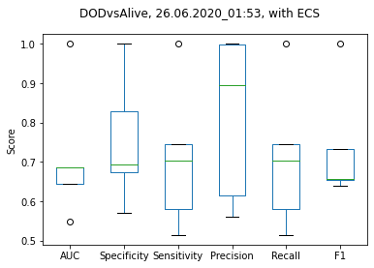
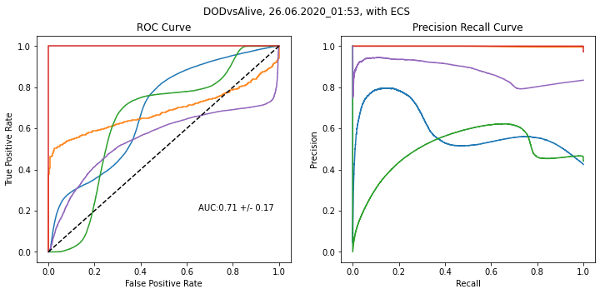
DODvsAlive – IR + ASMA

Slide 8
Died vs Alive

Slide 9
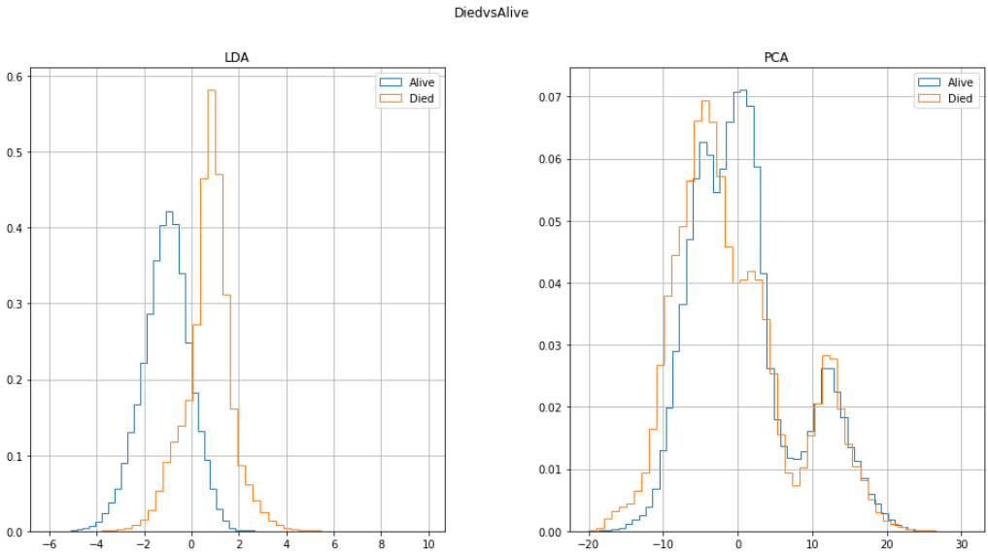
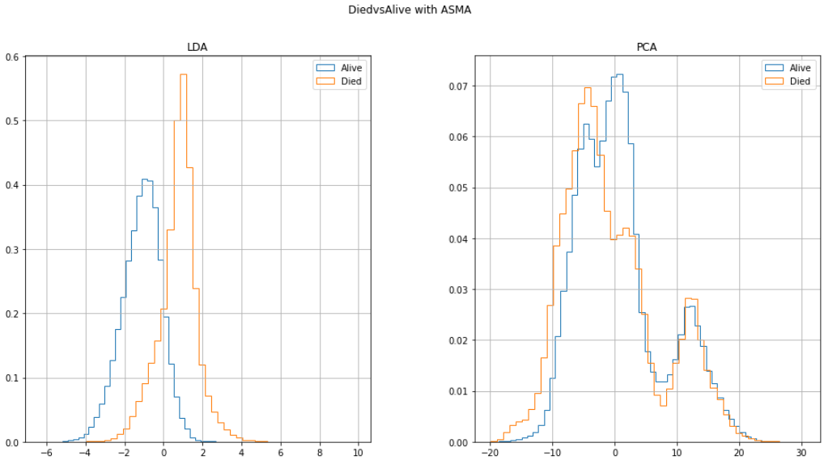

Slide 10
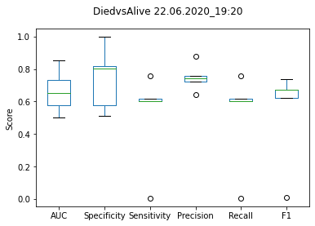
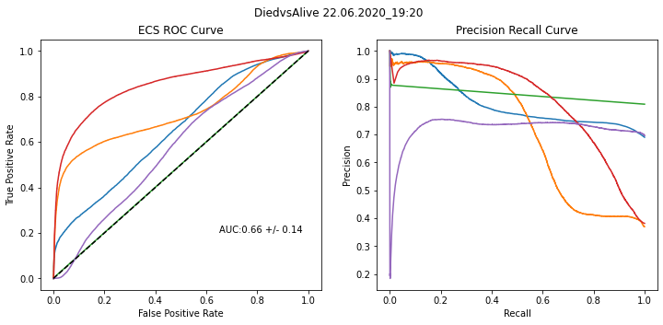
Died vs Alive - IR

Slide 11
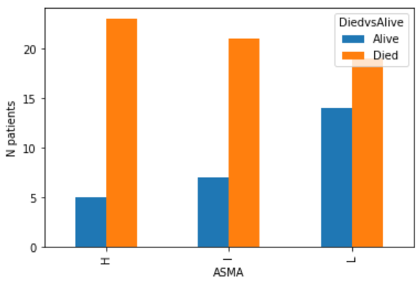
Died vs Alive - ASMA

Slide 12
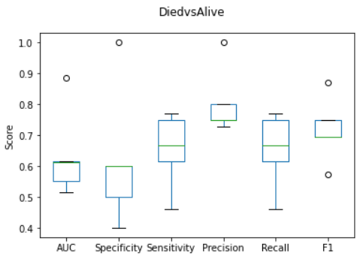
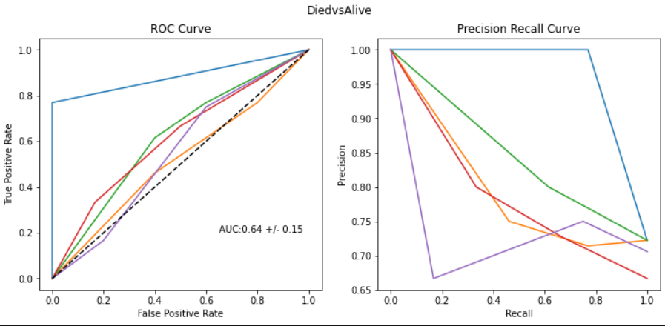
Died vs Alive - ASMA

Slide 13
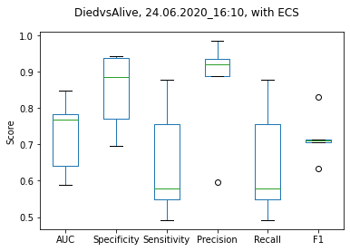
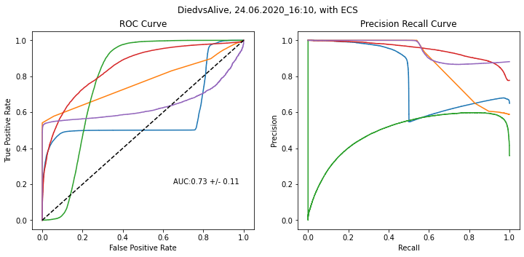
Died vs Alive – IR + ECS

Slide 14
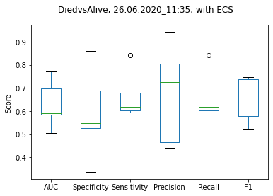
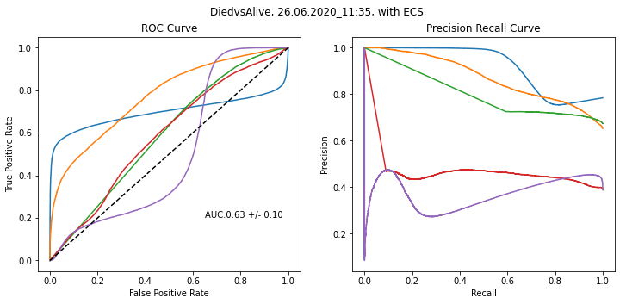
Died vs Alive – IR + ASMA

Slide 15
2 year survival

Slide 16
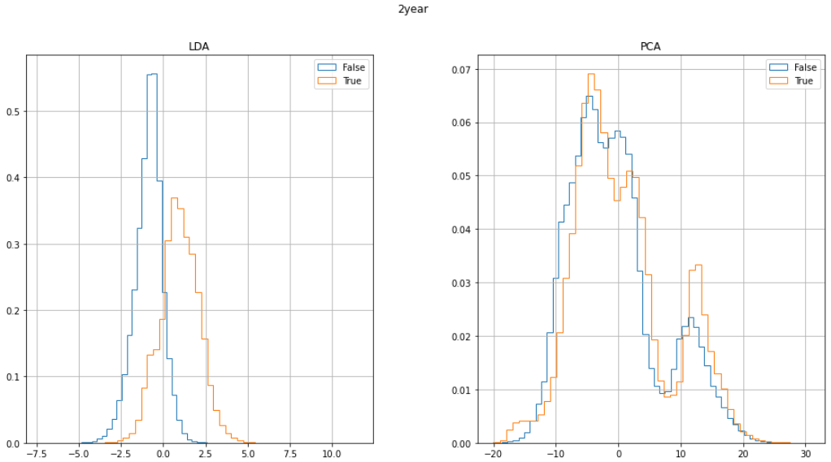
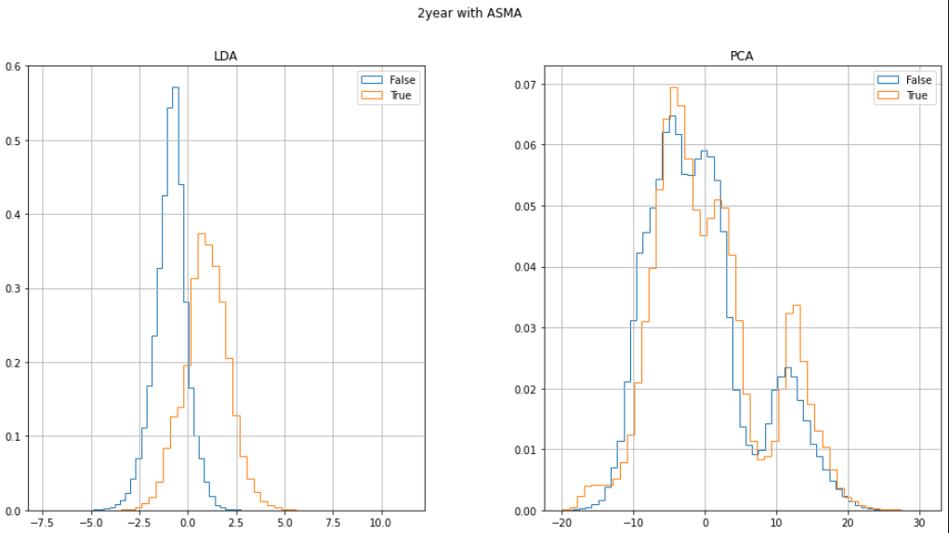

Slide 17
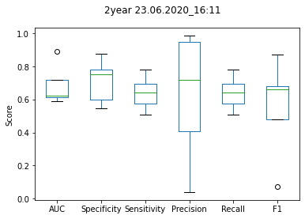
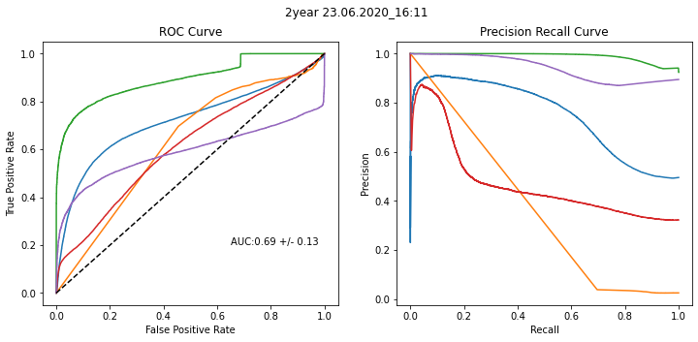
2 year survival- IR

Slide 18
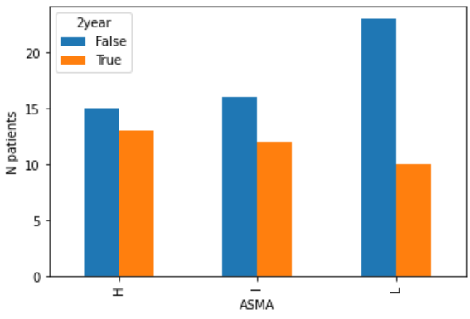
2 year survival- ASMA

Slide 19
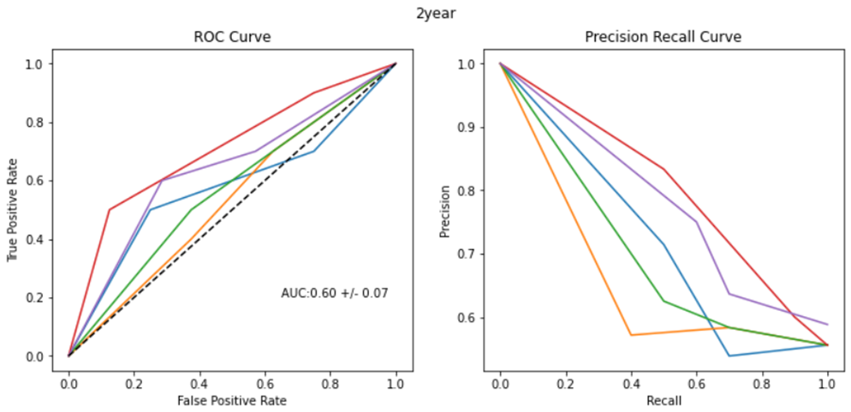
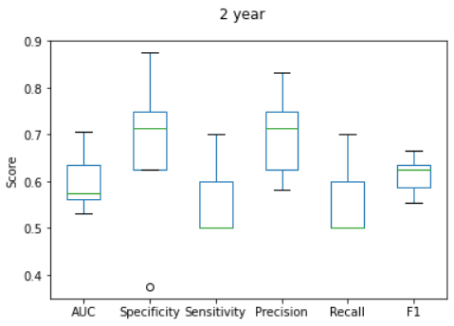
2 year survival- ASMA

Slide 20
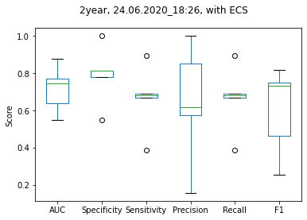
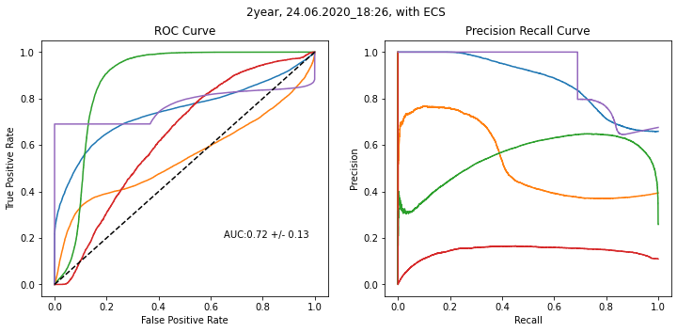
2 year survival– IR + ECS

Slide 21
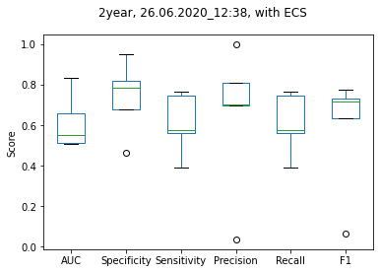
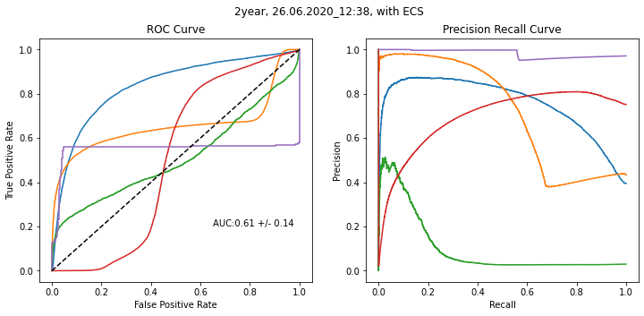
2 year survival– IR + ASMA

Slide 22
AUC results
 | DODvsAlive | Died vs Alive | 2year
IR | 0.74±0.18 | 0.66±0.14 | 0.69±0.14
IR + ECS | 0.73±0.18 | 0.73±0.11 | 0.72±0.13
IR + ASMA | 0.71±0.17 | 0.63±0.11 | 0.61±0.14
ASMA | 0.62±0.05 | 0.64±0.14 | 0.60±0.07
ECS | 0.66±0.1 | 0.67±0.01 | 0.70±0.1

Slide 23
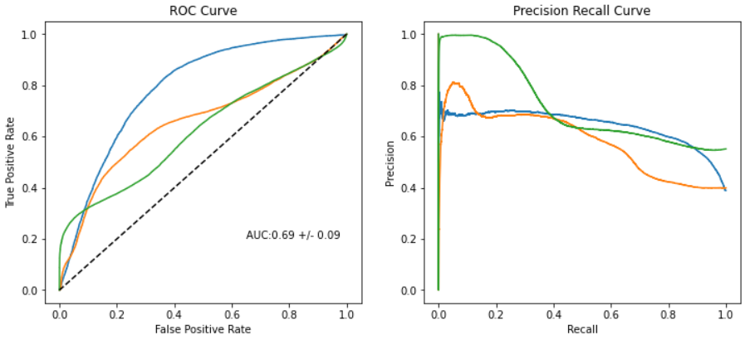
Death within 1 year

Slide 24
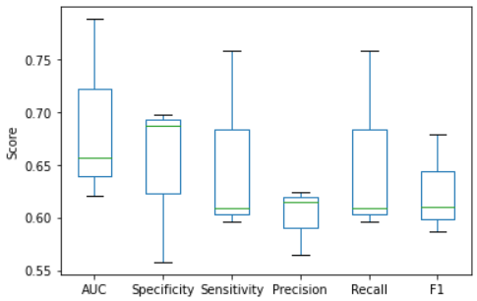
Death within 1 year

Slide 25
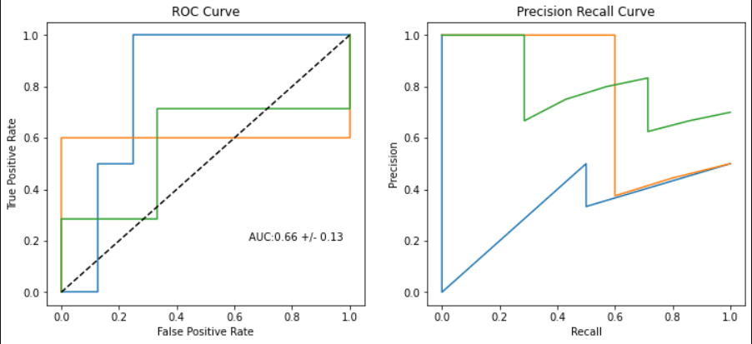
Death within 1 year

Slide 26
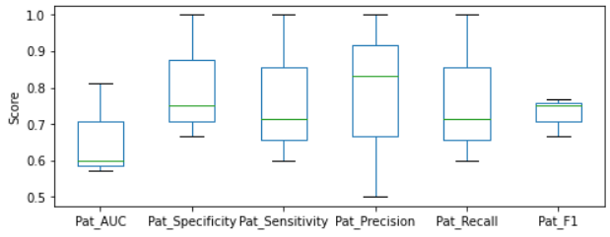
Death within 1 year

