Slide 1

大聯盟球員如何拿高薪
風管四 陳怡妏 風管四 林詩芸
風管四 李承駿 風管四 廖家誼
風管四 李承穎 風管四 陳彥成

Slide 2
目錄
CONTENTS
01
02
03
04
05
研究動機&目的
資料蒐集方式
研究方法
研究結果
結論

Slide 3

研究動機&目的
Research Motivation & Purpose

Slide 4

研究動機&目的
Research Motivation & Purpose
動機
世界十二強棒球賽甫結束，對於棒球的熱忱尚未結束的我們，想要對世界棒球殿堂—大聯盟做更深入的分析。大聯盟球員的薪資差距極大，少則數十萬多則上千萬，希望找出球團給薪的標準並建議有志進入大聯盟的各位朝這方面努力。
目的
探討球員的哪些表現或因素影響薪資的多寡最多
.

Slide 5
研究方法
Research Analysis

Slide 6
研究方法
Research Method
搜尋2019,2018,2017大聯盟球員的薪資、各項表現數據、年齡
利用迴歸分析看
p-value顯不顯著
Step1
Step2
Step3
Step4
先將球員分為投手群和打者群，並將薪資分成三群：100萬以下、100萬~1000萬、1000萬以上
再用PCA分析找出各薪資群的投手和打者有哪些特質

Slide 7
資料蒐集方式
Data collection

Slide 8


資料收集
Data collection
薪資
https://www.usatoday.com/sports/mlb/salaries/2014/player/all/
年齡
https://www.baseball-reference.com/players/m/mileywa01.shtml
各項表現
http://www.espn.com/mlb/stats/pitching/_/year/2014/type/expanded-2/order/false

Slide 9
棒球數據解釋
Explanation

Slide 10
棒球數據解釋
Explanation
投手
GP ：出賽次數
IP ：投球局數
H ：被安打
BB ：四壞球保送
SO ：三振
W ：勝投數
L ：敗投數
WAR ：球員的綜合評價
ERA ：防禦率
AGE ：年紀
SALARY：薪資
打擊
AB ：打數
R ：得分
RBI ：打點
SB ：盜壘成功
CS ：盜壘失敗
BB ：四壞球保送
SO ：被三振
AVG ：打擊率
OBP ：上壘率
SLG ：長打率
WAR ：球員的綜合評價
AGE ：年紀
SALARY：薪資

Slide 11

研究結果
Research Analysis

Slide 12
2017Pitching

Slide 13
2017 P10w
 | intercept | GP | IP | H | BB
10w | 240561 | -3317 | 1012 | 996 | 3636
sd | 25846 | 294 | 97 | 103 | 162
p-value | 0.0113 | 0.00776 | 0.00907 | 0.0105 | 0.00197
 | SO | W | L | WAR | ERA | age
10w | -791 | -13306 | -4174 | 36422 | -15094 | 5550
sd | 40.6 | 826 | 267 | 1650 | 5033 | 364
p-value | 0.00262 | 0.00384 | 0.00407 | 0.00205 | 0.0955 | 0.00426
n |  | r | adj. r | p-value
13 |  | 0.999 | 0.993 | 0.00542

Slide 14
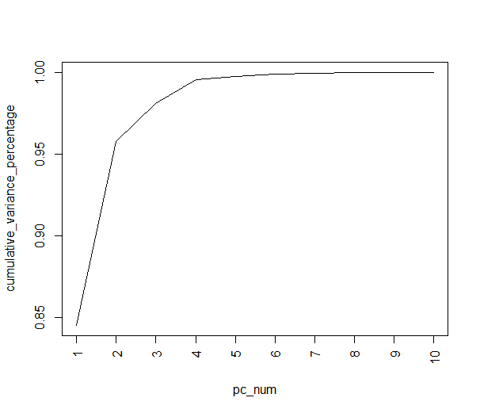
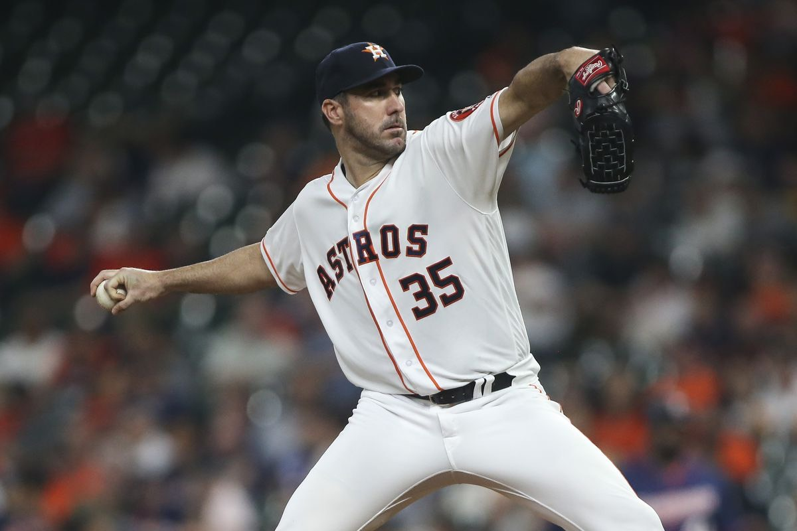
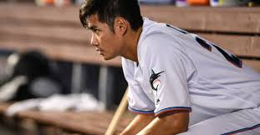
2017 P10w
ERA | SO | WAR | W | L
+ | - | - | - | +
Justin Verlande
陳偉殷
→廢物型(受傷)投手
GP | H | IP | W | L
- | - | - | - | +
→隊友不幫忙型(陳偉殷)投手

Slide 15
2017 P100w
 | intercept | GP | IP | H | BB
100w | -20391431 | 806764 | 17556 | -73652 | -74624
sd | 10259209 | 396593 | 64864 | 33142 | 48115
p-value | 0.0642 | 0.0589 | 0.79 | 0.041 | 0.14
 | SO | W | L | WAR | ERA | age
100w | -10611 | -113642 | 270923 | 753373 | 1307248 | 259740
sd | 15525 | 209578 | 297886 | 605545 | 1330381 | 105096
p-value | 0.504 | 0.595 | 0.377 | 0.231 | 0.34 | 0.0251
n |  | r | adj. r | p-value
27 |  | 0.506 | 0.198 | 0.182

Slide 16
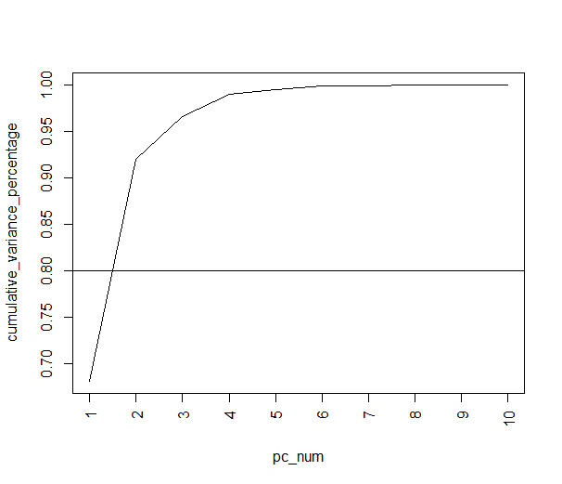

2017 P100w

Slide 17
2017 P1000w
 | intercept | GP | IP | H | BB
1000w | -25102 | -1396167 | -118964 | 230711 | -170986
sd | 46090058 | 4391545 | 487656 | 194940 | 260458
p-value | 1 | 0.759 | 0.813 | 0.271 | 0.53
 | SO | W | L | WAR | ERA | age
1000w | 31740 | 1148229 | -1126648 | 912644 | 3649099 | 883512
sd | 66651 | 1389545 | 1124499 | 2649900 | 6093559 | 952121
p-value | 0.647 | 0.433 | 0.346 | 0.739 | 0.566 | 0.381
n |  | r | adj. r | p-value
19 |  | 0.535 | -0.0456 | 0.557

Slide 18
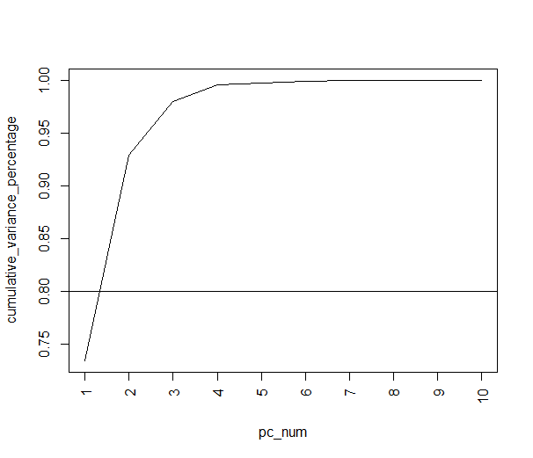
2017 P1000w

Slide 19
2017 P
 | intercept | GP | IP | H | BB
all | -31600198 | -315563 | 203309 | -107010 | -183265
sd | 18929457 | 681516 | 155270 | 78634 | 84031
p-value | 0.102 | 0.645 | 0.197 | 0.18 | 0.0341
 | SO | W | L | WAR | ERA | age
all | 10365 | 658036 | -46205 | -1096776 | 1391917 | 1034463
sd | 33088 | 495182 | 536563 | 1057315 | 3026783 | 264265
p-value | 0.755 | 0.19 | 0.932 | 0.305 | 0.648 | 0.000285
n |  | r | adj. r | p-value
59 |  | 0.453 | 0.339 | 0.000547

Slide 20
2017 P
ERA | WAR | L | W | SO
+ | - | + | - | -
→廢物型(受傷)投手
IP | GP | H | SO | age
- | - | - | - | -
→體力差的控球型投手

Slide 21
2018Pitching

Slide 22
2018 P10w
 | intercept | GP | IP | H | BB
10w | 281898 | 9080 | 2893 | -910 | -2141
sd | 526776 | 16528 | 2435 | 1396 | 1627
p-value | 0.602 | 0.592 | 0.256 | 0.526 | 0.211
 | SO | W | L | WAR | ERA | age
10w | 65.6 | -2152 | -10914 | -24408 | -10162 | -187
sd | 607 | 5703 | 11429 | 15616 | 38434 | 10987
p-value | 0.916 | 0.712 | 0.357 | 0.142 | 0.796 | 0.987
n |  | r | adj. r | p-value
24 |  | 0.325 | -0.194 | 0.769

Slide 23
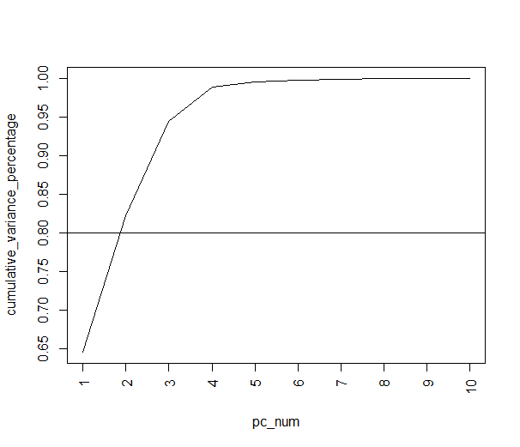
2018 P10w

Slide 24
2018 P100w
 | intercept | GP | IP | H | BB
100w | -8496251 | -519970 | 143467 | -73159 | -26236
sd | 18176586 | 552190 | 115327 | 72493 | 71569
p-value | 0.651 | 0.371 | 0.245 | 0.339 | 0.722
 | SO | W | L | WAR | ERA | age
100w | -19674 | 112633 | -340427 | 419347 | 3361193 | 352236
sd | 25146 | 320416 | 342349 | 1451074 | 3101469 | 349323
p-value | 0.454 | 0.733 | 0.346 | 0.779 | 0.307 | 0.34
n |  | r | adj. r | p-value
20 |  | 0.469 | -0.12 | 0.638

Slide 25
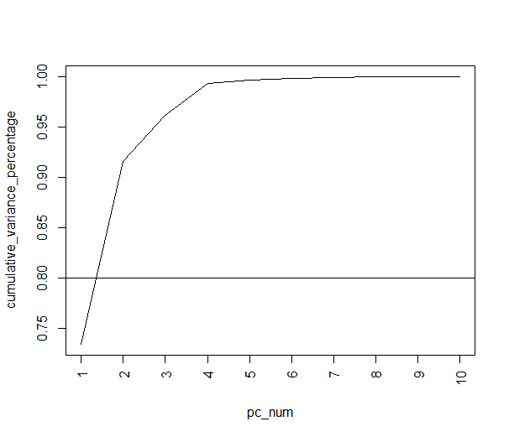
2018 P100w

Slide 26
2018 P1000w
 | intercept | GP | IP | H | BB
1000w | -197906043 | 6981766 | -1245830 | 222425 | -534929
sd | 480102119 | 13485671 | 2153669 | 1270544 | 680232
p-value | 0.708 | 0.64 | 0.604 | 0.872 | 0.489
 | SO | W | L | WAR | ERA | age
1000w | -108917 | 2197364 | 4599287 | 11480635 | 10729283 | 2698479
sd | 499718 | 5821823 | 8063525 | 17556569 | 28667591 | 5096545
p-value | 0.841 | 0.731 | 0.608 | 0.56 | 0.733 | 0.633
n |  | r | adj. r | p-value
14 |  | 0.415 | -1.54 | 0.973

Slide 27
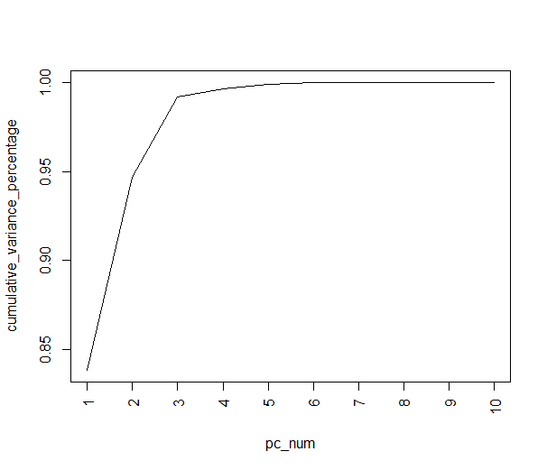
2018 P1000w

Slide 28
2018 P
 | intercept | GP | IP | H | BB
all | -72378895 | -912626 | 162161 | -25342 | 21145
sd | 20507991 | 729885 | 126279 | 80943 | 73358
p-value | 0.000944 | 0.217 | 0.205 | 0.756 | 0.774
 | SO | W | L | WAR | ERA | age
all | -7120 | 575923 | 462241 | 452821 | 3118857 | 2049815
sd | 32630 | 312043 | 451386 | 829540 | 2489951 | 254677
p-value | 0.828 | 0.07112 | 0.311 | 0.588 | 0.217 | 2.15E-10
n |  | r | adj. r | p-value
58 |  | 0.637 | 0.56 | 0.000000154

Slide 29
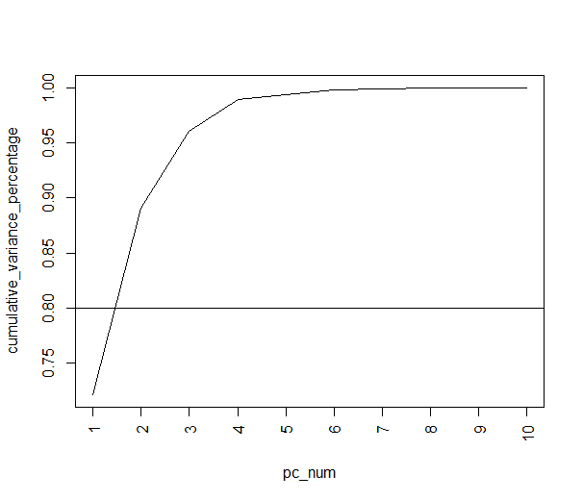
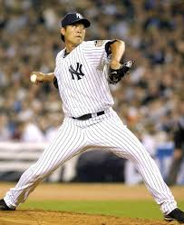
2018 P
王建民
ERA | WAR | SO | W | IP
+ | - | - | - | -
→廢物型(受傷)投手
H | GP | IP | L | age
- | - | - | - | -
→滾地球投手

Slide 30
2019Pitching

Slide 31
2019 P10w
 | intercept | GP | IP | H | BB
10w | 115832 | -30690 | 5006 | -210 | -1658
sd | 270535 | 9229 | 1619 | 1272 | 793
p-value | 0.681 | 0.0127 | 0.0175 | 0.874 | 0.0748
 | SO | W | L | WAR | ERA | age
10w | -1823 | 26128 | 18410 | -4920 | -21254 | 23407
sd | 459 | 4699 | 4793 | 9480 | 34507 | 7697
p-value | 0.0054 | 0.00085 | 0.00636 | 0.62 | 0.557 | 0.0188
n |  | r | adj. r | p-value
18 |  | 0.943 | 0.862 | 0.00185

Slide 32

2019 P10w
ERA | L | WAR | W | H
+ | + | - | - | +
→廢物型(受傷)投手
IP | GP | H | SO | age
- | - | - | - | -
→菜鳥滾地球投手

Slide 33
2019 P100w
 | intercept | GP | IP | H | BB
100w | -48650679 | 1186524 | 34302 | -18038 | 12608
sd | 22847427 | 630829 | 106520 | 62342 | 64772
p-value | 0.0621 | 0.0927 | 0.755 | 0.779 | 0.85
 | SO | W | L | WAR | ERA | age
100w | -4831 | -912051 | -14938 | 1350358 | 2057095 | 394514
sd | 22724 | 321260 | 237051 | 597903 | 2252002 | 230225
p-value | 0.836 | 0.0194 | 0.951 | 0.0503 | 0.385 | 0.121
n |  | r | adj. r | p-value
20 |  | 0.707 | 0.38 | 0.13

Slide 34
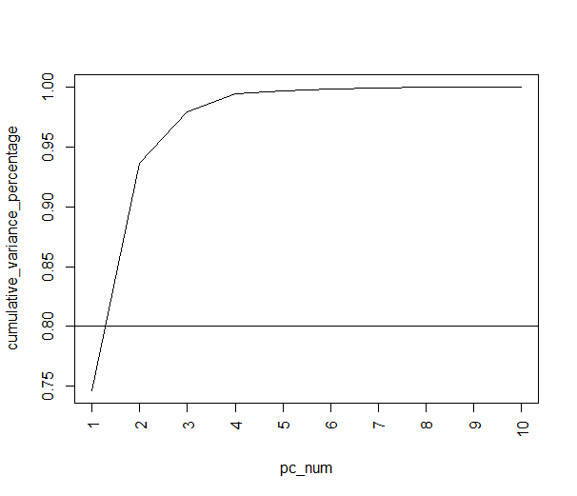
2019 P100w

Slide 35
2019 P1000w
 | intercept | GP | IP | H | BB
1000w | 37402869 | -7181230 | 762302 | -148812 | 193149
sd | 40653545 | 2017196 | 282196 | 127691 | 179379
p-value | 0.379 | 0.00518 | 0.0223 | 0.271 | 0.307
 | SO | W | L | WAR | ERA | age
1000w | -115372 | 406661 | -836432 | 2977671 | 14300136 | 1417386
sd | 67888 | 619401 | 1254881 | 2325732 | 5321984 | 705067
p-value | 0.12 | 0.526 | 0.52 | 0.229 | 0.0228 | 0.0721
n |  | r | adj. r | p-value
21 |  | 0.745 | 0.491 | 0.0526

Slide 36

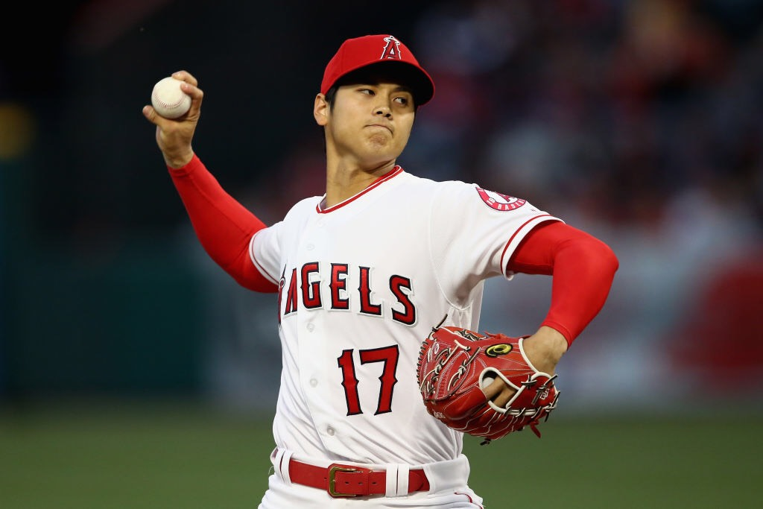
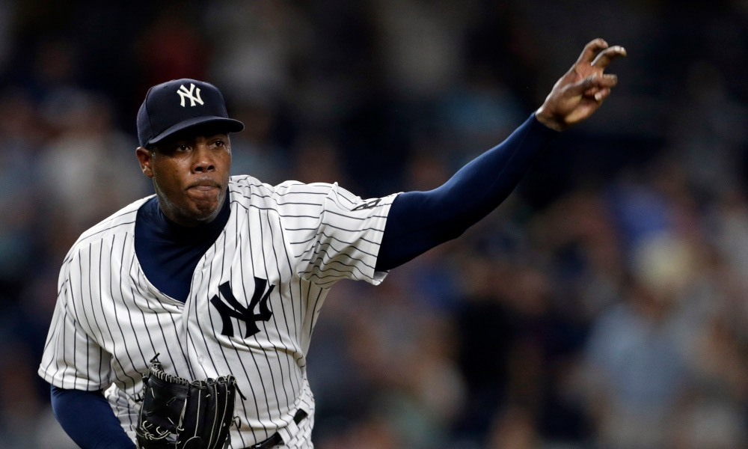
2019 P1000w
WAR | ERA | L | SO | W
+ | - | - | + | +
大谷翔平
Chapman
→超級全能型選手
GP | BB | IP | age | SO
- | - | - | + | -
→一局型投手

Slide 37
2019 P
 | intercept | GP | IP | H | BB
all | -14851917 | -1717755 | 203605 | -47922 | -82046
sd | 23196625 | 994714 | 150795 | 89065 | 85215
p-value | 0.525 | 0.0906 | 0.183 | 0.593 | 0.34
 | SO | W | L | WAR | ERA | age
all | 37312 | 273992 | -67467 | -1072876 | -26209 | 1657170
sd | 37435 | 454041 | 479158 | 1067612 | 3052874 | 281909
p-value | 0.324 | 0.549 | 0.889 | 0.32 | 0.993 | 0.000000384
n |  | r | adj. r | p-value
59 |  | 0.55 | 0.456 | 0.0000104

Slide 38


2019 P
WAR | ERA | SO | W | L
+ | - | + | + | -
Kershaw
→超級全能型選手
GP | IP | H | L | BB
- | - | - | - | -
→滾地球投手

Slide 39
2017Batting

Slide 40
2017 B10w
 | intercept | AB | R | RBI | SB | CS
10w | 431386 | 327 | 3700 | -164 | 1342 | -3115
sd | 681085 | 804 | 3665 | 1923 | 3712 | 8890
p-value | 0.532 | 0.688 | 0.322 | 0.933 | 0.721 | 0.729
 | BB | SO | AVG | OBP | SLG | WAR | age
10w | -469 | -137 | 1249528 | -1711645 | -223419 | 1197 | 2647
sd | 5098 | 634 | 3711641 | 4471346 | 809611 | 17868 | 10947
p-value | 0.927 | 0.83 | 0.739 | 0.705 | 0.785 | 0.536 | 0.811
n |  | r | adj. r | p-value
39 |  | 0.359 | 0.0632 | 0.325

Slide 41
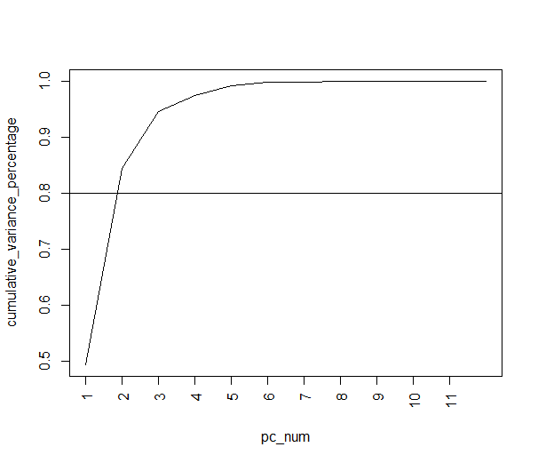
2017 B10w

Slide 42
2017 B100w
 | intercept | AB | R | RBI | SB | CS
100w | -3726487 | 7723 | 15221 | 41449 | 30056 | 87305
sd | 11765063 | 14724 | 42701 | 27504 | 41936 | 155287
p-value | 0.753 | 0.604 | 0.724 | 0.142 | 0.479 | 0.578
 | BB | SO | AVG | OBP | SLG | WAR | age
100w | -67368 | -34894 | -76981262 | 45371149 | -988975 | 306149 | 432400
sd | 58394 | 13909 | 51891188 | 54647060 | 11653124 | 317369 | 134247
p-value | 0.257 | 0.0174 | 0.148 | 0.413 | 0.933 | 0.342 | 0.00293
n |  | r | adj. r | p-value
45 |  | 0.441 | 0.232 | 0.0461

Slide 43
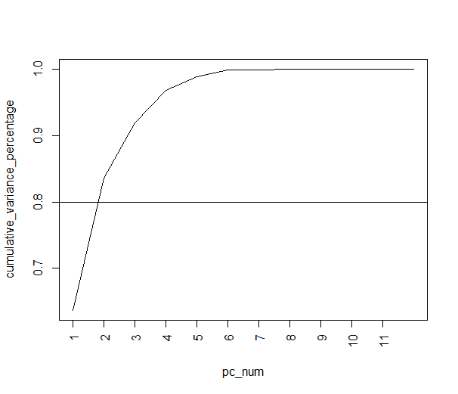

2017 B100w
Mike Trout
OBP | WAR | SLG | R | AVG
+ | + | + | + | +
→超級全能型選手
CS | SB | AB | R | age
- | - | - | - | +
→中庸型普通到爆球員

Slide 44
2017 B1000w
 | intercept | AB | R | RBI | SB | CS
1000w | -4237779 | -13985 | -305041 | 73605 | 213419 | 371255
sd | 27608489 | 27554 | 102718 | 75702 | 151928 | 421268
p-value | 0.879 | 0.615 | 0.00535 | 0.338 | 0.169 | 0.384
 | BB | SO | AVG | OBP | SLG | WAR | age
1000w | 186351 | 46979 | 14102446 | -84246314 | 20405382 | -579424 | 349501
sd | 127735 | 32895 | 101788609 | 118638475 | 29675906 | 558828 | 271044
p-value | 9.154 | 0.162 | 0.175 | 0.482 | 0.496 | 0.307 | 0.206
n |  | r | adj. r | p-value
48 |  | 0.416 | 0.216 | 0.0461

Slide 45
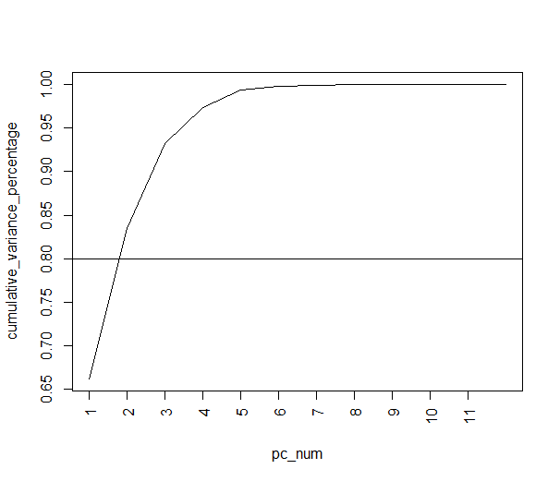
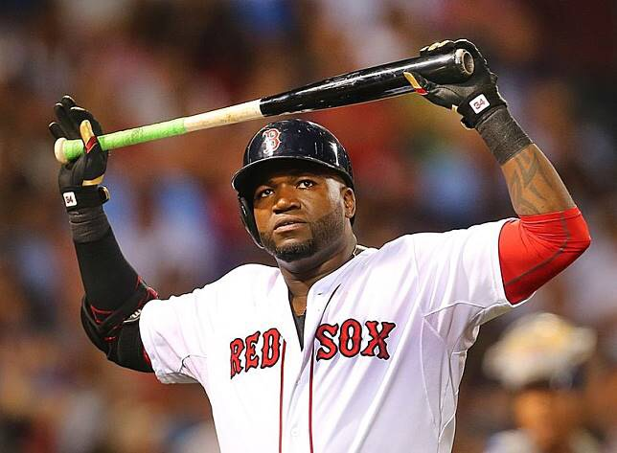
2017 B1000w
WAR | SLG | R | OBP | AVG
+ | + | + | + | +
David Ortiz
→超級全能型選手
SB | CS | SO | RBI | AVG
- | - | + | + | -
→重砲型球員

Slide 46
2017 B
 | intercept | AB | R | RBI | SB | CS
all | -36495722 | -3442 | -55756 | 72358 | 147874 | -79784
sd | 15227227 | 18817 | 67464 | 43384 | 75901 | 230612
p-value | 0.0181 | 0.855 | 0.41 | 0.098 | 0.0537 | 0.73
 | BB | SO | AVG | OBP | SLG | WAR | age
all | 34840 | -29768 | 14659319 | 1373718 | 7896614 | -308980 | 1347549
sd | 91642 | 18002 | 75076197 | 83914889 | 17778801 | 385153 | 134644
p-value | 0.704 | 0.101 | 0.846 | 0.987 | 0.658 | 0.424 | 1.77E-17
n |  | r | adj. r | p-value
132 |  | 0.571 | 0.527 | 7.37E-17

Slide 47
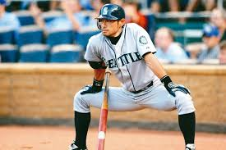
2017 B
WAR | SLG | OBP | R | RBI
+ | + | + | + | +
→超級全能型選手
SB | CS | RBI | AB | age
+ | + | - | + | -
鈴木一朗
→速度型球員

Slide 48
2018Batting

Slide 49
2018 B10w
 | intercept | AB | R | RBI | SB | CS
10w | 817620 | -338 | 483 | 1288 | 1903 | -5112
sd | 296769 | 460 | 1625 | 1314 | 1726 | 4934
p-value | 0.0155 | 0.474 | 0.771 | 0.344 | 0.289 | 0.318
 | BB | SO | AVG | OBP | SLG | WAR | age
10w | -92.8 | -239 | -199711 | 367410 | -247544 | -522 | -3769
sd | 2166 | 451 | 1778529 | 1690383 | 521366 | 6354 | 7608
p-value | 0.966 | 0.605 | 0.912 | 0.831 | 0.642 | 0.936 | 0.628
n |  | r | adj. r | p-value
27 |  | 0.368 | -0.174 | 0.747

Slide 50

2018 B10w

Slide 51
2018 B100w
 | intercept | AB | R | RBI | SB | CS
100w | 10938313 | -22929 | 81163 | 63369 | -32563 | -118839
sd | 9586779 | 11883 | 35198 | 39615 | 42104 | 138186
p-value | 0.26 | 0.0598 | 0.0257 | 0.117 | 0.443 | 0.394
 | BB | SO | AVG | OBP | SLG | WAR | age
100w | 34078 | 16685 | 52722153 | -43208819 | -26292147 | 393308 | 144196
sd | 71321 | 12074 | 63389556 | 66438003 | 14318873 | 296153 | 114238
p-value | 0.635 | 0.174 | 0.41 | 0.519 | 0.0728 | 0.191 | 0.213
n |  | r | adj. r | p-value
59 |  | 0.349 | 0.179 | 0.0401

Slide 52
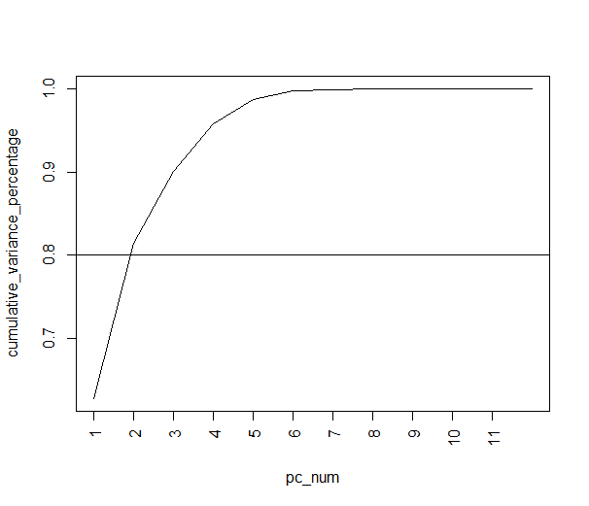
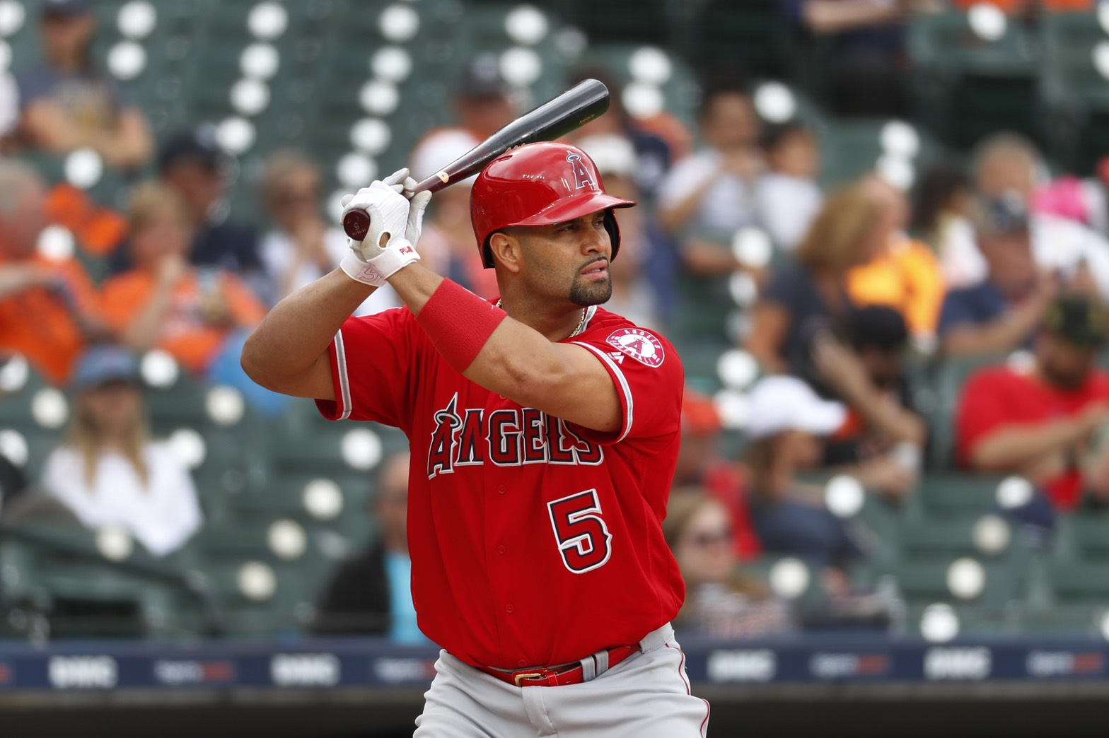
2018 B100w
WAR | R | OBP | SLG | RBI
- | - | - | - | -
→廢物型(受傷)打者
CS | SB | RBI | SLG | AB
- | - | + | + | -
Albert Pujols
→指定打擊型球員

Slide 53
2018 B1000w
 | intercept | AB | R | RBI | SB | CS
1000w | -7920798 | -14375 | -5708 | -27292 | 202692 | -905840
sd | 2078400 | 26772 | 71710 | 70810 | 141106 | 380928
p-value | 0.705 | 0.594 | 0.937 | 0.702 | 0.159 | 0.0223
 | BB | SO | AVG | OBP | SLG | WAR | age
1000w | 69660 | 51923 | 104735021 | -47629361 | 448931 | -13051 | 404705
sd | 161134 | 26646 | 133797896 | 150073841 | 31862540 | 561310 | 270864
p-value | 0.668 | 0.0584 | 0.438 | 0.753 | 0.889 | 0.982 | 0.143
n |  | r | adj. r | p-value
53 |  | 0.431 | 0.26 | 0.0141

Slide 54
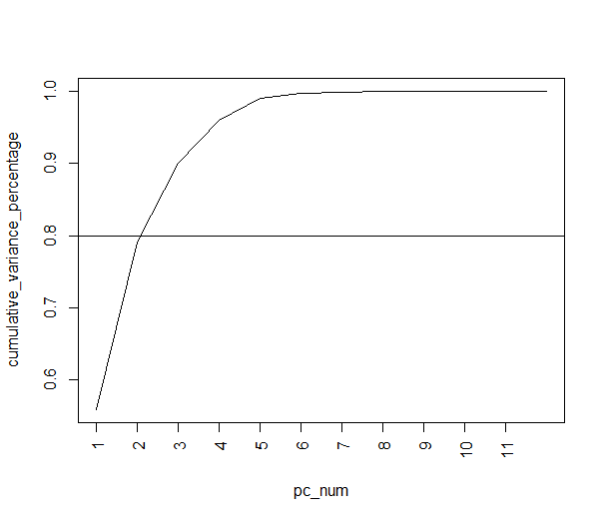
2018 B1000w
R | WAR | SLG | OBP | AVG
+ | + | + | + | +
→超級全能型選手
CS | SB | RBI | SO | BB
- | - | + | + | +
→喜歡等球的球員

Slide 55
2018 B
 | intercept | AB | R | RBI | SB | CS
all | -28937466 | -22643 | 34442 | 21826 | 34433 | -86573
sd | 15508179 | 20442 | 59227 | 57265 | 82048 | 248317
p-value | 0.0644 | 0.27 | 0.562 | 0.704 | 0.675 | 0.728
 | BB | SO | AVG | OBP | SLG | WAR | age
all | 176564 | 18759 | 128608441 | -133287752 | 15269525 | 314865 | 1301917
sd | 107105 | 20646 | 93003931 | 97800206 | 24409080 | 415379 | 163829
p-value | 0.102 | 0.365 | 0.169 | 0.175 | 0.533 | 0.45 | 9.27E-13
n |  | r | adj. r | p-value
139 |  | 0.433 | 0.379 | 5.26E-11

Slide 56
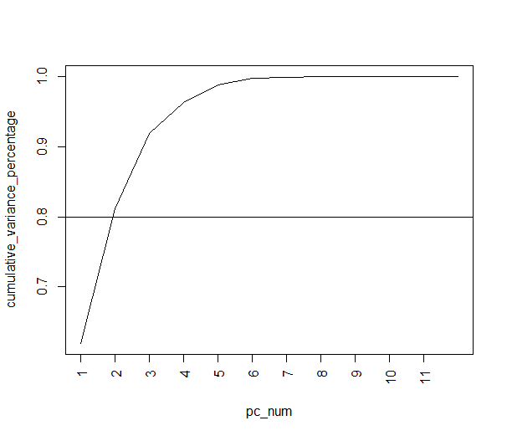
2018 B
R | WAR | SLG | OBP | AVG
+ | + | + | + | +
→超級全能型選手
CS | SB | RBI | SLG | age
- | - | + | + | +
→重砲型球員

Slide 57
2019Batting

Slide 58
2019 B10w
 | intercept | AB | R | RBI | SB | CS
10w | 459793 | 68.4 | 458 | -463 | -210 | 911
sd | 225901 | 279 | 1117 | 1241 | 1424 | 4821
p-value | 0.0527 | 0.808 | 0.686 | 0.713 | 0.884 | 0.852
 | BB | SO | AVG | OBP | SLG | WAR | age
10w | 176564 | 18759 | 128608441 | -133287752 | 15269525 | 314865 | 1301917
sd | 107105 | 20646 | 93003931 | 97800206 | 24409080 | 415379 | 163829
p-value | 0.102 | 0.365 | 0.169 | 0.175 | 0.533 | 0.45 | 9.27E-13
n |  | r | adj. r | p-value
36 |  | 0.154 | -0.287 | 0.969

Slide 59
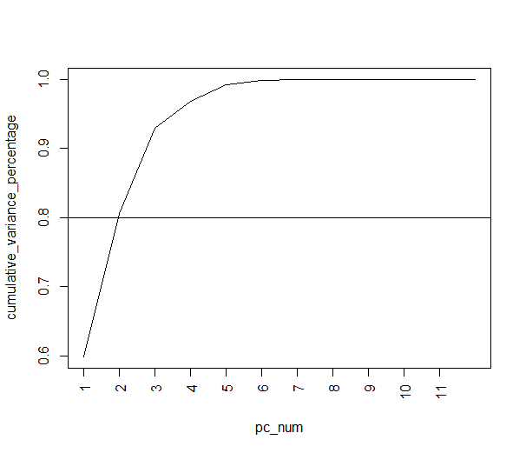
2019 B10w

Slide 60
2019 B100w
 | intercept | AB | R | RBI | SB | CS
100w | -15956469 | 14849 | -20266 | 10872 | 7257 | 172321
sd | 11610134 | 14807 | 46590 | 41492 | 49901 | 175511
p-value | 0.179 | 0.323 | 0.667 | 0.795 | 0.885 | 0.334
 | BB | SO | AVG | OBP | SLG | WAR | age
100w | -98681 | -12103 | -122692848 | 113936379 | 15740545 | -80940 | 260188
sd | 105571 | 14373 | 74973375 | 85511633 | 15328375 | 342590 | 145822
p-value | 0.357 | 0.406 | 0.112 | 0.192 | 0.312 | 0.815 | 0.0839
n |  | r | adj. r | p-value
45 |  | 0.327 | 0.0745 | 0.269

Slide 61
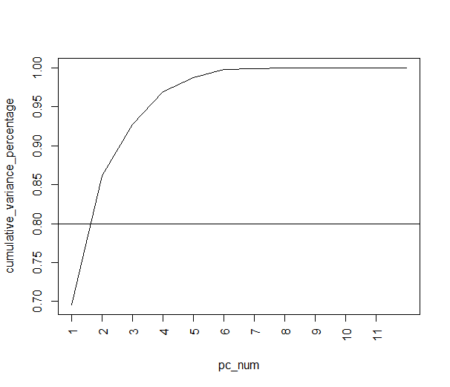
2019 B100w

Slide 62
2019 B1000w
 | intercept | AB | R | RBI | SB | CS
1000w | -39510333 | 19265 | -110228 | 60516 | -13734 | 339525
sd | 27520805 | 39849 | 118437 | 78996 | 191586 | 711590
p-value | 0.163 | 0.633 | 0.36 | 0.45 | 0.943 | 0.637
 | BB | SO | AVG | OBP | SLG | WAR | age
1000w | 60471 | -55470 | -39690034 | 148282361 | 2478261 | -1209610 | 454072
sd | 169885 | 46967 | 164657630 | 171051039 | 38173967 | 1012967 | 362397
p-value | 0.725 | 0.249 | 0.811 | 0.394 | 0.949 | 0.243 | 0.221
n |  | r | adj. r | p-value
40 |  | 0.405 | 0.141 | 0.173

Slide 63

2019 B1000w

Slide 64
2019 B
 | intercept | AB | R | RBI | SB | CS
all | -54569962 | 11661 | -3897 | 44494 | 5495 | 36051
sd | 14846394 | 20735 | 66197 | 52734 | 84262 | 312542
p-value | 0.000371 | 0.575 | 0.953 | 0.401 | 0.948 | 0.908
 | BB | SO | AVG | OBP | SLG | WAR | age
all | 98666 | -20736 | 35129070 | 9068554 | 3413338 | -725953 | 1346117
sd | 100698 | 23049 | 85703923 | 92059160 | 22264452 | 486802 | 157942
p-value | 0.329 | 0.37 | 0.683 | 0.922 | 0.878 | 0.139 | 1.03E-13
n |  | r | adj. r | p-value
121 |  | 0.529 | 0.477 | 4.79E-13

Slide 65
2019 B
R | WAR | SLG | OBP | RBI
+ | + | + | + | +
→中心打線打者
CS | SB | AB | age | BB
- | - | - | + | +
→代打戰術型球員

Slide 66
結論
Conclusion

Slide 67

結論
Conclusion
解釋能力看起來很差，但其實…

Slide 68

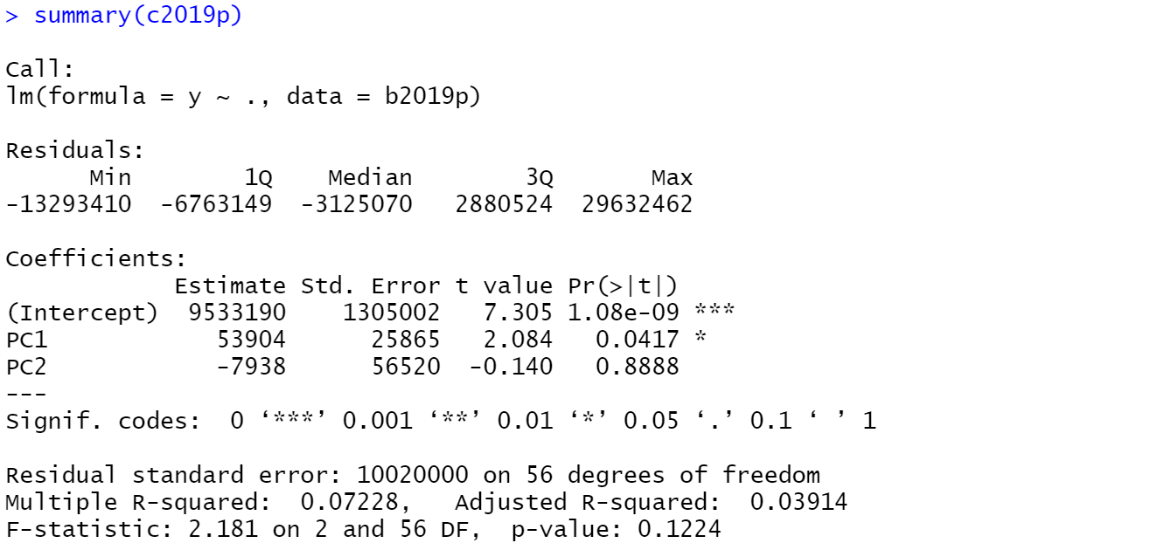
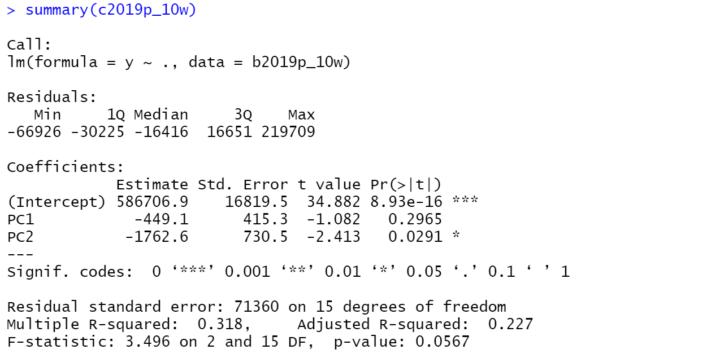
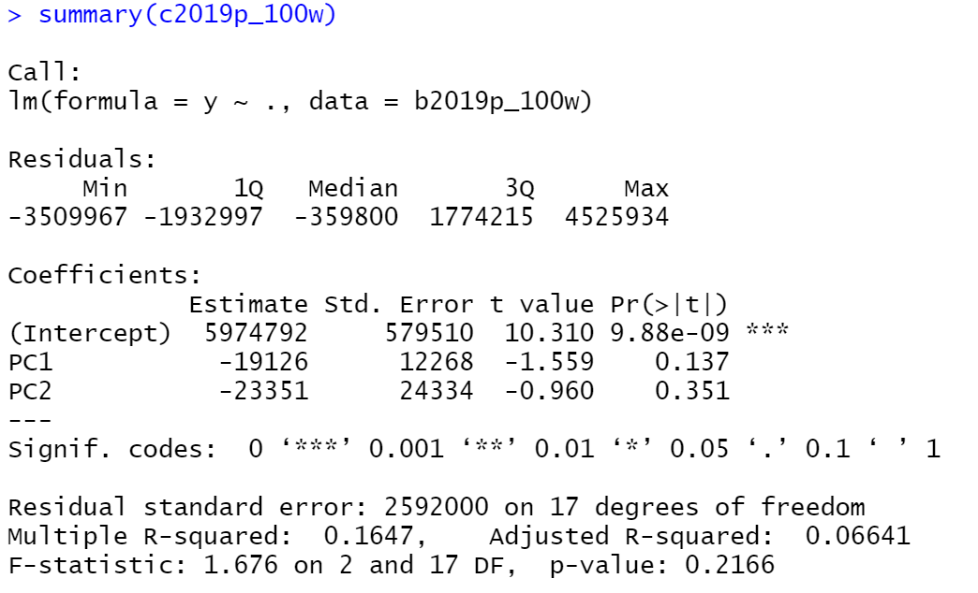
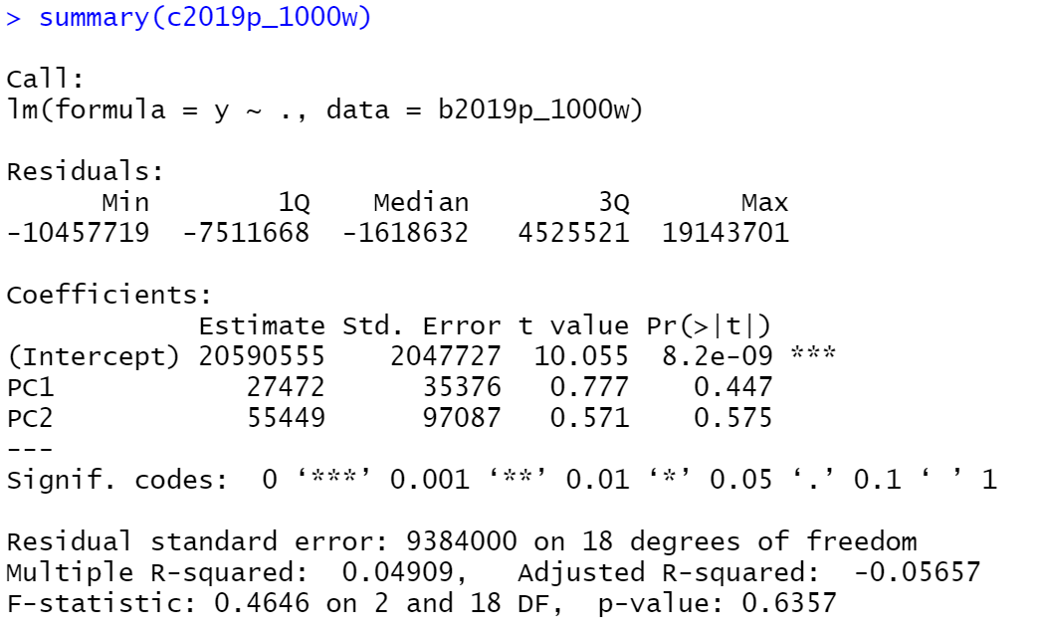
我們試過了…
We tried to…
1.改變變數
2.數據歸一化、標準化
3.用PC跑回歸

Slide 69
結論
Conclusion
結果…
數據解釋能力都不強

Slide 70
結論
Conclusion
我們認為
大聯盟球員薪資與表現關係不大，反而是年紀與其他無法量化的資料如聲望、名聲、人脈等關係有關

Slide 71

Q&A

