Slide 1
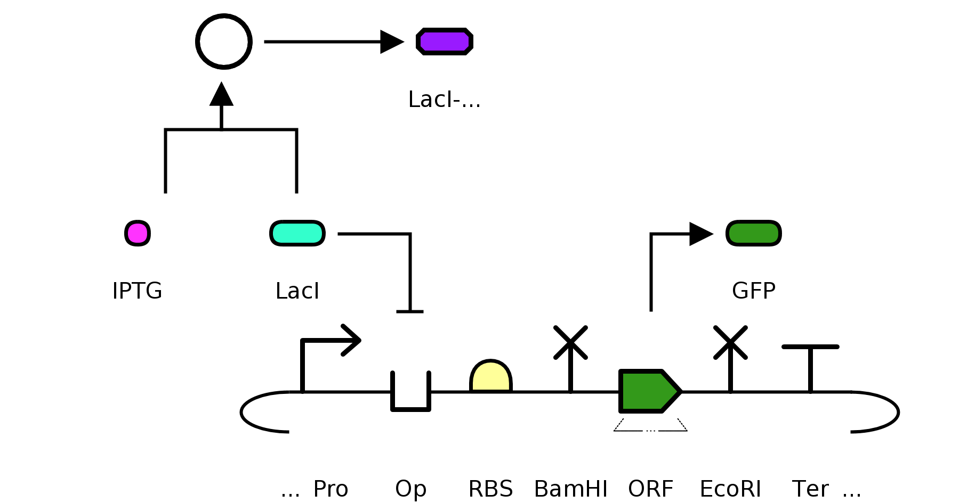
IPTG reporter
LacI produced by cell from lacI gene in lac operon in the E. coli bacterial chromosome.

Slide 2
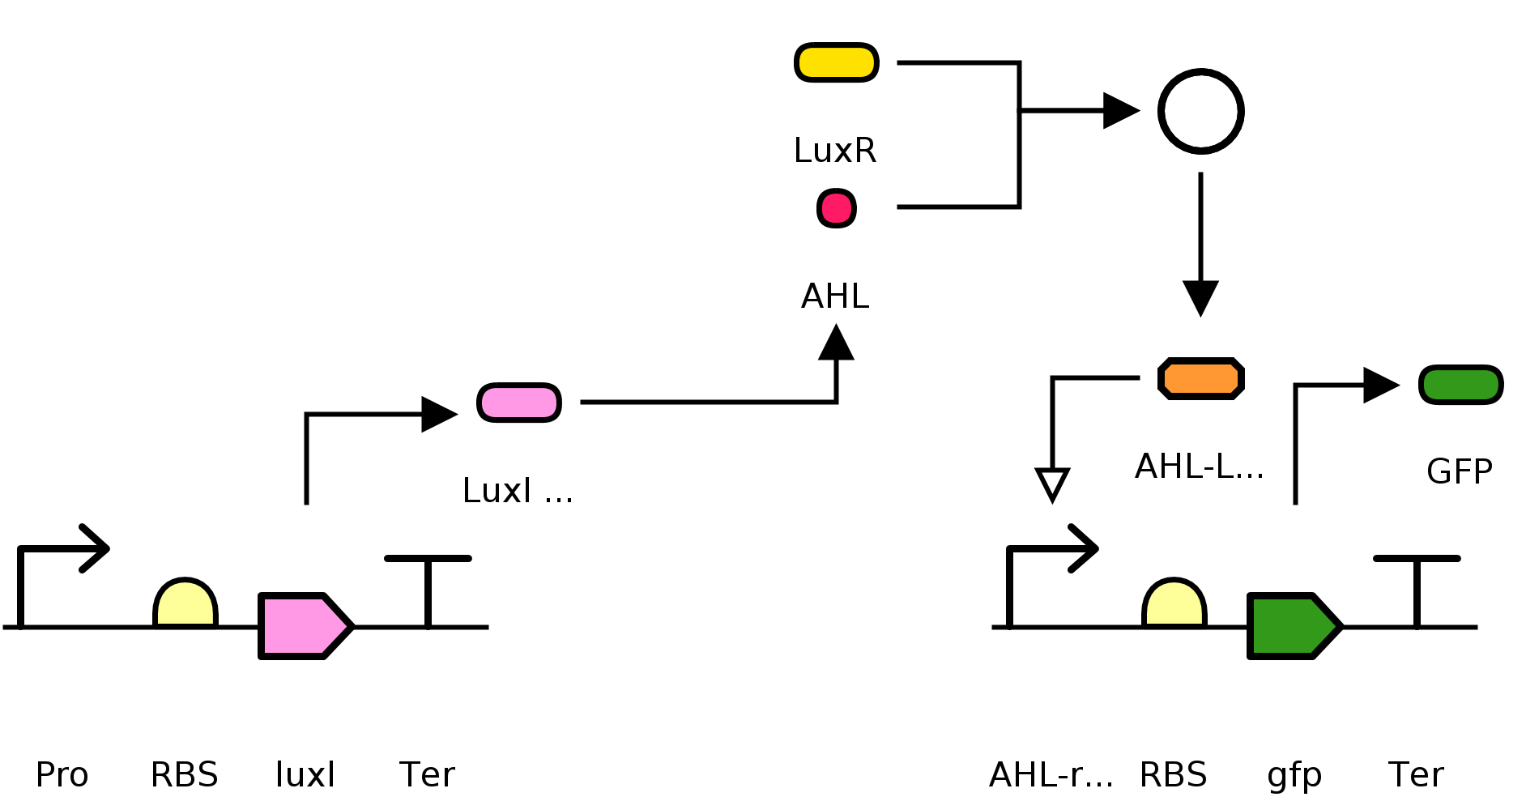
AHL sender and receiver
Sender
Receiver

Slide 3
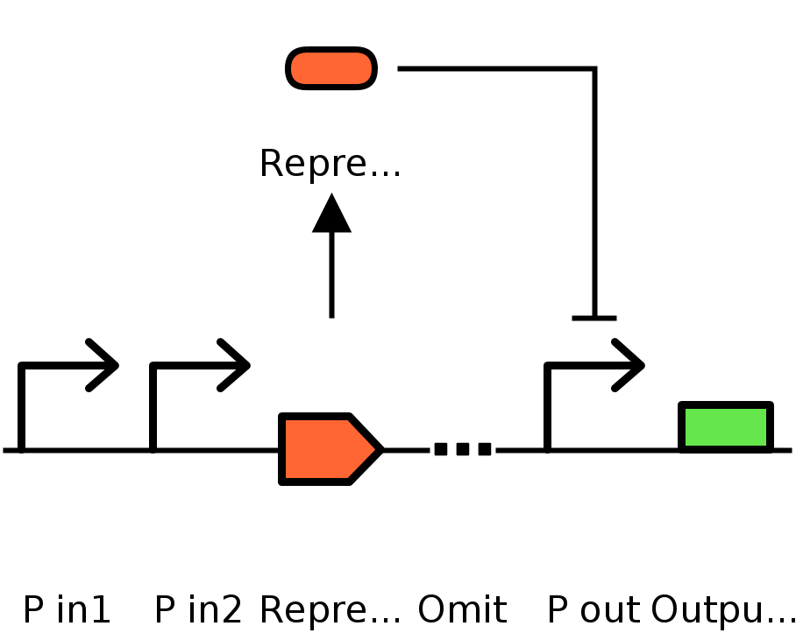
NOR gate

Slide 4
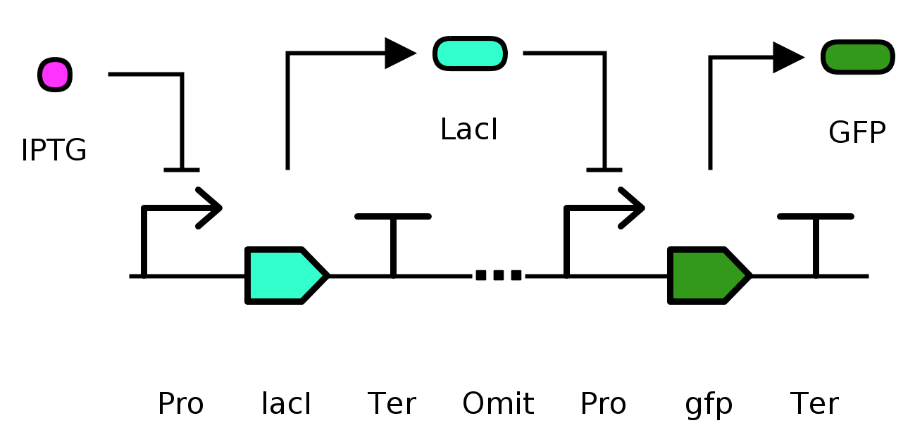
Inverter

Slide 5
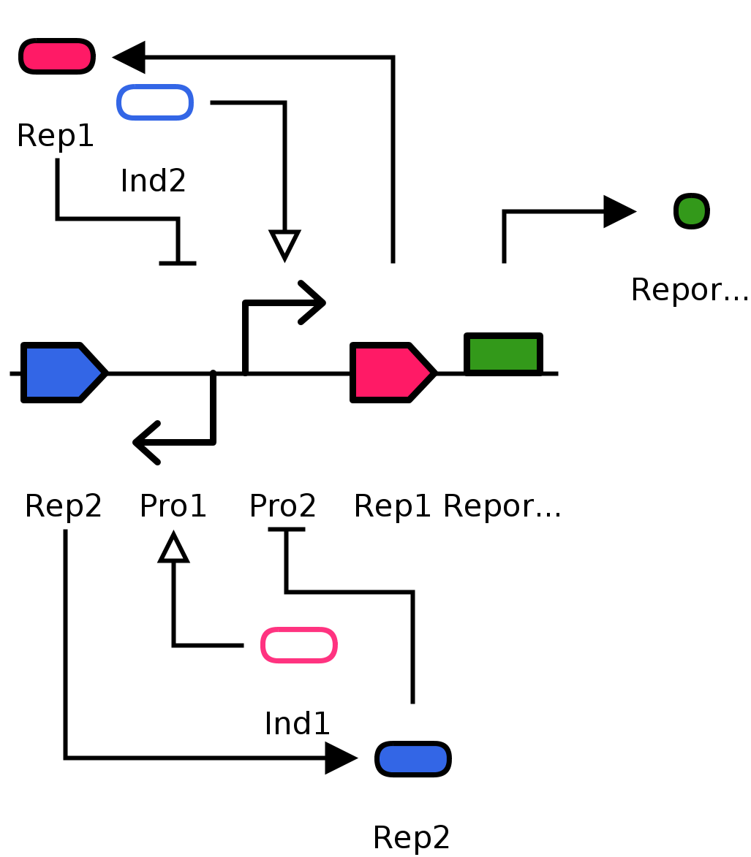
Toggle switch

Slide 6
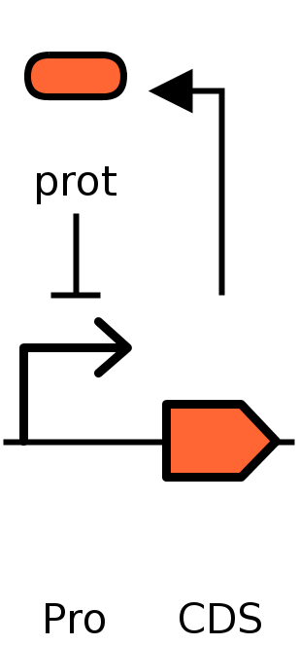
Negative autoregulation

Slide 7
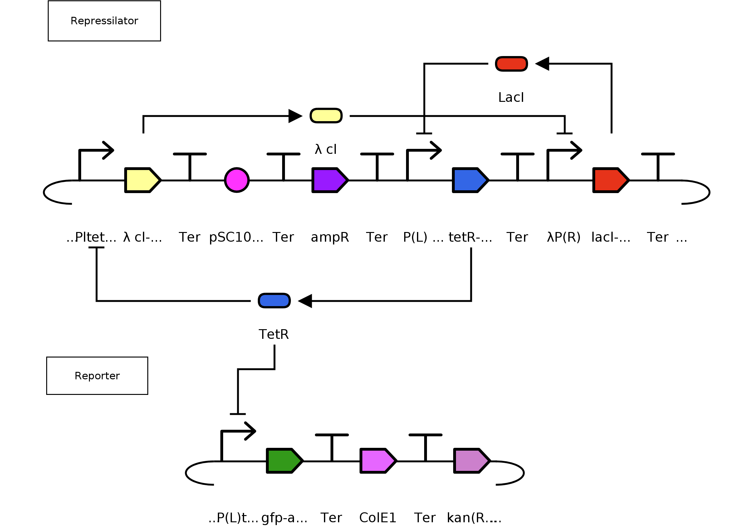
Repressilator

