Slide 1
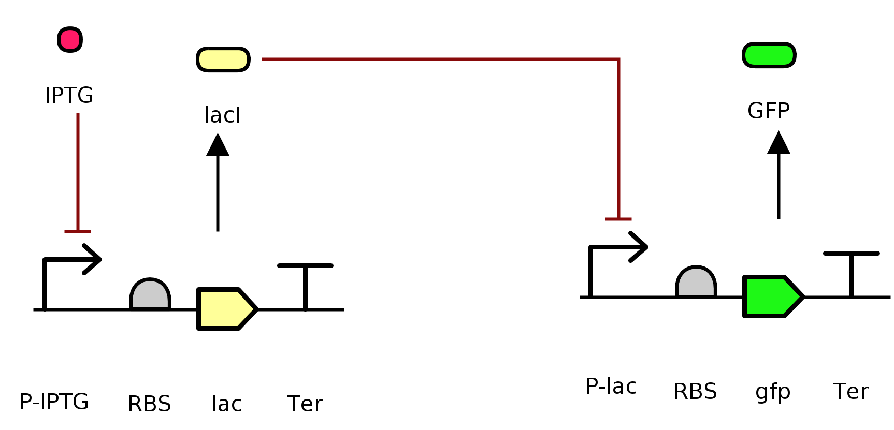
IPTG reporter (extended)
LacI
gfp
lac
Note: IPTG is a chemical input.
Notes:
Iptg reporter?

Slide 2
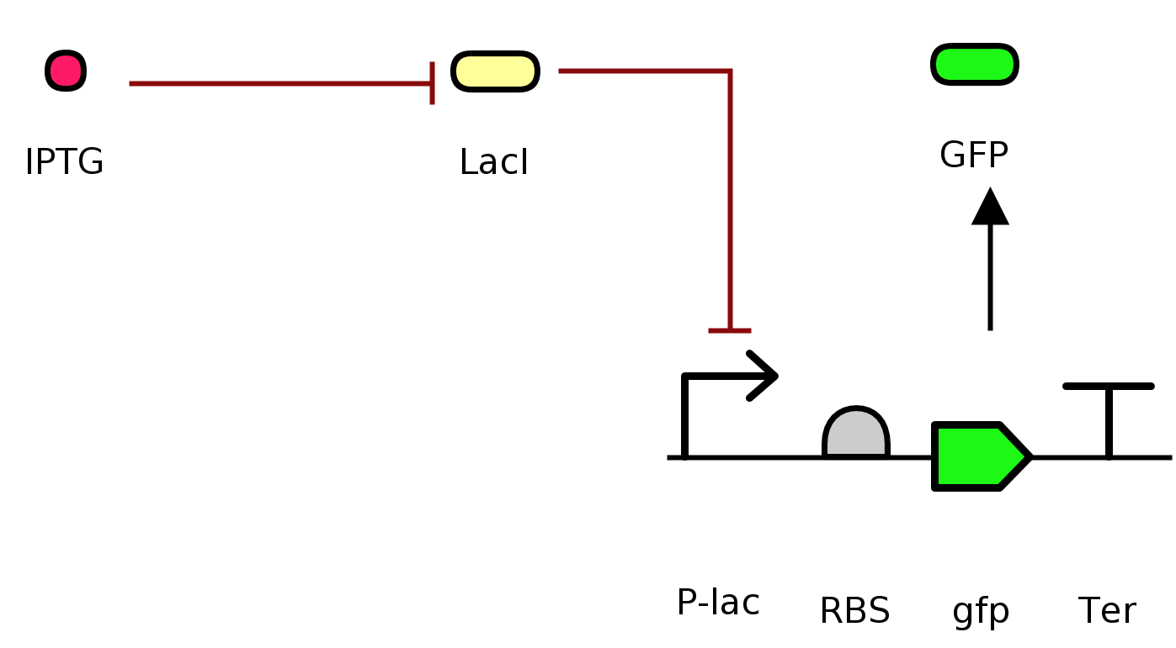
IPTG reporter
gfp
Note: LacI is supplied by the host cell; IPTG is a chemical input.

Slide 3
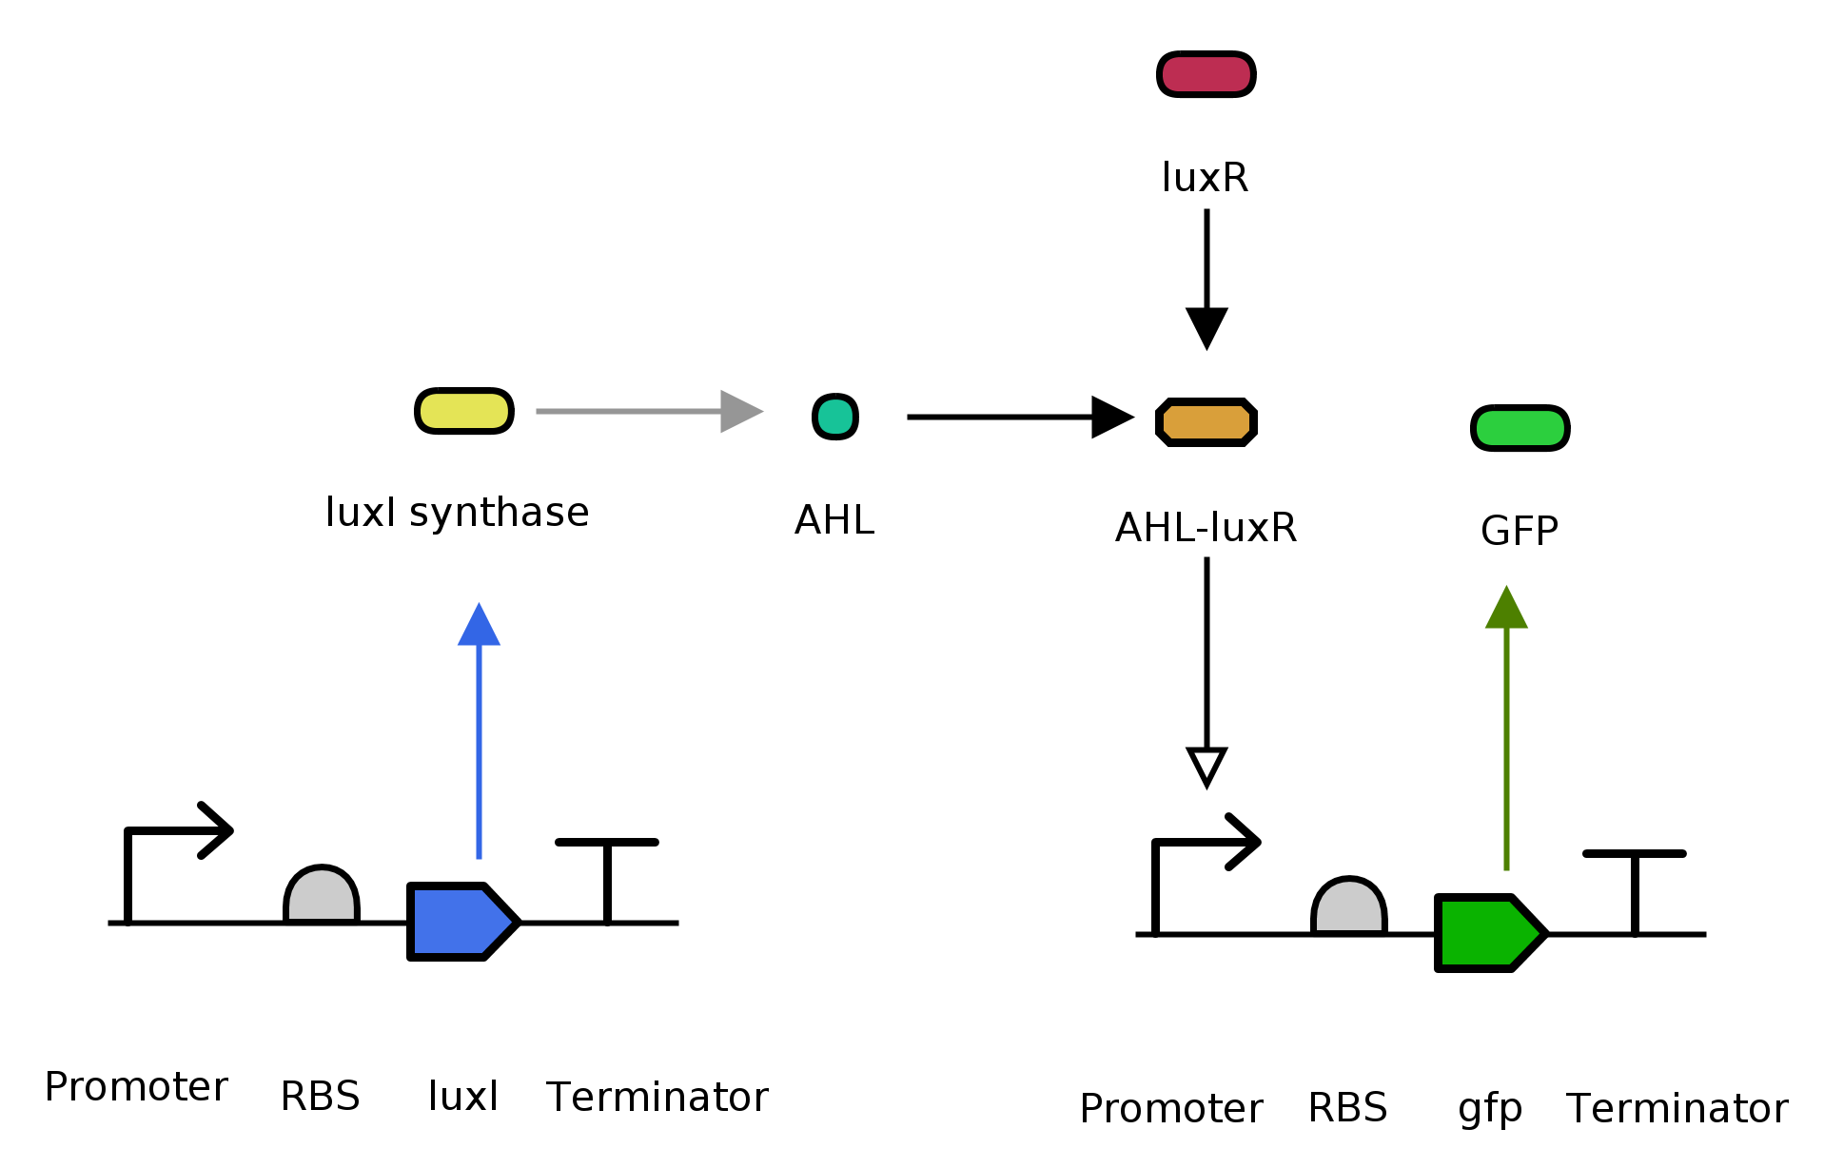
Receiver cell
Transcription →
LuxR
Sender cell
LuxI
luxI
gfp
Notes:
Sender/receiver

Slide 4
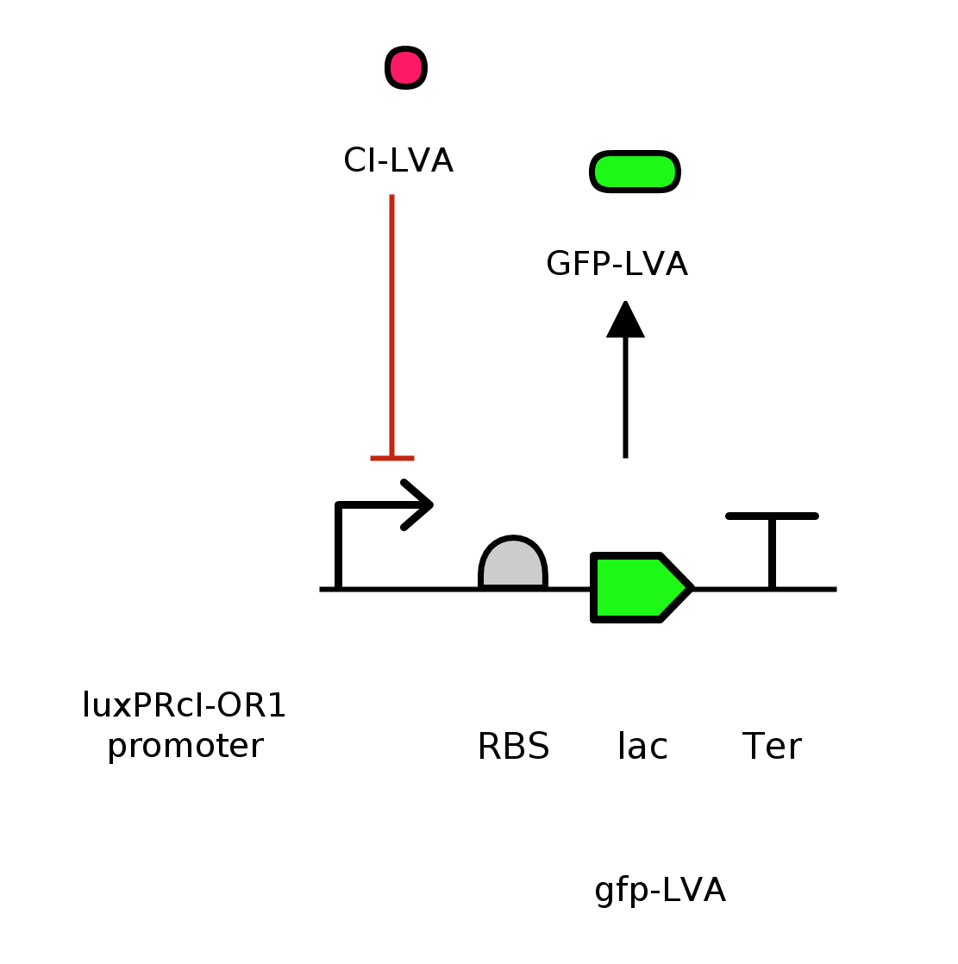
Inverter
luxPRcI-OR1 promoter
gfp-LVA
Note: CI-LVA protein is supplied upstream from within the host.

Slide 5
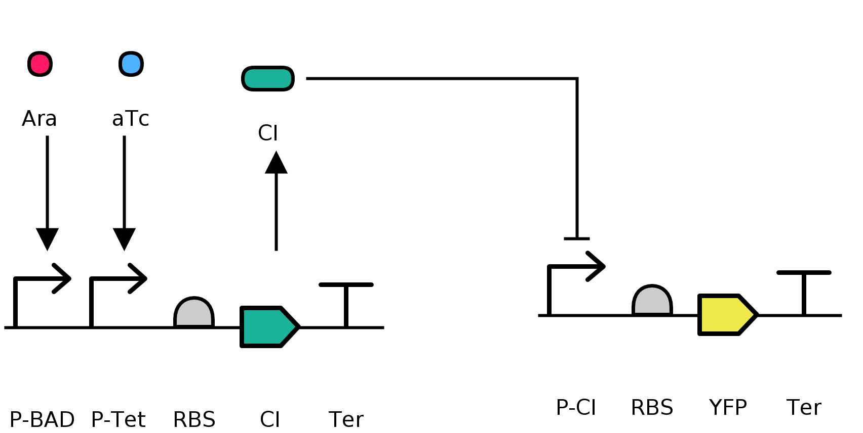
NOR gate
Host cell
Gate plasmid
Reporter plasmid
Notes:
NOTE: Ara and aTc are external outputs

Slide 6
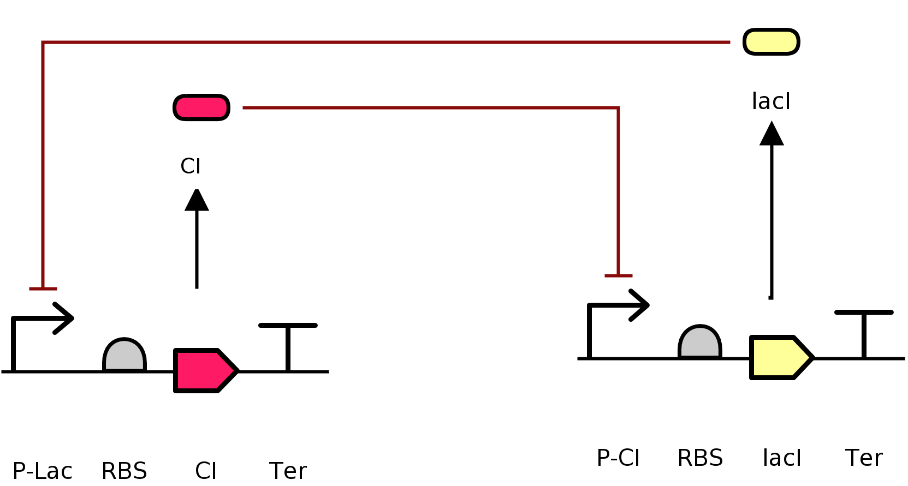
Toggle switch
lac
CI
Note: adding IPTG would inhibit LacI, causing the cell to flood with CI protein.

Slide 7
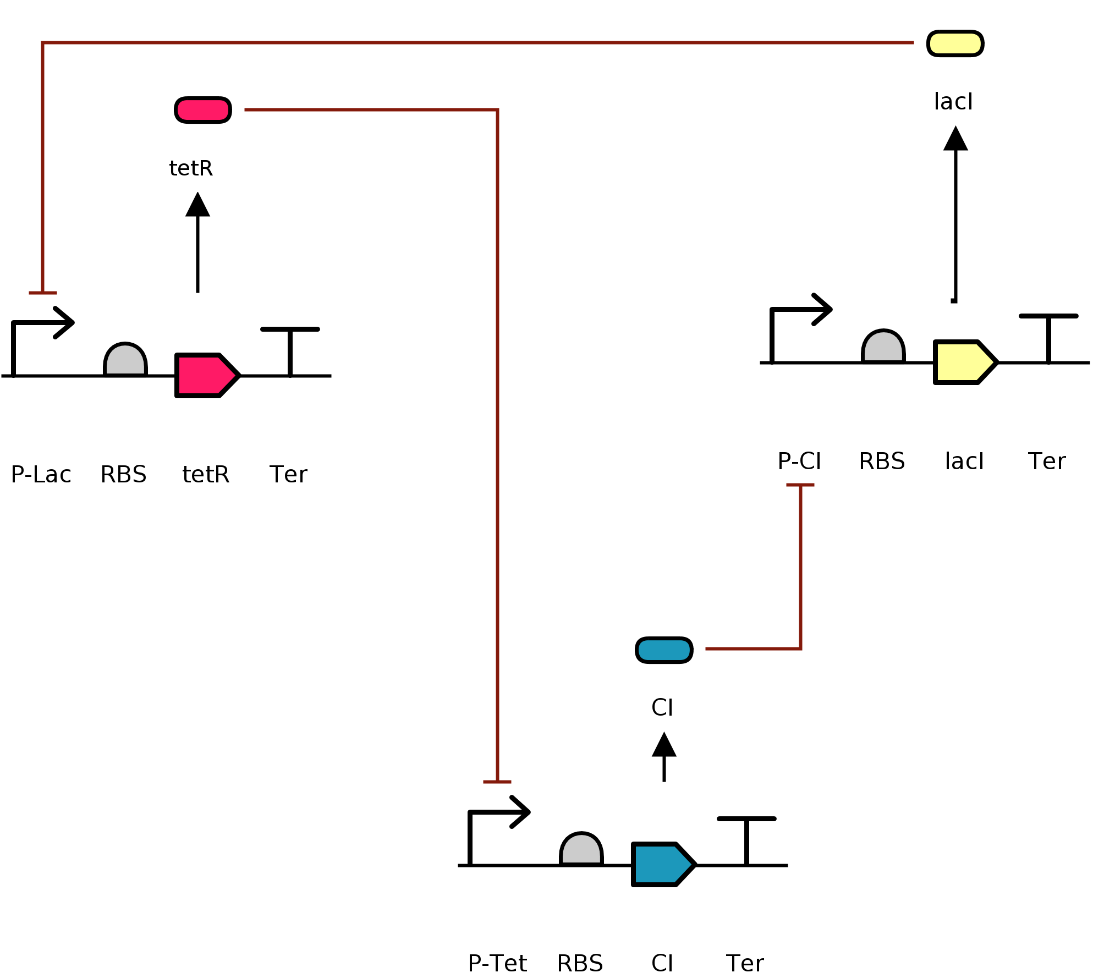
LacI
TetR
TetR
tetR
lac
Repressilator
CI

Slide 8
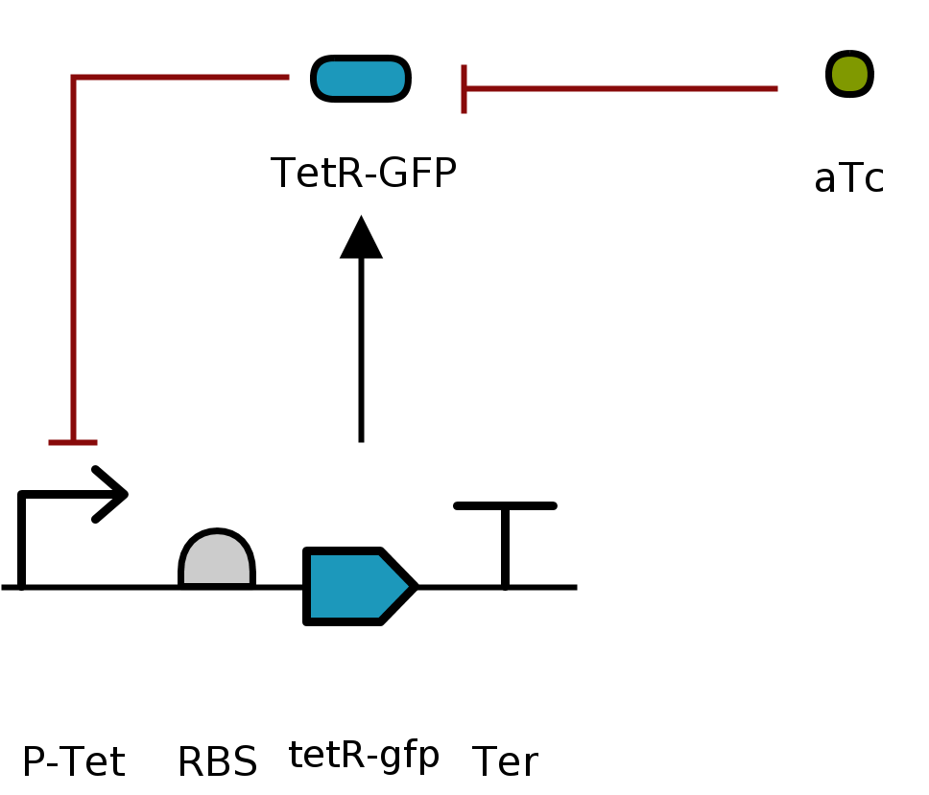
Autoregulation
tetR-gfp
Note: aTc is external input.

