Slide 1
Predicting The Rank of Women’s Tennis Players Based on Their Serve
A Machine Learning Case Study

Slide 2
Introduction
Tennis is a well watched sport
People enjoy predicting rankings
Rankings are predicted over 52 weeks
Can we predict the rankings based on serve statistics in women's tennis??

Slide 3



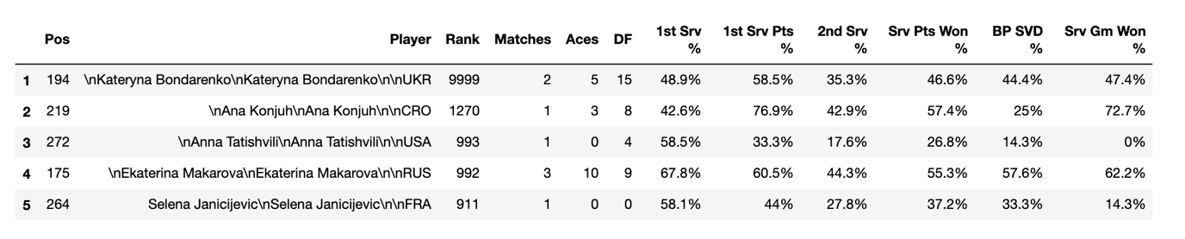
Data
Data collected from WTA website

Slide 4
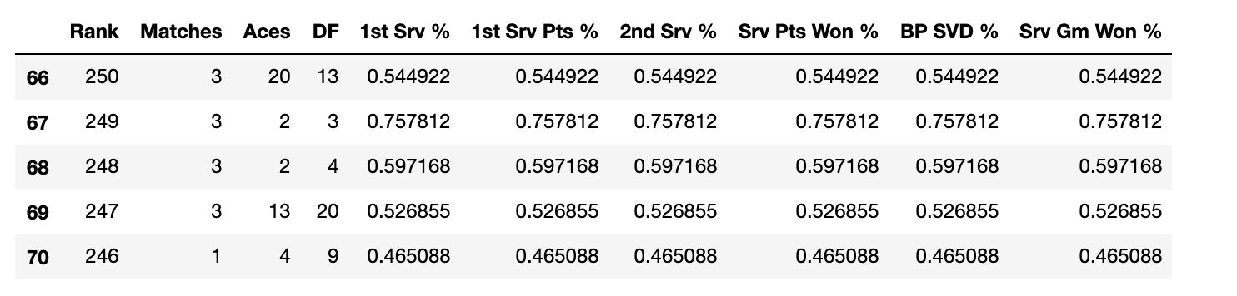
Data Cleaned
Player name and position removed
Ranks above 250 removed
Percentages turned into decimals

Slide 5
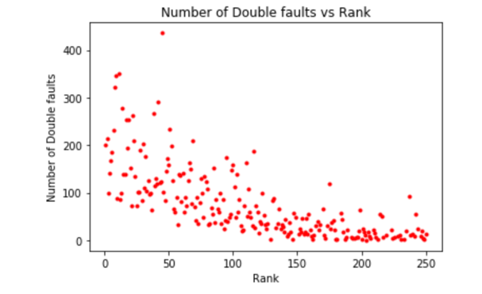
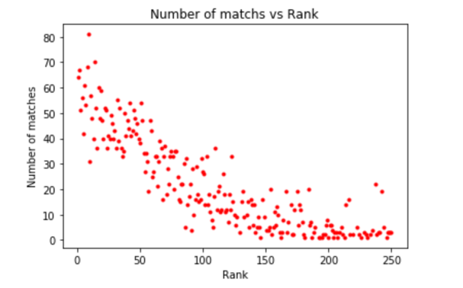
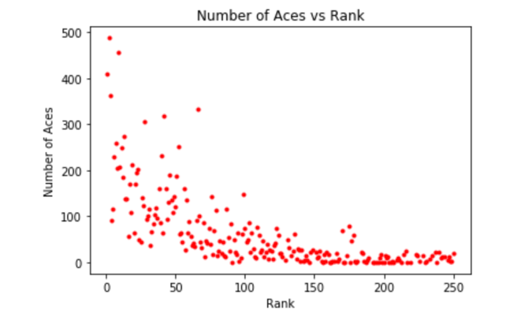
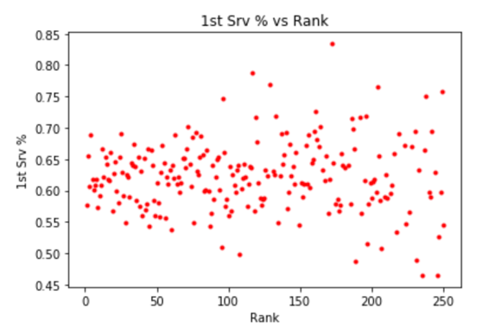
Exploratory Data Analysis
Look at 2D plots to see if there were any relationships between rank and our features

Slide 6
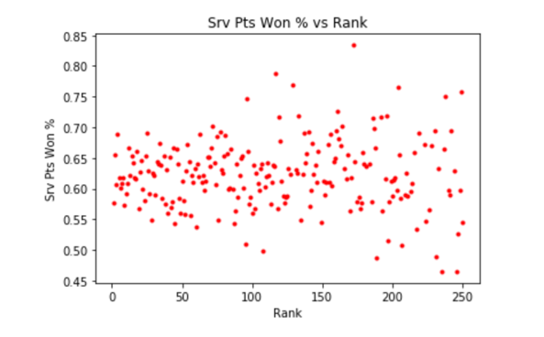
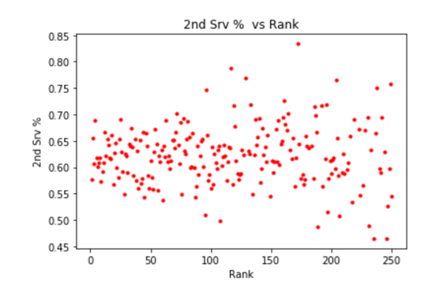

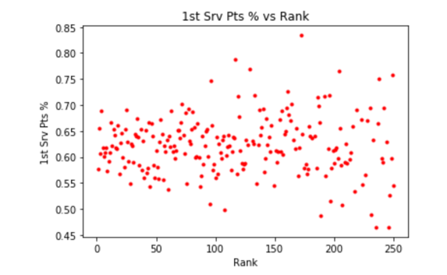
Exploratory Data Analysis
We saw a squared relationship between rank, matches, Aces and double faults
There doesn’t seem to be a relationship between serve percentages and rank

Slide 7
Machine Learning
A multiple linear regression was chosen for modelling
5 models were testing with different input feature sets

Slide 8
Results
Results show model 5 was the best, however was sub optimal
Model | Input Features | Variance | Residual sum of squares
1 | Matches, Aces, DF, 1st Srv %, 1st Srv Pts %, 2nd Srv %, Srv Pts Won %, BP SVD %, Srv Gm Won % | 0.67 | 1649.47
2 | Matches, Aces, DF | 0.68 | 1607.82
3 | 1st Srv %, 1st Srv Pts %, 2nd Srv %, Srv Pts Won %, BP SVD %, Srv Gm Won % | -0.01 | 4724.81
4 | Aces, DF | 0.49 | 2377.77
5 | Matches, DF | 0.73 | 1282.87

Slide 9
Discussion
Service stats based on 1st serve and second serve did not help the modelling
Aces, number of matches and double faults improved the modelling
Optimal model was produced using only aces and double faults.
Future models should include more parameters from the wider game such as return statistics, unforced errors and winners

Slide 10
Thanks for your time

