Slide 1
Data-Driven Retail Analytics: Digital Music Store Optimization using SQL
Ededge Groups Industry Engagement Program (EGIEP) Capstone Project
Yuanyuan Wei (COCO)
Frameworks Used: MySQL, Microsoft Excel, Microsoft PowerPoint
Notes:
Hi everyone, my name is yuanyuan, you can call me coco. Today, I am excited to present my SQL business analytics project for a global digital music store as part of the Ededge Groups Industry engagement program. Let’s dive right into our core business volume and transaction metrics.

Slide 2
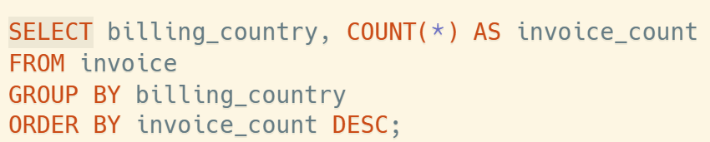
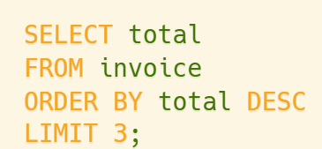
Global Sales Volume & High-Value Transactions
Global Sales Volume & Transaction Trends
The Main List Block
Market Leader: The United States is our largest active market hub, leading with 131 total invoices.
Secondary Density: Canada tracks right behind in second place with 76 invoices, followed closely by Brazil with 61 invoices.
Business Insight: Core customer acquisition is strongly concentrated across North and South American regions
The Metric Highlight Cards
Card 1: $23.76 (1st Peak Order Milestone)
Card 2: $19.80 (2nd Peak Order Milestone)
Card 3: $19.80 (3rd Peak Order Milestone)
Notes:
Starting with our macroeconomic market overview on Slide 2. By leveraging our grouping logic across the transactional database, our query reveals that the United States is our primary market hub, leading with ninety-one invoices. Canada and Brazil fill out the subsequent tiers. Looking specifically at high-value milestones in Task 3, our data isolates our peak single-order purchase maximum hitting twenty-three dollars and seventy-six cents, showing strong commercial performance limits.

Slide 3
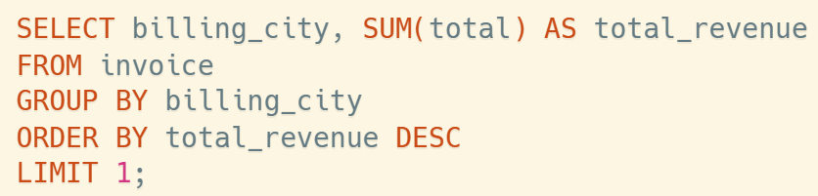
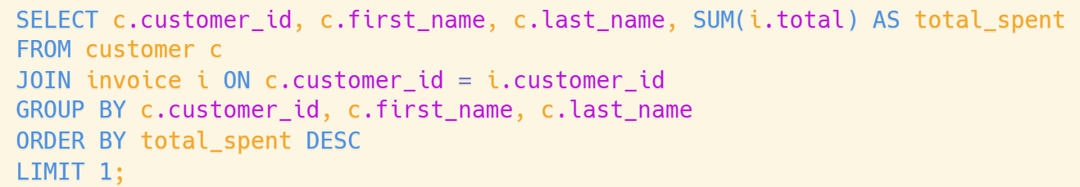
Top Revenue Markets & High-Value Customer Profiling
Top Revenue Cities & High-Value Customers
Key Insights
Featured Market
Prague stands out as our absolute highest revenue-generating city globally.
VIP Customer Profile
František Wichterlová
Total Gross Revenue $273.24
Total Customer Spend $144.54
Business Significance
Prague represents our highest-density transactional capital, making it a priority target for upcoming localized marketing spending.
Business Significance:
This user demonstrates elite customer lifetime value (CLV) and serves as the primary persona for luxury tier loyalty programs.
Notes:
Next, we isolated geographic revenue and individual customer lifetime value. As seen in the visual layout, our query isolated Prague as the undisputed highest revenue-generating city across our global platform, bringing in a total of two hundred and seventy-three dollars and twenty-four cents in gross sales. Additionally, we identified our top customer profile, František Wichterlová, who has contributed one hundred and forty-four dollars and fifty-four cents individually. This gives us clear target zones for high-value loyalty marketing

Slide 4
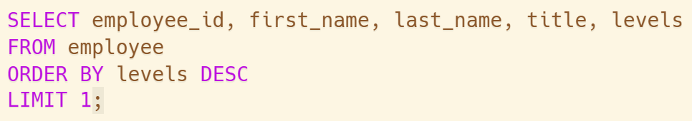
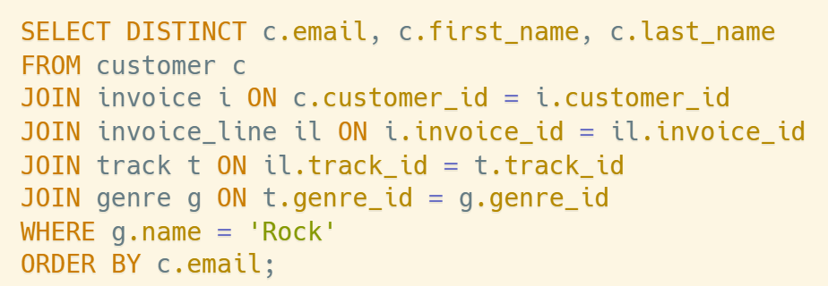
Target Audience Segmentation
Corporate Hierarchy & Target Demographics
Senior Executive
Andrew Adams holds the senior-most tier within the organization as General Manager (Level L6).
Technical Milestone
Deployed an advanced 5-table relational JOIN linking customer accounts directly to itemized content genres.
Audience Cohort
Successfully extracted a clean, segmented list of active Rock Music Listeners and their contact emails.
Business Insight
Creates automated, high-accuracy customer segments for promotional blasts, preventing advertising budget waste.
Notes:
Moving on to internal operations and audience segmentation. Our first query quickly mapped our internal staff hierarchy to find that Andrew Adams holds the senior-most tier within the organization as General Manager. Shifting to customer content demographics, I deployed a five-table relational JOIN to link user profiles directly to active genres. This successfully extracted a clean, automated database of active Rock music listeners, allowing us to deploy hyper-targeted promotional campaigns without wasting marketing capital on disinterested demographics.

Slide 5
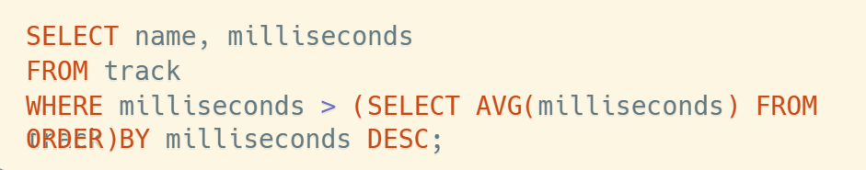
Content Duration Benchmarking
Identifying Long-Form Audio Outliers Against Dataset Averages
Platform Average
# | Track Name | Duration (Miliseconds)
1 | How Many More Times | 711,836 ms
2 | Advance Romance | 677,694 ms
3 | Sleeping Village | 644,571 ms
4 | You Shook Me (2) | 619,467 ms
5 | Talkin ‘’ Bout Women Obviously | 589,531 ms
Calculated dynamically via Subquery
393,599 ms
Average track length across dataset
Core Metric
Calculated dynamically via an advanced SQL inline subquery
Visual Trend
Outlying long-form tracks heavily dominate our active classic rock catalog
Notes:
For our track duration evaluation on Slide 5, I implemented an inline SQL subquery to dynamically calculate our platform's average song length, which settles at roughly six and a half minutes. As mapped out in our orange data chart, iconic long-form tracks like Led Zeppelin's 'How Many More Times' heavily exceed this baseline. This proves a high concentration of long-form progressive audio content within our catalog.

Slide 6
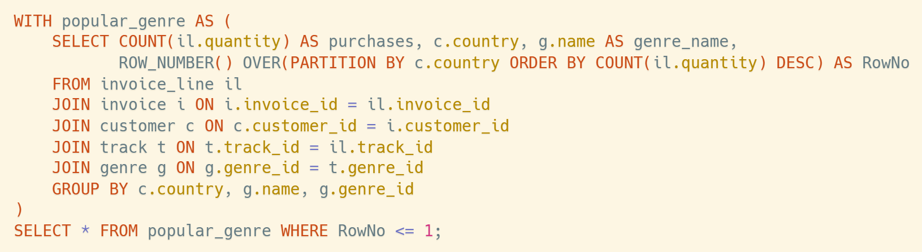
Global Genre Popularity Metrics
Analyzing Regional Consumer Affinities for Target Content Licensing
Technical Architecture
Employs an advanced SQL Window Function (ROW_NUMBER() OVER) nested inside a Common Table Expression (CTE).
Core Finding
Rock Music is verified as the undisputed #1 dominant music genre across nearly every international boun
dary.
Business Insight
Relational data proves that Rock music serves as our primary global consumer acquisition funnel.
Strategic Recommendation
Content licensing and procurement budgets should prioritize premium Rock music catalogs to maximize international user growth.
Notes:
On Slide 6, we tackle our most complex structural query. By nesting an SQL Window Function inside a Common Table Expression, we evaluated consumer genre affinities across international borders. As visualized in our global customer distribution chart, Rock music ranks as the undisputed number-one genre globally. Relational tracking verifies that Rock music serves as our primary global consumer acquisition funnel, meaning content licensing budgets should heavily prioritize premium rock catalogs.

Slide 7
Strategic Business Summary
Executive Recommendations
01
Geographic Reallocation
Shift 15% of broader digital marketing capital toward hyper-local advertisements inside high-yield markets like Prague.
02
Loyalty Infrastructure
Launch exclusive VIP early access perks and personalized rewards structures for top-tier spenders (modeled after profiles like František).
03
Content Curation
Expand long-form classical and rock music tracks to sustain long session streaming engagement from core platform user cohorts.
Sources: Dataset provided by Ededge
Notes:
To conclude, I have three strategic recommendations for the executive team. First, reallocate 15% of marketing capital toward hyper-local ads in Prague. Second, launch an exclusive VIP Tier Program to maximize retention among high-value spenders like František. And finally, expand our long-form rock music track licensing to sustain our core platform engagement. Thank you so much for your time!

