Slide 1
Intro to reverse Engineering
push %ebp // 0x55
mov %esp,%ebp // 0x89 0xe5
sub $0x14,%esp // 0x83 0xec 0x14
movl $0x1,0xfffffff8(%ebp) // 0xc7 0x45 0xf8 0x01 0x00 0x00 0x00
movl $0x7a68,0xfffffff4(%ebp) // 0xc7 0x45 0xf4 0x68 0x7a 0x00 0x00
cmpl $0xa,0xfffffff8(%ebp) // 0x83 0x7d 0xf8 0x0a
jne 0x80484d0 <main+32> // 0x75 0x06
jmp 0x8048570 <main+192> // 0xe9 0xa1 0x00 0x00 0x00
nop // 0x90
add $0xfffffff4,%esp // 0x83 0xc4 0xf4
push $0x8048600 // 0x68 0x00 0x86 0x04 0x08
call 0x80483b0 <printf> // 0xe8 0xd3 0xfe 0xff 0xff
add $0x10,%esp // 0x83 0xc4 0x10
add $0xfffffffc,%esp // 0x83 0xc4 0xfc
mov 0x8049768,%eax // 0xa1 0x68 0x97 0x04 0x08
push %eax // 0x50
push $0x8 // 0x6a 0x08
lea 0xffffffec(%ebp),%eax // 0x8d 0x45 0xec
push %eax // 0x50
call 0x8048380 <fgets> // 0xe8 0x8c 0xfe 0xff 0xff
Michael Edie
@c0demech

Slide 2







user@host$ Whoami
Slackware64 User (xfce4 + kwin + plank)
Admin @ smashthestack.org
Computer Science Major
Husband & Father
Motorcycle rider
Cryptocoin miner

Slide 3
outline
CPU Architecture Review (x86)
- Registers (ebp, eip, esp, eax)
- Instruction set (CISC)
Memory Management
- Process address space
- Stack
- Heap
Assembly Programming (Intel)
Tools
- Disassembler vs Debugger
- Static analysis vs Dynamic analysis
- GDB, GDB/PEDA, objdump, strings, binwalk, xxd, nm
- Radare2, IDA Pro, Ollydbg, binaryninja
References

Slide 4
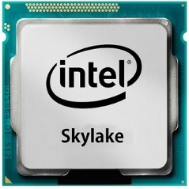
CPU architecture review
: General Purpose Registers (eip, esp, ebp, eax, ebx, ecx, edx, esi)
EIP – extended instruction pointer
ESP – extended stack pointer
EAX (used to store function return value / accumulator)
EBP (base pointer for stack frame)
: x86 derives from 8086, 80286, 80386, etc
: registers are temporary storage locations for instructions or data
: bit (0), byte (00), word (0000), dword (0000 0000)
: endian big vs little (0x12345678 >> 0x78563412)

Slide 5
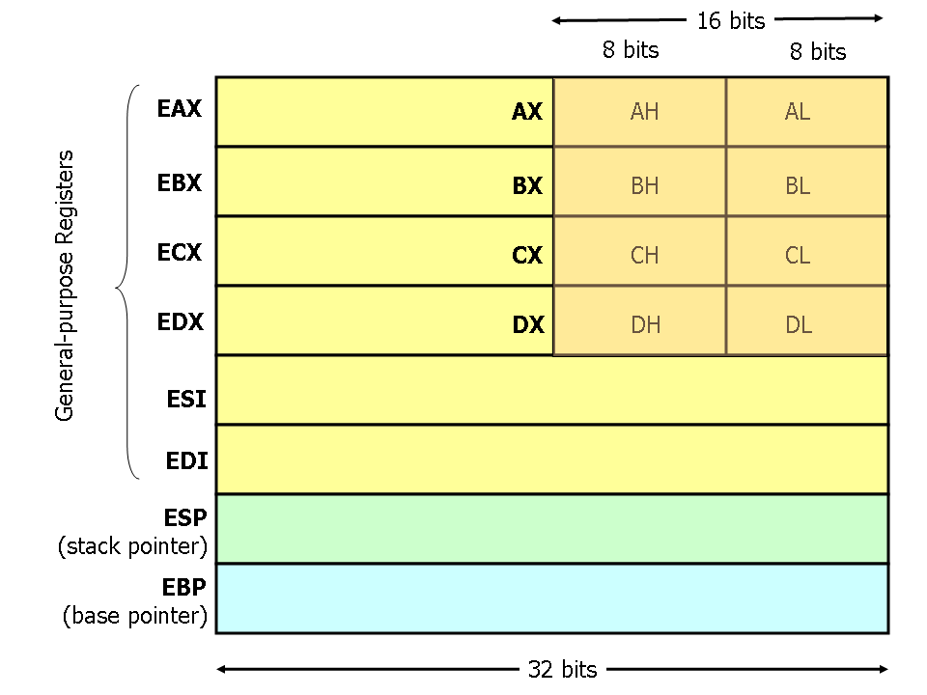
CPU architecture review

Slide 6
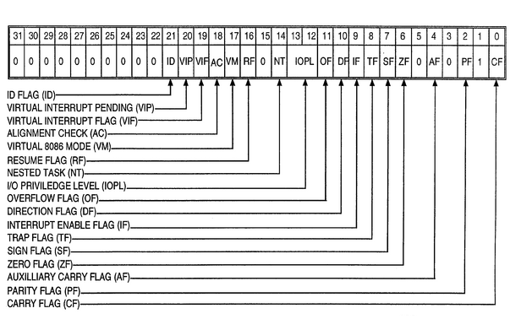
CPU architecture review
EFLAGS Register

Slide 7
CPU architecture review
: Complex Instruction Set Computer (CISC)
- The language that the CPU (Central Processing Unit) speaks // abstraction for x86
- The primary goal of CISC architecture is to complete a task in as few lines of assembly as possible.
- OPCODE / Operand
- Immediate Value
- Addressing: offset, indirect, direct, register
mnemonic destination, source
11010001 1101111101111101010110111011110
Every instruction is a bit string

Slide 8
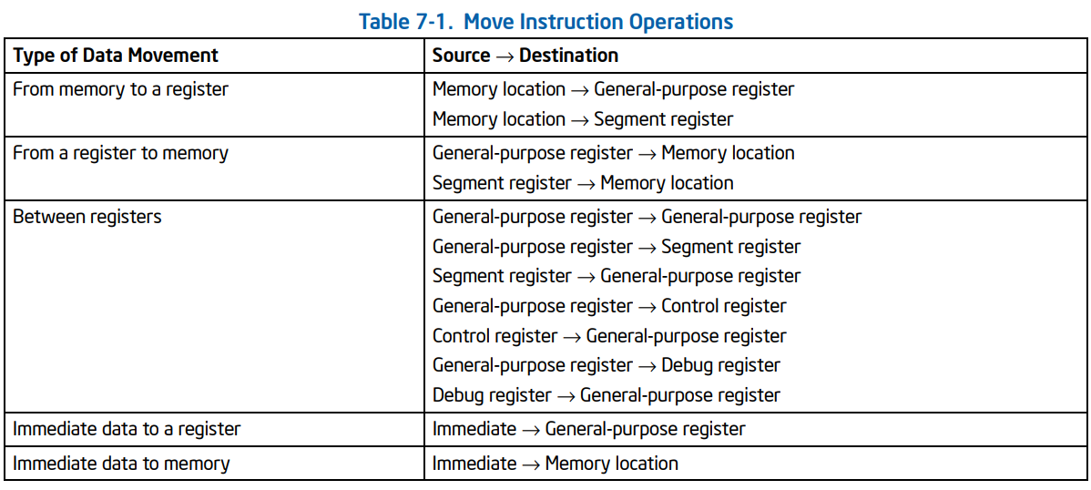
CPU architecture review
: MOV - The MOV instruction performs basic load data and store data operations between memory and the processor’s
registers and data movement operations between registers.

Slide 9
CPU architecture review
push eax
: PUSH - The PUSH instruction moves data to and from the stack.

Slide 10
CPU architecture review
pop eax
: POP - Loads the value from the top of the stack to the location specified with the
destination operand (or explicit opcode) and then increments the stack pointer.

Slide 11
CPU architecture review
nop
: NOP - This instruction performs no operation.
Note: The one-byte NOP instruction is an alias mnemonic for the XCHG (E)AX, (E)AX instruction.

Slide 12
CPU architecture review
add esp, 0x6
: ADD - adds the destination operand (first operand) and the source operand
(second operand) and then stores the result in the destination operand.

Slide 13
CPU architecture review
sub esp, 0x8
: SUB - subtracts the second operand (source operand) from the first operand (destination operand) and stores the result in the destination operand.

Slide 14
CPU architecture review
cmp DWORD PTR [eax+0xc], 0x0
: CMP - Compares the first source operand with the second source operand and sets the status flags in the EFLAGS register according to the results. The comparison is performed by subtracting the second operand from the first operand.

Slide 15
CPU architecture review
0x0000297f <+1359>: mov BYTE PTR [ebx+0x1180], al
jmp 0x297f <main+1359>
: JMP - Transfers program control to a different point in the instruction stream without recording return information. The destination (target) operand specifies the address of the instruction being jumped to.

Slide 16
CPU architecture review
0x0000297f <+1359>: mov BYTE PTR [ebx+0x1180], al
jmp 0x297f <main+1359>
: JMP - Transfers program control to a different point in the instruction stream without recording return information. The destination (target) operand specifies the address of the instruction being jumped to.

Slide 17
CPU architecture review
lea eax, [ebx-0xb68d]
: LEA - (Load effective address) Computes the effective address of the second operand (the source operand) and stores it in the first operand (destination operand).

Slide 18
CPU architecture review
call 0x2030 <getenv@plt>
: CALL - Saves procedure linking information on the stack and branches to the called procedure specified using the target operand.

Slide 19
CPU architecture review
ret
: RET - (Return from procedure) Transfers program control to a return address located on the top of the stack. The address is usually placed on the stack by a CALL instruction, and the return is made to the instruction that follows the CALL instruction.

Slide 20
memory management
: Process address space
- Every process has it’s own virtual memory that is mapped to physical RAM
- A process can address up to 4GB of memory (with a 32-bit address space)
Process space is segmented: Code, Data, Heap, Stack, Arguments and Environments
User space boundary: 0x00000000 to 0xbfffffff

Slide 21
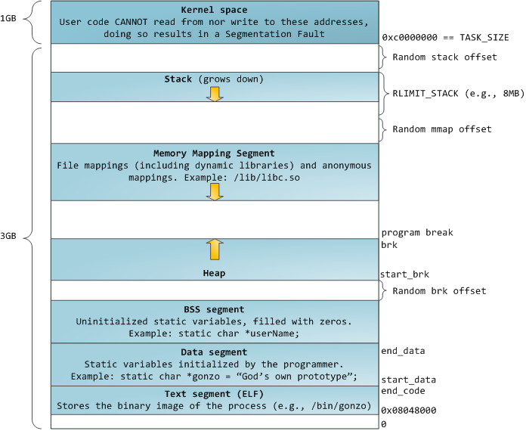
memory management
Process Address Space Layout
( Source: https://manybutfinite.com/post/anatomy-of-a-program-in-memory/ )

Slide 22
Memory management
: The Stack
- LIFO data structure
- Intel’s x86 architecture places its stack "head down"
All x86 architectures use a stack as a temporary storage area in RAM that allows the processor to quickly store and retrieve data in memory. The current top of the stack is pointed to by the esp register. The stack "grows" downward, from high to low memory addresses.
ulimit -s

Slide 23


memory management
High memory addresses
Stack growth
esp (points to top of the stack)
Low memory addresses

Slide 24
memory management
High memory addresses
Stack growth
esp (points to top of the stack)
Low memory addresses

Slide 25
Memory management
: The Heap
- Stored in RAM just like the stack.
- Unordered
- Complex
Heap is a general term used for any memory that is allocated dynamically. The memory is typically allocated by the OS, with the application calling API functions to do this allocation.

Slide 26
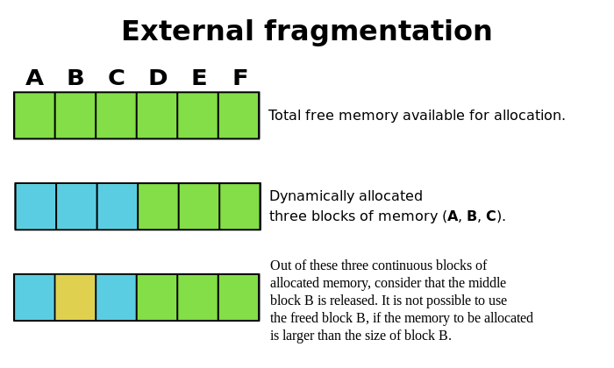
memory management
High memory addresses
Heap growth
Low memory addresses
Heap allocation is not sequential

Slide 27
Assembly programming
x86 Assembly (ASM) is the lowest level of programming abstraction before
the binary sequences known as machine language.
Fundamental for reverse engineering
Disassemblers translates machine code to assembly

Slide 28
Basic asm program
section .data
msg db "Hello, Georgia!",0xa
len equ $ - msg
section .text
global _start
_start:
; sys_write(file, msg, len) write our string to stdout.
mov edx,len ; third argument: message length.
mov ecx,msg ; second argument: pointer to message to write.
mov ebx,1 ; first argument: file handle (stdout).
mov eax,4 ; system call number (sys_write).
int 0x80 ; call kernel (executes function sys_write()).
; exit gracefully - sys_exit(0)
mov ebx,0 ; first syscall argument: exit code.
mov eax,1 ; system call number (sys_exit).
int 0x80 ; call kernel (executes function sys_exit()).

Slide 29
Basic c program
#include <stdlib.h>
int main ()
{
int i=0;
printf(“Hello, Georgia!\n”);
return(i);
}

Slide 30
Decimal | Binary | Hex
0 | 0000 0000 | 0x0
1 | 0000 0001 | 0x1
2 | 0000 0010 | 0x2
3 | 0000 0011 | 0x3
4 | 0000 0100 | 0x4
5 | 0000 0101 | 0x5
6 | 0000 0110 | 0x6
7 | 0000 0111 | 0x7
8 | 0000 1000 | 0x8
9 | 0000 1001 | 0x9
10 | 0000 1010 | 0xA
11 | 0000 1011 | 0xB
12 | 0000 1100 | 0xC
13 | 0000 1101 | 0xD
14 | 0000 1110 | 0xE
15 | 0000 1111 | 0xF
mov eax, 0xb
sub esp, 0x8

Slide 31
tools
Disassembler a software tool which transforms machine code into a human readable mnemonic representation called assembly language.
Debuggers allow the user to view and change the running state of a program.
Decompilers are different from disassemblers in one very important aspect. While both generate human readable text, decompilers generate much higher level text, which is more concise and much easier to read.

Slide 32
tools
Static analysis is the testing and evaluation of an application by examining the code without executing the application.
Dynamic analysis is the testing and evaluation of an application during runtime.

Slide 33
tools
GDB – GNU Debugger
PEDA – Python Exploitation Development Assistance
Strings – Objdump – binwalk – nm – xxd
radare2

Slide 34
Static analysis workshop

Slide 35
Questions ?

Slide 36
references
REMnux: A Linux Toolkit for Reverse-Engineering and Analyzing Malware
https://remnux.org/
X86 OPCODE and Instruction reference
http://ref.x86asm.net/coder32.html
The Intel386 Architecture and the System V ABI
http://www.sco.com/developers/devspecs/abi386-4.pdf
Anatomy of a Program in Memory (Blog)
https://manybutfinite.com/post/anatomy-of-a-program-in-memory/
Linux Assembly Resources
http://linasm.sourceforge.net/docs/instructions/index.php
ELF Binary Disassembly Walkthrough
http://labs.sawbox.net/txt/disastut.txt

