Slide 1
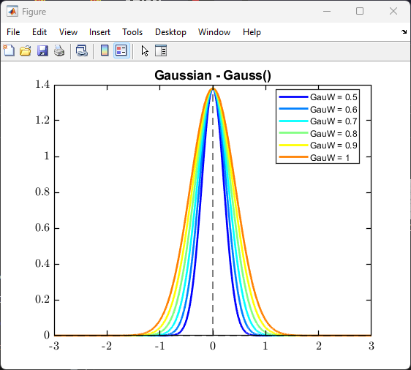
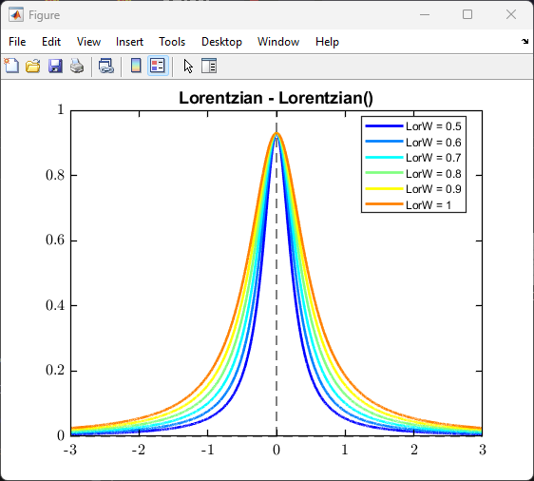
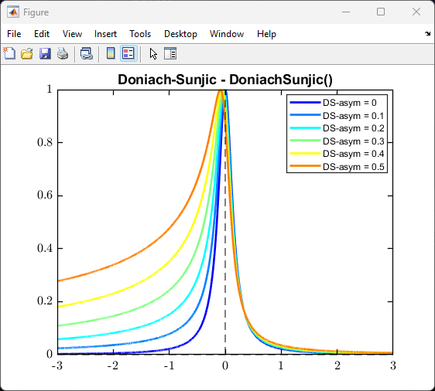
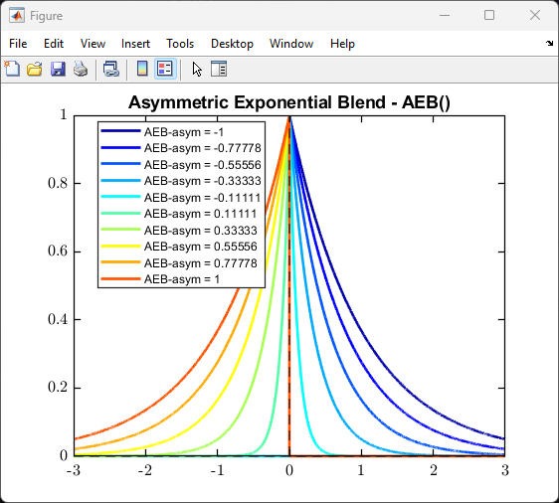
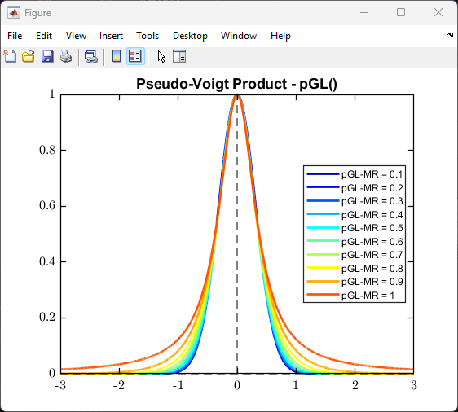
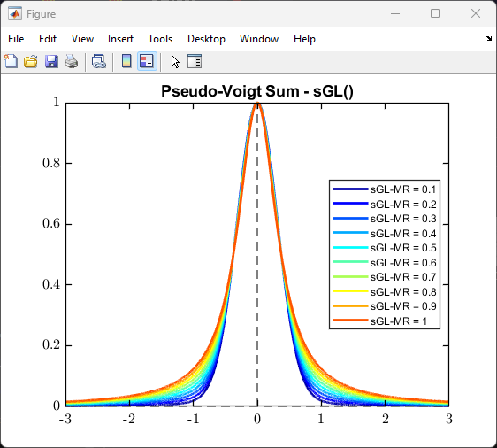
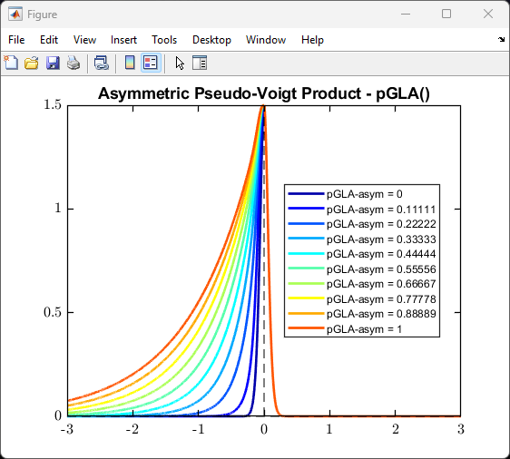
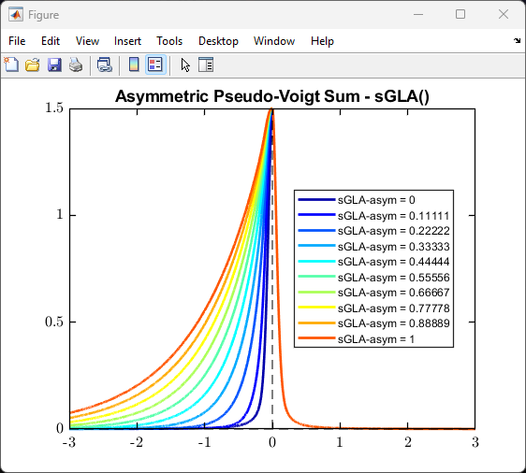
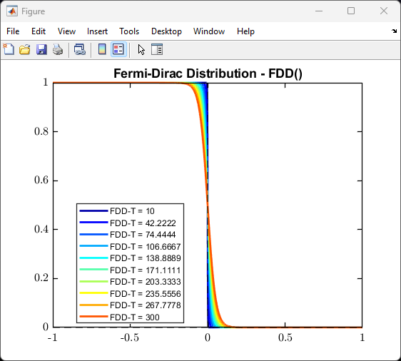
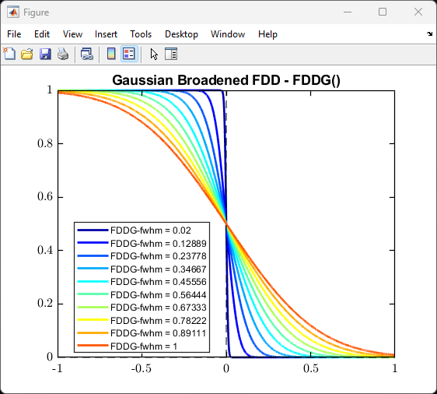
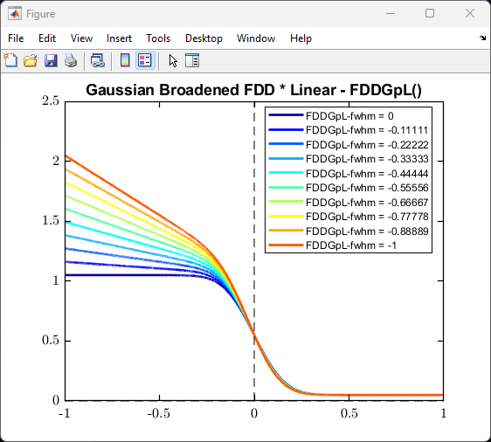
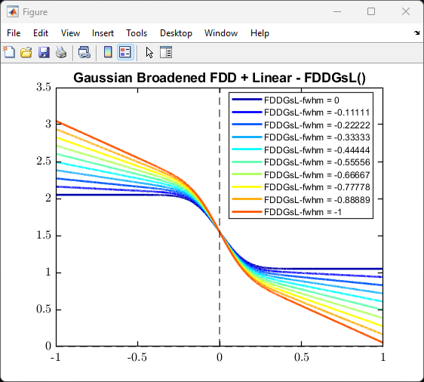
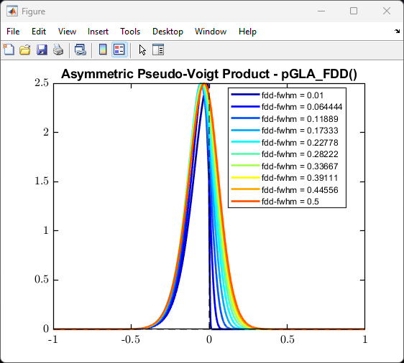
Showcase of the offered fundamental curve shapes

Slide 2
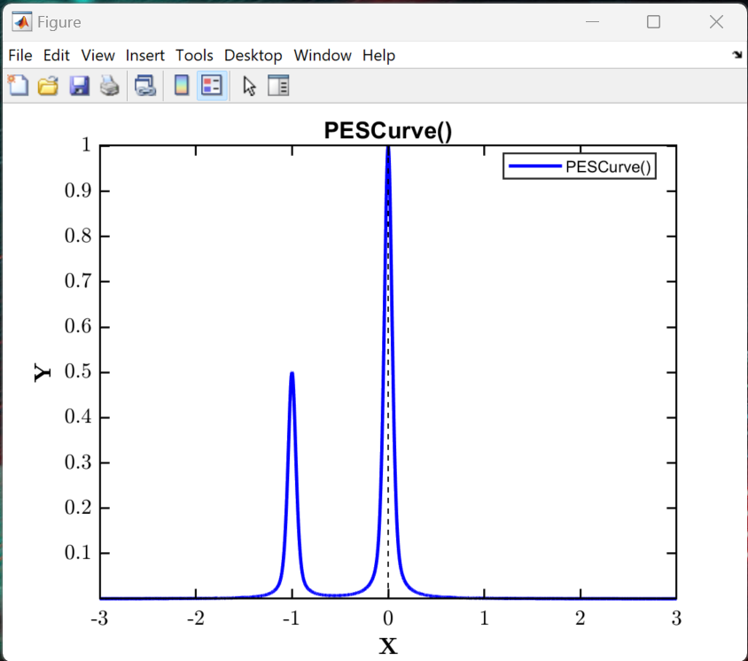
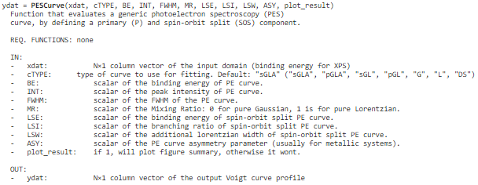
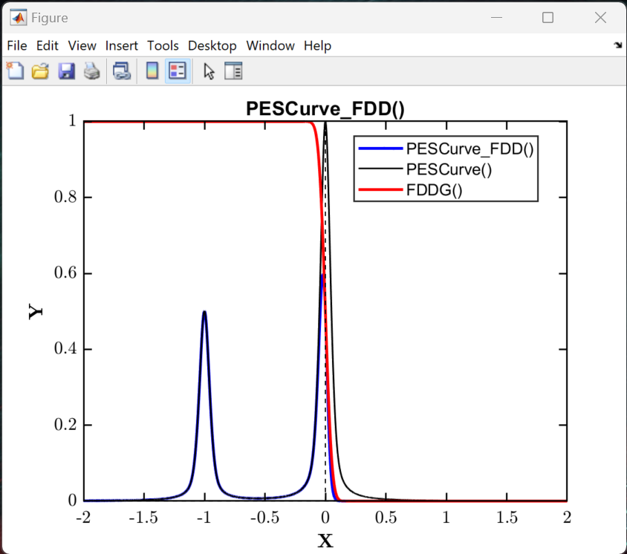
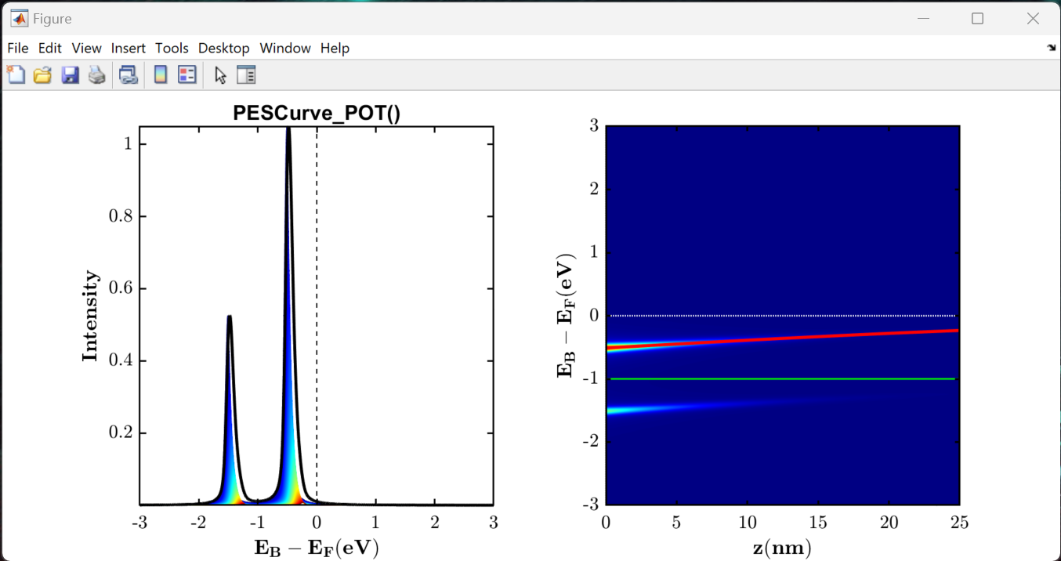
Showcase of the offered PES model curves
Use the PESCurve() function to generate a generalised PES model curve, defining a primary and spin-orbit split component.
A linear combination of these can be used to fit XPS data.
help PESCurve;
See ‘Example_003_PES_Model_Curves.mlx’ Live Script for examples.
PES Curve generated from the layer summation of a potential profile, enveloped over the IMFP.
PES Curve convolved with FDD at Fermi-edge

Slide 3
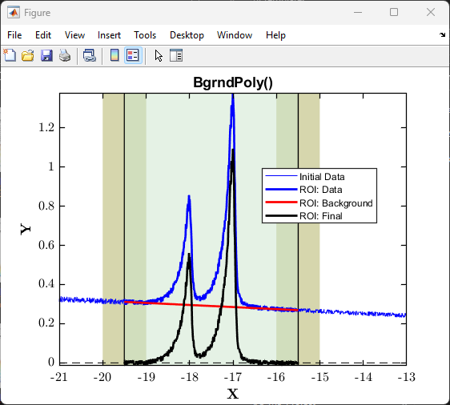
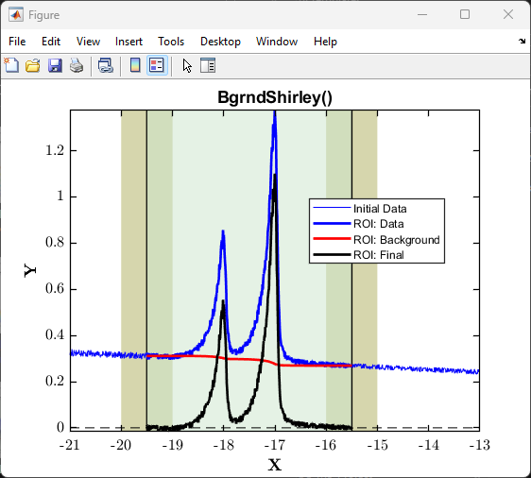

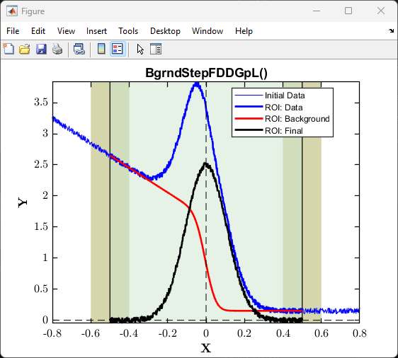
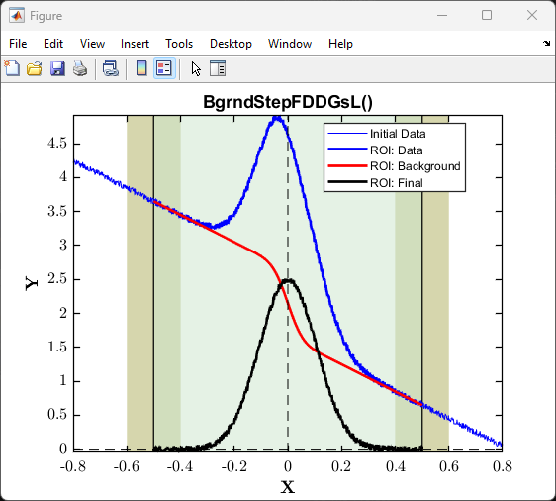
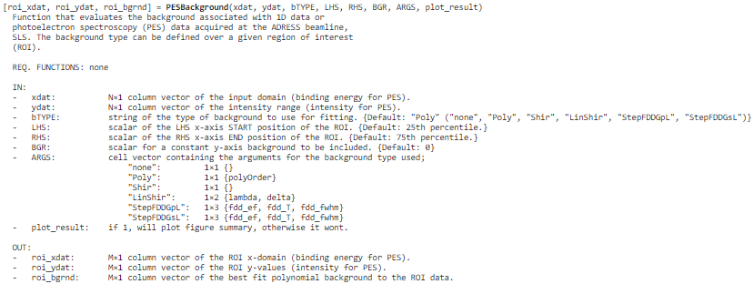
Showcase of the offered PES background curves
Use the PESBackground() function to call any of these background subtraction methods; polynomial, Shirley and linear step functions.
help PESBackground;
See ‘Example_003_PES_Background_Curves.mlx’ Live Script for example on how to use.

Slide 4
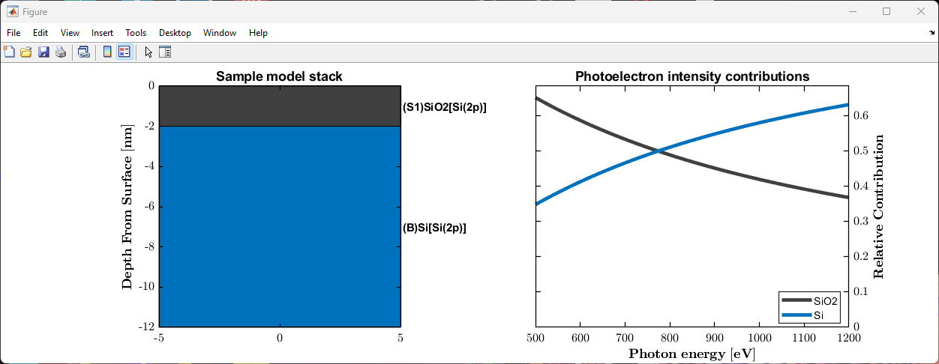
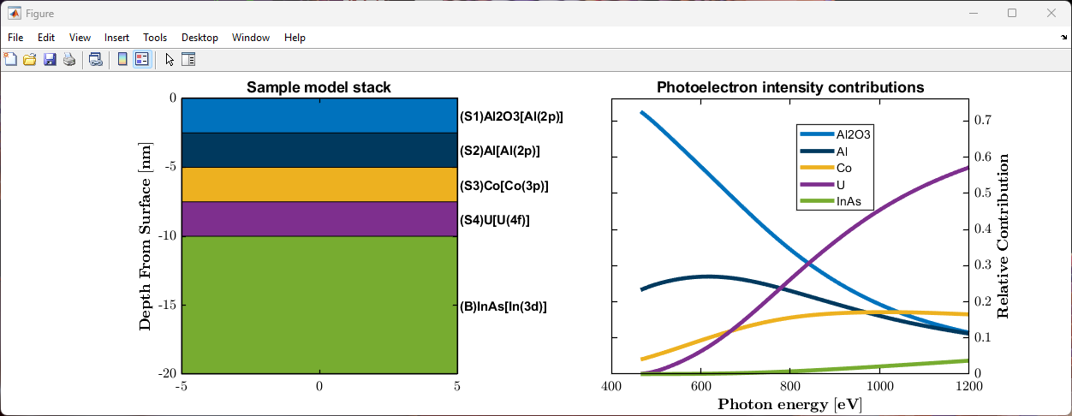
Simulating the photoelectron intensity contributions of an N-layered sample
pes_model_2L = nlayer_pes_model(500:1200, {'SiO2', 'Si'}, {'Si(2p)', 'Si(2p)'}, {2.0, Inf});
Tools can be used to fit the photon energy dependence of PES data.
nlayer_pes_model() function to simulate photoelectron intensity contributions of an N-layer model.
view_nlayer_pes_model() to quickly view solved model.
view_nlayer_sample() to quickly view the defined N-layer model sample stack.
overlayer_calc() to determine thickness of an overlayer on a bulk substrate using PES.
See ‘Example_020_Multilayer_PES_Modelling.mlx’ Live Script for example on how to use.

Slide 5
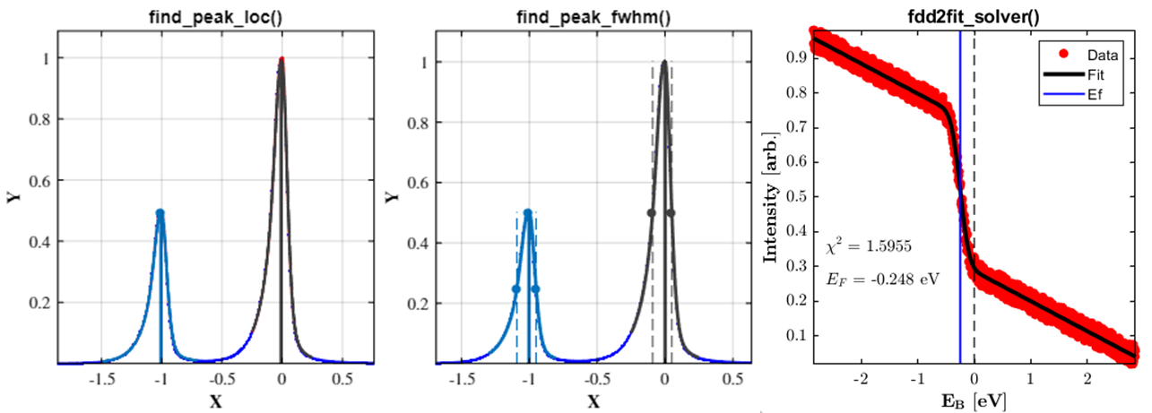
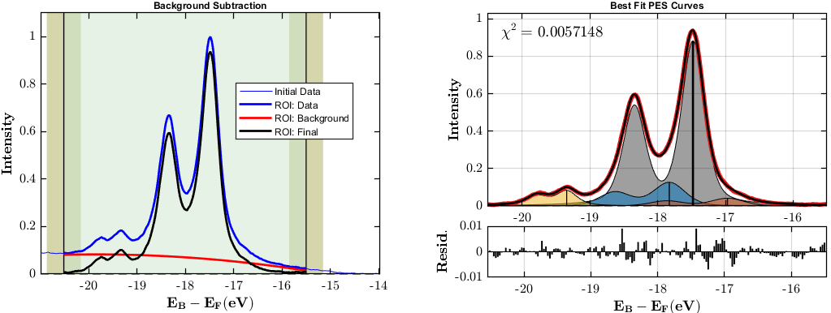
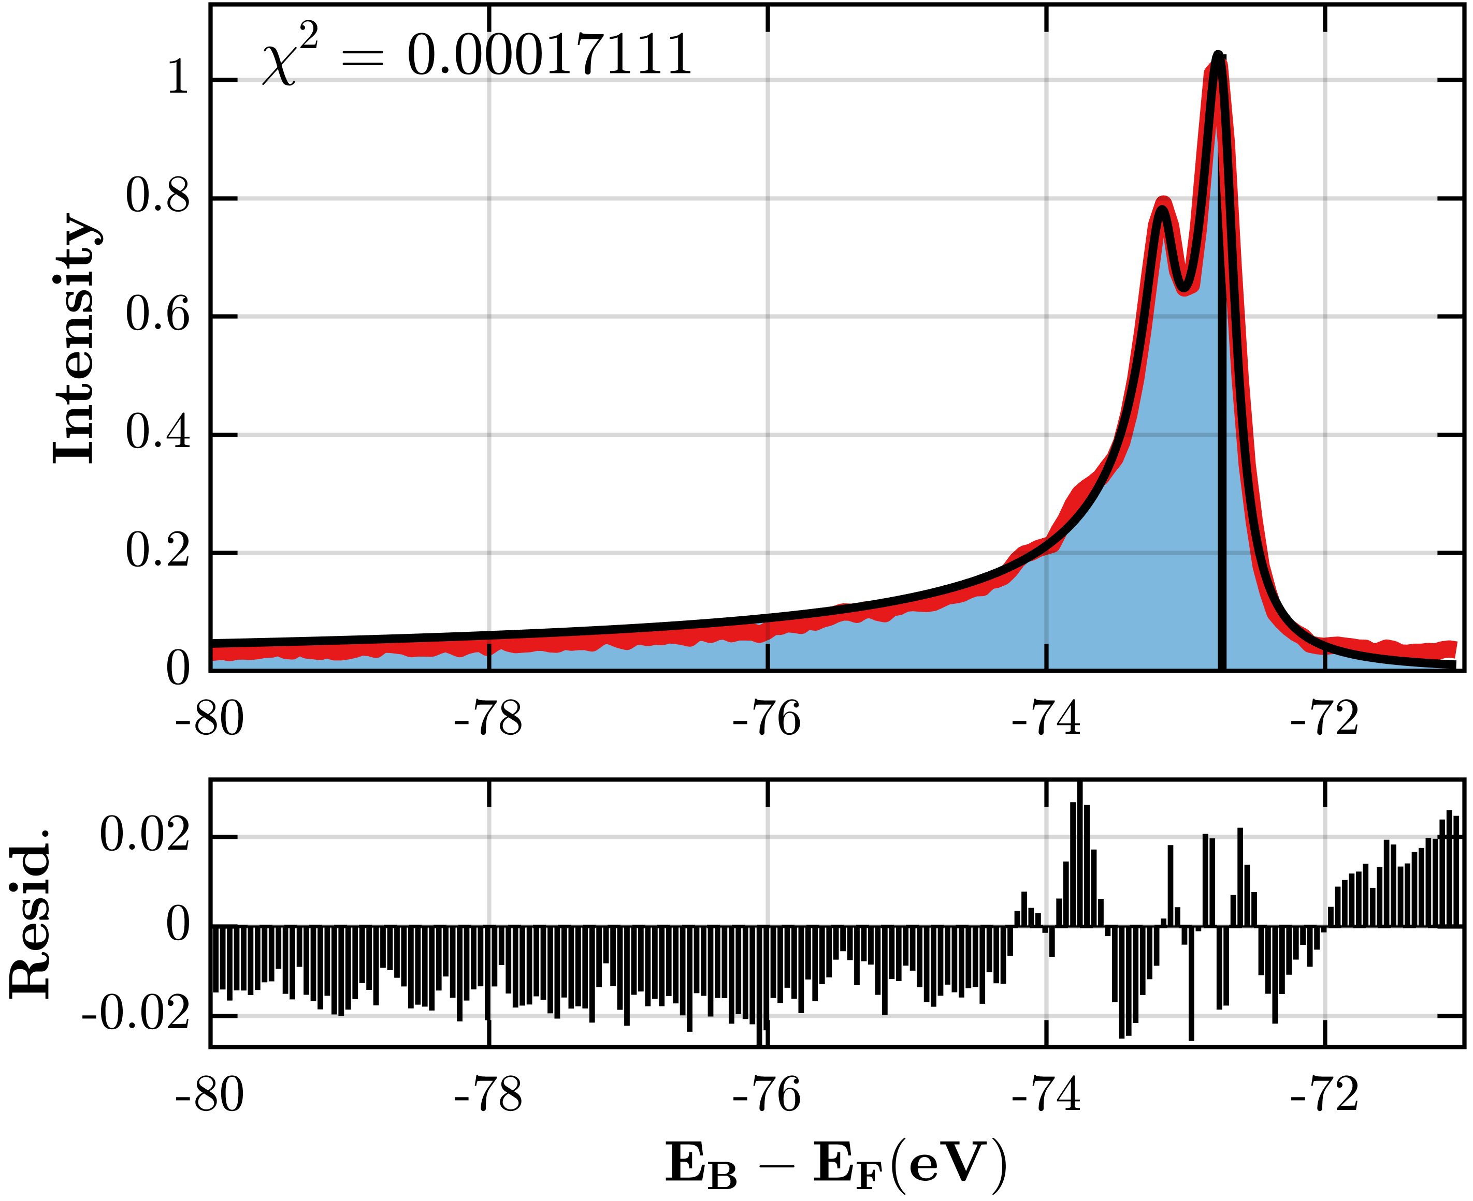
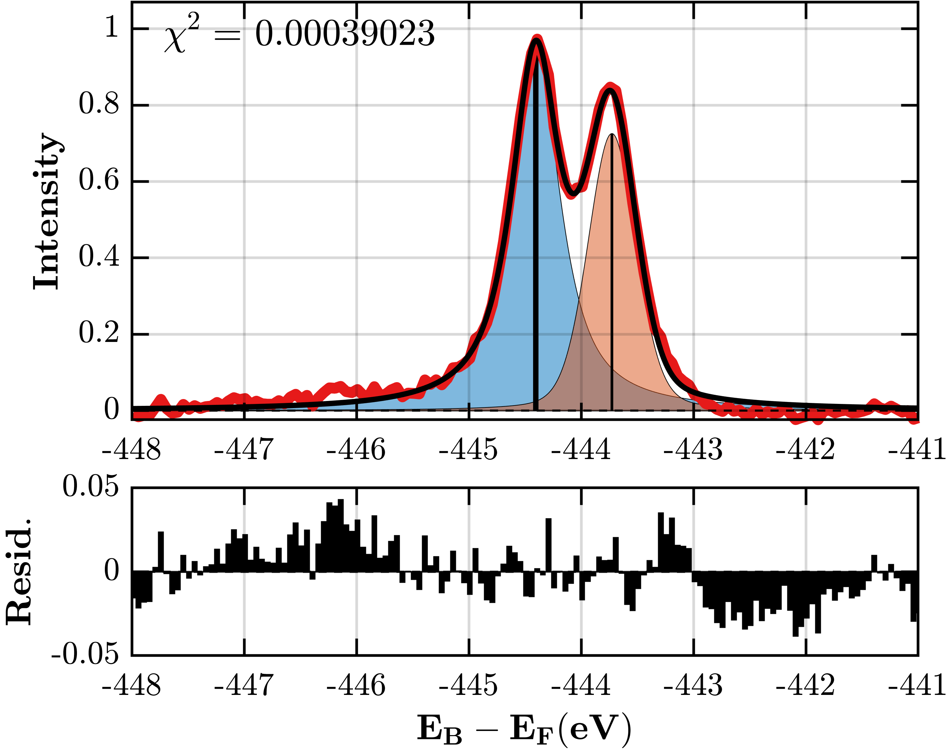
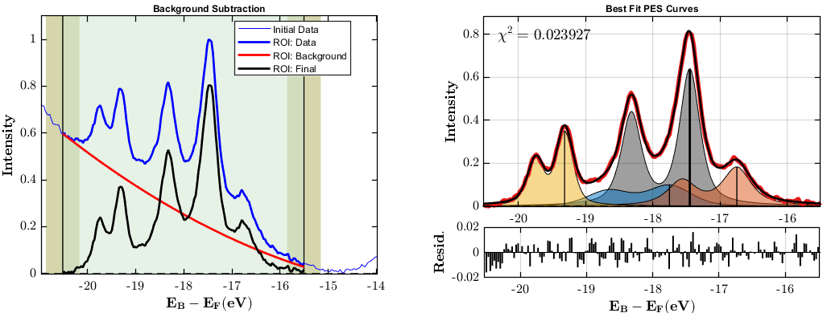
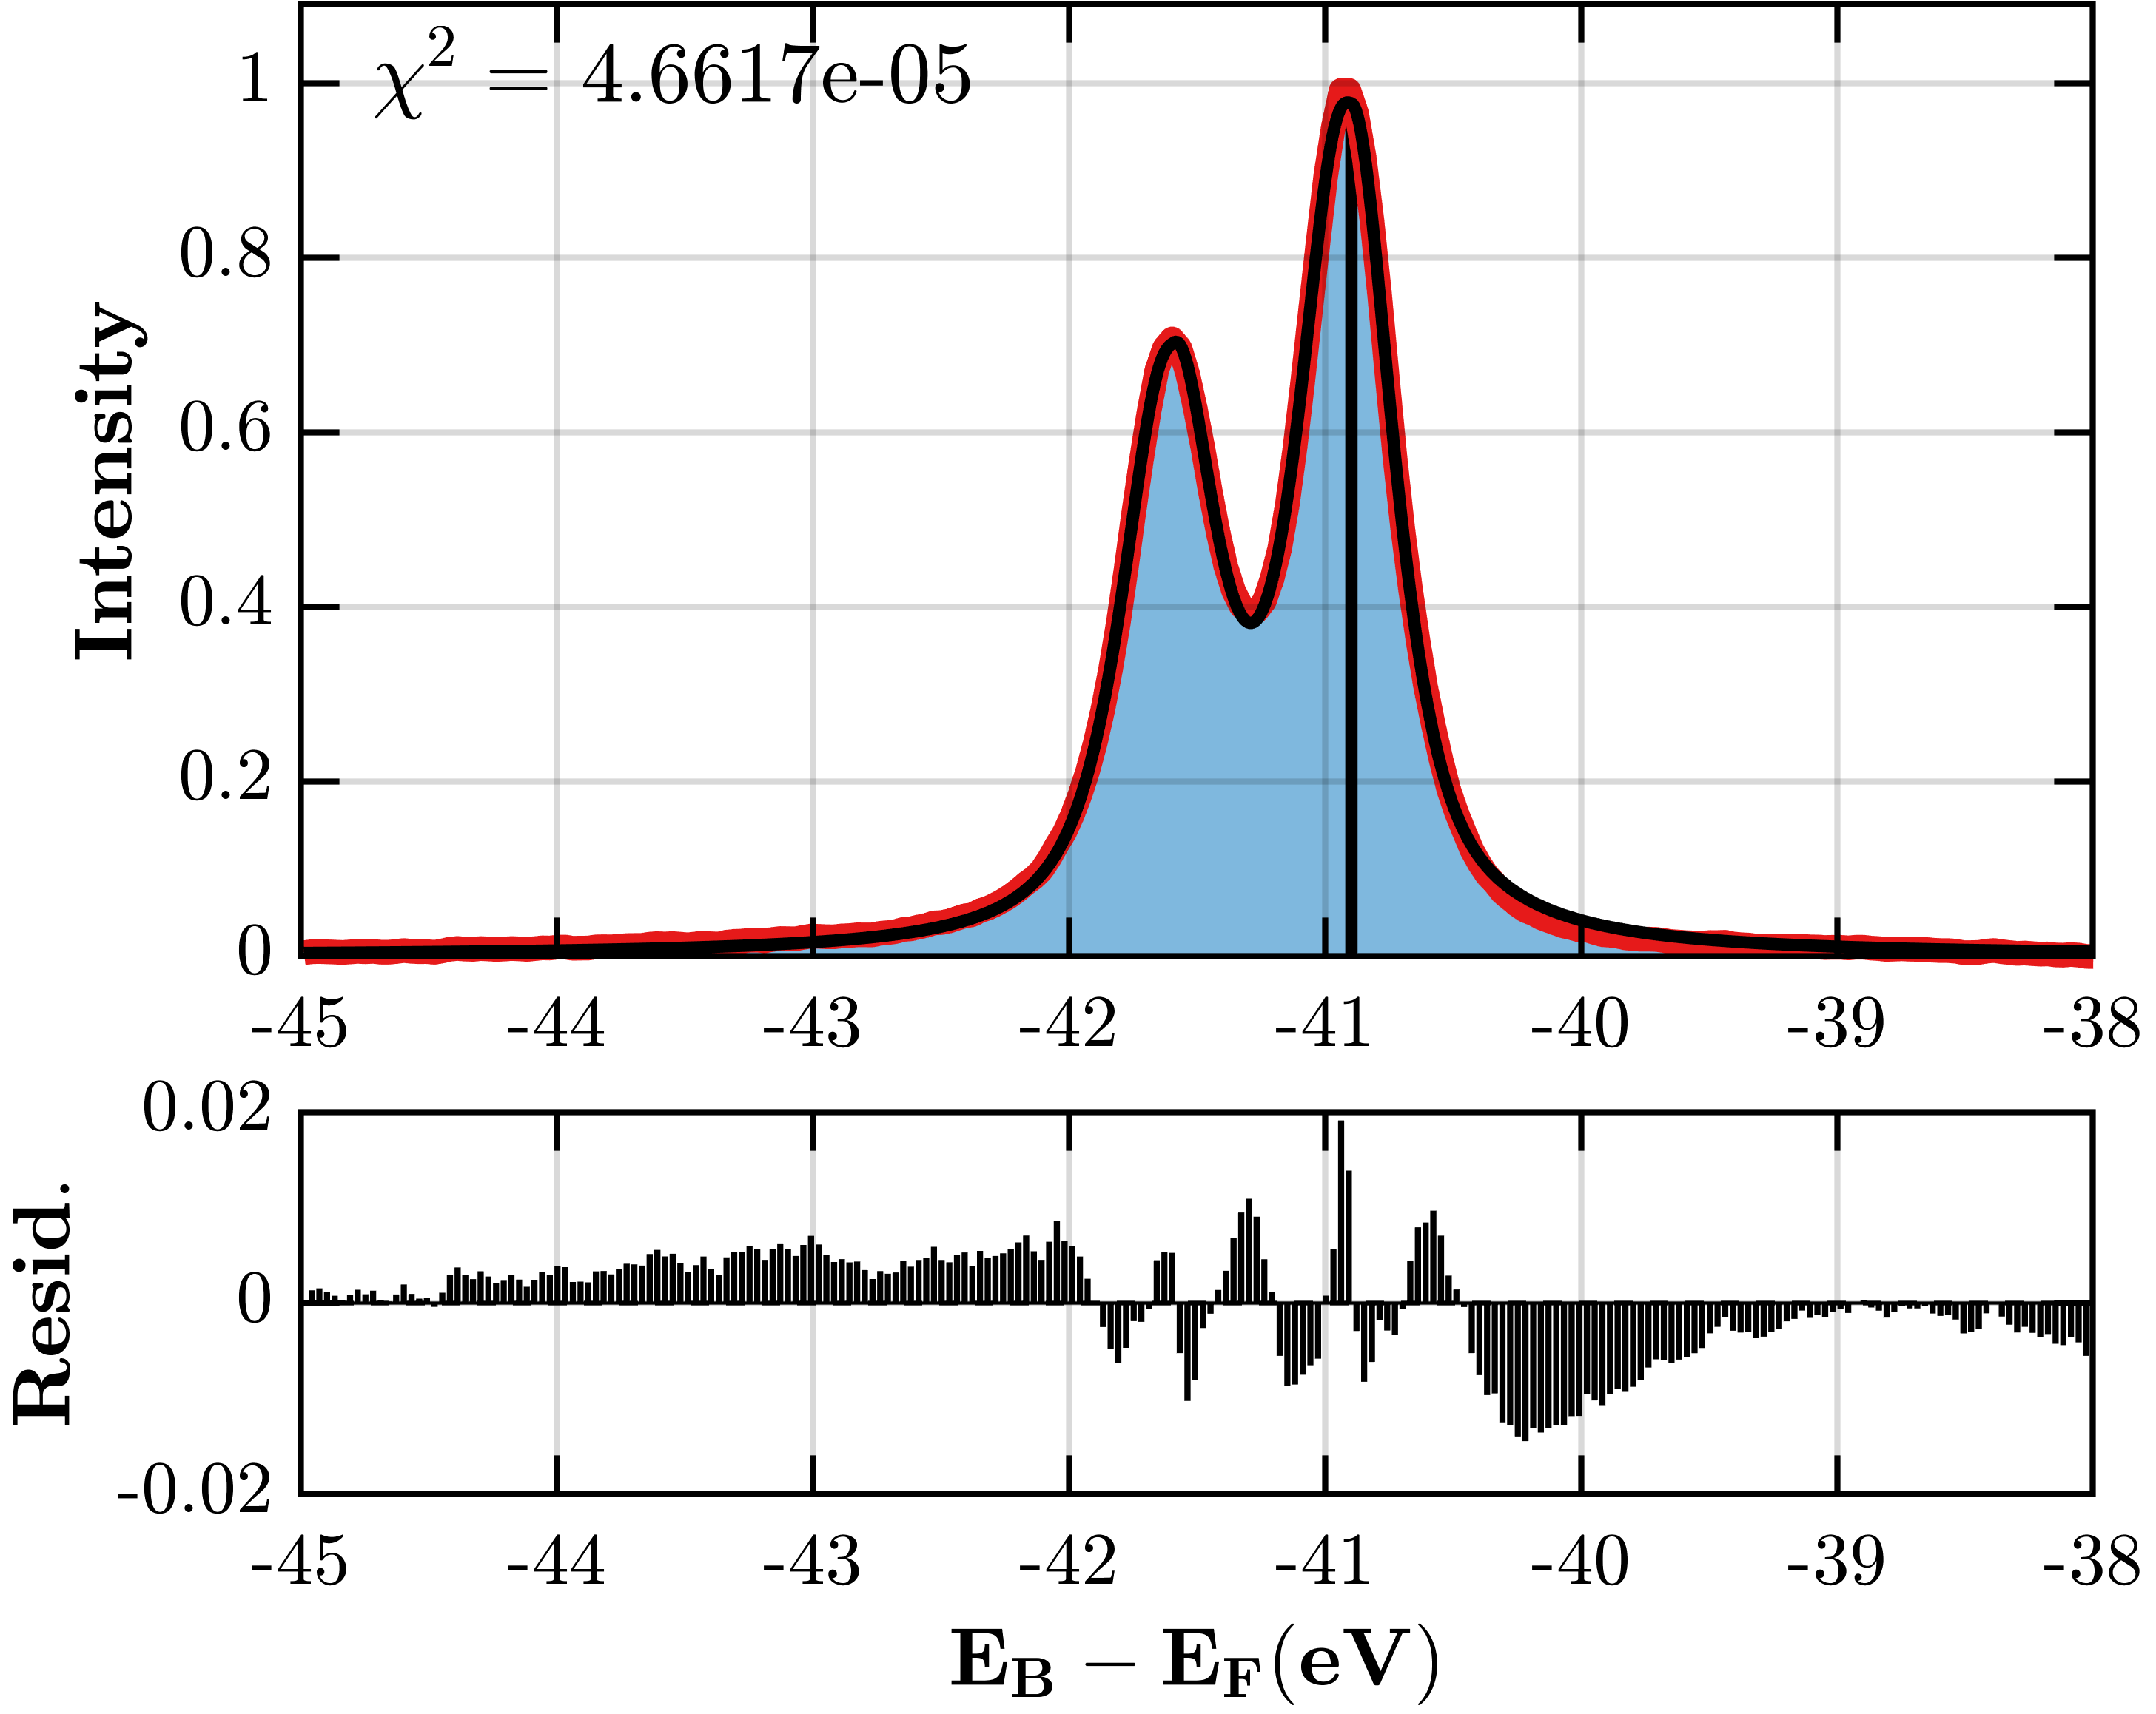


Showcase of curve fitting photoelectron spectroscopy data
Peak location finder
Example
Al(2p)
$hv$ = 550 eV
Peak FWHM finder
In(3d)
Example
$hv$ = 1150 eV
As(3d)
Fitting FDD for EB reference
See ‘Example_021-022_PES_Data_Fitting.mlx’ Live Script for an example on how to run the PES fitting routines.

Slide 6
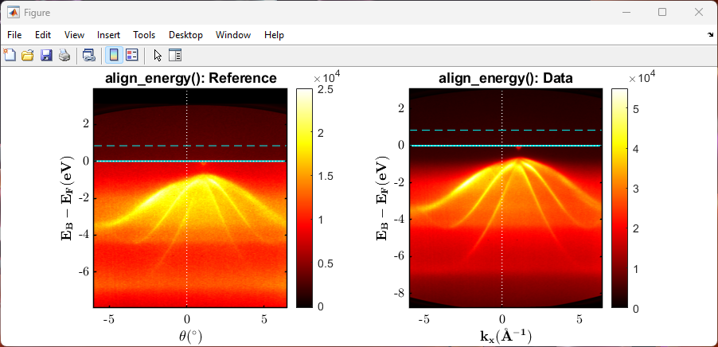
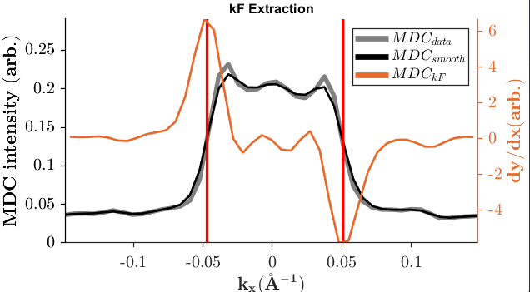
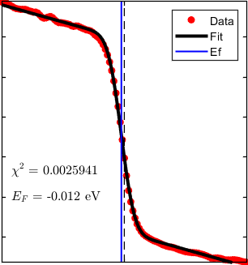
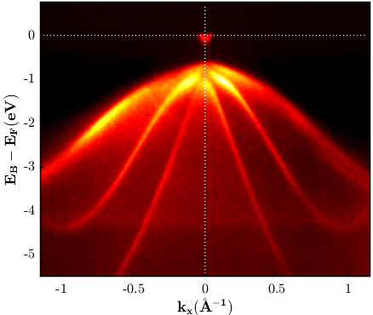
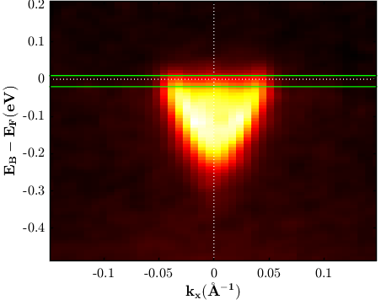
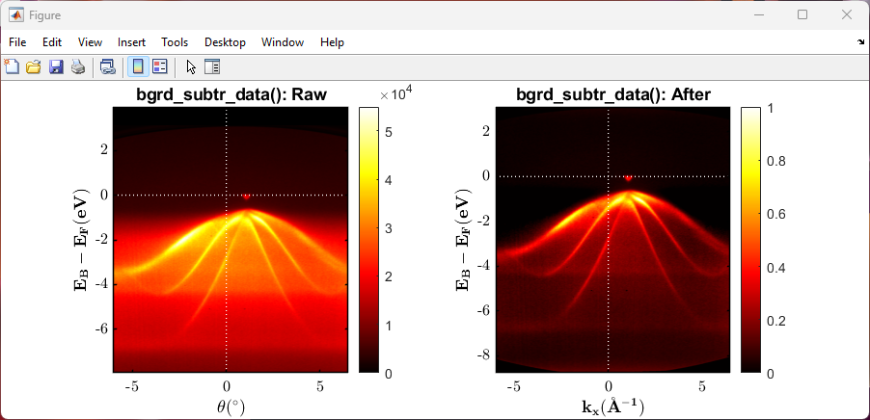
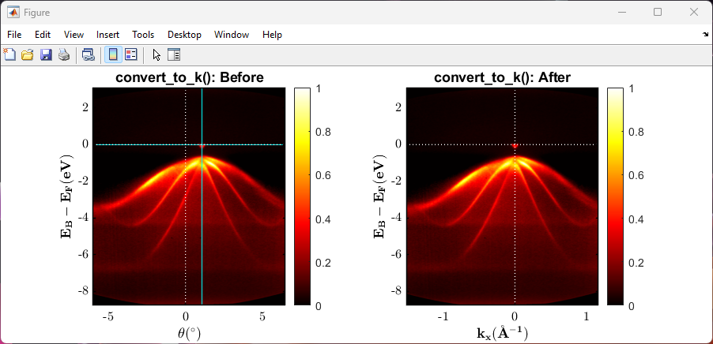
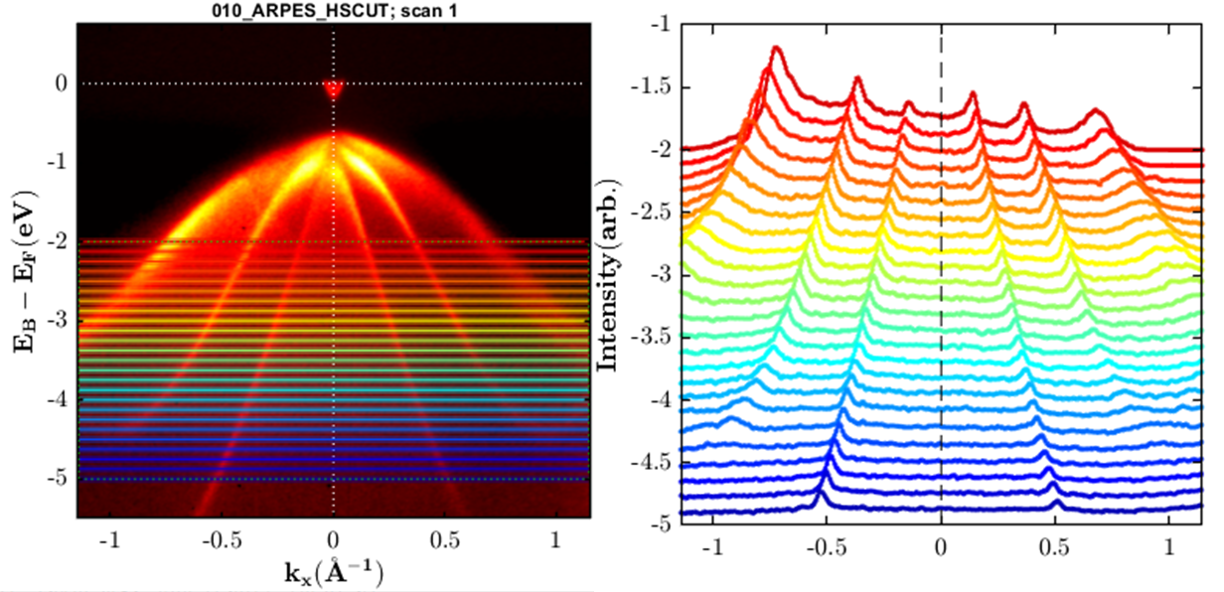

Showcase of the offered ARPES data processing tools
(1) Eb alignment
Final ARPES data after processing
(2) Background subtraction
Kf extraction using maximum gradient method
(3) Angle$→$Wavevectors
MDC Cut Series
See ‘Example_010-012_ARPES_EbKx_Processing.mlx’ Live Script on a step-by-step guide to process ARPES data.

Slide 7
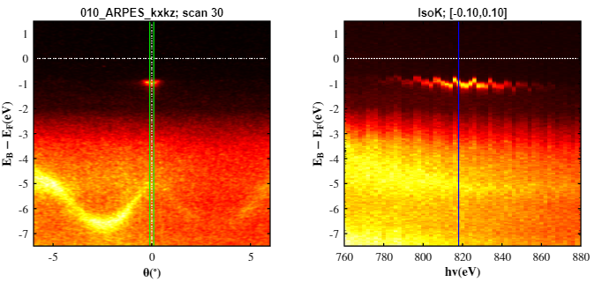
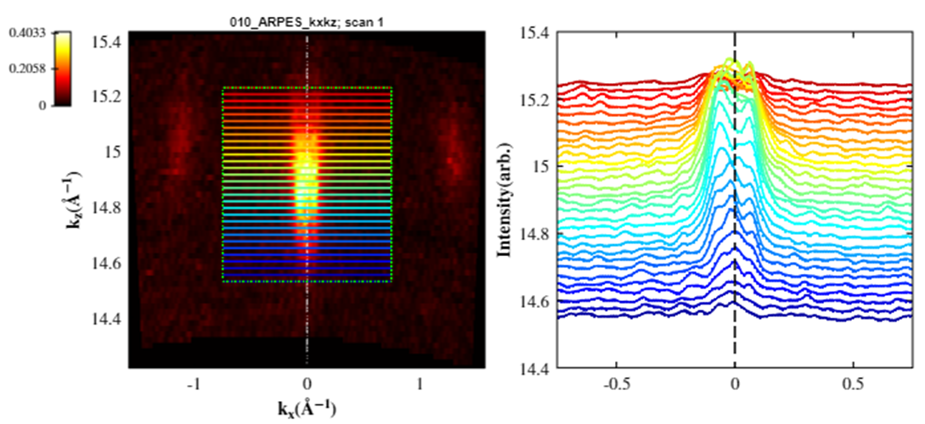
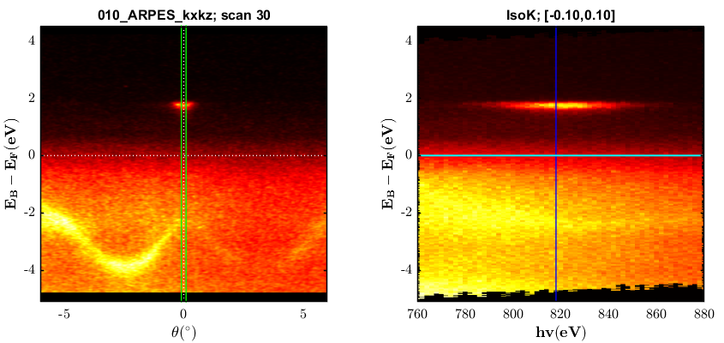
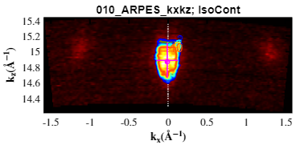
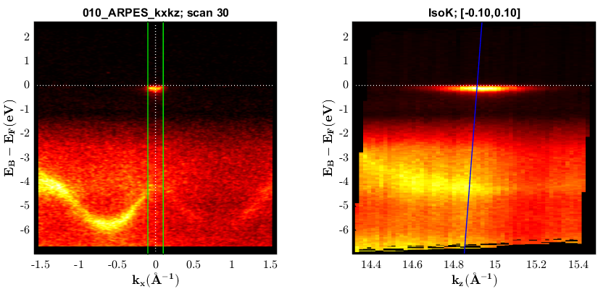
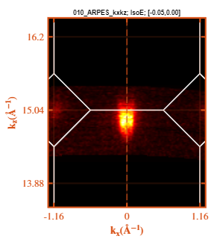
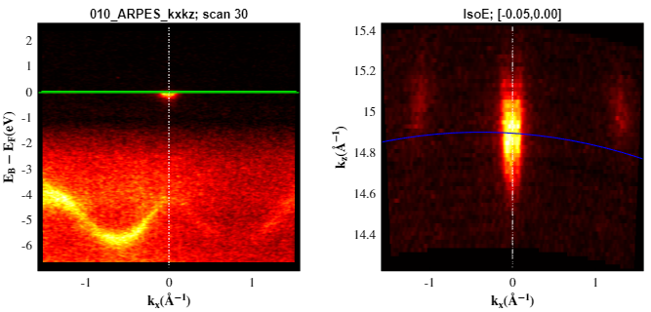

Showcase of curve fitting ARPES data
(1) 3D ARPES data
MDC Cut Series of IsoE Slice
(2) Eb alignment
Extracting electron pocket properties
(3) Angle$→$Wavevectors
IsoK Slicing
IsoE Slice with BZ overlay
IsoE Slicing
See ‘Example_010-012_ARPES_KxKz_Branched_Processing.mlx’ Live Script for another example.

Slide 8
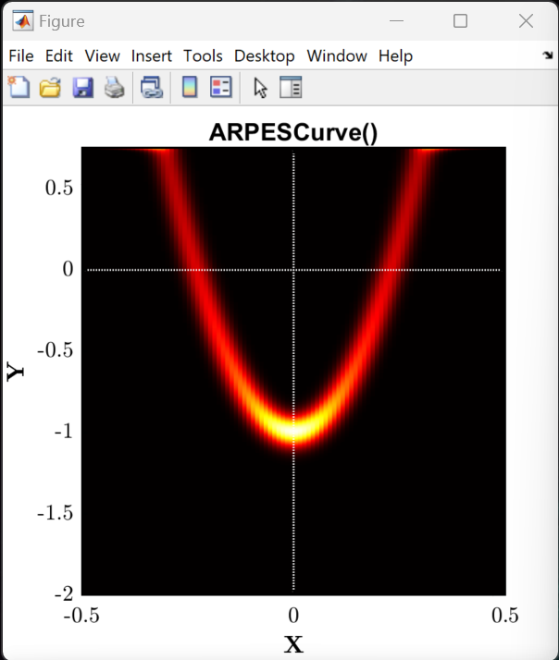
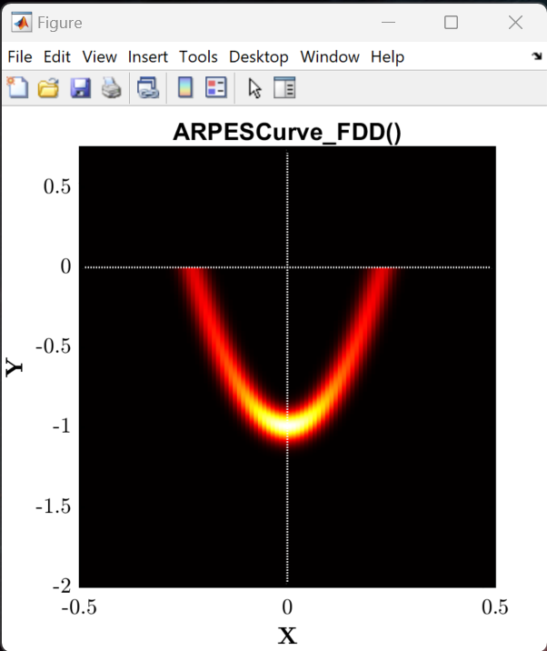
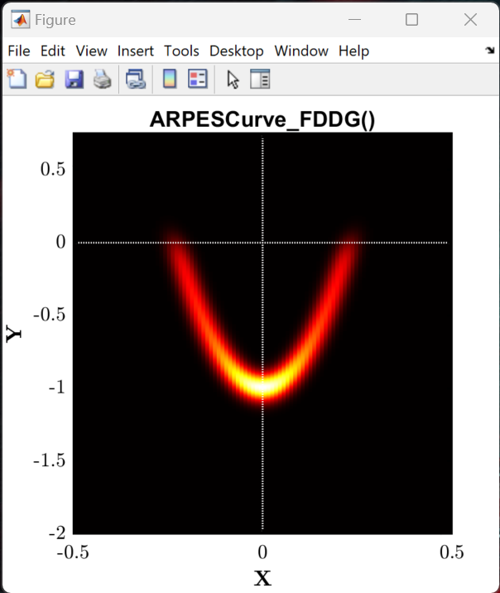
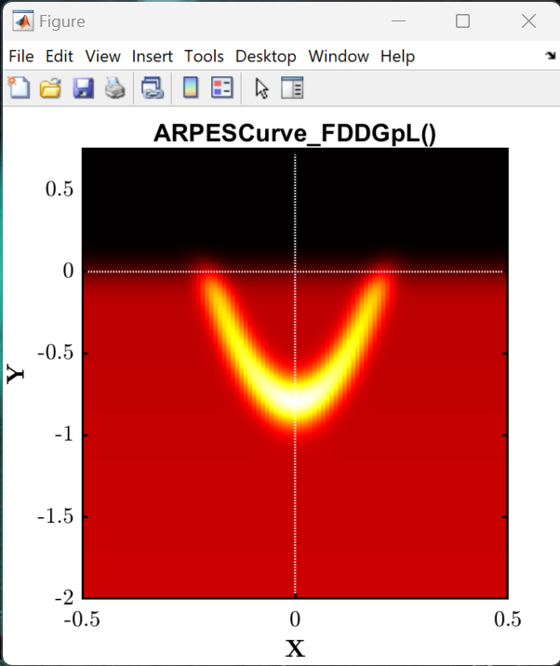
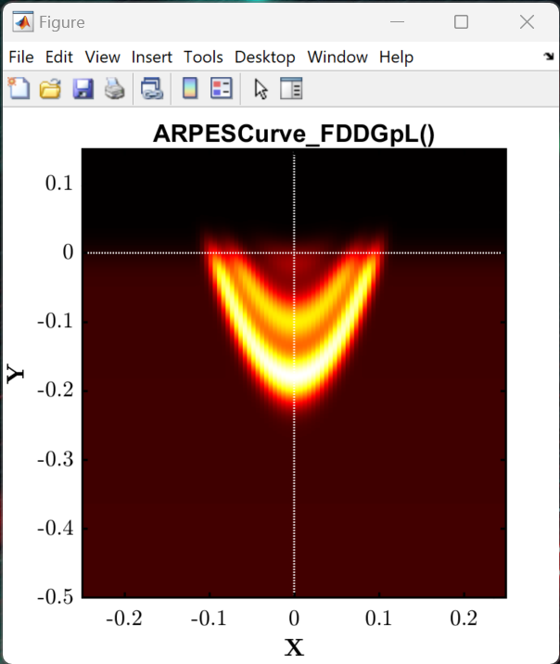




Showcase of the offered ARPES model curves
3 subbands example
See ‘Example_003_ARPES_Model_Curves.mlx’ Live Script for example on how to use.

Slide 9




Showcase of curve fitting ARPES data
Fit VB to Leading Edge
Fit VB to Leading Peak
-0.773 eV
-0.564 eV
Fit CB to N-Parabolas
MODEL
DATA
See ‘Example_013_ARPES_EbKx_Fitting.mlx’ Live Script for an example on how to run the ARPES fitting routines.

Slide 10



Brillouin Zone Navigation: Relating photon energy to $k_{z}$
extract_lattice()
HX-ARPES regime
2000 – 6000 eV
extract_bz_overlay()
SX-ARPES regime 310 – 1600 eV
UV-ARPES regime 10 – 200 eV
See ‘Example_002_BZ_Navigation.mlx’ Live Script for an example.
extract_hv_overlay()

