Slide 1
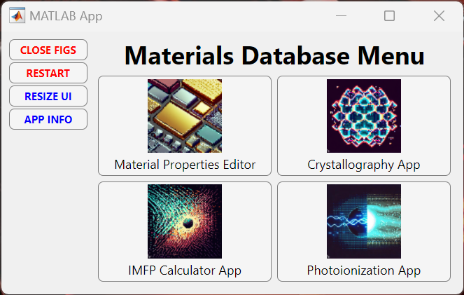

Slide 2
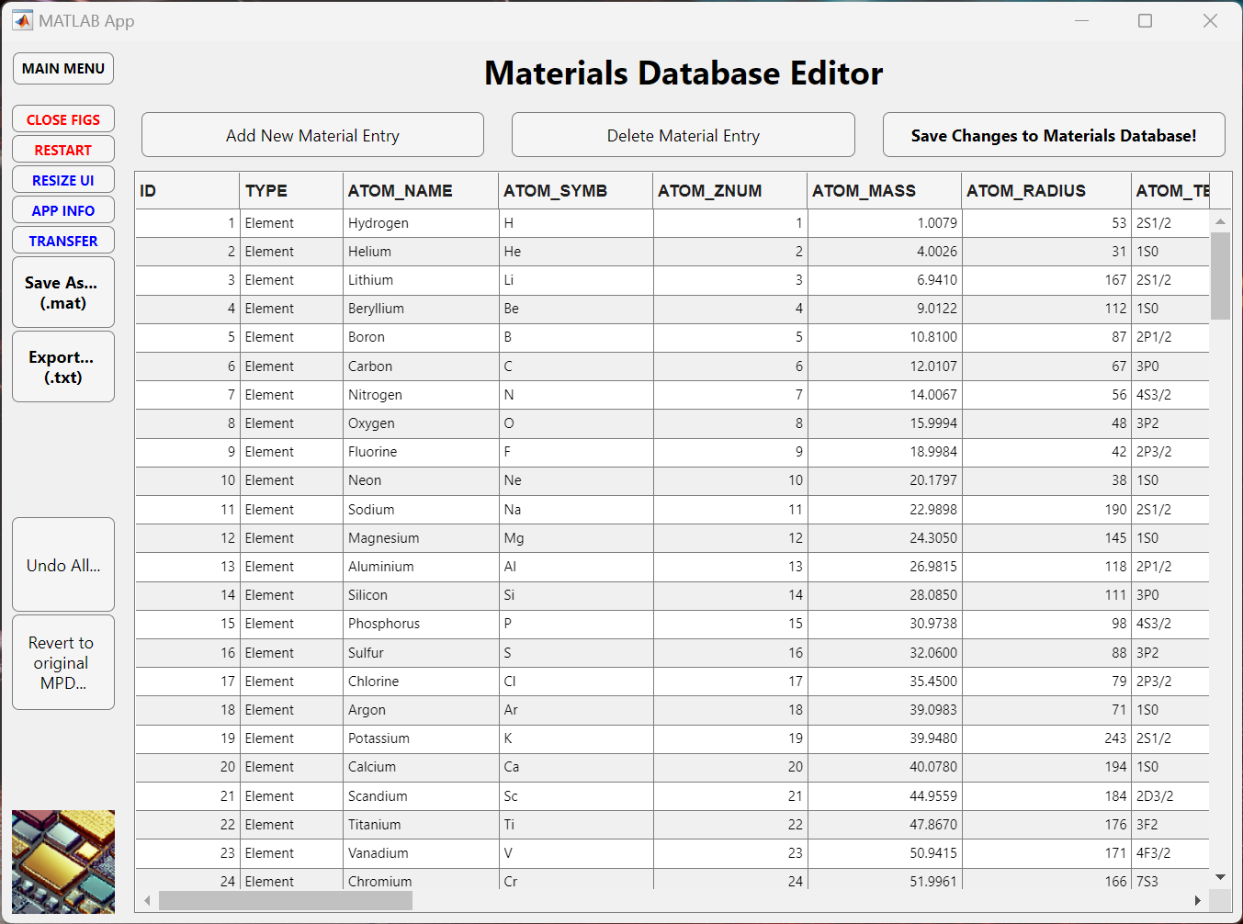
Currently 168 material entries with 42 properties each:
Database saved in ‘MPD_PCC.mat’ MATLAB file.
Elements, Oxides, Binary Semiconductors, Ionic Salts.
Use ‘get_mpd_props()’ to extract material properties.
Boot App with ‘APP_MATERIALSDATABASE’.

Slide 3
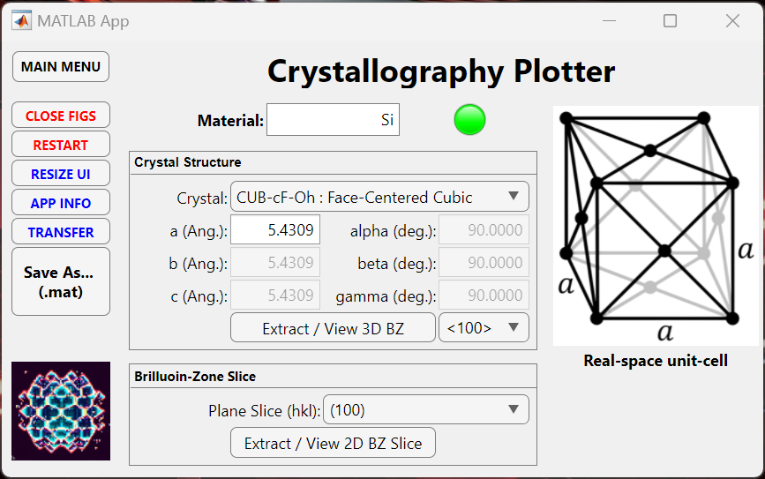
Currently 168 material entries with 42 properties each:
Database saved in ‘MPD_PCC.mat’ MATLAB file.
Elements, Oxides, Binary Semiconductors, Ionic Salts.
Use ‘get_mpd_props()’ to extract material properties.
Boot App with ‘APP_MATERIALSDATABASE’.

Slide 4
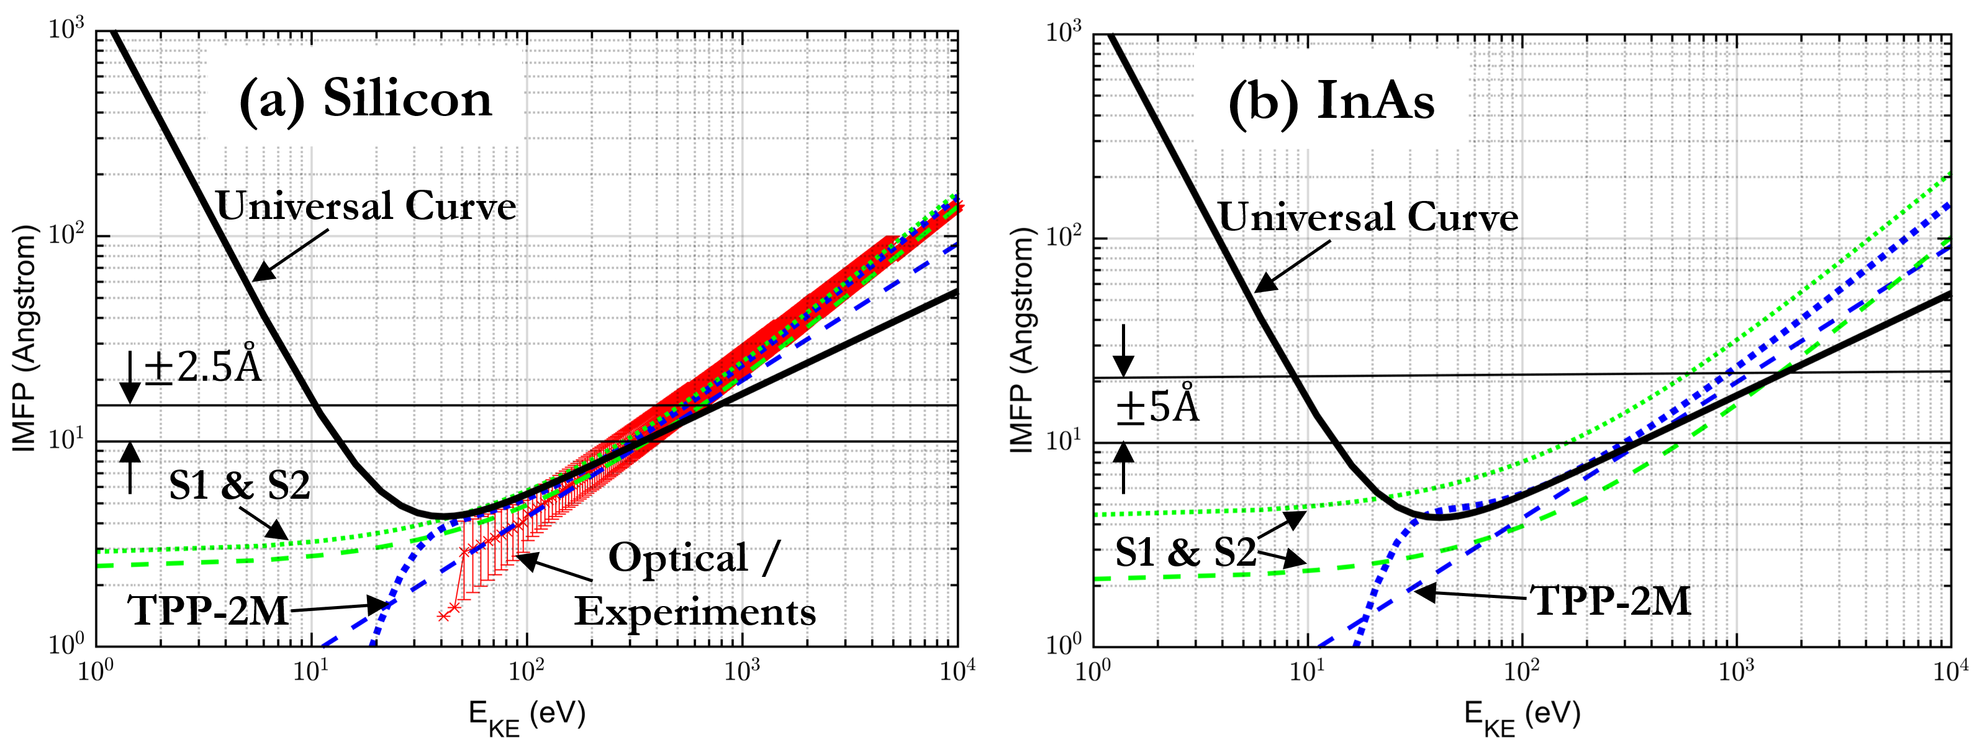
Showcase of the Electron Inelastic Mean Free Path Database
view_eimfp_props("Si");
view_eimfp_props("InAs");
Available electron IMFP calculator functions:
eimfp_optical() *gives all available optical experimental data
eimfp_S1()
eimfp_S1_mpd()
eimfp_S2_avg()
eimfp_tpp2m()
eimfp_tpp2m_avg()
eimfp_tpp2m_mpd() **Recommended IMFP calculator to use
eimfp_universal()
For a particular material:
Use ‘get_eimfp_props()’ to extract all experimental data.
Use ‘view_eimfp_props()’ to quickly view data.

Slide 5
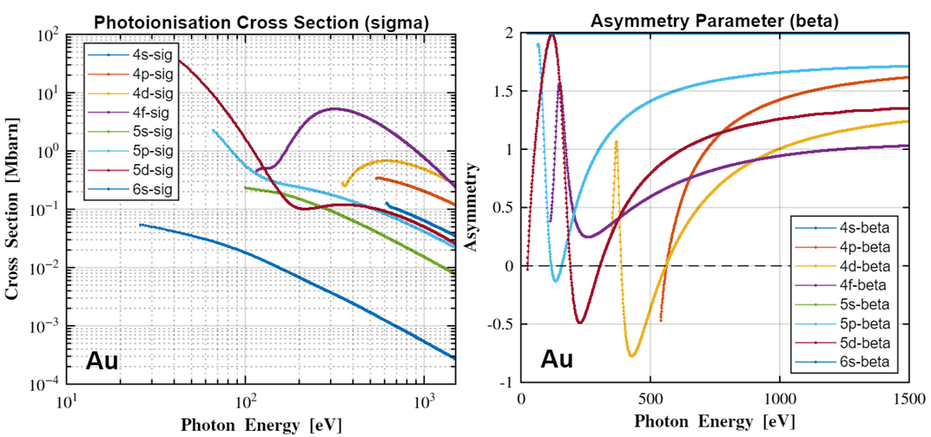
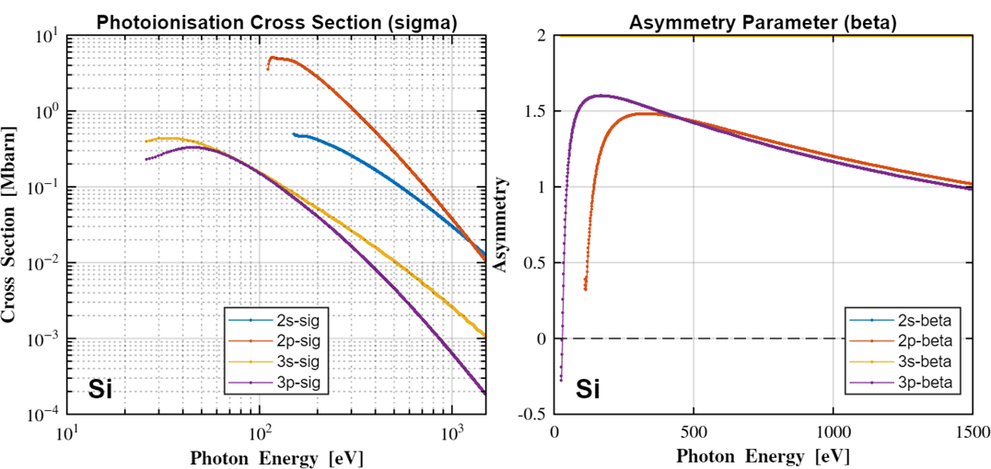
Showcase of the Photoionisation Cross-Section and Asymmetry Database
view_pixsad_props("Au");
Elements 1 – 103 available and use:
‘get_pixsad_props()’ to extract all experimental data.
‘view_pixsad_props()’ to quickly view data.
view_pixsad_props("Si");

Slide 6
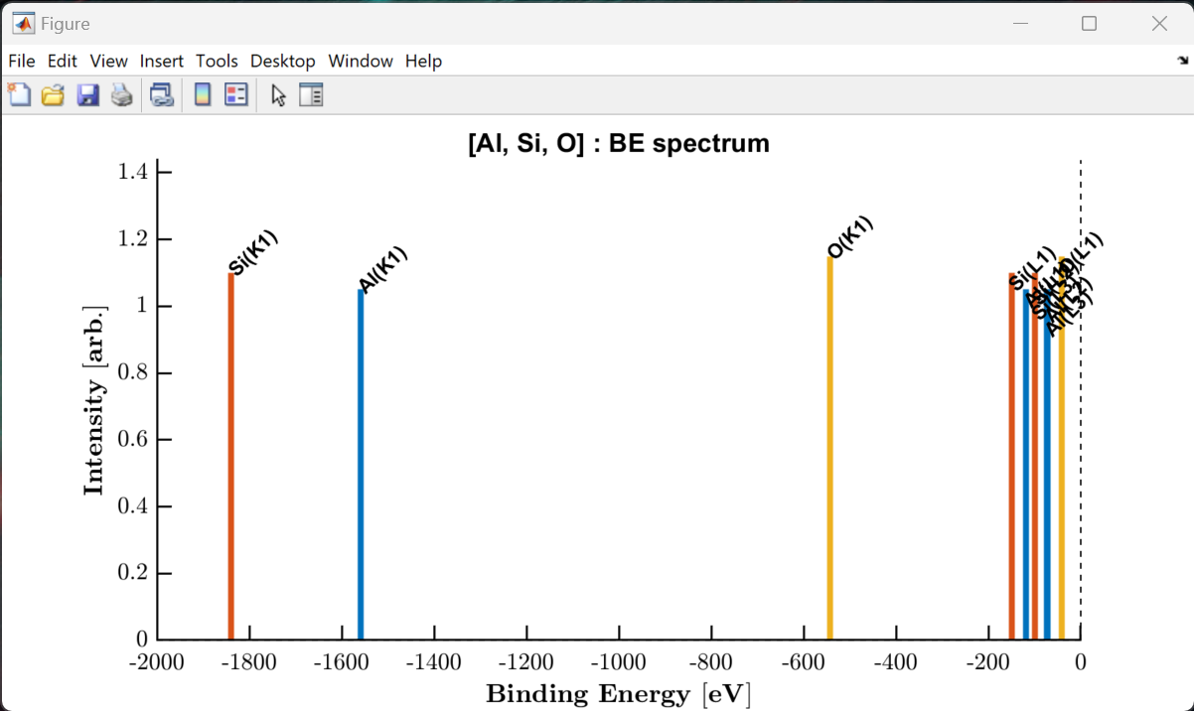
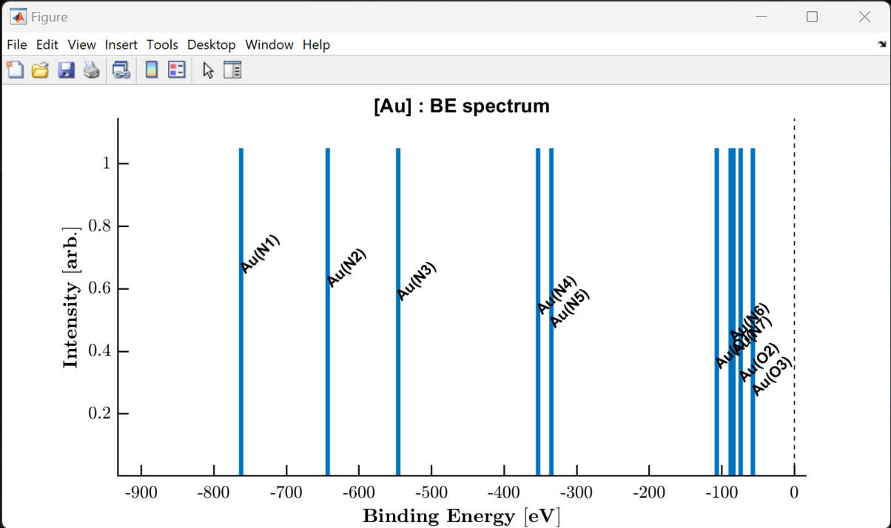
Showcase of the Photoionisation Energy and Fluorescence Database
view_be_spectrum(["Al", "Si", "O"]);
view_be_spectrum("Au");
Elements 1 – 103 available.
‘get_piefd_props()’ to extract all experimental data.
‘view_be_spectrum()’ to quickly view all occupied core-levels.

