Slide 1
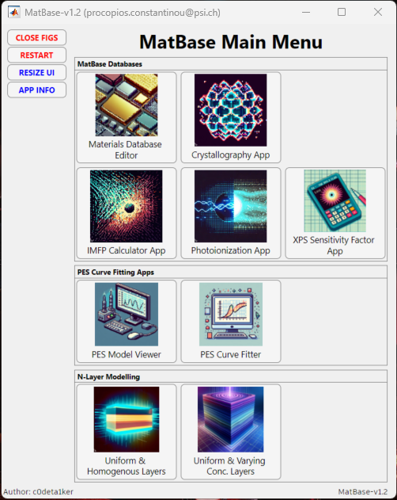

Slide 2
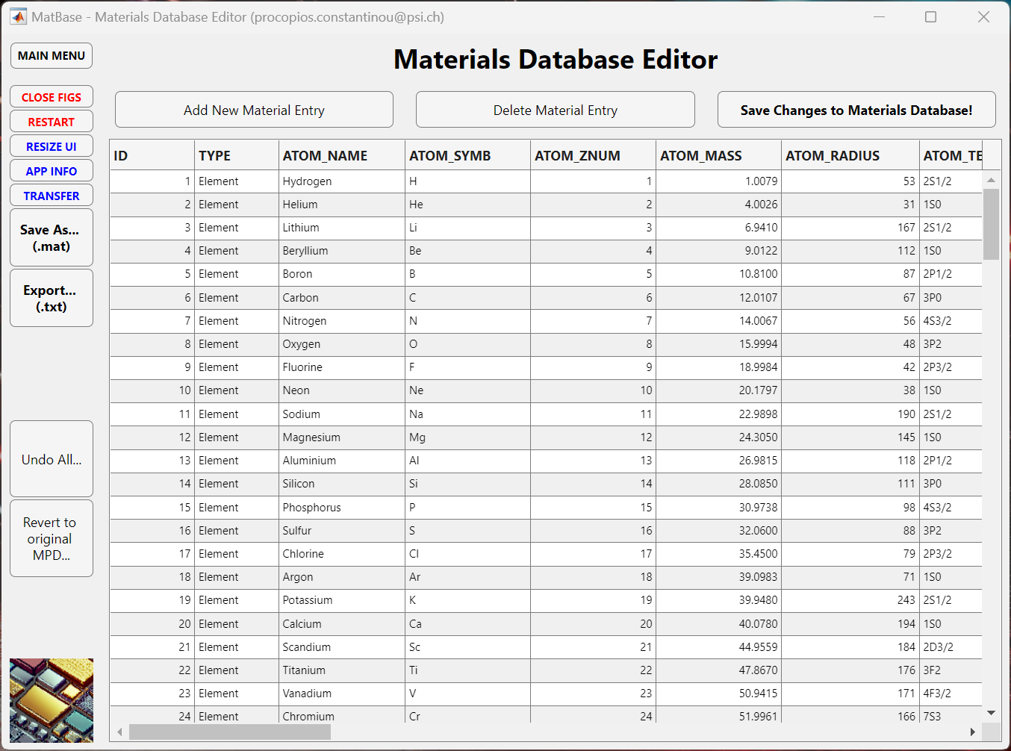
Currently 168 material entries with 42 properties each:
Database saved in ‘MPD_PCC.mat’ MATLAB file.
Elements, Oxides, Binary Semiconductors, Ionic Salts.
Use ‘get_mpd_props()’ to extract material properties.
Navigate to this App via ‘App_MatBase’ Main Menu.

Slide 3
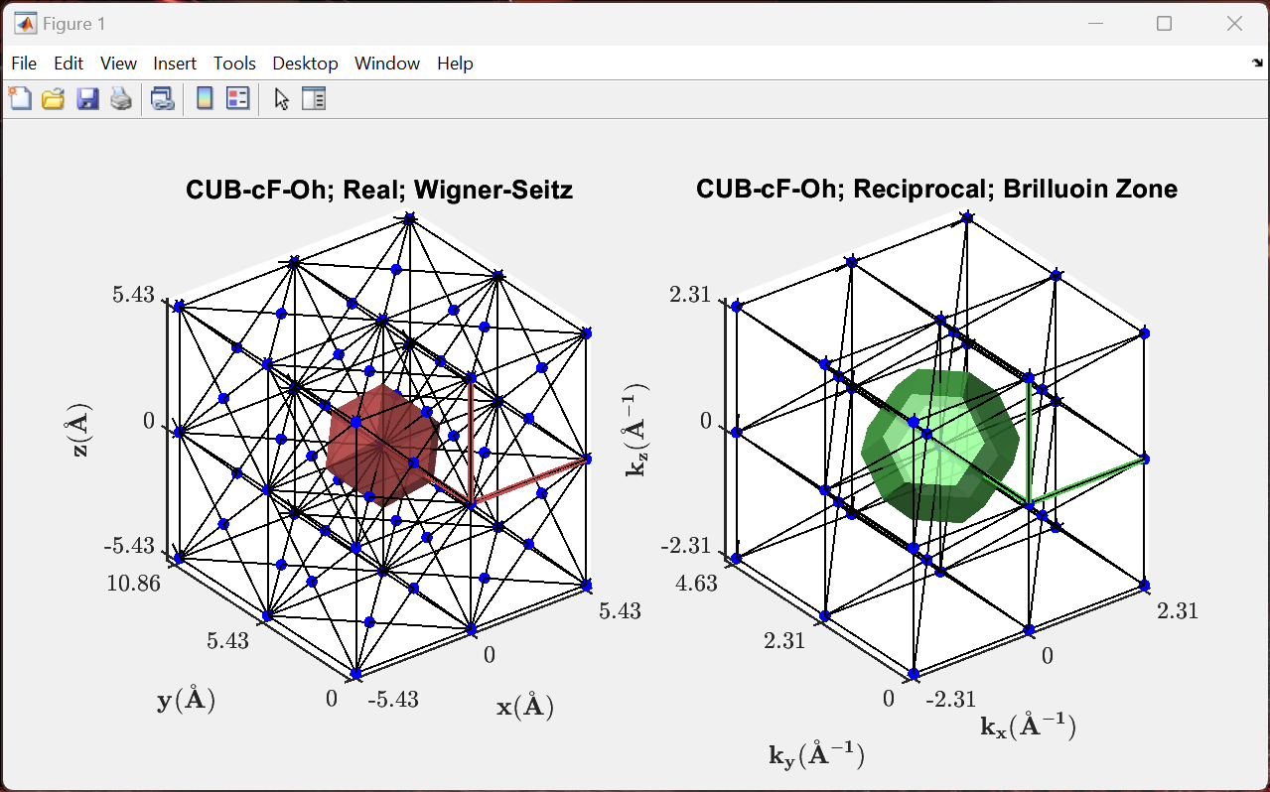
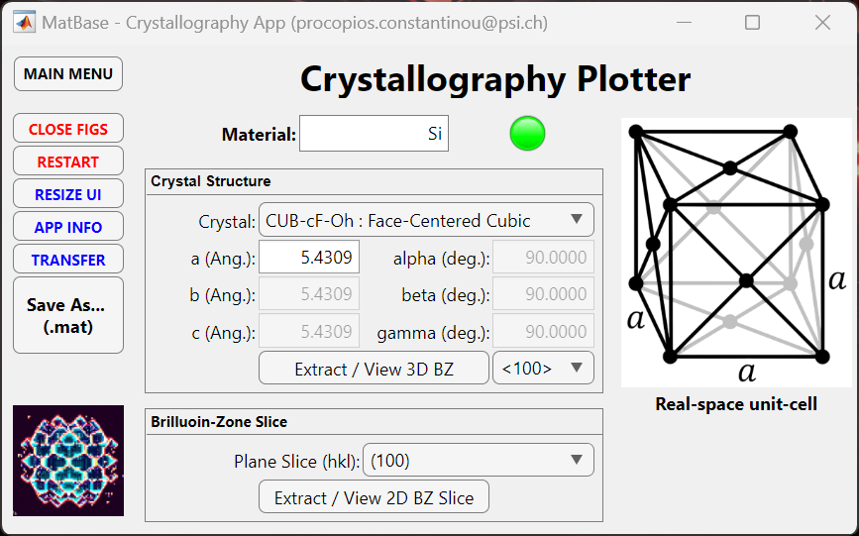
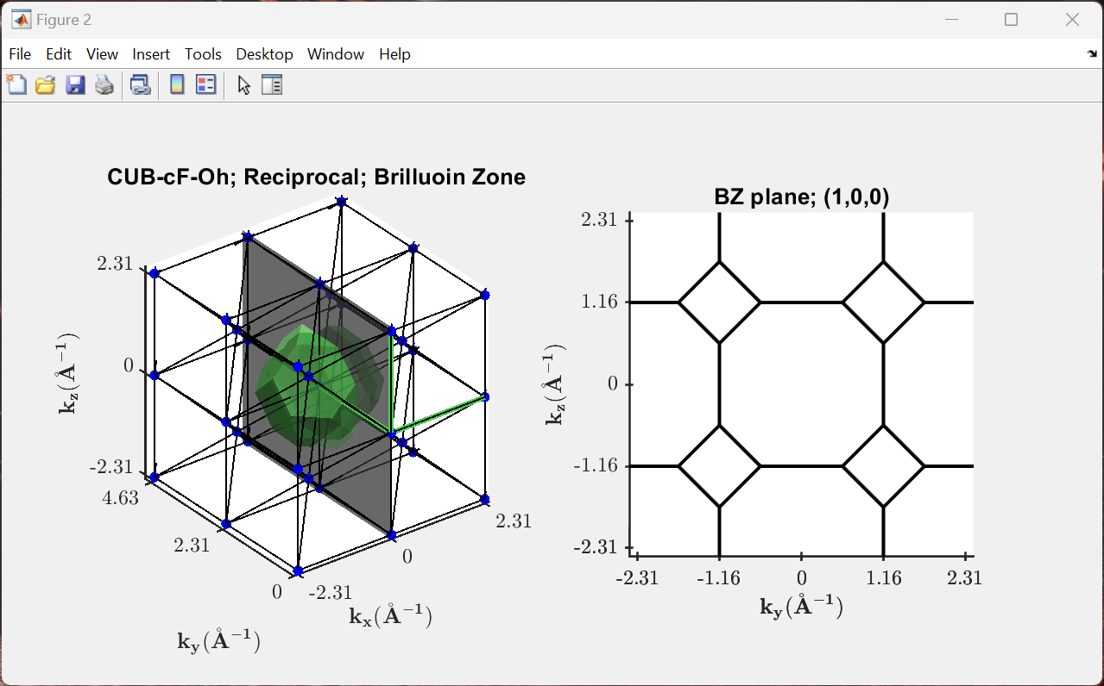
Access all material parameters from our database or manually enter data for materials not included.
Plot the 3D real- and reciprocal-space lattices.
Extract 2D slices through the Brillouin zone.
Navigate to this App via ‘App_MatBase’ Main Menu.

Slide 4
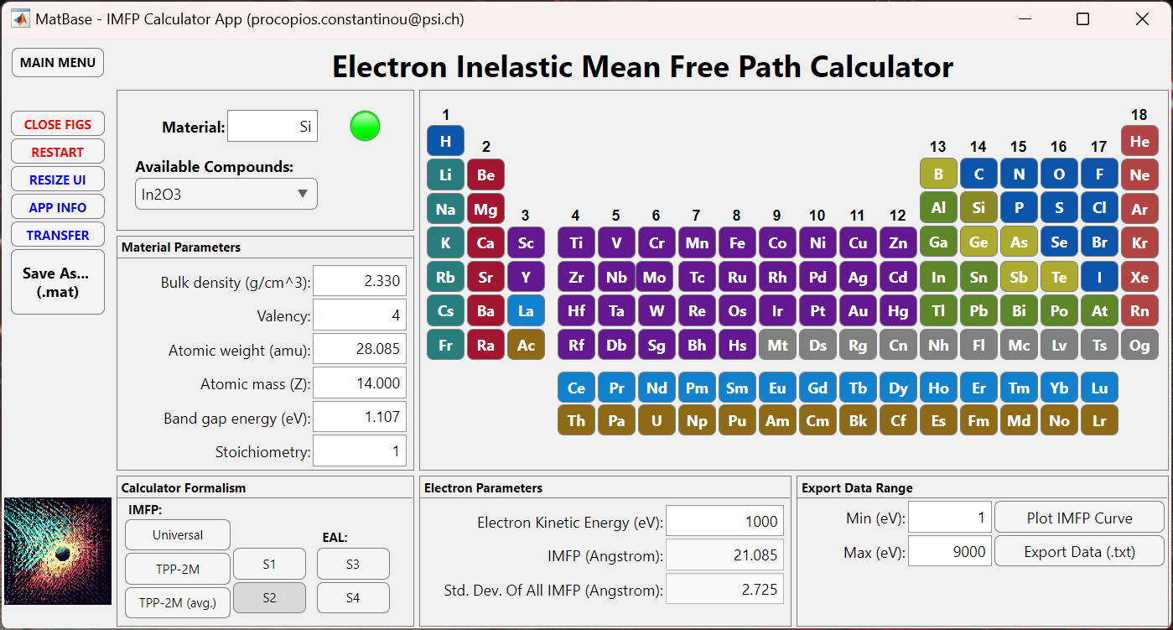
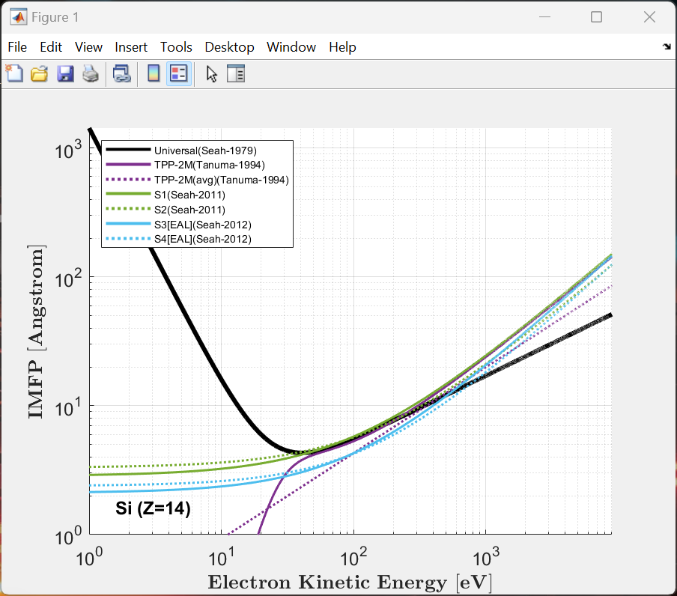
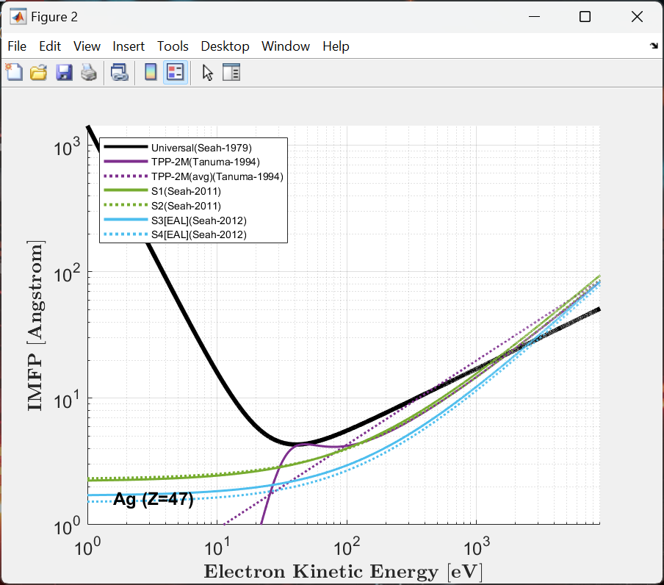
Access all material parameters from our database or manually enter data for materials not included.
Plot and calculate the IMFP using a range of formalisms; Universal, TPP-2M, S1, and S2 methods.
Export IMFP data as a text file.
Navigate to this App via ‘App_MatBase’ Main Menu.
Available electron IMFP calculator functions in MATLAB:
eimfp_optical() *gives all available optical experimental data
calc_imfp() **general IMFP calculator function

Slide 5
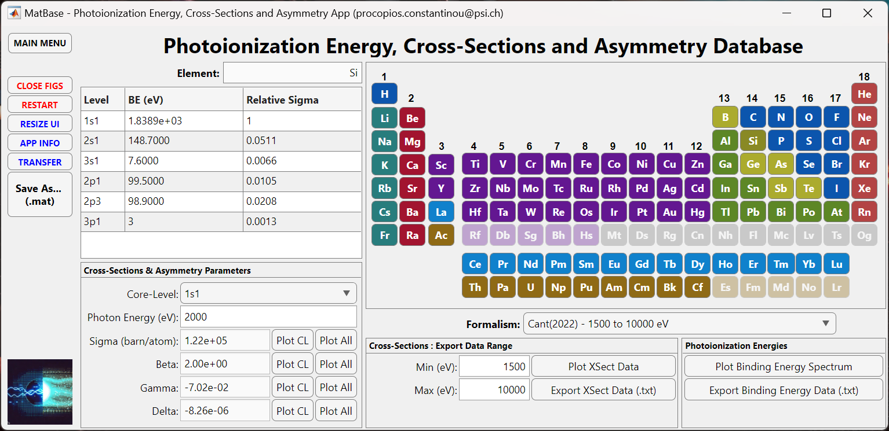
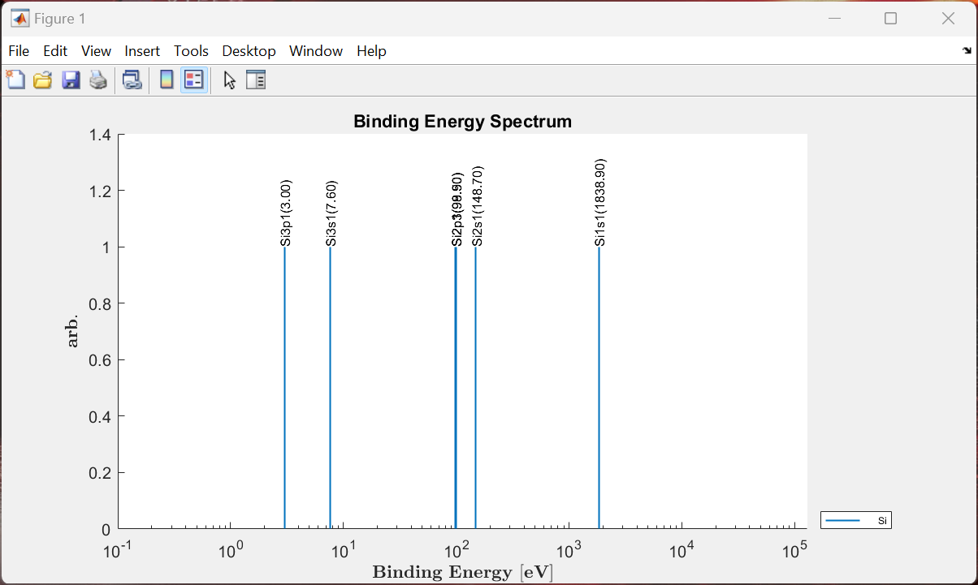
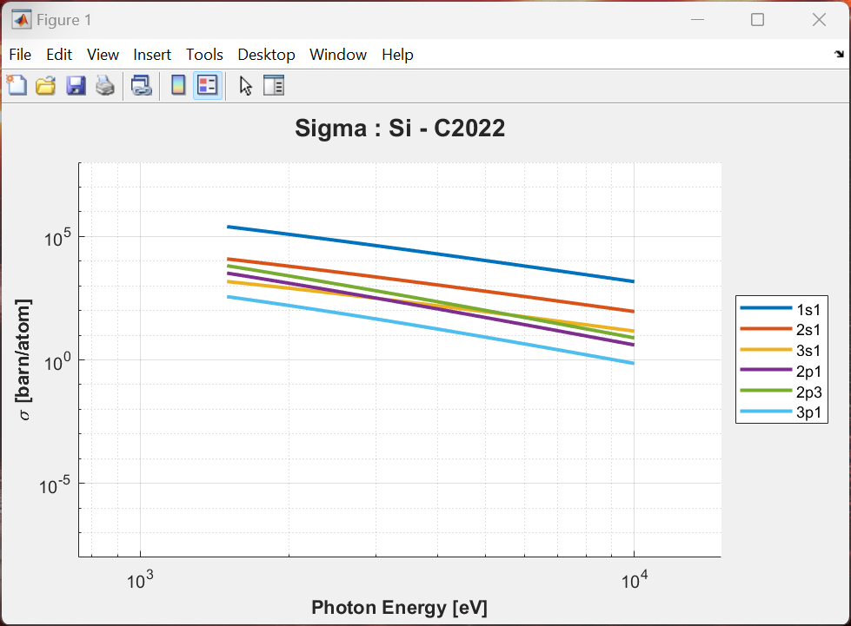
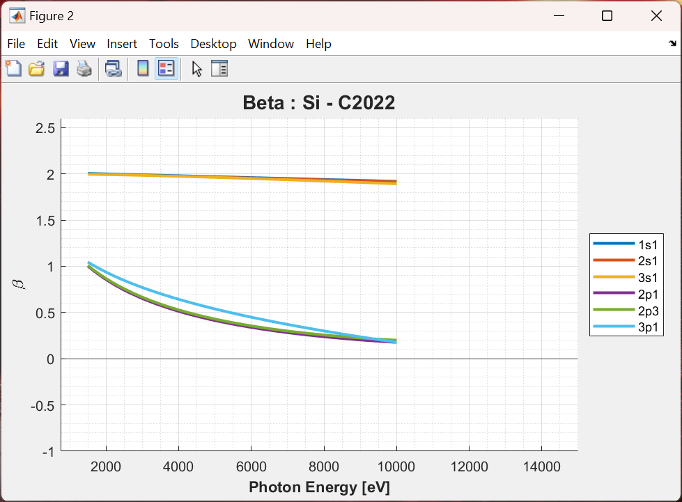
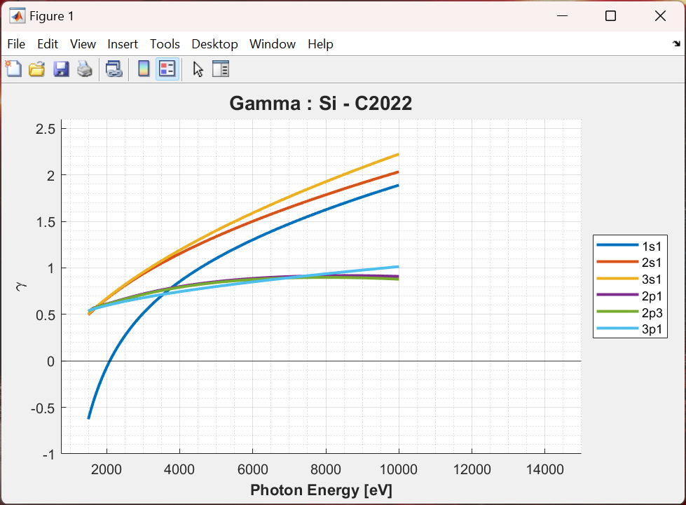
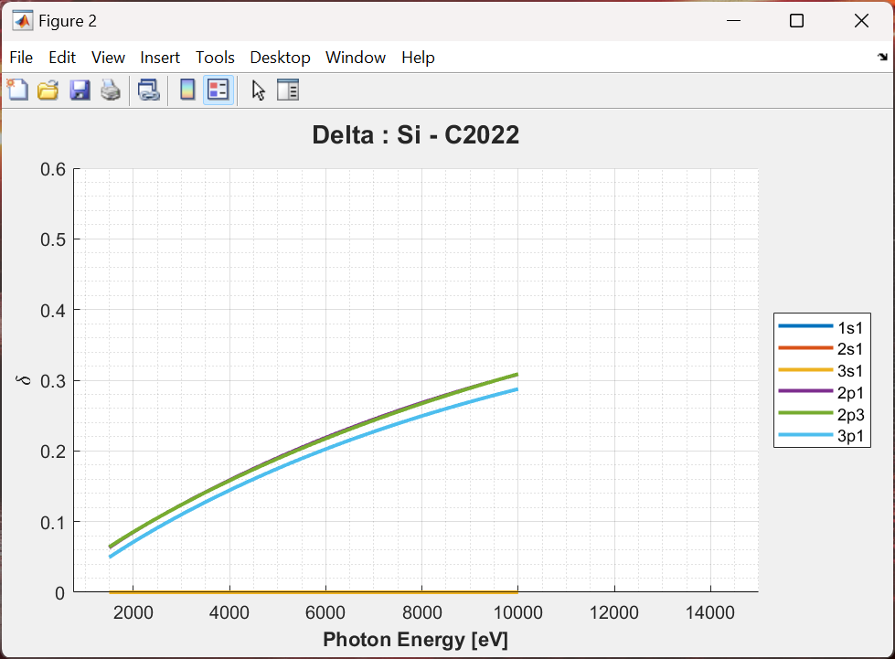
Elements 1 – 103 available.
Plot the binding energy spectrum, photoionization cross-sections, and photoionization asymmetry parameters.
Easily identify the best core-levels to probe by finding the maximum cross-sections.
Data from 4 different formalisms, including Scofield (1973), Yeh & Lindau (1985) and Trzhaskovskaya (2018).
Export the cross-section data as a text file.
Navigate to this App via ‘App_MatBase’ Main Menu.

Slide 6
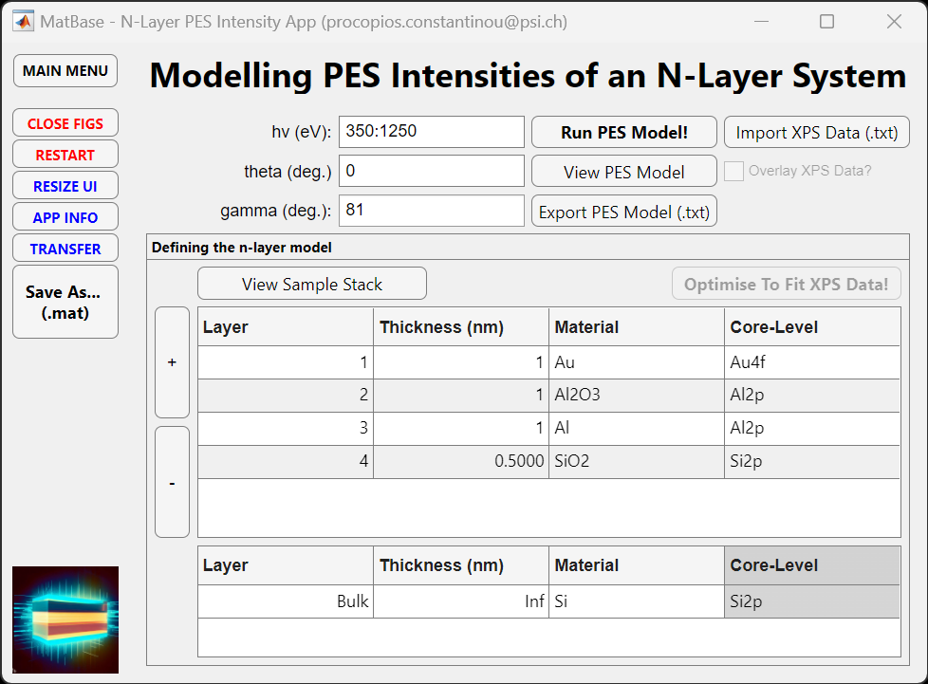
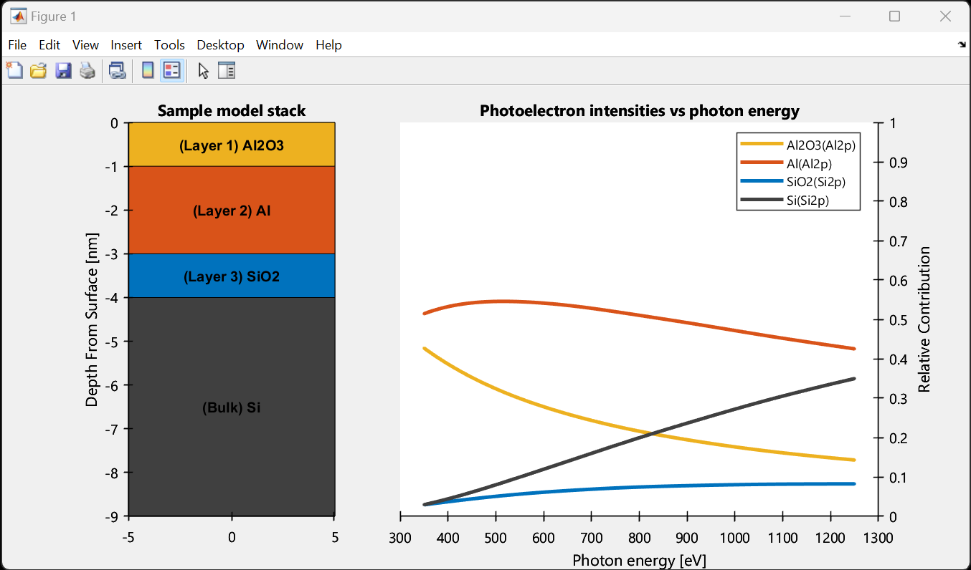
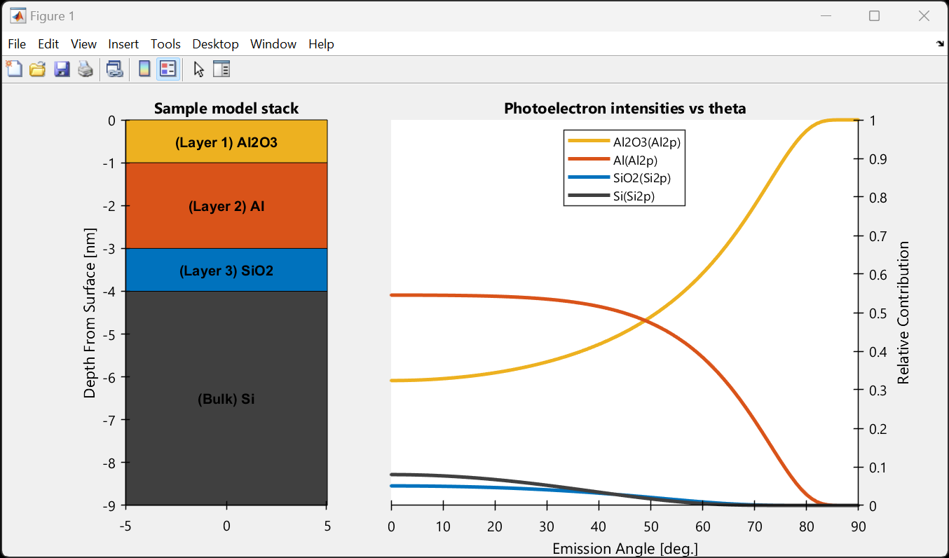
Access all material parameters from our database.
Access to photoionization cross-sections and photoionization asymmetry parameters from our database.
Easily define you N layered sample stack to plot the PES intensities from each layer versus photon energy or emission angle.
Export the data as a text file.
Navigate to this App via ‘App_MatBase’ Main Menu.

