Slide 1
Let’s Talk About Web Hacking
SEJOYNER

Slide 2
$whoami
SEJOYNER (c0ff33b34n)
Security Analyst @ ValueMentor
PenTester, Bug Hunter
HackTheBox Player (Elite Hacker)
https://c0ff33b34n.github.io

Slide 3
What this talk is about:
Basics of Bug Hunting/Pentesting
Bug Hunting v/s Pentesting
Recon Technique
And etc…

Slide 4
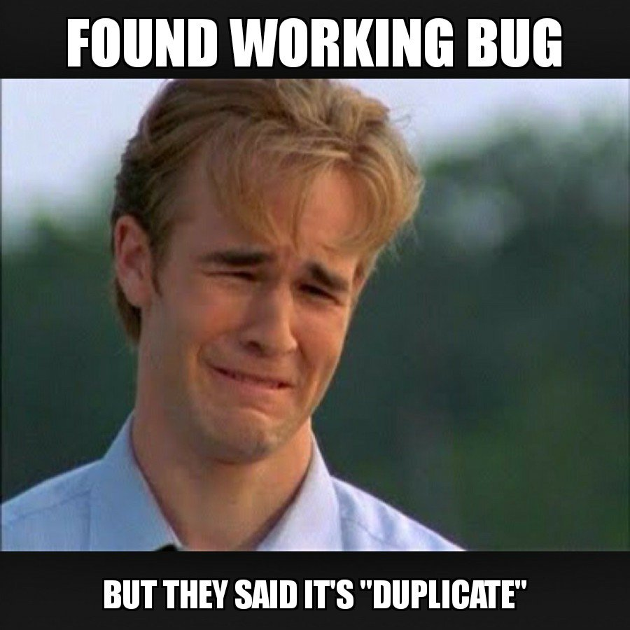
Duplicates!?

Slide 5
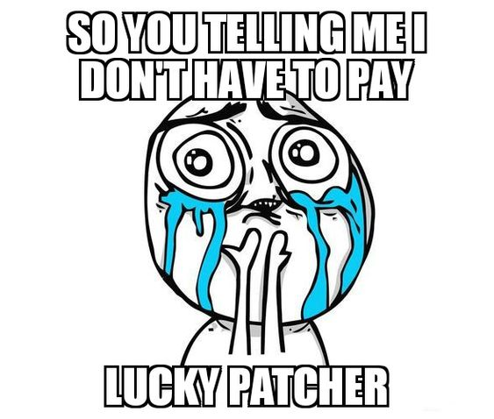
What and Why WebApp VAPT??

Slide 6

Benefits of Bug Hunting
Bounty $$$
Learning and Experience
Hall of Fame (HoF)
Swags, Hoodies, Certificates, etc…

Slide 7
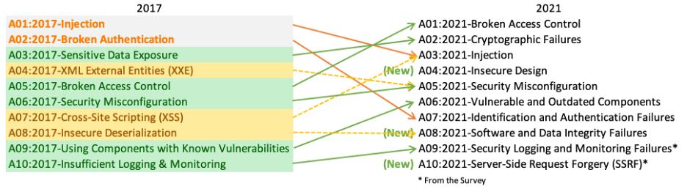
OWSAP top 10

Slide 8
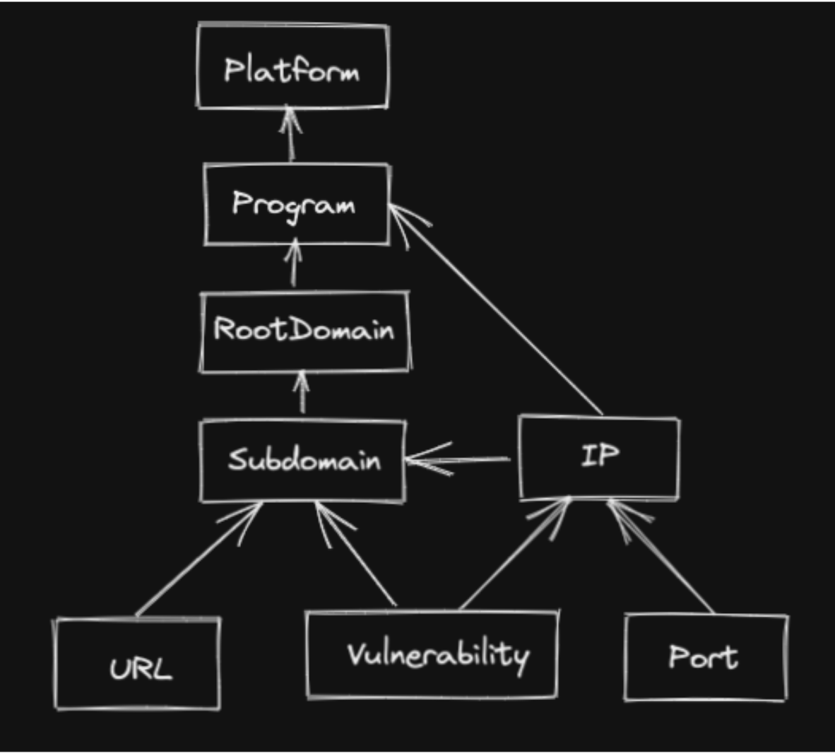
WorkFlow

Slide 9

Tools??
Burp Suite
Terminal
Browser, etc.

Slide 10
Recon!?
Recon can do Wonders
Widening scope
Get Critical infos, etc…
Subdomain enum
Dir fuzzing
Parameter fuzzing
Dorking, etc…

Slide 11

Bugs??

Slide 12
Let’s take a look at some common Vulnerabilities…
XSS
RCE
ATO
SQLi
CSRF
SSRF
RFI
LFI
Open Redirect
Etc…

Slide 13

DEMO TIME!

Slide 14
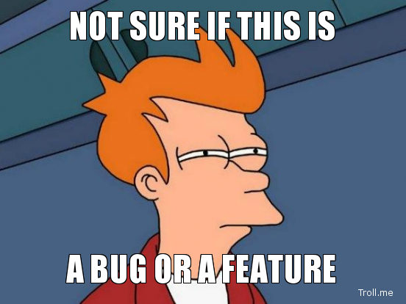
Impact Matters!!

Slide 15

What’s Next!?

Slide 16

Thank You!!

