Slide 1
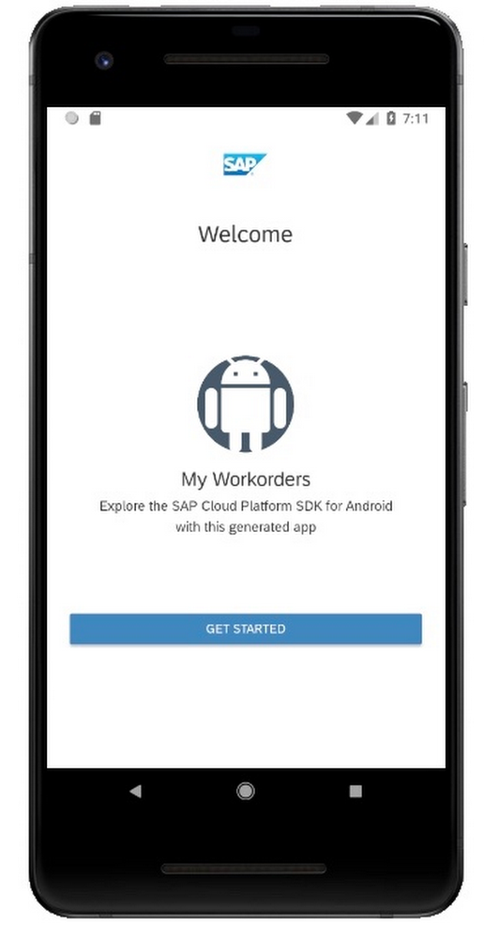
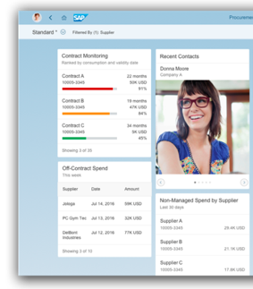
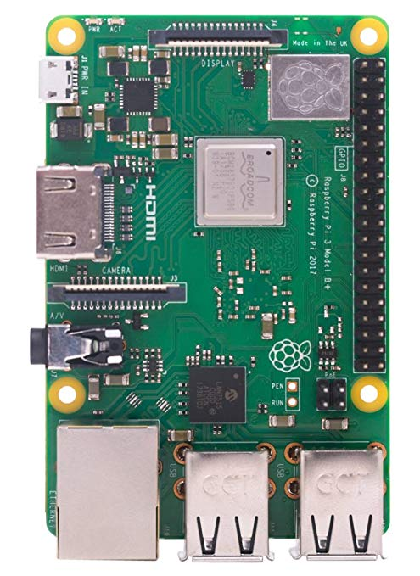
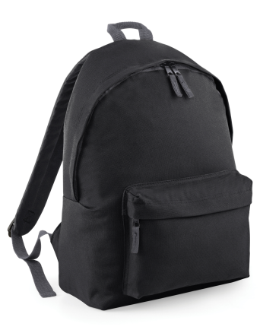

SAP Cloud Platform
SmartBackpack
Android App
Predictive Analytic
Machine Learning
Model
SAP Cloud Platform Mobile
SDK
odata
HANA
XS
Training
Bluetooth
SmartBackpackSAP
SAPUI5
Web App
Dashboard
Database
odata
SmartBackpackIOT
Device

Slide 2

Check and Reboot
SmartBackpackIOT Device
Android App
Bluetooth Service
IOT Communication Layer
Write
Read
Read
Config.json
Holding Zone
[historical data]
Holding Zone
[historical data]
[Realtime data]
Holding Zone
[historical data]
Monitoring Service [every 60s]
Loads
Write
Write
Check and Reboot
Sensor Service
Read
SAP
Cloud
Platform
Device Sensors

Slide 3
SmartBackpack
Android App
SAP Cloud Platform
ML
Services Layer
SAP CP
SDK
Predictive Analytic
Predictive suggestions (Data from all users)
(if the place is suitable before the trip)
(how can you prepare for the trip)
Real time feedback based on personal profile
(is it suitable for your condition)
(what can you do to improve the current situation)
Real Time/Historical Sensor Reading
User profile
HANA
XS
odata
Bluetooth
IOT Communication Layer
SmartBackpack
IOT
Device

Slide 4
SmartBackpack
Android App
IOT Communication Layer
DeviceListActivity
Main Activity
startActivityForResult
onOptionsItemSelected
ConnectThread
OnItemClickListener
onActivityResult
start
BluetoothChatService
connect
connectDevice
write
sendMessage
connected
write
ConnectedThread
sendToTarget
UI handler
Establish connection
write
send
SmartBackpack
IOT
Device

Slide 5
Launch
tabs
SmartBackpack
Android App
Check If user have a device nearby to pair with
Get sensor data and display values
With the predictive suggestions below
Historical data below
User Profile
With RUD options
yes
no
Menu Option
List of IOT devices with create option
Device Settings Page
SmartBackpack
IOT
Device

Slide 6

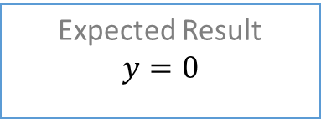









Training Dataset Sample
Machine Learning
Input features
User Profile
$x_{1}$ = age
$x_{2}$ = race
$x_{3}$ = gender
$x_{4}$ = asthmatic_level
Sensor Reading
$x_{5}$ = humidity
$x_{6}$ = temperature
$x_{7}$ = pm25
$x_{8}$ = pm10
Hidden layers
(Classification Problem)
Predicted Output
$$y=$$
$$x_{1}$$
[0]
Very Good
$$x_{2}$$
$$x_{3}$$
[1]
Ok
$$x_{4}$$
[2]
Uncomfortable
$$x_{5}$$
$$x_{6}$$
[3]
Very Uncomfortable
SAP HANA
DB
$$x_{7}$$
$$x_{8}$$
[4]
Hazardous
Expected Result
$$y=0$$

Slide 7
Value of data
User and Sensor data
Machine learning model
Classification
Pros:
more use case
To all user group (age, medical condition)
Cons:
Difficult to collect training dataset for machine learning

