Slide 1
CSE111 Checkpoint1
Cole Harris, Rohit Vedulla

Slide 2
Brief Synopsis
Will provide the functionality to sell merchandise as well as showcase and sell tickets for future events.
Post images of old events, so they can curate collections.
We will also implement the functionality to sell merchandise as well as tickets for future events.

Slide 3

Specification of the project requirements
Products
The main use case will be to allow customers to find and place orders on items listed by the admin.
Events
Cart
Admin
Customer
Checkout
Confirmation/Shipping
Stripe

Slide 4
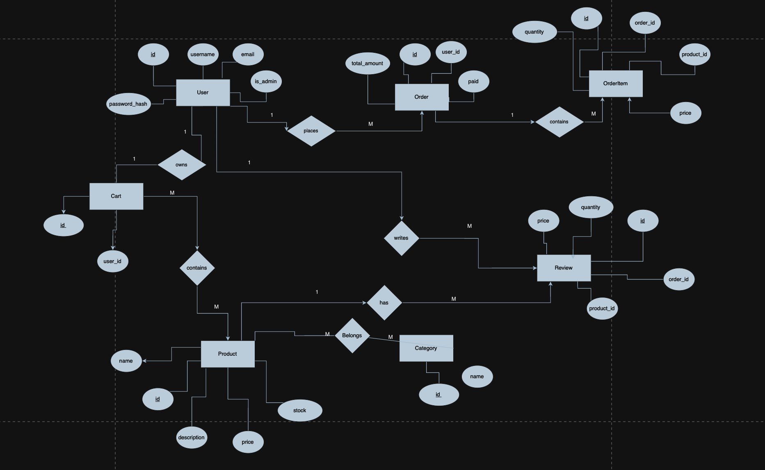
ER Diagrams

Slide 5
Tables
Cart
ROWID
ID
User_id
Product_id
Size
quantity
User
ROWID
id
username
email
Password_hash
Is_admin
Order
ROWID
id
User_id
name
email
address
address2
city
state
Zip_code
country
Total_amount
paid
OrderItem
ROWID
id
Order_id
Product_id
quantity
price
size
Category
ROWID
id
Item_id
Item_name
Item_price
size
Item_quantity
Review
ROWID
id
Order_id
quantity
price
Product_id
Product
ROWID
id
name
description
price
stock

