Slide 1
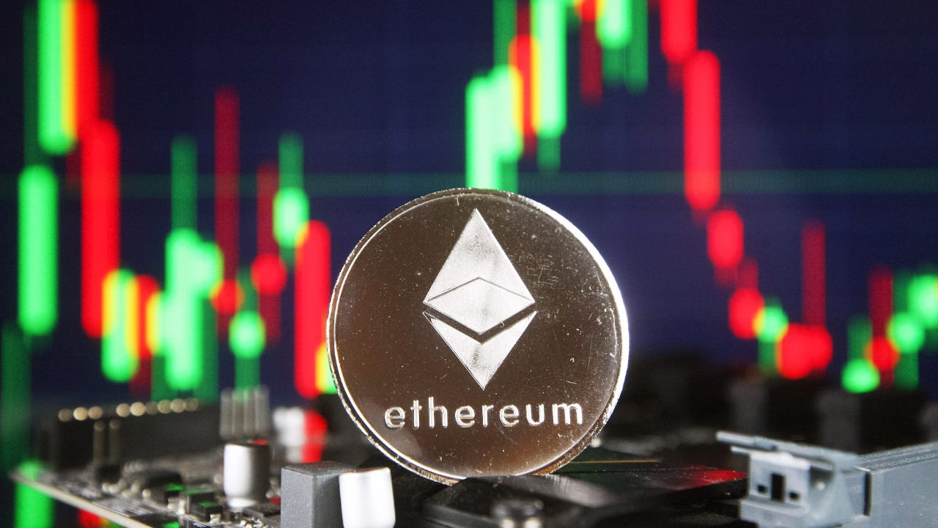
My Ethereum Dashboard
201824590 조승현
WEB APPLICATION PROGRAMMING (CB20011005-062)
Final Project Review
2024.11.19

Slide 2
Contents
Purpose of the project
Main features
Goal

Slide 3
Purpose
Develop a dashboard that allows users to easily access necessary information using blockchain APIs.
Additionally, create a simple program to track the flow of funds, similar to Chainalysis.
Utilize web application programming techniques learned in class, such as HTML, CSS, JavaScript, and jQuery, to implement this project.

Slide 4
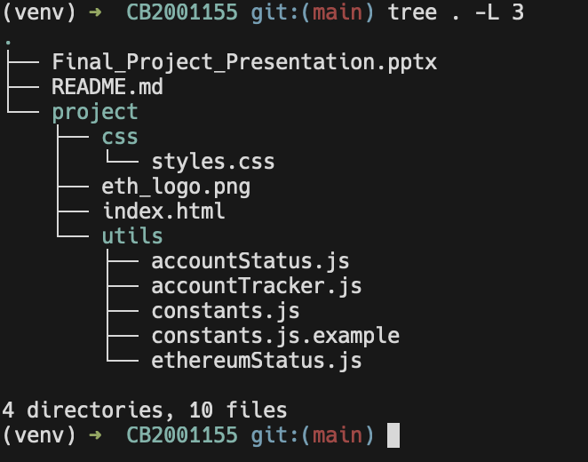
Project Layout
css/styles.css: basic styling
Index.html: main html file
Utils/*.js: JavaScript file fetches data from an API, processes it, and renders the feature pages within the 'content-area'.

Slide 5
Main features (1/3)
Ethereum Status View Ethereum metrics at a glance, including the current Ether price, recent blocks, and transactions. Each block and transaction can be clicked to navigate directly to the blockchain explorer for further details.

Slide 6
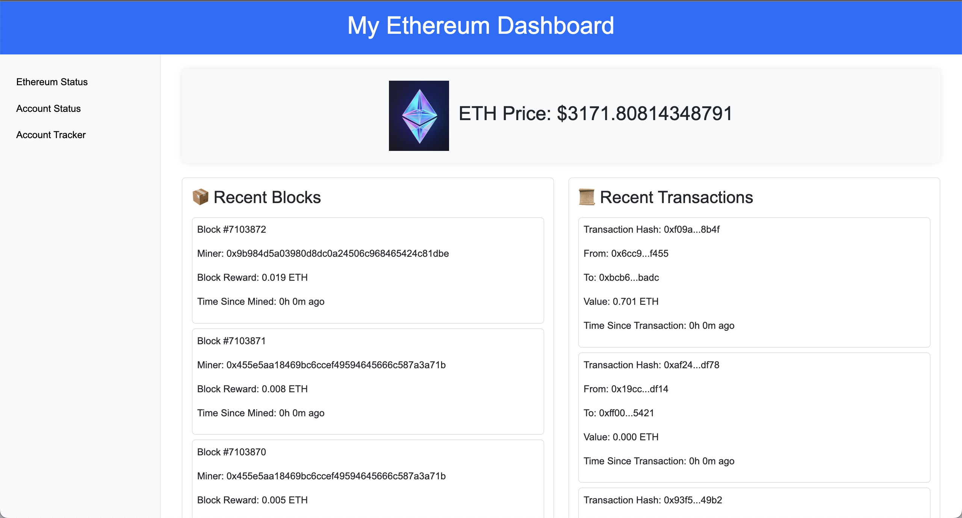
Main features (1/3)

Slide 7
Main features (2/3)
Account Status Display detailed information about a specific account, including a list of owned tokens and recent transaction history.

Slide 8
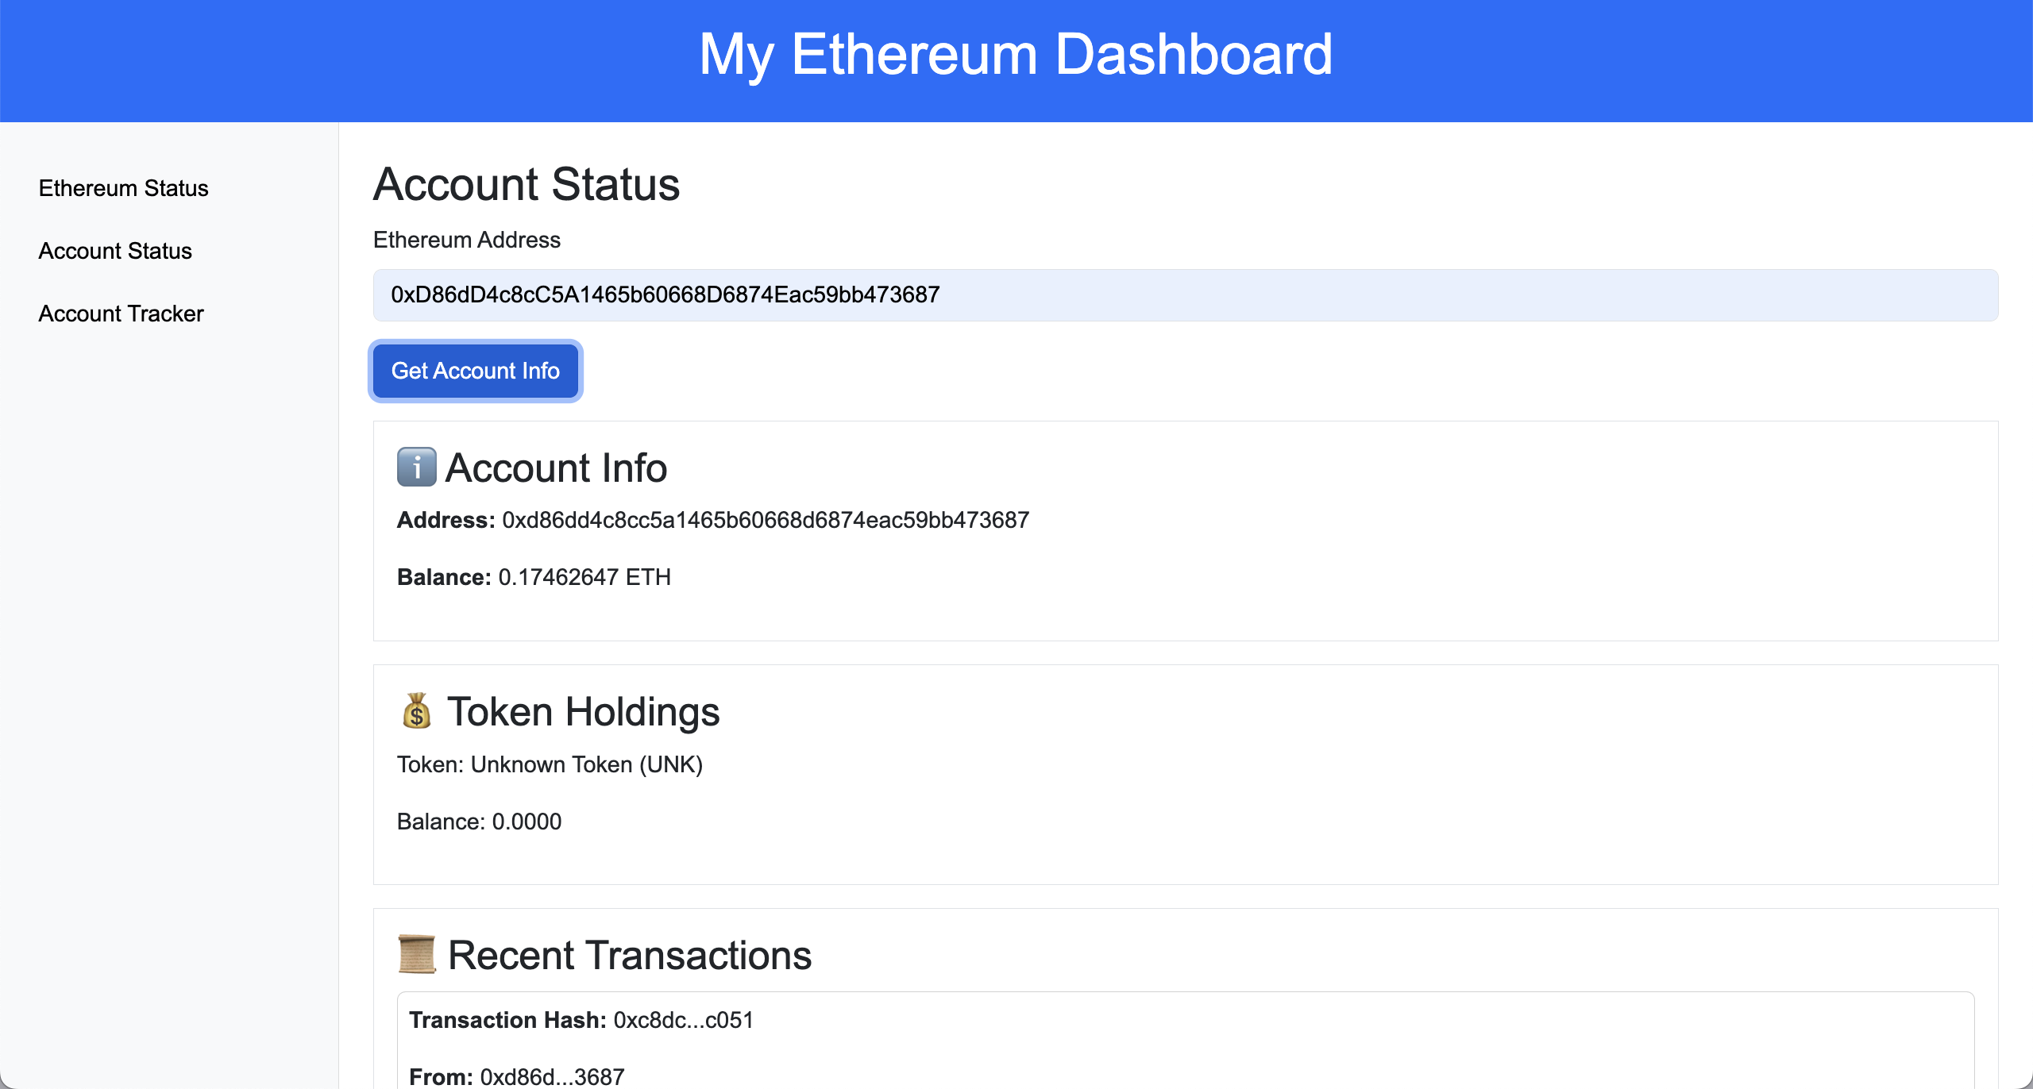
Main features (2/3)

Slide 9
Main features (3/3)
Account Tracker Track all accounts that have interacted with a specific account through transactions and visualize the connections in a graph. This feature can be used to analyze and trace the flow of funds.

Slide 10
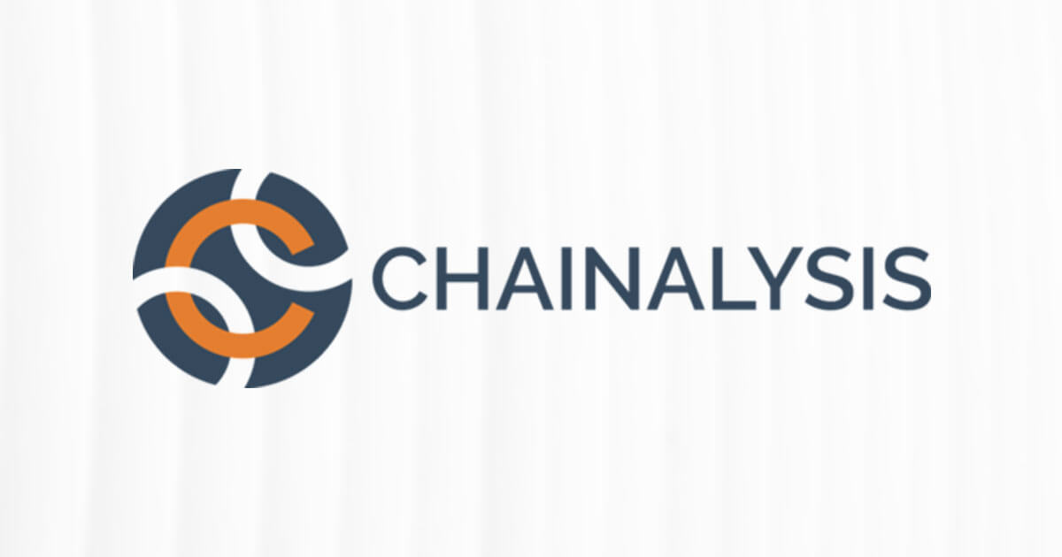
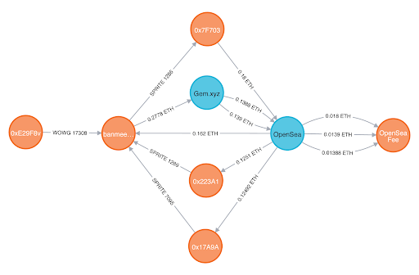
Main features (3/3)

Slide 11
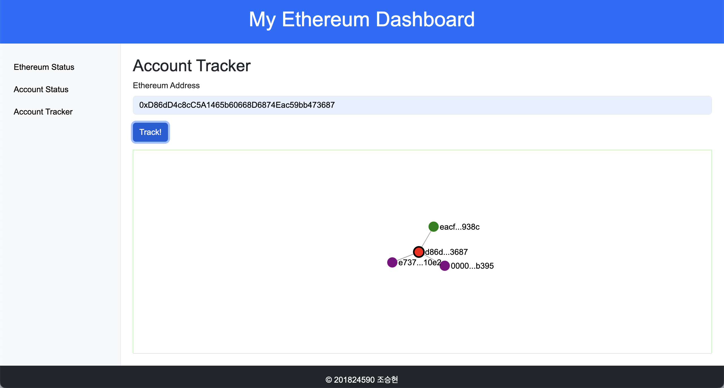
Main features (3/3)

Slide 12
Goal
Wallet Integration: Implement MetaMask wallet integration to enable seamless interaction with the dashboard.
UX Enhancement: Refine CSS styling and layout to improve user experience and visual appeal.
NFT Dashboard: Create an additional "NFT Holder" tab and develop a dashboard leveraging the OpenSea NFT API to provide insights and analytics on NFT holdings.

