Slide 1
Rebellion – Platform & Architecture
Common Framework & Services
V1.4 – Updated 2/9/2015
January 2015

Slide 2
Authentication & Authorization

Slide 3
Overview
By utilizing a custom build process, Rebellion will have separate client-side code for each channel, and separate configurations for each – including separate API endpoints for a common set of APIs.
This allows the Rebellion to have separate authentication & authorization methods both at the client side level, and at the API layer.
It also allows us to present separate sub-sets of APIs to each channel – so care specific APIs will not be available at the consumer API endpoint.
For the consumer channel ( “Big-C”), we will be using a system based on IAM and oAuth – this system will be designed to work with the SSO scheme provided by eUI / IAM.
For the assisted channel, we will be using a system based on OAM / WebGate stack and oAuth.
The un-assisted channel ( “Big-C”) will allow both anonymous and logged-in access, while the assisted channel will require log-in.
In the un-assisted channel, Rebellion UI is built with “default” permissions appropriate for anonymous users.

Slide 4
Logical Overview of Key System Layers
Rebellion UI
Single Page App
Common Code Base
API Facade
Apigee API Gateway
Abstracts Core APIs
Core APIs
Custom builds per channel
Rebellion UI Centric APIs
Connected to Back End System
Apigee API Gateway
Rebellion UI is an untrusted client of the API Façade.
API Façade is an trusted client of Core APIs (whitelisted IPs).
Core API Layer is a trusted client of back end systems.
Authentication & Authorization Requirements are different for different channels.
Different Channels have different sources of Identity.

Slide 5
Channel Variations – Authentication & Authorization
Assisted Channel
Only Authenticated Users can Download Rebellion UI Web App. (Authentication protects whole Application.)
Consumer Channel
Rebellion UI Web App is publically available for anonymous, unauthenticated use. (Authentication protects particular routes.)
OAM is ultimate source of Identity.
Authorization determines User Role.
WebGate intercepts unauthorized requests for the Rebellion UI Web App.
There is no WebGate protecting the App server.
IAM is the ultimate source of Identity.
Authorization determines if user is logged in, or anonymous.

Slide 6
Assisted Channel – Authentication & Authorization Across System Layers
Assisted Channel
UI
Facade
Core
Authentication is persisted in the UI as an OAM Cookie, which is encrypted and contains userId.
The API Façade initially validates this cookie, and caches as valid for a fixed TTL.
The API Façade also issues an oAuth token based on this cookie, which will be used by the UI in future interaction with Façade layer, and has a TTL less than the original OAM Cookie.
After initial authentication, the API Façade only accepts requests with valid oAuth token.
The API Façade passes the OAM Cookie to the Core when making requests. As needed (by Core API design) the Façade may also pass other information with each call (for example store id or data center segmentation id)
Core APIs are able to extract userId from OAM Cookie and enforce Authorization.
“Session” between UI & Façade is persisted via the existence of a valid OAM Cookie and valid oAuth token; and from the Core API Layer’s point of view, solely by OAM Cookie.

Slide 7
Consumer Channel – Authentication & Authorization Across System Layers
Consumer Channel
UI
Facade
Core
Log-in, Lost Password, and Registration pages are managed by the eUI / IAM system.
Authentication is passed to the UI from eUI / IAM as a IAM Cookie and as an IAM Authorization Code, and is persisted in the UI as an IAM Cookie.
The Façade validates the IAM Authorization Code, and returns an oAuth Token to the UI, and caches that token as valid for a fixed TTL. The Façade also queries eUI / IAM to obtain the user profile, and caches this data along with the oAuth Token. This oAuth Token will be used by UI in future interaction with Façade layer, and has a TTL less than the original IAM Cookie. After initial authentication, the Façade only accepts requests with a valid oAuth token.
The Façade passes the oAuth Token & userId (from cached profile) to the Core when making requests. As needed (by Core API design) the Façade may also pass other information with each call (for example store id or data center segmentation Id). Core APIs can use the oAuth Token if needed to validate user, and obtain profile information from IAM. It is expected that Core APIs will be able to check and enforce Authorization on a per-user, per-line basis.
“Session” between UI & Façade is persisted via the existence of a valid IAM Cookie and valid oAuth Token; and from the Core API Layers point of view, solely by oAuth Token.

Slide 8
Authentication & Authorization Key System Assumptions
General Assumptions:
The custom build process for Rebellion UI generates different versions of the Web App for each channel from a common code base.
These versions have different API Façade endpoints, and each API Façade endpoint has a different set of APIs available and different Authentication and Authorization policies.
The Core APIs also provide support for authentication against OAM & IAM.
Assisted Channel Assumptions:
The encrypted OAM Cookie, contains both userId and userRole.
The Core API Layer can extract userId and userRole from the OAM Cookie, and enforcement of API’s is ultimately enforced here in the Core API layer.
Core APIs will specify in their design specs whether they need additional data for authorization beyond the OAM Cookie (for example store id or data center segmentation id).
The Façade Layer will use the “third-party OAuth token” pattern to generate an oAuth token based on the OAM Cookie.
Consumer Channel Assumptions:
The Façade Layer will use the “third-party OAuth token” pattern to generate an oAuth token based on the oAuth Token provided by eUI / IAM.
The Core API layer will be able to differentiate between calls coming from the Façade layer for the Consumer channel, and the Façade layer for the Assisted Channel. It is suggested that two distinct proxy endpoints be used to differentiate between channel calls into Core API.
Additionally, the Core API layer will be able to use the oAuth Token to validate users against eUI / IAM, and obtain profile information as needed, and that enforcement of API’s is ultimately enforced within the Core API layer.
The Façade Layer will provide an API to generate oAuth tokens for anonymous users. When Core APIs see calls from the Façade for the anonymous users (users without an id), it will not attempt to validate the oAuth token will instead screen request with permission levels appropriate for an anonymous users. The oAuth Tokens generated for anonymous users will not validate against eUI / IAM.

Slide 9
Single Sign On (SSO) Scenarios
Consumer Channel
Between Web Apps in eUI / IAM ecosystem:
The IAM_SSO_Cookie when present will allow for SSO between Apps in the eUI / IAM ecosystem.
Between Rebellion & eService 1.0:
After login to Rebellion, legacy customers will be re-routed to eService 1.0. It is assumed that eService 1.0 will be able to recognize and ingest the IAM_SSO_Cookie.
Assisted Channel
From Windows Native Authentication to Rebellion
It is assumed that WebGate / OAM will provide WNA Authentication for the Rebellion UI in the Assisted Channel for Care with Desktop devices.
From Rebellion to Legacy Applications
On Desktop Devices:
HAS will be utilized (via HKD) to launch QV on Desktop Devices in the Assisted Channel.
In these scenarios, the OAM Cookie value will be passed to QV, and QV will be responsible for validating that cookie against OAM.
On Mobile Devices: (pending POC)

Slide 10
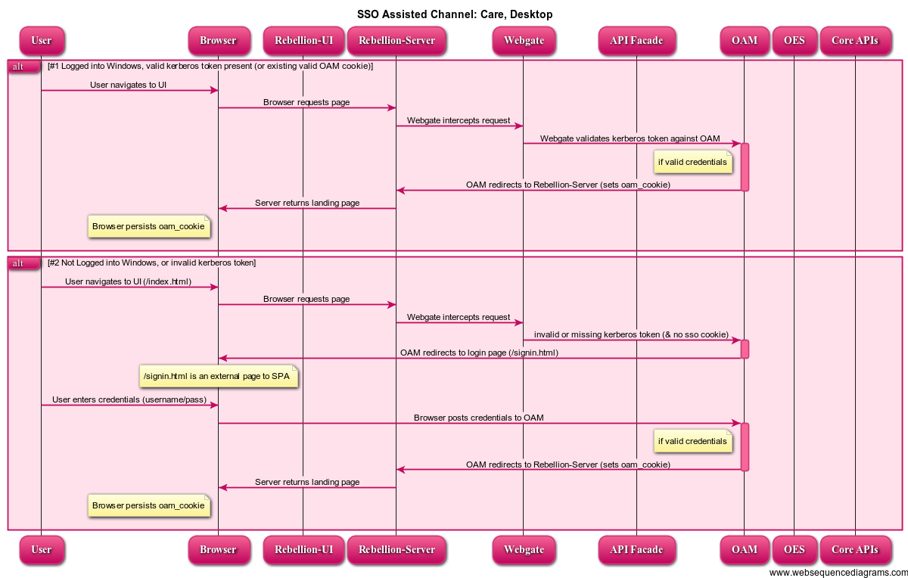
SSO Assisted Channel: Care, Desktop

Slide 11

SSO Assisted Channel: Retail, Desktop

Slide 12
SSO Assisted Channel: Retail, Mobile
The Architecture for Mobile Retail SSO is still under consideration pending POC.

Slide 13
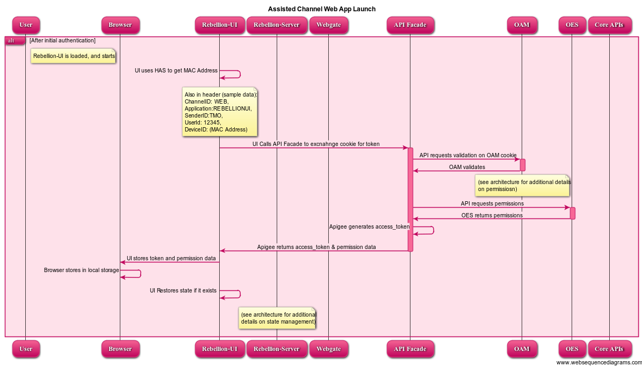
All Assisted Channel Variants: Web App Launch

Slide 14
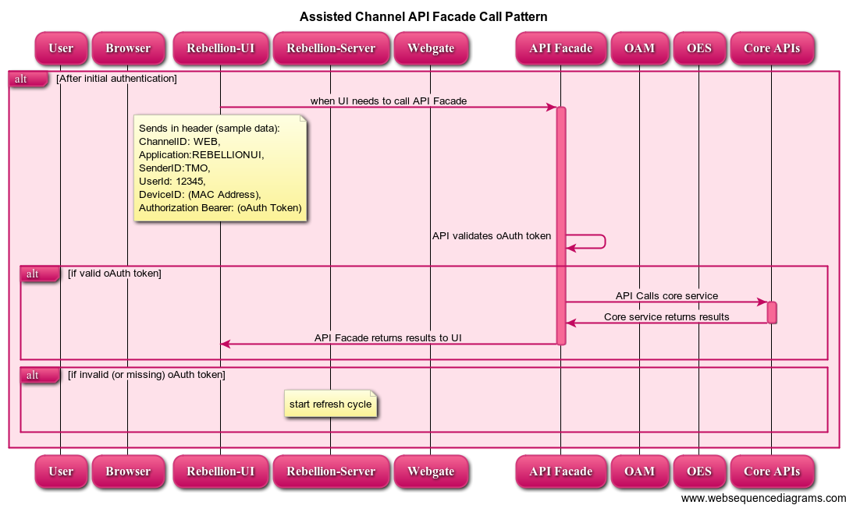
All Assisted Channel Variants: API Façade Call Pattern

Slide 15
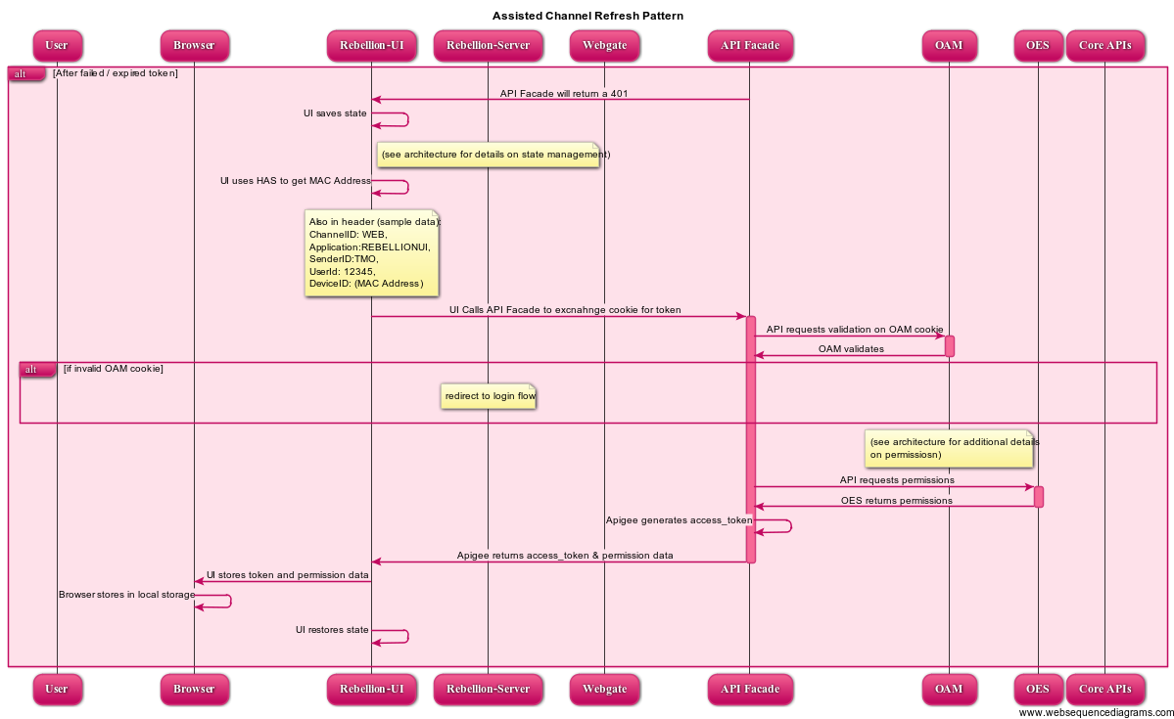
All Assisted Channel Variants: Refresh Pattern

Slide 16
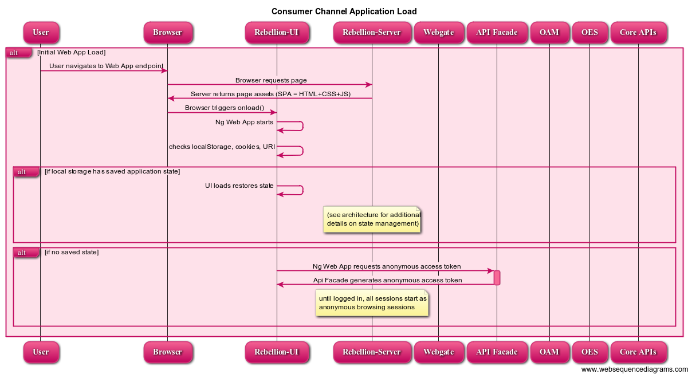
Consumer Channel Application Load

Slide 17
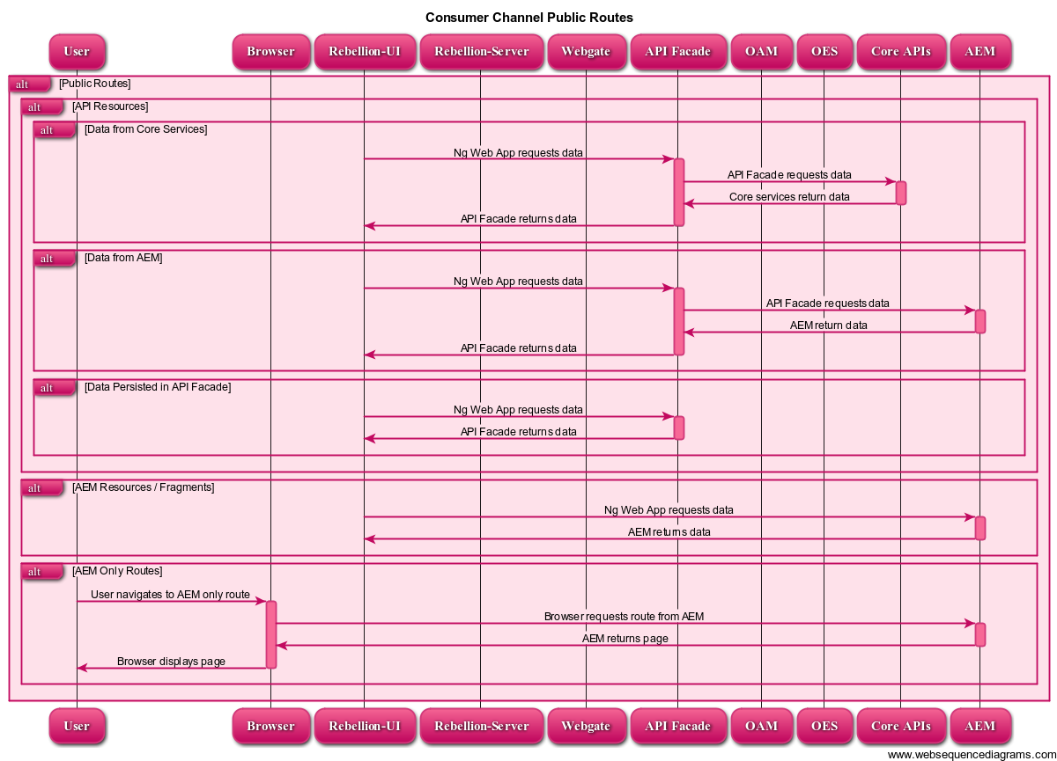
Consumer Channel Public Routes

Slide 18
Consumer Channel Protected Route Enforcement
As a client-side JS application, the Rebellion UI is “untrusted” (i.e. anyone with JS skills can interfere with a client-side JS application).
Thus, enforcement of routes ultimately happens at the API Façade layer.
When the API Façade layer returns a 401 (unauthorized) status code, a global error handler attached to the Ajax call is invoked.
This error handler will take the following steps when a 401 is passed:
Save the current application state (see rest of architecture for additional details on state management)
Captures the current browser URL and then redirects to the eUI login page, setting the ‘return_url’ query parameter in that redirect with the value of the current browser URL.
After login on the eUI page, control will be redirected to that “return_url” address, and a ‘authorization_code’ query parameter will be attached.
When the Web App starts, and notices the presence of that query parameter, it will process the rest of the authentication flow (i.e. the code for token exchange).

Slide 19
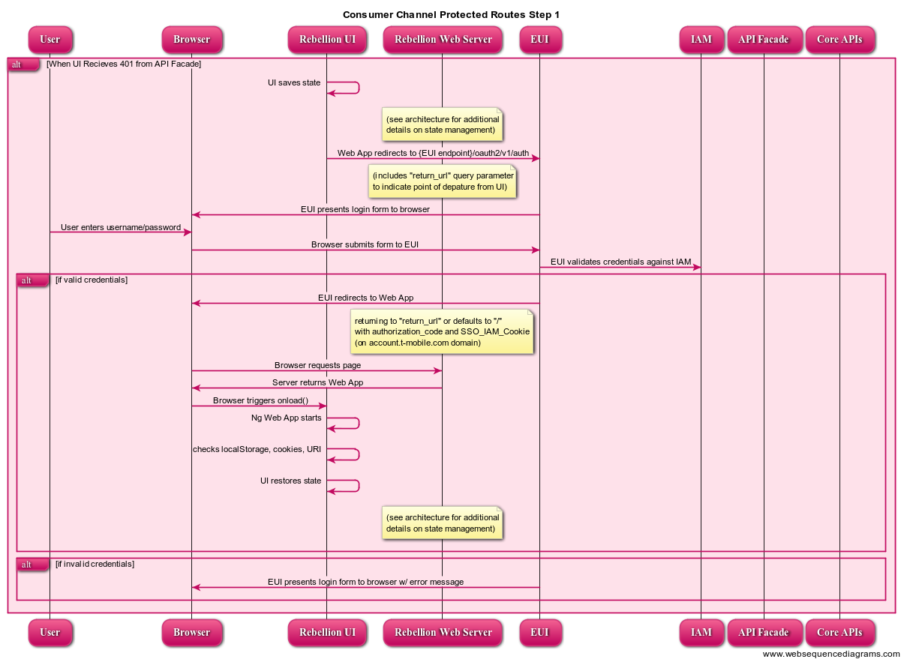
Sequence Diagrams: Consumer Channel Protected Routes Step 1

Slide 20
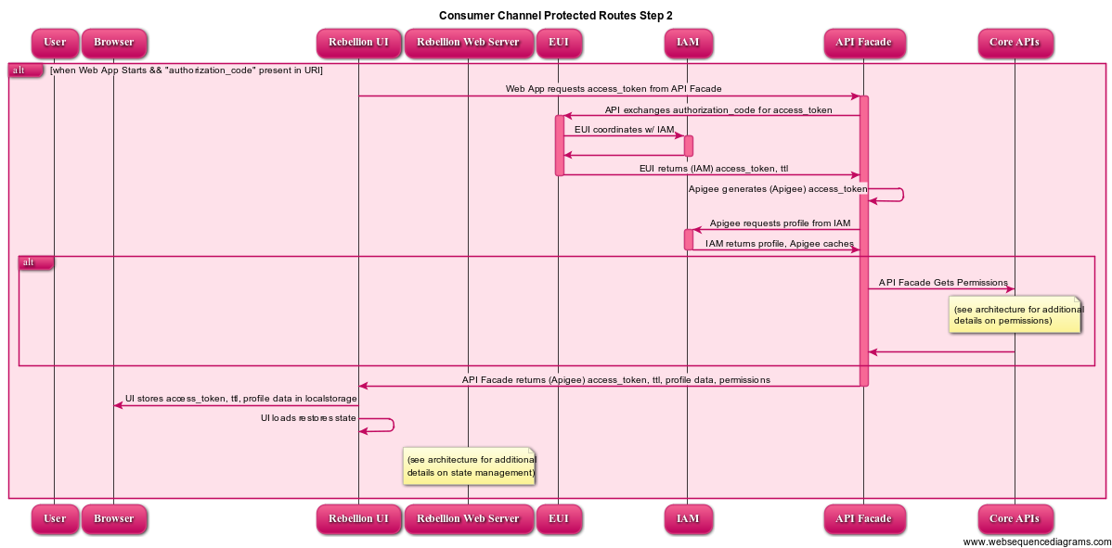
Sequence Diagrams: Consumer Channel Protected Routes Step 2

Slide 21
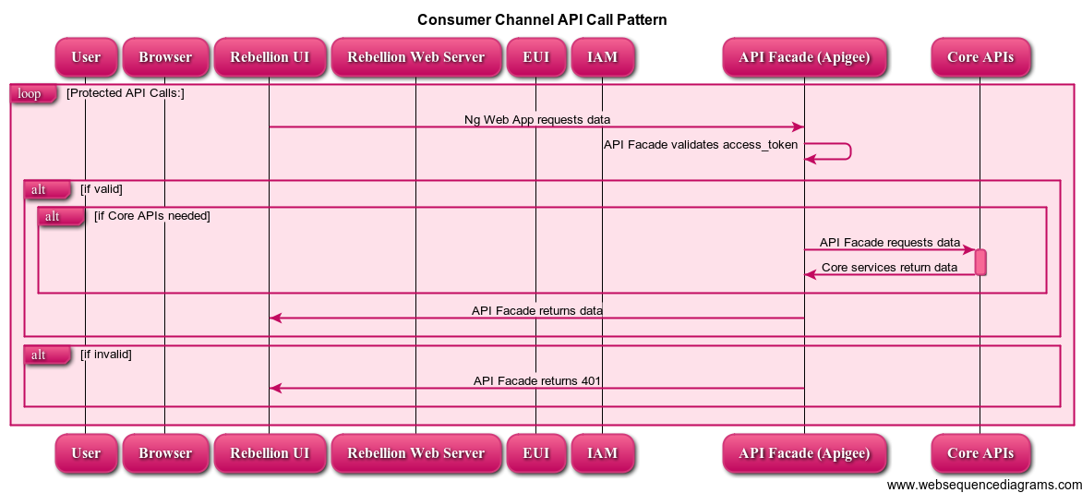
Sequence Diagrams: Consumer Channel API Call Pattern

Slide 22
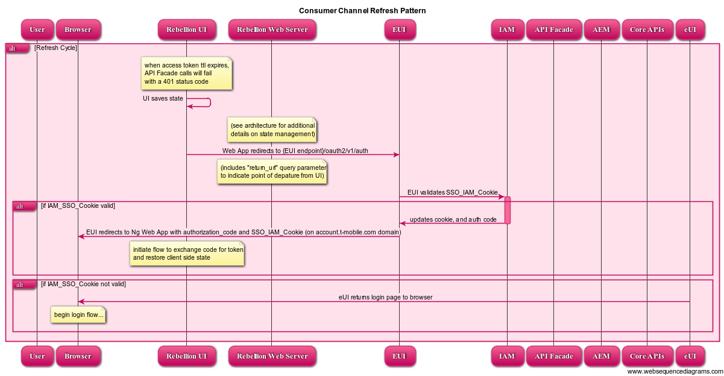
Sequence Diagrams: Consumer Channel Refresh Pattern

Slide 23
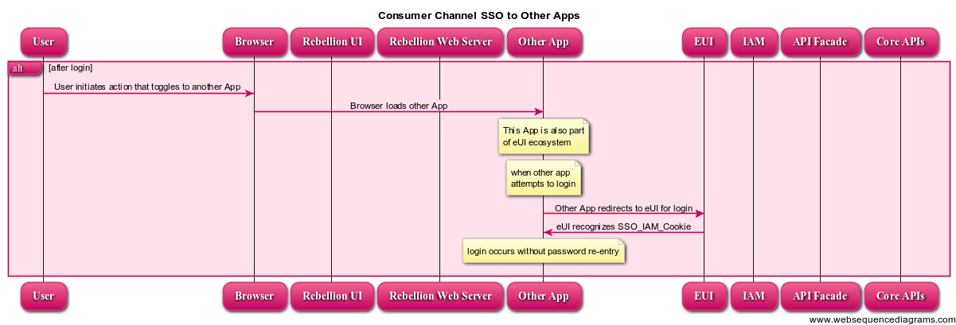
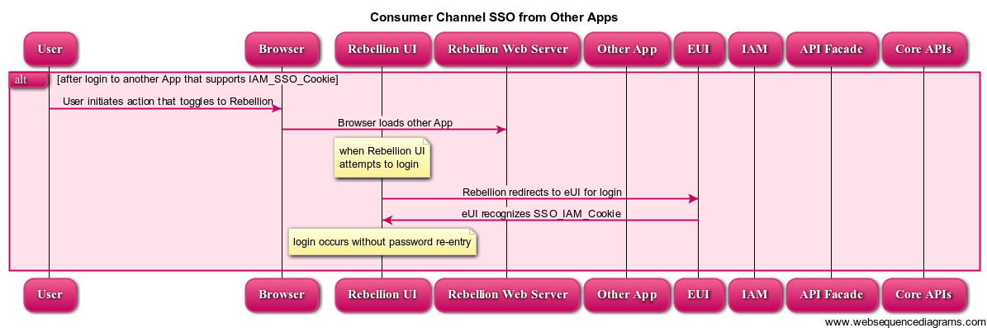
Sequence Diagrams: Consumer Channel SSO

Slide 24
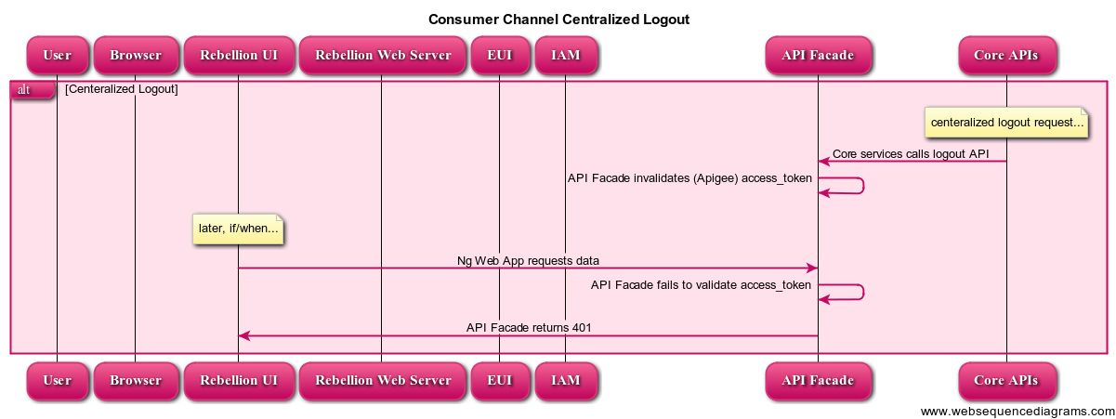
Sequence Diagrams: Consumer Channel Centralized Logout

Slide 25
Session
Assisted Channel
“Session” between UI & Façade is persisted in the assisted channel by the existence of a valid OAM Cookie and valid oAuth token; and from the Core API Layer’s point of view, solely by OAM Cookie.
Consumer Channel
“Session” between UI & Façade is persisted in the consumer channel by the existence of a valid IAM_SSO_Cookie and valid oAuth token; and consumer session is not tracked by the Core API Layer.

Slide 26
Authentication & Authorization Resources
(for API Façade / Integration):
Documentation on IAM: https://twire.t-mobile.com/docs/DOC-8282
Third Party Tokens & Apigee: http://apigee.com/docs/api-services/content/use-third-party-oauth-system
(for Digital Experience)
Documentation on eUI: https://twire.t-mobile.com/docs/DOC-8283
data stored in local storage:
{
"session": {
"access_token": "SplxlOBeZQQYbYS6WxSbIA"
},
"user": {},
"permissions": {},
"state": {}
}
Both Assisted channel and Consumer channel will end up storing a limited amount of data in local storage. The user, permissions, and state objects will be further clarified later in the architecture. The session object will contain the current access token that is provide from API Façade layer.

Slide 27
Search & Routing

Slide 28
Introduction
On day 1 of the Rebellion release, customers will exist in two different “stacks”.
Search & Routing exists to identify “where” a particular customer’s data resides, and “what” applications should be used to service that customer.
The initial model is for search & routing to begin with the Rebellion UI. This model will be used for the technical foundation project, but may be revised prior to R1.
Rebellion UI
API Facade
Legacy UI
Core APIs
1.0 Stack
E/// Stack
Samson

Slide 29
Consumer Channel Search & Routing (technical foundation model)
Rebellion will serve as the main entry point for both Legacy Customers and Rebellion Customers for the Technical Foundation POC
When Rebellion logs a user in, eUI will set the SSO_IAM cookie
Rebellion will then retrieve the correct host system from the core services.
Then it will redirect to either the eService 1.0 App (passing the SSO_IAM cookie) or continue on in Rebellion.
The “command to redirect to eService 1.0” (see diagram) takes the form of a JSON response (from the API Façade call to exchange code for token) like this: {“action” : “redirect-to-eservice”}
When the handler in the Web App for that API call detects this kind of response, it will redirect to eService 1.0
eService 1.0 will use the IAM_SSO_Cookie to achieve SSO.

Slide 30
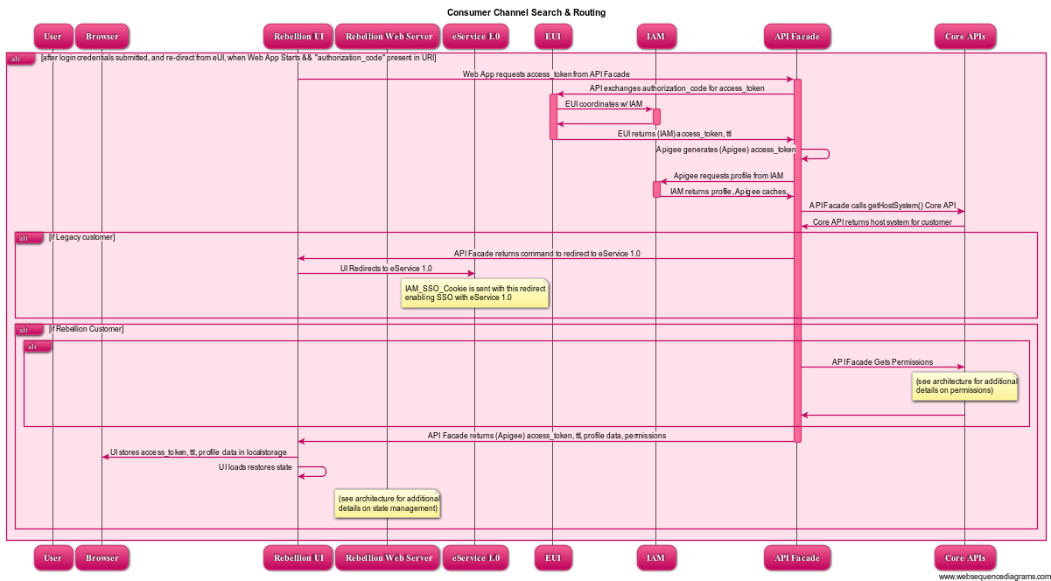
Consumer Channel Search & Routing (technical foundation model)

Slide 31
Assisted Channel, Desktop Search & Routing
Quick View Flex is typically launched at the beginning of a rep’s work session due to load time concerns, so practically speaking, QV may already be running – this architecture, however, will support SSO if needed.
When using Rebellion, reps will search for users, and when a user is a legacy Samson customer, the search API will return a “redirect to QV” command to the UI along with the extracted OAM cookie from the header.
The UI will utilize the HDK (HAS development kit) to send this redirect to HAS, passing along the customer BAN, MSISDN, and OAM Cookie.
HAS will launch QV Flex, passing along the BAN. HDK will implement a pattern where a command can be sent in JSON format like this:
{
“service": "TogggleToQV",
"parameters": {
"BAN": "123423“, “MSISDN”:”1234443232”, “OAM_COOKIE”:”132k4jh2l234j2lkj3h2342jkjsa992-a23423”
}
}
Toggling back to Rebellion form QuickView will be accomplished via OS (windows) application toggle.

Slide 32
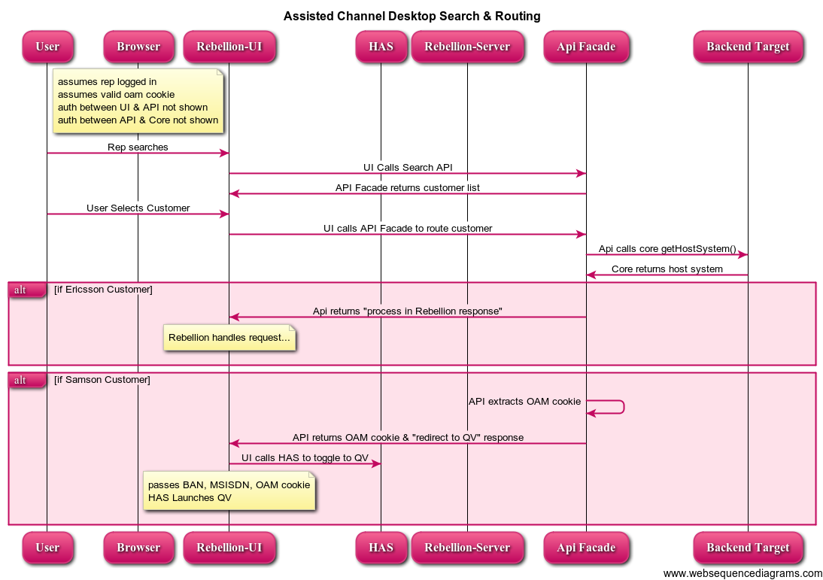
Assisted Channel, Desktop Search & Routing

Slide 33
Search & Routing Resources
(for API Façade / Integration):
Documentation on IAM: https://twire.t-mobile.com/docs/DOC-8282
Third Party Tokens & Apigee: http://apigee.com/docs/api-services/content/use-third-party-oauth-system
(for Digital Experience)
Documentation on eUI: https://twire.t-mobile.com/docs/DOC-8283
data format for calling HAS with command to toggle to QuickView:
{
“service": "TogggleToQV",
"parameters": {
"BAN": "123423“, “MSISDN”:”1234443232”, “OAM_COOKIE”:”132k4jh2l234j2lkj3h2342jkjsa992-a23423”
}
}

