Slide 1



Computer Engineering 2019/2020
Francisco Cordeiro 50037301

Slide 2
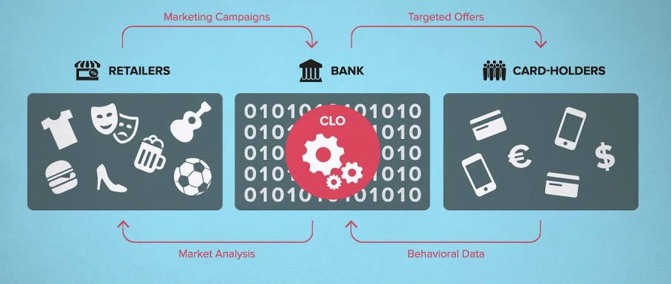

Card-linked offers

Slide 3
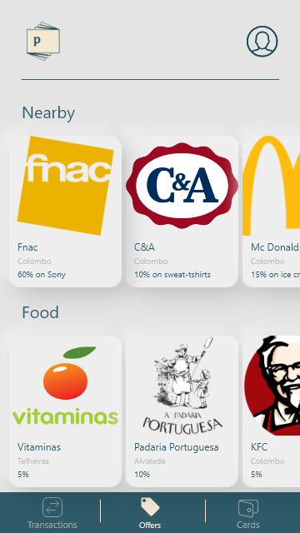
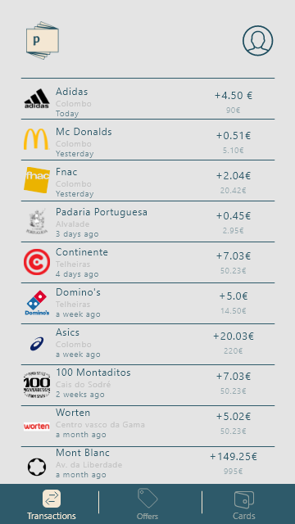
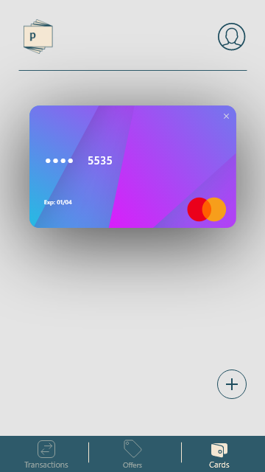
Objectives
Build a simple CLO app
Offers
Transactions
Cards

Slide 4
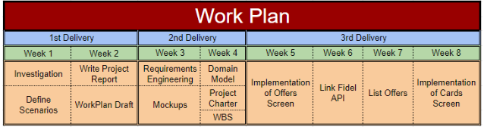
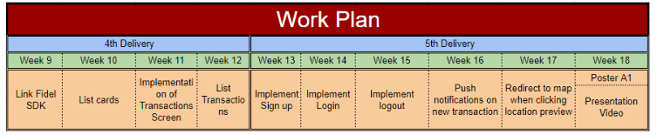
Work plan analysis

Slide 5

Questões

