Slide 1



Computer Engineering 2019/2020
Francisco Cordeiro 50037301

Slide 2


Slide 3
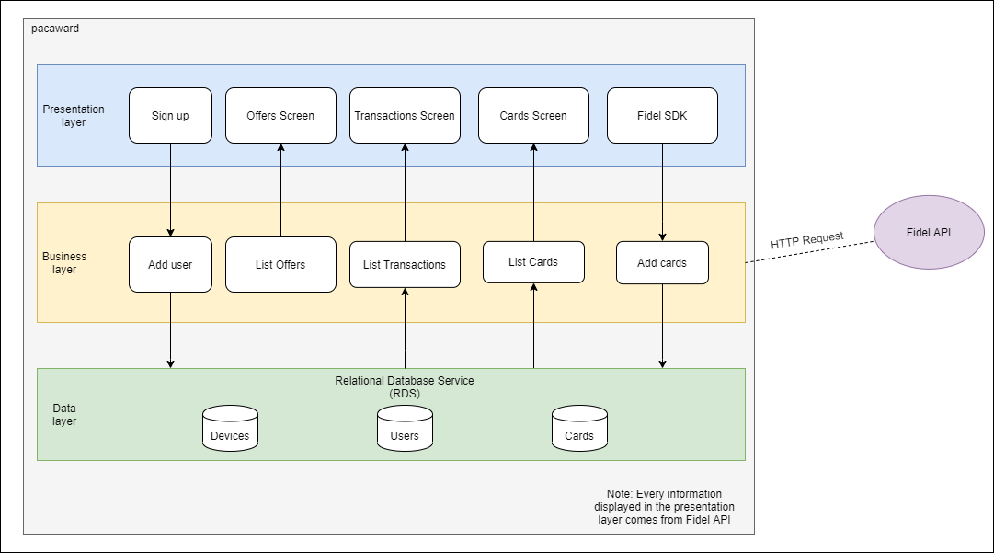
Architecture

Slide 4
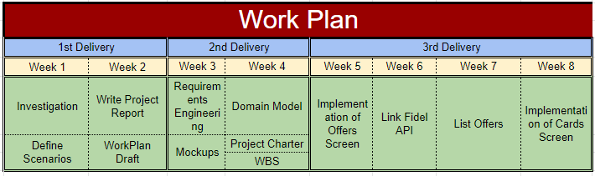
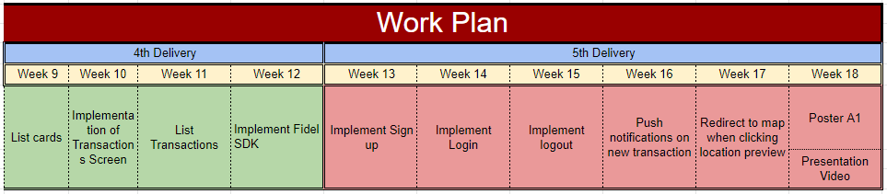

Work plan analysis

